Slide 1
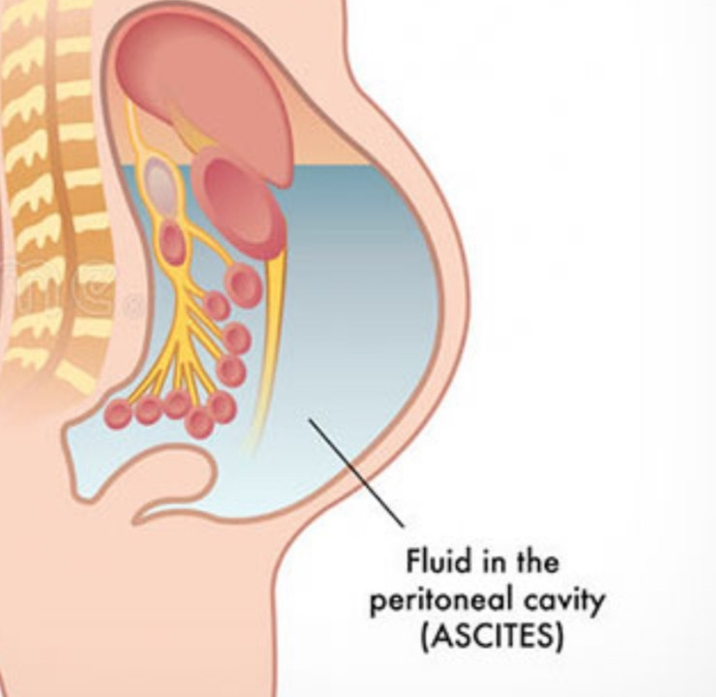
Ascites
Supervised by:-Dr :Diaa mobaideen
Presented by:- Ahmad al dahamsheh
Mohammed alnawafleh
Yousef saraireh

Slide 2
Ascites
Abnormal buildup or accumulation of free fluid in the peritoneal cavity.
Small amounts of ascites are asymptomatic, but with larger accumulations of fluid more than 1 L there is :
* abdominal distension
*fullness in the flanks
* shifting dullness on percussion
* fluid thrill/ fluid wave when ascites marked

Slide 3
Feature of ascites
Eversion of umbilicus .
Herniae.
Abdominal striae.
Divarication of recti and scrotal edema.
Dilated superficial abdominal veins due to portal hypertension.

Slide 4
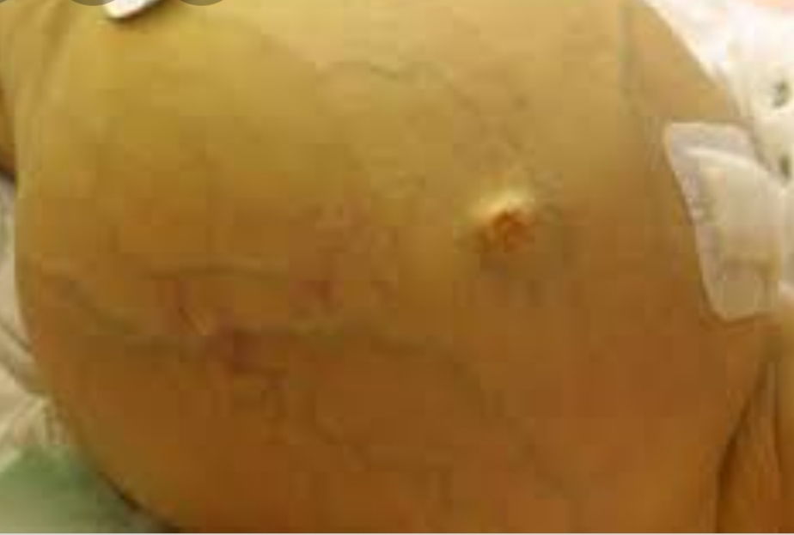
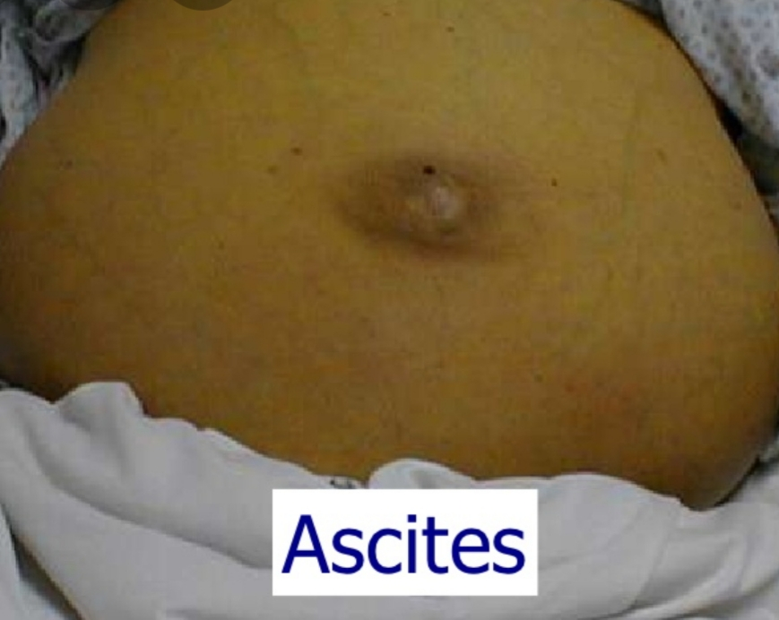
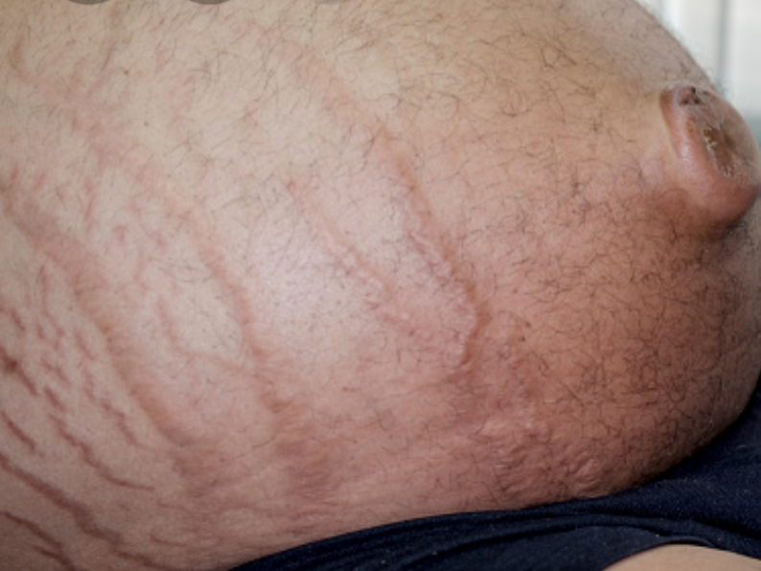

Slide 5
Causes of ascites
Systemic causes: cirrhosis/portal hypertension, heart failure, nephrotic syndrome
Localized causes: metastasis, TB, pancreatic.

Slide 6
2. Serum-ascites albumin gradient (SAAG)
SAAG = serum albumin − ascitic albumin
SAAG with >1.1 g/dL indicates portal hypertension
SAAG with <1.1 g/dL indicates normal portal pressure

Slide 7
SAAG with >1.1 g/dL = Portal hypertension
Normal synthetic function of the liver (>2.5 g/dL of ascetic fluid):
1. Heart failure 2. Inferior vena cava obstruction 3. Early Budd-chiari syndrome
Abnormal synthetic function of the liver (<2.5 g/dL of ascetic fluid):
1. Liver cirrhosis 2. Late Budd-chiari

Slide 8
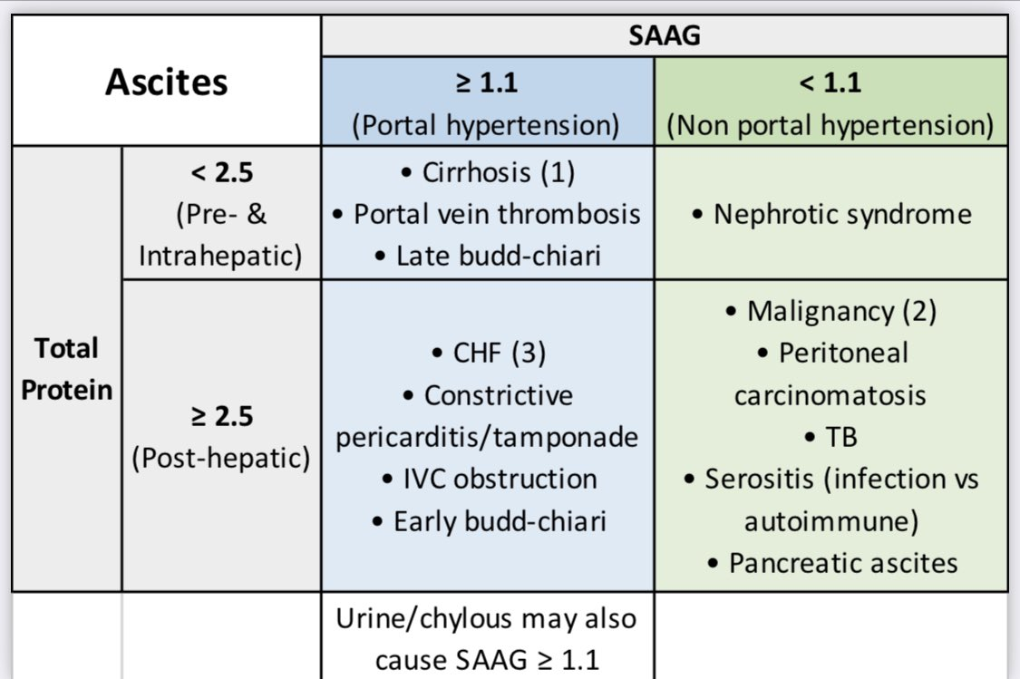
SAAG with <1.1 g/dL = No portal hypertension
Low ascetic fluid protein: Nephrotic syndrome
High ascetic fluid protein: Cancer, TB, Fungal infection

Slide 9
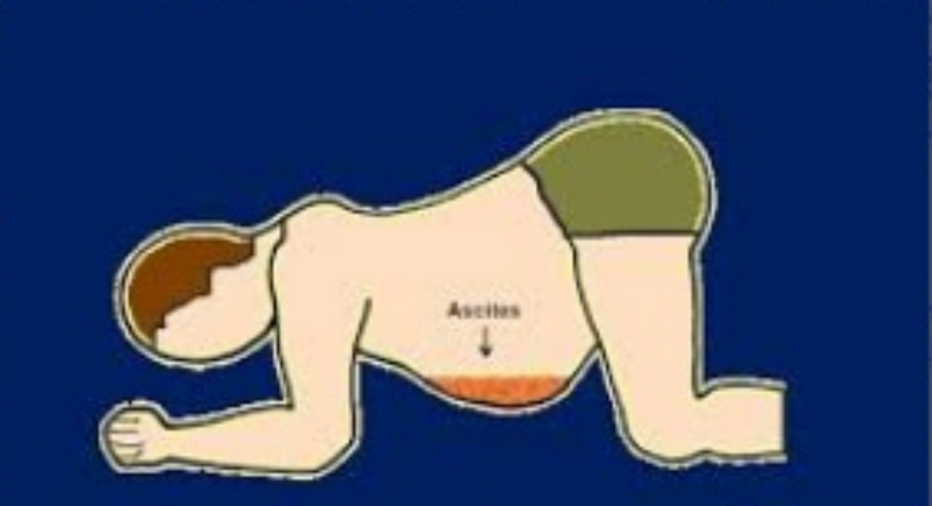
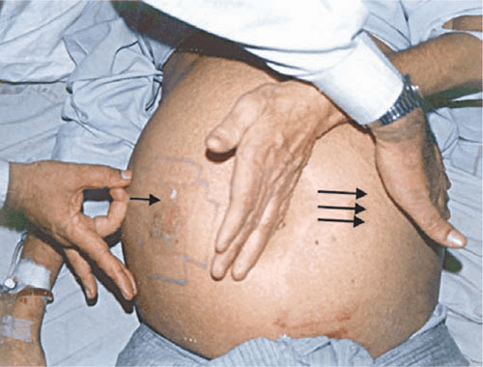
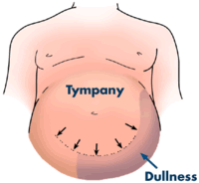
Physical examination
Inspection: abdominal distention and bulging flanks
Percussion: 1. Puddle sign: can detect 100-150 ml 2. Shifting dullness: can detect 1-1.5 L 3. Transmitted thrill: >2 L
Symptoms
1. Early satiety.
2. Increased abdominal girth
3. Weight gain
4. Respiratory distress

Slide 10
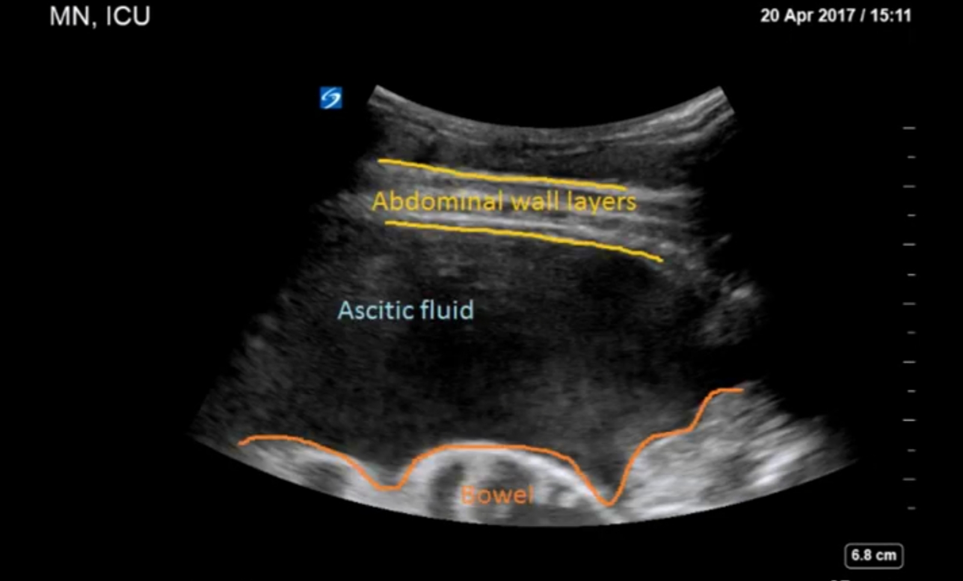
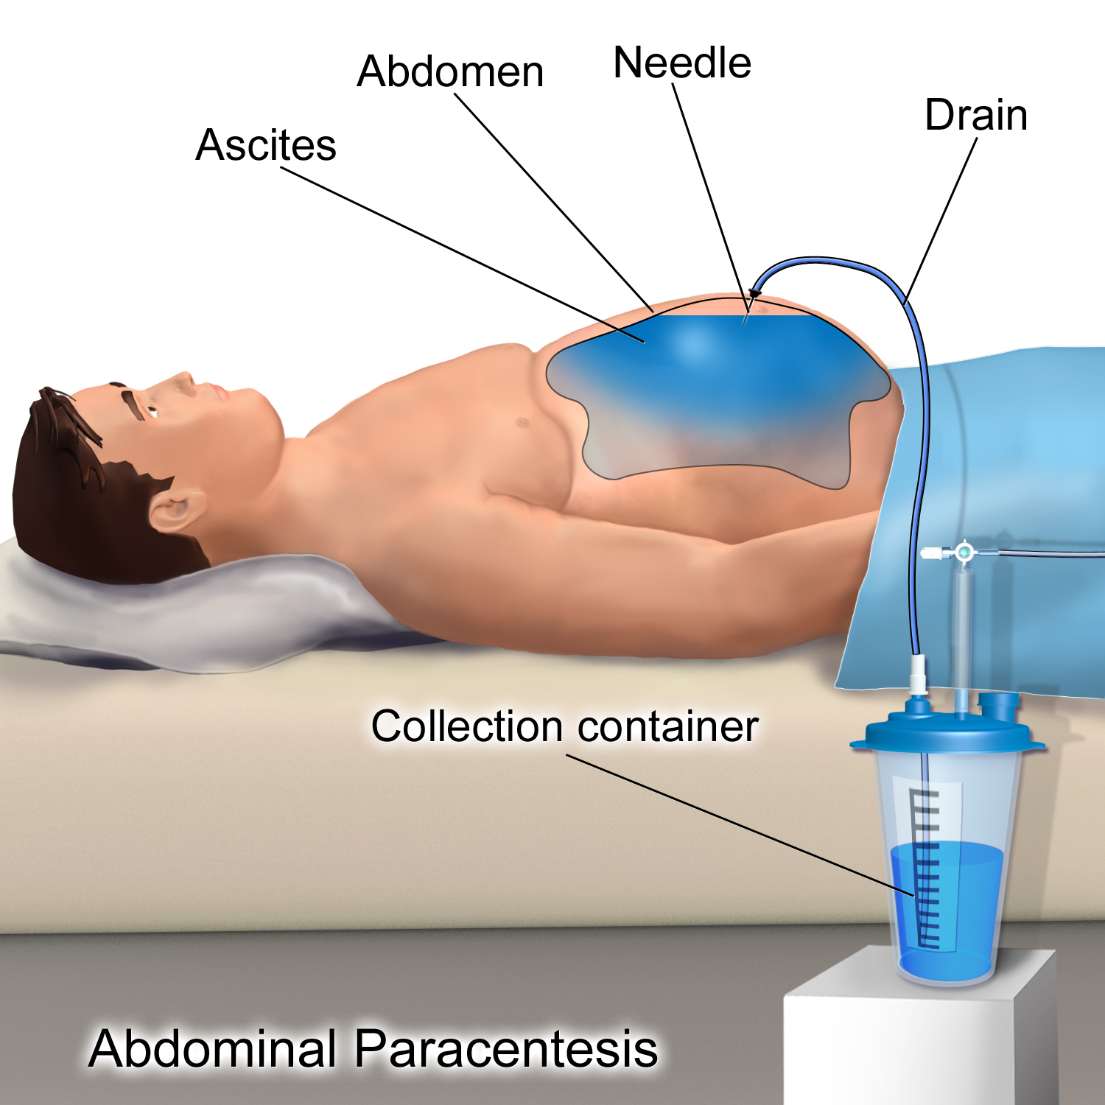
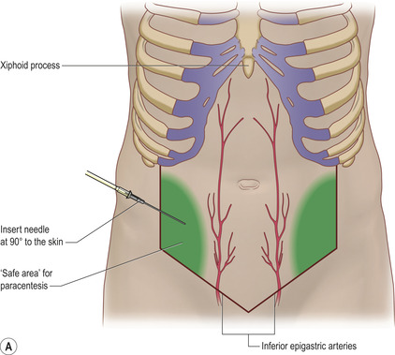
Investigation
Ultasonography is the best mean of detecting ascites particularly in the obese patient and those with small volumes of fluid .
Paracentesis can be used to obtain ascites fluid for analysis (Peritoneal cavity is punctured by needle to sample peritoneal fluid) .

Slide 11
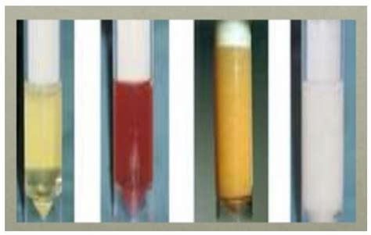
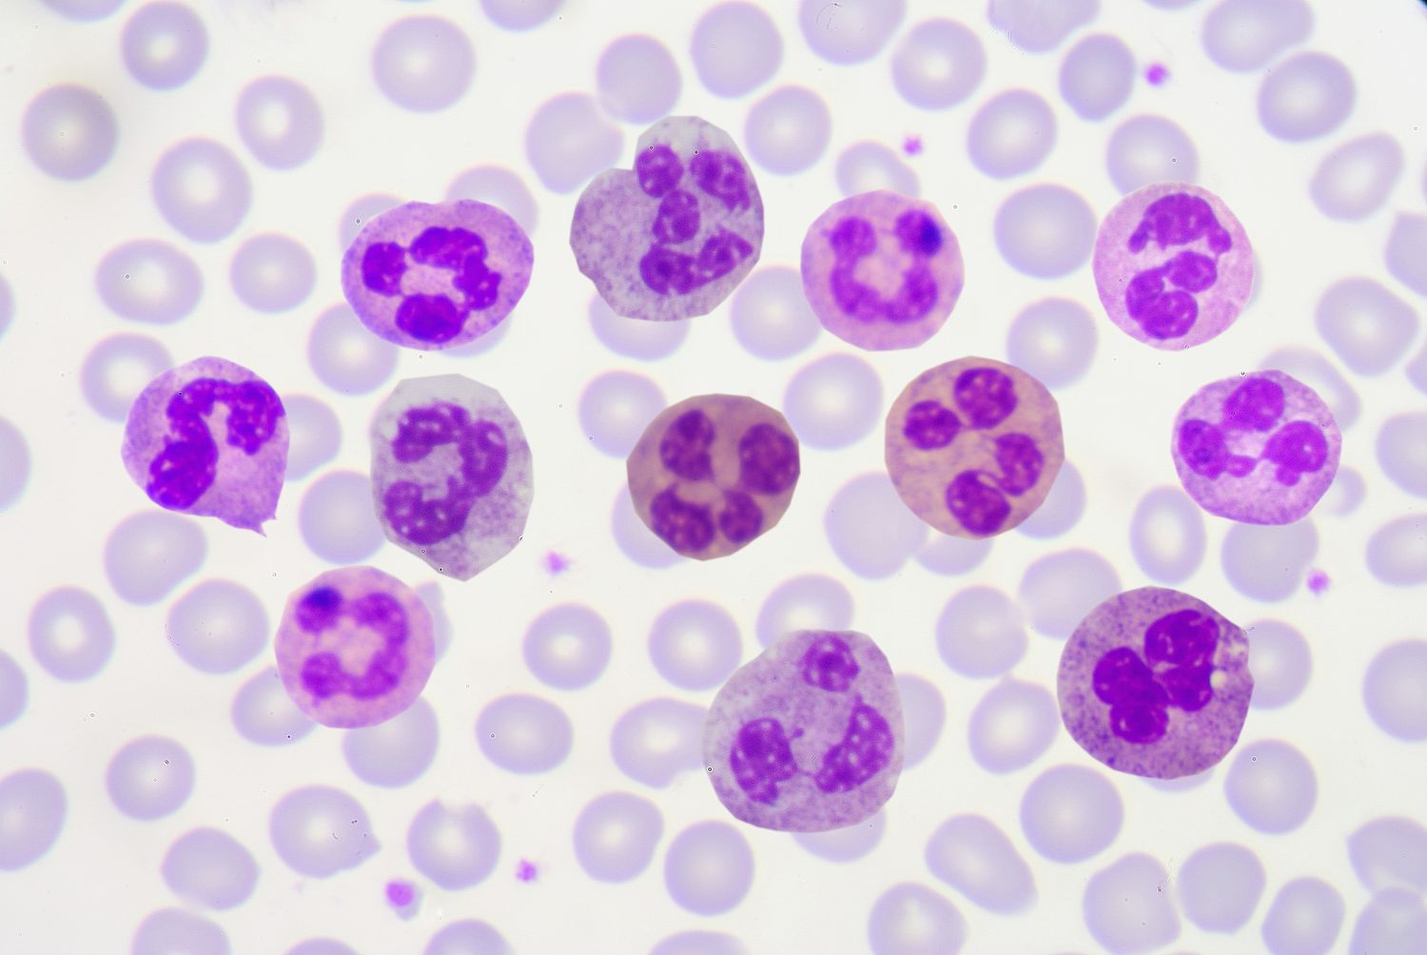
Fluid analysis :
Appearance
Clear: cirrhosis, HF, nephrotic.
Bloody: trauma, malignancy or TB (rarely)
Turbid: possible infection (SBP)
Milky: Chylous or pancreatic
CELL COUNT:
Normal ascitic fluid contains fewer than 500 leukocytes/µL and fewer than 250 polymorphonuclear leukocytes (PMNs)/µL. Any inflammatory condition can cause an elevated white blood cell count.
PMN count of greater than 250 cells/µL is highly suggestive of bacterial peritonitis

Slide 12
Culture/Gram stain
Cytological examination: may reveal malignant cell
The presence of triglyceride at a level > 1.1 g/L (110 mg/dL) is diagnostic of chylous ascites and suggests anatomical or functional abnormality of lymphatic drainage from the abdomen.

Slide 13
Management

Slide 14
Sodium and water restriction
Restriction of dietary sodium intake is essential to achieve negative sodium balance and a few patients can be managed satisfactorily by this alone
. Restriction of sodium intake to 100 mmol/24 hrs (‘no added salt diet’) is usually adequate.
Drugs containing relatively large amounts of sodium, and those promoting sodium retention, such as non-steroidal anti-inflammatory drugs (NSAIDs), must be avoided
Restriction of water intake to 1.0–1.5 L/24 hrs is necessary only if the plasma sodium falls below 125 mmol/L

Slide 16
Diuretics
Diuretics Most patients require diuretics in addition to sodium restriction
Diuresis may be improved if patients are rested in bed, perhaps because renal blood flow increases in the horizontal position
Spironolactone (100–400 mg/day): is the first-line drug because it is a powerful aldosterone antagonist
SIDE EFFECT:painful gynaecomastia and hyperkalaemia
amiloride (5–10 mg/day) can be substitution for spironolactone
loop diuretics, such as furosemide: but these can lead to fluid and electrolyte imbalance and renal dysfunction
Patients who do not respond to doses of 400 mg spironolactone and 160 mg furosemide, or who are unable to tolerate these doses due to hyponatraemia or renal impairment, are considered to have refractory or diuretic-resistant ascites and should be treated by other measures

Slide 17
Paracentesis
First-line treatment of refractory ascites is large-volume paracentesis.
Paracentesis to dryness is safe, provided the circulation is supported with an intravenous colloid such as human albumin (6–8 g albumin for each one liter of aspirated fluid if 5 L removed at once ) .
Paracentesis can be used as an initial therapy or when other treatments fail

Slide 18
Complications
Renal failure
It can be pre-renal and due to vasodilatation from sepsis and/or diuretic therapy, or due to hepatorenal syndrome which occurs in 10% of patients with advanced cirrhosis complicated by ascites,
Hepatorenal syndrome
It is a acute reversible form of renal failure in patient with cirrhosis
Cause:unkown
Triggers: refractory ascites….large volume paracentesis without albumin replacement ….SBP
Caused by combination of VD in splanchnic and VC in renal circulation
The first line of treatment : vasopressin (terlipressin) and albumin
Liver transplantation is the best option esp. for type 1

Slide 20
Spontaneous bacterial peritonitis
Infection of ascites fluid without detectable intra abdominal infection and caused usually by E.coli
Mechanism :
1.Translocation of gut bacteria through intestinal wall to colonize mesenteric LN ,thus entering the blood circulation and ascitic fluid
2.Hematogenous
S&S: fever –abdominal pain and tenderness—rebound tenderness-no bowel sounds—altered mental status
Diagnosis is based on :
1.Positive ascitic bacterial culture (monomicrobial)
2.Elevated absolute PMN count in ascitic fluid (more than 250cells /mm3)
Treatment: broad-spectrum antibiotics, such as cefotaxime (5-10 days)

Slide 21
Thank you

