Slide 1
Reverse transcription

Slide 2
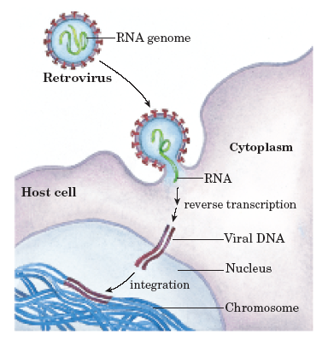
Reverse transcription
- The genetic information carrier of some
biological systems is ssRNA instead of
dsDNA (such as ssRNA viruses).
- The information flow is from RNA to
DNA, opposite to the normal process.
- This special replication mode is called
reverse transcription.
- HIV has an RNA genome that is
duplicated into DNA.
- The resulting DNA can be merged with
the DNA genome of the host cell.
- The main enzyme responsible for
synthesis of DNA from an RNA template
is called reverse transcriptase (RT).
- It has the following activities:
1- RNA-dependent DNA polymerase 2- RNase
3- DNA-dependent DNA polymerase

Slide 3
In the case of HIV, reverse transcriptase is responsible for
synthesizing a complementary DNA strand (cDNA) to the
viral RNA genome.
An associated enzyme, ribonuclease H, digests the RNA
strand, and reverse transcriptase synthesizes DNA
complementary strand to form a double helix DNA
structure.
This DNA is integrated into the host cell's genome by
integrase enzyme causing the host cell to generate viral
proteins that reassemble into new viral particles.
However, in retroviruses, the host cell remains intact as the
virus buds out of the cell but in the case of HIV, the host cell
undergoes apoptosis.
Some eukaryotic cells contain an enzyme with reverse
transcription activity called telomerase.

Slide 4
Telomerase is a reverse transcriptase that lengthens the ends of
linear chromosomes.
Telomerase carries an RNA template from which it synthesizes
DNA repeating sequence, or "junk" DNA.
This repeated sequence of DNA is important because, every
time a linear chromosome is duplicated, it is shortened in length.
Telomerase is often activated in cancer cells to enable cancer
cells to duplicate their genomes indefinitely without losing
important protein-coding DNA sequence (the discovery of RT
enriches the understanding about the cancer-causing theory
of viruses, where cancer genes in RT viruses, and HIV having RT
function).
Activation of telomerase could be part of the process that
allows cancer cells to become immortal.

Slide 5
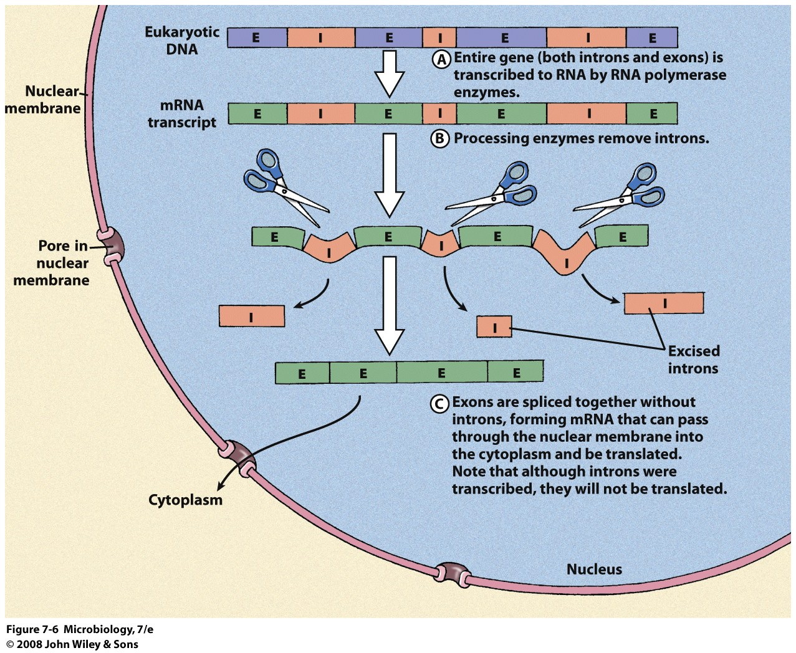
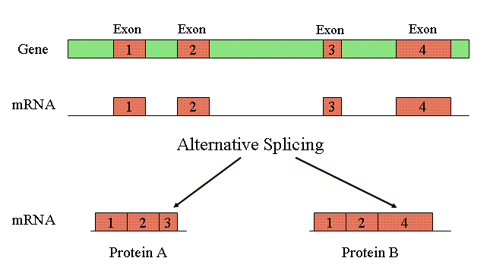
Alternative splicing (eukaryotes only)
- Exons are “coding” regions
- Introns are removed
- Different combinations of exons form different mRNA resulting in multiple proteins from the same gene
- Humans have 30 to 50 thousand genes but are capable of producing 100,000 proteins.

Slide 6
Genetic codes

Slide 7
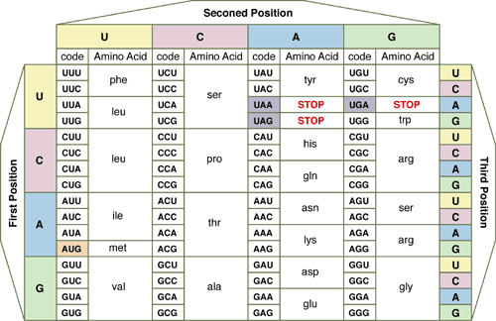

Slide 8
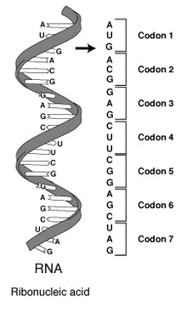
Genetic code
- It is the set of rules by which
information encoded in genetic material
(DNA or mRNA sequences) is translated
into proteins (amino acid sequences) by
living cells.
- With some exceptions, a triplet codon in
a nucleic acid sequence specifies a single
amino acid.
- Because the majority of genes are
encoded with exactly the same code, this
particular code is often referred to as
standard genetic code, though in fact
there are many variant codes.
- For example, protein synthesis in human
mitochondria relies on a genetic code
that differs from the standard genetic
code.

Slide 9
Characters of genetic code:
1- The genetic code is composed of nucleotide triplets. In other words,
three nucleotides in mRNA (a codon) specify one amino acid in a
protein.
2- The code is non-overlapping. This means that successive triplets are
read in order and each nucleotide is part of only one triplet codon.
The genetic code is read in groups (or "words") of three nucleotides.
After reading one triplet, the "reading frame" shifts over three letters,
not just one or two. In the following example, the code would not be
read GAC, ACU, CUG, UGA...
Rather, the code would be read GAC, UGA, CUG, ACU...

Slide 10
3- The genetic code is degenerate. In contrast, some amino acids can be
specified by more than one codon.
- There are 64 different triplet codons, and only 20 amino acids.
- Unless some amino acids are specified by more than one codon, some
codons would be completely meaningless.
- Therefore, some redundancy is built into the system: some amino
acids are coded for by multiple codons.
- In some cases, the redundant codons are related to each other by
sequence; e.g., leucine is specified by CUU, CUA, CUC, and CUG.
- The codons are the same except for the 3rd nucleotide position.
- This third position is known as the "wobble" position of the
codon.
- This property allows some protection against mutation - if a mutation
occurs at the third position of a codon, there is a good chance that the
amino acid specified in the encoded protein won't change.
- This is because in a number of cases, the identity of the base at the
third position can wobble, and the same amino acid will still be
specified.

Slide 11
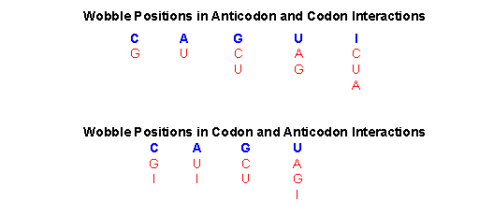
4- The genetic code is unambiguous. Each codon specifies a particular
amino acid, and only one amino acid. In other words, the codon ACG
codes for the amino acid threonine, and only threonine.
5- The code is nearly universal. Almost all organisms in nature (from
bacteria to humans) use exactly the same genetic code. The rare
exceptions include some changes in the code in mitochondria, and in
a few protozoan species.

Slide 12
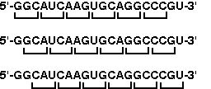
Reading frames
If you think about it, because the genetic code is triplet based, there are
three possible ways a particular message can be read, as shown in the
following figure:
Clearly, each of these would yield completely different results.
Genetic messages work much the same way: there is one reading frame
that makes sense, and two reading frames that are nonsense.
- The code contains signals for starting and stopping translation of the
code.
The start codon is AUG, which codes for methionine and encountered
signals for translation to begin and subsequent triplets are read in the
same reading frame.
Translation continues until a stop codon is encountered.
There are three stop codons: UAA, UAG, and UGA.

Slide 13
- To be recognized as a stop codon, the triplet must be in the same
reading frame as the start codon.
A reading frame between a start codon and an in-frame stop codon is
called an open reading frame.
- Translation can take place considering the following sequence:
5'-GUCCCGUGAUGCCGAGUUGGAGUCGAUAACUCAGAAU-3'
First, the code is read in a 5' to 3' direction.
The first AUG read in that direction sets the reading frame, and
subsequent codons are read in frame, until the stop codon, UAA, is
encountered.
In this sequence, there are nucleotides at either end that are outside of
the open reading frame. Because they are outside of the open reading
frame, these nucleotides are not used to code for amino acids.

Slide 14
This is a common situation in mRNA molecules, where the region at the
5' end that is not translated is called 5' untranslated region (5' UTR)
and at the 3' end is called the 3' untranslated region (3' UTR).
These sequences, even though they do not encode any polypeptide
sequence, are not wasted: in eukaryotes these regions typically contain
regulatory sequences that can affect when a message gets translated,
where in a cell an mRNA is localized, and how long an mRNA lasts in
a cell before it is destroyed.
A position of a codon is said to be a fourfold degenerate site if any
nucleotide at this position specifies the same amino acid, e.g. the third
position of the glycine codons (GGA, GGG, GGC, GGU) is a fourfold
degenerate site, because all nucleotide substitutions at this site are
[synonymous]; i.e., they do not change the amino acid. So, only the
third positions of some codons may be fourfold degenerate.

Slide 15
A position of a codon is said to be a twofold degenerate site if only
two of four possible nucleotides at this position specify the same amino
acid. For example, the third position of the glutamic acid codons (GAA,
GAG) is a twofold degenerate site.
A position of a codon is said to be a non-degenerate site if any
mutation at this position results in amino acid substitution.
There is only one threefold degenerate site where changing to three of
the four nucleotides may have no effect on the amino acid (depending
on what it is changed to), while changing to the fourth possible
nucleotide always results in an amino acid substitution.
This is the third position of an isoleucine codon: AUU, AUC, or AUA
all encode isoleucine, but AUG encodes methionine.

Slide 16
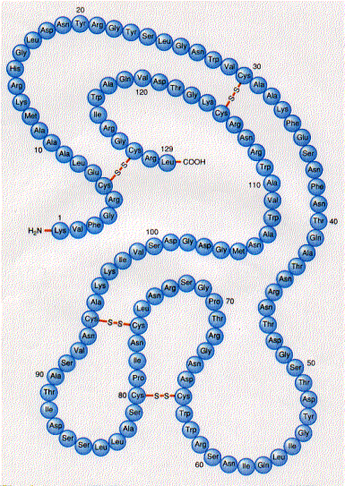
Protein synthesis

Slide 17
It is the process in which cells build proteins (a multi-step process,
beginning with amino acid synthesis and transcription of nuclear DNA
into messenger RNA, which then decoded by the ribosome to produce
proteins).
When a protein must be available on short notice or in large quantities,
a protein precursor is produced (proprotein).
A proprotein is an inactive protein containing one or more inhibitory
peptides that can be activated when the inhibitory sequence is removed
by proteolysis during posttranslational modification (trimming).
A preproprotein is a form that contains a signal sequence (an N-
terminal signal peptide) that specifies its insertion into or through
membranes, i.e., targets them for secretion.

Slide 18
The signal peptide is cleaved off in the endoplasmic reticulum.
Preproproteins have both sequences (inhibitory and signal) still
present.
For synthesis of protein, a succession of tRNA molecules charged with
appropriate amino acids have to be brought together with a mRNA
molecule and matched up by base-pairing through their anti- codons
with each of its successive codons.
The amino acids then have to be linked together to extend the growing
protein chain, and the tRNAs, relieved of their burdens, have to be
released.
These whole complex of processes is carried out by the ribosome,
formed of two main chains of rRNA, and more than 50 different
proteins.

Slide 19
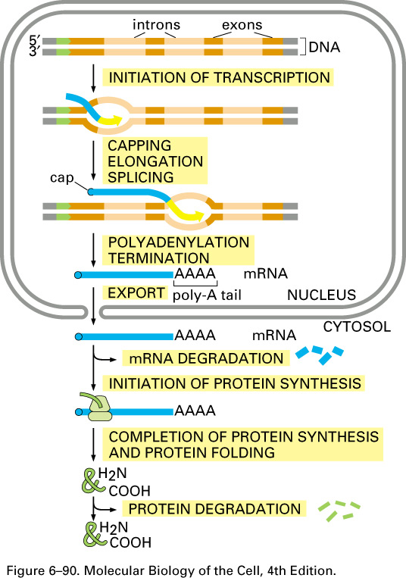
Gene expression
Transcription is synthesis of an
RNA that is complementary to
one of the strands of DNA.
Translation when ribosomes read
a messenger RNA and make protein
according to its instruction.
Gene encoding region (ORF)
transcription
mRNA
translation
Precursor protein
post - translational
modifications
Mature protein
folding
Biologically active protein

Slide 20
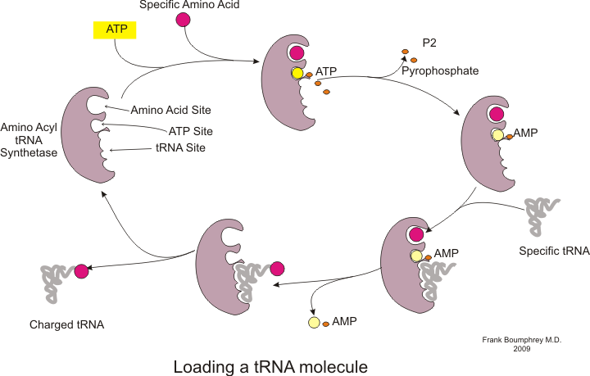
Charging the tRNA
tRNA acts as a translator between mRNA and protein
Each tRNA has a specific anticodon and an amino acid acceptor site.
Each tRNA also has a specific charger protein (aminoacyl tRNA
synthetases) which can only bind to that particular tRNA and attach
the correct amino acid to the acceptor site.
The energy to make
this bond comes
from ATP.

Slide 21
Aminoacyl tRNA synthetases:
There are 20 different synthetases one for each amino acid
that can catalyze the covalent bond between the amino acid
and tRNA
A single synthetase may recognize multiple tRNAs for the
same amino acid specified by the mRNA codon to which the
tRNA anticodon binds
Two classes of synthetases, differ in the 3-dimensional
structures, which side of the tRNA they recognize and how
they bind ATP
Class I - monomeric, acylates the 2’OH on the terminal ribose
Arg, Cys , Gln, Glu, Ile, Leu, Met, Trp Tyr, Val
- Class II - dimeric, acylates the 3’OH on the terminal ribose
Ala, Asn, Asp, Gly, His, Lys, Phe, Ser, Pro, Thr

Slide 22
Wobble
If there was one tRNA for each mRNA codon, there would
be 61 different tRNAs but there are fewer
Some tRNAs have anticodons that recognize 2 or more
different codons
Base pairing rules between the third base of a codon and its
tRNA anticodon are not a rigid as DNA to mRNA pairing
- Example: U in tRNA can pair with either A or G in the
third position of an mRNA codon
This flexibility is called wobble
There are two levels of control to ensure that the proper
amino acid is incorporated into protein through:
1- The reaction of amino acyl tRNA synthetase for charging
the proper tRNA
2- Matching the specific tRNA to a particular codon of
mRNA

Slide 23
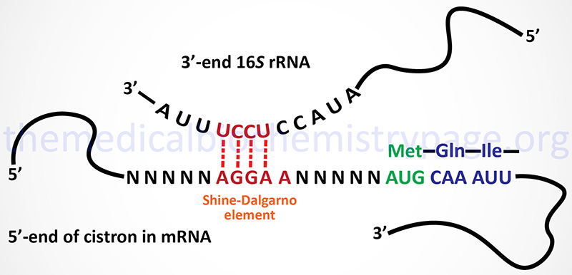
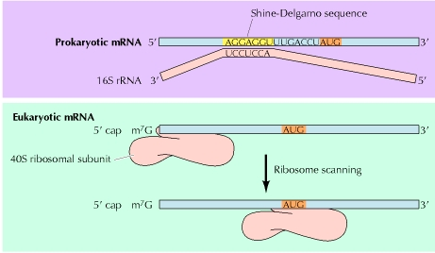
In prokaryotes, specific
sequences in the mRNA around
the AUG codon, called Shine –
Delgarno sequences, are
recognized by an initiation
complex consisting of a Met
amino-acyl tRNA, initiation
factors (IFs) and the small
ribosomal subunit.
In eukaryotes, there is a process
called ribosome scanning, where
mRNA is moving along the small
subunit of ribosome till finding the
codon of initiation (AUG) of
methionine to be located in the P
site.

Slide 24
Initiation
This phase of protein synthesis results in the assembly of a functionally
competent ribosome in which an mRNA has been positioned correctly
so that its start codon is positioned in the P (peptidyl) site and is paired
with the initiator tRNA.
The following ingredients are needed for this phase of protein
synthesis:
1- Two ribosome subunits - 30S and 50S 2- The mRNA
3- Three Initiation Factors - IF1, IF2 (GTP) and IF3
4- The initiator fMet-tRNA_{f}^{Met}
The following steps take place:
A- Binding of the ribosome 30S subunit with initiation factor (IF3)
promotes the dissociation of the ribosome into its two component
subunits.
B- The presence of IF3 permits the assembly of the initiation complex
and prevents binding of the 50S subunit prematurely, IF1 assists IF3
in some way, perhaps by increasing the dissociation rate of the 30S
and 50S subunits of the ribosome.

Slide 25
C- Binding of the mRNA and the fMet-tRNA_{f}^{Met}
IF3 assists the mRNA to bind with the 30S subunit of the ribosome so
that the start codon is correctly positioned at the peptidyl site of the
ribosome.
The mRNA is positioned by means of base-pairing between the 3' end
of the 16S rRNA with the Shine- Dalgarno sequence immediately
upstream of the start codon.
IF2(GTP) assists the fMet-tRNA_{f}^{Met} to bind to the 30S subunit in the
correct site - the P site.
At this stage of assembly, the 30S initiation complex is complete and
IF3 can dissociate.
D- Binding of the ribosome 50S subunit and release of Initiation Factors
Three events now happen "simultaneously".
As the 50S subunit of the ribosome associates with the 30S initiation
complex, GTP hydrolysis occurs on IF2.
This hydrolysis may be helped by the L7/L12 ribosomal proteins rather
than by IF2 itself.

Slide 26
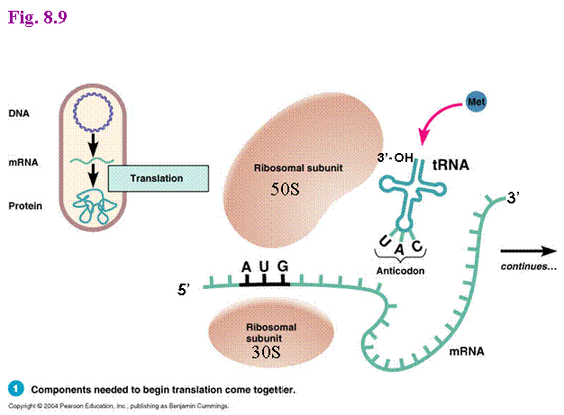

Slide 27
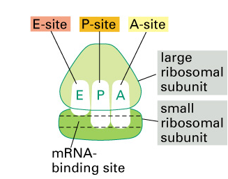
In addition to the APE sites there is an mRNA binding groove that
holds onto the message being translated
The A site binds an aminoacyl-tRNA (a tRNA bound to an amino acid);
P site binds a peptidyl-tRNA (a tRNA bound to the peptide being
synthesized).
The E site binds a free tRNA before it exits the ribosome.

Slide 28
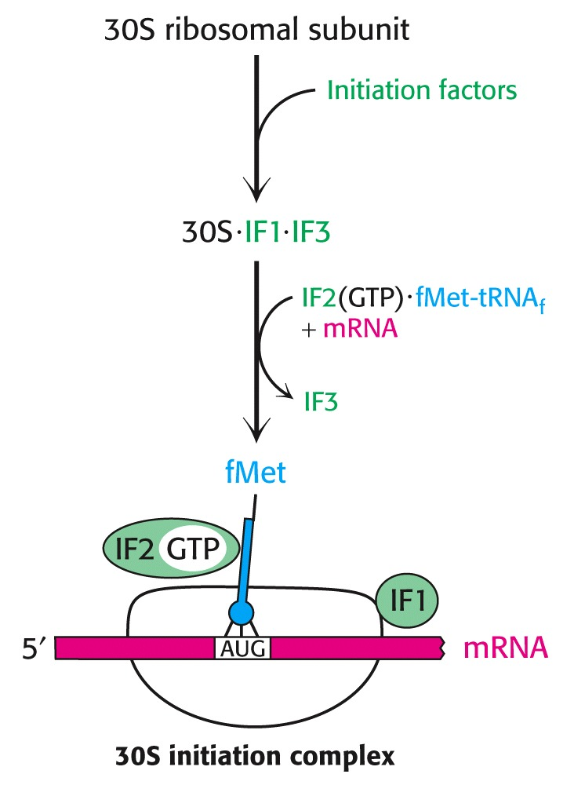
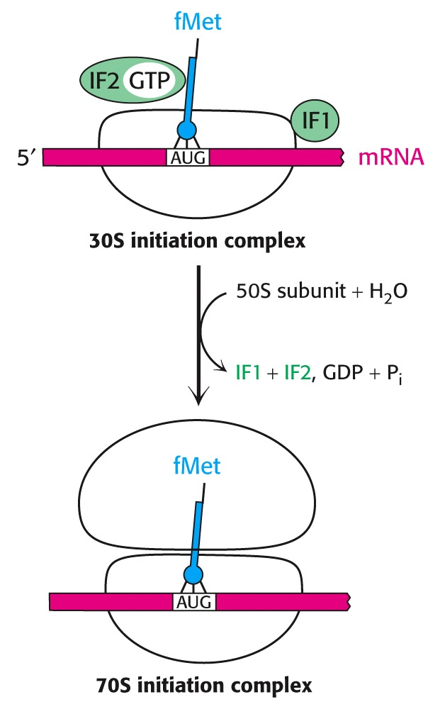

Slide 30
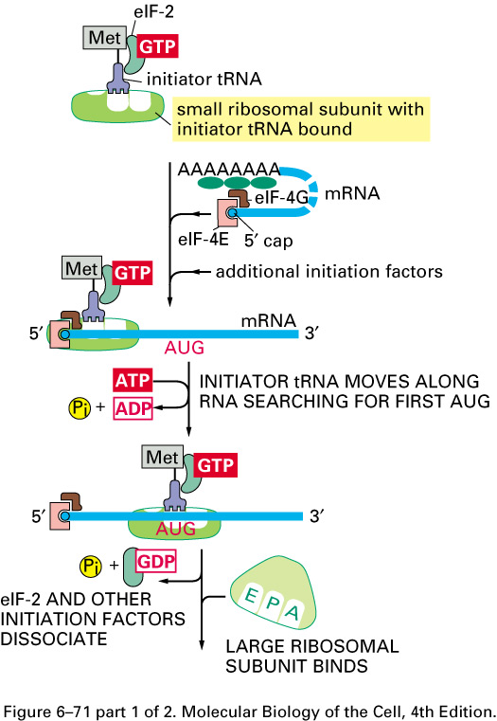
Eukaryotes use a
scanning mechanism
to initiate translation.
Recognition of the
AUG triggers GTP
hydrolysis by eIF-2
- GTP hydrolysis by
eIF2 is a signal for
binding of the large
subunit and beginning
of translation

Slide 31
Elongation
Three special Elongation Factors are required for this phase of protein
synthesis: EF- Tu (GTP), EF-Ts and EF-G (GTP).
-The Elongation phase of protein synthesis consists of a cyclic process
whereby a new aminoacyl-tRNA is positioned in the ribosome, the
amino acid is transferred to the C-terminus of the growing polypeptide
chain, and the whole assembly moves one position along the ribosome:
A new codon is now positioned at the A site and awaits a new
aminoacyl-tRNA.
- Binding of a new aminoacyl-tRNA at the A site
At the start of each cycle:
-The A (aminoacyl) site on the ribosome is empty
The P (peptidyl) site contains a peptidyl-tRNA, and the E (exit) site
contains an uncharged tRNA.
The elongation factor, EF- Tu (GTP) binds with an aminoacyl-tRNA
and brings it to the ribosome.

Slide 32
Once the correct aminoacyl-tRNA is positioned in the ribosome, GTP
is hydrolyzed, EF- Tu (GDP) undergoes a conformational change and
then dissociates away from the ribosome.
There are two ways that EF- Tu functions to ensure that the correct
aminoacyl-tRNA is in place:
EF- Tu prevents the aminoacyl end of the charged tRNA from entering
the A site on the ribosome.
This ensures that codon- anticodon pairing is checked first before the
charged tRNA is irreversibly bound in the A site and a new, potentially
incorrect, peptide bond is made.
GTP hydrolysis is SLOW and EF- Tu cannot dissociate from the
ribosome until it occurs.
The amount of time prior to GTP hydrolysis allows the final fidelity
check to take place.
Hydrolysis is associated with a conformational change in EF-Tu.

Slide 33
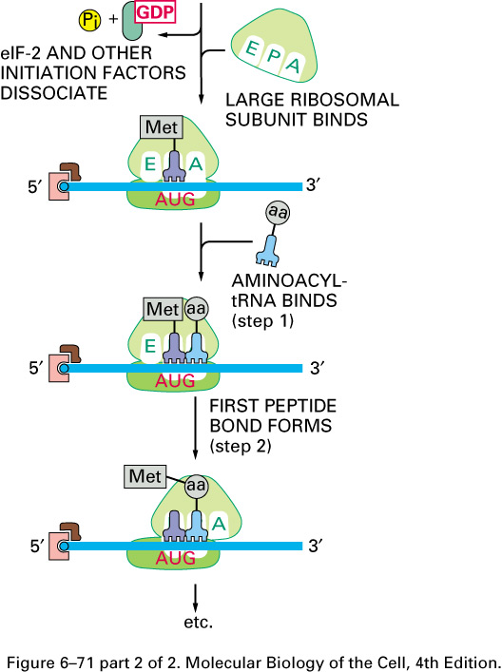
Elongation step of protein synthesis

Slide 34
Termination
-The final phase of protein synthesis requires that the finished
polypeptide chain be detached from a tRNA.
This can only happen in response to the signal that a stop codon has
been reached.
Binding of Release factors
There are no tRNAs that recognize the stop codons.
Rather stop codons are recognized by release factor RF1 (which
recognizes the UAA and UAG stop codons) or RF2 (which recognizes
the UAA and UGA stop codons).
These release factors act at the A site of the ribosome.
A third release factor, RF3 (GTP), stimulates the binding of RF1 and
RF2.
Hydrolysis of the peptidyl-tRNA
Binding of the release factors alters the peptidyltransferase activity with
a nucleophilic effect.
The result is hydrolysis of the peptidyl-tRNA and release of the
completed polypeptide chain.

Slide 35
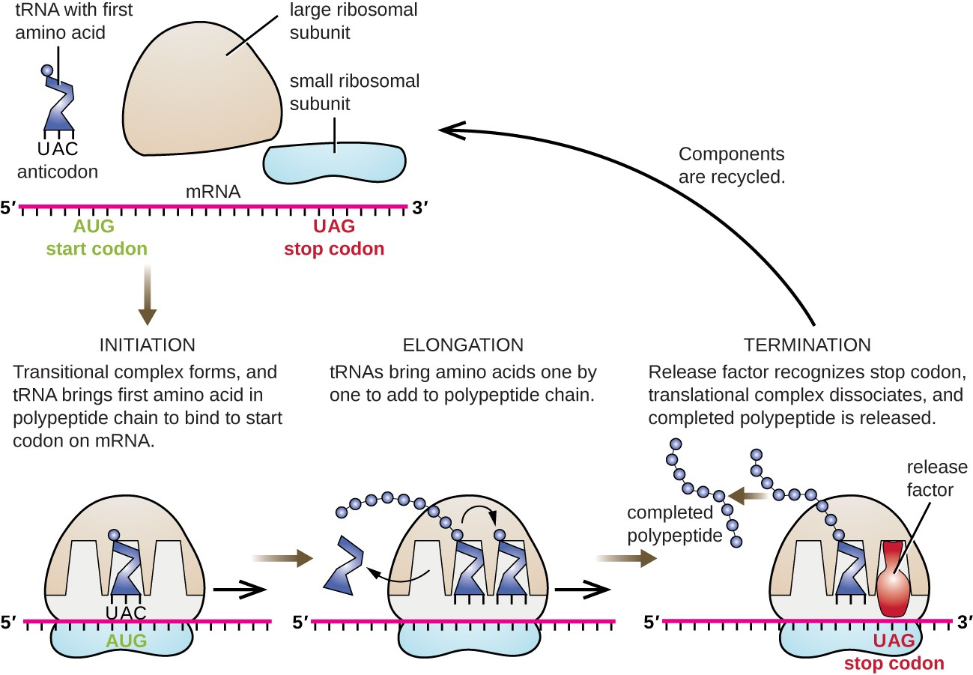
The uncharged tRNA in the E site can dissociate as can the
release factors.
GTP is hydrolyzed without dissociating tRNA in the P site.

Slide 36
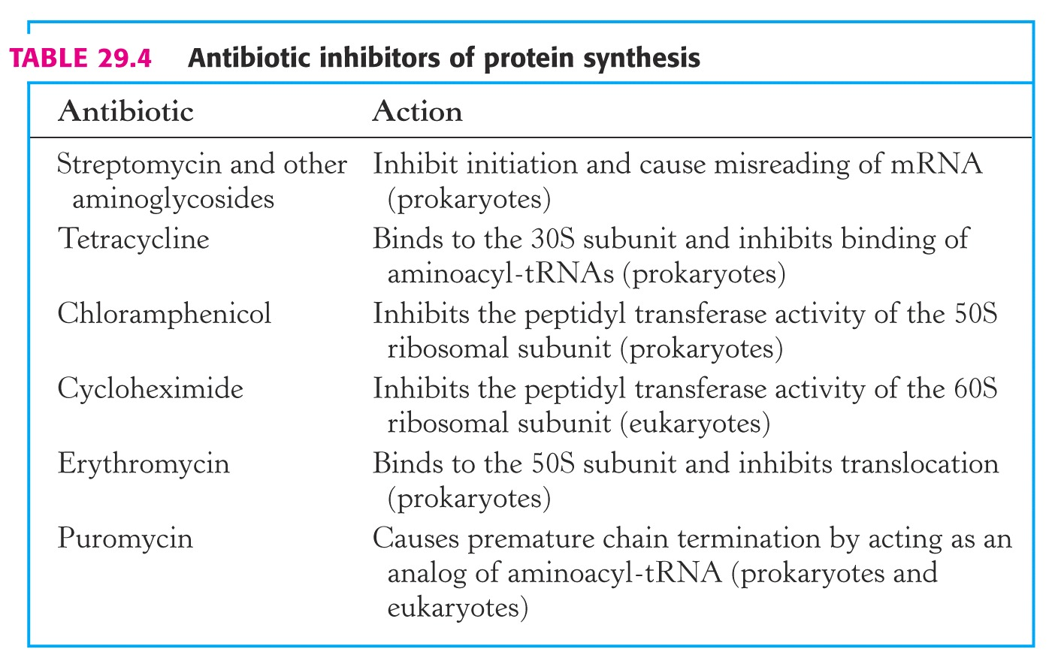
Diphtheria toxin Inhibits eEF-2 by ADP-ribosylation of
modified histidine in the factor

Slide 37
Antibiotics inhibiting translation
The bacterial ribosomal structure and the accessory functions differ in
many respects from its eukaryotic equivalent. The translation reaction
itself can be subdivided into three parts:
1.Formation of the initiation complex, blocked by Streptomycin and
Tetracyclins (the latter inhibiting binding of aminoacyl-tRNA to the
ribosomal A- site at the 30S ribosomal subunit.
2.Introduction of aminoacyl-tRNA and synthesis of a peptide bond,
inhibited by puromycin (leading to premature termination) and
chloramphenicol (probably inhibiting the peptidyltransferase).
3.Translocation of the mRNA relative to the ribosome blocked by
erythromycin and fusidic acid (the latter preventing release of EF-
G/GDP.

Slide 38
Protein synthesis in eukaryotes
A major difference between eukaryotes and prokaryotes is that, in a
typical eukaryotic cell, protein synthesis takes place in the cytoplasm
while transcription and RNA processing take place in the nucleus.
In bacteria, these two processes can be coupled so that protein synthesis
can start even before transcription has finished.
The steps of protein synthesis are basically the same in eukaryotic cells
as in prokaryotes.
The ingredients, however, can be different:
1- Ribosomes are larger. 60s and 40s subunits combine to give 80s
ribosomes which contain 4 RNAs: 28S,5.8S and 5S in
the 60S subunit; 18S in the 40S subunit.
2- While the initiating amino acid in eukaryotic protein synthesis is still
methionine, it is not formylated.
3- Eukaryotic mRNA is capped. This is used as the recognition feature
for ribosome binding -- not the 18S rRNA.
4- The initiation phase of protein synthesis requires over 10 eukaryotic
initiation factors (eIFs) one of which is the cap binding protein.

Slide 39
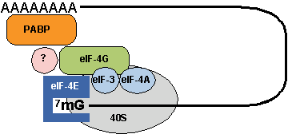
5- The eukaryotic elongation phase closely resembles that in prokaryotes. - The corresponding elongation factors are eEF-1a (EF-Tu), eEF-
1bg (EF-Ts) and eEF-2 (EF-G).
6- Eukaryotes require just a single release factor, eRF.
Coordinating protein synthesis with mRNA synthesis
It has recently been found that the eukaryotic initiation factor eEF-
4G binds not only with other factors in the initiation complex but also
with PABP (poly A binding protein) which binds to the poly A tail of
mRNA.
It is thought that the binding of eEF-4G to PABP serves as a critical
recruitment step for driving downstream translation.
In another sense, however, the binding of eEF-4G to PABP represents a
mechanism to ensure that only mature intact mRNAs are translated.

Slide 40
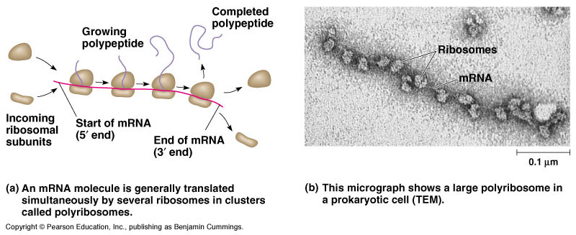
Most mRNA are translated by more than one ribosome at a time; the
result, a structure in which many ribosomes translate a mRNA in
tandem, is called a polysomes.

Slide 41
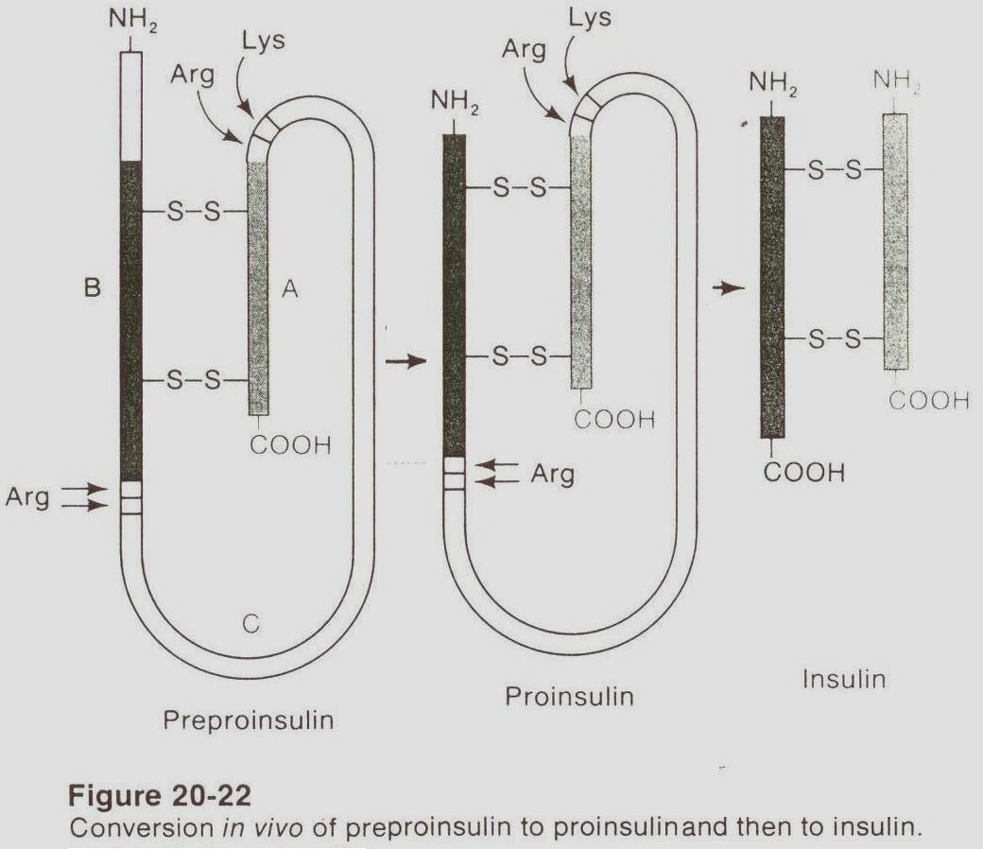
Post-translational modifications
- They are the chemical modifications of a protein after its translation
- Characterized by:
1- Being numerous and diverse
2- Able to change the charge, conformation or size of protein molecule
Effects:
1. Stability of protein
2. Biochemical activity (activity regulation)
3. Protein targeting (protein localization)
4. Protein signaling
(protein - protein
interaction.

Slide 42
1- Insulin, which is a low-molecular-weight protein having
two polypeptide chains which fold to allow interchain and
intrachain disulfide bridges.
A specific protease then clips out the segment that connects
the two chains which form the functional insulin molecule,
where a propeptide is removed from the middle of the chain;
the resulting protein consists of two polypeptide chains
connected by disulfide bonds.
2- Also, most nascent polypeptides, the initial methionine is
usually taken off during post-translational modification by
specific aminopeptidases.
3- Other modifications, like phosphorylation, are part of
common mechanisms for controlling the behavior of a
protein, for instance activating or inactivating an enzyme.

Slide 43
4- Some animal viruses, as poliovirus and hepatitis A virus,
synthesize long polycistronic proteins from one long mRNA
molecule, these proteins must be cleaved at specific sites to
provide the several specific proteins required for viral
function.
5- Collagen, an abundant protein in the extracellular spaces of
higher eukaryotes, is synthesized as procollagen three
polypeptide molecules, that align themselves in a particular
way that is dependent upon the existence of specific amino
terminal peptides.
6- Specific enzymes then carry out hydroxylations and oxidations
of specific amino acid residues within the procollagen molecules
to provide cross-links for greater stability with cleavage of the
NH2 terminal end to form a strong, insoluble collagen molecule.

Slide 44
Types of posttranslational modifications:
A- Trimming:
- Many proteins secretion from the cell are made as:
- large precursor molecules but functionally inactive
Change of protein from non active for active molecule by
removing portions of the protein chain by specialized
endoproteases
Sites of the cleavage reaction:
- Endoplasmic reticulum
- Golgi apparatus
- Secretory vesicles
N.B. zymogens which are inactive enzymes, become activated
through cleavage when they reach their proper sites of action.

Slide 45
B- Covalent alterations:
- Proteins may be activated or inactivated by the covalent attachment
of a variety of chemical groups
1- Phosphorylation :
- By adding phosphate group to the hydroxyl groups of (serine,
threonine, tyrosine residues in a protein) which is catalyzed by
protein kinases and reversed by protein phosphatases
- The phosphorylation may ↓ or ↑ the functional activity of protein
2- Glycosylation :
- Many of proteins → become part of a plasma membrane, lysosomes or
secreted from the cell have carbohydrate chains attached to serine or
threonine hydroxyl groups (O-linked) or the amide nitrogen of
asparagine (N-linked)
- Occurs: in the endoplasmic reticulum and golgi apparatus
- Used to : target protein to specific organelles

Slide 46
3- Hydroxylation :
As proline and lysine in endoplasmic reticulum by prolyl or lysyl
hydroxylases (e.g. in collagen).
4- Other covalent modifications :
a-Carboxylation:
- Carboxyl groups can be added to glutamate residues by vitamin K
- The resulting carboxyglutamate residues are essential for the activity of
several of the blood-clotting proteins
b- Biotinylated enzyme:
- Biotin is covalently bound to the amino groups of lysine residues of
biotin-dependent enzymes that catalyze carboxylation reactions
- Such as: pyruvate carboxylase
c- Farnesylated protein:
- Help anchor proteins in membranes.
- Note : many proteins are acetylated.

