Slide 1
Spinal cord injury
prepared by :
Lubna Sameer and Mohammed Hashem
ملاحظة تم تعديل السلايد بعد المحاضرة لاضافة ما كان ناقص و ازالة معلومة قديمة المحاضرة بالشكل هاذ كاملة حسب راي دكتور رامي

Slide 2
Normal anatomy and physiology
the spinal cord tracts

Slide 3
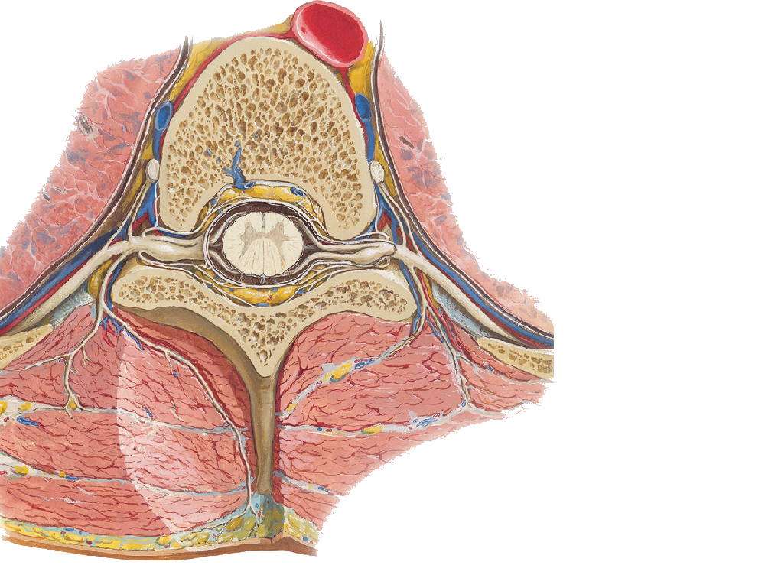
what is the spinal
the spinal cord is the most important part
here you can see the spinal root that come together to make the spinal nerves
theres 31 spinal nerves

Slide 4
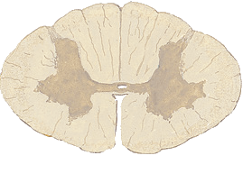
Cross section of the spinal cord
Posterior median sulcus
Posterior intermediate sulcus
Posterior horn
Lateral horn
Commissure
Anterior horn
Anterior white commissure
Anterior median fissure

Slide 5
The tracts
Gracile fasciculus
Cuneate fasciculus
Lateral corticospinal
▇ Ascending pathways
▇ Descending pathways
▇ Fibers passing in both directions
Anterolateral system (ALS) that includes the
spinothalamic
Anterior corticospinal
theres many tracts in the spinal cord but this seminar we'll focuses on three tracts because the signs and symptoms of theres lesions are the most clear

Slide 6
Dorsal column - medial lemniscus pathway
Carries vibration and proprioception sensation to the brain
Travels up the posterior (dorsal) part of the spinal cord (Cuneatus → Upperlimp / Gracilis →Lower limp)
1st syna[se in ipsilateral medulla on the Nu Cuneatus or gracilis
Nurons decussate to contralateral medial lemnisuc and continue upwards
2nd synapse in the VPL and continue to the somatosensory cortex

Slide 7
A question
What symptoms would a patien experience if the lateral portion of the right dorsal column was damaged at the C5 Spinal cord level ?
Notes:
Loss of vibration and proprioseption on the same side , however if the medial portion is spared some tracts are'nt effected meaning the Gracilus nu isnt effected means the sensation of the lower extrimity stays intacts

Slide 8
Spinothalamic Tract
Carries pain and temperature sensation
1st synapse in the ipsilateral gray matter posterior horn
Neuron decussate through anterior white commissure → reaches lateral white matter then continues upward
2nd synapse in the VLP then continues to the primary somatosensory cortex

Slide 9
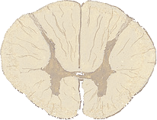
A question
A patient has damaged the anterior white commissure of the T1 spinal cord what symptoms would you expect ?
Notes:
the white commissure is used by the spinothalamic tract so it diccusaets to the other side
injury here will lead to loss of pain and temp at the level of the lesion bi- lateraly
(note that lessours tracts might make it a level higher or lower to the injury
this is seen in syringomyelia from C1 - T1

Slide 10
Corticospinal Tract
Carries motor input from the brain to the body
Neurons Originates in the primary motor cortex → travels through the internal capsule and medulla → decussates at medullary pyramids → contralateral tract and continues withing posterolateral white matter until axon reaches the appropriate level → enters the anterior horn of gray matter
1st Synapse occurs in the anterior horn of gray matter
Neuron exits spinal cord through anterior root → Synapses on NMJ

Slide 11
Upper and Lower Motor Neurons
UMN and LMN refer to the two neurons that make up the corticospinal tracts
UMN lesions damage the first neuron
Babinski, spastic paralys, Clasp-knife spasticity
increased tone and reflexes
LMN lesions damage the second neuron
Atrophy, fasciculations
Secreased tone and reflexes

Slide 12
Tracts vs Nu
When theres injury to a tracts it will effect all the levels below the injury level
When theres injury to a Nu in the horns it will effect only at the level of the injury
The white matter increases in the spinal cord as you go higher because the tracts keep adding up till reaching the destination

Slide 13
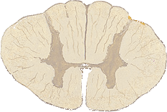
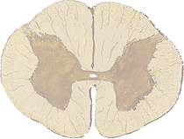
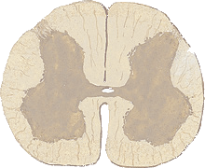
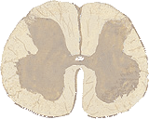
Cross section of the spinal cord
you can know what level in the spinal cord you're at by three main points
1 is the Posterio- intermediate sulcus (one or two dorsal columns faciculi)
2 is the lateral horn present
3 the size of the ventral horn
Notes:
Is there a large ventral horn ?
Yes → C5-T1 or L2-S2
No → T2 - L1 or C1 - C4
Are both dorsal columns present
Yes → above T5
No → Below T5
Is there a lateral horn ?
Yes → T1-L5
No → C1 - C8 or L3 - S5

Slide 15
Intro and Epidemiology

Slide 16
Intro
In this seminar will be focusing on the trauma side of spinal cord insults because this is what concern us in neurosurgery .
The most important aspect of clinical care for the spinal cord injury patient is preventing complications related to disability. Supportive care has shown to decrease complications related to mobility.
Although the majority of spinal injuries do not affect the cord or spinal root , about 10%will result in quadriplegia or paraplegia.
When talking about the injury we can talk about the spinal colomn it self or about the bone that protects it

Slide 17
Incidence
2-5 per million 18 - 35 years Male - 3:1
RTA 51% - cars
Domestic 16%
Industrial 11%
Sports 16%
Self harm 5%
Cervical 40%
Thoracic 10%
Lumbar 3%
Dorso lumbar 35%

Slide 18
Spinal injury (Bony injury)

Slide 19
Basic concepts
Bone anatomy
stable vs unstable fractures

Slide 20
Generally
A fracture is considered stable if it can take normal pressure without extra deficit
(theres an old classification that depends on the three colomns of the vertebral colomn but its not used now)

Slide 21
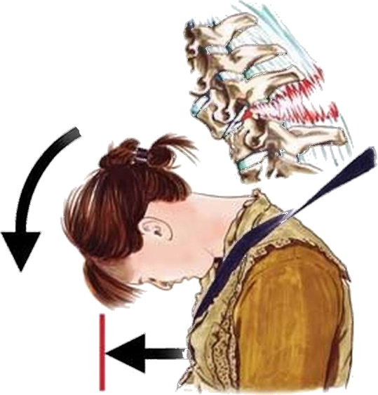
Hyperflextion - Rotation injuries
Most frequent type of injury to the cervical spine C5/C6 is the most common site and most commonly caused by RTAs
Most frequently at T12/L1
Usually one or both of the posterior facets are sublaxed or dislocated , and may be locked in this position .
There is extensive posterior ligament damage and these injuries are usually unstable .

Slide 22
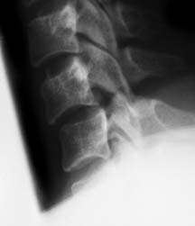
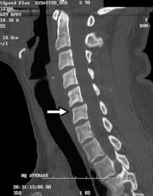
Hyperflextion - Rotation injuries
The spinal cord may be compressed sustaining direct damage, vascular impairment or secondary compression from subluxation (the joint is moving in a wrong way )
In the Thoracolumbar usually result in complete neurological deficit of either the spinal cord conus or cauda equina.

Slide 23
If theres a fracture through the vertibral body and the spinous process we call this a Chance fracture
often associated with epidural hematoma and cortical contusion

Slide 24
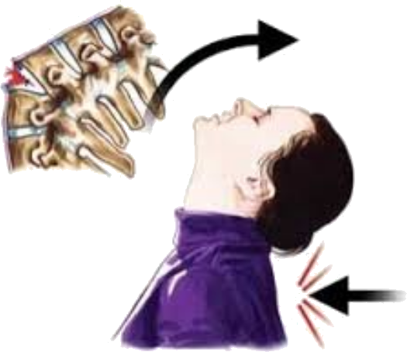
hyperextension injuries
Very uncommon in the Thoracolumbar area, Seen more in the cervical area
Most common in older age group and in patients with spinal canal stenosis .
Bony injury is usually not demonstrated and the major damage is to the anterior longitudinal ligament secondary to hyperextension .
It is nearly stable .

Slide 25
hyperextension injuries
Central cervical cord syndrome is the most common neurological impairment.
Most of injuries result in incomplete cord damage resulting from compression of the cord between the degenerative body and disc anteriorly and the hypertrophic ligamintum flavum protruding posteriorly .

Slide 26
Posterior displacement of the spinolaminar line, anterior displacement of the C2 vertebral body
fracture of the posterior elements of C2 this is seen in RTAs and is called the Hangmans fractrure (not associated with judicial hanging

Slide 28
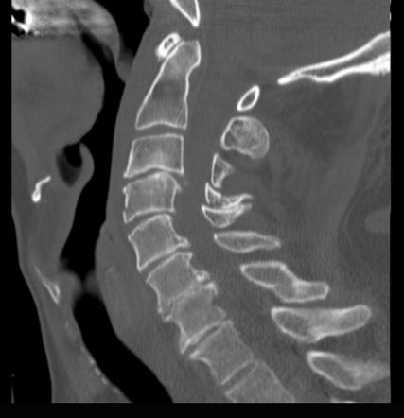
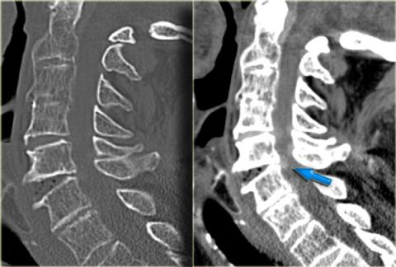

Slide 29
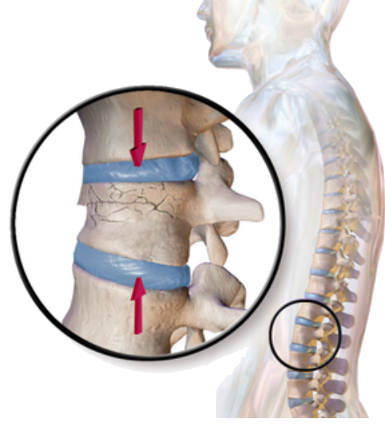
compression injury
Common in the Thoracolumbar area
Mostly seen in older age group and in patients with spinal canal stenosis .
The vertebral body is decreased in height
Caused by Axial loading injury, the disk above is pushed into the body
May be comminuted with the posterior aspect of the body encroaching upon the spinal canal.
Usually stable because the posterior bony elements and longitudinal ligaments are intact.

Slide 30
If theres a Comminuted compression fracture of the body wih displacement of bony fragments anteriorly and posteriorly its callled Burst Frature

Slide 31
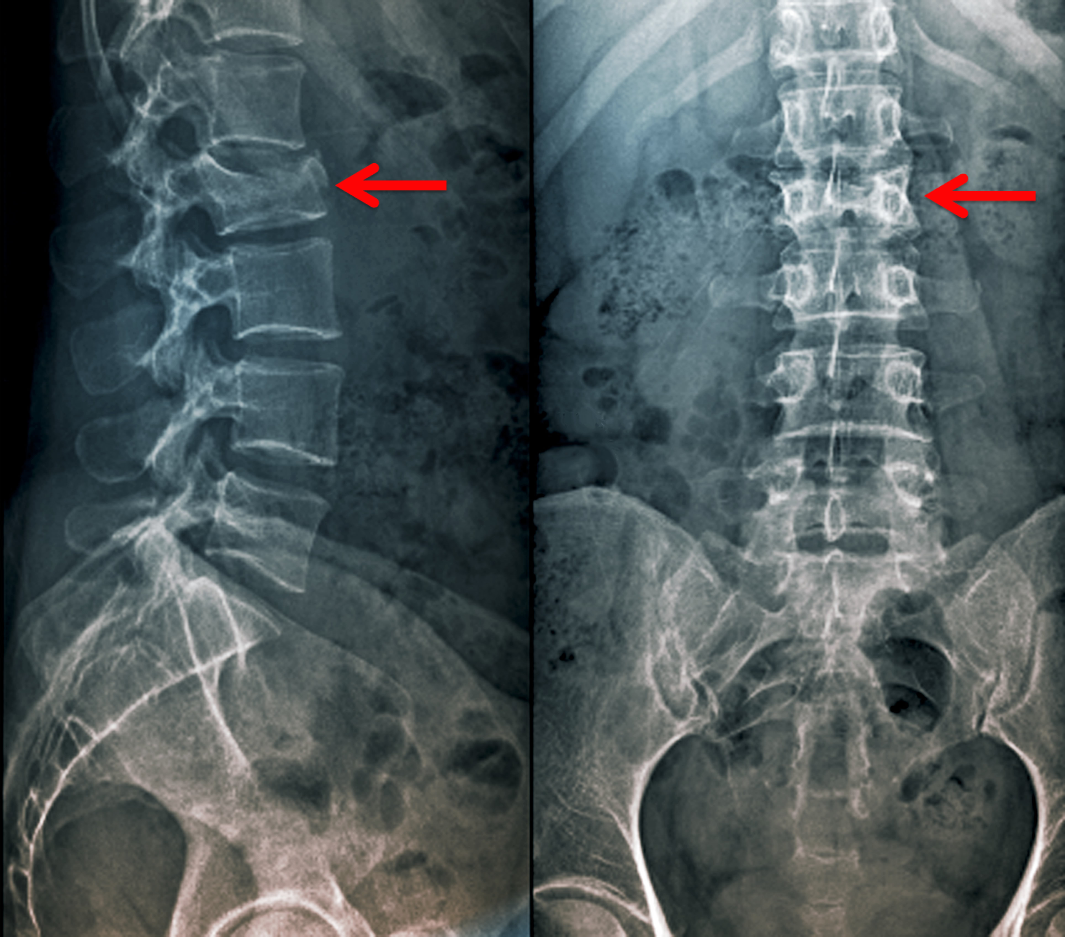
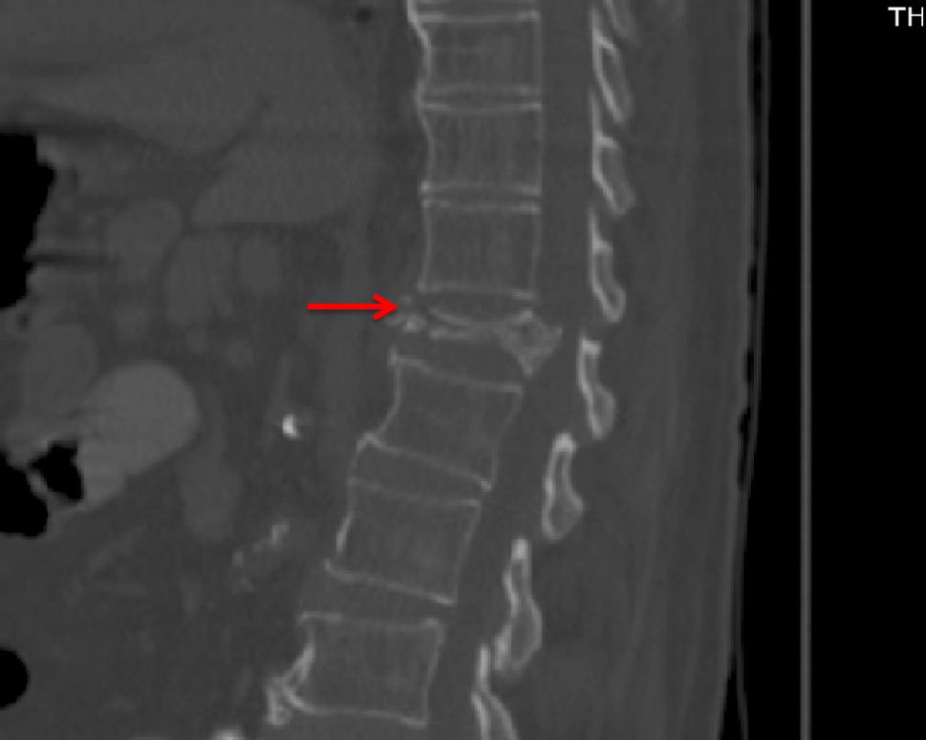
compression injury
may take many shapes but the most common is the wedge fracture

Slide 32
Jefferson's Fracture
ADD INFORMATION ABOUT
Bilateral factures of the posterior arch of the atlas from a direct vertical blow to the head.
The mechanism is due to the head pressing down on the spinal column and the atlas being squeezed between the occipital condyles above and the axis below
The grooves for the vertebral arteries are the site where the arches of the atlas are weakest and when fractures occur at this site bursting fragments are displaced outwards.

Slide 33
Jefferson's Fracture

Slide 34
Oduntoiud fracture
odontoid fractures are relatively common fractures of the C2 vertebral body (axis) that can be seen in low energy falls in eldery patients and high energy traumatic injuries in younger patients.
may be caused by displacement may be anterior (hyperflexion) or posterior (hyperextension)
neck pain worse with motion
dysphagia may be present when associated with a large retropharyngeal hematoma

Slide 35
Oduntoiud fracture classification

Slide 36
Spinal cord injury
Lubna Sameer

Slide 37
Management
and
investigations
Complete lesion
Incomplete lesion
*Motor Deficit
*Sensory deficit
*Autonomic Deficit
Brown squared syndrome
Anterior spinal cord syndrome
Central cord syndrome
Posterior spinal cord syndrome
Cauda equina syndrome
Conus medularis syndrome
*initial management
*indications of surgery
*aim of surgery

Slide 38
Damage to any part of the spinal cord or nerves at the end of the spinal canal
often causes permanent changes in strength, sensation and other body functions below the site of the injury.
Subdivided into:
Complete: almost all sensory and all motor functions are lost below the spinal cord injury along with spinal shock
(loss of reflexes)
Incomplete: some motor or sensory functions below the affected area are preserved

Slide 39
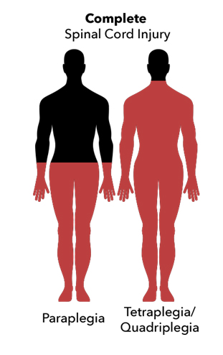
Complete lesion
A lesion to spinal cord where there is no preserved motor or sensory function below the level of the lesion , causing either a paraplegia or quadriplegia, depending on the level of lesion .
In the acute stage, reflexes are absent, there is no response to plantar stimulation, and muscle tone is flaccid.
Notes:
Paraplegia is an impairment in motor or sensory function of the lower extremities.
Quadriplegia, also known as tetraplegia, is a spinal cord injury that causes paralysis after an accident. Other causes include tumours or spinal cord diseases. The injury may cause partial or total limb paralysis (arms and legs)

Slide 40
Motor deficit
Sensory deficit
Autonomic deficit
Injuries to the spinal cord will result in an:
upper motor neurone paralysis characterized by :loss of voluntary function, increased muscle tone and hyperreﬂexia.
Injuries to the lumbar spine causing cauda equina injuries result in lower motor neurone paralysis characterized by reduced muscle tone, wasting and loss of reﬂexes.
combination of upper and lower motor neurone lesions results from a thoracolumbar injury involving the conus medullaris and cauda equina.
The tracts carrying the various sensory modalities are interrupted at the level of the lesion, affect sensory appreciation of pain, temperature, touch and position and tactile discrimination below the lesion.
Visceral sensation is also lost. Sensation may decrease over a few spinal segments before being lost altogether.
Occasionally there is a level of abnormally increased sensation, hyperaesthesia and hyperalgesia at or just below the lesion.
Vasomotor control
Cervical and high thoracic lesions above the sympathetic outﬂow at T5 may cause hypotension. Interruption of the sympathetic splanchnic vasomotor control will initially cause a severe postural hypotension as a result of impaired venous return.
Temperature control
The patient with a complete spinal lesion will not have satisfactory thermal regulation as there will be impairment of the autonomic mechanisms for vasoconstriction and vasodilatation
Notes:
cauda equina injuries term used to desicibe injury below level of L1..LMN

Slide 41
Incomplete lesion
A lesion to the spinal cord with incomplete damage to the cord , there maybe scattered motor function , sensory function or both below the level of the lesion
Brown squared syndrome
Anterior spinal cord syndrome
Central cord syndrome
Posterior spinal cord syndrome
Cauda equina syndrome
Conus medularis syndrome

Slide 43
Anterior spinal cord syndrome
compression of the anterior aspect of the cord Due to :
compression fracture of vertebral body or anterior dislocation, Usually reflect injury to the anterior spinal artery
-Damage to the corticospinal and spinothalamic tracts
-complete motor paralysis below the level of the lesion
-loss of pain and temperature at and below the level of injury
-preservation of light touch, proprioception and position sense, which are carried in the posterior columns.

Slide 44
Central cord syndrome
-Most common form of cervical spinal cord injury.
-More common in people over the age of 50 because osteoarthritis in the neck region causes weakening of the vertebrae
- Hyperextension with minor trauma among older persons with cervical spondylosis
the compression on the spinothalamic (temperature/pain tract) and the corticospinal tracts of the spinal cord, which can result in motor and sensory deficits.
It leads to motor deficits that are more pronounced in the upper extremities as compared to the lower extremities
Notes:
-In small central cord lesions, damage to spinothalamic fibers causes bilateral regions of suspended sensory loss to pain and temperature.
-With larger central cord lesions, the anterior horn cells are damaged, producing lower motor neuron deficits at the level of the lesion.
-In addition, the corticospinal tracts are affected, causing upper motor neuron signs, and the posterior columns may be involved.

Slide 45
Posterior spinal cord syndrome
-Rare type of incomplete spinal cord injury.
-occurs when the damage is towards the back of the spinal cord : Hyperextension injuries, Posterior vertebral body fracture
-Affect dorsal column tract
Loss of proprioception, vibration, two point discrimination and light touch

Slide 46
Brown sequard’s syndrome
-A lateral hemisection syndrome-involves unilaterally the:
Dorsal column,
Corticospinal tract
Spinothalamic tract
-Knife or bullet injuries and demyelination
are the most common causes

Slide 47
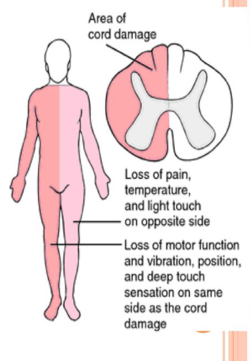
Notes:
paralysis on the same (ipsilateral) side as the lesion and deficits
Ipsilateral plegia below the lesion
Ipsilateral proprioception and light touch loss below the lesion
Contralateral pain and temperature loss below the lesion

Slide 48
Cauda equina syndrome
-rare and severe type of spinal stenosis where all of the nerves in the lower back suddenly become severely compressed
-injury to the lumbosacral nerve roots in the spinal canal.
-Perianal and "saddle" paraesthesia
.-Bowel, bladder and/or sexual dysfunction
-This syndrome is a nerve root injury rather than a true spinal cord injury
Causes:
Tumors and lesions
Trauma
Spinal stenosis (lumbar spine stenosis)
Inflammatory :
Paget disease, neurosarcoidosis, ankylosing spondylitis and chronic tuberculosis
central lumbar disk herniation

Slide 49
Signs and symptoms
Cauda equina syndrome (CES) is usually characterized by these so-called ‘red flag’ symptoms:
-Severe low back pain (LBP)
-Sciatica: often bilateral but sometimes absent, especially at L5/S1 with an inferior sequestration
-Saddle and/or genital sensory disturbance:
(anesthesia or paresthesia involving S3 to S5 dermatomes, including the perineum, external genitalia and anus)
-Bladder, bowel and sexual dysfunction

Slide 50
Conus Medullaris Syndrome:
-Lesions at vertebral level L2-saddle anaesthesia
-loss of bladder reflex: urinary retention-loss of bowel reflex: incontinence
-lower limb motor weakness, paraesthesia and numbness
-chronic lower backache
-Causes include disc herniation, spinal fracture, and tumors

Slide 51
Neurogenic shock vs spinal shock
Neurogenic Shock
Due to interruption of the sympathetic input from hypothalamus to the cardiovascular centers , Unopposed vagal tone
Hypotension (due to vasodilation, due to loss of sympathetic tonic input) and bradycardia
No real blood loss but blood is pooled in periphery
Spinal shock
Temporary loss or depression of all or most spinal reflex activity below the level of the injury.
Flaccid paralysis
Loss anal tone, reflexes, autonomic control
Notes:
Lesions above D6
Minutes – hours (fall of catecholamines may take 24 hrs)
Disruption of sympathetic outflow from D1 - L2
Unopposed vagal tone
Peripheral vasodilatation
Hypotension, Bradycardia & Hypothermia
BUT consider haemmorhagic shock if – injury below D6, other major injuries, hypotension with spinal fracture alone without neurological injury.
Spinal:
Transient physiological reflex depression of cord function – ‘concussion of spinal cord’
Loss anal tone, reflexes, autonomic control within 24-72hr
Flaccid paralysis bladder & bowel and sustained Priapism
Lasts even days till reflex neural arcs below the level recovers.

Slide 53
Radiological investigations
Plain cervical spine x-ray and CT will show the bone injuries.
MRI is also helpful in showing the associated cord , soft tissue and ligamentous pathology.

Slide 54
Management

Slide 55
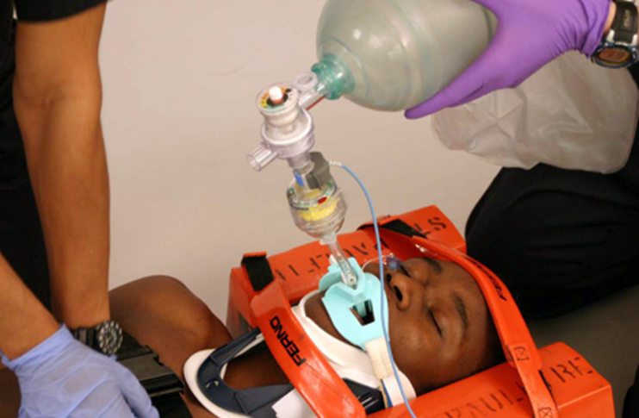
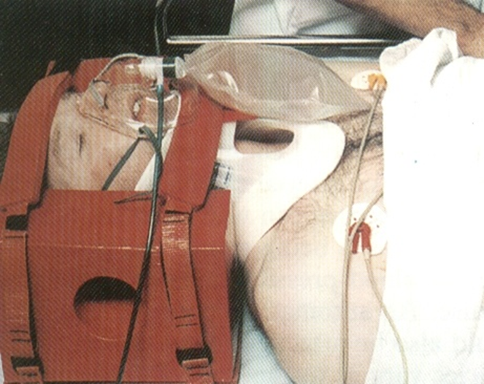
Initial Management

Slide 57
Systematic treatment in spinal trauma
Airway management
-modified jaw thrust and insertion of an oral airway, intubation may be required
Hypotension, hemorrhage, and shock
-Blood transfusion ,dopamin, adrenaline, opiate antagonists
Steroid Therapy
-should be initiated within 8 hours of injury ; methylprednisolone 30 mg/kg bolus over 15 minutes and an infusion of methylprednisolone at 5.4 mg/kg/h for 23 hours beginning 45 minutes after the bolus.
Head injuries and neurologic evaluation
Ileus
- Placement of a nasogastric (NG) tube
placement of a Foley catheter Urine output should be more than 30 mL/h

Slide 58
Spinal cord treatment: - Prevention of secondary injury - Antiedema tx - Decompressive surgery - Regeneration strategies: stem cell, growth factors, gene tx Spine treatment: -Stabilization -Decompression
Specific
Treatment

Slide 59
Progressive neurological deficit Open wounds Penetrating wounds Spinal cord compression Instability
Indications of Emergency Surgery
Aims of Surgical Treatment:
Immediate decompression
Immediate Stability
Restore Sagittal and coronal alignment
Restore neurological function
Early rehabilitation

Slide 60
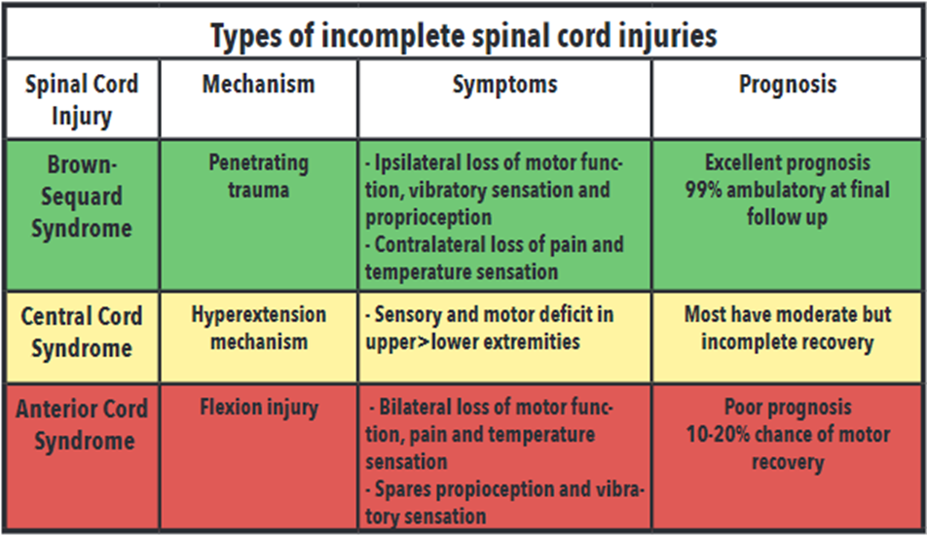
Summary

Slide 61
References: Essential neurosurgery Handbook of Neurosurgery

Slide 62
Thank you

