Slide 1
Decision making in healthcare
Dr. Israa Al-Rawashdeh MD,MPH,PhD
Faculty of Medicine
Mutah University
2021

Slide 2
OUTLINE
Definitions
Types of problems, decisions, and conditions of DM.
Models of decision making
Evidence Based Decision Making.

Slide 3
INTRODUCTION
It is a science! It is an art!
Almost everything that a human being does involves decisions.
Managers must be decision makers.

Slide 4
Definitions
A goal-directed behaviour in the presence of options.
“The thought process of selecting a logical choice from the available options.” (Business Dictionary).
The process of identifying and solving problems (Daft 1998).
The process of transforming inputs into outputs. The input is information, the output is new information (Herrmann 2015).
Is it this simple??

Slide 5
Well; It is not!
Healthcare operates within a complex system.
Making decisions in health care is often complicated by factors such as:
Uncertainty of information,
Varying interpretations of evidence, and
The multiple perspectives of decision makers.

Slide 6
Therefore,
There will be many economic, political, social and environmental factors both formal and informal which can have an impact on any decision-making process
Remember: The decision not to do something is as important as the decision to do something, and a non-decision is also an output.

Slide 7
Types of problems
Managerial decision-making typically centers on three types of problems:
- Crisis : A crisis problem is a serious difficulty requiring immediate action.
- Non-Crisis: A non-crisis problem is an issue that requires resolution but does not have the importance and immediacy characteristics of a crisis.
- Opportunity Problems: An opportunity problem is a situation that offers strong potential for significant organizational gain if appropriate actions are taken.

Slide 8
Types of decisions (Programmed vs. Non programmed Decisions)
Programmed decision
One that is made regularly, repetitive, routine.
Structured problems (clear problem, obvious criteria)
Information are available and complete.
Efficiency expected
Examples: Pre-set rules, policies, procedures
Non-programmed decision
Non- routine matters of an organization.
They are unique in nature and every situation requires special attention and occurs much less often than a programmed decisions.
Unstructured (Ambiguous or incomplete information)
More “important” problem
Judgment and creativity

Slide 9
Decisions and level of management
Strategic:
Broad scope
Product Selection
New Construction
Location Decisions
Technology Choices
Tactical:
Moderate scope
Staffing levels
Supply Chain
Equipment Selection
Financial Resource
Operational:
Narrow scope
Scheduling
Controlling Quality

Slide 10
Decision Making Conditions
Certainty: A situation in which a manager can make an accurate decision because the outcome of every alternative choice is known.
Risk: A situation in which the manager is able to estimate the likelihood (probability) of outcomes that result from the choice of particular alternatives but information are incomplete.
Uncertainty –The decision-maker is not aware of all available alternatives, the risks associated with each, and the consequences of each alternative or their probabilities.

Slide 11
Models of decision making
• Rational Model:
Most popular type of models
Based around a cognitive judgment
• Non-Rational Models:
Incremental Model
Satisficing Model
Garbage-Can Model

Slide 12
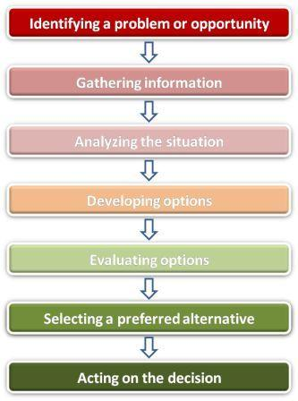
Rational (Classical) model:
This is the classical, scientific approach to decision-making which views the process as orderly and rational.
It is assumed that decision makers have nearly all information about a problem, its causes, and its solutions, where a large number of alternatives can be weighted and the best one selected.

Slide 13
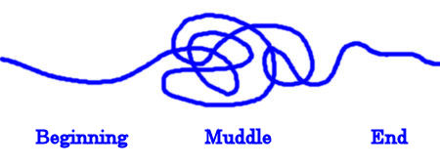
Non-Rational: Incremental model
‘Slowly building the blocks’
This model suggests that major decisions are broken down in small steps taking place in three major phases: the identification, development, & selection phases.
Not completely rational; analysis is limited, information is ambiguous and subject to interpretation.
Incremental trial-and-error process.
They correct or avoid mistakes through a succession of incremental changes

Slide 14
Non-Rational: Satisficing Model
Satisficing consists of choosing a solution that meets minimum standard of acceptance.
It is best when there is insufficient time, information, or ability to handle the complexity associated with the rational process.
therefore, stop seeking alternatives when find one that is good enough (Not seeking the optimal decision).

Slide 15
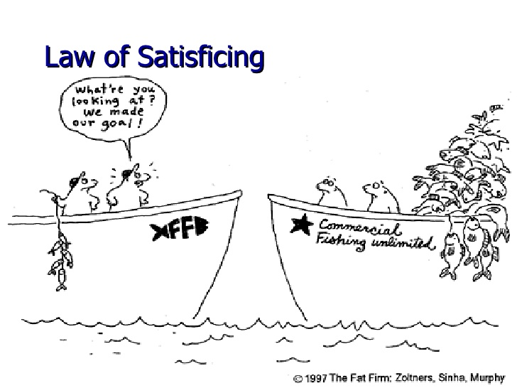

Slide 16
Non-Rational: Garbage can model
This describes decision-making processes in organizations characterized by uncertainty, where objectives are not well defined or inconsistent for individual decision-makers.
Decisions are made as a result of the interaction between: Problems, solutions, participants, and choice opportunities.
In other words, solutions and problems are matched rather than through a step-by-step process
Does not follow any orderly steps (Random)

Slide 17
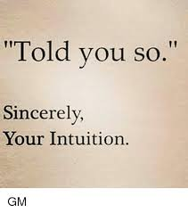
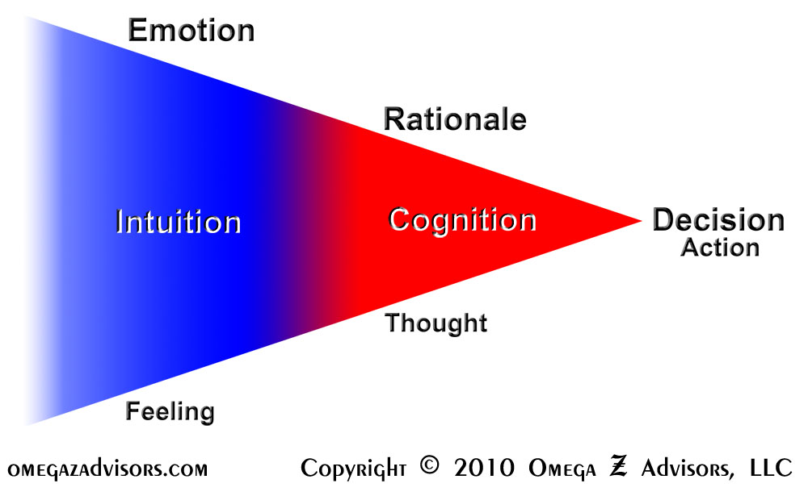
The Role of Intuition in Decision Making
Represents judgments, insights, or decisions that “come to mind on their own, without explicit awareness of the suggested alternatives and without clear evaluation of the validity of these alternatives”.
Rapid, automatic and relatively effortless decision-making
Most organizational decisions are not made in a logical, rational manner (Daft 2012)

Slide 18
Who Has the D? Rogers and Blenko 2006
Proposer (Recommend ): People in this role are responsible for making a proposal, gathering input, and providing the right data and analysis to make a sensible decision in timely fashion.
Approver (Agree): Individuals in this role have veto power – yes or no – over the recommendation.
Input: These people are consulted on the decision. Because the people who provide input are typically involved in implementation, recommenders have a strong interest in taking their advice seriously.
Ultimate Decision Maker (Decide): The person is the formal decision maker. The decider is ultimately accountable for the decision, responsible for consequences and has the authority to resolve any problem in the decision-making process and to commit the organization to action.
Executor (Perform): Once a decision is made, a person or group of people will be responsible for executing it. In some instances, the people responsible for implementing a decision are the same people who recommended it.

Slide 20
Characteristics of an Effective Decision-Making
It focuses on what is important
It is logical and consistent.
It acknowledges both subjective and objective thinking and blends analytical with intuitive thinking.
It requires only as much information and analysis as is necessary to resolve a particular dilemma.
It encourages and guides the gathering of relevant information and informed opinion.
It is straight forward, reliable, easy to use, and flexible.

Slide 21
Evidence Based Decision making

Slide 22
Origins of the Evidence-based Movement
1981: Dr. David Sackett, introduced a new method for physicians reading the literature. Called it “critical appraisal.”
1990: Dr. Gordon Guyatt, introduced a new concept he called “Scientific Medicine” !
1991 Guyatt coined “Evidence-Based Medicine” (EBM).
Aimed to improve the quality of information used to make decisions.
Migrated to other sectors - dentistry, nursing, management, etc..

Slide 23
What is Evidence-Based Medicine?
“The process of finding relevant information in the medical literature to address a specific clinical problem; In short, patient care based on evidence derived from the best available (“gold standard”) studies.”
John Last, A Dictionary of Epidemiology, Oxford, 1995
Notes:
Evidence-based medicine is both the process of finding the best evidence to apply to a clinical question, but also the application of that information into clinical care

Slide 24
Evidence-based . . .
Evidence-based Medicine (EBM)
Patient care based on evidence from the best available studies
Evidence-based Decision Making
Evidence-based decision-making Decisions should be based on a combination of critical thinking and the ‘best available evidence‘.
EBM extended to include population-based decision making in the form of guidelines and formulary decisions using formal evidence criteria and deliberative processes

Slide 26
Why Evidence-Based?
So much information, too little time!
problems which requires immediate attention can be better highlighted.
Reduces expenses
It ensures transparency and accountability.
Value of scientific knowledge for decision making
Need high quality, filtered information to make informed decisions
Decisions should not be based only on intuition, opinion or subjective information
Notes:
1. Information overload and time constraints:
Easy to become overwhelmed
Vast amount of information and scientific literature
Using an evidence-based approach helps to manage the amount of literature to review
Use one time efficiently.
2. Public health professionals need high quality evidence-based information to make informed decisions.
Using an evidence-based approach, find most relevant research.
Decide among several possible interventions, and decide which one is the best and to rule out or discontinue interventions that are not effective.
3. Public health practitioners & policy makers value scientific knowledge as a basis for making decisions.
Trend in public health to say we want to implement this program because it is evidence-based
4. Decisions should not be based only on intuition, opinion or anecdotal information.

Slide 27
Challenges of EBDM
Periodic statistics (generated from day to day administration) are important source of evidence (clear, objective, numerical data ) are needed.
The availability of statistical information does not always lead to good decision making: skill and knowledge is also required to be able to access, understand, analyze and communicate statistical information.
Clear or consistent evidence may not be available at the time of decision making as it generally requires many different kinds of evidence.

Slide 28
Challenges of EBDM
Politics may influences evaluation design, process and use of findings
Difficulties in handling sensitive information
Evaluation findings (Evidences) are not always used by the implementation part and maybe treated as a fault-finding exercise.

Slide 29
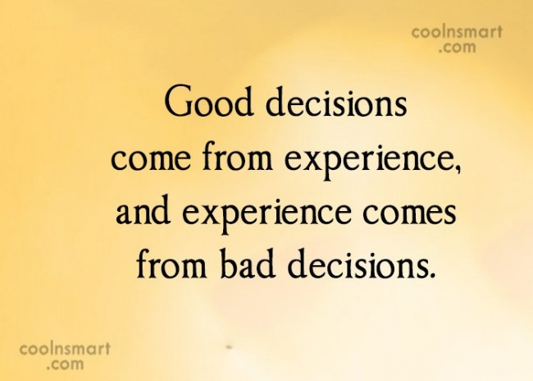
Thank you
The man who insists upon seeing with perfect clearness before he decides, never decides.

