Slide 1
Diabetic Nephropathy
Supervised by Dr Waleed Alhalabi
Presented by : Rahaf Abusalm
Wajd Alhabashneh

Slide 2
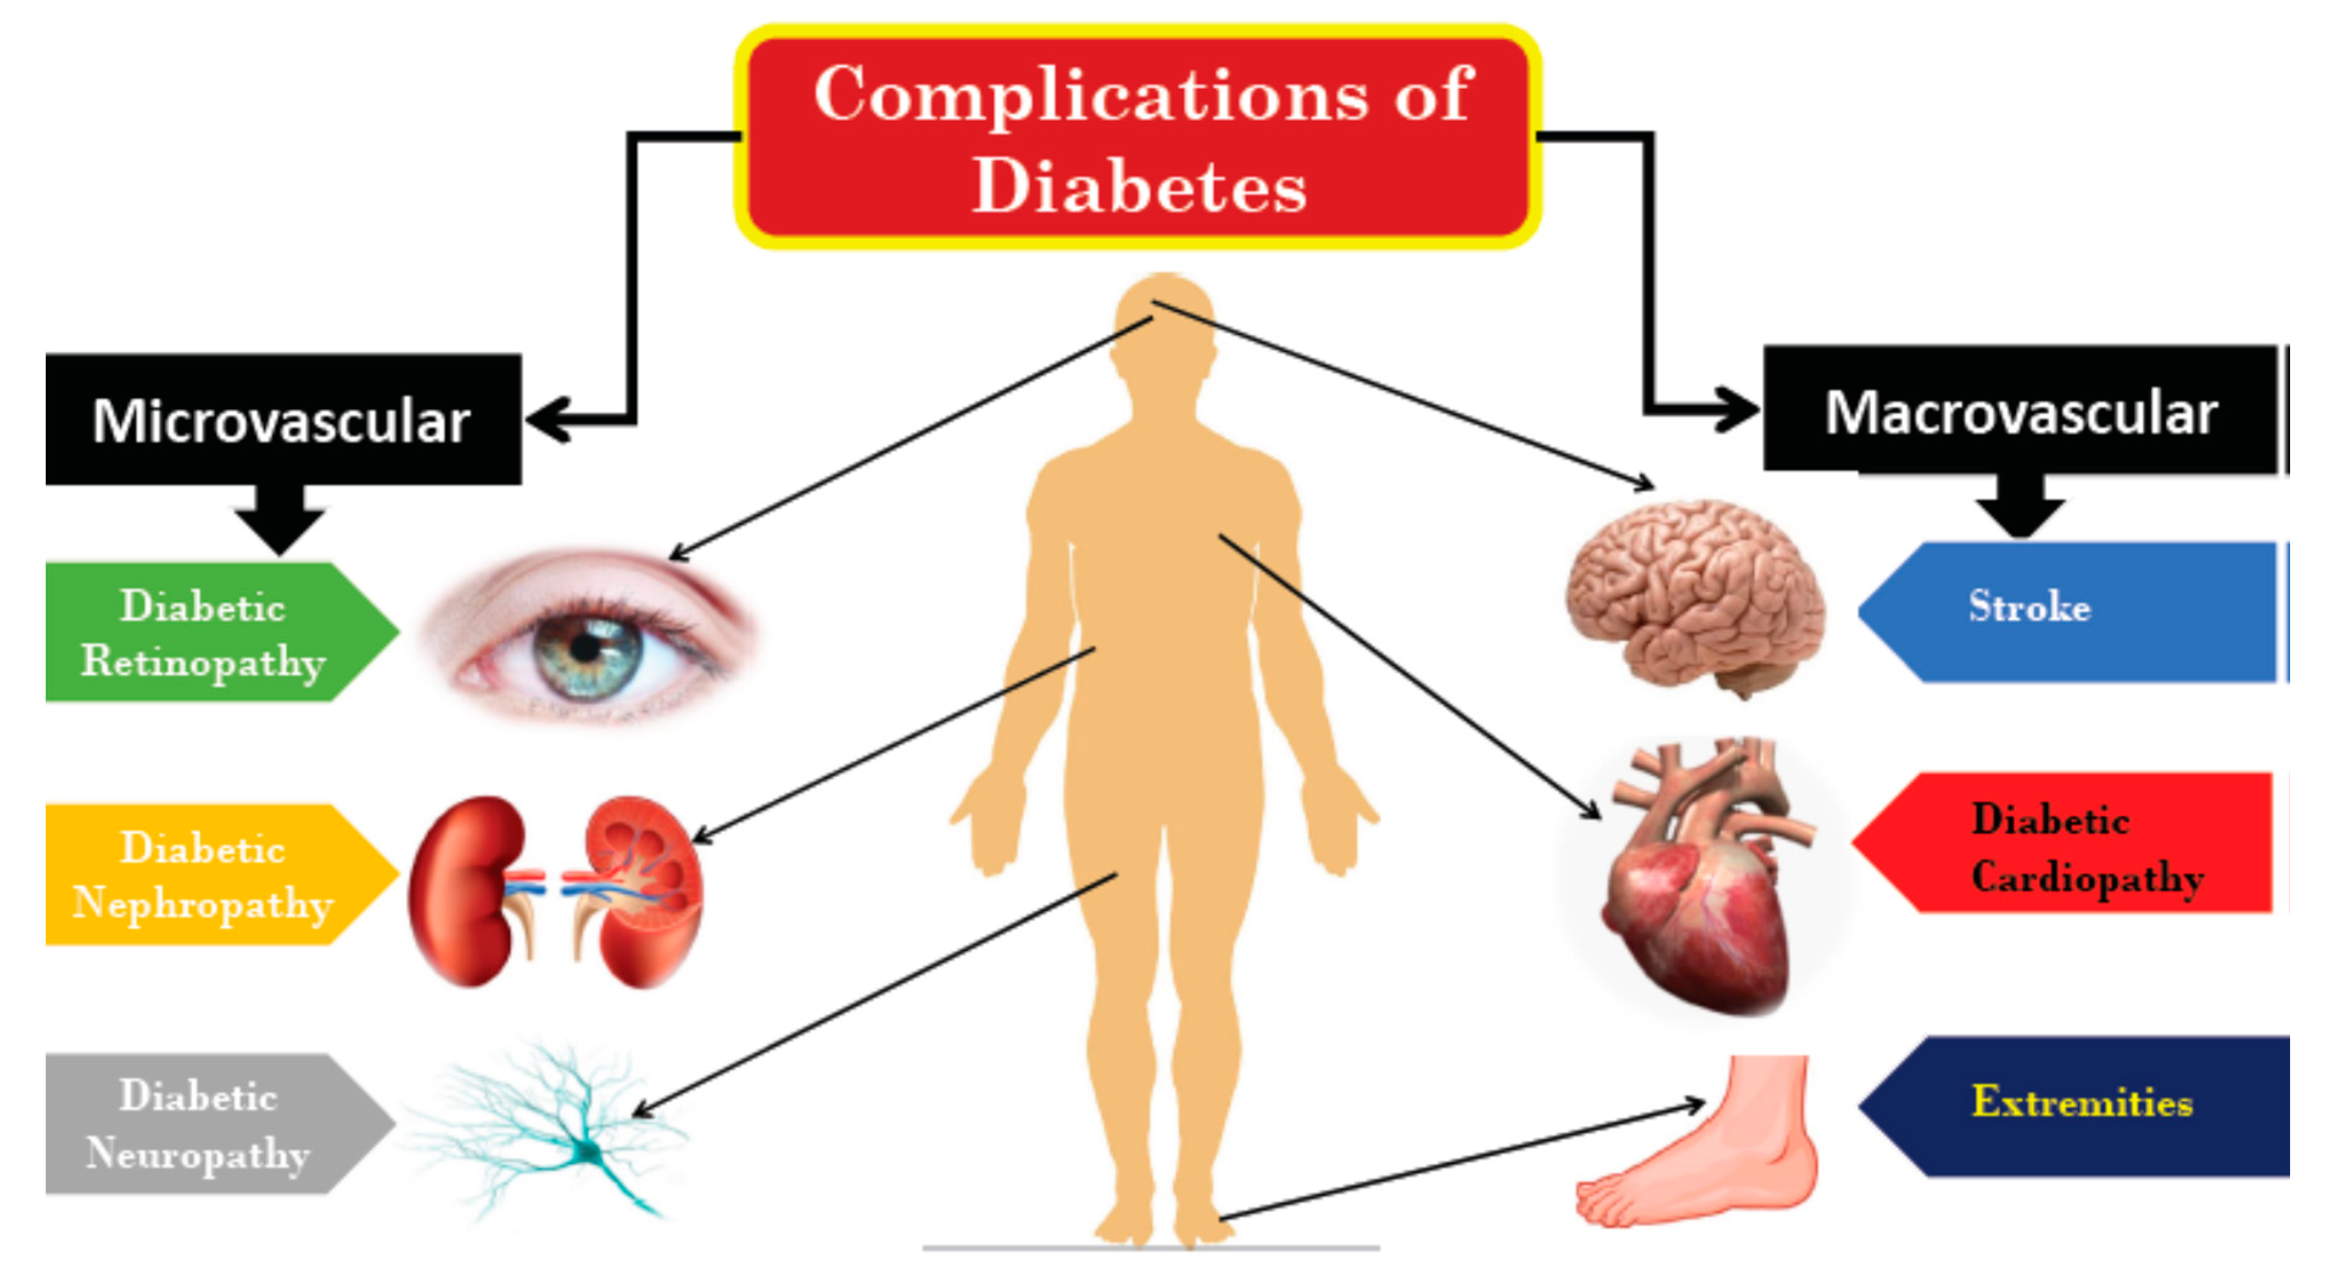
Is it important to know about Diabetic nephropathy?
Diabetic nephropathy consumes a very significant amount of healthcare resources as it’s
one of the most significant complications of diabetes mellitus and is the leading cause of CKD (and ESRD) in the western world, and its incidence is rising in developing countries
Why??
1)increased incidence of T2DM
2)improved life expectancy for these patients and better access to ESRD care.
Also, There is very good evidence that the quality of diabetes care has a significant impact on the natural history of DN, with early treatment delaying or preventing onset.

Slide 3
Definition of diabetic nephropathy
Persistent albuminuria = (>300mg/day) on at least two occasions, 3 months apart.
Patients with microalbuminuria (230mg/day) are often said to have incipient nephropathy and this is the earliest evidence of diabetic renal disease.
Overt nephropathy is a clinical syndrome characterized by:
*Both incipient and overt nephropathy are important markers of increased cardiovascular morbidity and mortality in both T1DM and T2DM. They warrant aggressive intervention to improve all cardiovascular risk factors (e.g. LDL cholesterol, BP, smoking cessation, exercise, etc.).
Progressive decrease in GFR
Increase in BP

Slide 4
Progression of nephropathy in Type1 and type2 dm
type2DM
type1DM
Proteinuria is less specific than type1.
Microalbuminuria in 20-30% of patients after 15 years + increase in BP
without treatment
without treatment
20-40% will develop into overt DN
overt nephropathy will develop over 10-15 years
The rate of decline of GFR is less
predictable than for T1DM
progressive fall in GFR over time(2-20mL/min/ year).
50% will develop ESRD within 10 years (>75% within 20 years) but
has recently fallen to <10%
~20% will have progressed to ESRD within 20 years

Slide 5
Progression of Diabetic nephropathy
The evolution of DN is classified into 5 stages:
Stage | duration | Clinical and pathological correlation
1 | At diagnosis | Hyperfiltration with renal hypertrophy and ↑ GFR
2 | <5 years | Early histological changes , clinically silent
3 | 5-15 years | Microalbuminuria. BP now starts to rise
4 | 15-25 years | Overt diabetic nephropathy with declining GFR
5 | >25 years | Advanced CKD/ESRD
This applies to both T1DM and T2DM but more predictable in type2 .

Slide 6
NOTE
UKPDS:
UK Prospective Diabetes Study (UKPDS) is a prospective, randomised, intervention trial of 5100 newly-diagnosed patients with Type 2 DM which aims to determine whether improved blood glucose control will prevent complications and reduce the associated morbidity
Mortality risk :
• In the UKPDS, annual mortality risks were
1.4% : no microalbuminuria
3.0% :microalbuminuria
4.6%: macroalbuminuria
and 19.2%: CKD and ESRD
* Risk of death was higher than the risk for progression to the next phase once microalbuminuria present.
Intensive monitoring and treatment influence natural history, preventing incipient, and progression to overt, nephropathy.

Slide 7
Diabetic nephropathy and risk of death
• T2DM is associated with substantially increased risk of premature death that is primarily focused on those with nephropathy.
• 10-year mortality data in ~15,000 subjects in the 3rd US National Health and Nutrition Examination Survey (NHANES III) revealed:
*Reference group (subjects without diabetes or kidney disease) = 7.7%.
*For T2DM without kidney disease = 11.5%.
*For T2DM with kidney disease =31.1%
representing an absolute risk difference with the reference group of 23.4% (adjusted for other risk factors : demographics, smoking, and BP)

Slide 8
risk factors for the development and progression of DN
Poor glycemic control.
Onset of T1DM before age 20.
Increase in BP
Smoking.
male gender.
Ethnicity (Indo-Asians, African Americans, Pima Indians in the US).
Familial tendency.
Socio-economic factors(poverty)
the most important factors increasing progression are:
BP.
Glycemic control.
Degree of proteinuria.

Slide 9
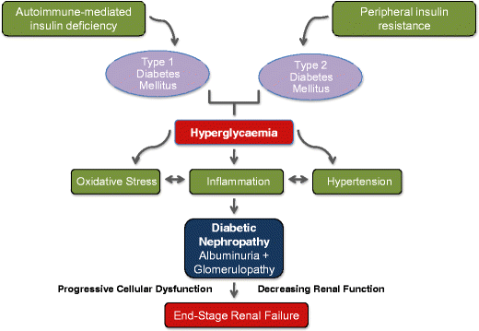
pathology
The pathogenesis of DN is multifaceted, with several mechanisms contributing to the renal injury and development of the characteristic histological changes

Slide 10
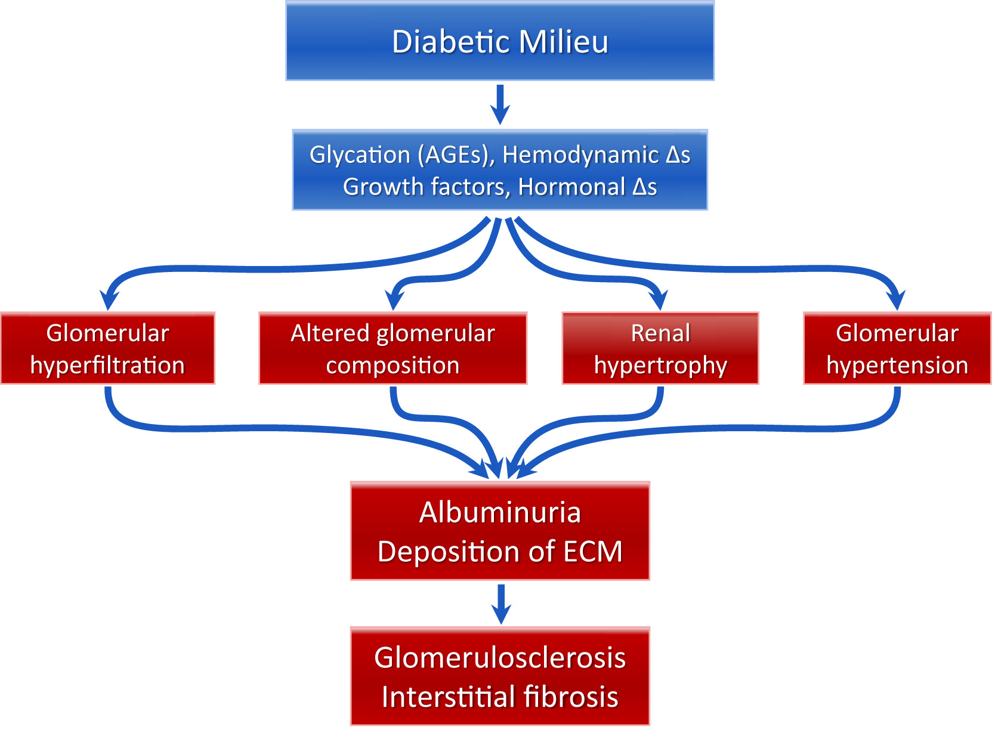
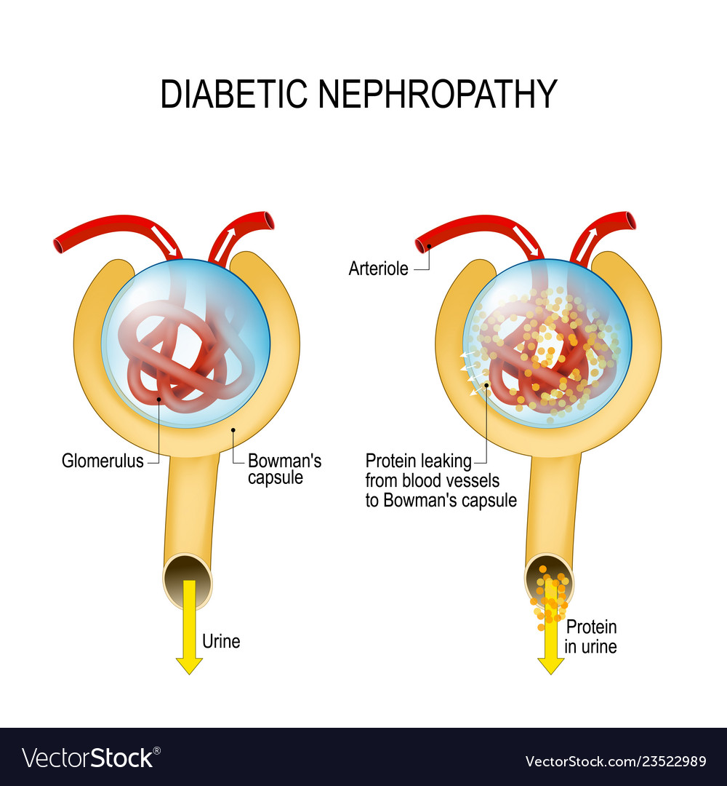

Slide 11
The cardinal histological features of diabetic nephropathy are:
1) Mesangial expansion (→ intercapillary, Kimmelstiel–Wilson nodule formation, often with capillary lumen encroachment).
3) Glomerular and tubular basement membrane thickening.
4) Nodular glomerulosclerosis.
Vascular changes:
1) Vessel changes from ↑ BP.
2) Arteriosclerosis.
3) Afferent and efferent arteriolar hyalinosis.

Slide 12
• Tubular atrophy and interstitial fibrosis appear as DN and CKD progress.
• Immunostaining may demonstrate non-specific linear staining for IgG in glomerular and tubular basement membranes and Bowman's capsule.
• Arteriolar damage, interstitial fibrosis, and secondery FSGS(focal segmental glomerulosclerosis) may be the dominant lesions in older T2DM patients (often with less proteinuria and more vascular disease clinically).

Slide 13
pathogenesis
Hyperglycemia
Glomerular haemodynamics
Podocyte function and proteinurea
Genetics
Renin angiotensin system

Slide 14
Hyperglycaemia
The magnitude of hyperglycaemia correlates with the functional and structural changes of DN.
Hyperglycaemia role in renal disease :
A)Stimulates mesangial cell matrix production and cell growth, leading to early glomerular enlargement.
B)Formation of advanced glycation end-product (AGE)
AGES result from non-enzymatic reaction between glucose and proteins.
They normally undergo renal excretion and accumulate as DN progresses, particularly in the circulation and the kidneys.
They impair function of glycated proteins and cause abnormal interactions through cross link formation.
C)Causes ↑ oxidative stress.

Slide 15
• Leads to activity of protein kinase C and hexosamine pathways (both increase production of various profibrotic cytokines, including TGF-B).
• Increases expression of glomerular TGF-B (and other mitogens) → cellular hypertrophy, ↑ collagen synthesis, and ↑ matrix deposition.
• Promotes VEGF expression, possibly via the adenosine A receptor (→ endothelial injury, vascular change, and podocytopathy).
Glomerular haemodynamics
Glomerular hypertension and hyperfiltration occur early
*GFR is 25-50% increased in 50% of patients with type 1 diabetes after 5 years.
This is caused by :
1-mediators involved in RAS, nitric oxide, and cyclo-oxygenase pathways.
2- increased levels of Endothelin – 1 (a potent vasoconstrictor) in both plasma and renal tissue .
3- increased expression of ET-A and ET-B receptors .
ET-A → smooth muscle vasoconstriction and glomerulosclerosis
ET-B → vasodilation
4- Systemic hypertension
Haemodynamic disturbance → arteriolar and glomerular sclerosis

Slide 16
Podocyte function and proteinuria
*Podocyte function is abnormal, with reduced expression of nephrin and altered glomerular permeability.
*Proteinuria further promotes tubular injury and interstitial fibrosis.
Renin-angiotensin system
*Local renal RAS activation leads to cell growth and matrix accumulation.
*Angiotensin Il generates reactive oxidative species and NADPH oxidase in vascular smooth muscle and the kidney.
These may explain some of the additional benefit of RAS inhibition beyond BP control.
Genetics
A poorly understood genetic predisposition appears to operate.
DN is more common in Northern Europe and the USA.
Certain ethnic groups are affected more than others ( Indo-Asians in the UK, African Americans, Pima Indians (astonishingly, by age 20, ~50% of Pima Indians with diabetes will have developed DN, and 15% will have progressed into ESRD.
DN is more likely in relatives of diabetic patients with nephropathy.
It is unclear why new cases of DN are rare after 15 years of diabetes.

Slide 17
( prevention, screening, and assessment)
Primary prevention
1- Improve glycaemic control:
Aim HbA1C <7%.
*Clinical trials ( DCCT and UKPDS) have consistently demonstrated the benefits of intensive blood glucose control for primary prevention of DN.
2- Target BP <130/80mmHg.
3- Stop smoking
4- Encourage weight loss and exercise.
* The role of RAS blockade with ACE-I or ARB for prevention of microalbuminuria is controversial.

Slide 18
Screening
Early detection affords the opportunity to delay or prevent progressive CKD and ESRD.
Annual screening by uACR should be performed (preferably an early morning sample, no UTI, stable glucose control)
When to start screening?
Start after 5 years of T1DM and at the time of diagnosis of T2DM.
uACR (mmol/mg) | 24h albuminuria
<2.5 | <30mg/day
2.5-30 | 30-300mg/day (microalbuminuria
>30 | Overt proteinuria
Diagnosis
A clinical diagnosis is usually possible.
T1DM:
Proteinuria, retinopathy, DM of >10 years duration.
T2DM:
Retinopathy often not present, duration of DM frequently uncertain.
*other differential diagnosis for DN is : Non-specific renal damage (arteriolar damage, interstitial fibrosis, and 2° FSGS)
and may be indistinguishable in terms of clinical presentation. However,management of both is the same.

Slide 19
A renal biopsy is rarely required to establish the diagnosis of DN
Indications for renal biobsy:
1) No diabetic retinopathy:
Particularly in T1DM (retinopathy is observed in 85–99% of patients with established nephropathy).
~30% of those without retinopathy will have an alternative lesion at biopsy (membranous GN, IgA nephropathy, etc.)
T2DM patients have DN without retinopathy more commonly.
Note: this implies proper ophthalmic assessment, not just brief fundoscopy.
2) Dysmorphic red cells, red cell casts, or macroscopic hematuria:
Microscopic hematuria, usually + to ++ only, is seen in ~60% patients with DN. However, it will usually require independent investigation
3) Rapid onset, rapidly increasing, or massive proteinuria.
* Conversely, a lack of proteinuria may cast doubt on the diagnosis and make histology desirable( possible drug-induced TIN,renovascular disease)
4) Rapidly deteriorating GFR despite good BP and glycaemic control.
5) Symptoms or signs suggestive of a multisystem disorder, e.g. vasculitis, connective tissue disorder, hepatitis C, HIV.

Slide 20
Further investigation and assessment
• Urinalysis (hematuria, quantify proteinuria)
• SCr, eGFR, U&E, serum albumin, HbA1C, lipid profile.
• Consider serum and urine protein electrophoresis in older patients.
• Check visual acuity, fundoscopy, and arrange ophthalmology review, if not already under follow-up.
• Check BP.
• Examine for other evidence of vascular disease (bruits, peripheral pulses, etc.).
• Assess for peripheral neuropathy.
• ECG.
Consider USS kidneys esp. if microscopic haematuria present (kidneys are often normal-sized in DN despite GFR).

Slide 21
Management
Treatment goals:
(i)prevention of progression from microalbuminuria (incipient DN) to macroalbuminuria (overt DN)
(ii)prevention of progressive decline in renal function in patients with macroalbuminuria
(iii)prevention of CV events.
Glycemic control
The ADVANCE and ACCORD studies have suggested that intensive treatment of hyperglycemia in T2DM does not necessarily lead to an acceptable risk/benefit ratio.
Participants had strong CV risk profiles (including prior events) and were at high risk of future events. Microvascular end points, including renal outcomes, were improved in both studies. However, primary CV outcomes were not improved by intensive glycemic therapy and, in ACCORD, intensive treatment was associated with a 22% increase in all-cause mortality. So, more aggressive glycemic management in higher risk T2DM patients (usually later in the course of their disease) delivered only a weak protective effect with respect to CV outcomes.
KDOQI practice guidelines recommend maintaining HbA1c at <7%. However, some authorities suggest a target between 7-8% in patients with longstanding disease who are at higher CV risk.

Slide 22
Insulin secretagogues
1))sulphonyl urea
2))meglitinides(repaglinide)
3))glitazones(rosiglitazones+piogliglitazones)
4))a-glucosidase inhibitors (acarbose)
5)) biguanide(metformin)
6))SGLT2(gliflozin)
7))INCRETINS
A))GLP1 RA
B))DPP4-inhibitors (gliptins)

Slide 23
sulphonUlurea
Glitazones
1)Rosiglitazone (avando)
2)Pioglitazine (actos)
3)Thoglitazone(cause hepatic necrosis )
Notes
Act by decrease insulin resistance
The most important side effect of those drugs are fluid retention and heart failure
Glimepiride (Amaryl)
Glibenclamide(daunil)
Gliclazide (diamicron)
Glipezide(minidiap)
SIDE EFFECTS OF SULPHONULUREA:
1)HYOGLYCEMIA
2)WEIGHT GAIN
Notes
Glimepiride and Glibenclamide are best avoided
no dose adjustment in gliclazide and glipizide
MEGLITINIDES
(NO DOSE ADJUSTMENT )
1)REPAGLINIDE(novonorm)
2) NATEGLINIDE

Slide 24
ACARBOS :a-glucosidase inhibitors
BIGUANIDE (metformin/glucophage)
Mechanism of action:
decrease glucose absorption by GIT
Side effects :
Diarrhea
Flatulance
Notes:
Avoid if GFR less than 25 ml/min
Mechanism of action :
decrease hepatic glucose production
Decrease intestinal glucose absorption
Increase peripheral glucose utilization
Side effects
GI upset
Lactic acidosis
Notes:
Give the patient full dose if the GFR >60
If the GFR < ml/min give the patient ½ the dose
Is contraindicated if the GFR LESS THAN 30 ml/min
Metformin and SGLT2 are the first choices
Metformin decease CVS disease
Biguanides decrease HBA1C (1-1.5%)

Slide 25
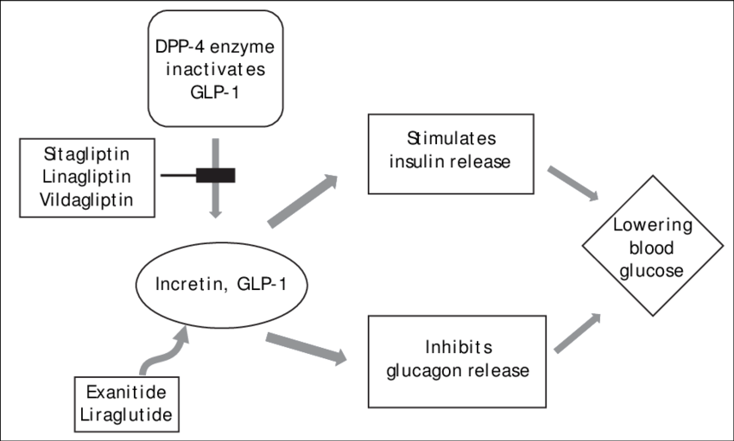
GLP1-Ra
Mechanism of action :
Increase insulin release
Decrease gastric emptying
Decrease appetite.
Examples:
exenatide (Bydureon)
liraglutide (Victoza)
semaglutide (Ozempic)
Benefits
1) decrease CVS disease
2) decrease chronic kidney
disease(semaglutide)
Side effects :
SC
Git upset
Pancreatitis
C cell thyroid carcinoma
increase heart failure

Slide 26
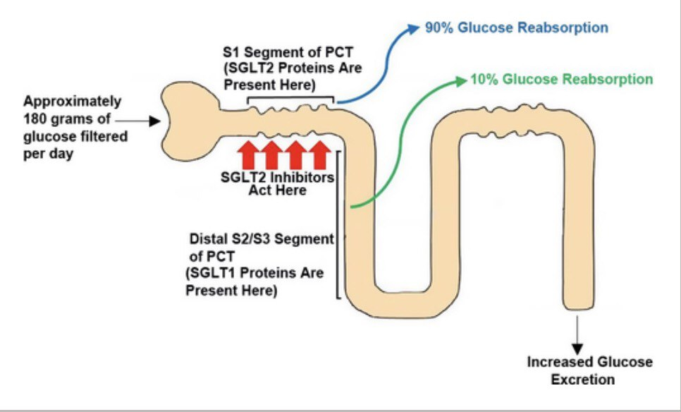
Sglt2 inhibitors
EXAMPLES:
Canagliflozin ( invokana)
Empagliflozin ( jardiance)
Dapagliflozin ( farxiga)
Mechanism of action.
Decrease tubular glucose reabsorption
Decrease osmotic glucosurea
Shift from carbs to ketogenesis
risk:
UTI
DKA(specially with fasting +in critically ill patients )
hypovolemia
Benefits :
decrease CVS disease
Decrease CKD progression
Notes
Canagliflozin:can do dose adjustment

Slide 27
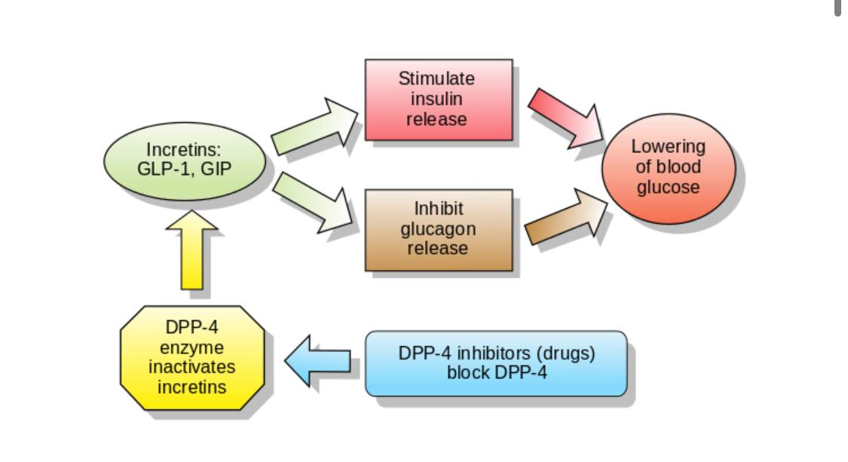
Dpp4(inhibitors)
examples
Sitagliptin(januvia)
saxagliptin(onglyza)
Linagliptin(trajenta)
Vildagliptin (galvus)
Side effects
Flu like symptoms
Nasopharyngitis
Headache
Notes
Do not give two incretins at the same time (GLP1RA +DPP4 inhibitors )

Slide 28
Blood pressure
increase in BP is proportional to increased albumin excretion.
• Numerous studies have demonstrated that treatment of BP, irrespective of the agents used, has a beneficial effect on albuminuria.
*ACE-I or ARBs reduce the risk of progression of microalbuminuria to macroalbuminuria (by 60-70%), reduce macroalbuminuria, and reduce the rate of decline in GFR.
Strict adherence to evidence would generally see ACE-I used in T1DM and ARBs in T2DM. However, most clinicians are pragmatic and principally guided by tolerability.
ACE-I also demonstrably reduce the risk of MI, CVA, and CV death (by -25% at 2 years). This might be true for ARBs as well.
Allow ≥25% change in SCr and eGFR. Greater increases may indicate the presence of renal artery stenosis (a >70% renal artery stenosis is present in ~15% of individuals with T2DM and ↑ BP).
Monitor K+ after 1 week and then monthly for first 2-3 months.

Slide 29
A low-salt diet enhances the renoprotective effects of ARBs in T2DM. Furthermore, lower urinary Nat excretion, reflecting lower intake, is associated with fewer CV events.
Target BP:
In the UKPDS, a 12% risk reduction in diabetic complications was found with each 10mmHg drop in SBP, with lowest risk at 120mmHg.
KDIGO recommend a BP target of <130/80mmHg if >30mg/24h proteinuria.
UK Renal Association (and NICE) also recommend <130/80mmHg.
Recent guidelines for hypertension from non-nephrological bodies, e.g. ESH-ESC (2013), have suggested the evidence for a target of <130/80mmHg is not particularly robust and suggested a target SBP of <140mmHg for most hypertensive groups, including diabetics.
Many nephrologists will aim <125/75mmHg if proteinuria >1g/24h.

Slide 30
Proteinuria
Proteinuria is itself an important treatment target
Aim <0.5g/24h (uACR <30mg/mmol or uPCR <50mg/mmol), as BP allows.
•ACE-1 or ARBs should be used in normotensive patients with proteinuria (micro-or macroalbuminuria).

Slide 31
Diabetic nephropathy: management 2
Additional RAS blockade
• There has been much interest in combination therapy for RAS inhibition in DN.
For ACE-I + ARB therapy
Aldosterone has been associated with progression of renal disease through increased fibrosis and proteinuria.
• Plasma aldosterone often decreases with ACE-I or ARB therapy, but levels eventually return to baseline in many (-40%)—a phenomenon termed 'aldosterone escape'.
• The addition of the aldosterone antagonist spironolactone to a regimen including an ACE-I or ARB has an anti-proteinuric (and variable BP) effect in both T1DM and T2DM.
* There is a significant risk of ↑ K+, particularly in patients with ↓ GFR, and this often limits the utility of spironolactone in practice.
• Combination therapy with a direct renin inhibitor has also been studied, with initial studies suggesting a BP-independent antiproteinuric effect in T2DM.
• However, the ALTITUDE study (aliskirin + ACE-I/ARB in T2DM) was stopped early because of adverse events in the combination therapy group (renal failure, ↑ K+, ↓ BP, CV events).

Slide 32
Other interventions
Treat dyslipidaemia:
Aim fasting LDL <3.0mmol/L.
Statins are usually necessary (and demonstrably reduce cardiac events in diabetic patients).
Statins may reduce proteinuria and preserve GFR in overt DN.
• The role of aspirin and other antiplatelet agents for primary prevention of CV events in patients with DN is uncertain. However, if no contraindication, low-dose aspirin (75mg od) is often recommended.
• Smoking cessation.
. Modest dietary protein restriction (0.8g/kg per day) may slow decline in GFR.
Some advocate a more stringent restriction to 0.6g/kg/day in selected patients.

Slide 33
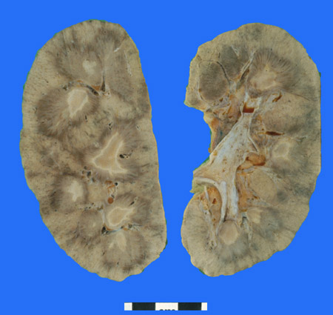
Other diabetes-related urinary tract disorders
Papillary necrosis
Occurs in ~1:20 with diabetic nephropathy.
May be asymptomatic but can present as pain (recurrent renal colic) or infection.
Haematuria, modest proteinuria (<2g/24h), and sterile pyuria are common.
Renovascular disease
Suspect if difficult to control BP, fluid retention, or >20% rise in SCr (or fall in eGFR), following an ACE-I or ARB.

Slide 34
Neurogenic bladder (diabetic cystopathy)
A degree of bladder dysfunction is present in ~40% of patients with long-standing diabetes.
Cause: It results from peripheral and autonomic neuropathy (characterized by segmental demyelination with impaired conduction).
Manifestations: firstly, loss of sensation of bladder filling, with subsequent progressive loss of motor function. Incomplete emptying leads to a large-volume bladder, with a significant post-micturition volume and urinary stasis leading to : Recurrent UTIs and urinary incontinence

Slide 35
Investigations: MSU for M,C+S. USS bladder before and after voiding.
Ask the patient to complete a bladder diary.
Urodynamic findings include decreased bladder sensation, impaired detrusor contractility, and eventual detrusor areflexia. Detrusor hyperreflexia is also recognized.
Screen for other manifestations of autonomic dysfunction( postural HR and BP) .
Exclude significant prostatic disease.
Interventions: 1) regular voiding in the absence of urge ( every 2h)
2) drugs (e.g. the parasympathomimetic agent bethanechol)
3) intermittent self-catheterization, (also ↓ bladder volume and may help partial recovery of detrusor function)
4) long-term catheterization, urinary diversion, and treatment of associated infection.

Slide 36
Urinary tract infection
Female with diabetes have twice the incidence of UTI, compared to those with out diabetes.
Diabetes is also a risk factor for UTIS in males.
There is also a higher incidence of pyelonephritis and renal abscess formation.
90% of cases of emphysematous pyelonephritis occur in patients with diabetes.
Contrast induced-AKI
Patients with diabetes, probably as a result of intrarenal microvascular disease, are more susceptible to CI-AKI.

Slide 37
OTHER DIABETES-RELATED URINARY TRACT DISORDERS
Considerations in ESRD from diabetic nephropathy
► Patients with T1DM (and selected patients with T2DM) should be considered for combined kidney/pancreas transplantation.
Diabetic patients often need to initiate dialysis at an earlier stage than patients with ESRD from another cause (eGFR in the 10-15mL/min range)
Because : 1) they are often more symptomatic
2)tolerate volume overload less well
3)have a heightened propensity to hyperkalaemia.
*Survival and causes of death in diabetic patients on dialysis:
Diabetic patients with ESRD have a 5-year survival rate of ~30% (compared with ~60% in those without diabetes).
This is largely a consequence of their comorbidity, particularly CV disease.
A higher incidence of withdrawal from dialysis treatment is also reported.

Slide 38
Dialysis modality: peritoneal dialysis vs haemodialysis
No clear difference in outcome between PD and HD has been observed.
USRDS data and Canadian studies have offered conflicting results (potentially explained by different patient demographics and comorbidities). Overall, there is a suggestion that older diabetic patients survive longer on HD, and younger patients longer on PD.
Renal transplantation in diabetics
Renal transplantation is safe and effective. In appropriately selected patients, it can offer improved survival and rehabilitation, compared to dialysis.
Studies have shown similar 1- and 5-year graft survival in diabetic and non-diabetic patients undergoing transplantation when data are censored for patients dying with a functioning graft. Living donor graft survival is superior to deceased donor grafts (80% vs 64% 5-year graft survival).

