Slide 1
ACUTE PANCREATITIS
Supervised by : DR.TARIQ ALADWAN
DONE BY : MONA ABUZAID
LAMA RAED
ARWA AJALEEN

Slide 2
Spleen
** Pancreas
- is a combined exocrine and endocrine gland
-The pancreas is a retroperitoneal organ that lies in an oblique position, sloping upward from the C-loop of the duodenum to the splenic hilum.
**weighs 75 to 100 g and is about 15 to 20 cm long
Pancreas
Duodenum

Slide 3
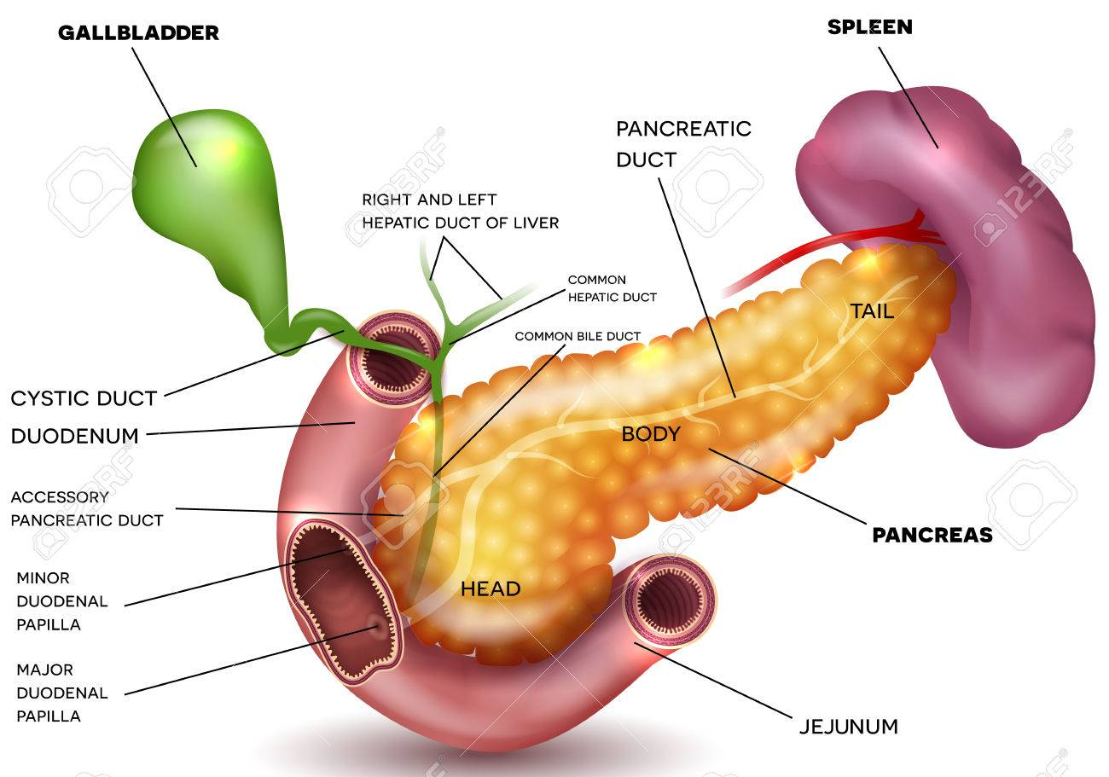
Parts of pancreas
Neck

Slide 4
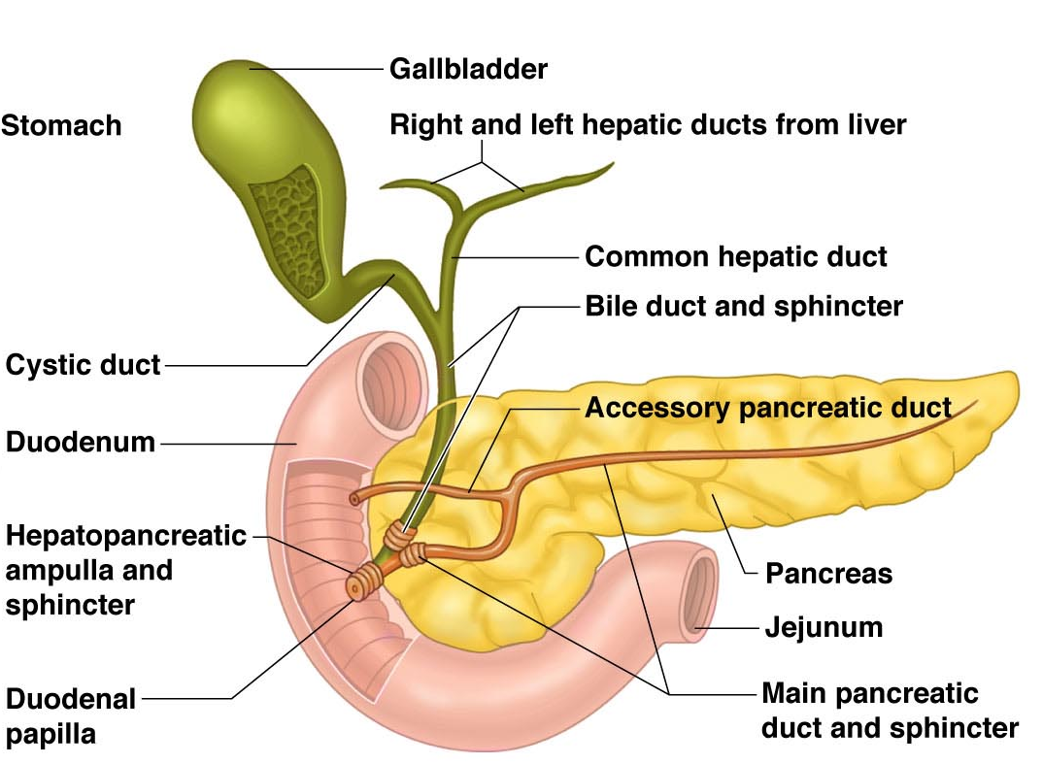
1- Main pancreatic duct (duct of Wirsung); runs along the long axis of the pancreas from the tail to the head.
- It fuses with CBD forming hepato-pancreatic duct that opens into the major duodenal papilla (ampulla of Vater) in the 2nd part of the duodenum.
2- Accessory pancreatic duct, begins from the lower part of the head and uncinate process.
- It opens into the 2nd part of the duodenum on the minor duodenal papilla, one inch above the major duodenal papilla.
Pancreatic ducts
Minor duodenal papilla
Major

Slide 5
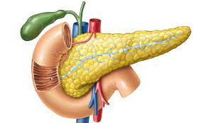
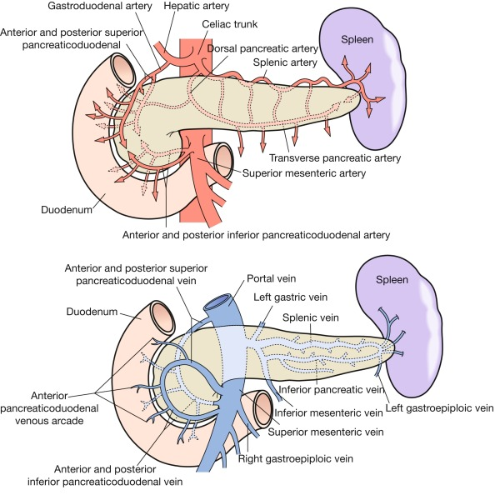
Blood supply:
Arteries : splenic superior and inferior pancreaticoduodenal arteries .
Veins :corresponding veins into portal system.
Lymph drainage :
celiac and superior mesenteric lymph nodes.
Nerve supply:
sympathetic and parasympathetic (vagal) nerve.

Slide 6
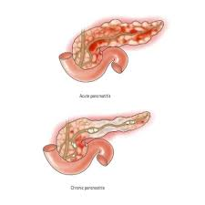
Acute pancreatitis
is an inflammatory disorder of the pancreas that is characterized by edema and, when severe, necrosis, defined as an acute condition presenting with abdominal pain and is usually associated with raised pancreatic enzyme levels in the blood or urine.
underlying mechanism of injury in pancreatitis is thought to be premature activation of pancreatic enzymes within the pancreas, leading to a process of auto-digestion.

Slide 7
Acute pancreatitis may be categorized as mild or severe:
Mild acute pancreatitis is characterized by interstitial edema of the gland and minimal organ dysfunction. Eighty per cent of patients will have a mild attack of pancreatitis, the mortality from which is around 1 per cent.
Severe acute pancreatitis is characterised by pancreatic necrosis, a severe systemic inflammatory response and often multi-organ failure. In those who have a severe attack of pancreatitis, the mortality varies from 20 to 50 per cent.
About one-third of deaths occur in the early phase of the attack, from multiple organ failure, while deaths occurring after the first week of onset are due to septic complications.

Slide 8
Incidence
Worldwide annual incidence may range from 5 to 80 per 100 000. The disease may occur at any age, with a peak in young men and older women.
The incidence of acute pancreatitis also shows significant variation related to the prevalence of etiological factors and ethnicity, Smoking is an independent risk factor for acute pancreatitis.

Slide 9
Etiology
The most common causes are gallstones and alcohol ,accounting for up to 80% of cases.
The median age at index presentation of acute pancreatitis varies with etiology: with alcohol- and drug-induced pancreatitis presenting in the third or fourth decade compared with gallstone and trauma in the sixth decade.
The gender difference is probably more related to etiology: in males alcohol is more often the cause while in females it is gallstones.

Slide 11
Gallstones:
It was proposed that the “common channel” hypothesis allowed bile to reflux into the pancreatic duct , Another proposal was that transient incompetence caused by the passage of a stone through the sphincter might allow duodenal fluid and bile to reflux into the pancreatic duct, A third possibility is that acute pancreatitis is due to the gallstone obstructing the pancreatic duct and leading to ductal hypertension.
2. Alcohol:
There are several mechanisms by which ethanol causes acute pancreatitis by acting on the acinar and stellate cells , The secretory burst coupled with ethanol induced spasm of the sphincter of Oddi probably incites acute pancreatitis

Slide 12
3. Iatrogenic:
The most common iatrogenic cause is ERCP in which acute pancreatitis occurs after about 5% to 10% of procedures , The risk of post-ERCP acute pancreatitis is increased if the contrast agent is infused repeatedly under high pressure by the endoscopist and in patients with sphincter of Oddi dysfunction.
4. Hereditary Pancreatitis:
an autosomal dominant disorder usually related to mutations of the cationic trypsinogen gene (PRSS1). Mutations in this gene cause premature activation of trypsinogen to trypsin and causes abnormalities of ductal secretion, both of which promote acute pancreatitis,

Slide 13
5. Hyperlipidemia:
Patients with types I and V hyperlipoproteinemia can experience episodes of abdominal pain, Lipase is thought to liberate toxic fatty acids into the pancreatic microcirculation, leading to microcirculatory impairment and ischemia.
6. Drugs :
Isolated cases of acute pancreatitis have been associated with exposure to certain drugs, such as thiazide diuretics, furosemide, estrogen replacement therapy, and steroid therapy in children.
7. tumors:
A pancreatic or periampullary tumor should be considered in patients with idiopathic acute pancreatitis, especially in those over 50 years old. Approximately 1% to 2% of patients with acute pancreatitis have a pancreatic tumor.

Slide 14
Clinical presentation
abdominal tenderness, often with signs of peritonitis in the upper abdomen.
Rarely, pancreatic fluid and bleeding from the pancreas into the retroperitoneum may result in a bruise-like discoloration around the umbilicus (Cullen’s sign) or in the flanks (Grey Turner’s sign).
Another rare sign is tetany as a result of hypocalcaemia.
In addition to hemoconcentration, patients with acute pancreatitis often have azotemia with elevated blood urea nitrogen and creatinine levels, hyperglycemia, and hypoalbuminemia.

Slide 15
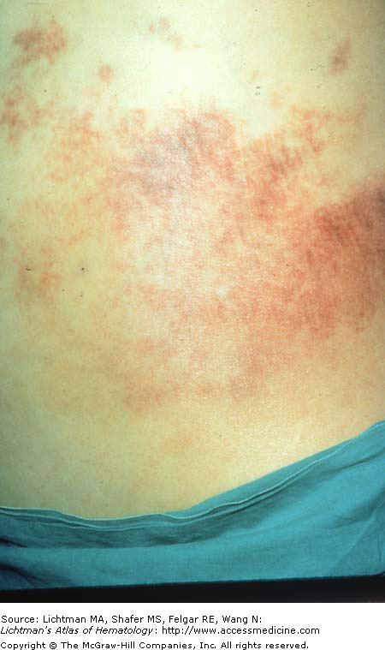
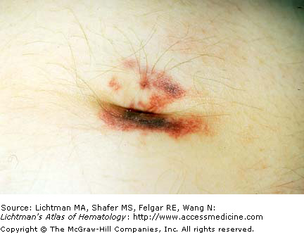
Grey Turner sign
Cullen’s sign

Slide 16
Management of Acute Pancreatitis
The essential requirements for the management of acute pancreatitis are
-accurate diagnosis
-appropriate triage(to get the right patient to the right place at the right time with the right care provider)
-high-quality supportive care
-monitoring for
-treatment

Slide 17
Diagnosis
The diagnosis of acute pancreatitis requires the patient to present with
-abdominal pain consistent with acute pancreatitis (acute onset of a severe constant epigastric pain that often radiate through to the mid back) and
-the elevation of serum amylase or lipase (>3 times upper limit of normal).
-Imaging (usually by contrast-enhanced CT scanning) is only required for the diagnosis
of acute pancreatitis when these diagnostic criteria are not met.

Slide 18
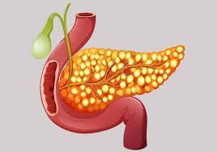
contrast-enhanced CT scan
It may be necessary to perform to diagnose acute pancreatitis in
-patients who are severely ill or
-in those presenting with undifferentiated abdominal pain.
- the diagnosis of local complications; in particular, the development and extent of pancreatic necrosis and the different Collections

Slide 19
NOTES
There is no correlation
between the extent of serum amylase elevation and severity
of pancreatitis
But there is no advantage in using CT scanning to predict the severity of acute pancreatitis
Don’t forget that hyperamylasemia can also occur in association
with other diseases
A normal serum amylase doesn’t exclude acute pancreatitis particularly if the patient has presented a few days later

Slide 20
supportive care
Pain Management
Pain is the cardinal symptom of acute pancreatitis, and its relief is
a clinical priority. the choice of analgesic.
analgesia should be administered intravenously, Those with
mild pain can usually be managed with a NSADs
drugs (e.g., metamizole 2 g/8 h IV),
while those with more severe pain are best managed with opioid analgesia (e.g buprenorphine 0.3 mg/4 h IV). Administration of buprenorphine,pentazocine, procaine hydrochloride, and meperidine are all of value in controlling abdominal pain.
Morphine is to be avoided because of its potential to cause sphincter of Oddi spasm

Slide 21
Predicting Severity
pancreatitis severity is important in making triage decisions
about whether a patient should be transferred to a tertiary
hospital or an intensive care unit and in making decisions
about fluid therapy and whether an ERCP is indicated, as well
as other issues.
We predict the severity by the most widely used
Ranson’s criteria OR by APACHE II

Slide 22
Ranson’s prognostic signs of pancreatitis
Criteria for acute pancreatitis not due to gallstones
At admission :
-Age >55 y
-WBC >16,000/mm3
-Blood glucose >200 mg/dL
-Serum LDH >350 IU/L
-Serum AST >250 U/dL
During the initial 48 h :
-Hematocrit fall >10 points
-BUN elevation >5 mg/dL
-Serum calcium <8 mg/dL
-Arterial PO2 <60 mmHg
-Base deficit >4 mEq/L
-Estimated fluid sequestration >6L

Slide 23
Criteria for acute gallstone pancreatitis
At admission During the initial 48 h
Age >70 y Hematocrit fall >10 points
WBC >18,000/mm3 BUN elevation >2 mg/dL
Blood glucose >220 mg/dL Serum calcium <8 mg/dL
Serum LDH >400 IU/L Base deficit >5 mEq/L
Serum AST >250 U/dL Estimated fluid sequestration >4 L
**Fewer than three positive criteria predict mild, uncomplicated
disease, whereas more than six positive criteria predict severe disease with a mortality risk of 50%.

Slide 24
Classification of Severity
For Accurately classifying or staging acute pancreatitis severity
The key determinants of severity are
local complications (absent, sterile, or infected) and
Systemic complications (absent, transient organ failure, persistent organ failure).
Two classification systems have recently
been proposed: the three grades (mild, moderately severe, and
severe) of the Revised Atlanta Criteria (RAC) and the four
categories (mild, moderate, severe, critical) of the Determinants
Based Classification (DBC)

Slide 25
*Determining Etiology
*Fluid Resuscitation
is the most important intervention in the early management of acute pancreatitis it is probably
best to resuscitate with a balanced crystalloid and aim
to restore normal blood volume, blood pressure, and urine
output. In one study, lactated Ringer’s solution was superior
to normal saline in reducing the systemic inflammatory
Response.

Slide 26
*Nutritional Support
Parenteral nutrition is now known to be more expensive, riskier, and not more effective than enteral nutrition and should only be offered
if the patient’s calculated nutritional requirements cannot be
achieved by the enteral route.
Early initiation of enteral nutrition (within the first 24 hours of admission) is not superior to delaying an oral diet until 72 hours (A delay
in commencing enteral nutrition may contribute to the
development of intestinal ileus and feeding intolerance, but
aggressive early enteral feeding, particularly before adequate
resuscitation, may put the patient at risk of nonocclusive
mesenteric ischemia)
if after 3 to 5 days there is evidence of feeding intolerance, tube
feeding should be commenced.

Slide 27
Imaging: Therapeutic Endoscopic Retrograde Cholangiopancreatography(ERCP)
Randomized trials have demonstrated that early ERCP (within 24 or 48 hours of admission) reduce complications, but not mortality, in patients with predicted severe gallstone associated acute pancreatitis
More recent evidence has suggested
that early ERCP confers no benefit in the absence of concomitant cholangitis

Slide 28
Antibiotics
SO Antibiotics are not indicated
Overall, it appears that the most recent and generally better designed studies do not support
the use of prophylactic antibiotics to reduce the frequency of pancreatic infectious complications, surgical intervention, and death

Slide 29
Investigations in acute pancreatitis should be
aimed at answering three questions
Is a diagnosis of acute pancreatitis correct?
How severe is the attack?
What is the aetiology?
Remember

Slide 30
Complications of acute pancreatitis

Slide 32
Systemic complications Pancreatitis may involve all organ systems and place demands on the surgeon beyond his or her skills. Patients with systemic complications should be managed by a multidisciplinary team that includes intensive care specialists. When there is organ failure, appropriate supportive therapies may include inotropic support for haemodynamic instability, haemofiltration in the event of renal failure, ventilatory support for respiratory failure and correction of coagulopathies (including DIC). There is no role for surgery during the initial period of resuscitation and stabilisation; surgical intervention is contemplated only in the patient who deteriorates as a result of local complications following successful stabilisation.

Slide 33
Local complications and their management
Usually by the end of the first week, major organ failure is under control, then local complications become pre-eminent in the management of these patients. The course of the patient should be followed carefully and, if clinical resolution does not take place or signs of sepsis develop, a CT scan should be performed. Local complications in pancreatic disease are serious and carry a significant mortality. The management approach is conservative on the whole, with surgery restricted to situations in which conservative management has failed.

Slide 34
Acute fluid collection , this occurs early in the course of acute pancreatitis and is located in or near the pancreas. The wall encompassing the collection is ill defined. The fluid is sterile and most such collection resolve. No intervention is necessary unless a large collection causes symptoms or pressure effects, in which case it can be percutaneously aspirated under ultrasound or CT guidance. Transgastric drainage under EUS guidance is another option. An acute fluid collection that does not resolve can evolve into a pseudocyst or an abscess if it becomes infected.
Sterile and infected pancreatic necrosisThe term 'pancreatic necrosis' refers to a diffuse or focal area of non-viable parenchyma that is typically associated with peripancreatic fat necrosis. Necrotic areas can be identified by an absence of contrast enhancement on CT. These are sterile to begin with, but can become subsequently infected, prob- ably due to translocation of gut bacteria. Infected necrosis is associated with a mortality rate of up to 50 per cent.

Slide 35
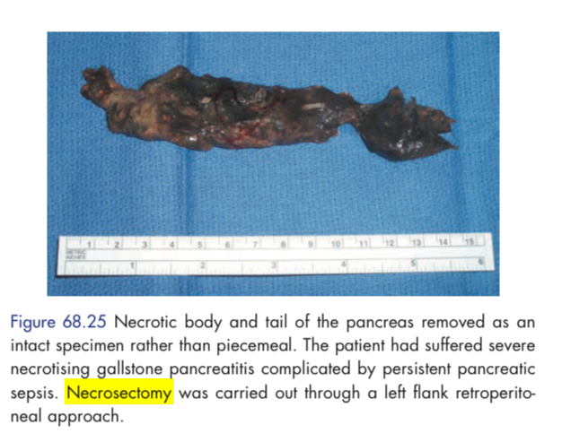
Sterile necrotic material should not be drained or interfered with. However, if the patient shows signs of sepsis, CT scan should be performed and a needle passed into the area under CT guidance. This may be done under ultrasonographic guidance as well. If the aspirate is purulent, percutaneous drainage of the infected fluid should be carried out , and appropriate antibiotic should be commenced .
If the sepsis worsens despite this, then a pancreatic necrosectomy should be considered.

Slide 36
Pancreatic abscessThis is a circumscribed intra-abdominal collection of pus, usually in proximity to the pancreas. It may be an acute fluid collection or a pseudocyst that has become infected. Percutaneous drainage with the widest possible drains placed under imaging guidance is the treatment, along with appropriate antibiotics and supportive care. Repeated scans may be required depending on the progress of the patient, and drains may need to be flushed, repositioned or reinserted. Very occasionally, open drainage of the abscess may be necessary.
Pancreatic ascitesThis is a chronic, generalised, peritoneal, enzyme-rich effusion usually associated with pancreatic duct disruption. Paracentesis will reveal turbid fluid with a high amylase level. Adequate drainage with wide-bore drains placed under imaging guidance is essential. Measures that can be taken to suppress pancreatic secretion include parenteral feeding and administration of octreotide. An ERCP may allow demonstration of the duct disruption and placement of a pancreatic stent.

Slide 37
Pancreatic effusionThis is an encapsulated collection of fluid in the pleural cavity, arising as a consequence of acute pancreatitis. Concomitant pancreatic ascites may be present, or there may be a communication with an intra-abdominal collection. Percutaneous drainage under imaging guidance is necessary.
HaemorrhageBleeding may occur into the gut, into the retroperitoneum or into the peritoneal cavity. Possible causes include bleeding into a pseudocyst cavity, diffuse bleeding from a large raw surface, or a pseudoaneurysm. The last is a false aneurysm of a major peri- pancreatic vessel confined as a clot by the surrounding tissues and often associated with infection. Recurrent bleeding is com- mon, often culminating in fatal haemorrhage. CT, angiography or magnetic resonance angiography (MRA) helps to make the diagnosis. Treatment involves embolisation or surgery.

Slide 38
Portal or splenic vein thrombosis This may often develop silently and is identified on a CT scan. A marked rise in the platelet count should raise suspicions. In the context of acute pancreatitis, treatment is usually conservative. The patient should be screened for pro-coagulant tendecies. If varices or other manifestations of portal hypertension develop, they will require treatment, such as endoscopic injection or banding, B-blockade, etc. Thrombocytosis may mandate the use of aspirin or other anti-platelet drugs for a period. Systemic anticoagulation, if instituted early in the process, may achieve recanalisation of the vein, but it is not routinely used as it carries considerable risks in a patient with ongoing pancreatitis.

Slide 39
Pseudocyst , pseudocyst is a collection of amylase-rich fluid enclosed in a wall of fibrous or granulation tissue. Pseudocysts typically arise following an attack of acute pancreatitis, but can develop in chronic pancreatitis or after pancreatic trauma. Formation of a pseudocyst requires 4 weeks or more from the onset of acute pancreatitis . They are often single but, occasionally, patients will develop multiple pseudo- cysts. If carefully investigated, more than half will be found to have a communication with the main pancreatic duct.
Site of pseudocyte in the lesser sac between the pancreas and stomach .
Clinical presentation: 1. A small pseudocyst is painless and may be discovered by follow up ultrasonography. 2. A large cyst causes discomfort and manifests as an upper abdominal swelling that may reach the size of a melon

Slide 40
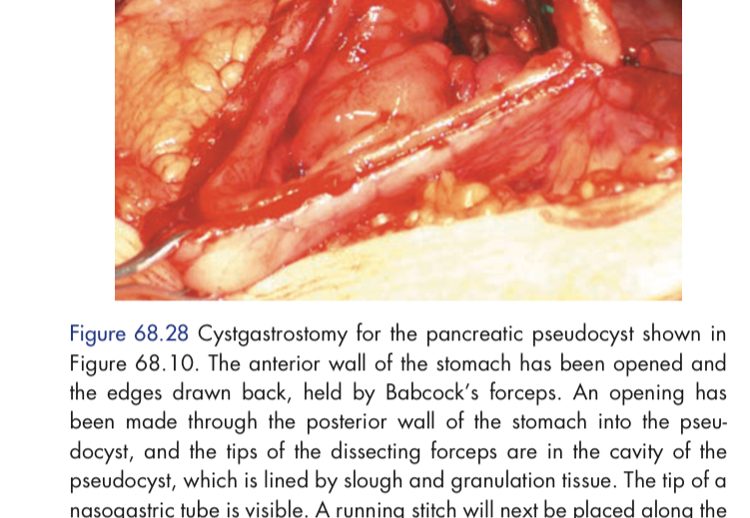
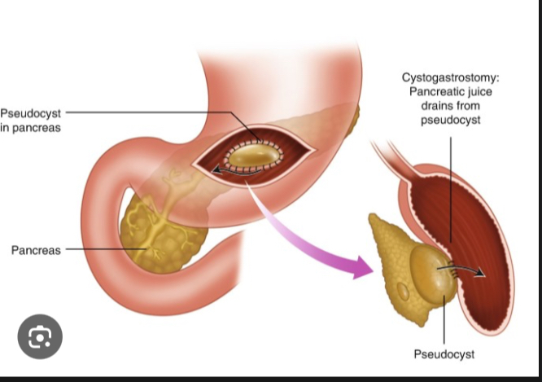
Complication : infection , hemorrhage, rupture .
Treatment -Most of these cysts resolve spontaneously –
clinical and ultrasound follow-up is needed –
A persistent pseudocyst for 6 weeks→ is surgically drained. -Waiting for 6 weeks to allow the development of a strong cyst wall that can hold sutures. -The cyst is internally drained to the stomach (Cystogastrostomy) or to a jejunal loop (cystojejunostomy)

Slide 41
Thank you
Resources :
Schwartz’s Principles of Surge eleventh edition
Bailey & Love's Short Practice of Surgery, 26th Edition

