Slide 1
Urinary Incontinence Dr. Ahlam Al-Kharabsheh

Slide 2
Urinary incontinence
The involuntary leakage of urine.
**It remains undetected and undertreated worldwide despite its
substantial impact on affected individuals.
In a US survey, only 45% of women who reported urinary incontinence occurring
at least once a week sought care for their incontinence symptoms.
The prevalence of incontinence in women is high
In older than 65, the prevalence of urinary incontinence is 20%.
For younger and middle-aged women, the prevalence is 5-10%.
**Urinary incontinence has profound effects on quality of life and
is associated with depression and anxiety, work impairment,
social isolation, and sexual dysfunction

Slide 3
Anatomy of the urinary system:
Normal Urethral Closure
- Normal urethral closure is maintained by a combination of intrinsic & extrinsic factors:
The extrinsic factors:
The levator ani muscles, the endopelvic fascia, & their attachments to the pelvic sidewalls & the urethra
The intrinsic factors includes:
the striated muscle of the urethral wall
vascular congestion of the submucosal venous plexus
the smooth muscle of the urethral wall & associated blood vessels
the epithelial coaptation of the folds of the urethral lining

Slide 4
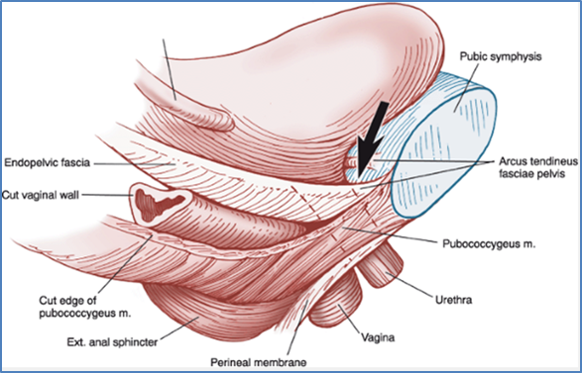

Slide 5
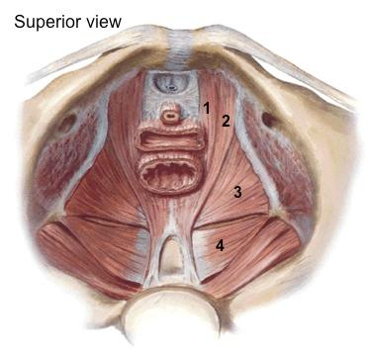
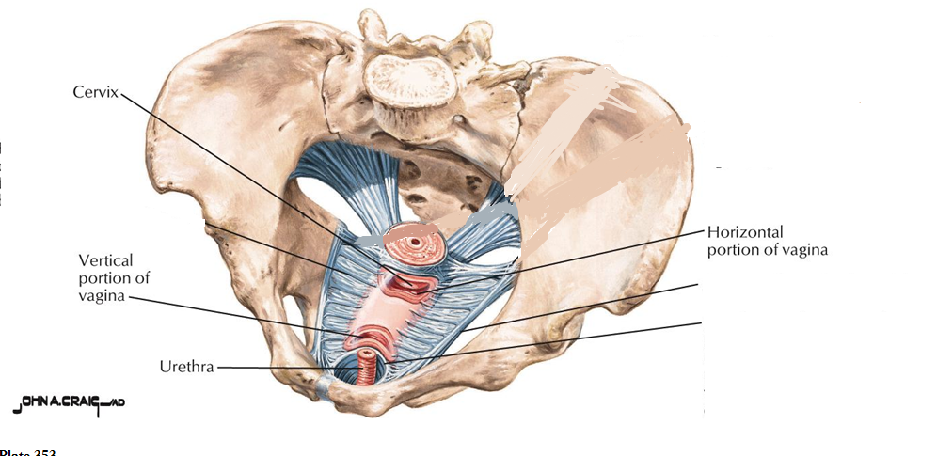
5
6
8
7
6
8

Slide 6
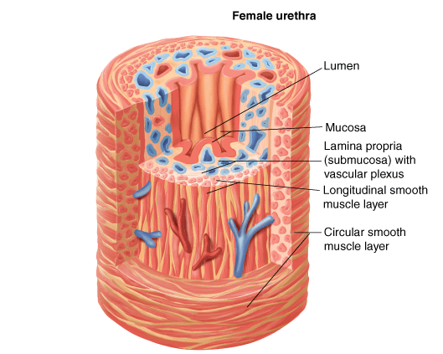

Slide 7
The Bladder
The bladder is a low-pressure system that expands to accommodate increasing
volumes of urine without an appreciable rise in pressure.
- Filling :
During bladder filling, there is an accompanying increase in muscle fiber recruitment of the pelvic floor & urethra → increase in outlet resistance. The bladder muscle (the detrusor) should remain inactive during bladder filling, without involuntary contractions
- Micturition:
When the bladder has filled to a certain volume, fullness is registered by tension-stretch receptors, which signal the brain to initiate a micturition reflex → this reflex is permitted or not permitted by cortical control mechanisms, depending on the social circumstances & the state of the patient's nervous system.
Normal voiding is accomplished by voluntary relaxation of the pelvic floor & urethra, accompanied by sustained contraction of the detrusor muscle, leading to complete bladder emptying

Slide 8
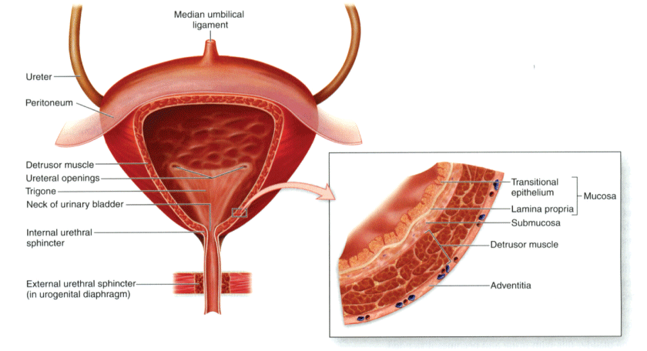

Slide 9
Innervations
- The lower urinary tract receives its innervation from three sources:
Sympathetic nervous system
Parasympathetic nervous system
The neurons of the somatic nervous system (external urethral sphincter)
The sympathetic nervous system:
- Originates in the thoraco-lumbar spinal cord, principally T11 through L2-L3
- Acts on two types of receptors:
Alpha-receptors → in the urethra & bladder neck → increases urethral tone & thus promotes closure
Beta-receptors → in the bladder body → decreases tone in the bladder body
The parasympathetic nervous system:
Controls bladder motor function — bladder contraction & bladder emptying
Originates in the sacral spinal cord, primarily in S2 to S4
The somatic nervous system
The somatic innervation of the pelvic floor, urethra, & external anal sphincter originates in the sacral spinal cord, primarily in S2 to S4

Slide 10
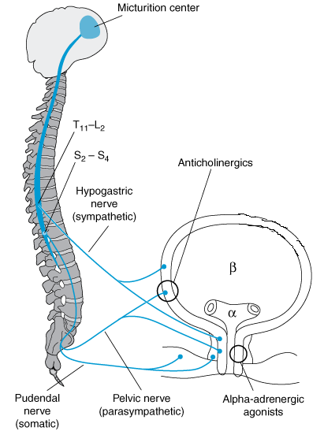

Slide 11
Classification: There are many cause of urinary incontinence divided into urethral and extra-urethral causes

Slide 12
Urethral causes
Stress incontinence:
The most common type
Patient have involuntary leakage of urine that occurs with sneezing, coughing, laughing, or anytime an increase in intra-abdominal pressure exceeds urethral sphincter closure mechanisms
Stress incontinence may be provoked by minimal or no activity when there is severe sphincter dysfunction
Causes
. Damage of the nerve supply of the pelvic floor , urethral sphincter and damage to pelvic floor muscle during vaginal delivery. (Prolonged second stage, large babies and instrumental deliveries cause the most damage.))
. Atrophy due to menopause .
. Chronic raise in intra abd pressure (cough , obesity, constipation…
. Congenital collagen diseases

Slide 13
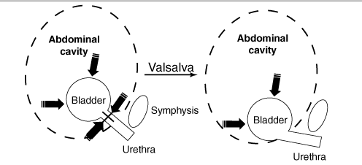
Pressure-Transmission Theory

Slide 14
Urge incontinence:
Patient typically have symptoms of involuntary leakage of urine accompanied by urgency.
Women may have increased daytime frequency and nocturia .
Common triggers include running water, hand washing, and cold weather exposure.
Urge incontinence is believed to be caused by detrsuor overactivity.
Causes are poorly understood

Slide 15
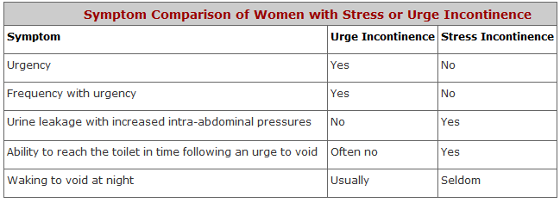

Slide 16
Mixed stress and urge urinary incontinence :
. Symptoms of urge and stress incontinence
Overflow incontinence:
Involuntary, continuous, urinary leakage or dribbling and
incomplete bladder emptying.
It is caused by impaired detrusor contractility or bladder outlet obstruction (rare in women)
If the bladder is over-distended:
An increases in intra-abdominal pressure can force urine past the urethral sphincter, causing stress incontinence
In some cases, bladder over-distention may provoke an uninhibited contraction of the detrusor muscle, leading to incontinence.

Slide 17
Causes of urethral incontinence :
Genitourinary
In older women, several physiologic changes occur in the lower urinary tract that can cause incontinence:
Involuntary detrusor contractions or overactivity
Decreased detrusor contractility
Low estrogen levels
Decrease in urethral closure pressure
Others:
Interstitial cystitis (painful bladder syndrome).
Pelvic organ prolapse (Cystocele)

Slide 18
Systemic conditions
Neurologic disorders: e.g. stroke, multiple sclerosis, Parkinson disease, disc herniation, spinal cord injury…
Diabetes mellitus: overflow incontinence and poor urinary stream can be present in patients with diabetic autonomic neuropathy
Cancers
Potentially reversible causes (Functional incontinence)
Medications ( alpha blockers, ACE inhibitors, Anti-depressant)
Decreased mobility (e.g., post-surgery)
Change in cognitive or mental status ( sedation from medications as Morphine & mepredine)
Stool impaction
Alcohol and caffeine intake

Slide 19
Extraurthral causes: The observation of urine leakage through channels other than the urethra.
*Congenital
Bladder exstrophy and ectopic ureter
*Fistula
Abnormal opening between the urinary tract and the outside
It has obstetric and gynaecologycal causes such as obstructed labor , malignancy and radiotherapy

Slide 20
EVALUATION
History:
- Patient’s urinary symptoms (volume, onset of incontinence, timing, severity, hesitancy, precipitating triggers, nocturia, intermittent or slow stream, incomplete emptying, continuous urine leakage, and straining to void)
Voiding (bladder) diaries// Frequency- volume bladder charts are useful for assessing incontinence frequency, severity, and volume of urine loss during incontinent episodes.
Severity of symptoms & degree of bother and effect on quality of life (Questionnaires to assess quality of life and urinary incontinence) :
1- UDI-6: Urogenital Distress Inventory, short form.
2- IIQ-7 : Incontinence Impact Questionnaires, short form.

Slide 21
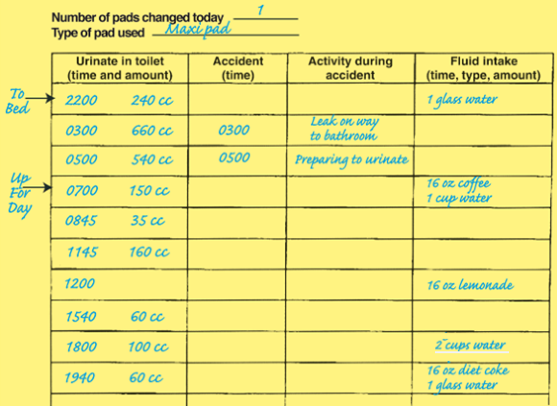

Slide 22
History:
- If there is indications to evaluate for underlying serious causes or potentially reversible conditions. Alarm symptoms on history include:
sudden onset of incontinence
the presence of abdominal or pelvic pain
Hematuria
changes in gait or new lower extremity weakness,
cardiopulmonary or neurologic symptoms
mental status changes
- Other: drug history, constipation, caffeine intake …etc.

Slide 23
Physical examination
All women presenting with incontinence need a pelvic examination.
In addition, a comprehensive examination is often necessary to detect potentially reversible factors and underlying serious conditions
- The detailed pelvic examination in women includes:
Inspect the vaginal mucosa for signs of atrophy (thinning, pallor, loss of rugae), and inflammation
Palpate bimanually to evaluate for masses or tenderness.
Assess for pelvic organ prolapse: hold the blade firmly against the posterior vaginal wall. Ask the woman to cough once, looking for urethral leakage &/or cystocele.
Bladder stress test: is performed by asking the patient, with a full bladder, to stand, relax, and give a single vigorous cough

Slide 24
Investigations:
Urine analysis
Postvoid residual volume (PVR) — In general, a PVR of < 50 mL is considered adequate emptying, and a PVR > 200 mL is considered inadequate and suggestive of either detrusor weakness or bladder outlet obstruction
Urodynamic testing:
group of tests used to assess function of the urinary tract. Some specific types of urodynamic testing are:
Cystometry (Cystometrogram) evaluates bladder function by measuring pressure and volume of fluid in the bladder during filling, storage, and voiding.
Uroflowmetry measures the rate of urine flow.
Clinical evaluation with urodynamics may lead to a more accurate diagnosis of incontinence type

Slide 25
Normal observations and results —
The normal bladder should not have involuntary phasic contractions during filling despite provocation. It should initially expand without resistance or increased intraluminal pressure.
The urethral sphincter should relax and open when the patient wants to initiate voiding, accompanied by detrusor contractions.
During voiding, detrusor contraction should be smooth and lead to a steady urine stream.

Slide 26
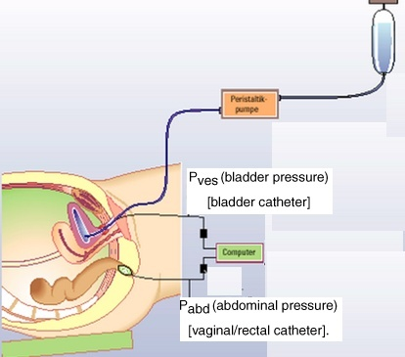

Slide 27
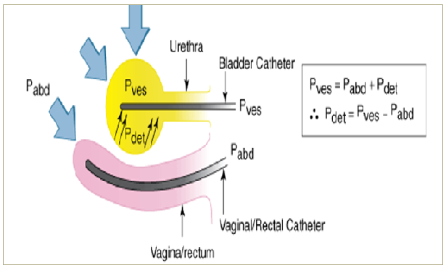

Slide 28
Technique
The patient begins by emptying her bladder as much as possible
A catheter is inserted into the bladder
Intravesical & rectal catheters are placed to measure detrusor and abdominal pressure
Water or normal saline is used to fill the bladder
the woman is asked to describe sensations during filling, including when the first feeling of bladder fullness occurs.
Provocative maneuvers, such as coughing, Valsalva, listening to running water are helpful for determining if they cause leakage and whether the leakage is related to uninhibited detrusor contractions or stress incontinence
Once the bladder is completely full, the woman is asked to begin voiding, and measurements are made of pressure, volume, and flow rate.

Slide 29
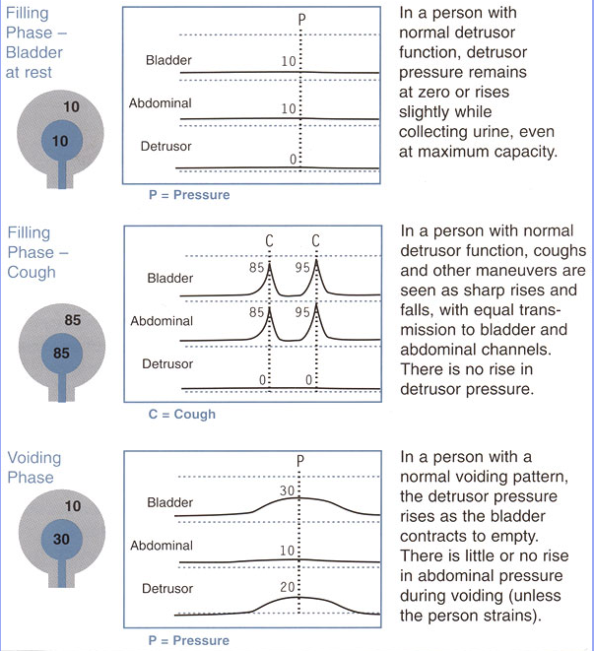

Slide 30
- Approximate of normal cystometric values for women are:
Residual urine → < 50 mL
First desire to void → occur between 150 & 250 mL
Strong desire to void → doesn’t occur until > 250 mL
Bladder compliance → between 400 & 600 mL
No uninhibited destructor contraction during filling, despite provocation
No stress or urge incontinence
Voiding occurs because of voluntarily initiated & sustained detrusor contraction
Flow rate during voiding is > 15 mL / sec with detrusor pressure of < 25 cm H2O

Slide 31
Overactive bladder “Detrusor overactivity” urodynamic observation characterized
by involuntary detrusor contractions during the filling
phase which may be spontaneous or provoked.
Genuine stress incontinence (Urodynamic stress incontinence USI) is characterized by leakage that occurs with an increase in abdominal pressure, such as coughing or Valsalva, without a rise in true detrusor pressure

Slide 32
Prevention
Behavioral and lifestyle changes: weight loss for obesity, smoking cessation, increasing physical activity/exercise, improving diet.
Pelvic floor muscle exercises are effective in preventing and reversing some urinary incontinence in the first year after vaginal delivery or following pelvic surgery
Management of conditions associated with incontinence (Diabetes, constipation)
Specific medications and surgical procedures may adversely affect continence such as hysterectomy.

Slide 33
Treatment
Stress incontinence
Non-surgical Treatment
Reduce factors that worsen the problem → obesity, smoking, medication, excessive fluid intake
Pelvic floor exercise & biofeedback, Electrical stimulation of pelvic floor muscle
Estrogen therapy (in postmenopausal women with urogenital atrophy).
Vaginal Pessaries.
Medication: Duloxetine, Impiramine.
Surgical Management
Anterior vaginal colporrhaphy ineffective
Retro-pubic bladder neck suspension operations (Burch, MMK)
Tension-free vaginal tape (TVT, TVT-O)
Sling operations (Miniarc, Monarc)
Peri-urethral injections
Notes:
For the elderly or frail patient with a scarred, narrowed vagina or in cases where other surgery has failed,
Periurethral bulking injections.
Early success at three-month follow up ranges from 80 to 90%, but there is a time-dependent decline to approximately 50% at three to four
years.
Complications are uncommon and minor: Dysuria, urinary tract infection and retention

Slide 34
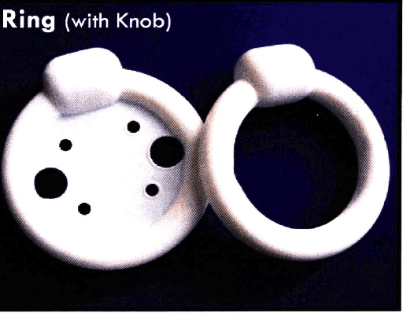

Slide 35
Urge incontinence
Conservative measure: (effective in between 60 and 70%)
Cut down volume of fluid consumed – should consume between 1 & 1.5 liters a day
Avoid caffeine based drinks
Bladder training: the patient is instructed to void on a timed schedule, starting with a relatively frequent interval
Medications:
Anti-muscarinic drugs (tolterodine and oxybutynin)
Newer anticholinergic drugs include solifenacin, fesoterodine and darifenacin
B3 adrenergic receptor agonist: Mirabegron
Estrogen
Intra-vesical therapy ( Botulinum toxin )
Sacral nerve root neuromodulation
Surgery (cystoplasty, urinary diversion) in refractory cases

Slide 36
Overflow incontinence:
Medical therapy to enhance bladder emptying provided there is no obstruction
Treatment of the underlying cause of obstruction e.g. myomectomy or hysterectomy in the case of fibroid, removal of the urethral stricture …etc.
Intermittent self catheterization

