Slide 1
Biochemical pathways regulating the Function of Sensory Organs
Dr. Nesrin Mwafi
Biochemistry & Molecular Biology Department
Faculty of Medicine, Mutah University

Slide 2
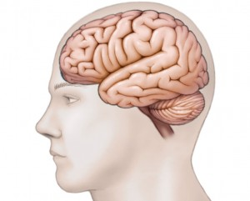
Sensory Organs and Sensory Neurons
Vision >
Olfaction >
Taste >

Slide 3
Biochemistry of Vision I

Slide 4
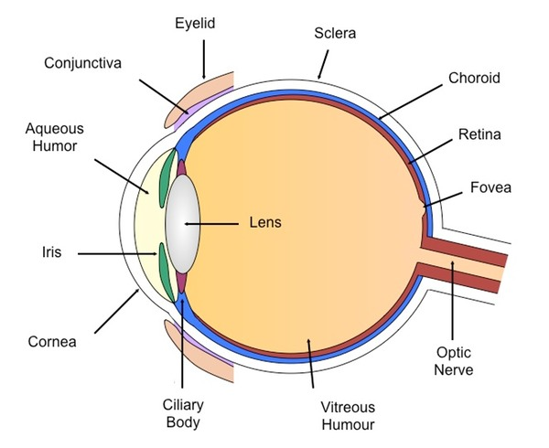
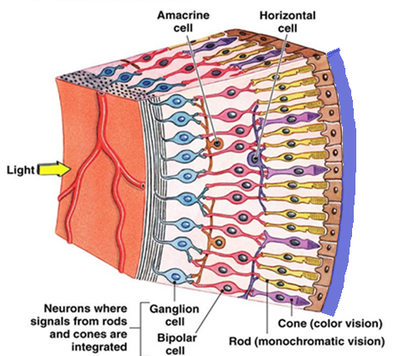
The Structure of Human Eye
Pigment
epithelium
choroid
Blind
spot

Slide 5
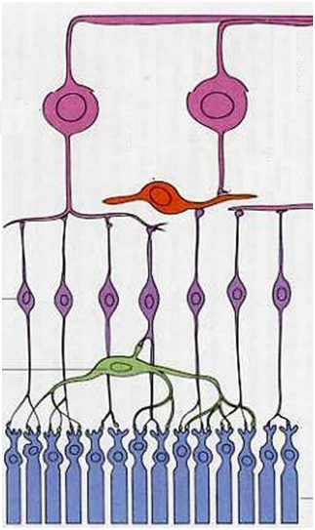
The Structure of Retina
The retina has 3 layers of neurons (the photoreceptor, the bipolar and the ganglion cells) and 2 layers of synapses including the unique ribbon synapses or lateral connection via the horizontal and amacrine cells
Horizontal cells make synapses with rods, cones and bipolar cells whereas the amacrine cells connect bipolar with ganglion cells. Thus horizontal and amacrine cells are involved in the indirect path of visual input transmission.
Ganglion
cells
Amacrine
cell
Bipolar
cells
Horizontal cell
Photoreceptor
cells

Slide 6
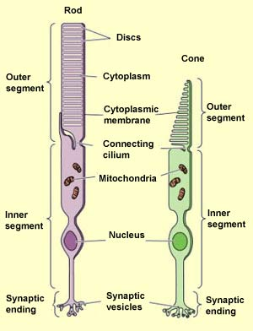
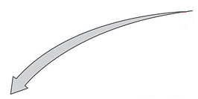
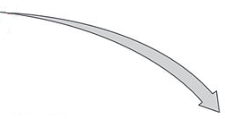
Photoreceptor cells
Retina contains two types of photoreceptors:
Free floating
discs
Outer
segment
interdisc
space
[
I
I
I
I
I
intradisc
space
I
Visual pigment
Visual pigment
I
I
I
I
I
I
Membranous
discs

Slide 7
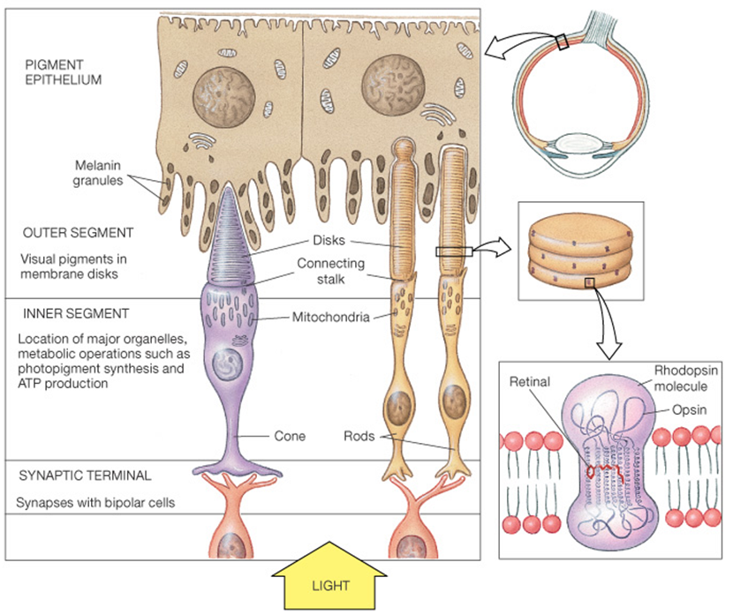
Visual Pigment

Slide 8
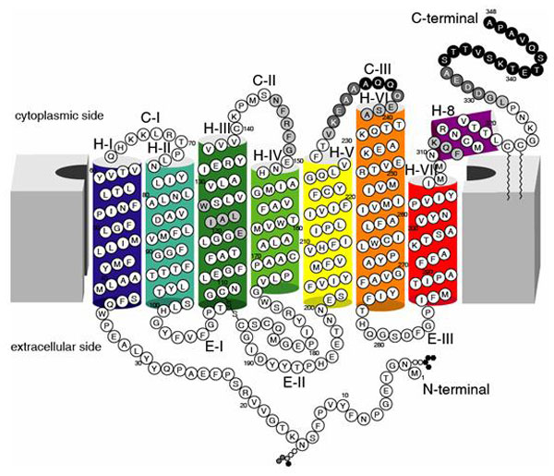
Structure of Rhodopsin
Retinal
attachment site
(lysine 296)
Rhodopsin is the only visual pigment in rods
It consists of the transmembrane protein (GPCR) called opsin and light sensitive moiety called retinal (the aldehyde form of Vitamin A)

Slide 9
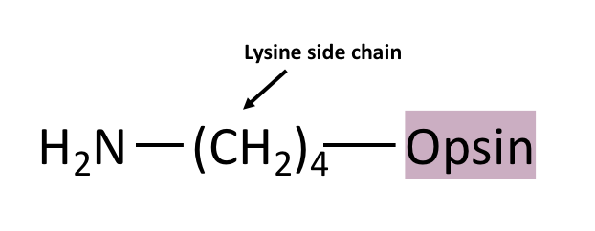
Retinal Binding to Opsin
cis
11
12
+
11-cis Retinal
Opsin
Schiff base linkage
+ H₂O
Lysine side chain

Slide 10
Iodopsin
Iodopsin is the visual pigment in cones consisting of cone opsin protein (photopsin) and the same light sensitive moiety: retinal
3 different types of iodopsins and consequently 3 different types of cone cells (which give us color vision):
L cones (photopsin I + retinal) red light, 560nm
M cones (photopsin II + retinal) green light, 530nm
S cones (photopsin III + retinal) blue light, 420nm

Slide 11
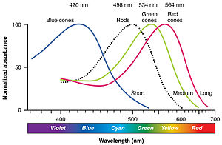
3 Different Cones
530nm
560nm
420nm
498nm

Slide 12
Phototransduction
Phototransduction is the process by which the light detected by photoreceptor cells in the retina is converted into electrical (or cellular) signals.

Slide 13
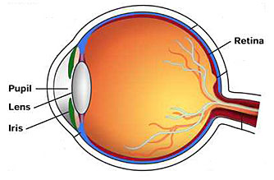
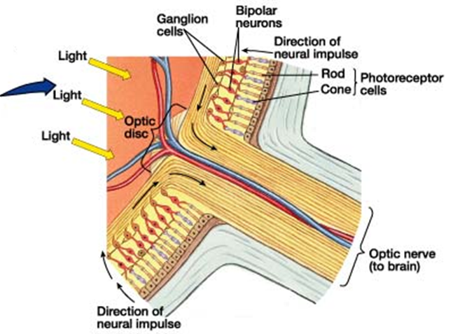
Phototransduction

Slide 14
Phototransduction
Phototransduction is the process by which the light detected by photoreceptor cells in the retina is converted into electrical (or cellular) signals.
These are transmitted as nerve impulses back through layers of retina to optic nerve fibers
The optic nerve carries the information to the brain to be processed there
What is the molecular mechanism involved in visual cycle and how does the absorbed light create a response ?

Slide 15
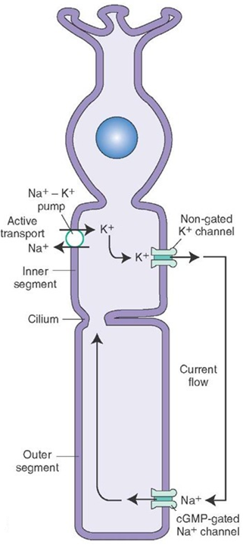
Phototransduction Cascade
In the absence of light, the photoreceptor cell is in the depolarized state with membrane potential of -40 mV. This depends on:
Non-gated K⁺ channel: outflux of K⁺ (ongoing outward K⁺ current)
cGMP-gated Na⁺ channel: influx of Na⁺
(inward Na⁺ current known as dark
current)
Na⁺- K⁺ pump: it is an active transport requires ATP (to transfer 3 Na⁺ out and 2 K⁺ in)

Slide 16
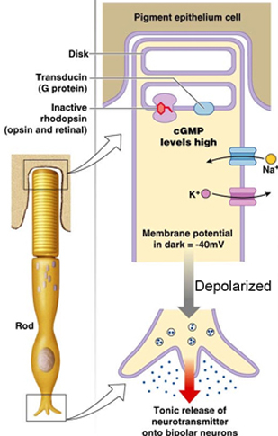
Phototransduction Cascade
In darkness, rhodopsin is inactive and cGMP level is high thus Na⁺ channels are open.
The neurotransmitter molecules are released from synaptic terminal of photoreceptor cell.

Slide 17
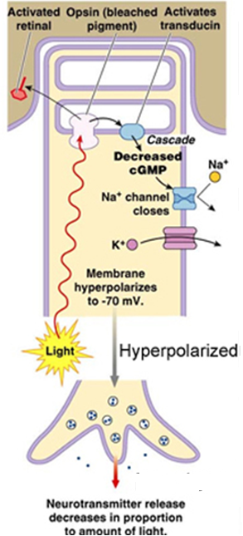
Phototransduction Cascade
In presence of light, a series of changes occur within rhodopsin which activate a downstream signaling cascade resulting in the closure of Na⁺ channels. Indeed, rhodopsin dissociates, the activated opsin decreases cGMP which in turn closes Na⁺ channels and hyperpolarizes the cell. Consequently, less neurotransmitter molecules are released.

Slide 18
Photoisomerization of retinal
Schiff base linkage
Lysine side chain
visual purple
(Photo-bleached)
visual yellow

Slide 19
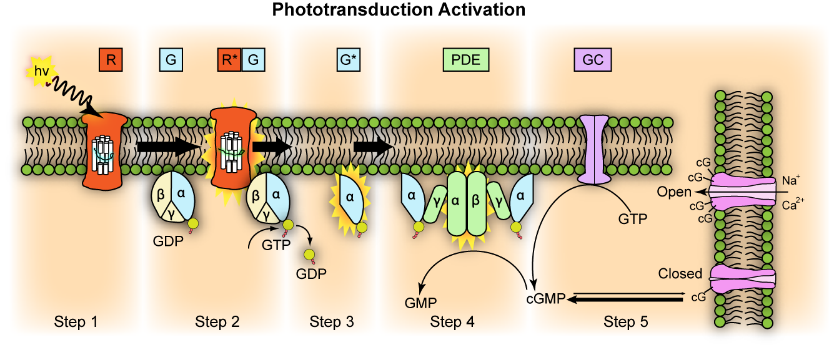
G-protein signaling pathway
Intradisc space
Na⁺
Cytoplasmic side
Na⁺

Slide 20
G-protein signaling pathway
The activated rhodopsin (R*) binds to and activates the heterotrimeric G-protein “transducin” by exchanging its GDP with GTP
The α-subunit of transducin bound to GTP (the activated transducin, G*) dissociates from its β and γ subunits
G* binds to the inhibitory γ subunits of phosphodiesterase enzyme (PDE) activating its two catalytic subunits: α and β. The activated PDE converts cGMP to GMP so reduces the cGMP level and consequently the closure of Na⁺ channels. Thus, the membrane is hyperpolarized and the rate of neurotransmitters release is reduced
Normally, Guanylyl cyclase (GC) enzyme synthesizes cGMP from GTP. So cGMP is the second messenger in phototransduction cascade

Slide 21
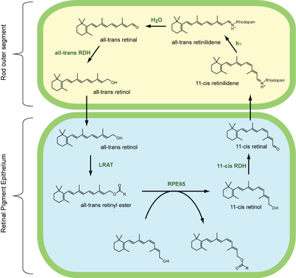
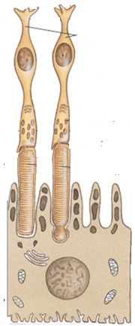
Regeneration of Visual Pigment

Slide 22
Regeneration of Visual Pigment
In darkness, inactive rhodopsin consists of opsin covalently linked to 11-cis retinal via schiff base bond. Light induces photoisomerization of 11-cis retinal to all trans retinal. The rhodopsin becomes activated (called meta-rhodopsin II) and loses its visible purple color (photobleached)
Long after visual cycle is complete, the activated rhodopsin dissociates and the all-trans retinal is released to be recycled back to 11-cis retinal
A series of biochemical reactions occur both in the outer segment of photoreceptor cell and the pigment epithelium layer in retina to regenerate the visual pigment again
First, all-trans retinal is reduced to all-trans retinol via all-trans retinol dehydrogenase (all-trans RDH) which travels back to retinal pigment epithelium (RPE).

Slide 23
Regeneration of Visual Pigment
In RPE, all-trans retinol is first esterified by lecithin retinol acyltransferase (LRAT) to form all-trans retinyl ester (a chemically stable storage form of vitamin A in RPE).
When further chromophore is required, the isomerase enzyme RPE65 (retinal pigment epithelium specific 65-KDa protein) synthesizes 11-cis retinol by using all-trans retinyl ester as substrate.
11-cis retinol is converted via 11-cis retinol dehydrogenase (11-cis RDH) to 11-cis retinal before travelling back to the outer segment of photoreceptor cell where it is again conjugated to an opsin to form new functional visual pigment (e.g. rhodopsin)

Slide 24
Photoreceptor cells
Retina contains two types of photoreceptors:
Rod cells: about 120 million, function in dim light (night vision) and do not perceive color, with high sensitivity and low resolution
Cone cells: about 6 million, function in bright light (daytime vision)and are responsible for color vision, with low sensitivity and high resolution

Slide 25
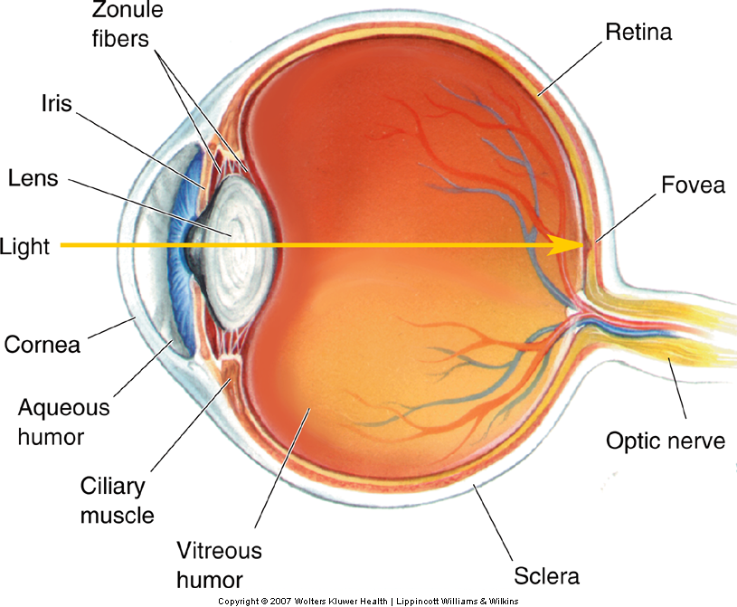
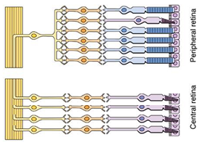
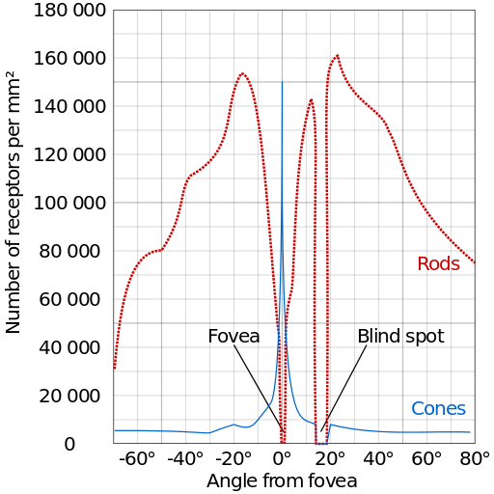
Distribution of Rods & Cones across Retina
Peripheral retina
v
fovea
Central retina
Blind spot
Peripheral retina

Slide 26
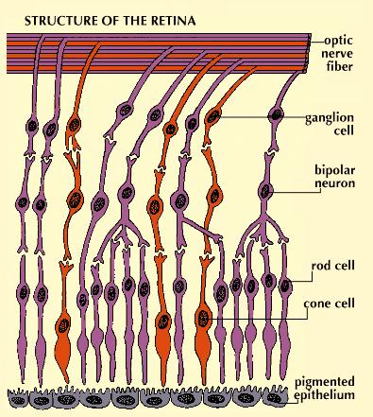
Synaptic pattern of Photoreceptors
High degree of convergence
reduces resolution in rod system, whereas 1:1 relationship of cones to bipolar and ganglion cells increases the resolution or visual acuity.
Rod
Cone bipolar
neuron

Slide 27
Rods vs. Cones
Rods | Cones
Used for scotopic vision (vision under low light conditions) or night vision | Used for photopic vision (vision under high light conditions) or day vision
Very light sensitive | Not very light sensitive
Loss causes night blindness | Loss causes legal blindness
Low visual acuity (poor resolution) as many rods are connected to one bipolar cells showing a high degree of convergence | High visual acuity; better spatial resolution as each cone is connected to one bipolar cell
Not present in fovea | Concentrated in fovea
Outer segment is rod shaped | Outer segment is cone shaped
Confer achromatic or monochromatic vision | Confer color vision (trichromatic vision)
Stacks of membrane-enclosed disks are unattached to cell membrane directly | Disks are attached to outer membrane
About 120 million rods distributed around the retina (peripheral vision) | About 6 million cones distributed in each retina (central vision)
One type of photosensitive pigment (Rhodopsin) | Three types of photosensitive pigments in humans (blue, green and red cones)

