Slide 1
Hemolytic anemia
Dr. Bushra AlTarawneh, MD
Anatomical pathology Mutah University School of Medicine- Department of Laboratory medicine & Pathology HLS lectures 2021

Slide 2
Hemolytic anemia Hemolysis could be due to: 1. Intrinsic factors (look for inherited disease, or history of life long anemia, or family history of anemia, gallstones, and jaundice) 2. Infection 3. plasma factors 4. Mechanical

Slide 3
Hemolytic anemia
Immune
Non-Immune

Slide 4
Hemolytic anemia Hemolysis could be: 1. Intravascular 2. extravascular (areas of sluggish circulation or hypo-oxygenation)

Slide 5
https://slideplayer.com

Slide 6
Hemolytic anemia Hemolysis could be: 1. Intracorpuscular: a.Hereditary defects 1.Defects in RBC membrane 2.Enzyme defects 3.Hemoglobinopathies 4.Thalassemia syndromes b. Acquired Defects 1. PNH 2. extracorpuscular (areas of sluggish circulation or hypo-oxygenation) Immunhemolytic anemia, Infections, Microangiopathic,…

Slide 7
https://www.slideshare.net

Slide 8
https://www.thinglink.com

Slide 9
Features of Hemolytic Anemia (Intra- and Extravascular)
Shortened RBCs survival
Elevated erythropoietin level leading to increased erythrpoiesis and early release of RBCs from marrow
Reticulocytosis
Accumulation of products of Hb. Catabolism
Elevation in ind. Bilirubin and LDH

Slide 10
Clues? Intravascular Hemolysis: *Hburia, Hbemia, and Hemosiderinuria *Marked decrease in Haptoglobin “almost absent” Extravascular Hemolysis: *More common *No Hburia, Hbemia, and Hemosiderinuria *Mild decrease in Haptoglobin *Splenomegaly

Slide 11
Marrow Response To Hemolysis
Erythroid hyperplasia with decreased M:E ratio, it may reach 1:5. ( normal ratio is 4.5 :1)
In chronic cases, EMH may take place.
Erythropoiesis can increase up to 8 times its normal level. Therefore hemolysis may take place without development of anemia.
Anemia develops if:
Rate of hemolysis increases beyond the compensatory rate (hemolytic crisis).
The BM stops producing RBCs (aplastic crisis)

Slide 12
Hemolytic anemia
Approach:
Establish the presence of Hemolysis:
* Serum unconjugated bilirubin
* Serum Haptoglobin
* Smear positive/negative

Slide 13
NORMAL HUMAN HEMOGLOBINS
Hemoglobin A (α2 β2): 96% of adult hemoglobin, 5% is composed of glycosylated Hb A (Hb A1c)
Hemoglobin F (α2γ2) :
75% at birth
< 5% at 6 months
< 1% in adults
Hemoglobin A2 (α2δ 2): 3% of adult hemoglobin

Slide 15
(1) SICKLE CELL DISEASE
Most common familial hemolytic hemoglobinopathy
Molecular basis: one base pair mutation resulting in the substitution of valine for the glutamic acid at the 6th position of the β chain of Hb.
Physiologic consequences of the intracellular polymerization process:
Ca influx, efflux of K and water, ↑ MCHC
Accelerated red cell destruction (life span decreased from a normal 120 days to 10-12 days).
Released Hb. Inactivates NO → vessels narrowing
Vaso-occlusive phenomena.

Slide 16
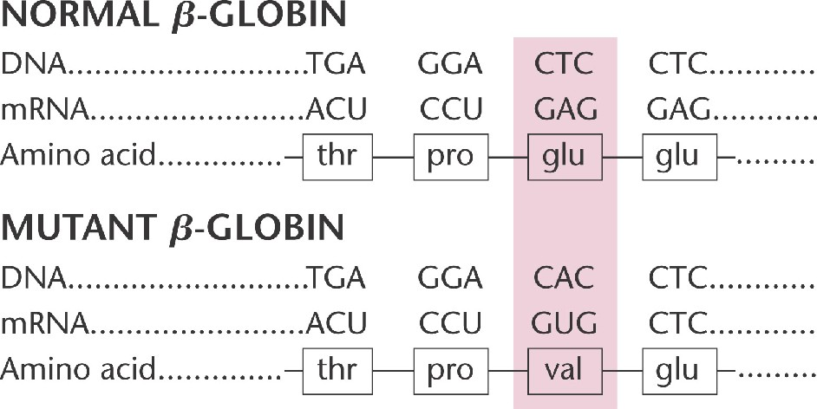

Slide 17
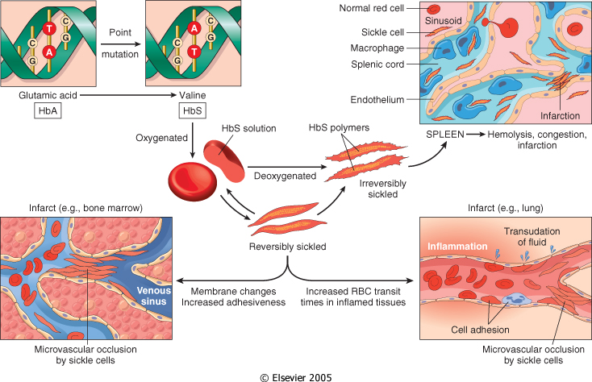

Slide 18
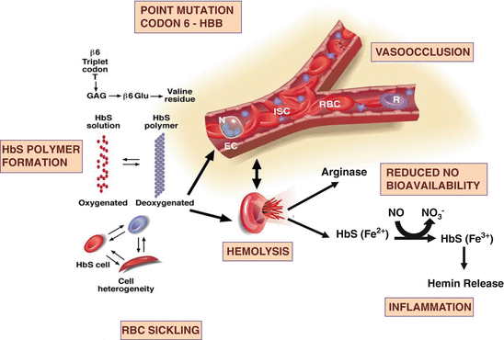

Slide 19
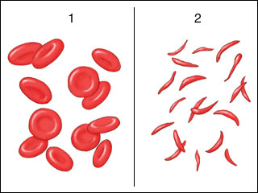
Normal RBCs
Sickled RBCs

Slide 20
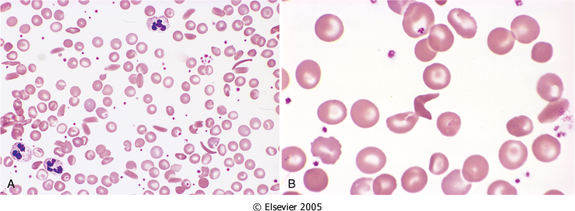

Slide 21
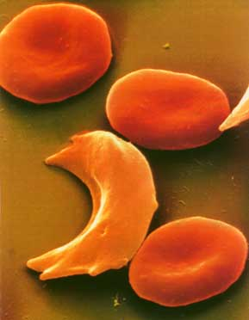
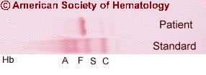

Slide 23
FACTORS AFFECTING THE DEFGREE OF SICKLING
Type of Hb
Hb. Concentration
Blood circulation
Notes:
23

Slide 24
FACTORS AFFECTING THE DEFGREE OF SICKLING
(1) Type of Hb
Heterozygous HbA: HbS 50:50
Homozygous HbS: 100%
HbF: High levels protect against sickling.
Other hemoglobinopathies:
SC (moderate)

Slide 25
FACTORS AFFECTING THE DEFGREE OF SICKLING
(2) Hb. Concentration
Alpha thalassemia: lowers MCHC and sickling.
Notes:
25

Slide 26
FACTORS AFFECTING THE DEFGREE OF SICKLING
(3) Blood circulation
*Spleen and BM: sluggish blood flow…more sickling
*Inflammation: slows the flow by increasing the adhesion of leukocytes and RBC’s
Notes:
26

Slide 27
CLINICAL CONSEQUENCES OF SICKLING
(1) Chronic hemolysis.
(2) Ischemic manifestations (microvasculature obstruction):
bones, liver, kidneys, skin, retina,…etc.
Crises:
Vaso-occlusive or painful crises
Aplastic crises
Hemolytic crises
Increased risk of infections.

Slide 28
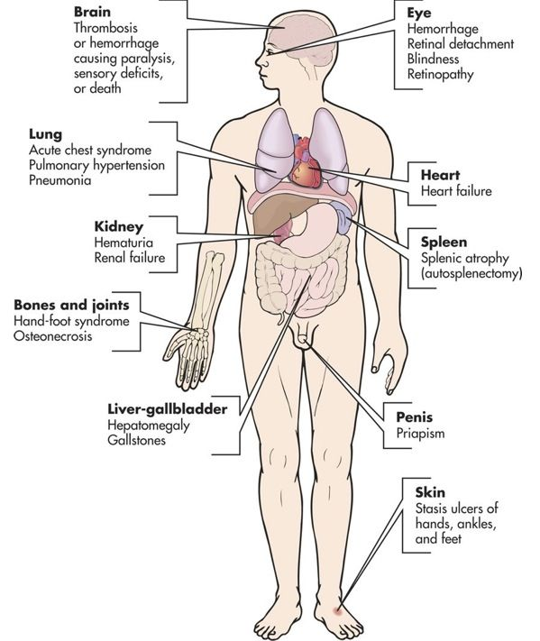
https://www.pinterest.com

Slide 29
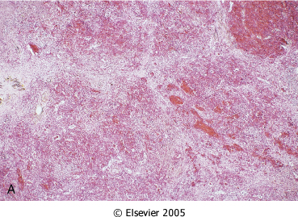
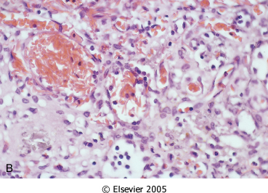
Spleen in Sickle Cell Anemia

Slide 30
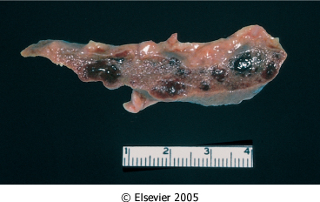
Figure 13-12: Splenic remnant in sickle cell anemia. (Courtesy of Drs. Dennis Burns and Darren Wirthwein, Department of Pathology, University of Texas Southwestern Medical School, Dallas, TX.)

Slide 31
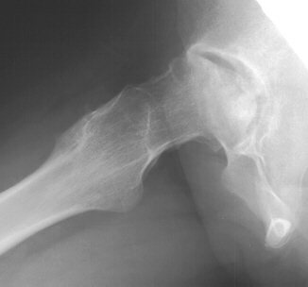
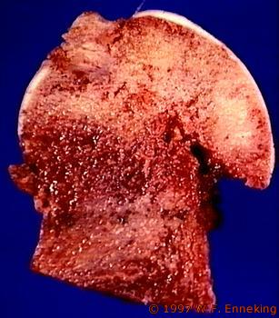
Femoral head necrosis

Slide 32
DX.
Clinical History:
Asymptomatic till 6 months of age.
Moderate to severe anemia (6-8 g/dl).
Unremitting course punctuated by sudden crises.
CBC and blood smear
Hemoglobin electrophoresis

Slide 33
Rx. 1- Adequate hydration 2- Pain relief 3- Antibiotic therapy 4. In severe cases, exchange transfusion to reduce the Hgb S.

Slide 34
(2) Thalassemia

Slide 35
FEATURES OF THALASSEMIA
Inherited
Decreased globin chain synthesis leading to hypochromic microcytic anemia.
Unbalanced Hb synthesis leading to formation of tetramers of single chain:
Hgb Barts ( γ4)
Hgb H ( β4)
α4 precipitate
Resulting in ineffective erythropoiesis and hemolysis
Elevated levels of Hgb A2 and Hgb F.

Slide 36
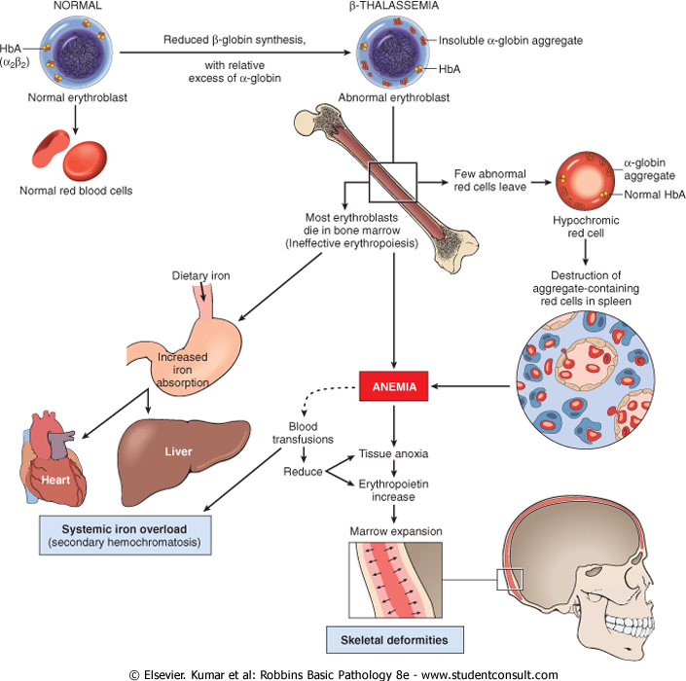
Downloaded from: StudentConsult (on 30 January 2012 05:46 PM)
© 2005 Elsevier

Slide 37
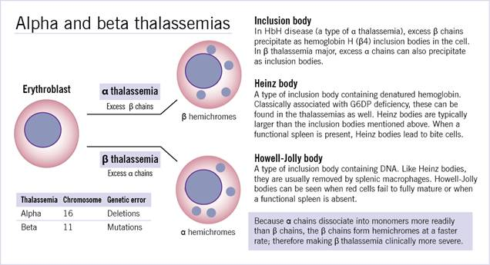

Slide 39
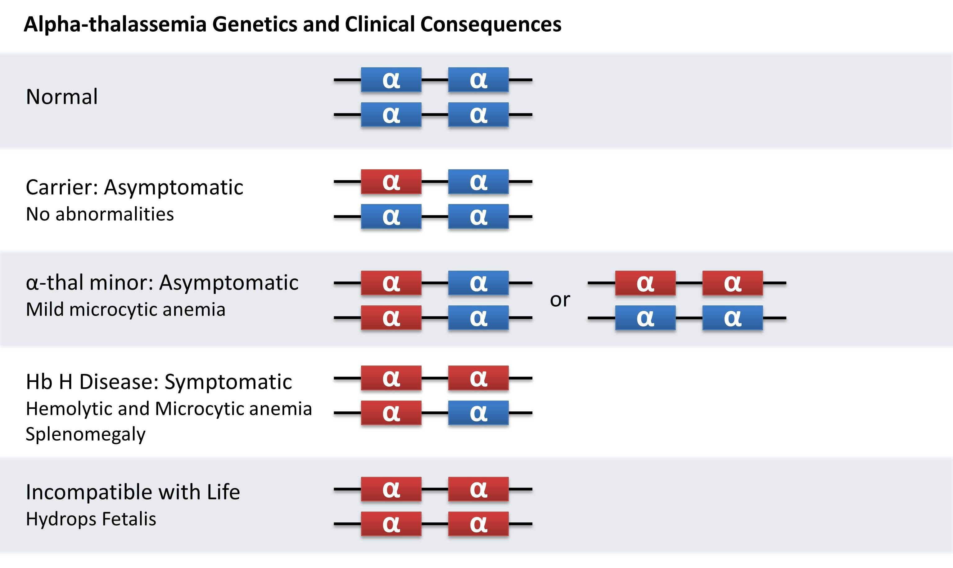

Slide 40
Hemoglobin H Disease
Three gene deletion
Moderately severe chronic hemolytic anemia
(Less damage than free α in β Τhalassemia)
Formation of HbH (tetramer of 4 β chains)
HbH has high affinity to oxygen (O2 dissociation curve similar to myoglobin)
HbH is unstable, and leads to shortened red cell life span.
Seen primarily in Asian populations
Stress by infection or exposure to toxic drugs may exacerbate the condition compromising the already anemic patient.

Slide 41
Common mutations resulting in b-thalassemia
Promoter region mutations usually result in β⁺ thalassemia.
Mutations within the exons result in b⁰ thalassemia.
Mutations interfering with mRNA processing lead to either b⁺ or b⁰ thal. depending on effect of the mutation.

Slide 42
Common mutations resulting in beta-thalassemia
Point mutation:
Splicing point
Promoter
Stop codon
Downloaded from: StudentConsult (on 30 January 2012 05:46 PM)
© 2005 Elsevier

Slide 44
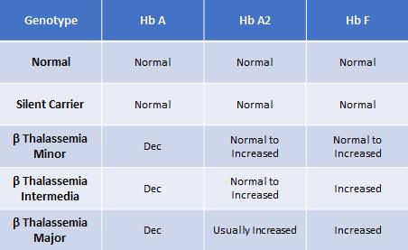

Slide 45
Thalassemia Major
Genotype: β⁰/β⁰, β⁺/β⁺, β⁰/β⁺
Age of manifestations: 6-9 months
Hb. Level: 3-6 gm/dl (if untransfused)
Transfusion dependent
Hypochromic microcytic RBCs, Anisocytosis, poikilocytosis, basophilic stippling, target cells, fragmented cells
Reticulocytosis, nucleated RBCs

Slide 46
Thalassemia Major
Very high HbF, absent or decreased HbA
Expansion of bone marrow: facial bone, and skull changes
Extramedullary hematopoiesis and hepatosplenomegaly
Stunted growth and cachexia
Secondary hemochromatosis

Slide 47
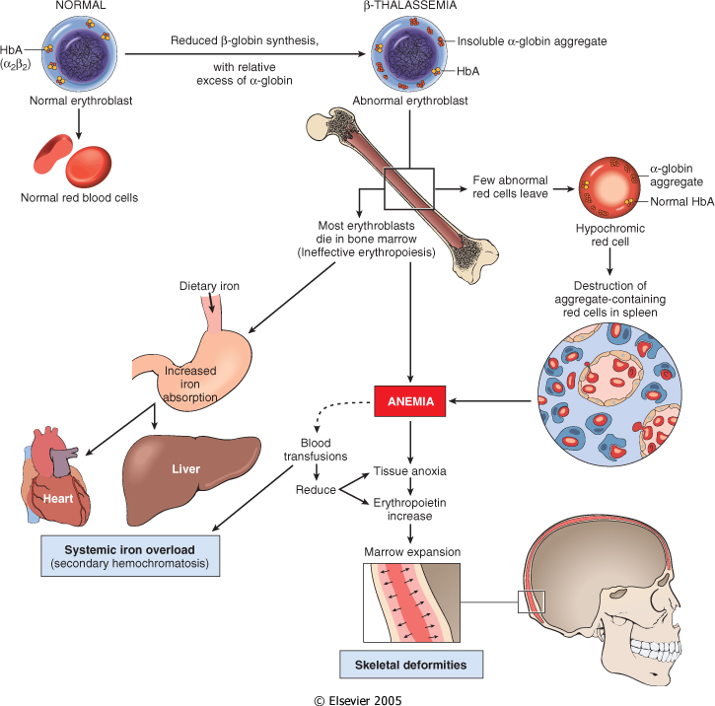

Slide 48
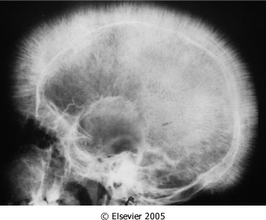

Slide 49
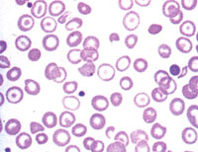
Hypochromic microcytic RBCs in Thalassemia

Slide 50
Thalassemia Minor
Heterozygous for β⁰ ορ β⁺ gene
increased HbA2 (> 3.5%) and/or HbF (1- 10%)
Mild microcytic anemia (Hb 9-11 g/dL), target cells, possibly an enlarged spleen and basophilic stippling, target cells
Differential Dx: Iron deficiency anemia
Genetic counseling

Slide 51
(3) GDPD Deficiency (HNSHA)

Slide 52
Role of glucose-6-phosphate dehydrogenase (G6PD) in defense against oxidant injury
The disposal of H2O2, a potential oxidant, is dependent on the adequacy of reduced glutathione (GSH), which is generated by the action of NADPH. The synthesis of NADPH is dependent on the activity of G6PD

Slide 53
GLUCOSE-6-PHOSPHATE DEHYDROGENASE (G6PD)
The GD gene coding for G6PD is located on the telomeric region of the long arm of chromosome X.
G6PD is important in generating NADPH which is needed for generating GSH.

Slide 54
G6PD DEFICIENCY
200 millions affected worldwide.
Reduced GSH causes hemolysis in cells exposed to oxidant agent.
In the A- (African) type, Normal enzyme but decrease t1/2
patients are asymptomatic unless exposed to oxidizing agent. Only aging A- RBCs have decreased G6PD.
(Med) Mediterranean type more severe; Enzyme deficiency
patients are asymptomatic until exposed to oxidizing agent. Severe forms produce continuous hemolysis

Slide 55
G6PD DEFICIENCY
The majority of patients are asymptomatic most of the time and go through life without ever being aware of their genetic trait.
Hemolysis after a lag of 2-3 days
Males more vulnerable than female (heterozygous)
Hemolysis due to oxidant stress
Drugs: eg. Antimalarials, sulfonamides, furantoins,…etc.
Favism
Products of free radicals in infections.
Oxidation leads to denaturation of globin chains, and precipitation at membranes forming Heinz bodies.
RBCs: Bite cells and Heinz bodies
Features of Extra/Intravascular hemolysis
Features of chronic hemolysis

Slide 56
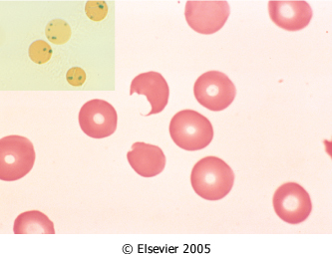

Slide 57
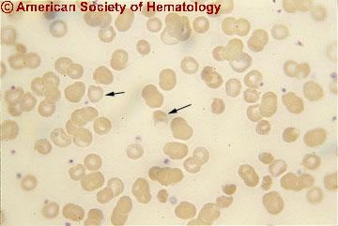
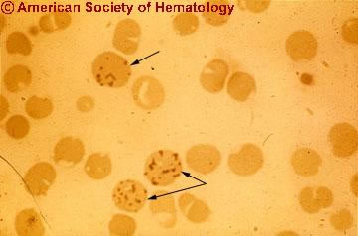

Slide 58
(4) HEREDITARY SPHEROCYTOSIS

Slide 59
Non-immune
Weaken vertical interaction between membrane skeleton and intrinsic protein (band 3)….membrane vesicles…shed of membrane and little cytoplasm….as a result surface area to volume ratio (S/V) decreased…spherocytes result “less deformability”

Slide 60
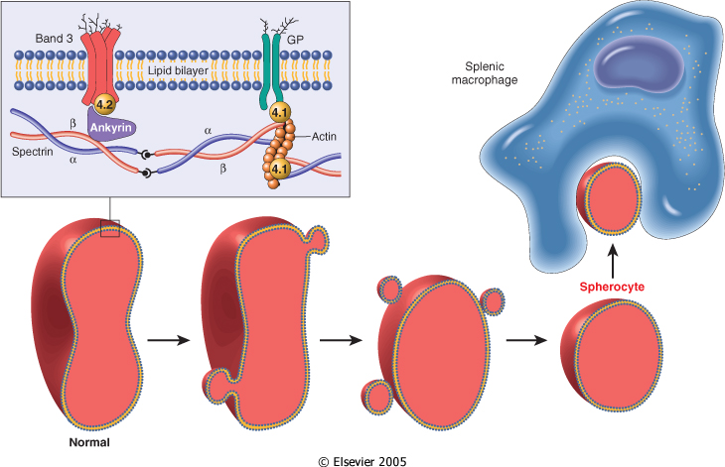
Schematic representation of the red cell membrane cytoskeleton and alterations leading to spherocytosis and hemolysis. Mutations weakening interactions involving &alpha;-spectrin, &beta;-spectrin, ankyrin, band 4.2, or band 3 all cause the normal biconcave red cell to lose membrane fragments and adopt a spherical shape. Such spherocytic cells are less deformable than normal and therefore become trapped in the splenic cords, where they are phagocytosed by macrophages.

Slide 62
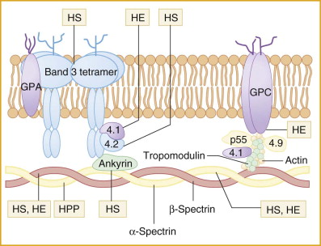

Slide 63
HEREDITARY SPHEROCYTOSIS
Etiology: mutations in (ABS) : Spectrin, Ankyrin, and band 3
General features:
Autosomal dominant, 20% mutation (AR worse)
Spherocytes in peripheral blood
High reticulocyte count
Splenomegaly (500-1000 gm)
Mildly elevated indirect bilirubin
Increased osmotic fragility especially after incubation for 24 hours at 37ºC (in hypotonic)
Splenectomy helps in correcting anemia

Slide 64
HEREDITARY SPHEROCYTOSIS
Anemia, splenomegaly and jaundice
Severity of anemia correlates with spectrin deficiency.
Severe HS (10%); transfusion dependent
Mild HS (20%), no anemia (erythropoiesis compensates for production)
Typical HS (70%); moderately severe anemia
Clinical course often is stable but may be punctuated by aplastic crises.

Slide 65
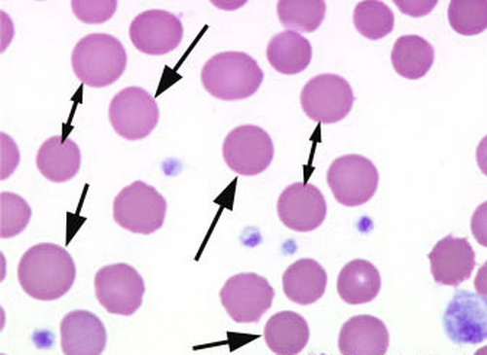

Slide 66
HEREDITARY SPHEROCYTOSIS
Complications:
Gallbladder stones
Foot and lower leg ulcers
Aplastic crisis
Skeletal abnormalities (severe cases)

Slide 67
Immune Hemolytic Anemia
Due to antibodies
Antibodies may arise spontaneously or be induced by exogenous agent such as chemicals or drugs.
Uncommon and classified according to:
The nature of the antibody
The presence of predisposing conditions.

Slide 68
Immune Hemolytic Anemia Three broad categories: 1. Alloimmune: The patient produces alloantibodies to foreign red cell antigens (transfusion, pregnancy, or organ transplant) 2. Autoimmune: Autoreactive antibodies (loss of self recognition of individual's own red cell antigen) 3. Drug-induced: Antibodies against red cells coated with drug or it is metabolites.

Slide 69
Hemolytic Anemia due to Autoantibodies
Warm Antibody: IgG/IgA type
Activated at body temp. (37 c)
Opsonization, phagocytosis and spherocytosis
80% of immune hemolytic anemias
Primary (50-70%)
Secondary:
lymphomas &leukemias
Hepatitis B and A
SLE
Drugs
Cold Antibody: IgM type active at 0-4ºC
(seasonal) or at periphery (fingers, toes)
IgM/C3b: late complement fixation does not occur, blood moves to warm are (spleen)
Dissociation of IgM and Opsonization through C3b in spleen (extravascular hemolysis)
IgM agglutination (Raynaud phenomena)
Acute
Infectious mono
Mycoplasma
Chronic:
idiopathic
Lymphomas
Cold hemolysin (paroxysmal cold hemoglobinuria 1-7%)
IgG type
Post infections: measles, mumps, mycoplasma, others

Slide 71
Paroxysmal Nocturnal Hemoglobinuria (PNH)
Acquired clonal stem cell disorder result from somatic (non germline) mutation in myeloid stem cell.
Characterized by production of abnormal RBCs, granulocytes and platelets.
RBC's are susceptible to destruction by complement.
Deficiency or decrease of:
CD55 (DAF)
CD59 (MIRL)
C8 binding protein
CD58
CD14, CD24, CD16
All these proteins are attached to anchor protein phophatidylinositolglycal (PIG) which is affected in PIGA mutation

Slide 72
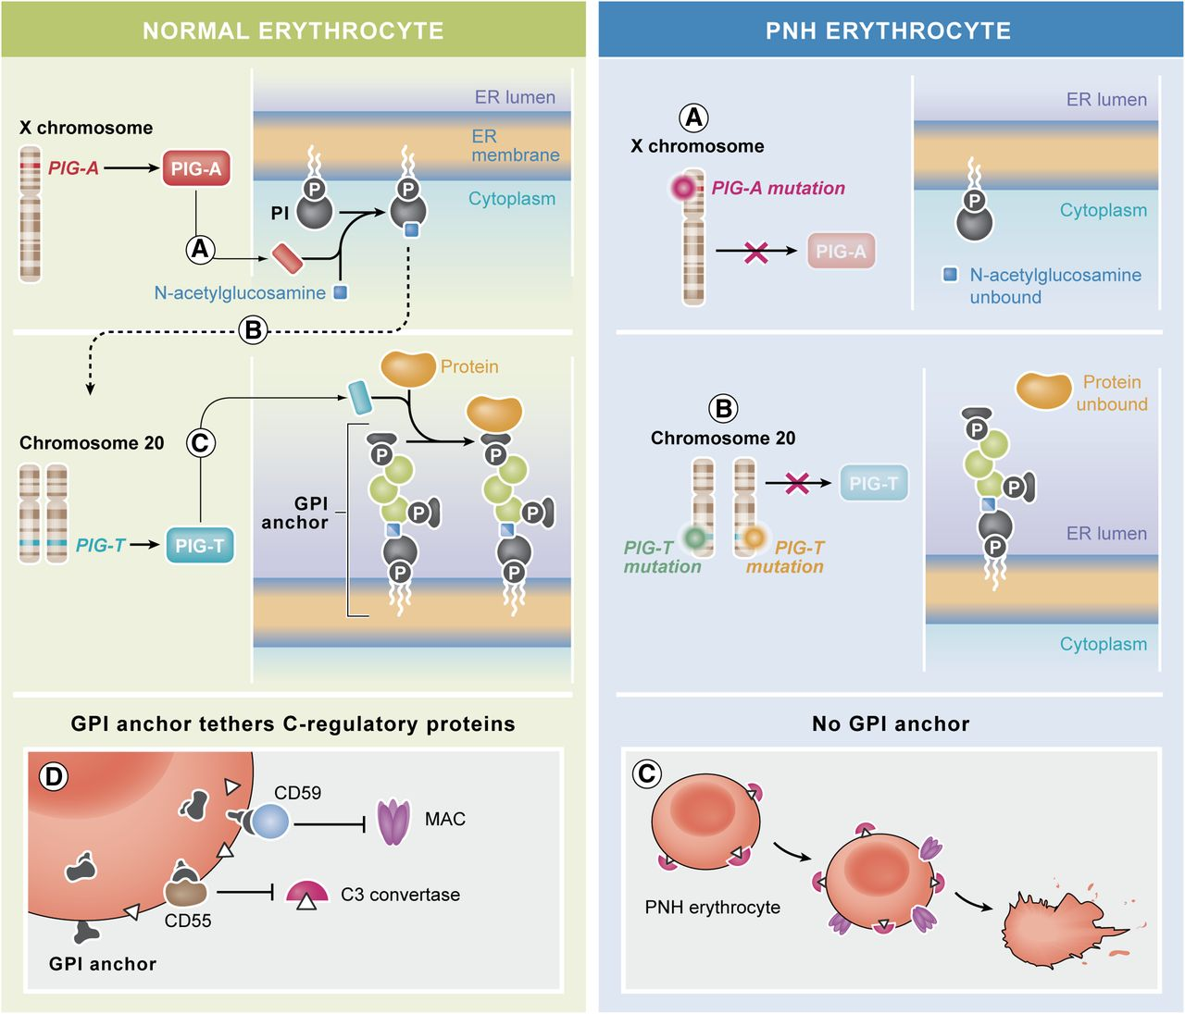

Slide 74
PNH
Somatic mutation:
Occurs after conception
In all cells except eggs and sperms
Not passed to children
PIGA gene is X-Linked (on X-chromosome)
Young adults
Chronic hemolysis with hemosiderinuria with or without hemoglobinuria
Normochromic normocytic anemia. Less commonly, microcytic hypochromic
Reticulocytosis
Venous thrombosis
Flow cytometry for expression of CD55, CD58, CD59

Slide 75
Hemolytic anemias due to mechanical trauma to RBCs
Etiology
Artificial valves
March hemolysis
Microangiopathic hemolytic anemia
DIC
Malignant hypertension
TTP
Hemolytic uremic syndrome
Morphology
Significant poikilocytosis with helmet cells, triangular cells and schistocytes

Slide 76
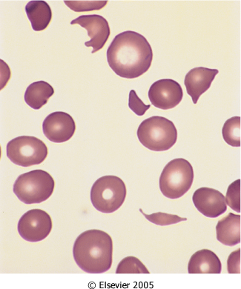

Slide 77
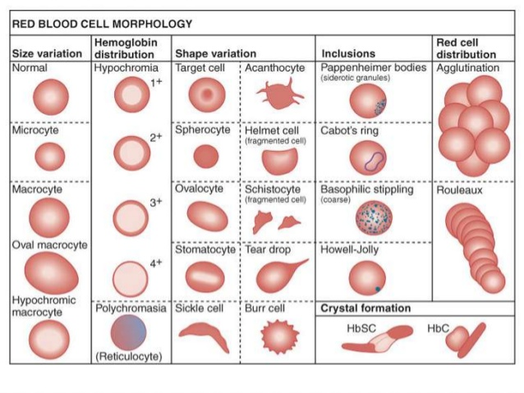

Slide 78
