Slide 1
Lower Limb foot
Dr Amal Albtoosh
2021

Slide 3
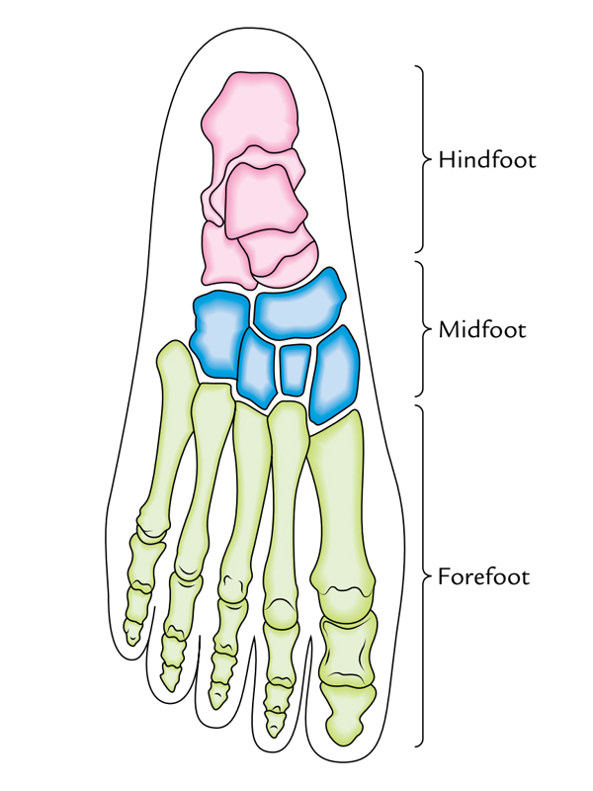

Slide 4
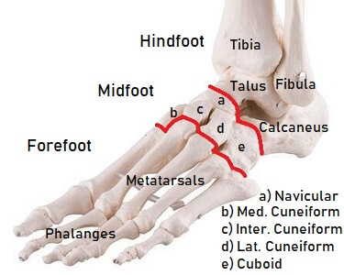
Bones of the Foot
The bones of the foot are:
the tarsal bones (7 bones)
the metatarsal bones (5)
and the phalanges (14)

Slide 5
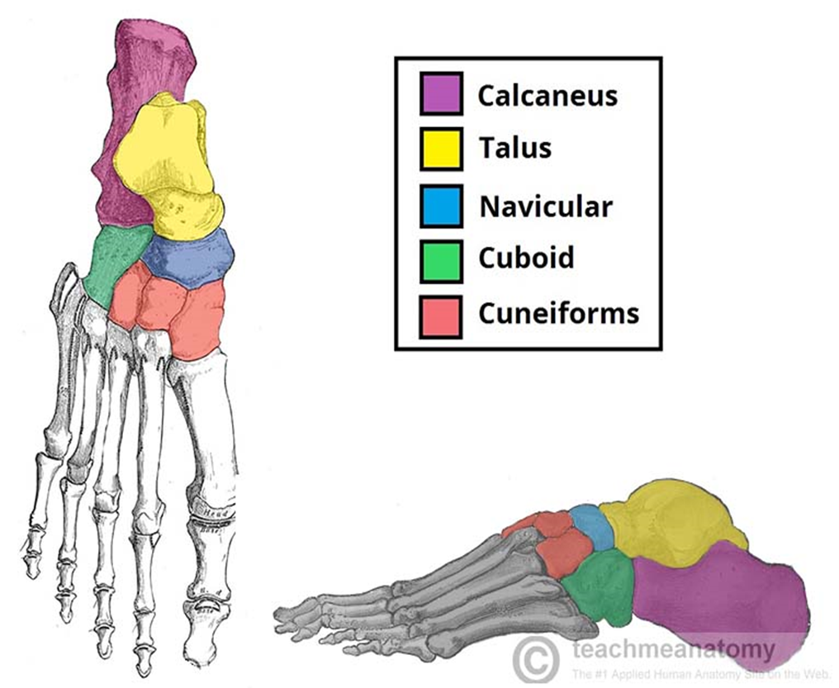
TARSAL BONES
The tarsal bones are the:
Calcaneum (or calcaneus) "heel-bone”,
the talus (anklebone),
the navicular (boat-shaped),
the cuboid,
and the three cuneiform (wedge’) bones.

Slide 6
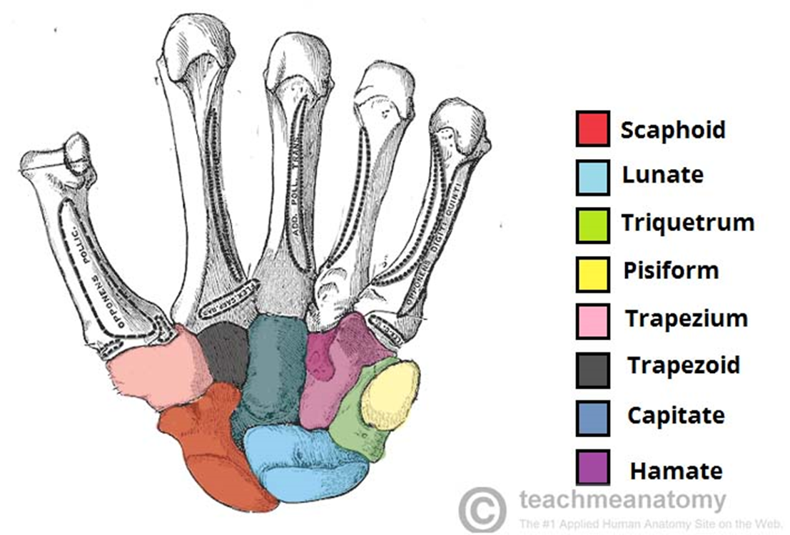
Carpal bone [ for comparison]

Slide 7
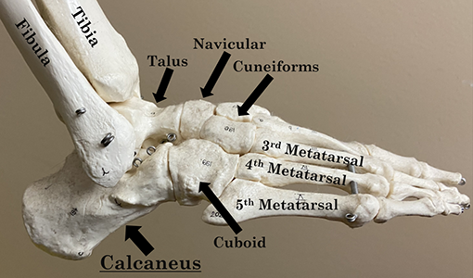

Slide 8
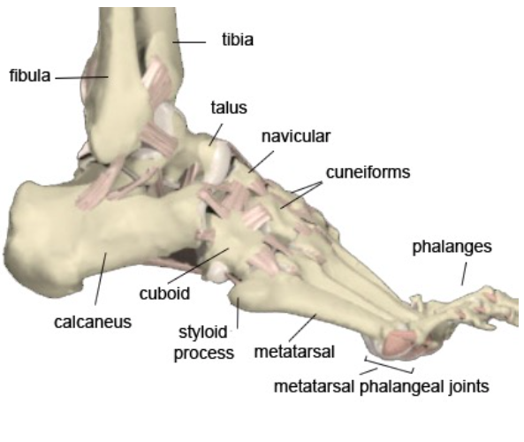
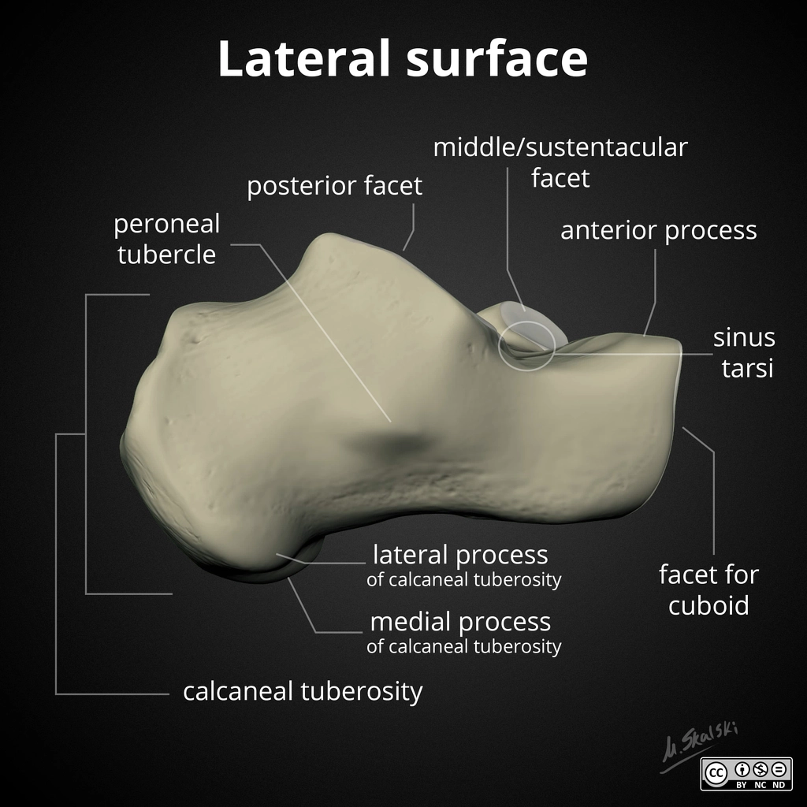
TARSAL BONES
Calcaneum
The calcaneum is the largest bone of the foot. It articulates above with the talus and in front with the cuboid bone.
The posterior surface forms the prominence of the heel
the medial surface possesses a large, shelf like ridge (the sustentaculum tali)
(the sustentaculum tali) that assists in supporting of the talus.

Slide 9
Muscles of the foot
The muscles acting on the foot can be divided into two distinct groups; extrinsic and intrinsicmuscles.
The extrinsic muscles arise from the anterior, posterior and lateral compartments of the leg.
They are mainly responsible for actions such as eversion, inversion, plantarflexion and dorsiflexion of the foot.
The intrinsic muscles are located within the foot and are responsible for the fine motor actions of the foot, for example movement of individual digits.
the intrinsic muscles of the foot can be divided into those situated on the dorsum of the foot, and those in the sole of the foot.

Slide 10
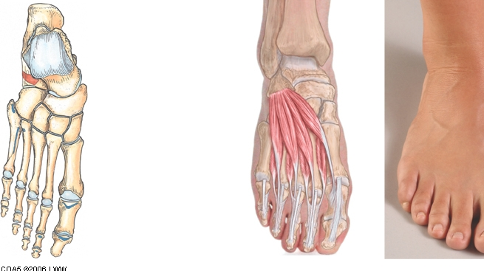
Dorsal Aspect/ Foot
many of the extrinsic muscles attach to the dorsum of the foot, there are only two intrinsic muscles located in this compartment – the EXTENSOR DIGITORUM BREVIS. & Extensor hallucis brevis
mainly responsible for assisting some of the extrinsic muscles in their actions. Both muscles are innervated by the DEEP FIBULAR NERVE

Slide 11
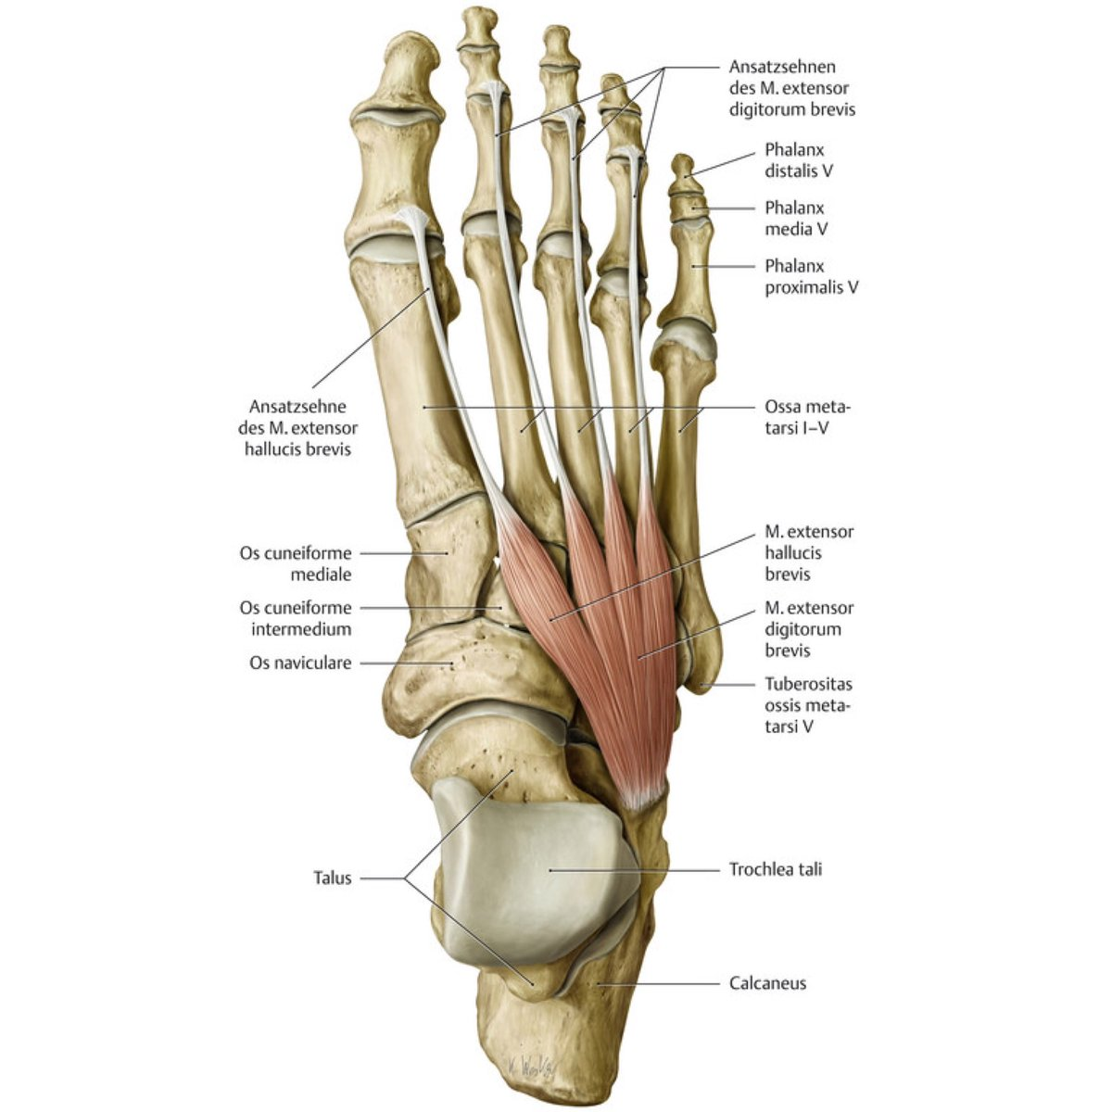
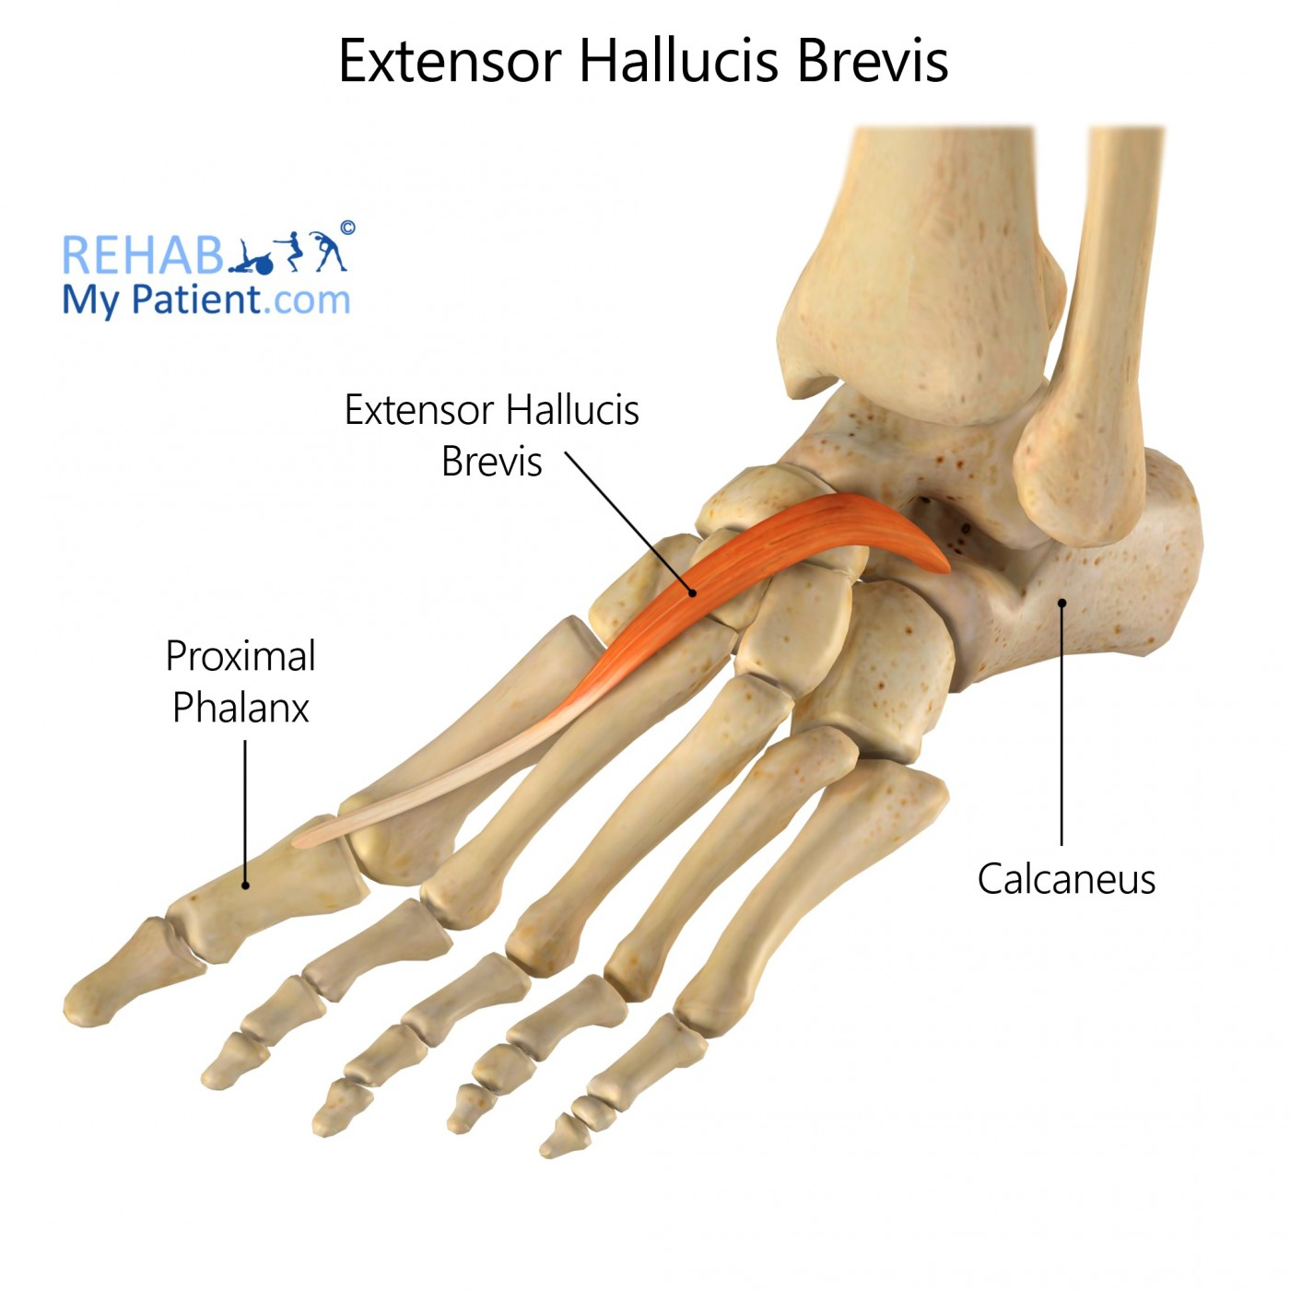

Slide 12
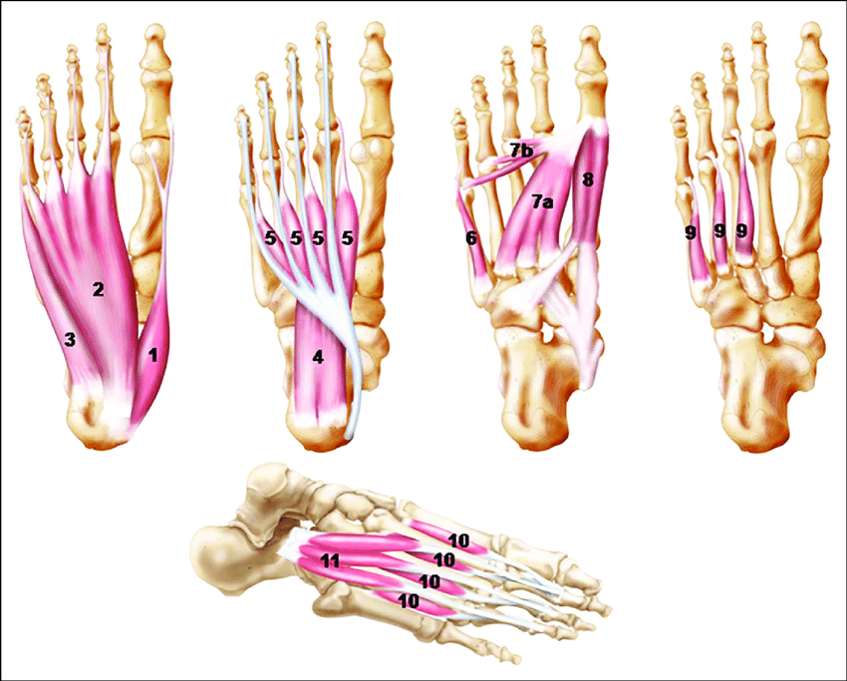
Planter muscles
There are 10 intrinsic muscles located in the sole of the foot.
They act collectively to stabilize the arches of the foot, and individually to control movement of the digits.
All the muscles are innervated either by the medial plantar nerve or the lateral plantar nerve, which are both branches of the tibial nerve.
The muscles of the plantar aspect are described in four layers (superficial to deep).

Slide 13
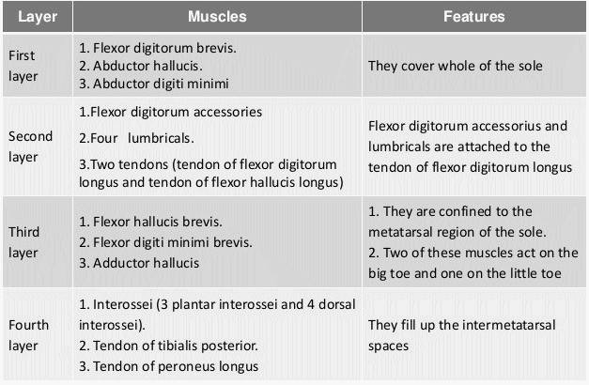
In the second layer flexor digitorum accessories is known as Quadratus plantae
Actually Quadratus plantae is more popular and famous

Slide 14
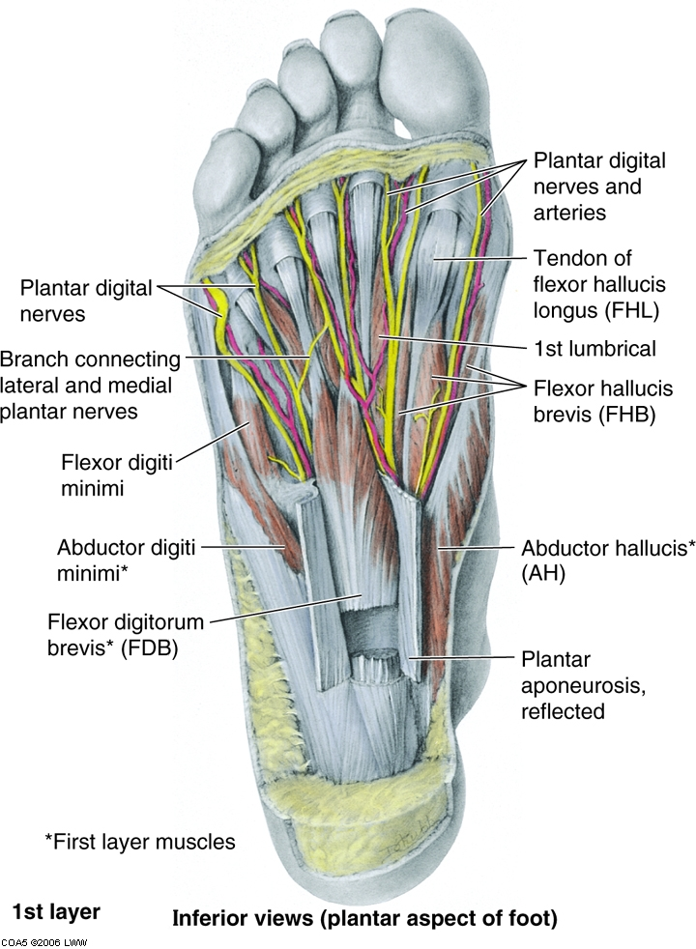
Foot 1
Abductor Hallucis
Flexor Digitorum Brevis
Abductor Digiti Minimi

Slide 15
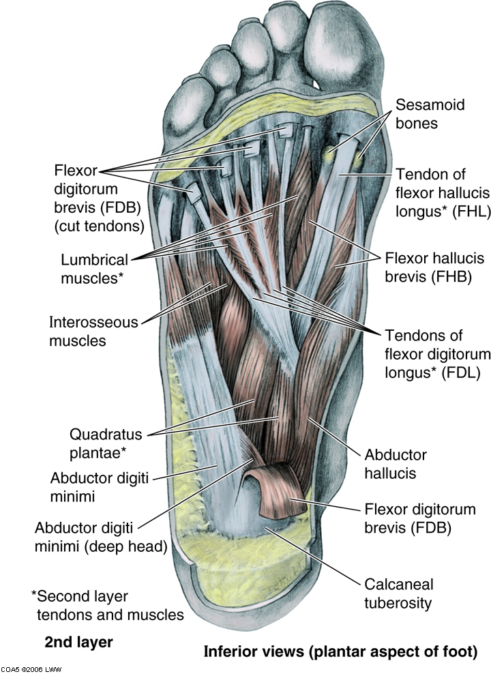
Foot 2
Tendons of long flexors of the toes – Flexor Digitorum Longus and Flexor Hallucis Longus
Quadratus Plantae
Lumbricals

Slide 16
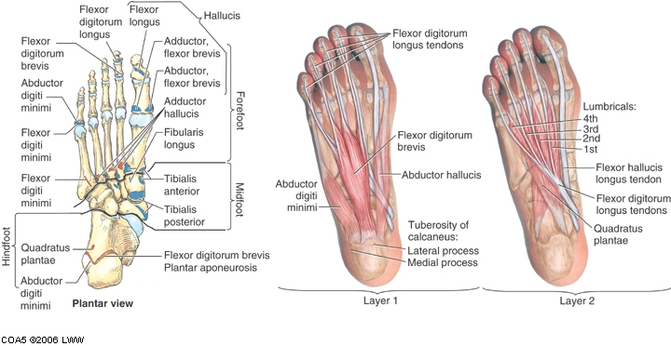
Layers 1&2

Slide 17
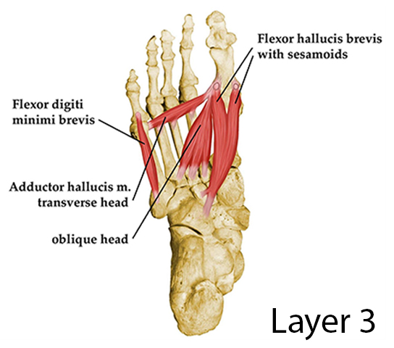
Foot 3
Flexor Hallucis Brevis:
it inserts by splitting to medial and lateral sides attaches to the proximal phalanx of great toe. The insertion tendons containing sesamoid bones
Adductor Hallucis :
It has two heads: transverse and oblique
Flexor Digiti Minimi Brevis

Slide 18
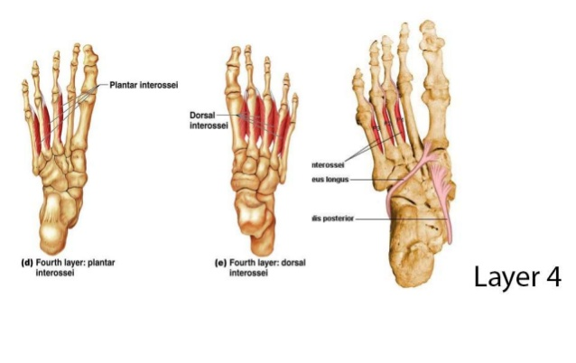
Foot 4
3 Plantar Interossei
ACTION:
PAD – Plantar ADduct
4 Dorsal Interossei
Adjacent sides of Metatarsals 1-5
Insertion of the 1st on med. side proximal phalanx of 2nd digit
Insertion of the 2nd-4th on lat. side proximal phalanx of 2nd -4th digits
ACTION
DAB – Dorsal ABduct

Slide 20
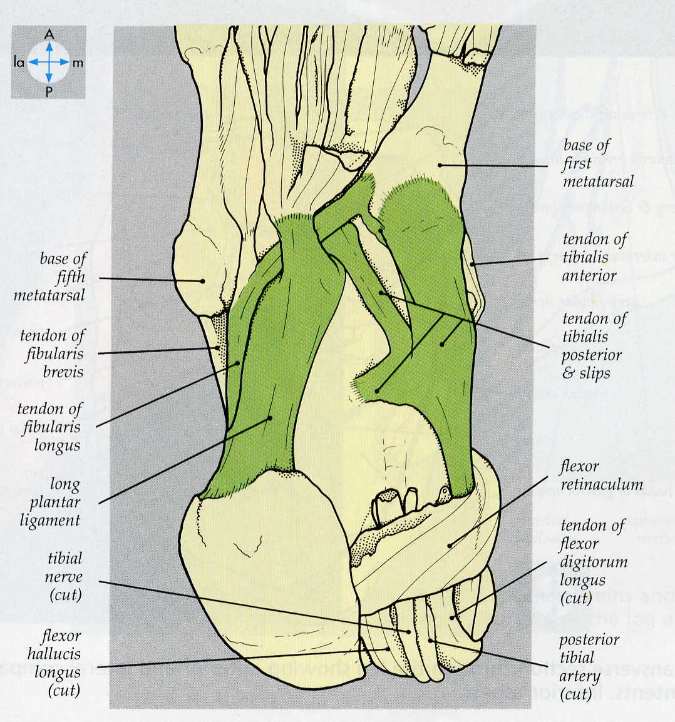
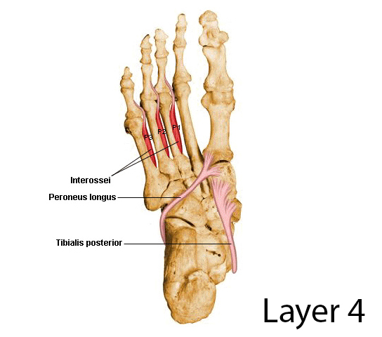
Foot 4 – Tendons and Ligaments
Tendons:
Peroneus (Fibularis) Longus → inserts into Base 1st Metatarsal & Med. Cuneiform
Tibialis Posterior → inserts into Navicular, Med. Cuneiform, Cuboid, Calcaneus, base of Metatarsals 2-4
Ligaments:
Long Plantar Ligament.
Plantar surface of calcaneus → Groove of Cuboid; Base of Metatarsals

Slide 21
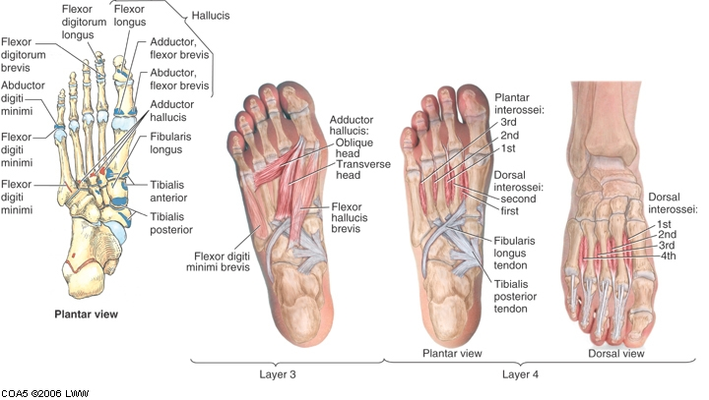
Layers 3&4

Slide 22
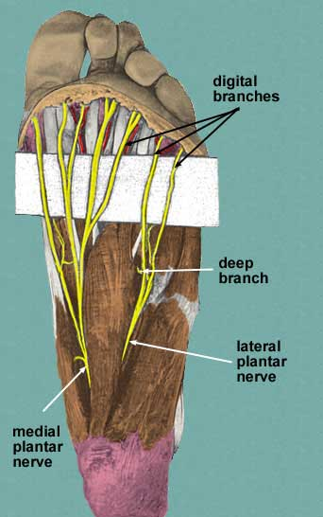
Plantar Nerves
Medial Plantar Nerve:
Abductor Hallucis
Flexor digitorum brevis
Flexor hallucis brevis
Lumbrical to 2nd digit
Lateral Plantar Nerve:
All other muscles

Slide 23
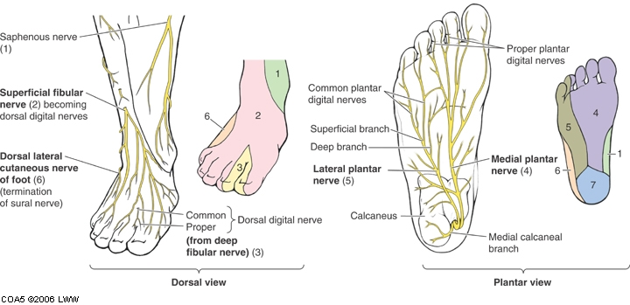
Cutaneous Nerves of the Foot
(from tibial and sural nn.)

Slide 24
To sum up
https://youtu.be/WBTsXyz8n7M

Slide 25
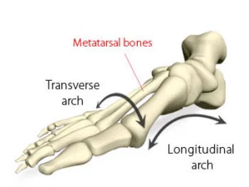
Foot
Tarsal and Metatarsal bones arranged in Longitudinal and Transvers Arches
These improve weight-bearing capabilities and resilience of the foot
Arches:
Distribute weight
Act as Shock absorbers
Act as Spring-boards

Slide 26
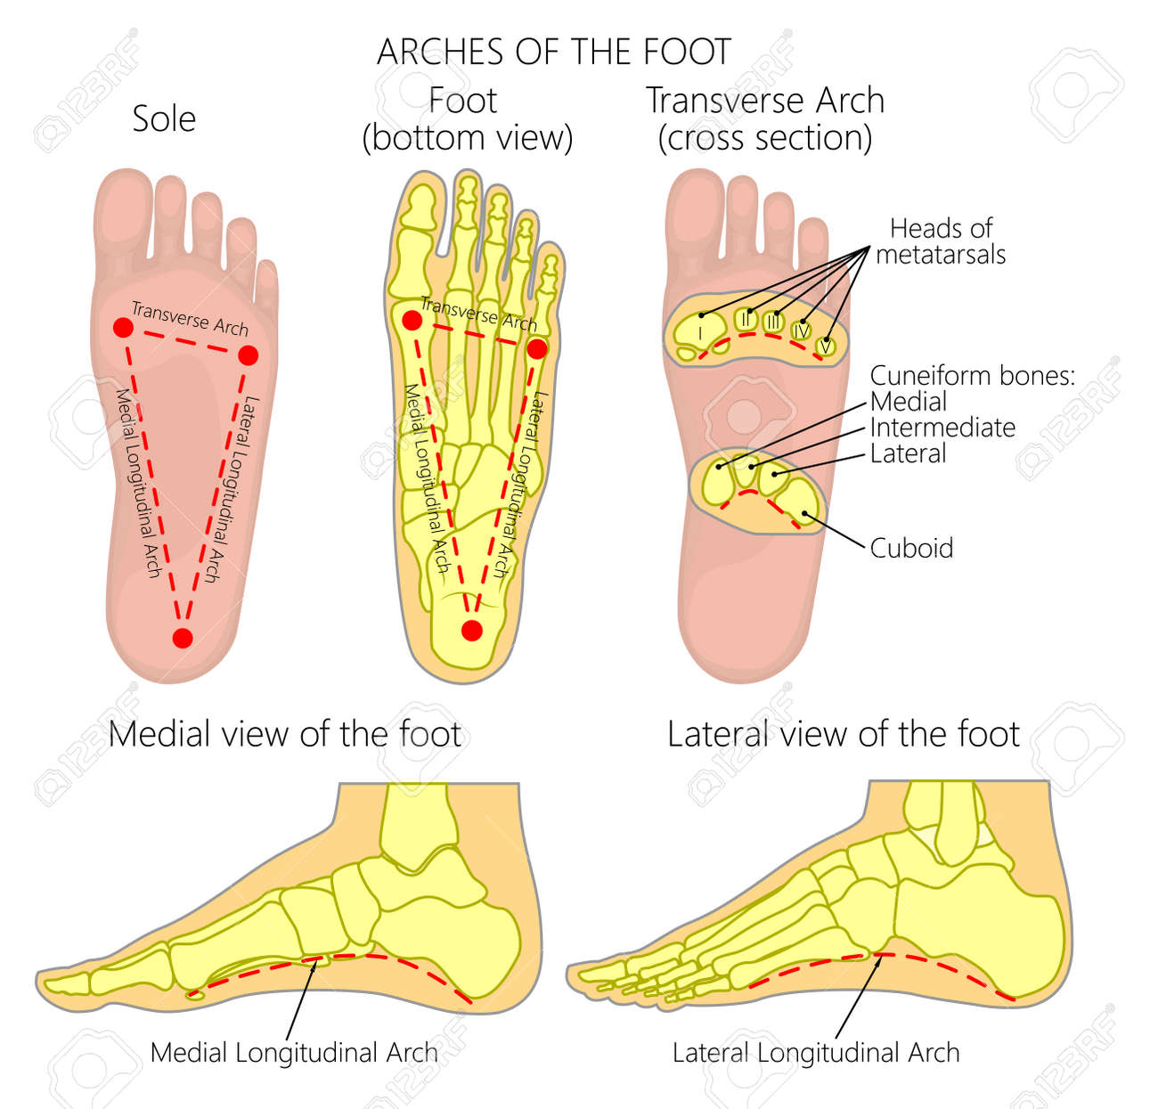

Slide 27
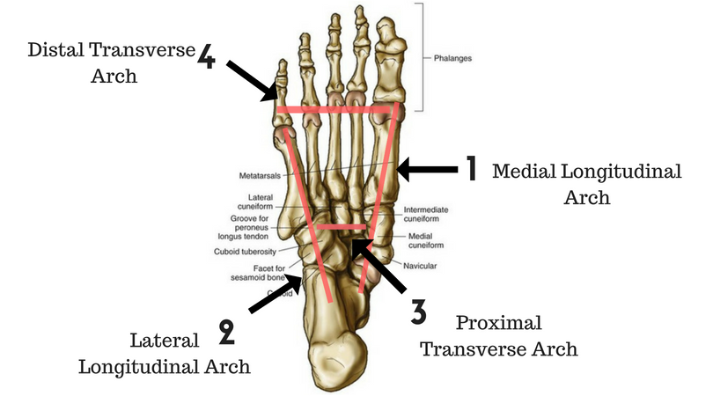

Slide 28
Transverse arch
Supported by:
Tendon of Tibialis Posterior
Tendon of Peroneus (Fibularis) Longus
Adductor Hallucis muscle
Deep Transverse Metatarsal Ligament
a. Proximal (metatarsal) arch
• Is formed by the navicular bone, the three cuneiform. bones, the cuboid bone, and the
bases of the five metatarsal bones of the foot.
• Is supported by the tendon of the peroneus (fibularis) longus.
b. Distal arch
• Is formed by the heads of five metatarsal bones.
• Is maintained by the transverse head of the adductor hallucis.

Slide 29
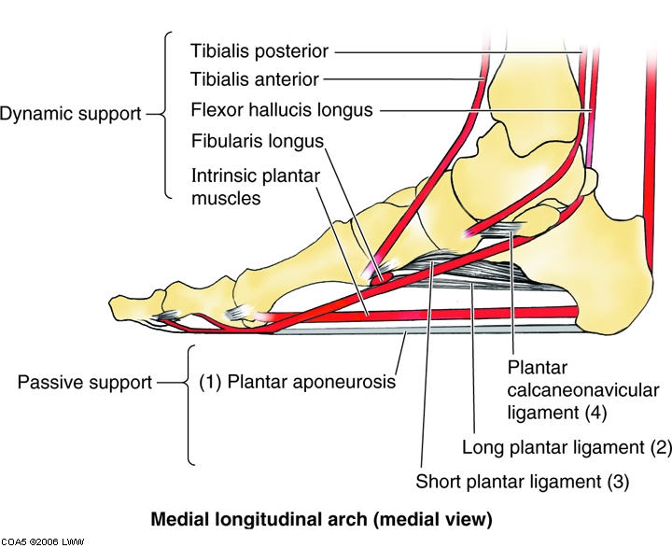
Longitudinal Arch
Supported by muscles, tendons and ligaments

Slide 30
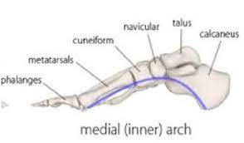
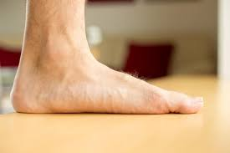
Medial longitudinal arch
Is formed and maintained by the interlocking of the talus, calcaneus, navicular, cuneiform, and three medial metatarsal bones.
Flat foot: is a condition where the medial longitudinal arch disappears or collapses

Slide 31
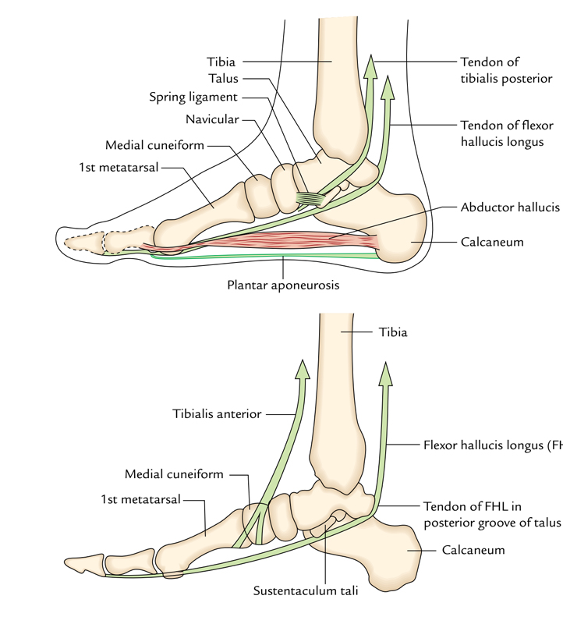
Medial longitudinal arch
Has, as its keystone, the head of the talus, which is located at the summit between the sustentaculum tali and the navicular bone.
is supported by the spring ligament and the tendon of the flexor hallucis longus.

Slide 32
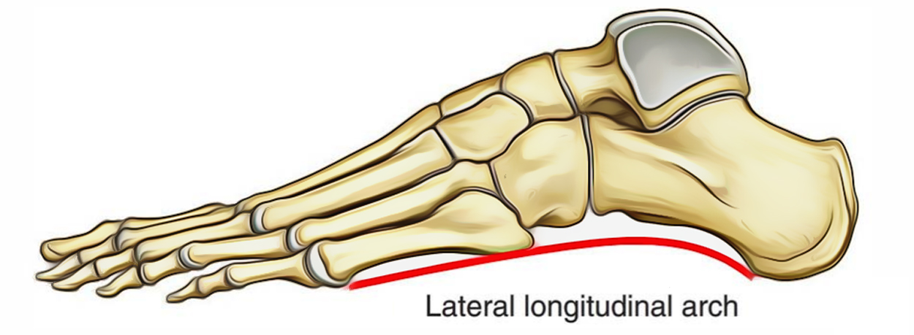
Lateral longitudinal arch
Is formed by the calcaneus, the cuboid bone, and the lateral two metatarsal banes. The keystone is the cuboid bone.
1. Supports the body in the erect position and 2. acts as a spring in locomotion.

Slide 33
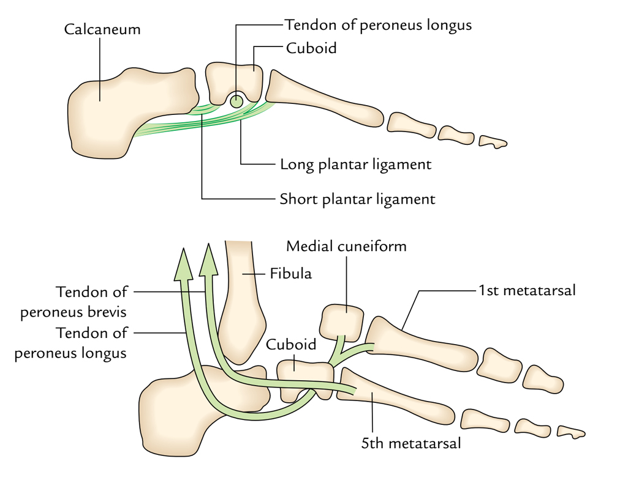
Lateral longitudinal arch
Is supported by the PERONEAL (FIBULARIS) longus AND BREVIS tendons and the long and short plantar ligaments.

Slide 34
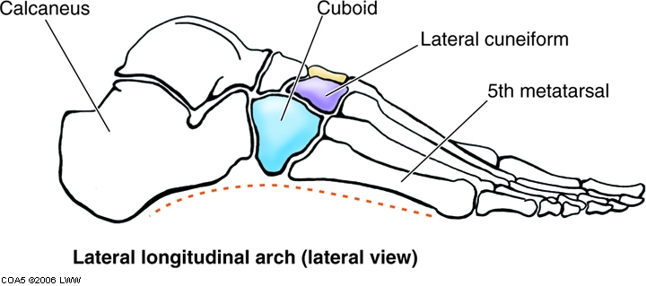
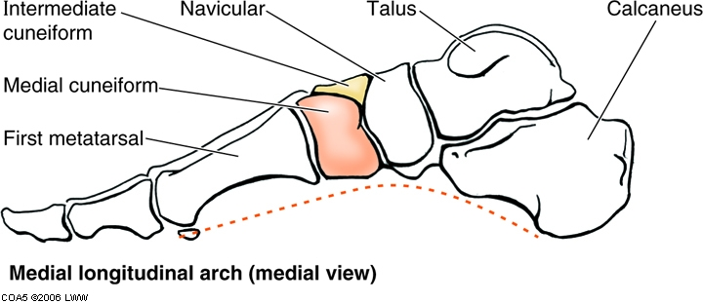
Longitudinal Arch

Slide 35
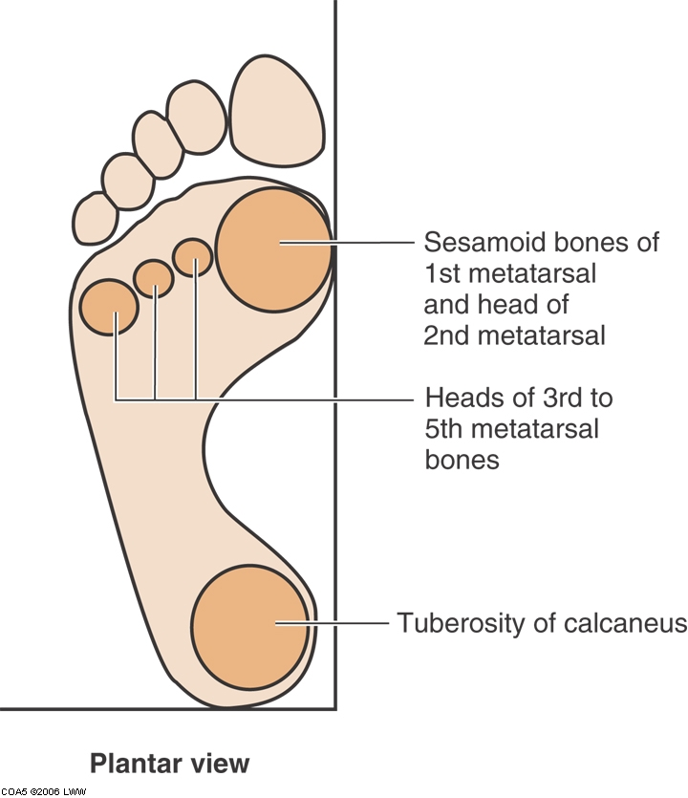
Weight distribution
Weight distributed almost equally between Calcaneus and Heads of Metatarsals

