Slide 1
Puerperium and It’s Complication
Prepared by : Juman Alzaghari
Khaled Samara Suha Khaled
Supervised by:
Dr. Ahlam Alkarabsheh

Slide 2
Definition
The period following delivery of the baby and placenta to about 6 weeks postpartum
The reproductive organs and maternal physiology return toward the pre-pregnancy state.
although menses may not return for much longer.

Slide 3
Objectives
Abnormal puerperium (psychological problem )
The baby blues
Postpartum depression (PPD)
Postpartum psychosis
Bowel function disorder
Micturition problems
Infections
Endocrine problems
Pelvic septic
Thrombophibits
Normal puerperium
Genetical track change
General systemic change

Slide 4
Genetical track change
1- Uterus
A - Uterine involution:- process by which uterus is return to a non-pregnant state after childbirth. It occurs by autolysis of smooth muscle cells by enzymatic digestion. marked mostly in the body of the uterus. - 1000g → 100 – 200 g ( Uterine involution ) in about 3 weeks postpartum. - 6 weeks following delivery uterus reach to weight 50-100g. - Accelerated by the release of oxytocin (Breastfeeding).

Slide 5
uterus involution
The physiological process of involution is most marked in the body of the uterus. Changes occur in the following components:
Muscles
Blood vessels
Endometrium

Slide 6
Muscles
Involution occur by process of autolysis (catabolism) whereby muscle cells diminished in size as result of enzymatic digestion of cytoplasm of myometrium
No effect on Number of muscle cell
Excess protein produced from autolysis absorbed into bloodstream and excreted in urine.

Slide 7
Blood vessels
The arteries are constricted by contraction of its wall and thickening of the intima followed by thrombosis.
Placental bed vessels undergo thrombosis and are replaced by elastin

Slide 8
Endometrium
The superficial layer becomes necrotic and is sloughed in the lochia.
The basal layer adjacent to the myometrium remains intact and is the source of new endometrium.
The endometrium arises from proliferation of the endometrial glandular remnants and the stroma of the inter glandular connective tissue.

Slide 9
Endometrium
By the 10th day: endometrial glands are evident .
By the day 16: the endometrium is restored. ( except at placental site)
At about 6 weeks: the endometrium of placental site is restored
The placental site undergoes a series of changes after delivery:
Hemostasis caused by arterial smooth muscle contraction and myometrium compression on the vessels ("physiologic ligatures”).
Consist of thrombosed vessels
The size of the placental bed decreases by half, and the changes in the placental bed result in the quantity and quality of the lochia.
placental site involution described as a process of exfoliation. (prevent scaring)

Slide 10
Assess of involution : fundal height
Fundal height decrease 1cm per day
Immediately after delivery, the fundus is normally firm, nontender, globular, and located midway between the symphysis pubis and umbilicus.
In the next 12 hours, it rises to just above or below the umbilicus, then recedes by approximately 1 cm/day to again lie midway between the symphysis pubis and umbilicus by the end of the first postpartum week.
NOTE: The uterus never returns quite to nulliparous size but close to it.

Slide 12
B- Lochia:
- It’s a blood stained uterine discharge that flows after delivery to about 3-5 weeks postpartum. - It is composed of cervical mucous, vaginal transudate and necrotic debris. - Lochia flow slightly increased after breastfeeding (oxytocin release). - Stages of Lochia:-
Traits | Lochia rubra | Lochia serosa | Lochia alba
Colour | Red | Yellow or pale brown | Pale white
Composition | Mainly RBC leucocytes, decidua , mucus | Mainly mucus , and serum few RBC and leucocytes | Mucus ,seous ,exudates ,epithelial cell, leucocytes
Duration | 1-4 days | 2-3 weeks | Till the 6 weeks
Notes:
During uterine involution, the superficial layer of the endometruim becomes necrotic and is sloughed in lochia.
The basal layer adjacent to the myometrium remains intact and is the source of new endometrium.

Slide 13
After Pain
Uterine contractions that continue following delivery. To Stop the bleeding from the area where the placenta was attached.
Characteristic of after pain:
Occur during the 1st 2-3 days of puerperium
Abdominal pains (like cramps) and back pain.
Strong, regular, and coordinated.
The intensity, frequency and regularity of contraction decrease after the 1st postpartum day.
More severe in breastfeeding mother and multiparas women
May require analgesia for pain relief .

Slide 14
cervix
It loses its elasticity and regains its prepregnancy firmness.
Initially soft and edematous, and has little tone. Small lacerations may be seen.
In the first few days the cervix can readily admit two fingers.
By the end of the 1st week → it should
become increasingly difficult to pass more than one finger
By the end of the 2nd week→ the internal os is closes
the external os can remain open permanently, giving a characteristic funnel shape to the parous cervix.
The cervix reverts back to the non-pregnant state, but never to the nulliparous state.

Slide 16
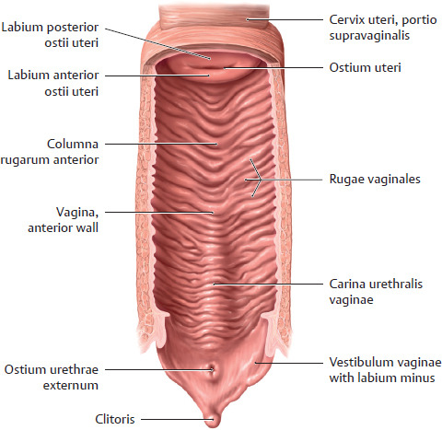
Vagina
Although it may never regain its nulliparous state, the supportive tissues of the pelvic floor gradually regain their former tone.
The vagina is Oedematous, poor tone following delivery. It remains stretched and smooth for a few days.
By end of third week, Rugae begin to appear but never return back to its nulliparous state
Women who deliver vaginally should be taught to perform Kegel Exercises (intermittent tightening of the perineal muscles)

Slide 18
hCG, hot flashes
Human chorionic gonadotropin (hCG) levels – The fall and disappearance of hCG postpartum follows a biexponential curve. hCG values typically return to normal, nonpregnant levels two to four weeks after a term delivery, but this can take longer. The most serious concern in women with rising hCG levels postpartum is gestational trophoblastic disease
Hot flashes – Caused by estrogen withdrawal after placental delivery.

Slide 19
Ovulation and Menstruation
Menstrual flow usually returns by 6-8 weeks in women who do not breastfeed, although it is highly variable.
Woman who does not breastfeed may ovulate as early as 27 days of delivery
Women who breastfeed have longer period of amenorrhea and anovulation This depends on some factors; which include how much and how often the baby is fed and whether the baby's food is supplemented with formula.
About half of women who breastfeed return to period within 36 weeks of delivery
The delay in the return to normal ovarian function in the lactating mother is caused by the suppression of ovulation due to the elevation in Prolactin.
Although Ovulation may not occur for several months. Contraceptive counselling and use should be emphasized to avoid undesired pregnancy.
Notes:
The delay in the return to normal ovarian function in the lactating mother is caused by the suppression of ovulation due to the elevation in Prolactin.

Slide 20
2. General Physiological Changes
Weight loss
Uterine evacuation & normal blood loss: 5-6 kg.
Loss of plasma volme and diuresis of extracellular fluid: 2-3 kg.
Weight loss depends on mother’s weight gain during pregnancy, and activity
Well management of weight can help reduce risk of cardiovascular diseases.
Temperature
A reactionary increase may occur following difficult delivery, but does not exceed 38°C and drops within 24 hours. This rise in temperature is due to the absorption of waste products of muscular contractions of labor.

Slide 21
Abdominal wall
The abdominal wall is lax postpartum but regains most, if not all, of its normal muscular tone over several weeks; however, separation (diastasis) of the rectus abdominis muscles may persist. Long-term sequelae may include abdominal discomfort and cosmetic issues, which may be managed conservatively or surgically.

Slide 23
Cardiovascular System
Immediately following delivery, there is marked increase in peripheral vascular resistance due to the removal of the low-pressure uteroplacental circulatory shunt
The cardiac output and plasma volume gradually returns to normal during the first 2 weeks of puerperium.
Rises of pulse may indicate presence of hemorrhage or infection.
Notes:
The changes that occurred during pregnancy (e.g., increases in heart rate, cardiac output, and blood volume) generally return to baseline by approximately 6 weeks postpartum.

Slide 24
Blood
Leukocytosis and thrombocytosis occur during and after labour.
Hematocrit drops because of blood loss during delivery, rises after 3 to 7 day of postpartum unless substantial blood loss has occurred.
Blood volume returns nearly to pre-pregnant state in about 1 week.
Hypercoagulable state of pregnancy continues in the first 2 weeks of puerperium (risk of DVT and PE)

Slide 25
Bowel function
Constipation : It is common in the first few days of puerperium and is due to many factors:
Low fiber diet , dehydration during labour
Fear of evacuation due to pain from :
– sutured perineum
Prolapsed haemorrhoids
Anal fissure
(advice on adequate fluid intake , increase fiber intake , stool softener )

Slide 26
Urinary system - Bladder function
Urinary retention
relatively common in the first 24 hours after childbirth, especially with difficult, traumatic or instrumental delivery, or if regional anesthesia (spinal/epidural) is used
After traumatic or instrumental delivery, women may find it difficult to void because of pain and periurethral edema
There is diuresis during the first five days after delivery .
Increase urine production in puerperium:
Fluid overload , edema . Diuresis body’s mechanism of getting rid of the excess fluid retained during pregnancy
Increased fluid intake of breastfeeding mothers

Slide 27
Abnormal puerperium

Slide 28
Psychological problems:
1.Baby blues
It appears that about 50 to 85% of women experience postpartum blues during the first few weeks after delivery.
symptoms : feelings of sadness, women with the blues more commonly report mood lability, tearfulness, anxiety or irritability , Feeling overwhelmed and that you cant take care of the baby
onset : These symptoms typically peak on the fourth or fifth day after delivery and may last for a few hours or a few days, remitting spontaneously within two weeks of delivery .
Treatment: Resolves spontaneously

Slide 29
Post Partum Depression PPD
It’s a specific form of depression that is related solely to pregnancy and childbirth
PPD generally lasts for 3-6 months, with 25% of patients still affected at 1 year.
PPD greatly affects the patient's ability to complete activities associated with daily living.

Slide 30
The symptoms of postpartum depression include:
Depressed or sad mood
Tearfulness
Loss of interest in usual activities
Feelings of guilt
Feelings of worthlessness or incompetence
Fatigue
Sleep disturbance
Change in appetite
Poor concentration
Suicidal thoughts

Slide 31
Who is at Risk for Postpartum Depression?
Previous episode of PPD
Depression during pregnancy
History of depression or bipolar disorder
Recent stressful life events
Inadequate social supports
Marital problem

Slide 32
Postpartum Psychosis
Postpartum psychosis is the most severe form of postpartum psychiatric illness.
It is a rare event that occurs in approximately 1 to 2 per 1000 women after childbirth. Its presentation is often dramatic, with onset of symptoms as early as the first 48 to 72 hours after delivery. The majority of women with puerperal psychosis develop symptoms within the first two postpartum weeks.

Slide 33
Symptoms : hallucinations - hearing, seeing, smelling or feeling things that are not there
delusions – thoughts or beliefs that are unlikely to be true
a manic mood – talking and thinking too much or too quickly, feeling "high" or "on top of the world"
a low mood – showing signs of depression, being withdrawn or tearful, lacking energy, having a loss of appetite, anxiety, agitation or trouble sleeping
sometimes a mixture of both a manic mood and a low mood - or rapidly changing moods
loss of inhibitions
feeling suspicious or fearful
restlessness
feeling very confused
behaving in a way that's out of character

Slide 35
Puerperal pyrexia
Done by : Khaled Samara
Supervised by : Dr.Ahlam Al-Karabsheh

Slide 36
Definition
A temperature of 38 Celsius or higher on any 2 of the first 10 days postpartum , exclusive of the first 24 hours .
Notes:
Fever within 6 weeks of delivery
Can consist of shivering fit followed by fever

Slide 37
Introduction
Puerperal pyrexia also called : childbirth fever , childbed fever , postpartum fever .
The majority of the occurrences happening more than 2 days after birth .
The most common cause of postpartum fever is endometritis .
Mild pyrexia in labour is common especially after prostaglandin induction

Slide 38
History
Caused by a local fever known as ‘the weed’ .
Alexender Gordon had seen it in London .
Gordon believed that he cured many of his patients with a combination of heavy bleeding and purging .
His meticulous note taking allowed him to draw the conclusion that Puerperal fever transmitted from patient to patient by the attending doctor or midwife .
Notes:
The severe epidemic of fever which occurred in the town in these years was thought by the inhabitants to be caused by a local fever known as ‘the weed’ for which bleeding was contra-indicated. Puerperal fever was a disease previously unknown in Aberdeen but Alexander Gordon had seen it in London and he kept detailed notes on each case. These enabled him to prove that puerperal fever was a contagious disease which was transferred between women by a shared doctor or midwife. He was also the first to postulate a clear link with erysipelas, a skin disease commonly known as St Anthony’s fire; a theory that would only be proved a century later.
Gordon believed that he cured many of his patients with a combination of heavy bleeding and purging. He then advocated a preventative strategy which consisted of burning the patient’s clothing and bedlinen and insisting that midwives and doctors carefully washed themselves, changed their clothing and had infected clothing fumigated.
Unfortunately, the women of Aberdeen found his methods of treatment and prevention abhorrent. The belief that the fever was due to ‘the weed’ persisted and many believed his treatment had actually caused deaths. Members of the medical profession were indignant at the suggestion that they had spread the disease and that they had been named in his treatise.
In modern times, antiseptic conditions and antibiotics make it a rare and treatable disease, but in the 18th century, there was no agreement amongst the medical profession on what it was, what caused it or even what it was called. This severely hampered research into the disease and it was not until the late 19th century that the main conclusions in Alexander Gordon’s treatise were accepted and acted upon. Had it gained the attention and respect it deserved when it was published, countless numbers of women across the world who died from puerperal fever might have been saved.
It was this meticulous note-taking that allowed Gordon to draw the conclusion that the fever was transmitted from patient to patient by the attending doctor or midwife, and to predict which women would fall ill by knowing who attended their labour.

Slide 39
Etiology
Notes:
Common drugs causing fever alpha methyldopa and nifidipine
In tropical country like India you should exclude malaria .

Slide 40
Atelectasis
It appears in the first 24 hours after deliveries , particularly after general anesthesia .
May be associated with fever and can be prevented by early and regular chest physiotherapy .
Aspiration pneumonia (Mendelson’s syndrome ) must be suspected .
Notes:
Other causes : incisional pain and cigarette smoking
Pneumonia symptoms : cough , purulent sputum and dyspnea
Investigations : CXR and sputum culture
Management : physiotherapy and antibiotics
Mendelson’s syndrome = spiking mperature asscociated with wheezing , dyspnea or evidence of hypoxia following a general anesthetic

Slide 41
Urinary tract infection
UTI : frequency , dysuria , hematuria
Rigors from pyelonephritis
95% caused by Escerichia coli , Proteus , Klibsiella
GTI : tender bulky uterus
prolonged bleeding / pink or discoloured lochia
painful inflamed perineum
may be caused by E.Coli , GAS , Staphylococcus spp and Clostridium welchii
Notes:
- It is referred to as puerperal sepsis and is synonymous with older descriptions of puerperal fever, milk fever and childbed fever.
- It was not realized until the mid –nineteenth century that the high maternal mortality and morbidity in the UK was due to poor hygiene
- The discovery of sulphonamides in 1935 and the simultaneous reduction in the virulence of haemolytic streptococci resulted in dramatic fall in maternal mortality

Slide 42
Urinary tract infection
Organisms commonly associated with puerparal genital infections :
Aerobes
Anaerobes
Miscellaneous
Notes:
1)Aerobes = gram positive ,,,, beta-hemolytic streptococcus group A,B,D ---- S.aureus and Staphylococcus epidermidis ---Enterococci streptococcus faecalis
gram negative ,,, E.Coli … H.influenzae …. Klebsiella pneumoniae … pseudomonas aeruginosa … proteus mirabilis
gram variable ,,, Gardenella vaginalis
2)Anaerobes = peptococcus spp … peptostreptococcus spp …. Bacteroides ..B.fragilis … B.bivius … B.disiens ,,,, Fusobacterium
3) Miscellaneous = Chlamydia trachomatis ,, Mycoplasma hominis ,,,Ureaplasma urealyticum

Slide 43
Urinary tract infection
Investigations :
CBC
Urea and electrlytes
Culture of blood or swabs from high vaginal or infected wound
Pelvic ultrasound
Clotting screen
Blood lactate
ABG
Notes:
CBC = Anemia ,leukocytosis , thrombocytopenia
Urea= fluid and eletrolytes imbalances
Culture = bacterial growth
U/S = retained products , pelvic abscess
Clotting sceen = DIC
Blood lactate = acidosis
ABG = acidosis and hypoxia (shock)

Slide 44
Urinary tract infection
Management :
Co-amoxiclav or cephalosporin plus metronidazole

Slide 45
Endometritis
The most common cause
Risk factors : emergency C/S , prolonged membrane rupture , prolonged labor and multiple vaginal examination during labor
It frequently includes organisms such as :Ureaplama , Streptococcus ,Mycoplasma and Bacteroides

Slide 46
Endometritis
Pathology :
primary site :Symptoms appear 2-3 days after delivery
Uterus ( endomyometrium), cervix , vagina
secondary site: Symptoms appear late 7-10 days after delivery
parametritis , salpingo oopheritis ,peritonitis and septic pelvic thrombophlebitis
Tertiary site : If disseminated to blood stream causing septicemia
Clinical featuers :
SYMPTOMS :
fever, chills ,rigors
Maliase ,headache ,persistent lower abdominal pain ,nausea and vomiting
Foul smelling discharge ( lochia).
edematous white limbs ( SPT )

Slide 47
Endometritis
SIGNS :
GE : toxic look , fever, pallor , tachycardia, hypotension .( look to calf tenderness to rule out DVT)
Abdomen : tenderness, guarding ,subinvluoted uterus.
PV: foul smelling purulent discharge ( maybe blood stained ) and jumping sign
LL affection : swollen white painful limbs
examine episiotomy / CS wound to rule out infection.

Slide 48
Endometritis
Complication:
Immediate
peritonitis,septicemia and shock
Abscess: pelvic ,subphrenic
Septic pelvic thrombophlebitis
Death from septicemia

Slide 49
Endometritis
Delayed
Infertility : chronic tubo-ovarian mass.
Ectopic pregnancy.
Intestinal obstruction following adhesion

Slide 50
Baby:
Isolate if mother severely ill ,otherwise can be with mother.
Expressed breast milk can be given to the baby
Mother
Bed rest
Tepid sponging
Increase oral fluid intake / IV fluid
Analgesia , antipyretics
IV antibiotics
preferred initial regimen ( no GBS colonization ) (normal renal function)
clindamycin 900mg every 8 h plus gentamicin 5mg/kg every 24h
preferred initial regimen ( GBS colonization )
as above plus ampicillin 2g IV every 6h or ampicillin- sulbactam 3 g iv every 6h

Slide 51
Wound infection
Wound infections in the postpartum period include infections of the perineum developing at the site of an episiotomy or laceration, as well as infection of the abdominal incision after a cesarean birth.
Morbidity and mortality
The most common consequence of wound infection is increased length of hospital stay or hospital readmission.
About 7% of abdominal wound infections are further complicated by wound dehiscence.
History
perineal infections: inordinate amount of pain, malodorous discharge, or Vulvar edema.
On PE erythematous and edematous wound , wound dehisince and may be accompanied by purulent discharge
Notes:
Known risk factors include diabetes, hypertension, obesity, treatment with corticosteroids, immunosuppression, anemia, development of a hematoma, chorioamnionitis, prolonged labor, prolonged rupture of membranes, prolonged operating time, abdominal twin delivery, and excessive blood loss.

Slide 52
Wound infection
Abdominal wound infections develop around postoperative day 4 and are often preceded by endometritis. These patients present with persistent fever despite antibiotic treatment.
On PE Infected incisions may be erythematous, warm, tender, and indurated. Purulent or serosanguineous may or may not be obvious.
Treatment
remove suture under tension
Clean and dress with antiseptic solution
Analgesia + Abs
Sitz bath
Healing by primary intension or secondary suturing

Slide 53
Septic pelvic Thrombophlebitis
SPT is defined as venous inflammation in the abdomen /pelvis with thrombus formation
It’s ass with fever and is unresponsive to antibiotic therapy .
Bacterial infection of the endometrium seeds organisms into venous circulation which damages the vascular endothelium and in turn results in thrombus formation.
The thrombus acts as a suitable medium for proliferation of anaerobic bacteria
Ovarian veins are often involved because they drain the upper half of the uterus ( when the ovarian veins are involved , the infection is most often unilateral Rt > Lt ). Occasionally, the thrombus has been noted to extend to the vena cava or to the left renal vein
Risk factor : low socioeconomic status , cesarean delivery, PROM and excessive blood loss.
Notes:
. Eighty to 90% occur in the right side due to the dextrotorsion of enlarging uterus with compression of right ovarian vein.

Slide 54
Septic pelvic Thrombophlebitis
Incidence : it’s 10 times more common after CS ( 1 PER 800) than after vaginal delivery ( 1 PER 9000) , the condition affect less than 1% of patient with endometritis
Clinical features :
Patients with ovarian vein thrombosis may describe lower abdominal pain, with or without radiation to the flank, groin, or upper abdomen.
Other symptoms include nausea, vomiting, and bloating.
Picket fence fever
PE: fever greater than 38°C( picket fence fever) ,, tachycardia
pulmonary involvement is significant, the patient may be tachypneic and stridulous,,,
On abdominal examination, 50-70% of patients with ovarian vein thrombosis have a tender, palpable, ropelike mass extending cephalic beyond the uterine cornu.
Notes:
Septic thrombophlebitis may result in the migration of small septic thrombi into the pulmonary circulation, resulting in effusions, infections, and abscesses. Only rarely is a thrombus large enough to cause death

Slide 55
Septic pelvic Thrombophlebitis
INVESTIGATION :
Important laboratory studies included urinalysis, urine culture, and CBC count with differential.
Imaging: CT scan and MRI are the studies of choice for the diagnosis of septic pelvic thrombophlebitis
Treatment
The standard therapy after diagnosis of septic pelvic thrombophlebitis includes anticoagulation with intravenous heparin to an aPTT that is twice normal and continued antibiotic therapy.
A therapeutic aPTT is usually reached within 24 hours, and heparin is continued for 7-10 days.
Initially, it was thought that patients defervesce within 24-28 hours
More recent studies show that it takes 5-6 days for the fevers to resolve.
Notes:
Surgical management is reserved for the rare Rx faliure or massive PE reqiuring IVC or ovarian vein placation or insertion of filter like device

Slide 56
Breast engorgement
Breast engorgement results in breast fullness and firmness, which is accompanied by pain and tenderness.
Primary engorgement is due to interstitial edema and onset of copious milk production. It typically occurs between 24 and 72 hours postpartum, with a normal range of one to seven days; peak symptomatology averages three to five days postpartum.
Secondary engorgement typically occurs later if the mother's milk supply exceeds the amount of milk removed by her infant.
Breast engorgement is uncomfortable and may give rise to a mild temperature elevation for a short time; however, any fever should prompt an investigation to rule out an infectious source
Notes:
The affected area varies from primarily areolar involvement in some mothers, more peripheral involvement in others, and, in some mothers, both peripheral and areolar involvement.
the treatment of breast engorgement, such as manual expression, firm support, cabbage leaves, ice bags and electric breast pumps, have all been
recommended in the past, but allowing the baby easy access to the breast is the most effective method of treatment and prevention

Slide 57
Breast engorgement
The condition spontaneously resolves over a few days, but supportive care (warm compresses or a warm shower before feeding to enhance let-down and facilitate milk removal, cool compresses after or between feedings, mild analgesics such as acetaminophen [paracetamol] or ibuprofen) is appropriate and reviewed separately
In women who are not breastfeeding, the use of a tight brassiere and avoidance of breast stimulation suppresses lactation in 60 to 70 percent of patients and is the recommended treatment; there are no high-quality studies comparing use of nondrug approaches with no treatment

Slide 58
Infectious Mastitis
Mastitis is commonly related to breastfeeding problems, and occurs when a blocked duct obstructs the flow of milk and distends the alveoli. If this pressure persists, the milk extravasates into the perilobular tissue, initiating an inflammatory process
The affected segment of the breast is painful and appears red and oedematous.
The woman also experiences flu-like symptoms with a tachycardia and pyrexia.
The most common infecting organism is S. aureus, which is found in 40% of women with mastitis.(which originates from the infant’s oral pharynx. ) (Other bacteria include coagulase-negative staphylococci and Streptococcus Viridans)
Notes:
In contrast to breast engorgement, the pyrexia with infective mastitis develops later (typically third to fourth postpartum week) and persists for longer.

Slide 59
Infectious Mastitis
Management:
1- Early localized mastitis can be managed with massage of the breast (towards the nipple) and analgesia.
2- If the mastitis worsens, then a sample of the milk should be taken for microbiological culture and flucloxacillin commenced while awaiting sensitivity results
An appropriate antibiotic should be continued for 7 to 10 days
Breastfeeding may be discontinued but is not contraindicated. A breast pump can be used to maintain lactation until the infection has cleared if lactation is discontinued.
About 10% of women with mastitis develop a breast abscess (diagnosed
using ultrasound). Treatment is by a radial surgical incision and drainage under
general anaesthesia.
Notes:
Because the majority of staphylococcal organisms are penicillinase-producing, a penicillinase-resistant antibiotic, such as dicloxacillin, should be used. )

Slide 60
VTE and PE
Pregnant women have a four- to five fold increased risk of symptomatic venous thromboembolism (VTE) compared with nonpregnant women, with an estimated incidence of one to two per 1000 pregnancies.
In developed countries, pulmonary embolism remains one of the most common causes of maternal mortality
VTE accounts for 1.1 deaths per 100 000 deliveries
The last trimester and immediate postpartum were considered the highest risk periods for deep vein thrombosis (DVT) and pulmonary embolism (PE).
Notes:
The prothrombotic changes associated with pregnancy do not revert completely to normal until several weeks after delivery
Most cases occurred during the first 4 weeks postpartum (95%)

Slide 61
VTE and PE
RISK FACTORS FOR VTE POSTPARTUM:
age >35 years, operative delivery, blood group A, hypertension, and postpartum bleeding.
Previous VTE
Hereditary thrombophilia
High body mass index / immobilization
Caesarean delivery
Symptoms of DVT may include the following:
Edema Leg pain Tenderness Warmth or erythema of the skin over the area of thrombosis
Pulmonary embolism should be suspected in patients with one or more of the following symptoms: acute-onset dyspnea, pleuritic pain, and hemoptysis.
Notes:
The most important individual risk factor for VTE is a personal history of thrombosis particularly when unprovoked or associated with oral contraceptive use or VTE in pregnancy.

Slide 62
VTE and PE
Physical examination in DVT may include :
Calf pain on dorsiflexion of the foot (Homans sign)
A palpable, indurated, cordlike, tender subcutaneous venous segment
Variable discoloration of the lower extremity
Investigation :
D-Dimer Testing
Coagulation Profile to evaluate for a hypercoagulable state
Imaging studies used in deep venous thrombosis (DVT) include doppler ultrasonography, venography, MRI.
Notes:
D dimer is a degradation products of cross-linked fibrin by plasmin
A prolonged prothrombin time or activated partial thromboplastin time does not imply a lower risk of new thrombosis.
The criterion standard to diagnostic imaging for DVT remains venography with pedal vein cannulation, intravenous contrast injection, and serial limb radiographs.

Slide 63
Treatment options for DVT include the following:
Anticoagulation (mainstay of therapy) - Heparins, warfarin, factor Xa inhibitors, and various emerging anticoagulants
Pharmacologic thrombolysis
Endovascular and surgical interventions
Physical measures (eg, elastic compression stockings and ambulation)
Percutanous transcatheter treatment of DVT includes the following:
Thrombus removal with catheter-directed thrombolysis
Mechanical thrombectomy
Angioplasty
Stenting of venous obstructions
Notes:
Heparin products used in the treatment of DVT include the following:
Low-molecular-weight heparin (LMWH; eg, enoxaparin)
Unfractionated heparin (UFH)
Endovascular therapy is performed to reduce the severity and duration of lower-extremity symptoms, prevent PE, diminish the risk of recurrent VTE, and prevent PTS

Slide 64
Thank you

Slide 65
Post Partum Hemorrhage

Slide 66
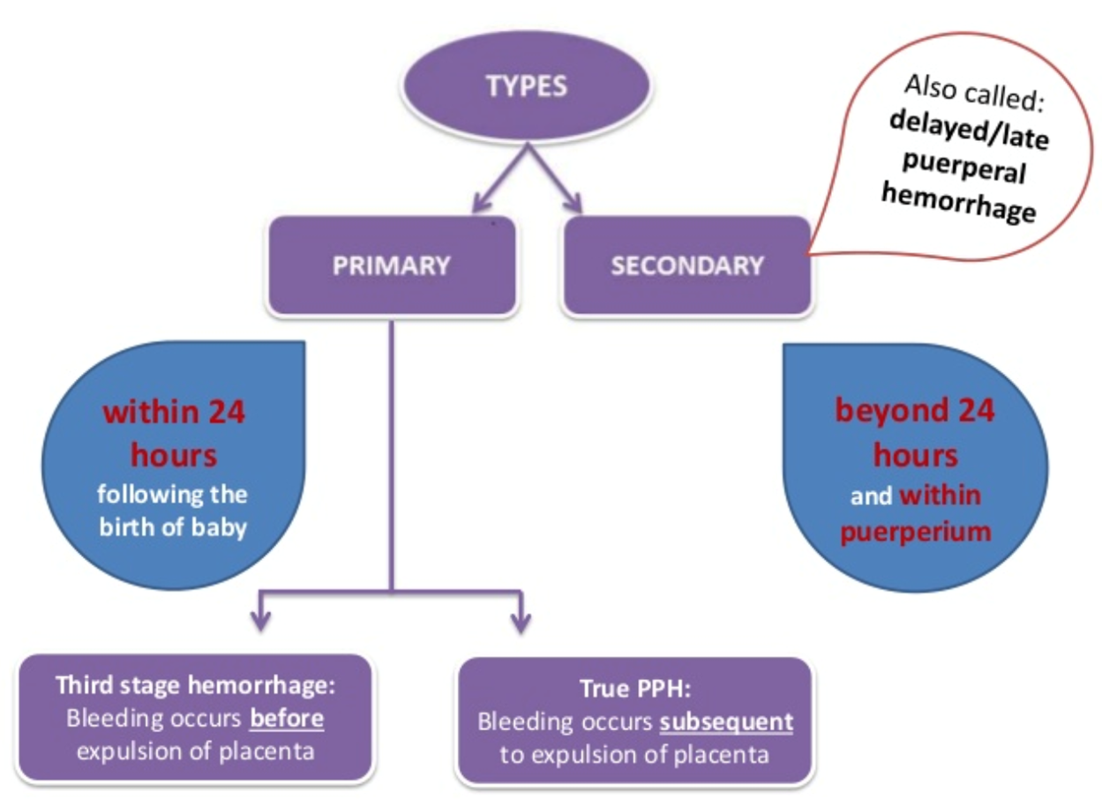
Postpartum hemorrhage is defined as blood loss in excess of 500 mL at the time of vaginal delivery or in excess of 1000 mL for cesarean delivery. Postpartum hemorrhage is a leading cause of maternal mortality worldwide. The prevalence of postpartum hemorrhage is approximately 1 to 3 % of all deliveries and accounts for 25% of all maternal deaths.
10% drop in hematocrit value between admission & PP period,or a need for blood transfusion.
Definition of PPH depends on ‘ clinician’s judgment that enough blood loss has occurred

Slide 67
CAUSES OF POSTPARTUM HEMORRHAGE
Uterine cause:
UTERINE (90%)Uterine atony (70-80%)Retained placental products, abnormal placentationUterine ruptureUterine inversion
Non uterine cause :
This occurs in (10%) of casesLower genital tract lacerationsPelvic hematomasCoagulation disorders;(Abruptio placentae, Retained dead fetus,Amniotic fluid embolism,Inherited coagulopathy ).

Slide 68
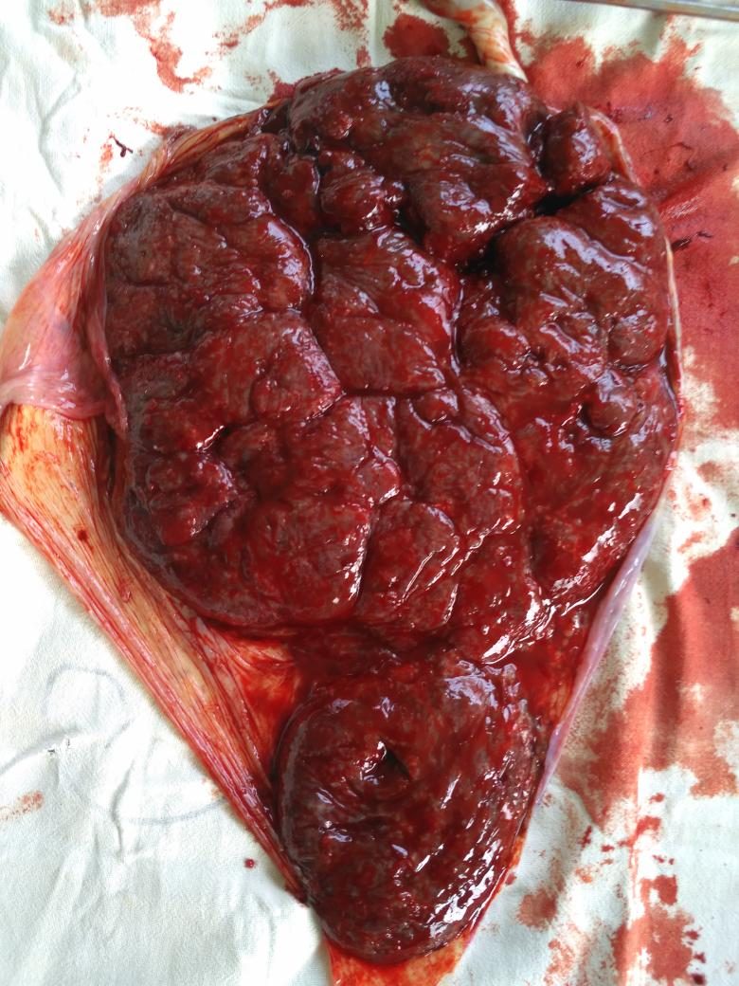
Focal or Diffuse Uterine Atony: most common cause of excessive postpartum bleeding (80%), History of postpartum hemorrhage,prolonged labor(>12 hrs in multipara, >18 hrs in prmigravida), Precipitous labor(within <3 hrs) , grand multiparity (a parity of 5 or more),overdistention of the uterus (Multiple gestations, Polyhydramnios, Fetal macrosomia)…
Trauma-Related:15%,due to lacerations (including uterine rupture) or surgical incisions,uncontrolled vaginal delivery causing incidental injury, difficult delivery, and operative vaginal delivery (medical instruments like forceps, vacuum extraction or episiotomy), incision from cesarean section delivery..
Retained Placenta/Membranes:placenta fails to appear after 30min from fetal delivery,due to atonic uterus ,abnormal adherent placenta ,contraction ring, accessory placental lobe and abnormal trophoblastic uterine invasion (e.g. cervix, vagina, perineum)..

Slide 69
Coagulopathy or other bleeding diathesis : Can be caused by amniotic fluid embolism, placental abruption, preeclampsia with severe features, or HELLP syndrome (hemolysis, elevated liver enzymes, low platelets), Can also be a result when there is a severe reduction of clotting factors due to persistent heavy bleeding and hemodilution of the remaining clotting factors (eg, placenta accreta spectrum).
Uterine inversion: Collapse of the uterine fundus into the endometrial cavity turning the uterus partially or completely inside out,its rare condition more common with cesarean section ,due myometrial weakness ,previous uterine inversion and submucous fundal fibroid polyp

Slide 70
Clinical picture:
Symptoms;vaginal bleeding, risk factors
Signs:General:shock
Abd. Uterine atony: a soft spongy boggy uterus (feels like dough)
Traumatic: lacerations (cervix, vagina, perineum),
contracted uterus ,sever pain, sudden of fetal distress
during labor, Or [soft subinvoluted uterus with bleeding if uterine rupture was occurred ]
Uterine inversion: cupping of the fundus, beefy-appearing
bleeding mass in the vagina,neurogenic shock.
PV & Bimanual: contracted uterus or not, presence of laceration ,retained placenta, uterus is below the level of internal os .

Slide 71
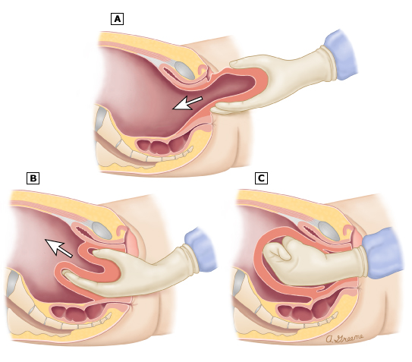
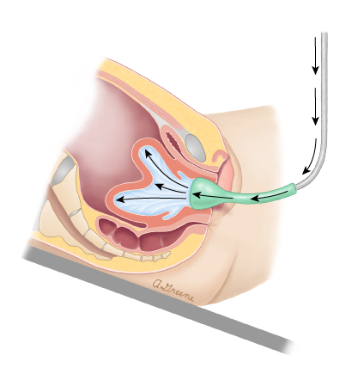

Slide 72
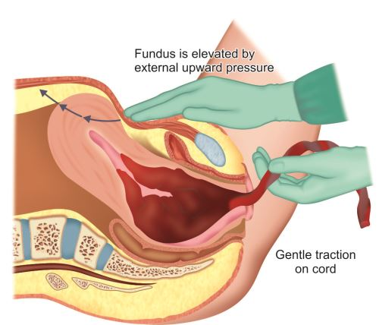
Management:
1) Prevention: proper ANC, in high risk patients obtain large-bore (18 gauge) IV access before delivery, hydrate patient, oxytocic agents readily available in delivery room, cross-match blood & prepare 2 units .
Active management of 3rd stage of labor
Administration of a utero-tonic (IM slowly) with delivery of anterior shoulder or within 1 min of birth
Early cord clamping by two sponge forceps with 2-3 cm in between and cutting (delay of 1 minute is advisable)
Applying controlled cord traction while applying counter-traction on uterus by pressing one hand just above the mothers pubic bone (don’t pull immediately, maintain tension until next uterine strong contraction ((round uterus)), to not dislodge the placenta)
Inspection of placenta and
Exploration of cervix & upper vagina and make sure there’s no active bleeding
Massage the abdomen for a few minutes every 15 minutes for the first two hours to help the uterus to continue to contarct

Slide 73
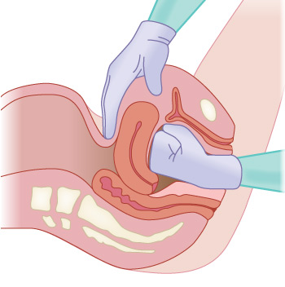
2) Rescussitation in shok..
3)Exploration : retained parts to be digitally removed, repair any tears , laprotomy to repair ruptured uterus.
In atonic uterus : before laprotomy : external ut. Massage ,bimanual ut compression , bakri balloon.
++Ecbolics[oxytocin, methergine, PGs]
4) Radiological intervention:uterine artery embolisation.
Laparotomy:-Bilateral uterine artery ligation/Bilateral internal iliac artery ligation.
-External tamponade(B-Lynch suture)
-subtotal hysterectomy

Slide 74
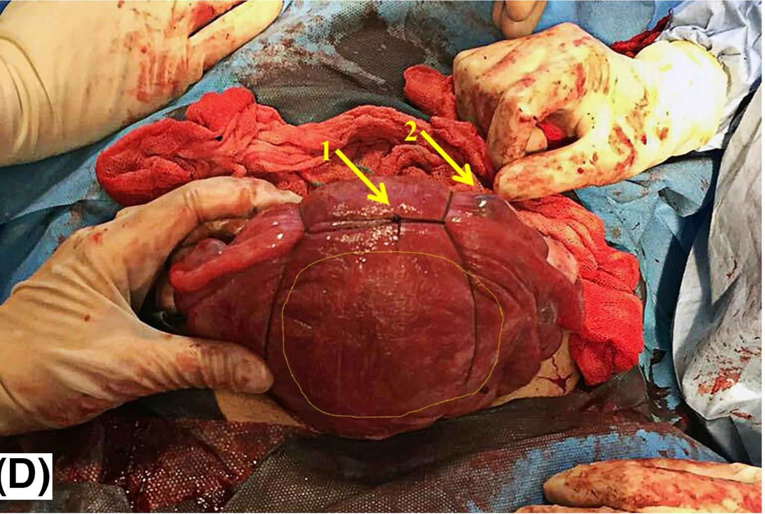
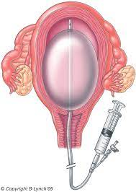

Slide 75
Complications: shock , Disseminated intravascular coagulation, Transient or permanent renal damage , Acute respiratory dysfunction, Abscess formation 2ry to infection of pelvic hematomas, Frequent need for additional surgical procedures, Transfusion related hepatitis & AIDS, Long term sequel: Sheehan’s Syndrome
Low fibrinogen <100 ml/dl
Fibrinogen-degradation product

Slide 76
Post-partum contraception planning
If the mother
Non lactating: combined oral contraceptive pills , implanon… or intrauterine device
Breast feeding : progesterone only contraception(mini pill, Depo-Provera,implanon)
If complete her family With any risks
>>sterilization(bilateral complete or partial salpingectomy) Tubal ligation

Slide 77
Routine immunizations:Postpartum women, including those who are breastfeeding, should receive all recommended vaccines that could not be, or were not, administered during pregnancy (eg, measles/mumps/rubella, varicella, Tetanus toxoids diphtheria acellular pertussis [Tdap], human papillomavirus, influenza, COVID-19).
Anti-D immune globulin — RhD-negative mothers of RhD-positive infants should be given anti-D immune globulin as soon as possible after delivery and within 72 hours.

