Slide 1
Breast 3 ( History taking & Examination )
Tariq Khaled Aladwan, MD
Consultant General, Laparoscopic and
Oncoplastic Breast Surgery.
Faculty Of Medicine, Mutah University.

Slide 2
Breast History Taking

Slide 3
# Age and sex :
Try to correlate the age of the patient presentation with the most common pathology encountered in this age group,
Examples:
o After birth: mastitis neonatorum.
o At puberty: pubertal mastitis.
o Adolescence: hard fibroadenoma.
o Childbearing period: soft fibroadenoma, duct papilloma.
o Carcinoma occurs at any age after puberty.

Slide 4
# Complaint :
The chief complaints are : swelling, pain, and nipple discharge.
>> Swelling (lump) :
Ask about :
* Mode of onset
* Duration and rate of growth (course). Long duration with slow rate of growth usually indicates benign lesions.
* Associated manifestations suggesting inflammatory process ( redness, fever, rigors)
* Associated manifestations suggesting specific infection (mainly T.B.)
* Risk factors for malignancy (hormonal, irradiation, family history, etc.)
* Manifestation suggesting metastatic disease (dyspnea, jaundice, headache, jaundice, bone pains, etc.

Slide 5
>> Pain :
* SOCRATES approach
* Usually, pain is associated with inflammatory lesions as acute mastitis
* Fibrocystic disease is characterized by cyclic pain (mastalgia) that is related to menstruation.
* Tumors (benign or malignant) are painless
* Carcinoma is painless in early stages and painful in advanced stages with local invasion.

Slide 6
>> Nipple Discharge :
Ask about :
* Amount ( Minimal or Profuse ).
* Colour & Character :
Bright red blood: duct papilloma / duct carcinoma
Purulent: abscess.
Milky: galactocele.
Serous: Fibrocystic disease.
Cheesy : duct ectasia.
* Unilateral or bilateral.
* Uni-ductal or multi-ductal.
* Spontaneous or induced with squeezing.

Slide 7
# Past history :
Ask about :
* Menstrual history ( including Menarche)
* Marital state.
* Number of pregnancies & miscarriages.
* History of lactation.
* History of breast trauma.
* History of previous troubles ( diseases, surgeries ) in the breast.

Slide 8
# Breast History Taking Checklist :

Slide 9
Breast Examination

Slide 10
Exposure of these patient :
Patient should be undressed down to the waist
Positioning of these patient :
>> Two complementary positions are used for breast examination :
Sitting upright “especially during inspection” :
This position makes the breasts pendulous”.
Lying supine with head of the bed raised 45 degrees :
This position is the best compromise between lying flat which makes the breasts fall sideways.

Slide 11
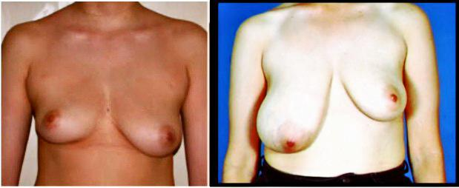
# Inspection :
>> Stand in front of the patient while she is in the sitting position and resting the hands on the thighs.
>> Size and symmetry :
The two sides must be compared, examining the normal side first.
* There is enormous variation within individuals
* It is quite normal for there to be a difference between the sides.
* However, any marked size difference of recent onset is likely to be caused by significant pathology.

Slide 12
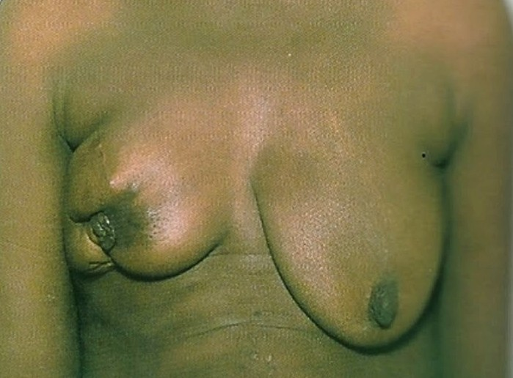
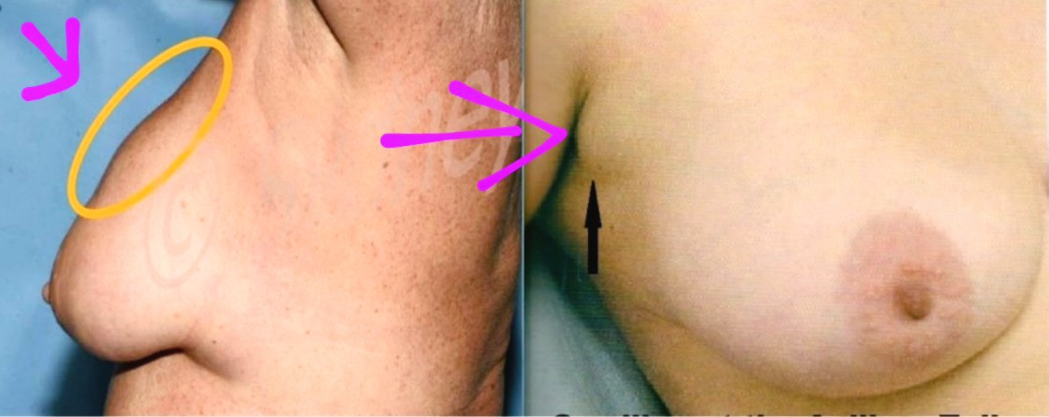
>> Shape and contour :
Whether the breast has normal shape or
Disfigured.
>> Visible swelling ;
Comment if there is any visible swelling on inspection
(number, shape and size).

Slide 13
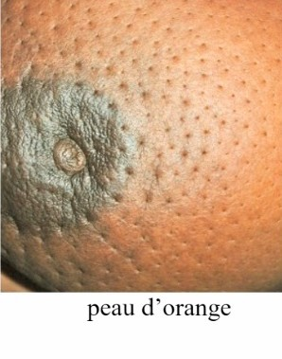
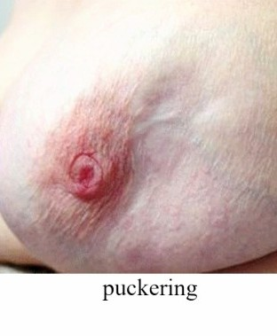
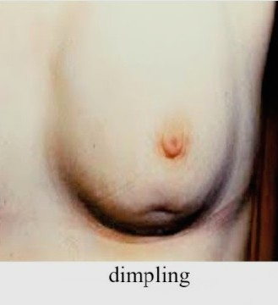
>> The breast skin :
Observe if there is any :
* Redness
* Dilated veins
* Scars
* Peau de'orange:
Cutaneous lymphatic edema. Where the affected skin is tethered by
the sweat ducts where it cannot swell, leading to an appearance that
resembles orange skin. “it can be a sign of malignancy”
* Puckering (wrinkling) due to skin fixation by tumor.
* Dimpling (ligaments of cooper invasion).
* Nodules.
* Ulceration.

Slide 14
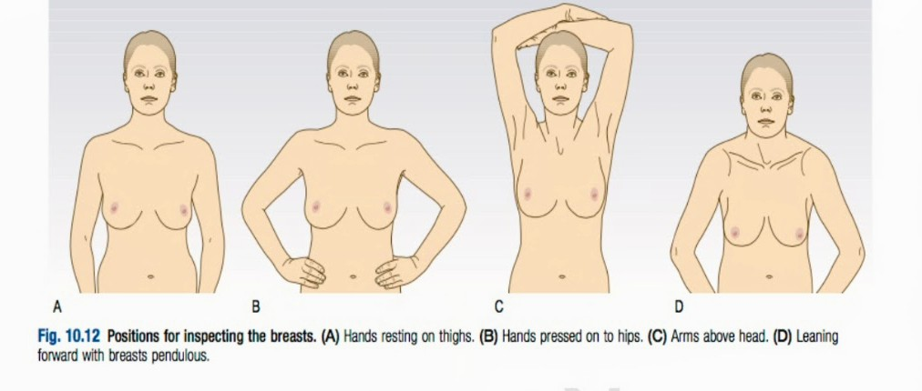
>> Ask the patient to do some maneuvers that may help in making these signs more visible :
* Ask the patient to press her hands firmly on her hips to contract the pectoral muscles and inspect again, this may reveal previously invisible swelling.
* Ask her to slowly raise her arms above her head, as skin changes become more apparent particularly tethering to a carcinoma, and to enable to expose the underside of breast,
* Ask her to lean forward to expose the whole breast and exacerbate skin dimpling.
* Inspect axillary tail for visible swell

Slide 15
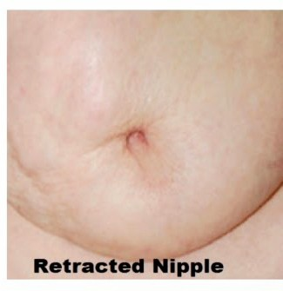
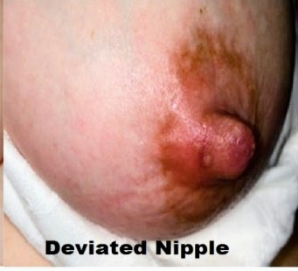
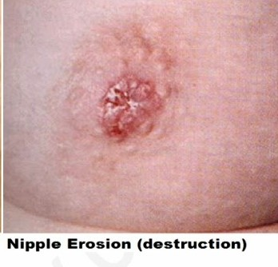
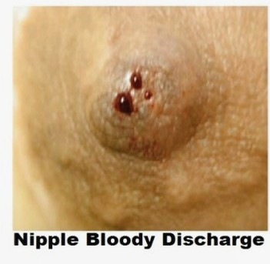
>> The nipples and areolae: (4 Ds) :
Observe if there is any:
* Depression (Retraction or Inversion) :
It may be congenital. Recent inversion raises the suspicion for malignancy.
* Deviation :
If it is deviated from the normal direction.
he normal nipple points forwards, slightly outwards and downwards.
Note if the nipple is :
Not prominent
Displaced
Deviated
* Destruction :
> As in “Paget’s disease of the nipple”
Compare findings to eczema and cracks of the nipple.
* Discharge :
> If there is not spontaneous discharge, ask the patient to squeeze her nipples and note if there is any nipple discharge.
> If present comment on the same way of history (refer back)

Slide 16
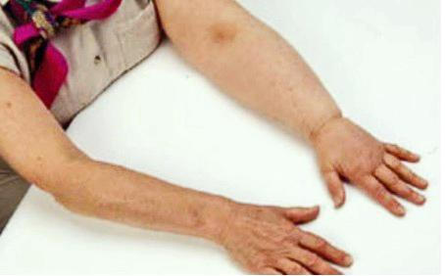
>> Axilla :
** Inspect the axilla and observe if there are any visible swellings
>> Arm :
>> Inspect the arm for swelling “lymphedema”

Slide 17
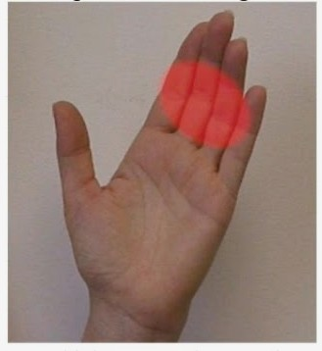
# Palpation :
• Palpation of the breast should be performed with the patient lying at about 45 degrees
on the couch with the hands by her sides
• Ask the patient if there is any pain or tenderness—and examine that area last. Also ask
her to tell you if you cause any pain during the examination.
• You should begin the examination on the asymptomatic side, allowing you to determine
the texture of the normal breast first.
• Palpation should be performed by keeping the flat of the fingers and gently rolling the
substance of the breast against the underlying chest wall.
• Most breasts will feel ‘lumpy’ if pinched. Do not use ‘the flat of the hand’ this is wrong,
use the fingers, which are far more sensitive.
• In fibrocystic disease, a nodular texture of the breast is often palpable by fingers but
not by the flat of the hand

Slide 18
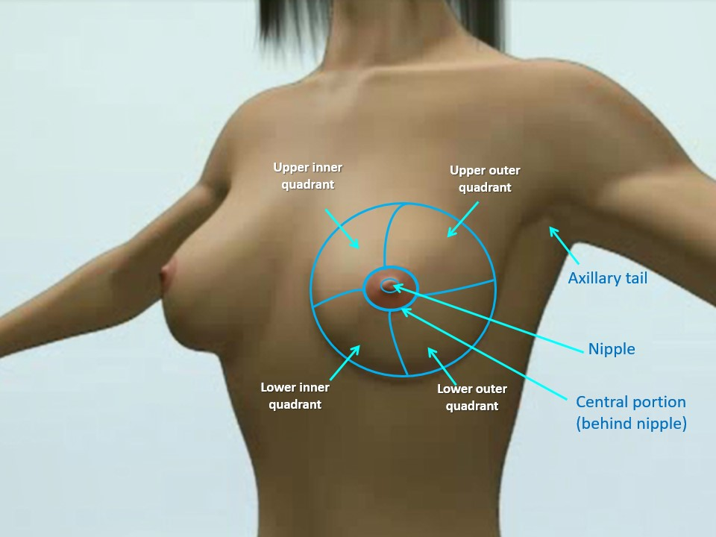
• You should proceed in a systematic way to ensure that the whole breast is examined
>>> Four breast quadrants :
* Upper outer
* Upper inner
* Lower inner
* Lower outer
* Retro-areola region “ Central “
* Axillary tail: lies over the anterior axillary fold.
* Inferior aspect of the breast “ in case of large sized breast “.
• Observe if there are abnormal swelling palpated in these areas.

Slide 19
• If there is any swelling “ Lump” felt, proceed for systematic examination of the swelling “refer
Back to the lump examination” and comment on:
* Site :
Locate in which quadrant.
* Size
* Shape
Wedge shaped: milk engorgement.
Globular: cyst or fibroadenoma.
Irregular: carcinoma.
* Surface :
Smooth: benign
Irregular: carcinoma.
* Edges :
Well defined & regular: benign
Ill defined & irregular: carcinoma.

Slide 20
* Consistency :
Cystic.
Firm.
Hard.
Stony hard: it is very important sign of malignancy.
* Warmth :
Present over inflammatory swellings, sometimes carcinoma or sarcoma.
* Tenderness :
The more tender the lump is the less likely to be malignant.
* Relation to overlying skin:
Try to move the swelling and test for skin fixation, if a lump is tethered to the skin, it behaves as if it is tied to it, the mass cannot be moved without moving the skin. (skin pinching test )

Slide 21
* Relation to overlying skin:
Try to move the swelling and test for skin fixation, if a lump is tethered
to the skin, it behaves as if it is tied to it, the mass cannot be moved
without moving the skin. (skin pinching test)
* Mobility :
Within the breast tissue by holding the breast in one hand and moving the lump by the
other hand.
>> Carcinoma: the tumor is fixed in its bed
>> Fibroadenoma: freely mobile within the breast tissue (breast mouse).
In relation to the underlying muscles :
>> The lump may be fixed to the underlying muscle, where it can be moved to some degree
if the muscle is relaxed but are less mobile if the muscle is tensed.

Slide 22
>> Pectoralis major muscle:
Ask the patient to rest her hand on her hip with the arm relaxed.
Hold the lump between your thumb and forefingers and test its mobility by moving it in two planes at right angles to each other (e.g. up/down and left/right).
Ask the patient to press her hand against her hip causing contraction of the pectoralis major.
Feel the anterior fold of the axilla to verify the pectoralis major is fully contracted
Repeat the mobility testing and comment.
Any restriction in mobility indicates adherence to the pectoral fascia & pectoralis muscle

Slide 23
>> Serratus anterior :
■ Tumors in the lower outer quadrant lie on the serratus anterior.
■ It should be put in contraction to test mobility of these tumors.
■ This is done by asking the patient to place outstretched hand upon your shoulder and press hard.
* In relation to the chest wall :
o Fixity to the chest wall results in loss of all mobility irrespective of muscular contraction.

Slide 24
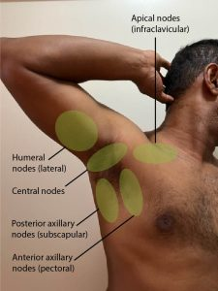
# Palpation of The Axilla
Stand on the patient’s right side.
Take hold of her right elbow with your right hand and let her forearm rest on your right forearm. Persuade her to allow you to take the weight of her arm. Place your left hand flat against the chest wall and sweep the tips of your fingers from the top of the axilla and from side-to- side to feel the nodes against the chest wall.
To reach the apex of the axilla, you will have to push the tips of your fingers upwards and inwards.
Next, move your left hand anteriorly over the anterior axillary fold and downwards into the axillary tail and behind the edge of the pectoralis major muscle.
Lastly, palpate for infra- and supra- clavicular lymphadenopathy

Slide 25
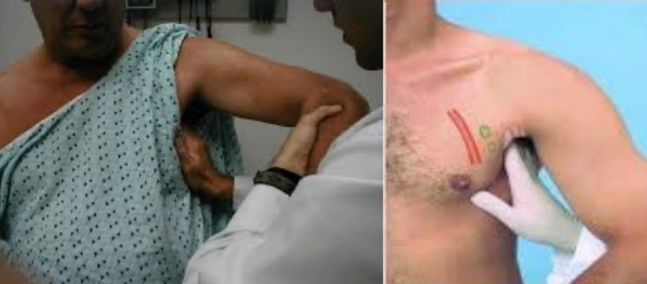

Slide 26
# Breast Examination Checklist :

Slide 27
Thank you

