Slide 1
obstetric shock
Presented by : Taqwa Lasasmah
Yara khaled
Majdulean alsharari
Somya khaled
Supervised by: DR Ala Uwais

Slide 3
Classic Clinical Picture of Shock
Low blood pressure.
Rapid weak (thready) pulse.
Pallor.
Cold clammy sweat.
Cyanosis of the fingers.
Air hunger.
Dimness of vision.
Restlessness.
Oliguria or anuria.

Slide 9
Obstetric haemorrhage
Obstetric haemorrhage is a leading cause of maternal mortality worldwide and is responsible for up to 50% of maternal deaths in some countries. In the UK it is responsible for approximately 10% of all direct maternal deaths.

Slide 10
Antepartum haemorrhage
This is defined as vaginal bleeding after 20 weeks’ gestation. It complicates 2– 5% of pregnancies and most cases involve relatively small amounts of blood loss. However, significant blood loss poses a risk of mortality and morbidity to both mother and baby.

Slide 11
causes can be classified into placental, fetal and maternal:
Placental causes: placental abruption; placenta praevia.
Fetal cause: vasa praevia.
Maternal causes:
vaginal trauma;
cervical ectropion;
cervical carcinoma;
vaginal infection and cervicitis.

Slide 12
Placental causes are the most worrying, as potentially the mother’s and/or fetus’s life is in danger and often the bleeding may be more severe than with other causes such as cervical ectropion. However, any antepartum haemorrhage must always be taken seriously, and any woman presenting with a history of fresh vaginal bleeding must be investigated promptly and properly. The key question is whether the bleeding is placental and is compromising the mother and/or fetus, or whether it has a less significant cause.

Slide 13
History
How much bleeding?
Triggering factors (e.g. postcoital bleed). Associated with pain or contractions?
Is the baby moving?
Last cervical smear (date/normal or abnormal)?

Slide 14
Examination
Pulse, blood pressure.
Is the uterus soft or tender and firm?
Fetal heart auscultation/CTG.
Speculum vaginal examination, with particular importance placed on visualizing the cervix (having established that placenta is not a praevia, preferably using a portable ultrasound machine).

Slide 15
Investigations
Depending on the degree of bleeding, full blood count, clotting and, if suspected praevia/abruption, cross-match 6 units of blood.
Ultrasound (fetal size, presentation, amniotic fluid, placental position and morphology).

Slide 16
Placental abruption
Placental abruption is the premature separation of the placenta from the uterine wall. The bleeding is maternal and/or fetal and abruption is acutely dangerous for both the mother and fetus (Figure 14.4).
Prevention: avoidance of precipitating factors such as control of blood pressure, and avoidance of precipitants cocaine and smoking.
Risk factors: hypertension (including preeclampsia), smoking, trauma to the maternal abdomen, cocaine, polyhydramnios, multiple pregnancy, fetal growth restriction (FGR).
Warning signs: maternal collapse, feeling cold, light-headedness, restlessness, distress and panic, painful abdomen, vaginal bleeding.

Slide 17
Clinical presentation
The characteristic presentation of placental abruption is that of painful bleeding associated with a tense rigid abdomen. The absence of a tense abdomen does not rule out a placental abruption. Placental abruption may be diagnosed on ultrasound but the absence of any ultrasound changes does not rule it out and patients should be managed on the basis of their clinical findings. Maternal signs and symptoms may include vaginal bleeding, abdominal pain, sweating, shock, hypotension, tachycardia, absence or reduced fetal movements and tense painful abdomen. CTG may reveal evidence of fetal distress.

Slide 18
CAN WE DEPEND ON AMOUNT OF BLEEDING TO DERTERMIND SEVERITY???????
NO!!!

Slide 19
maTERNAL HYPOTENIOS & FHR
The degree of vaginal bleeding does not necessarily correlate with the degree of abruption as abruptions may be concealed (i.e. significant separation between placenta and uterus but blood is concealed between the placenta and uterus so there is little vaginal bleeding seen [Figure 14.4B]).

Slide 20
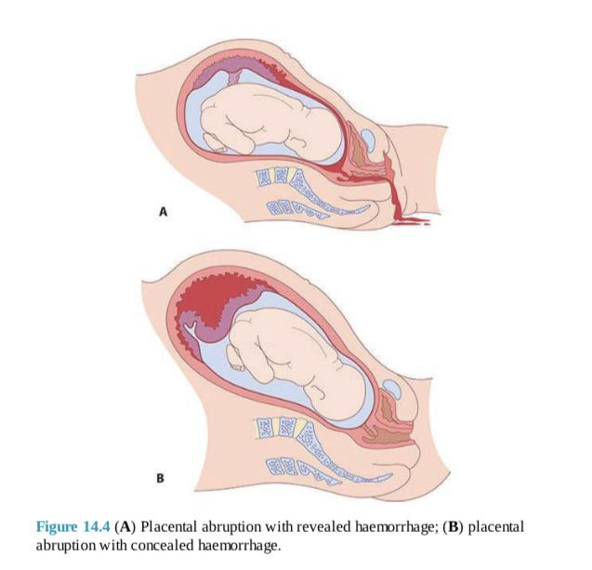

Slide 21
Placenta praevia
A placenta covering or encroaching on the cervical os may be associated with bleeding, either provoked or spontaneous. The bleeding is from the maternal not fetal circulation and is more likely to compromise the mother than the fetus (Figure 14.5).
Prevention: avoidance of non-clinically indicated caesarean section.
Risk factors: multiple gestation, previous caesarean section, uterine structural anomaly, assisted conception.
Warning signs: low-lying placenta at 20 week anomaly scan, maternal collapse, feeling cold, light-headedness, restlessness, distress and panic, painless vaginal bleeding

Slide 22
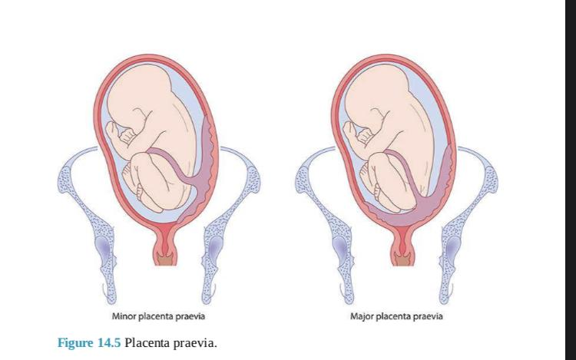

Slide 24
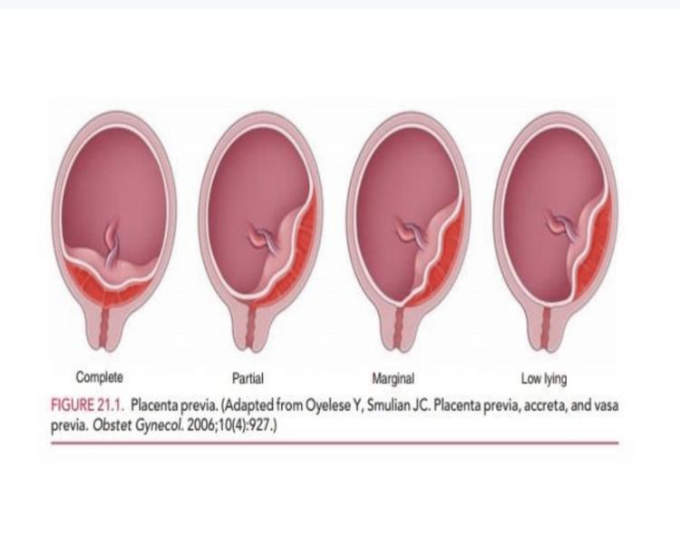

Slide 25
Clinical presentation and diagnosis
The characteristic presenting complaint of bleeding associated with a placenta praevia is that of painless vaginal bleeding. The bleeding may trigger preterm labour so often patients with bleeding from placenta praevia will have irregular abdominal pain associated with uterine contractions. A placenta praevia is diagnosed using ultrasound, preferably transvaginal, to allow accurate measurement of the placental edge from the internal os. Often patients will have been highlighted as having a low-lying placenta at their anomaly scan so there should be a high index of suspicion in any of these patients presenting with vaginal bleeding.

Slide 26
Management
If there is minimal bleeding and the cause is clearly local vaginal bleeding, symptomatic management may be given (for example antifungal preparations for candidiasis) as long as there is reasonable certainty that cervical carcinoma is excluded by smear history and direct visualization of the cervix. Placental causes of bleeding are a major concern. A large-gauge intravenous cannula is sited, blood sent for full blood count, clotting and cross-match, and appropriate fetal and maternal monitoring instituted

Slide 27
PRINCIPLE CAUSES OF NEONATAL MORBIDITY AND MORTALITY RELATED TOOO?????
Preterm delivery
Rather than anemia
Hypoxia or growth
restriction

Slide 28
. If there is major fetal or maternal compromise, decisions may have to be made about immediate delivery irrespective of gestation; an attempt at maternal steroid injection should still be made. If this is the situation, and bleeding is continuing, emergency management is required. If bleeding settles, the woman must be admitted for 48 hours, as the risk of re- bleeding is high within this time frame. Rhesus status is important: if the mother is rhesus negative, send a Kleihauer test (to determine whether any, or how much, fetal blood has leaked into the maternal circulation) and administer anti-D. When there is substantial vaginal bleeding (in excess of 500 ml) antenatal corticosteroids should be considered if gestation is under 35 weeks as the risk of preterm delivery is significant.

Slide 29
Vasa praevia
Vasa previa occurs when fetal vessels traverse the fetal membranes over the internal cervical os. These vessels may be from either a velamentous insertion of the umbilical cord or may be joining an accessory (succenturiate) placental lobe to the main disc of the placenta. The diagnosis is usually suspected when either spontaneous or artificial rupture of the membranes is accompanied by painless fresh vaginal bleeding from rupture of the fetal vessels. This condition is associated with a very high perinatal mortality from fetal exsanguination. If the baby is still alive, once the diagnosis is suspected the immediate course of action is delivery by emergency caesarean section.

Slide 30
KEY LEARNING POINTS
Placenta praevia is most dangerous for the mother.
Placental abruption is more dangerous for the fetus than the mother.
Vasa praevia is not dangerous for the mother but is nearly always fatal for the baby.
Management involves resuscitation and stabilization of mother and senior input regarding timing of delivery.

Slide 32
Signs and symptoms of haemorrhage
Symptoms: anxiety, thirst, nausea, cold, pain, dizziness.
Signs: rising fundus, peritonism, reduced urine output, tachypnoea, tachycardia, hypotension, narrow pulse pressure.

Slide 40
Sepsis
Sepsis in the UK remains an important cause of maternal death. In the 2006–2006 triennium, sepsis was the leading cause of direct maternal death in the UK, with deaths due to group A streptococcal infection contributing significantly. As a result of concerted effort through regulatory bodies, such as the Royal College of Obstetricians and Gynaecologists, clinical practice guidelines, Confidential
Enquiry recommendations and the Surviving Sepsis campaigns, mortality from genital tract sepsis halved between 2006–2008 and 2010–2012.

Slide 41
Prevention: one in 11 of the women in the recent Confidential Enquiry report died from the flu. More than half of these women’s deaths could have been prevented by a flu vaccination. All maternal observations should be documented on a MEOWS chart to allow early detection of sepsis and subsequent treatment.
Risk factors: ruptured membranes, immunocompromised patients, immunosuppressants, obesity, diabetes, minority ethnic group origin, anaemia, urinary tract infections, vaginal discharge, previous pelvic infection, group B streptococcal infection, amniocentesis and other invasive procedures, cervical cerclage, group A streptococcal infection in close contacts.
Warning signs: pyrexia, hypothermia, tachycardia, increased respiratory rate, hypotension, rise in MEOWS score and oligouria. Patients may rigor, have a rash, have reduced levels of consciousness and not respond to initial treatment.

Slide 42
Management
The Surviving Sepsis Campaign Resuscitation bundles have key points in the timely management of sepsis:
Obtain blood cultures prior to antibiotic administration.
Administer broad-spectrum antibiotic within 1 hour of recognition of severe
sepsis. Every 1 hour delay in administrating antibiotics increases mortality by approximately 8%.
Measure serum lactate.

Slide 43
In the event of hypotension and/or a serum lactate ≥4 mmol/l, deliver an initial minimum 20 ml/kg of crystalloid or an equivalent.
If there is no response, administer vasopressors for hypotension that is not responding to initial fluid resuscitation to maintain mean arterial pressure (MAP) ≥65 mmHg.
In the event of persistent hypotension despite fluid resuscitation and/or lactate ≥4 mmol/l, aim to achieve a central venous pressure (CVP) of ≥8 mmHg or a central
venous oxygen saturation ≥70% or mixed venous oxygen saturation ≥65%.

Slide 44
Severe sepsis may be defined as:
Temperature >38oC or <36oC.
Heart rate >100 beats per minute.
Respiratory rate >20 respirations per minute.
White cell count >17 × 109/l or <4 × 109/l with >10% immature band forms.
Severe sepsis has a higher maternity mortality and requires aggressive prompt treatment and timely involvement of the multidisciplinary team.

Slide 45
Antibiotic use
Each hospital should have its own antibiotic guidelines as the incidence of resistant organisms varies both throughout countries and by country. The selection of antibiotics should be guided by risk factors and potential sources of sepsis. A combination of either piperacillin/tazobactam or a carbapenem plus clindamycin provides very broad coverage for the treatment of severe sepsis.

Slide 46
Other antibiotic options include:
Co-amoxyclav: provides gram-positive and anaerobe cover. Does not cover methicillin-resistant Staphylococcus aureus (MRSA), Pseudomonas or extended spectrum β-lactamase-(ESBL) producing organisms.
Metronidazole: provides anaerobic cover.
Clindamycin: covers streptococci and staphylococci including MRSA. Clindamycin also switches off exotoxin production.
Gentamicin: provides gram-negative cover against coliforms and Pesuodomonas.a

Slide 47
KEY LEARNING POINTS
Management of sepsis:
Blood cultures before antibiotics.
Culture of other samples should be performed based on clinical suspicion (e.g. high vaginal swab, midstream urine, sputum culture).
Key organisms involved in puerperal sepsis are Lancefield group A beta- haemolytic streptococcus and Escherichia coli.
Early diagnosis, rapid administration of broad-spectrum antibiotics and review by senior doctors and midwives is essential to reduce mortality and improve outcome.
Measure lactate and haemoglobin and plan repeat measurements to help assess the response to initial treatment.
Measure accurate hourly urine output.
Administer high-flow oxygenaa

Slide 48
Amniotic fluid embolism
Deﬁnition: Passage of amniotic fluid into the maternal circulation leads to sudden collapse during labour this causes acute cardiorespiratory compromise and severe DIC but can only be conﬁrmed postmortem with the presence of fetal cells (squames or hair) in the maternal pulmonary capillarie.

Slide 49
Pathology :The condition is more common with strong uterine contraction,whether spontaneous or induced, occurs after rupture of membranes particularly when there are open maternal blood vessels in the placental site or in cervical lacerations. The embolism passes to the pulmonary vessels leads to: Sudden death, Shock, or Later death due to DIC and postpartum haemorrhage

Slide 50
Clinical presentation
Maternal collapse
Shortness of breath
Chest pain
Feeling cold
Light headedness
Restlessness
Distress and panic
Pins and needles in the ﬁngers
Nausea and vomiting
If death does not occur in this stage, DIC develops within 1hour leading to generalised bleeding

Slide 51
Risk factors
Older maternal age.
Multiparity.
Intense contractions during labor.
Abdominal trauma
Cesarean section.
Induction of labor.
Placenta previa.
Eclampsia.
Multiple pregnancy.

Slide 52
Diagnosis
ECG: evidence of right side heart failure.
X-ray: non speciﬁc mottled chest appearance.
Lung scan: with technetium 99m albumin shows perfusion defect
Laboratory tests: evidence of DIC

Slide 53
DDx
Acute pulmonary oedema
Pulmonary aspiration (Mendelson's) syndrome.
Other coagulation defects

Slide 54
Management
Oxygen: endotracheal intubation and positive pressure respiration is usually indicated as the patient is often unconscious
Aminophylline: 0.5gm slowly IV to reduce bronchospasm.
Isoprenaline: 0.1gm IV to improve pulmonary blood flow and cardiac activity.
Digoxin and atropine: if central venous pressure is raised and pulmonary secretions are excessive

Slide 55
Hydrocortisone:1gm IV followed by slow IV infusion causes vasodilatation and improves tissue perfusio.
* Bicarbonate solution: if there is respiratory acidosis.
* Low molecular weight dextran: reduces platelets aggregation in vital organ.
Heparin: for treatment of DIC if there is no active bleeding.
Vaginal delivery: is safer than C.S. if the baby is not yet delivered

Slide 56
Uterine Inversion

Slide 57
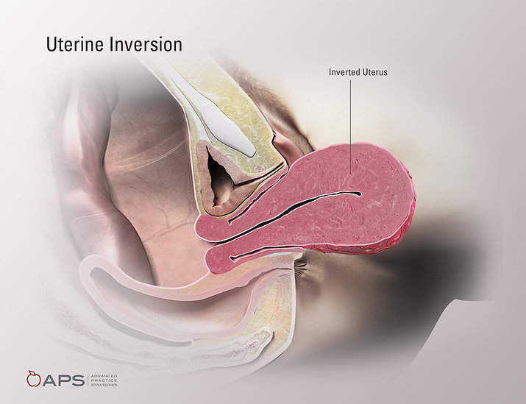
Definition
Uterine inversion occurs when the uterine fundus turns partially or completely inside out the endometrial cavity. Rare , but a life threatening Obstetrical Emergency.

Slide 58
Uterine inversion
It’s estimated to occur in 1 in 2500 deliveries.
It may occur with Vaginal or CS deliveries .
it is a life-threatening obstetric emergency. If not promptly recognized and treated, uterine inversion can lead to severe hemorrhage and shock, resulting in maternal death.

Slide 59
Pathogenesis:
The pathogenesis of uterine inversion is incompletely understood. It has been attributed to use of excessive cord traction and fundal pressure (Credé maneuver) during the third stage of labor, especially in the setting of an atonic uterus with fundal implantation of the placenta.
It is likely that other factors play a role since spontaneous inversions occur and inversion is rare even though cord traction and the Credé maneuver are common.

Slide 61
Risk factors that predispose to Uterine inversion :
1- Macrosmia
2- Rapid or prolonged labor.
3- Usage of uterine relaxant(tocolytics).
4- short umblical cord
5- Nullparity
6- placenta accreta
They are present in fewer than 50 percent of inversion cases.

Slide 62
CLASSIFICATION
Uterine inversion classified according to:
Severity of uterine inversion.
Timing of the event.

Slide 63
According to uterine inversion severity
First Degree : Inverted uterine wall extends to but not through the cervix.
Second Degree : Inverted uterine wall protrudes through the cervix but remains in the vagina.
Third Degree : Inverted uterine fundus extends outside the vagina.
Fourth Degree :Total inversion; both the vagina and uterus are inverted.

Slide 65
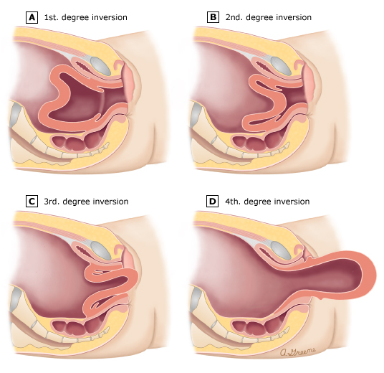

Slide 66
According to timing of the event
Acute : Within 24 hours of delivery . (85% of cases)
Subacute : More than 24 hours but less than 4 weeks postpartum.
Chronic : more than 4 weeks after delivery

Slide 67
Clinical presentation
The clinical presentation depends on the extent and time of occurrence of the inversion.
Signs and symptoms include one or more of the following:
Mild to severe vaginal bleeding.
Mild to severe lower abdominal pain.
A smooth, round mass protruding from the cervix or vagina.
On abdominal examination, absence of uterine fundus.
urinary retention.

Slide 68
The most common presentation is complete uterine inversion with severe postpartum hemorrhage,often leading to hypovolemic shock.
Shock out of proportion to blood loss has been described and attributed to increased vagal tone from stretching of the pelvic parasympathetic nerves by Stretching of the broad ligament or compression of the ovaries as they are drawn together (neurogenic shock), but this is controversial and may just reflect underestimation of blood loss

Slide 69
On vaginal examination, the inverted fundus fills the vagina, and providers may initially misdiagnose it as a protruding fibroid; however, on transabdominal palpation, the uterine fundus is absent at its expected periumbilical position.

Slide 70
Incomplete uterine inversion occurs in approximately 10 percent of cases and is associated with more subtle findings.
In contrast to complete inversion, blood loss may be minimal. Examination through the dilated cervix reveals a mass (ie, fundus) in the uterine cavity; on abdominal examination, a cup-like defect (fundal notch) may be palpated in the area of the normally globular fundus.

Slide 71
In incomplete inversion there will be absence of heavy bleeding or careful examination of the fundus, these patients may not be identified for days or weeks.
Because of increasing cervical constriction over time, delayed recognition of inversion is more likely to require surgical intervention to replace the uterus, and the uterus may become edematous and infected.

Slide 72
Diagnosis
Mainly Clinically
- Classic observations include :
1- Vaginal bleeding potentially leading to shock
2- appearance of a smooth rounded mass protruding from the cervix or vagina
3- Lack of palpation of fundus in its normal position (key finding)
4- various degrees of maternal cardiovascular collapse.

Slide 73
Diagnosis (cont.)
In incomplete inversions :
a mass is may note be seen externally and postpartum hemorrhage is usually the most striking symptom.
Radiographic imaging (eg, ultrasound, magnetic resonance) is rarely necessary, but has been used to confirm inversion when the diagnosis was uncertain and the patient was hemodynamically stable.
Importantly, in women with significant vaginal bleeding, treatment should not be delayed for radiologic confirmation.

Slide 74
Differential diagnosis
Prolapsed fibroid (differentiated through abdominal examination for the fundus or by US).
Occult laceration of the genital tract with uterine atony.
Severe uterine atony.
Uterine rupture.

Slide 75
Management

Slide 76
Goals
Manage postpartum hemorrhage and shock, if present
Replace the uterus to its correct position
Prevent recurrent inversion
Notes:
The management of puerperal uterine inversion is based on clinical experience described in case reports and small retrospective case series, as well as good clinical judgment. No randomized trials have been performed.

Slide 77
Immediately Attempt to manually replace the Inverted uterus :
- This is best accomplished by placing a hand inside the vagina and pushing the fundus with the fist along the long axis of the vagina toward the umbilicus (Johnson maneuver).

Slide 79
Discontinue uterotonic drugs ( oxytocin ) and give uterine relaxants
Nitroglycerin (glyceryl trinitrate administered IV) . It has an extremely short half-life, which could be advantageous in women with severe hemorrhage and hemodynamic instability.
Terbutaline : IV or SC
- Manual replacement is then reattempted

Slide 80
If the above measures to replace the uterus fail, then the patient should be taken promptly to the operating room to attempt surgical correction of the inversion.

Slide 81
Establish adequate intravenous access and aggressive fluid/blood product resuscitation:
placement of two large bore intravenous lines (eg, at least one intravenous catheter should be 16-gauge) and begin infusion of crystalloid to support blood pressure.
Draw blood for baseline laboratory tests, including a complete blood count and coagulation studies (fibrinogen concentration, prothrombin time, activated partial thromboplastin time).
Blood should be administered, as needed, to treat hypovolemia and prevent cardiovascular collapse.

Slide 82
Management of the placenta
After the uterus has been replaced, the most conservative approach is to await spontaneous separation of the placenta, and performing manual extraction for usual obstetric indications (eg, hemorrhage, prolonged third stage).

Slide 83
After Correction of Inversion :
Atony is common after restoration of the normal uterine position. Once placental removal has been successfully accomplished, uterotonic agents are administered to induce myometrial contraction and maintain uterine involution, thereby impeding reinversion and reducing the risk of hemorrhage

Slide 84
Secondary (surgical) interventions:
Hantington procedure.
Haultain procedure.
Hydrostatic reduction (if both are not possible)

Slide 85
THANK YOU

