Slide 1
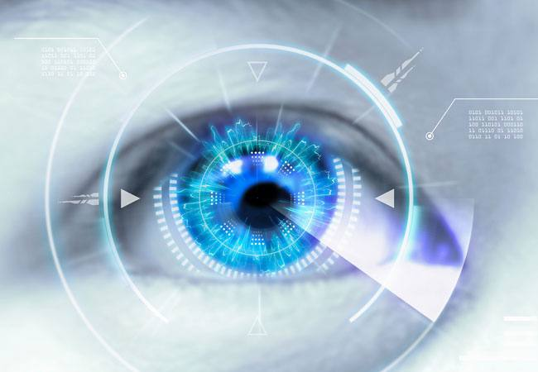
Cataract
Done by :-
Walid Azayzeh
Monther Al-Qatawneh

Slide 2
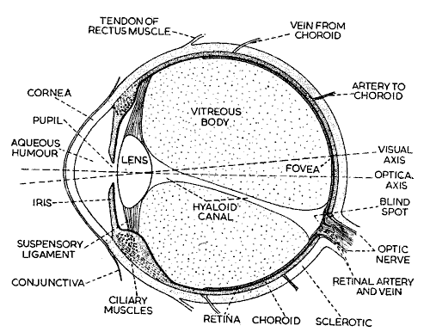

Slide 3
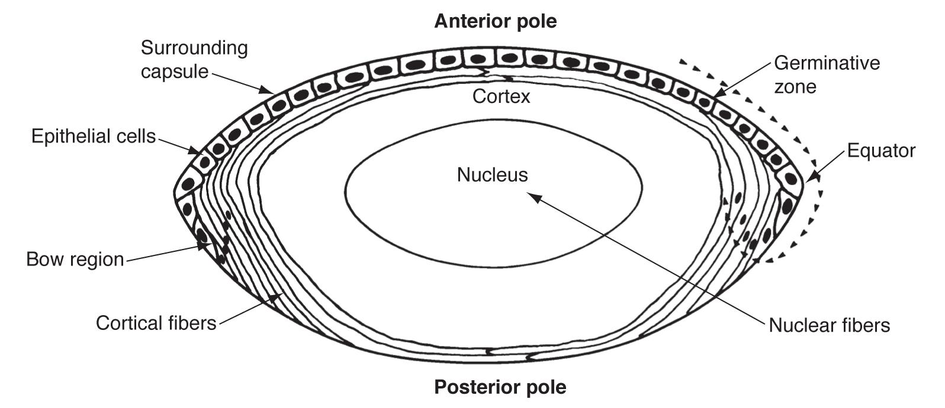
Lens
Is biconvex ,normally transparent and avascular structure .
It is held in position by the suspensory ligament

Slide 4
Cataract : cataract is a dense, cloudy area that forms in the lens of the eye cataract begins when proteins in the eye form clumps
Epidemiology:
the common cause of treatable blindness in the world
Typical onset 50 to 60 years ( gradual and progressive )
female = male

Slide 5
Cataract
Diseases that affect the lens may affect :
Structure
Shape
Position

Slide 6
Causes
Senile (age related ) : results from cumulative exposure to environmental and other influences such as smoking , UV light and blood sugar level
Pre-senile :- which may be associated with specific ocular or systemic diseases

Slide 7
Pre-Senile cataract associations : Systemic causes :
DM
Metabolic diseases Galactosemia ,Hypocalcemia )
Systemic drugs ( steroids , chlorpromazine)
Infection ( Cong. Rubella )
Myotonic dystrophy
Atopic dermatitis ( cause shield cataract )
Systemic syndromes ( Down”s Lowe”s)
Congenital Cataract ( inherited )
External radiation

Slide 8
Pre-Senile cataract associations : Ocular conditions :
Trauma
Uveitis
High myopia
Topical medications ( steroid and anti-psychotic )
Intraocular tumours

Slide 9
Nuclear Cataract
Cortical Cataract
posterior subcapsular cataract
mature cataract
Shield cataract
pre-senile traumatic cataract

Slide 10
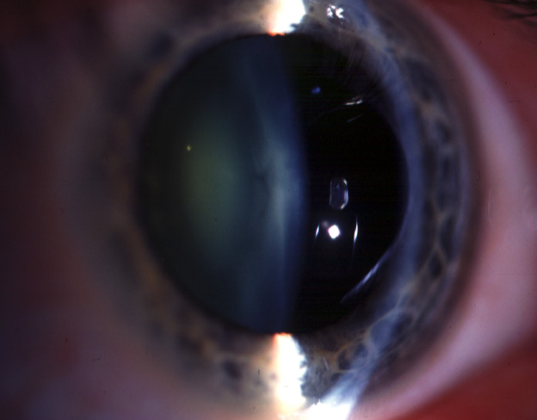
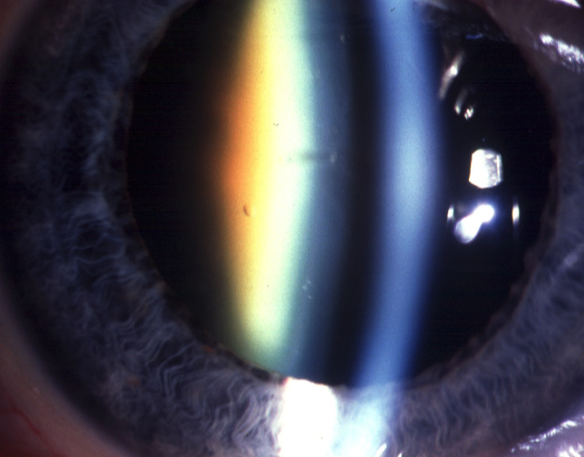
Nuclear cataract
Progression
Exaggeration of normal nuclear
ageing change
Increasing nuclear opacification
Causes increasing myopia
Initially yellow then brown

Slide 11
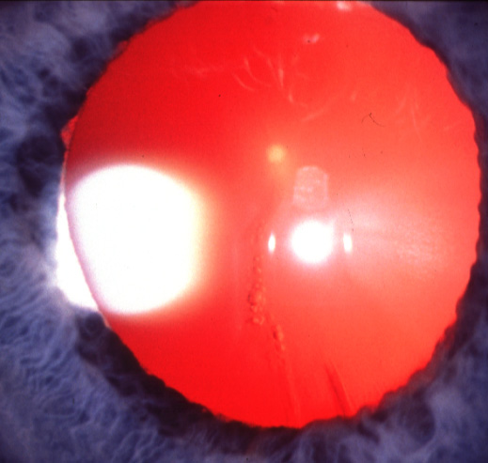
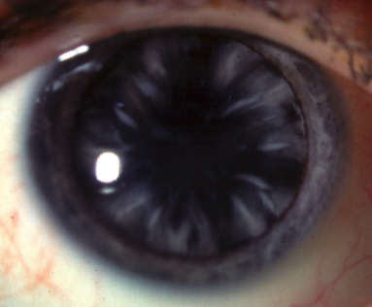
Cortical cataract
Progression
Initially vacuoles and clefts
Progressive radial spoke-like opacities

Slide 12
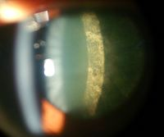
Posterior subcapsular cataract

Slide 13
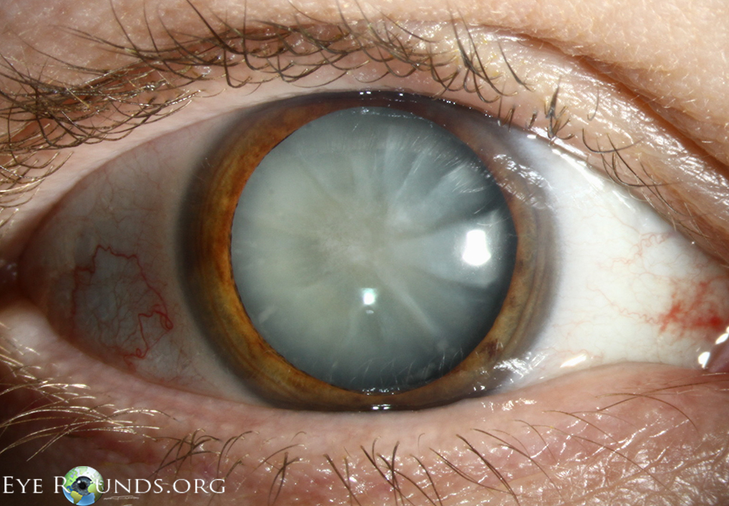
Mature cataract

Slide 14
Pre-senile traumatic cataract

Slide 15
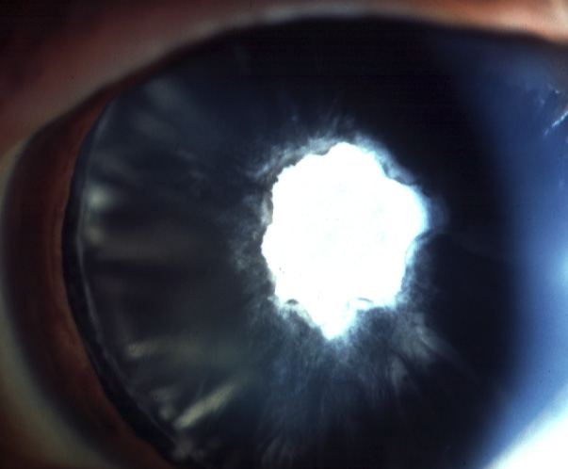
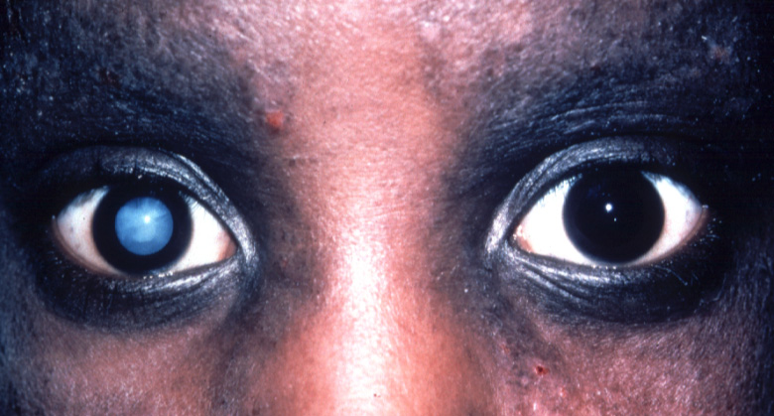
Other causes of cataract - atopic dermatitis
Cataract develops in 10%
of cases between 15-30 years
Anterior subcapsular plaque
(shield cataract ..درع
Bilateral in 70%
Wrinkles in anterior capsule
Frequently becomes mature

Slide 16
Symptoms :
1)Loss of vision
2) Glare
3) Change in refractive error
4) Leukocoria

Slide 17
Signs :
1) Decreased visual acuity especially when measured in light(VA)
2) Lens opacity
3) Black spot in the center of the red reflex

Slide 19
Treatment
SURGICAL
No more wait to RIPEN

Slide 20
Cataract surgery :
The operation involves removal of most of the lens
Replacement of the refractive power of the removed lens
Topical , LA and GA

Slide 21
Techniques
Phacoemulsification
Extra Capsular Cataract Extraction (ECCE ) : remove the lens but capsule still present
Intra Capsular Cataract Extraction
( ICCE ) : remove the lens with its capsule.

Slide 22
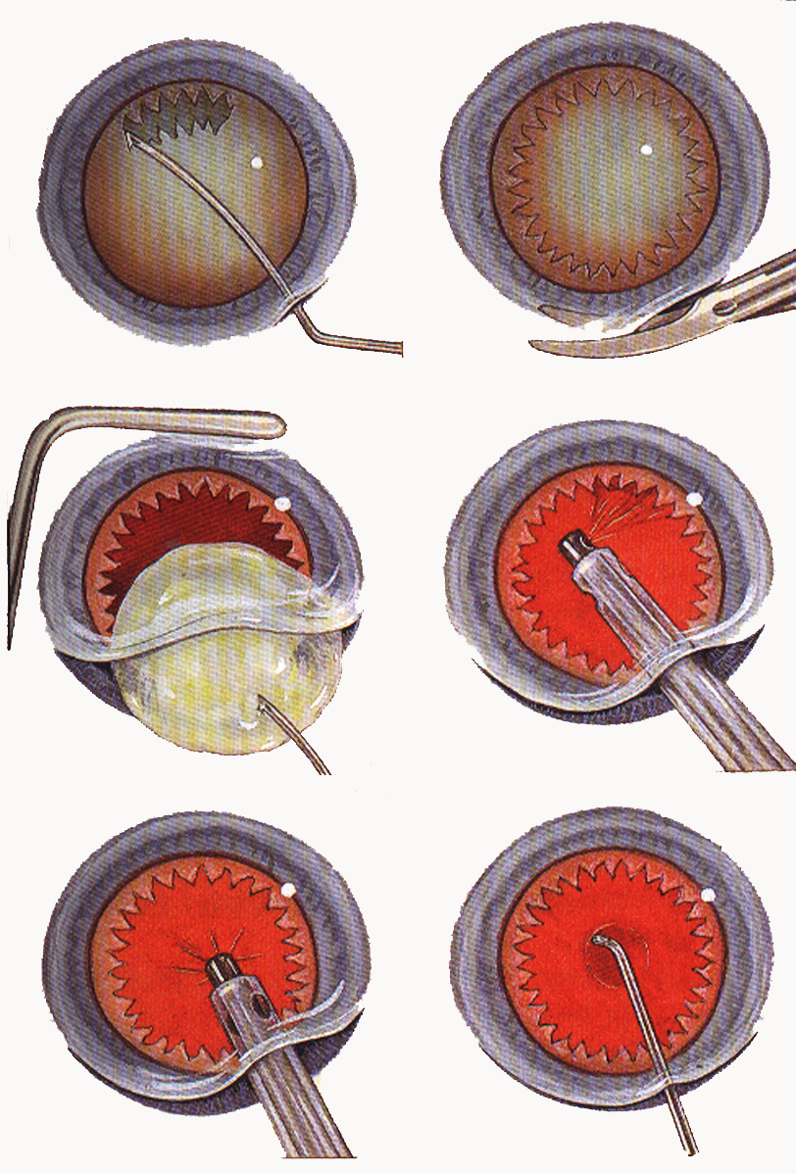
Extracapsular cataract extraction
1. Anterior
capsulotomy
2. Completion of
incision
3. Expression of
nucleus
4. Cortical cleanup
5. Care not to aspirate
posterior capsule
accidentally
6. Polishing of posterior
capsule, if appropriate

Slide 23
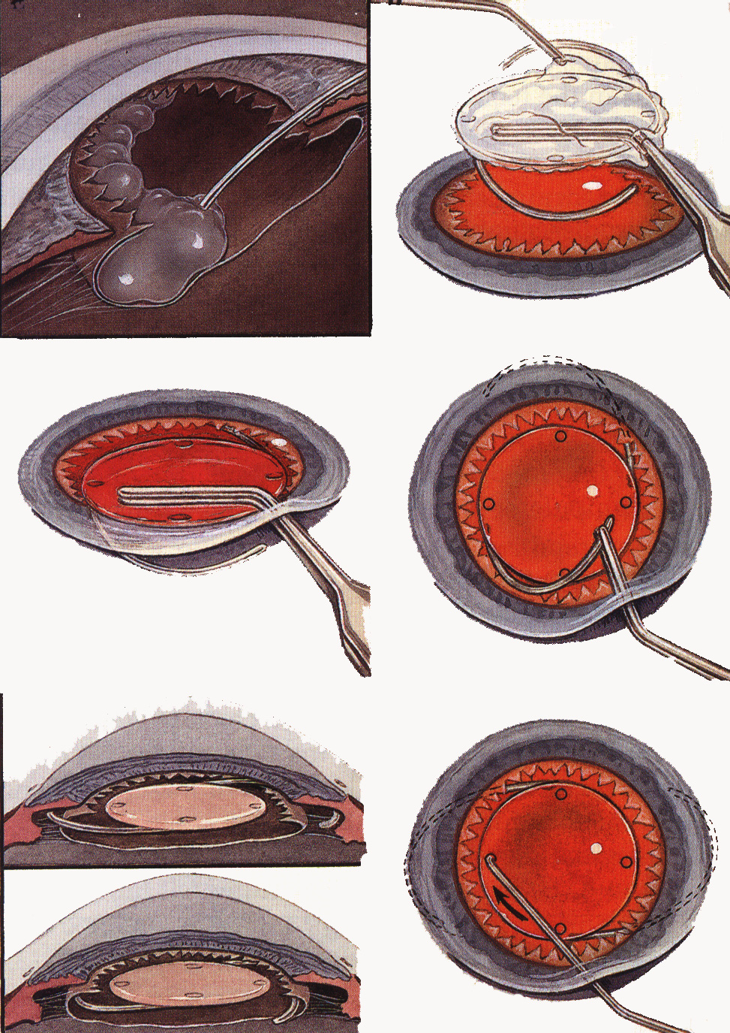
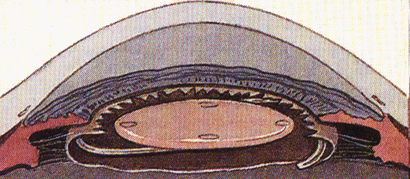
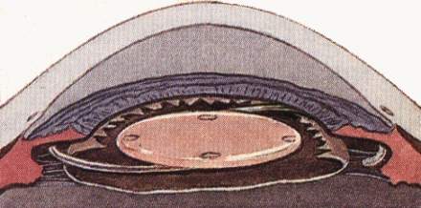
Extracapsular cataract extraction ( cont. )
7. Injection of viscoelastic
substance
8. Grasping of IOL and
coating with viscoelastic
substance
9. Insertion of inferior
haptic and optic
10. Insertion of superior
haptic
11. Placement of haptics
into capsular bag
and not into ciliary
sulcus
12. Dialling of IOL into
horizontal position

Slide 24
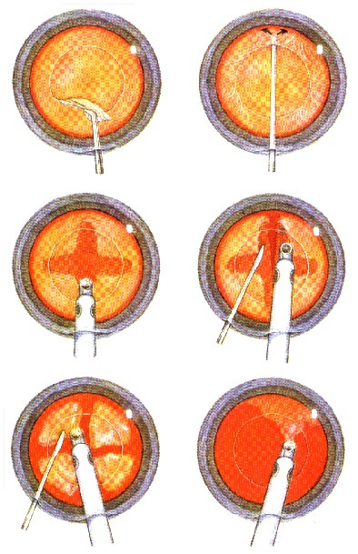
Phacoemulsification
1. Capsulorrhexis
2. Hydrodissection
3. Sculpting of nucleus
4. Cracking of nucleus
5. Emulsification of
each quadrant
6. Cortical cleanup and
insertion of IOL

Slide 26
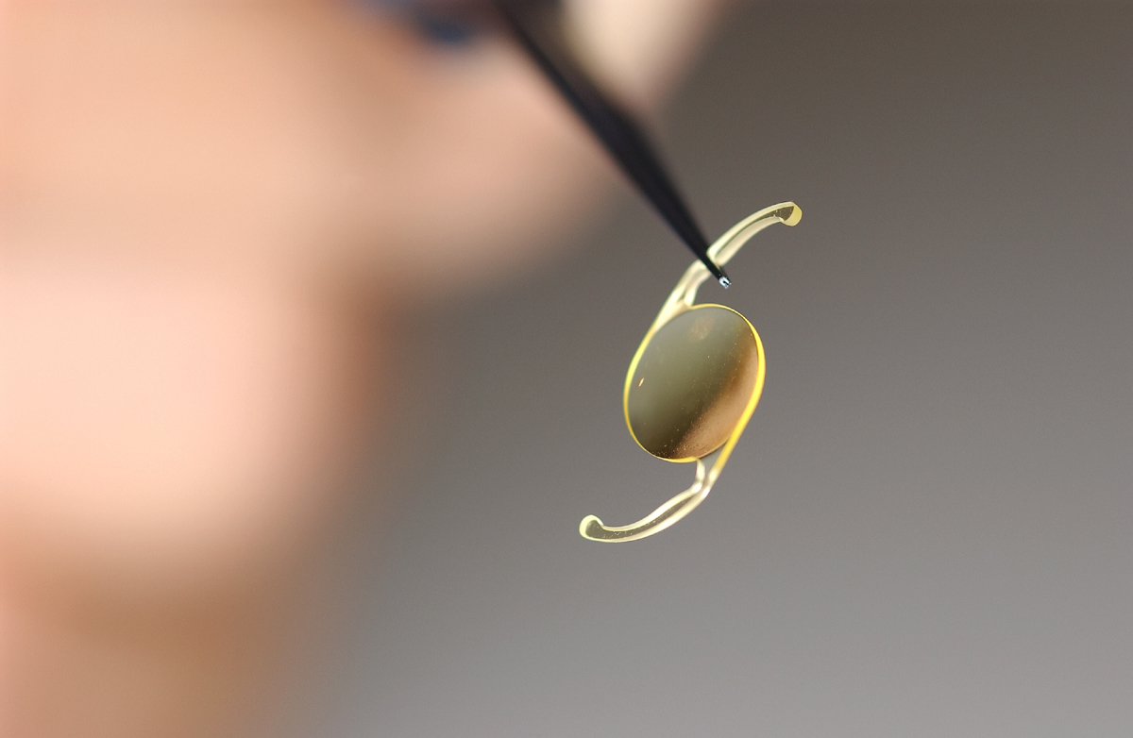

Slide 27
Techniques :
Phaco and ECCE involves removal of the lenticular material leaving part of the lens capsule mostly the posterior part to give supprot for the artificial lens that will be implanted .
ICCE removal of the whole lens

Slide 28
Compensation for the lens refractive power :
Artificial intraocular lenses made of inert synthetic material
Spectacle نظارة
Contact Lenses

Slide 29
Post-Operative care
Steroids ( topical ,systemic )
Antibiotics ( topical , systemic )
Near vision adds

Slide 30
Complications :
Vitreous loss
iris prolapse ( early postoperative comp. )
Endophthalmitis
Postoperative astigmatism
Macular edema
Retinal detachment
Opacification of the posterior capsule

Slide 31
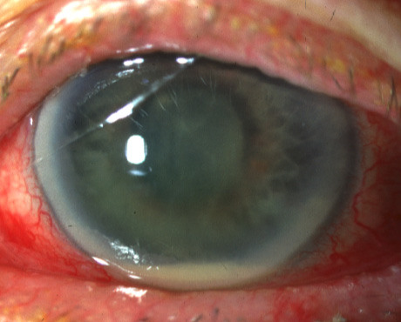
Acute bacterial endophthalmitis
Incidence - about 1:1,000
Common causative
organisms
Staph. epidermidis
Staph. aureus
Pseudomonas sp.
Source of infection
bacterial flora is most
frequent culprit
Contaminated solutions
and instruments
Environmental flora including that of surgeon and operating room personnel

Slide 32
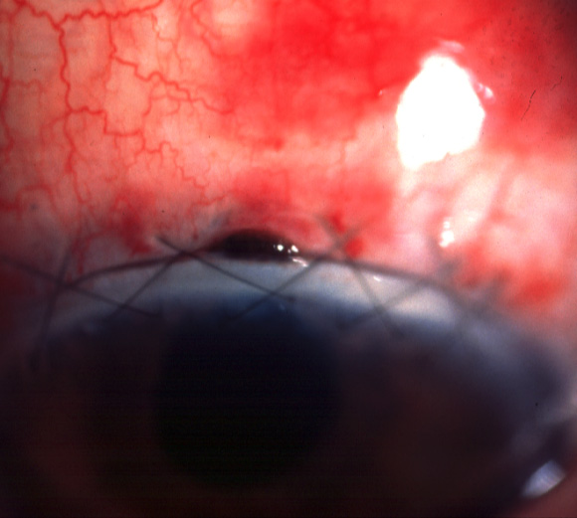
Early postoperative complications
Iris prolapse
Cause
Usually inadequate
suturing of incision
Most frequently follows
inappropriate management
of vitreous loss
Treatment
Excise prolapsed iris tissue
Resuture incision

Slide 33
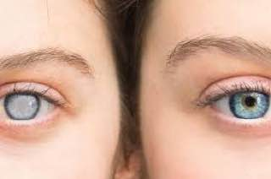
Thank you

