Slide 1
t-table Degrees of Freedom | Probability, p, level of significance, alpha, α
 | 0.1 | 0.05 | 0.01 | 0.001
1 | 6.31 | 12.71 | 63.66 | 636.62
2 | 2.92 | 4.30 | 9.93 | 31.60
3 | 2.35 | 3.18 | 5.84 | 12.92
4 | 2.13 | 2.78 | 4.60 | 8.61
5 | 2.02 | 2.57 | 4.03 | 6.87
6 | 1.94 | 2.45 | 3.71 | 5.96
7 | 1.89 | 2.37 | 3.50 | 5.41
8 | 1.86 | 2.31 | 3.36 | 5.04
9 | 1.83 | 2.26 | 3.25 | 4.78
10 | 1.81 | 2.23 | 3.17 | 4.59
11 | 1.80 | 2.20 | 3.11 | 4.44
12 | 1.78 | 2.18 | 3.06 | 4.32
13 | 1.77 | 2.16 | 3.01 | 4.22
14 | 1.76 | 2.14 | 2.98 | 4.14
15 | 1.75 | 2.13 | 2.95 | 4.07
16 | 1.75 | 2.12 | 2.92 | 4.02
17 | 1.74 | 2.11 | 2.90 | 3.97
18 | 1.73 | 2.10 | 2.88 | 3.92
19 | 1.73 | 2.09 | 2.86 | 3.88
20 | 1.72 | 2.09 | 2.85 | 3.85
21 | 1.72 | 2.08 | 2.83 | 3.82
22 | 1.72 | 2.07 | 2.82 | 3.79
23 | 1.71 | 2.07 | 2.82 | 3.77
24 | 1.71 | 2.06 | 2.80 | 3.75
25 | 1.71 | 2.06 | 2.79 | 3.73
26 | 1.71 | 2.06 | 2.78 | 3.71
27 | 1.70 | 2.05 | 2.77 | 3.69
28 | 1.70 | 2.05 | 2.76 | 3.67
29 | 1.70 | 2.05 | 2.76 | 3.66
30 | 1.70 | 2.04 | 2.75 | 3.65
40 | 1.68 | 2.02 | 2.70 | 3.55
60 | 1.67 | 2.00 | 2.66 | 3.46
120 | 1.66 | 1.98 | 2.62 | 3.37
infinity | 1.65 | 1.96 | 2.58 | 3.29

Slide 2
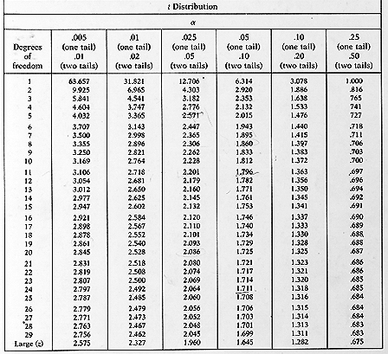

Slide 3
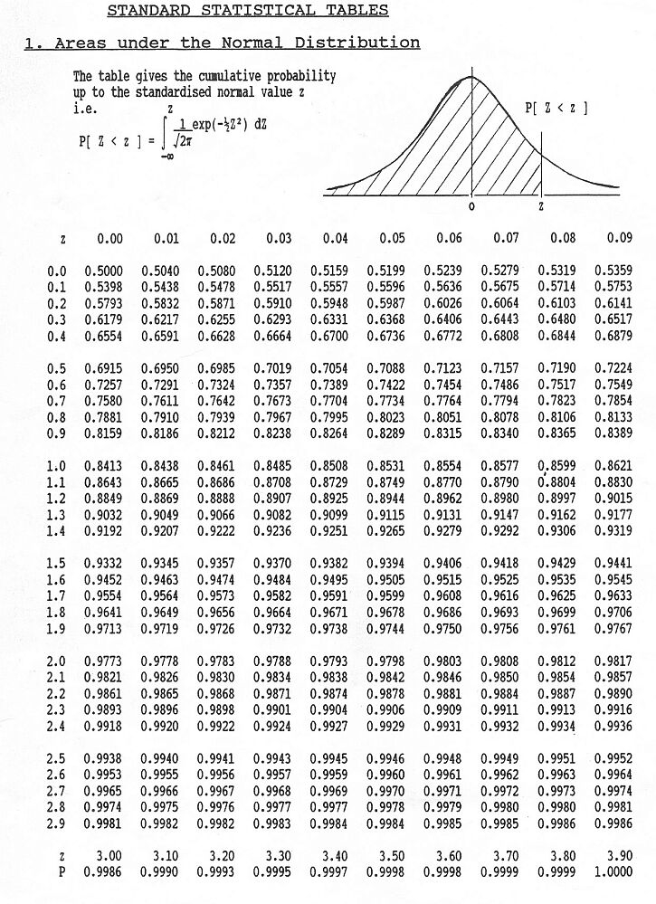

Slide 4
A sample of 100 teachers were selected randomly from schools at Al-Karak area. The mean systolic blood pressure for teachers in this sample was 110 mm Hg, and variance was 100.
[1] The degree of freedom for this sample is
100
109
110
99
Non of the above
[2] The standard error is
100
1
10
99
Non of the above
[3] The percentile rank of a teacher whose blood pressure 90 mm Hg, is closest to:
50th
25th
2nd
98th
Non of the above
[4] The blood pressure of a teacher in this sample with a z-score of 0.7 is
100 mm Hg
103 mm Hg
117 mm Hg
109 mm Hg
Non of the above
[5] The 95% confidence interval for blood pressure values is
110 ± 1.96 SE
100 ± 1.96 SE
100 ± 2.58 SE
90 – 110
Non of the above
[6] What area under the standard normal curve falls outside the Z values ±2.5 ?
a. .0062
b. .9876
c. .0124
d. .4938
e. non of the above

Slide 5
