Slide 1
Testicular tumor
Done By: supervised By : dr samer rawashdeh
Ayman Qtemat
Issa samardali
Qusai albajawi

Slide 2
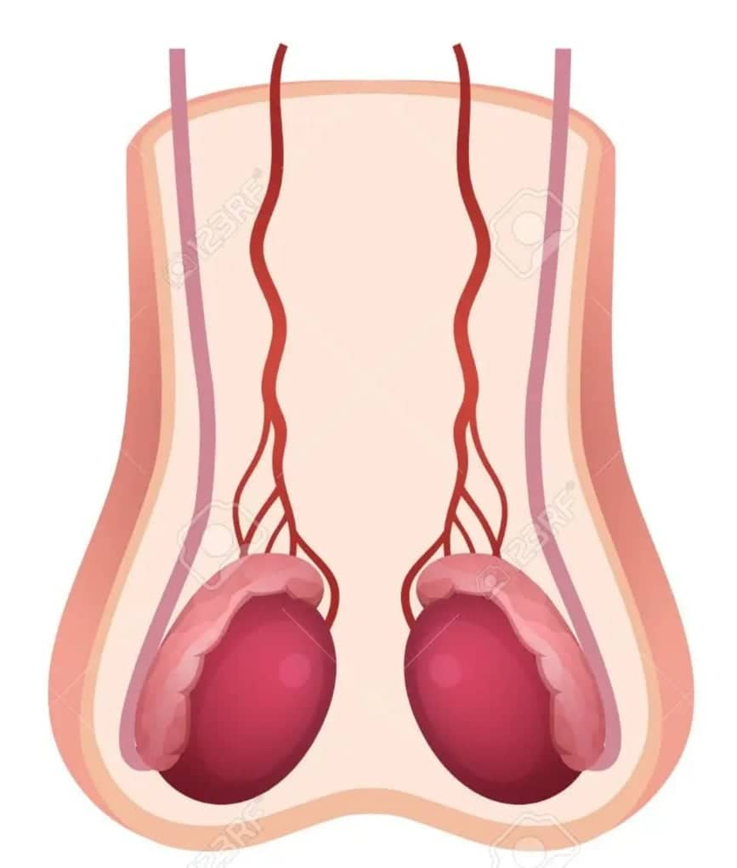
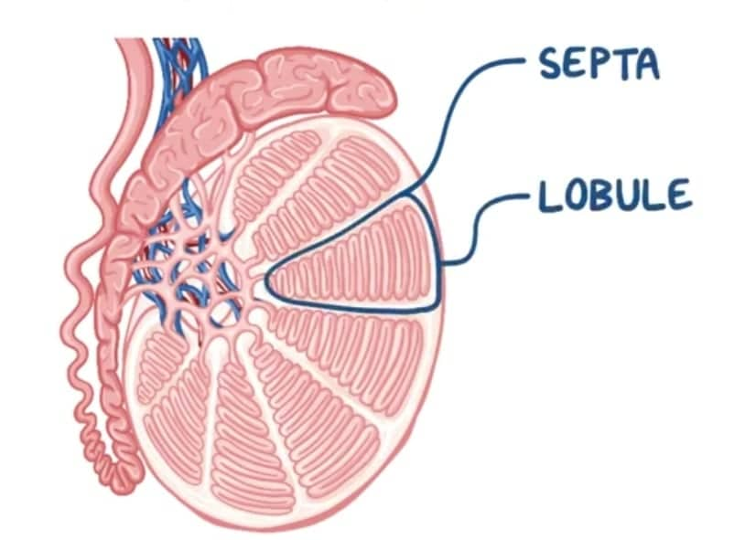
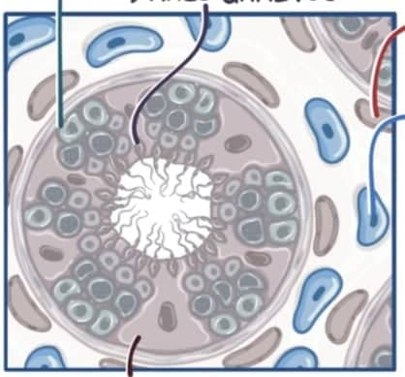
testis ( testicle ) : revission
The male gonads are the testes , located in the scrotum .
They serve two important functions :
1-hormon production ( androgen ) , such as testosterone .
2- sperm production . The male cells needed to fertilize female egg.
Covered by Tunica Albuginea ( white fibrous layer )
Each lobule contain up to 4 seminiferous tubules where sperm is synthesized
Three main cells :
1- germ cells ( spermatogonia ) :
Sperm production
2- sertoli cell :
Provide nutrients to developing sperm
3- leydig cell :
Testosterone hormone synthesis
Germ cell
Leydig cell
Sertoli cell

Slide 3
Incidence and mortality :
Most common solid tumor in males ages20-45, rare below 15y and above 60y
Constituting 1–2% of all male cancers and 5% of all urological tumours, It is considered the most curable cancer
The incidence is increasing in most European countries
But mortality is decreasing because of the introduction of platinum based chemotherapy
Risk factors :
1- Age: the commonest affected age group is 20–45y, with germ cell tumours.
2- Race: - white Caucasian people living in Europe and USA have the highest risk.
-Whites are three times more likely to develop TC than blacks in the USA.
-TC is rare in non-Caucasian races.
3-Previous TC: confers a 12-fold increased risk of metachronous TC.
4-cryptorchidism:Ultrastructural changes are present in these testes by age 3y, although earlier orchidopexy does not completely eliminate the risk of developing TC.
5- Human immunodeficiency virus (HIV): patients develop seminoma 35% more frequently than expected.
6- Genetic factors: appear to play a role, given that first-degree relatives are at higher risk by 4–9-fold, but a defined familial inheritance pattern is not apparent.
7- Maternal oestrogen exposure: during pregnancy increase risk of cryptorchidism, urethral anomalies, and TC in male offspring.
Trauma and viral-induced atrophy: have not been convincingly implicated as risk factors for TC.

Slide 4
Intratubular germ cell neoplasia (testicular intraepithelial neoplasia ,TIN):
synonymous with carcinoma in situ, although the disease arises from malignant change in spermatogonia; 50% of cases develop invasive germ cell TC within 5y.
The precursor lesion for most testicular GCTs, TIN may be observed adjacent to TC.
Risk factors include :
1-cryptorchidism 2- extragonadal germ cell tumour 3-atrophic contralateral testis (<12mL) 4- Klinefelter’s syndrome
5-previous or contralateral TC (5%) 6- and infertility.
It is present in the contralateral testis of up to 5% of TC patients.
If TIN is diagnosed, treatment is with radiotherapy.

Slide 5
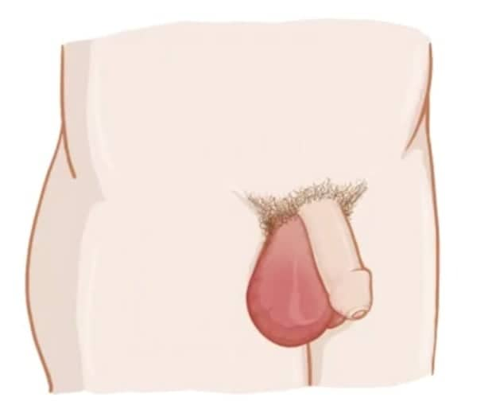
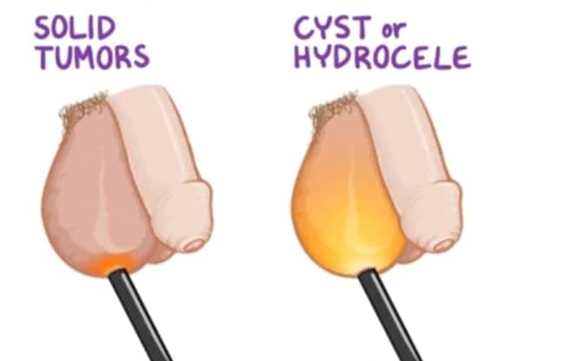
Symptoms :
1- Most patients present with a painless scrotal lump.
Delay in presentations not uncommon, particularly those with metastatic disease. This may be due to patient factors (fear, self-neglect, ignorance, denial) or earlier misdiagnosis.
2- 5% of patients develop acute scrotal pain due to intratumoural haemorrhage , causing diagnostic confusion.
3- 10% of patients develop symptoms suggestive of advanced disease, including weight loss, lumps in the neck, chest symptoms or bone pain.
More common on the right
Signs :
1-Observation may reveal asymmetry or slight scrotal skin discoloration.
2-palpation may reveal a hard , non-tender , irregular, non-transilluminable mass in the testis or replacing the testis.
3-assess the epididymis, spermatic cord, and overlying scrotal wall, which may be normal or involved in10–15% of cases.
4-Rarely , a secondary hydrocele may be present.
5-General examination may reveal cachexia , supraclavicular lymphadenopathy , chest signs , hepatomegaly , lower limb oedema, or abdominal mass , all suggestive of metastatic disease.
6- Gynaecomastia is seen in about 5% of patients with TC due to endocrine manifestations of some tumours.

Slide 6
Differential diagnosis :
causes of painless scrotal swellings :
1- Hydrocele
2- Spermatocele
3- Indirect inguinal Hernia
4- Syphilitic gumma
5- TB
most presentations of acute scrotal pain:
1-Epididimoorchitis
2- Epididymitis
3- testicular Torsion

Slide 7
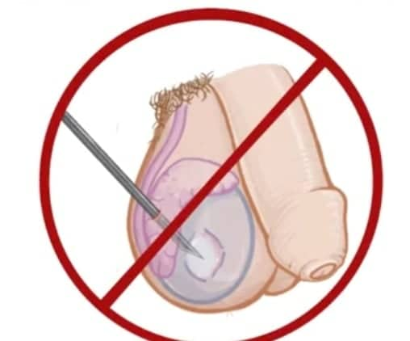
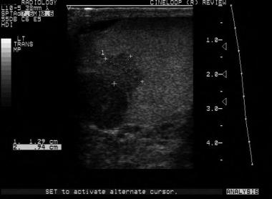
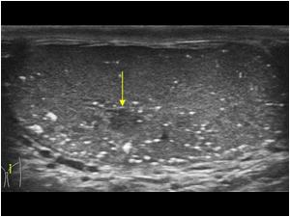
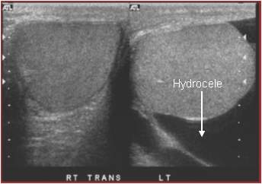
Investigation :
1- Ultrasound is the first-line investigation of any scrotal lump and will confirm whether the palpable lesion is within the testis.
The sensitivity of USS for detecting a testicular tumor is almost 100%, including impalpable lesions of 1–2mm and ‘occult’ primary tumours in patients presenting with systemic symptoms and signs.
Any hypoechoic area within the tunica albuginea should be regarded with suspicion.
2- abdominal and chest CT for staging purpose
Can identify small nodal deposits <2 cm
MRI and PET scan no advantage over CT

Slide 8
3- Serum tumor marker :
These tumor markers incorporated into staging system and used for making decisions regarding treatment
Clinical uses:
1- measured at presentation
2-1-2 weeks after radical orchidectomy
3- and during follow-up to assess response to treatment
4- Elevation after orchidectomy generally represents metastatic disease
5- Conversely normalization does not rule out metastatic disease .
2 main types :
1-oncofetal proteins
2-cellular enzymes

Slide 9
1- oncofetal proteins :
1- alpha fetoprotein :
is expressed by trophoblastic elements within 50–70% of teratomas and yolk sac tumours.
The presence of elevated serum AFP strongly suggests a non-seminomatous element , normally <10ng/mL.
Half-life: 4-6 days
Falsely elevated in liver dysfunction, viral hepatitis and ETOH
2- human chorionic gonadotrophin :
is expressed by syncytiotrophoblastic elements of : choriocarcinomas (100%),
teratomas (40%), and
seminomas (10%)
Half life 24-36 hours
Falsely elevated in hypogonadism and marijuana use
2-Cellular enzymes
1- Lactic Acid Dehydrogenase:
Presents normally in smooth, cardiac and skeletal muscle, liver and brain(therefore, less specific)
Most useful in monitoring treatment response in advanced seminoma or tumors where other markers are not elevated
Many false positives
LDH correlates to tumor burden
2- Placental alkaline phosphatase (PLAP):
is a fetal isoenzyme, elevated in up to 40% of patients with advanced germ cell tumours. It is not widely used as it is non-specific, may be elevated in smokers.

Slide 10
Spread :
1- TC spreads by local extension into the epididymis, spermatic cord, and rarely, the scrotal wall.
2- Lymphatic spread occurs via the testicular vessels, initially to the para-aortic nodes. Involvement of the epididymis, spermatic cord, or scrotum may lead to pelvic and inguinal node metastasis.
3- Bloodborne metastasis to the lungs( most common ), liver, and bones is more likely once the disease has breached the tunica albuginea.
TNM Staging:
Tumor: (pathological)
Node: clinical (physical examination, imaging with CT abdomen and chest)
Metastasis: involves physical examination, imaging(with CT), and biochemical investigations.
Stage 1 disease :
disease limited to the testis
Stage 2 disease
disease limited to lymph nodes
Stage 3 disease
disease involves distant areas

Slide 11
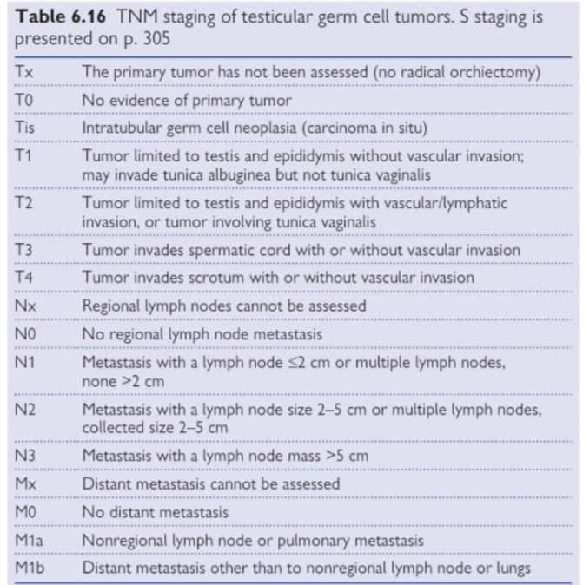

Slide 12
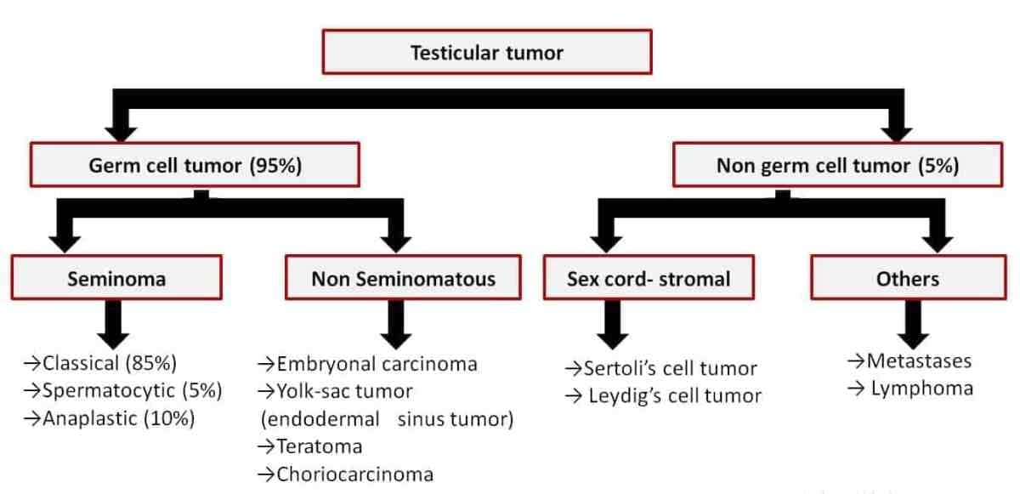

Slide 13
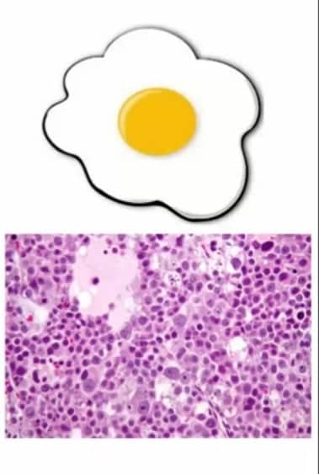
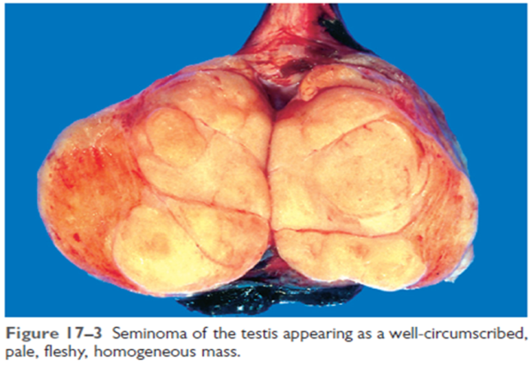
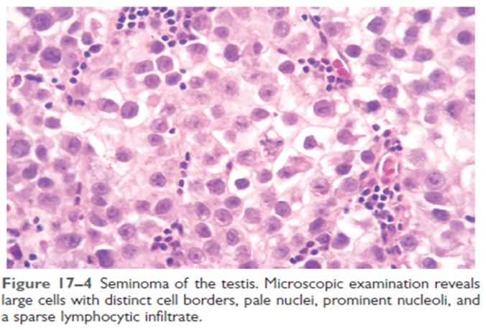
Seminoma :
Most common germ cell tumor
Pure seminomas never secrete AFP
5-10% secrete HCG (usually classic)
At diagnosis:
65-75% confined to the testis
10-15% with regional retroperitoneal nodes
5-10% with advanced juxtorenal or visceral disease
Types of seminoma :
1- classic (82-85%) : on age 30s
2-anaplastic (5-10%) :
3-spermatocytic (2-12%) : in older population , low metastasis potential
“ fried egg “ appearance .

Slide 14
Treatment of seminoma :
1- radical inguinal orchiectomy .
2- radiotherapy .
Radical inguinal orchiectomy :
Inguinal approach
Avoid seeding the scrotum and disrupting lymphatics
Wait 5 half lives before rechecking markers
Tis | Carcinoma in situ
T1 | Localized to tunica albugina
T2 | Invading tunica albugina & epididymis & showing vascular or lymphatic involvement
T3 | To spermatic cord
T4 | Invading the scrotum
N1 | Lymph node mass or multiple lymph node masses ≤ 2 cm in greatest dimension
N2 | Lymph node mass or multiple lymph node masses >2 cm but ≤ 5 cm in greatest dimension
N3 | Lymph node mass >5 cm in greatest dimension
Radical inguinal orciectomy :
Surgical removal of spermatic cord and testicle through inguinal canal
M1a | Nonregional ln mets or pulmonary mets
M1b | Other distant mets

Slide 15
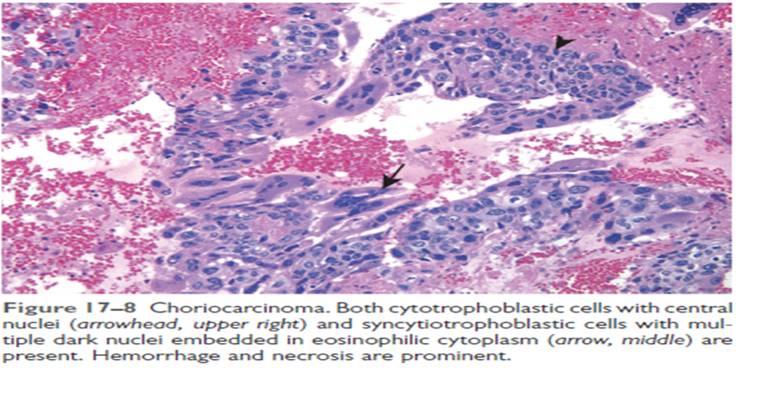
NSGCT :
1- Yolk Sac (Infantile embryonal)
Peak age: infants and children
Also may spread hematogenously
Secretes AFB and B-HCG
MOST COMMON TUMOR IN INFANTS AND CHILDREN
Epithelial like cells arranged in glands with vacuolated cytoplasm
( SCHILLER-DUVAL bodies )
2- Choriocarcinoma
Peak age 20-30
Worst prognosis of all testis tumors
Hematogenous spread (especially to lungs)
Always secrete B-HCG (100%)
Central hemorrhage, syncytiotrophoblasts (eosinophilic cytoplasm) and cytotrophoblasts (closely packed, clear cytoplasm, single nuclei)

Slide 16
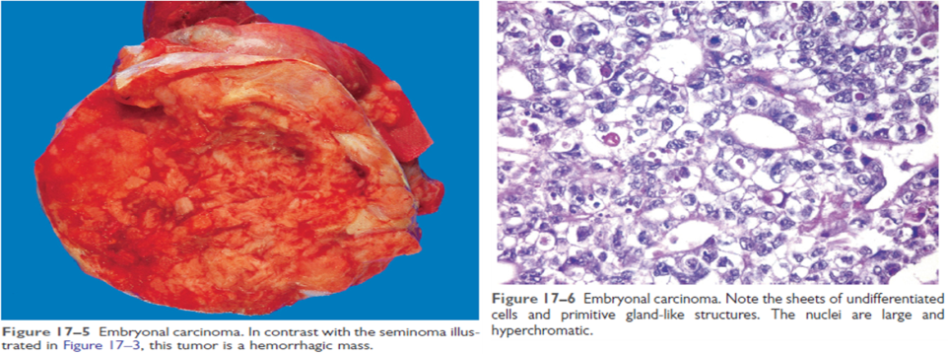
3- Teratoma
Peak age 25-35
Poor response to chemotherapy and XRT
Pure forms should not secrete AFB or B-HCG
Can arise from malignant transformation after chemotherapy for NSGCT
Contains all 3 germ layers in the mature form and is undifferentiated in immature form
4- Embryonal
Peak age 25-35
May secrete both AFP and B-HCG
Epitheloid cells in glands or tubules with pale cytoplasm, 1+ nucleoli and giant cells

Slide 17
Treatment of stage 1 :
1- RPLND
- Retroperitoneal lymphadenopsthy is usually the first and only evidence of extragonadal metastasis of NSGCT .
Allows for more accurate staging .
30% clinical stage I is pathologic stage II
Definitive treatment for N1 .
N2 will need post RPLND chemotherapy
Relapse rate 5-13% (5-10% outside of RPLND field: primarily in the lungs)
Treat relapses with chemotherapy
RPLND :
Major morbidity is ejaculatory dysfunction
Modified nerve sparing RPLND preserves function in 90-99%
Identify the sympathetic nerves
Dissection is limited to below the level of the IMA on the ipsilateral side only
2- Chemotherapy
Traditionally not used for lower stages
2 cycles of BEP(bleomycin, etoposide, platinum).
Added advantage of treating metastatic disease that RPLND misses
Initial data promising but long term unconfirmed

Slide 18
Surveillance :
Surveillance requires the following:
1- Year 1:
monthly clinic visit, serum markers and chest X-ray, abdominal CT – months 3 and 12 .
2- Year 2:
2-monthly clinic visit with serum markers and chest X-ray, abdominal CT –months 24 .
3- Years 3, 4, and 5: 3-monthly clinic visit, serum markers, and chest x-ray .
4- Annual clinic visit, serum markers, and chest X-ray thereafter to 10y
Relapse rate 25% and usually occurs in first 8-10 months (commonly outside of the retroperitoneum)

Slide 19
Treatment IIA-IIB
1- RPLND
Advocated for lower volume disease
Cures 50-70% of stage IIa/b without further intervention
2- Chemotherapy
Favored for patients with nodes >3cm
If markers normalize but residual mass is seen on CT, RPLND is advocated
20% residual cancer
40% teratoma
40% fibrosis
Relapse or residual cancer is treated with salvage chemotherapy (VIP) – vinblastin, ifosfamide, cisplatin
Treatment IIC-III
Primary chemotherapy
In IIC disease with partial response, may proceed to RPLND
Salvage chemotherapy or high dose chemotherapy with autologous bone marrow transplant
No response to first line chemotherapy
Incomplete resection after RPLND

Slide 20
Summary of treatment in NSGCT :
After orchiectomy :
1- stage 1 :
RPLND +/- chemotherapy ( if relapse )
2- stage 2A+2b :
RPLND + chemotherapy
3- stage 2C+ stage 3 :
Chemotherapy
Histolopathology | Notes :
Fried egg appearance | 1- M . C germ cell tumor 2- never secrete AFP | Seminoma
Schiller-duval bodies | 1- M.C in children | Yolk sac
Two cells L 1- cytotrophoblast 2-syncytiotrophoblast | 1- most aggressive 2- 100% beta HCG 3-spread hematogenously | Choriocarcinoma
Three germ cell layers | Mature vs immature | teratoma
Epitheloid cell and giant cells with pale cytoplasm |  | Embryonal
Prognosis :
Seminoma (at 5 years)
I: 98%
IIA: 92-94%
IIB-III: 33-75%
NSGT (at 5 years)
I: 96-100%
IIA: >90%
IIB-III: 55-80%

Slide 21
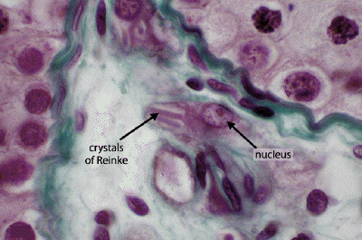
Leydig Cell
usually secret androgen causing precocious puberty in children or gynecomastia in adults.
1-3% of all testis tumors
Bimodal age distribution: ages 5-9 and 25-35
Bilateral in 5-10%
No association with cryptorchidism
Prepubertal children may present with virilization and elevated urinary 17-ketosteroid levels,
adults are usually asymptomatic (25% gynecomastia)
Treatment: radical orchiectomy and RPLND for malignant tumors (10% malignant)
Histopathology :
Solid sheets of cells with oval nuclei
Reinke crystals (fusiform shaped cytoplasmic inclusion) are pathognomic al though rare

Slide 22
sertoli cell :
Less than 1% of all testicular tumors
Bimodal age of distribution: < 1 year and 20-45 years old
10% lesions are malignant
Virilization seen in children and gynecomastia in adults
Radical orchiectomy with RPLND in malignant disease
Gonadoblstoma :
0.5% of testicular tumors
Seen in patients with gonadal dysgenesis
4/5 patients are phenotypic females with streak gonads
Radical orchiectomy with gonadectomy of the contralateral gonad (bilateral in 50%)
testicular lymphoma :
Old age more than 60 years
Usually bilateral

Slide 23
Thank you

