Slide 1
Gastric cancers
Presented by :
Wala’a Nawaiseh
Batool Alhrout
Eman Odibat
Firas Nawaiseh
Supervised by:
Dr Saad Alazzawi

Slide 2
Outlines
▶ Gastric adenocarcinoma
▶ Gastric lymphoma
▶ Gastrointestinal stromal tumors (GIST)

Slide 3
Gastric Cancers (GC)

Slide 4
Gastric Cancers (GC)
Common Primary
Adenocarcinoma (95%),
Lymphoma (4%),
Malignant GIST (1%)
Rare Primary
Carcinoid, Angiosarcoma, Carcinosarcoma, and Squamous cell carcinoma
Secondary From :
Melanoma , Breast(Blood born)
Colon or Pancreas (Direct ext.)
Ovary (By peritoneal seeding )

Slide 5
Gastric Adenocarcinoma:
▶ Worldwide : Fifth most common cancer and third most common cause of cancer related deaths.
▶ Incidence and mortality are declining in developed countries.
▶ Twice higher incidence and mortality in blacks/Asians.
▶ Male to female 2:1
▶ Geographical discrepancy (higher incidence in Japan/East Asia).
▶ Requires treatment in a high volume tertiary centers
▶ Multidisciplinary approach for treatment offers better outcome
(nutritional,endoscopic,surgical,medical, radiation oncologists)

Slide 6
GC Worldwide incidence
Western
Europe
Male 16.4
Female 8.2
Male 36.3
Female 16.9
Male 77.9
Female 33.3
Male 10.8
Female 4.9
Male 43.6
Female 19.0
Male 5.9
Female 2.6
Male 11.5
Female 4.3
Male 18.6
Female 13.3
Male 8.4
Female 4.0
Eastern
Europe
Japan
Australia/ New Zealand
China
Northern Africa
Southern
Africa
In terms of geographic distribution, high rates apply to Japan, China and Eastern Europe and low rates to North America.
Pazdur R et al. Cancer management: A multidisciplinary approach. edition,2002
Central
America
North America

Slide 7
Risk factors :
▶ H.pylori infection :Usually with prolonged infection >10 years
▶ Diet salted, smoked, poorly preserved food
▶ Occupations: metal, mines, rubber, wood, asbestos workers
▶ Obesity
▶ Genetics
▶Smoking
▶Alcohol is NOT a risk factor
▶ Hyperplastic polyps : less risk factor than in colon ca (villous, >1 cm)
▶ Chronic atrophic gastritis (need H.pylori eradication
▶ Chronic non- healing gastric ulcers
▶ Pernicious anemia
▶ Blood group A

Slide 8
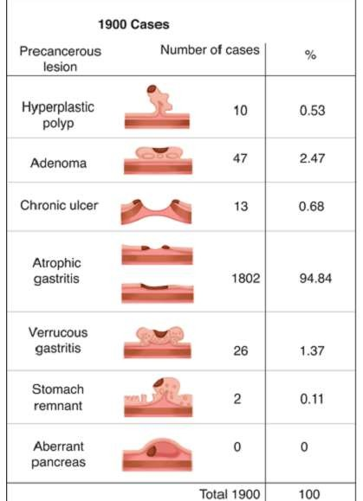
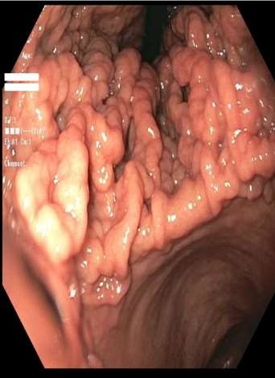
Precancerous changes
▶ precancerous diseases
▶ chronic atrophic gastritis
▶ gastric ulcer
▶ gastric polyps
▶ gastric remnant
▶ Ménétrier's disease
▶ precancerous lesion
▶ atypical hyperplasia

Slide 9
Pathology :
▶ Arises from the mucus producing cells, not the acid producing ones.
▶ Various classifications schemes for gastric CA.
▶ Anatomical : (according to the site):
Proximal (cardia) 🡪 might be treated as pure gastric or considered distal esophageal (siewert )
Distal (non cardia) – more with H.pylori infection.
Diffuse (9%) , linitis plastica

Slide 10
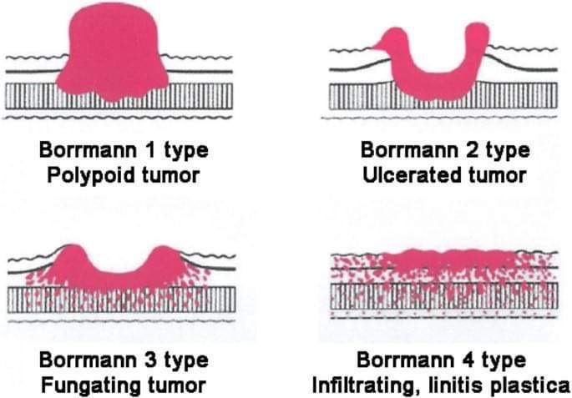
2- Bormann’s Classification
▶ Classification on gross appearance of the lesion

Slide 11
▶ 3- Histopatholigical (lauren classification) 🡪 the most adapted classification
Intestinal type :
- more in elderly, males.
usually well to moderately differentiated.
associated with metaplasia / chronic / atrophic gastritis.
More distal and localized than proximal
more tendency to spread through lymphatics and hematogenously.
liver is the m.c site of mets.
Better prognosis
Diffuse type :
- more in younger , females
- usually poorly differentiated + signet ring cells
- without gastritis
-More proximal
-spread transmurally with local invasion, lymphatics and peritoneal mets.
-Usually worse prognoses

Slide 12
Spread Patterns
▶ Direct invasion / transmural
▶ Lymph node dissemination
▶ hematogenous spread
▶ Transperitoneal/transcoelemic spread

Slide 13
Clinical Presentation :
▶ Asymptomatic, discovered incidentally
▶ Early gastric CA :
No obvious signs and symptoms.
Vague epigastric abdominal pain for months , Mistreated as dyspepsia or PUD.
▶ Progress to more obvious epigastric pain, anorexia, weight loss and vomiting +/- hematemesis
(most common Sx’s)
▶ Dysphagia also in proximal tumors.
▶ Symptoms of G.O.O in distal tumors (indicate locally advanced disease)
▶ Palpable epigastric mass in 30%.
▶ Chronic anemia
▶ Sx’s & Sx’s of large bowel obstruction. (invasion to transverse colon)

Slide 14
▶ Signs and symptoms of metastatic disease : (40% have stage IV disease on presentation
palpable left supraclavicular (Virchows) LN.
palpable periumbilical (Sister Mary Joseph’s) nodule.
Blumer’s shelf on DRE. (palpable peritoneal deposit)
ascites.
Jaundice.
Palpable ovarian mass (Krukenberg tumor).
▶ Elective vs. Emergency presentation ( G.O.O , perforating malignant gastric
ulcer, upper GI bleeding)

Slide 15
Diagnosis / Assessment / Staging
▶ Full Hx and PEx (age, chronicity of pain and non response to usual antacids)
▶ CBC (anemia) , KFT , LFT (usually normal but can be elevated in liver mets)
▶ CEA :
High in only 30%.
Not useful for diagnosis / screening
Useful in monitoring response to treatment, surveillance for recurrence.
▶ Assessment of nutritional status (weight, BMI, serum albumin, pre-albumin, zinc, Mg++ )
▶ AXR : (distended stomach in GOO, perforation, obstruction)

Slide 16
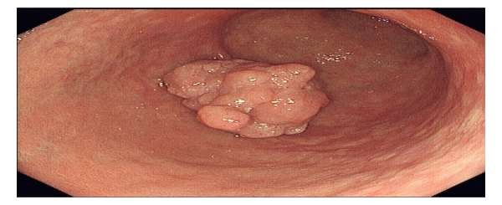
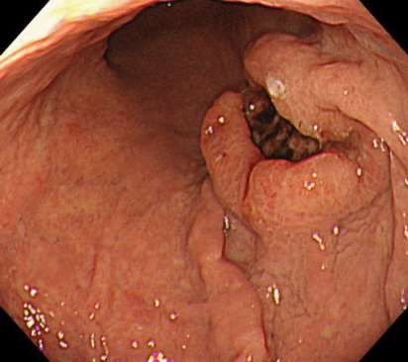
▶ Upper Endoscopy :
The Gold standard for diagnosis
Allows direct anatomical localization for planning surgery.
Confirms Dx and histopathological features with biopsy.
Possible stenting for obstructed inoperable disease.
95 % accuracy

Slide 17
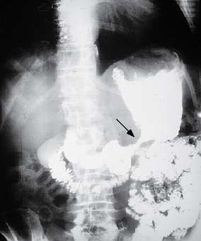
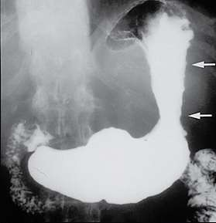
Barium swallow
75% accuracy
for obstructive lesions only
Apple core sign”
Linitis plastica "leather-flask" appearing stomach

Slide 18
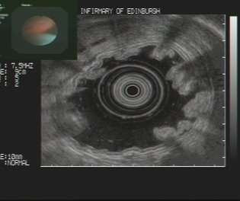
▶ Endoscopic Ultrasound (EUS) :
Utilizes both endoscopy + direct Ultrasound imaging.
The most specific and sensitive for determining the ‘T’ stage of the tumor
Very accurate in evaluating the local LN status ‘N’ stage.
Allows sampling of local LN
for locally advanced gastric CA.

Slide 19
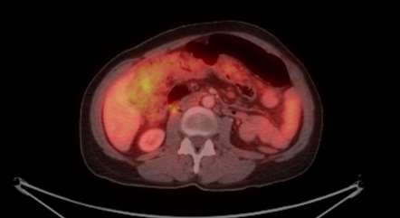
▶ Contrasted CT (chest/abd/pelvis) :
Usually for staging purposes
Solid organ mets, non regional LN mets
Ascites
Large peritoneal deposits
▶ Limitations : early gastric ca, small <5mm peritoneal and
liver mets
▶ PET/CT :
CT combined with FDG radiolabeled glucose
More uptake by metabolically active cells (including
malignant cells)
Improve detection of occult mets than regular CT , but
still limited.

Slide 20
▶ Staging Laparoscopy :
▶ Now considered a Standard of care in locally advanced gastric CA
▶ Before initiation of treatment.
▶ Performed in O.R by inserting 1,2 or 3 trocars
▶ Complete inspection of the abdominal cavity for small mets (peritoneal surfaces, mesentry, under surface of diaphragm and liver surface)
▶ Advantages :
Identify small mets that are missed by CT (<5mm).
Obtain tissue biopsy of suspicious nodules
Perform peritoneal lavage and fluid cytology
Local disease status (involvement of adjacent organs)
▶ Among patients deemed to have non metastatic disease initially, 36% of patients were actually stage IV disease which alter the treatment (occult peritoneal mets 21%, +ve wash cytology 13%, liver mets 6%) – in a study performed at MD Anderson cancer center –Texas, USA.
▶ Might need to be repeated after NACTX, before definitive surgery.

Slide 21
Staging of Gastric Adenocarcinoma (TNM)
▶ Necessary for 1-determining extent of disease, 2-planning of tx, 3- reflecting prognosis.
▶ (T) :
Tis : carcinoma in situ, high grade dysplasia.
T1 : tumor invading submucosa/lamina propria.
T2 : tumor invading muscularis propria.
T3 : tumor invading subserosa without visceral peritoneium.
T4 : tumor invading serosa (visceral peritoneium) or adjacent organs.
▶ (N) :
N0 : no evidence of local LN involvement, N1 : 1-2 LN, N2: 3-6 LNs, N3 : 7 or more LNs.
- +ve LN makes it stage III
▶ (M): 🡪 M0 : no distant mets, M1: distant mets (stage IV)
▶ Mets to non-regional LNs (mesenteric,para-aortic,portal,retroperitoneal) is M1.(stage IV)
▶ +ve abd wash cytology is M1 (stage IV)
▶ Staging might change after surgery

Slide 22
Treatment :
▶ Various factors contribute to treatment selection:
Clinical stage of the disease
Patient related factors (Age, co-morbidities)
▶ Possible treatment options
1.Chemotherapy (Neoadjuvant, Adjuvant, palliative):
Neoadjuvant :for any patients with locally advanced non metastatic disease on clinical pre-op staging T3/T4, N+, M0 (stage II, III)
Adjuvant chemotherapy :-Given as a continuation of pre op chemo regimen or for those who have higher stage than before surgery (pts who were thought to be less than T1/2,N-)
2.Radiotherapy (only for palliation)
3.Endoscopic resection (very early disease, selected patients):
Only for early disease confined to mucosa (Tis, T1a)N0M0
Absolute indications : well differentiated, <2cm, no ulceration, T1a

Slide 23
4.Surgical resection (mainstay of treatment, the only curative one)
GOAL is to remove the tumor with at least 5cm tumor free margins and performing routine Lymphadenectomy.
Extent of gastrectomy depends on the anatomical location of the tumor and might include total/ subtotal or distal gastrectomy
Total gastrectomy : (for proximal and midbody tumors) -Removal of the whole stomach and reconstruction with ROUX en-Y configuration
Partial (distal/subtotal) gastrectomy: (for antral/distal tumors)Removing part of the stomach with remaining proximal gastric pouch (supplied by short gastric vessels),reconstruction can be done with Billroth II OR with ROUX en-Y configuration
Splenectomy :
-Only if spleen or splenic hilum are involved , no rule for prophylactic routine splenectomy
Multivisceral organ resection : (e.g. pancreas, transverse colon):
For T4 tumor involving adjacent organ/s
Only if you can get –ve margins, patient can tolerate it, and no mets

Slide 24
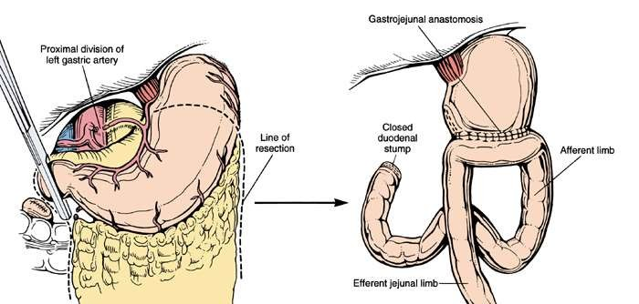
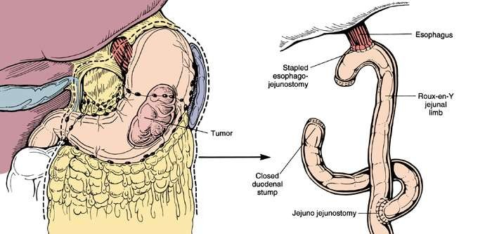

Slide 25
▶ Lymphadenectomy (LN dissection) :
Current recommendation is D1 dissection
D1:Removal of all Nodal tissue within 3 cm of the primary tumor.
D2: D1+ removal of hepatic,splenic,celiac,and lymph gastric lymph nodes ; involves splenectomy and partial pancreatectomy to remove parasplenic and parapancreatic nodes when these are drainage sites of primary.
D3: D2+ removal of para-aortic nodes.

Slide 26
Metastatic gastric adenocarcinoma
▶ 40% of pts present with metastatic disease at diagnoses.
▶ 36% of patients who were initially deemed to have a non metastatic disease found
to be metastatic
▶ Some patients might be non metastatic but not fit for curative treatment and
surgery (severe comorbidities, locally unresectable disease)
▶ Some pts may have recurrence after curative treatment
▶ The goal of treatment in all of these patients is only palliative (improve symptoms and quality of life only)- less chance of bleeding, perforation, relief of obstruction

Slide 27
▶ Palliative treatment options :
▶ Chemotherapy (minimal prolongation of survival, improve symptoms)
▶ Radiotherapy (decrease tumor size, less chance of
bleeding/obstruction/perforation)
▶ Ascites : repeated tapping.
▶ Endoscopic : (stenting for obstruction, management of bleeding)
▶ Surgical :
Palliative bypass (gastrojejunostomy)
Gastrostomy tube for decompression
Palliative resection not advised for most of patients

Slide 28
▶ Survival :
Depends on stage, completeness of resection
5 yrs- survival :
local disease 50-80%,
- +ve LN 30%,
Metastatic 5%
▶Post op follow up / surveillance:
In clinic every 3 months in the first 2 years , then every 6 months
Include full Hx, PEx, labs
Endoscopy at 1,2,5 years if partial gastrectomy only
CT scan every 6 months in the first 2 years , then annualy
▶ Recurrence :
High even after complete resection (30%)
Most occur in the first 2 years (80%)
Can be local (surgery site) ,
distant (liver) ,
peritoneal mets
Carry a dismal prognoses (6 months survival)
Treated as palliative only (usually chemotherapy)

Slide 29
Gastric Lymphoma :
▶ 5% of gastric neoplasms.
▶ The Stomach is the commonest extranodal primary site for non-Hodgkin's lymphoma
▶ Secondary Lymphoma is commonly seen in stomach from another site
▶ The histologic types
low-grade B-cell lymphomas of the mucosa-associated lymphoid tissue (MALT) type.
high-grade diffuse large B-cell lymphoma (DLBCL);
Mixed containing both
▶ chronic gastritis and infection with H. pylori is the main predisposing factor
▶ Symptoms :
▶ pain (88%), anorexia(47%), weight loss (25%), bleeding (19%), and vomiting (18%).
▶ Obstruction and perforation, Anaemia and epigastric mass.

Slide 30
Investigations
Labs: CBC, LDH , B2-macroglobulin, bone marraow biopsy
Staging CT
Endoscopy + biopsy (histology + test for H.pylori) Might need deep biopsies
EUS is the best modality.

Slide 31
Treatment :
▶ Early low grade MALT lymphoma 🡪 H.pylori eradication therapy
▶ Assessment of response with endoscopy, most pt will have complete remission
▶ persistent MALT lymphoma after H. pylori therapy 🡪 external beam radiation
(90% to 100% rate of complete response)
▶ Single agent chemotherapy +/- Rituximab
▶ For DLBCL : combination of chemotherapy (R-CHOP)
▶ Autologous stem cell transplantation
▶ surgical intervention in bleeding, perforation, obstruction, and residual disease
after primary therapy.
▶ 5 yrs-survival : 90% for low grade, 50% for high grade tumors.

Slide 32
Gastrointestinal Stromal Tumors (GIST)
Historically, these lesions were classified as leiomyomas or leiomyosarcoma
<1 % of gastric CA
mesenchymal tumors
Arises from interstitial cells of Cajal (pacemakers of GI motility)
95% stain with Ab against c-KIT (CD117) 70% stain for CD34
3-5% of the remainder of KIT-negative GISTs contain PDGFR-alpha mutations.
Solitary , grows extraluminaly to a large size
Variable clinical behavior, from slow-growing indolent tumors to aggressive malignant
cancers with the propensity to invade adjacent organs, metastasize to the liver, and
recur locally within the abdomen.
Site, size (>5cm) and mitoses(>5HPF) determines indolent vs more aggressive tumors
- The stomach is the most common site of GIST. Other includes small bowel, colon and
rectum

Slide 33
GIST tumours
▶ Presentation-
▶ might be asymptomatic/ discovered incidentally or
Abdominal pain
Anorexia
Nausea, Vomiting
Weight loss
Epigastric fullness
Early satiety
Bleeding/perforation/obstruction

Slide 34
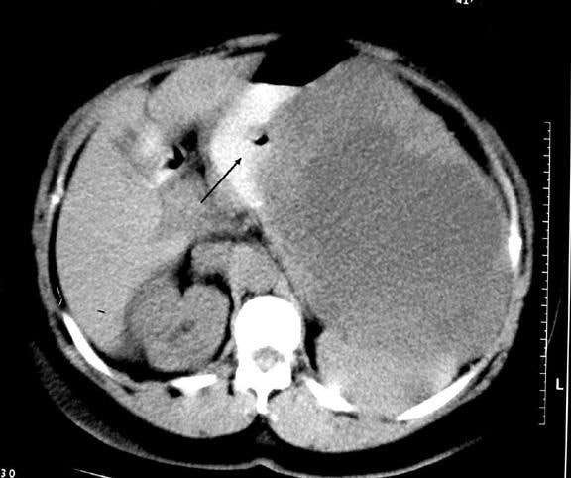
Investigations:
▶ Labs
▶ Barium swallow, u/s , and AXR gives limited informations
▶ CT scan 🡪 very important to obtain
- site, size, characteristics of tumor, relation to surrounding
organs
mets)
▶ Endoscopy : (sometimes misses submucosal lesions)
▶ EUS better than endoscopy , also can obtain biopsy.
▶ Biopsy is not always indicated if dx is suggestive and surgery Is
needed anyway

Slide 35
GIST tumours
▶ Treatment
▶ Surgery-local excision of tumor with 1cm –ve margins
Lymph node clearance unnecessary as spread is not common
Large tumors may need formal gastrectomy+/- adjuvant therapy (imatinib)
Tumor rupture/spillage during surgery and positive margin significantly worsens the
prognoses
▶ Medical therapy consists of tyrosine kinase inhibitors (TKI), c-KIT inhibitor imatinib mesylate
(Gleevec).
Preoperatively, to enable resectability or decrease morbidity by shrinking the tumor
After surgery, to decrease recurrence
In metastatic disease, as definitive treatment
In recurrent, unresectable disease, as definitive treatment

Slide 36
Thank you
Sources and references:
Schwartz’s Principles of Surgery eleventh edition.
Bailey & Love's Short Practice of Surgery
Past material

