Slide 1
Risk Management in Healthcare
Dr. Israa Al-Rawashdeh MD,MPH,PhD
Faculty of Medicine
Mutah University
2022

Slide 2
First, Do Not Harm
Primum non nocere
Hippocratic Oath
BUT….
Things can go wrong sometimes!

Slide 3
Definition of Risk?
“ A POTENTIAL THREAT OR POSSIBILITY THAT AN ACTION OR EVENT WILL ADVERSELY AFFECT THE ABILITY TO ACHIEVE DESIRED OBJECTIVE AND that may be avoided through preventive action/s”
DESIRED OBJECTIVE: NO SURPRISES !!!

Slide 4
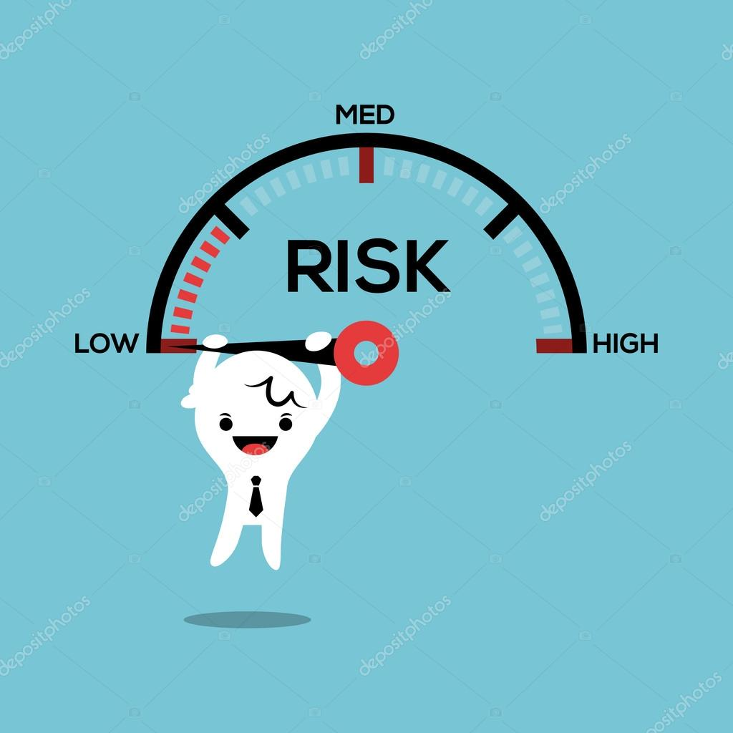
Risk
Risk is described both qualitatively and quantitatively.
“ Qualitatively , risk is proportional to both the expected adverse impact which may be caused by an event and to the probability of this event.
“ In statistics , risk is often mapped to the probability of some event which is seen as undesirable .”

Slide 5
Categories of Risk in healthcare
Patient care-related risks
Medical staff-related risks
Employee-related risks
Property-related risks
Organizational risks
Financial risks

Slide 6
Patient Care-related Risks
Risk associated with clinical practice – direct patient care and indirect.
Direct association with patient care:
Consequences of inappropriate or incorrectly performed medical treatments
Confidentiality and appropriate release of information
Protection from abuse, neglect and assault
Was patient informed of risks?
Non-discriminatory (equal) treatment
Indirect patients care :
security, personal, infection control, management of buildings and the environment.

Slide 7
Medical Staff-related Risks
Was the patient properly managed?
Do we have adequately trained staff?
Medical Staff-related Risks:
Occupational safety and health,
Working practice,
Legislative requirements,
Training and education.

Slide 8
Employee-related Risks
Maintaining a safe environment
Employee Health Policy
Risk of occupational illness and injury
Provision for the treatment and compensation of workers for work-related illnesses or injuries

Slide 9
Property-related Risks
Losses of assets due to fires, floods, etc.
Loss or damage of paper and/or electronic records
Presence of insurance to protect facility from losses
Organizational risks
Claims management,
Communication and information technology development.

Slide 10
Examples of risk in healthcare
Healthcare-acquired infections
Violent Incidents in Hospitals
Preparedness for Pandemics
Disruptive Staff Behaviour
Environmental Pollutants
Emergency Preparedness

Slide 11
Examples of Projects that Pose risk
New equipment: The purchase of anything from a new brand of tongue depressors to a new robotic operating system
New physical space: Expansion of the existing physical space or moving to a new location
Additional staff: The hiring of clinical or administrative staff
Additional services: The addition of services provided to your patients, such as an in-house pharmacy or imaging equipment.
Expansion of population services: The addition of community outreach initiatives, such as flu shots provided at the local community center.
Technology: The use of technology or enabling physicians to access patient information from outside the facility so they can provide interpretation and consults.

Slide 12
Risk management
Is the organized effort of strategies determined to reduce the negative impact of risk.
There are two ways :
Reactive vs proactive
Reactive: strategy is a response based approach to risk. A plan that specifies what actions staff members should take after an adverse outcome has occurred.
Proactive : a plan to prevent the opportunity for an adverse outcome (harm) before it happens.
Reactive strategies should be studied to determine if a proactive strategy might be developed to prevent this specific outcome from happening again.

Slide 13
RISK MANAGEMENT STEPS

Slide 14
Step1: Establish the Context
Establishing the context defines the scope for the risk management process and sets the criteria against which the risks will be assessed.
It is done by an evaluation of the external and internal factors that may currently impact the healthcare system.
Risks can arise due to external or internal influences:
External risks are exposures that result from conditions that the health system commonly cannot influence, such as the structural factors (economic, political or demographic structure), situational factors (focusing events, natural disasters, epi/pandemics), cultural factors (society norms) or international factors (globalisation, donors).
Internal risks are exposures that derive from decision-making and the use of internal and external resources, including the health system operations and its objectives

Slide 15
Step2: Identify Risks
Risk identification is the process whereby the healthcare professional and the healthcare employees become aware of the risks in the health care services and environment.
The risks identified are entered in the Risk Management Tool (RMT) (See next slide)

Slide 16
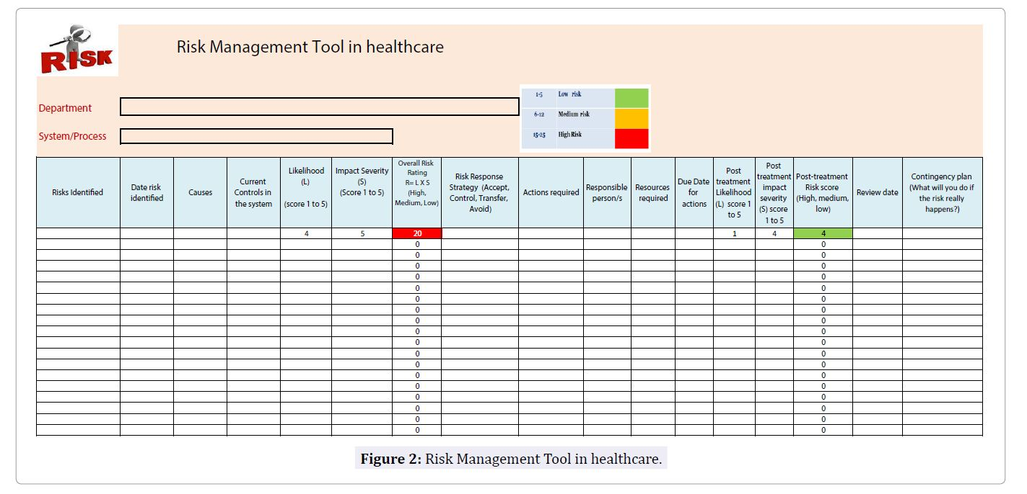

Slide 17
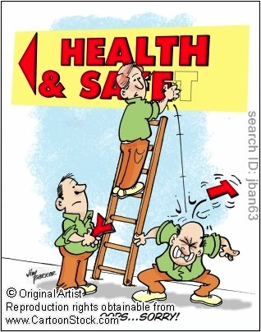
Step2: Identify Risks
(what can go wrong?)
Identify why and how can it happen
Consider the possible causes and scenarios of each risk identified.
Cause - identify the potential triggers that may result in the risk event occurring. A single risk event may have a specific cause or multiple possible causes. A single cause may be applicable to multiple risks.
Consequence - identify the possible impact should the risk event occur. A single risk event may have a specific consequence or multiple possible consequences. A consequence may be common across multiple risks

Slide 18
Sources of risk identification
Step2: Identify Risks
Discussions with department Chiefs, managers and staff
Patient Tracer Activity (Tracing the journey of a patient from admission till discharge)
Retrospective screening of patient records
Reports of accreditation bodies
Incident reporting system & unanticipated events
Healthcare associated infections (HAI) reports
Patient complaints and satisfaction survey results
Specialized committee reports (such as Morbidity and mortality committee, medication management and use, Infection control, blood utilization, facility management and safety committee).

Slide 19
Step3: Analyse & Evaluate Risks
Analyze Risks: Risk analysis is about developing an understanding of the risks identified. It includes the following:
Analyse inherent risk - What is the likelihood and consequence of a risk event if it were to occur in an uncontrolled environment?
Identify and evaluate controls - What existing controls are in place to address the identified risk and how effective are these controls in design and operation?
Analyse residual risk - What is the likelihood and consequence of a risk event if it were to occur in the current control environment?

Slide 20
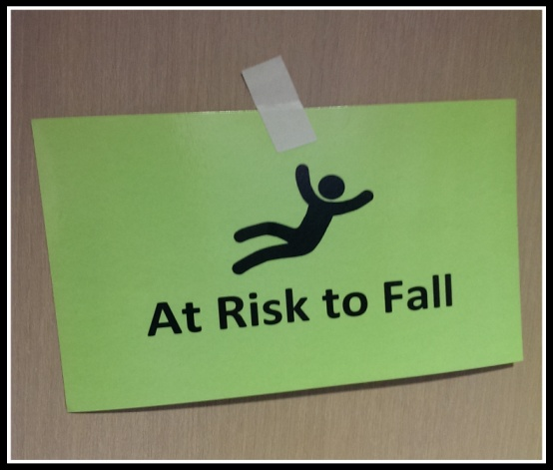
who is exposed to the harm?
Identify Who is at Risk
3 groups: staff, patients, and visitors.
Physical, financial, psychological harm

Slide 21
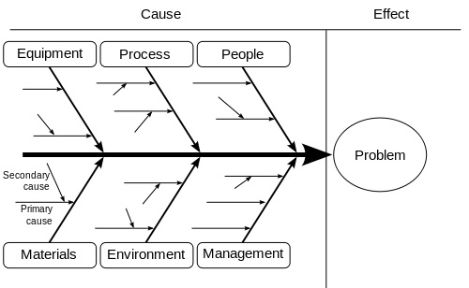
Step3: Analyse & Assess Risks
Risk analysis can be done using Root Cause Analysis (RCA)

Slide 22
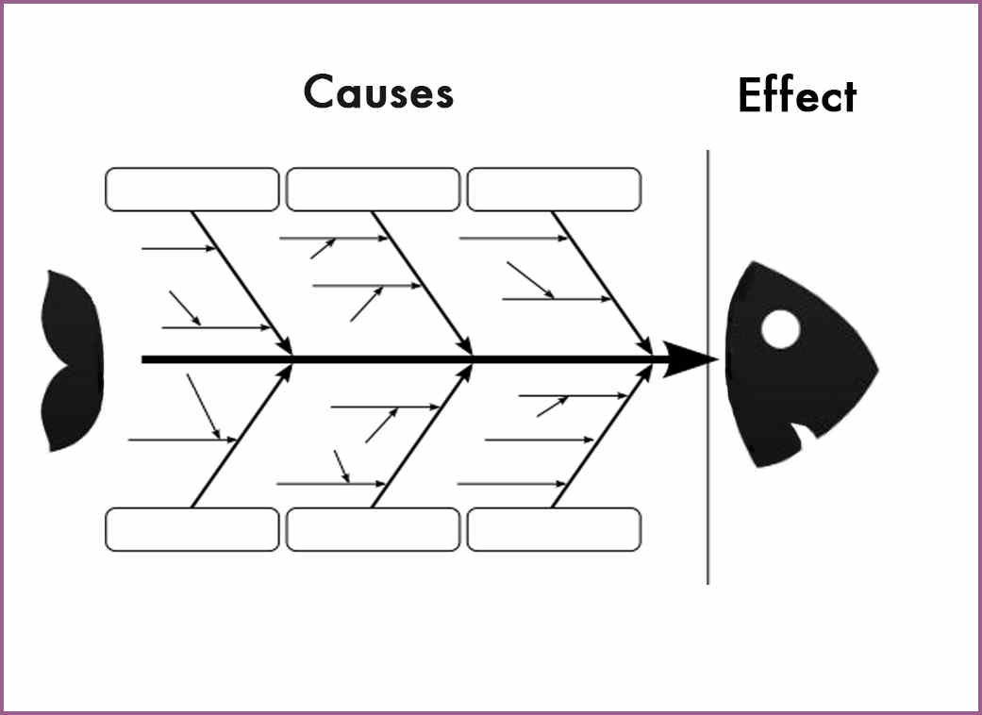
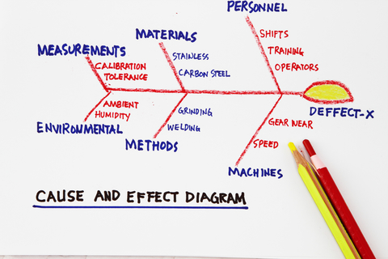
Root Cause Analysis
Fishbone diagram
Systematic Approach
Best method to do RCA is brain storming!
The purpose is to prevent recurrence at lowest cost in the simplest way.
A root cause : if removed from the problem-fault-sequence prevents the final undesirable outcome from recurring.
A causal factor is one that affects an event's outcome, but is not a root cause (i.e. removing a causal factor can benefit an outcome, it does not prevent its recurrence with certainty)
Not all problems have a single root cause.

Slide 23
RCA example:
Environment

Slide 24
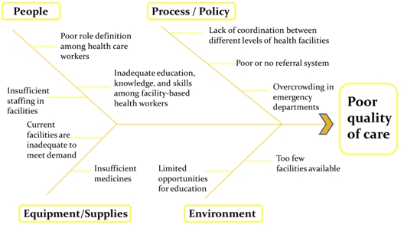

Slide 25
Step3: Analyse & Assess Risks
Risk assessment: Determine the Risk Level
Risk score (R) = Likelihood (L) × Severity of impact (S)

Slide 26
Risk Assessment
Quantitatively or Qualitatively
In Quantitative Risk Assessment (QRA) a numerical estimate is made of the probability that a defined harm will result from the occurrence of a particular event.
Require measurable and objective data for determining asset value, probability and risk values.
More accurate
Difficult to implement
Large scale complex organizations

Slide 27
Example

Slide 28
Qualitative risk assessment:
Categorization of the risks
Relies on the risk assessor’s experience and knowledge (subjective rating system)

Slide 29
Categories
Low risk = probability of any harm is unlikely (<10%); any harm caused could be minor or insignificant
Medium risk = probability of harm is moderate (10%—50%); any harm caused could be moderate; preventive measures can reduce possibility; moderate limitations should be initiated
High risk = probably of harm is likely or almost certain (>50%); any harm caused could be major or catastrophic; preventive measures can somewhat reduce probability; strict limitations must be initiated

Slide 30
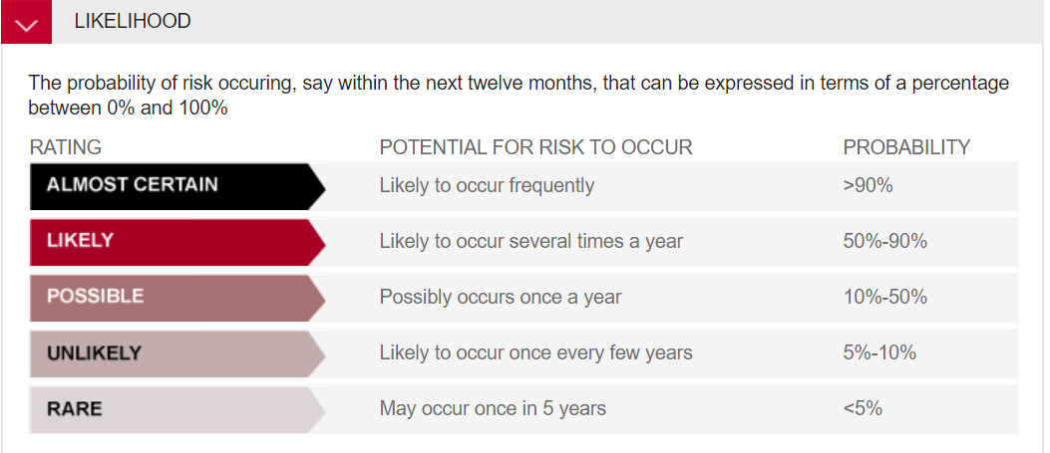
Likelihood Risk score (R) = Likelihood (L) × Severity of impact (S)
Based on the expertise, knowledge!
1-5 score
5
4
3
2
1

Slide 31
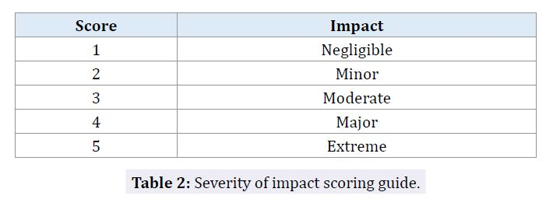
Severity of impact (S) Risk score (R) = Likelihood (L) × Severity of impact (S)
Severity of impact indicates the impact of harm to service users, employees, service provision, environment or the organization.
The scoring ranges from 1 (Negligible impact) to 5 (Extreme impact).

Slide 32
Risk Impact Areas
People
Economic
Information
Property
Reputation
Capability

Slide 33
Examples of impact severity
 | Insignificant | Negligible | Moderate | Major | Extreme
People | Minor injury or first aid treatment | Injury requiring treatment by medical practitioner and/or lost time from workplace. | Major injury / hospitalization | Single death and/or multiple major injuries | Multiple deaths
Property | Minor damage or vandalism to asset. | Minor damage or loss of <5% of total assets | Damage or loss of <20% of total assets | Extensive damage or loss <50% of total assets | Destruction or complete loss of >50% of assets
Economic | 1% of budget (organizational, division or project budget as relevant) | 2-5% of annual budget | 5-10 % of annual budget | > 10% of budget | > 30% of project or organizational annual budget

Slide 34
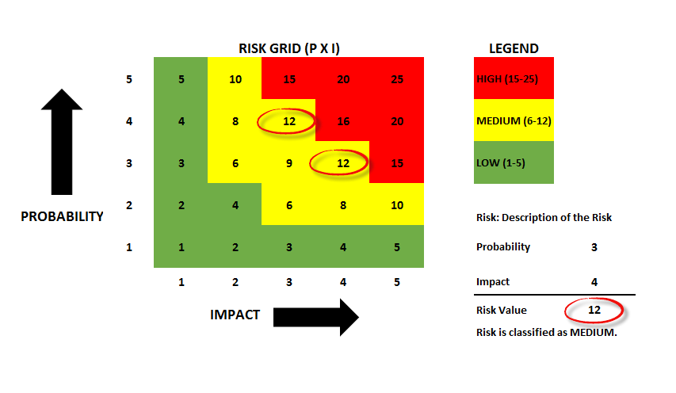
Risk Assessment matrix Risk score (R) = Likelihood (L) × Severity of impact (S)
Slip on wet floor

Slide 35
Step 4: Treat risk
The purpose of risk evaluation is to prioritize the risks based on risk analysis score and to decide which risks require treatment and the mode of treatment.

Slide 36
Controlling Risk
Step 4: Treat risk
Determine the action
Risk Avoidance – This strategy involves a decision on the part to avoid completely a particular risk by discontinuing the operation producing the risk e.g. the replacing a hazardous chemical by one with less or no risk potential.
Risk Reduction (mitigation) – Here the risks are systematically reduced through control measures, and by implementing a strategy that is designed to reduce the likelihood or consequence of the risk to an acceptable level. This occurs when risk avoidance is considered to be excessive in terms of time or expense.

Slide 37
Controlling Risk
Step 4: Treat risk
Risk Transfer – This refers to the legal assignment of the costs of certain potential losses from one party to another. The most common way is by insurance. The third-party accepting the risk should be aware of and agree to accept this obligation.
Risk Retention – making decision that the risk rating is at an acceptable level or that the cost of the treatment outweighs the benefit.
This option may also be suitable in situations where a residual risk remains after other treatment options have been put in place or no treatment option is available.
No further action is taken to treat the risk. However, ongoing monitoring is recommended. Usually occurs in case of frequent but low severity risks.
Residual Risk: Residual risk is the risk that remains after we apply controls. It's not always feasible to eliminate all the risks. Instead, we take steps to reduce the risk to an acceptable level. The risk that's left is residual risk.

Slide 38
Develop a risk treatment plan
Step 4: Treat risk
Determine the level of treatment plans required for each risk level. For example, for risks rated as ‘high', a treatment plan must be developed. However for risks rated as ‘low' and ‘very low' that have improvement opportunities, development of a treatment plan may be chosen according to other factors.
For each risk identified in the risk assessment, detail the following:
Specify the treatment option selected - avoid, reduce, share/transfer or accept.
Document the treatment plan - outline the approach to be used to treat the risk. Any relationships with other risks should also be highlighted.
Assign an owner - who is accountable for monitoring and reporting on progress of the treatment plan implementation.
Specify a target resolution date - where risk treatments have long lead times, consider the development of provisional measures.

Slide 39
