Slide 1
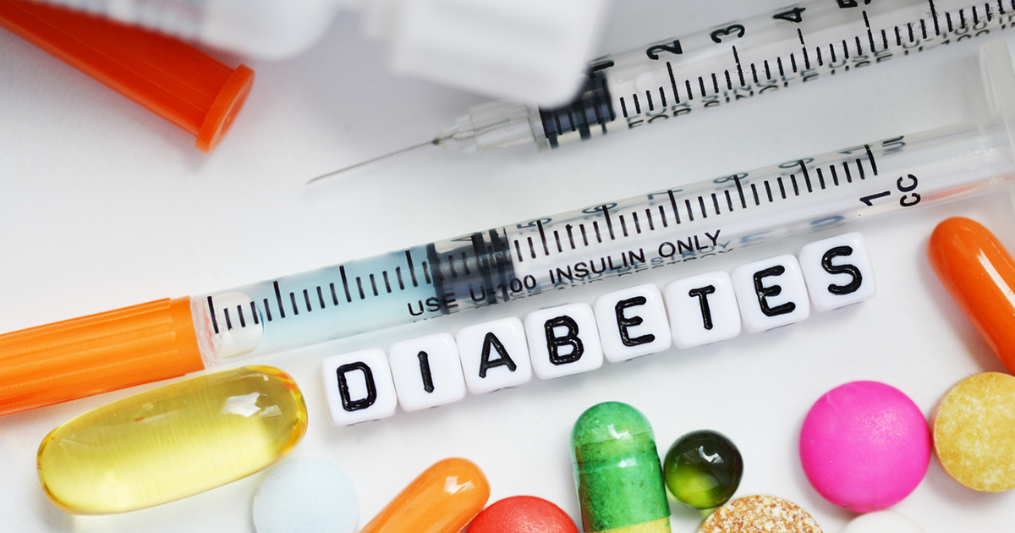
Diabetes Community Health
Dr. Israa Al-Rawashdeh MD,MPH,PhD
Faculty of Medicine
Mutah University
2022

Slide 2
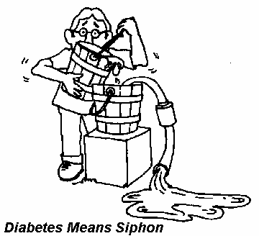
Historical background
Diabetes mellitus is derived from the Greek word diabetes meaning siphon - to pass through and the Latin word mellitus meaning honeyed or sweet.
Diabetes has been known about for many centuries. As early as the 5th century AD descriptions of diabetes mentioned two forms, one in older, fatter people and the other in thinner people with short survival.

Slide 3
Definition
The term diabetes describes a group of metabolic disorders characterized and identified by the presence of hyperglycaemia in the absence of treatment. The heterogeneous aetio-pathology includes defects in insulin secretion, insulin action, or both, and disturbances of carbohydrate, fat and protein metabolism (WHO, 2019).

Slide 4
Epidemiology and global burden of diabetes
Diabetes is found in every population in the world and in all regions.
In 2019, WHO estimated that diabetes was the ninth leading cause of death (1.5 million deaths directly caused by diabetes).
Almost half of all deaths (48%) due to diabetes occurred before the age of 70 years.

Slide 5
Epidemiology and global burden of diabetes
The rising prevalence of T2DM is associated with rapid cultural and social changes, ageing populations, increasing urbanization, dietary changes, reduced physical activity and other unhealthy lifestyle and behavioural patterns.
As well as increased diagnosis.

Slide 6
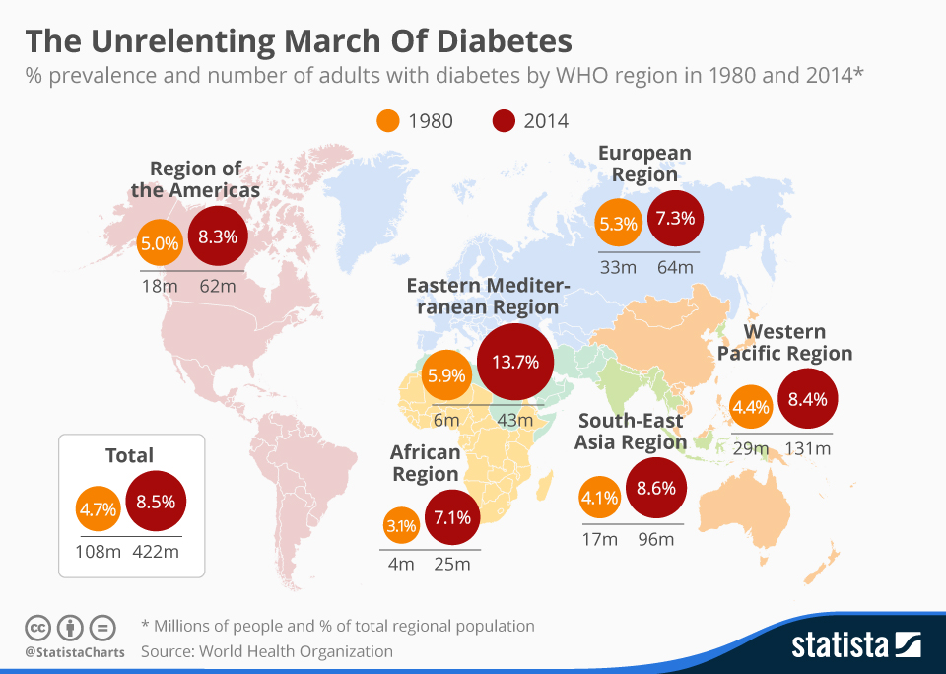
The age-adjusted prevalence in adults is 8.5% in 2014

Slide 7
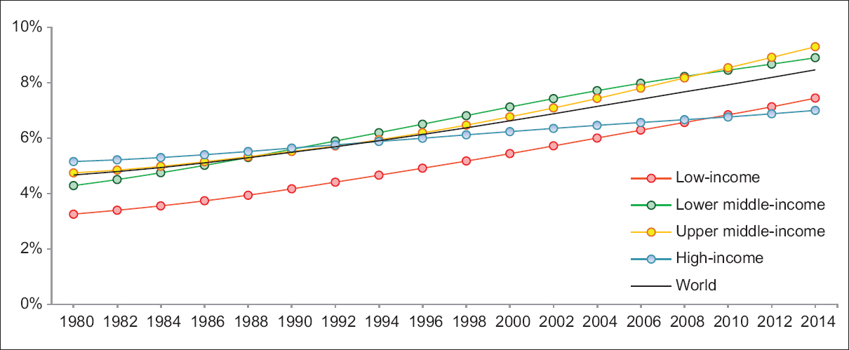
Trends in prevalence of diabetes, 1980-2014, by country income group
Over the past decades, the greatest rise in low- and middle-income countries compared to high-income countries.

Slide 8
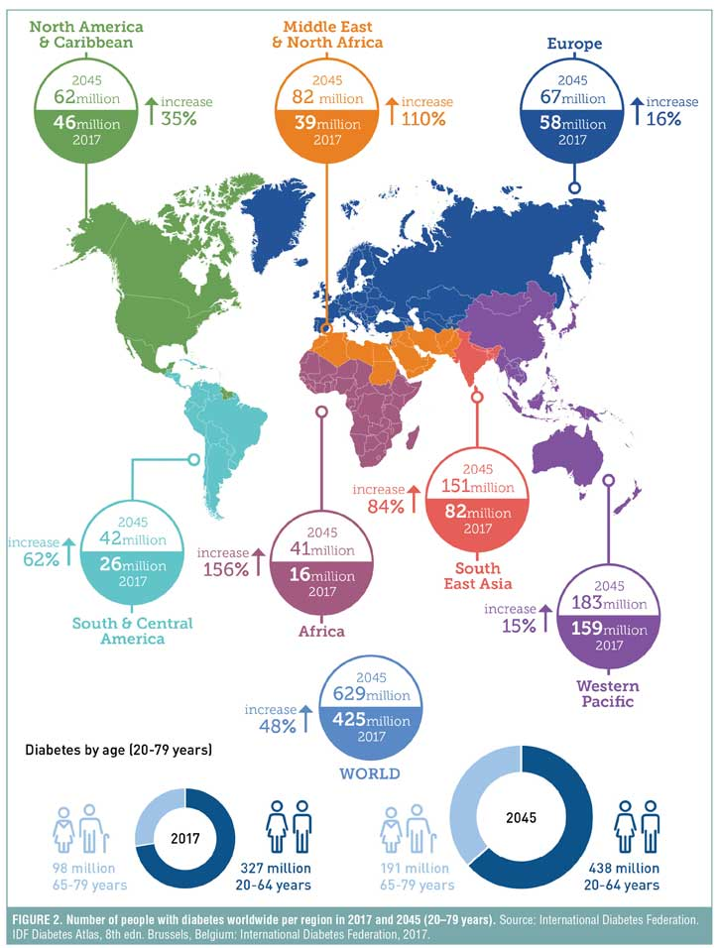
If trends continue, the IDF predicts that an estimated 629 million people worldwide will be living with diabetes by 2045.

Slide 9
Diabetes mellitus mortality rate account of 7% of total deaths in all ages in Jordan
World Health Organization – Jordan Diabetes profiles, 2016

Slide 10
Epidemiology and global burden of diabetes
One in two (50.1%) people living with diabetes do not know that they have diabetes.
Annual global health care spending on diabetes among adults was US$ 850 billion (IDF, 2017).
The effects of diabetes extend beyond the individual to affect their families and whole societies.

Slide 11
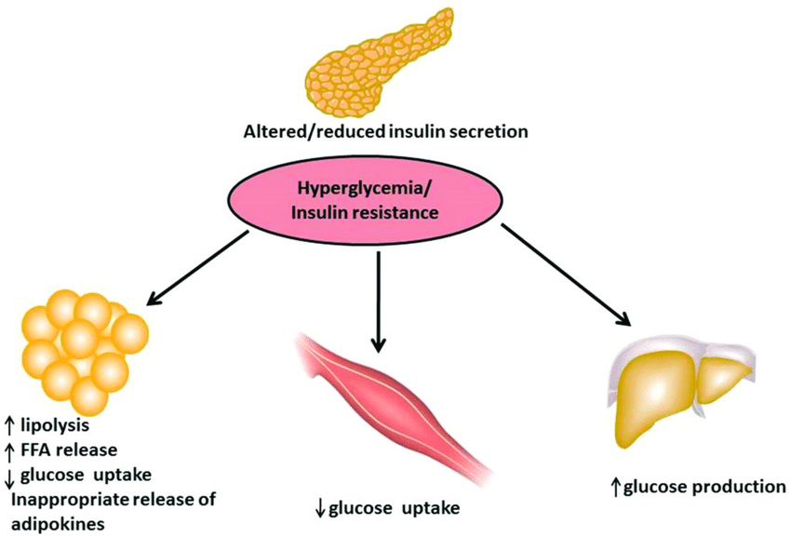
Aetio-pathology of diabetes
The underlying characteristic common to all forms of diabetes is the dysfunction or destruction of pancreatic β-cells.
Many mechanisms can lead to a decline in function or the complete destruction of β-cells (these cells are not replaced, as the human pancreas seems incapable of renewing β-cells after the age of 30 years).
These mechanisms include genetic predisposition and abnormalities, epigenetic processes, insulin resistance, auto-immunity, concurrent illnesses, inflammation, and environmental factors.

Slide 12
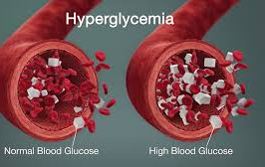
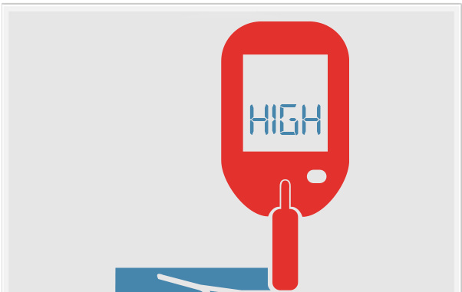
Definition
Hyperglycaemia or raised blood sugar is a common effect of uncontrolled diabetes
Impaired glucose tolerance (IGT) and impaired fasting glycaemia (IFG):
Are intermediate conditions in the transition between “normality” and diabetes.

Slide 13
WHO classification of diabetes 2019
Type 1 diabetes
Type 2 diabetes
Hyperglycaemia first detected during pregnancy Diabetes mellitus in pregnancy Type 1 or type 2 diabetes first diagnosed during pregnancy Gestational diabetes mellitus
Hybrid forms of diabetes Slowly evolving immune-mediated diabetes of adults Ketosis prone type 2 diabetes
Other specific types Monogenic diabetes Monogenic defects of β-cell function Monogenic defects in insulin action Diseases of the exocrine pancreas Endocrine disorders Drug- or chemical-induced Infections Uncommon specific forms of immune-mediated diabetes Other genetic syndromes sometimes associated with diabetes
Unclassified diabetes: This category should be used temporarily when there is not a clear diagnostic category especially close to the time of diagnosis of diabetes

Slide 14
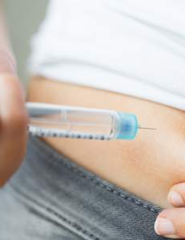
Type 1 diabetes (T1DM):
Previously known as insulin-dependent or childhood-onset diabetes IDDM.
Between 70% and 90% of people with T1DM at diagnosis have evidence of an immune-mediated process with β-cell autoantibodies against glutamic acid decarboxylase (GAD65), islet antigen-2 (IA-2), ZnT8 transporter or insulin
Characterized by a lack of insulin production.
Males and females are equally affected. Despite T1DM occurring frequently in childhood, onset can occur in adults. (The rate of β-cell destruction is rapid in some individuals and slow in others).
In adults, T1DM accounts for approximately 5% of all diagnosed cases of diabetes globally (CDC, 2011).

Slide 15
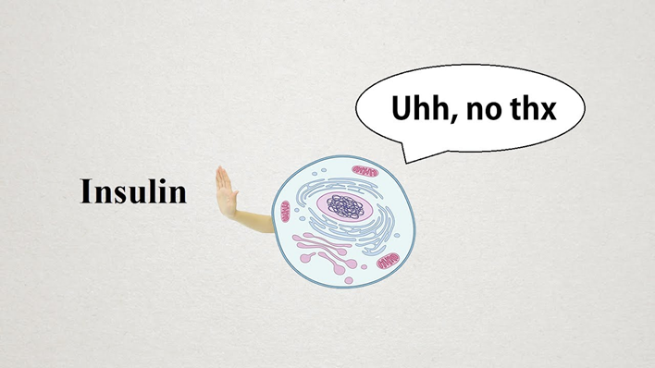
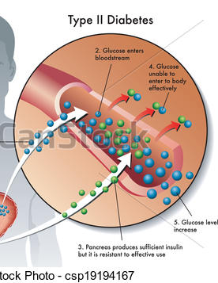
Type 2 diabetes mellitus (T2DM)
Formerly called Non–Insulin-Dependent Diabetes Mellitus (NIDDM) or adult-onset diabetes.
It results from the body’s ineffective use of insulin and is the most common type among adults (90%) (CDC, 2011).
Unlike patients with T1DM, patients with T2DM are not absolutely dependant on insulin. This distinction was the basis for the older terminology for types 1 and 2 (Insulin Dependent and Non-Insulin Dependent Diabetes Mellitus) respectively (CDC, 2011).
T2DM is most common in adults, but an increasing number of children and adolescents are also affected

Slide 16
Risk factors for T2DM
Aetiology of T2DM is multifactorial!
Many factors increase the risk of developing T2DM including .
Risk factors for type 2 diabetes:
overweight/obesity
physical inactivity
age
diabetes in first degree relatives
history of gestational diabetes
cardiovascular disease and its risk factors
ethnicity (South Asian, Afro-Caribbean, Hispanic, populations in the Middle East)

Slide 17
Hyperglycaemia first detected during pregnancy
Diabetes mellitus in pregnancy: defined by the same criteria as in non-pregnant persons.
Gestational diabetes mellitus
It is considered as a risk factor for developing T2DM in mothers later in life.
Diagnosed at glucose cut-off points that are lower than those for diabetes

Slide 18
Risk factors and risk markers for Gestational diabetes
Age (the older a woman of reproductive age is, the higher her risk of GDM);
Overweight or obesity;
Excessive weight gain during pregnancy;
A family history of diabetes;
GDM during a previous pregnancy;
A history of stillbirth or giving birth to an infant with congenital abnormality;
and excess glucose in urine during pregnancy .
Diabetes in pregnancy and GDM increase the risk of future obesity and type 2 diabetes in offspring.

Slide 19
Symptoms and signs of diabetes
Symptoms of diabetes:
• thirst (Polydipsia) • frequent urination (Polyuria) • blurring of vision • fatigue • Slow healing infections
Signs of Diabetes:
• unintentional weight loss with (Polyphagia) • signs of acute metabolic deterioration (signs of severe dehydration, Kussmaul’s respiration, vomiting, altered level of consciousness) Ketoacidosis (DKA) maybe the first presenting sign in T1DM. • clinical signs of chronic complications (acute coronary disease, stroke, kidney disease, vision loss, diabetic foot)

Slide 20
Clinical presentation
The course of T2DM is usually insidious!
T2DM often remains undiagnosed for many years because the hyperglycaemia is not severe enough to provoke noticeable symptoms of diabetes
By the time these appear and diagnosis is confirmed, the majority of patients are likely to have already developed vascular complications , That’s why early diagnosis is important.

Slide 21
Diagnosis
Four diagnostic tests for diabetes are currently recommended including measurement of:
fasting plasma glucose;
2-hour (2-h) post-load plasma glucose after a 75 g oral glucose tolerance test (OGTT);
HbA1c; and
A random blood glucose in the presence of signs and symptoms of diabetes.

Slide 22
Criteria for the Diagnosis of Diabetes
Fasting plasma glucose (FPG) ≥126 mg/dL (7.0 mmol/L)
OR
2-h plasma glucose ≥200 mg/dL (11.1 mmol/L) during an OGTT
OR
A1C ≥6.5%
OR
Classic diabetes symptoms + random plasma glucose ≥200 mg/dL (11.1 mmol/L)
American Diabetes Association Standards of Medical Care in Diabetes. Classification and diagnosis of diabetes. Diabetes Care 2017; 40 (Suppl. 1): S11-S24
Notes:
Fasting plasma glucose, the 2 hour plasma glucose after a 75-g oral glucose tolerance test, and A1C are equally appropriate diagnostic tests for diabetes.
These diagnostic criteria are:
Fasting plasma glucose (FPG) ≥126 mg/dL
OR
2-hour plasma glucose ≥200 mg/dL during an OGTT
OR
A1C ≥6.5%
Or in a patient with classic symptoms of hyperglycemia a random plasma glucose ≥ 200 can also be used.
In the absence of unequivocal hyperglycemia, the result should be confirmed by repeat testing.
[SLIDE]
22
Reference
American Diabetes Association. Standards of medical care in diabetes—2014. Diabetes Care 2014;37(suppl 1):S15; Table 2

Slide 23
Impaired glucose tolerance
Two-hour glucose levels of 140 to 199 mg per dL (7.8 to 11.0 mmol) on the 75-g oral glucose tolerance test.
A patient is said to be under the condition of IGT when he/she has an intermediately raised glucose level after 2 hours, but less than would qualify for type 2 diabetes mellitus. The fasting glucose may be either normal or mildly elevated.

Slide 24
Complications
Complications
Acute Complications
Chronic Complications

Slide 25
Acute complications of diabetes
Two important acute complications are hypoglycaemia and hyperglycaemic emergencies.
Hypoglycaemia (abnormally low blood glucose) It can cause loss of consciousness and coma and is potentially life-threatening. It is most frequently defined at plasma glucose of ≤3.9 mmol/L (70 mg/dL),
Symptoms and signs of hypoglycaemia • headache • hunger • irritability, anxiety • paraesthesias • palpitations • sweating • trembling • difficulty in speaking • confusion • ataxia • stupor • pallor • seizures • coma
2. Hyperglycaemic emergencies: Diabetic ketoacidosis (DKA) and hyperosmolar hyperglycaemic state (HHS) are life-threatening conditions with somewhat different biochemical features.

Slide 26
Chronic complications of diabetes
Macrovascular complications: Coronary heart disease, cerebrovascular disease and peripheral vascular disease are a major cause of morbidity and mortality in people with diabetes.
Microvascular complications:
Diabetic eye disease: Diabetic retinopathy is a leading causes of blindness.
Diabetic kidney disease: Diabetic Nephropathy. If untreated, once the stage of proteinuria is reached it often ends in renal failure in about 5 to 7 years
Diabetic Nerve damage (Neuropathy) The most common forms are distal symmetrical peripheral neuropathy, which is predominantly sensory. Loss of protective sensation in peripheral neuropathy is a predisposing condition leading to foot ulcer and amputation (Diabetic foot).

Slide 27
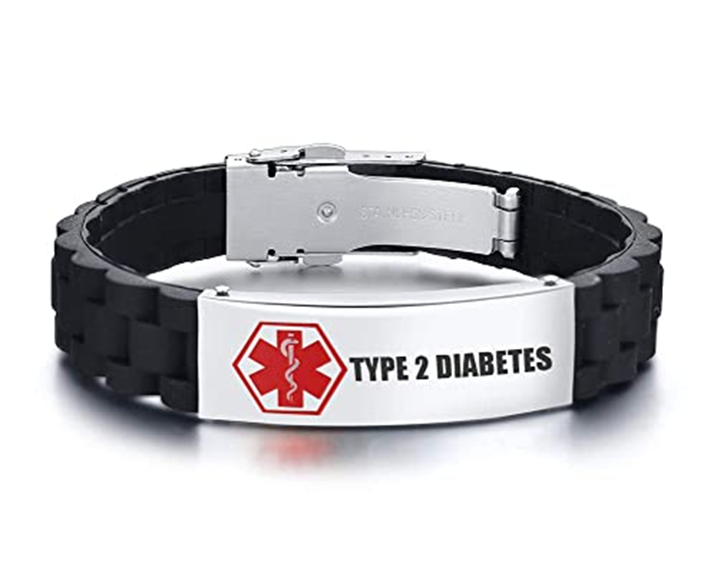
Prevention
At present, type 1 diabetes cannot be prevented.
For type 2 diabetes lifestyle modification with physical activity and/or healthy diet can delay or prevent the onset of type 2 diabetes, decreased smoking.
Community-based interventions can reach individuals and families through campaigns, education, social marketing and encourage physical activity both inside and outside school and the workplace. IDF recommends physical activity at least between three to five days a week, for a minimum of 30-45 minutes.
The earlier healthy habits acquired, the better outcome.
Secondary prevention includes early detection , prevention and treatment appropriate action taking at the right time is beneficial in term of quality of life and is cost effective specially if it can prevent hospital admissions

Slide 28
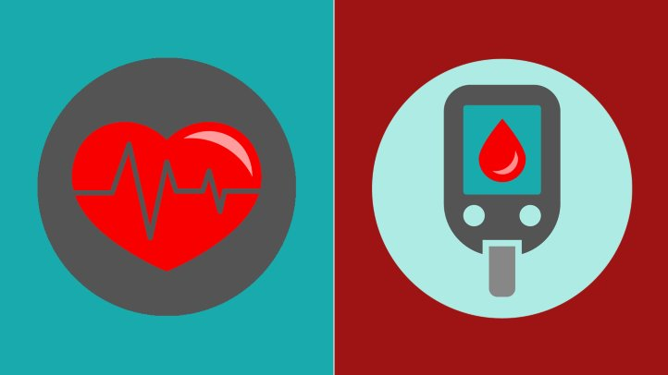
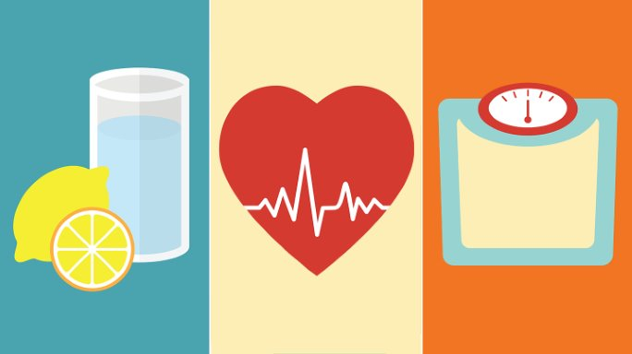
Treatment:
The aim is to maintain serum glucose level within normal.
T1DM
Insulin
T2DM
Lifestyle modifications (increase insulin secretion and decrease insulin resistance).
Proper nutrition, weight loss, and physical exercise are the first line of treatment for DM 2.
All patients should be advised on avoidance of tobacco use and harmful use of alcohol.
Medications are given either to increase insulin secretion to help overcome the resistance, or to directly decrease the resistance and re-sensitize insulin receptor.
Many classes of drugs; biguanides (metformin) and sulfonylureas. Given orally.

Slide 29
Complications management
The aim is to treat complications and rehabilitate patient to lead a life as normal as possible.
For example : periodic checkups for visual acuity and retina (retinopathy), renal function (nephropathy), and testing peripheral nerves sensation (neuropathy), in order to prevent farther deterioration and periodic foot examination.
T1DM : annually after 5 years of diagnosis; patient is >15 years old.
T2DM : annually, starting at the time of diagnosis.

Slide 30
In Jordan
Estimations of the prevalence of T2DM in Jordan were reported variably over the past decade to range from 11-17% (Ajlouni et al., 2008) (Internationa Diabetes Federation, 2015).
An increase in the prevalence of T2DM by 31.5% was reported between 1998 and 2008 (Ajlouni et al. 1998; Ajlouni et al. 2008).
Overweight 62.3%
Obesity 28.1%
Physical inactivity 12.1%
WHO 2016

Slide 31
Health services for diabetes patients IN JORDAN
Health sectors (public and private) provide primary, secondary and tertiary healthcare services to patients with diabetes (MoH, 2014).
In addition, a National Centre for Diabetes, Endocrinology and Genetics (NCDEG) was established in 1996.
NCDEG attracts patients from all over the country who are either physician-referred or self-referred.

Slide 32
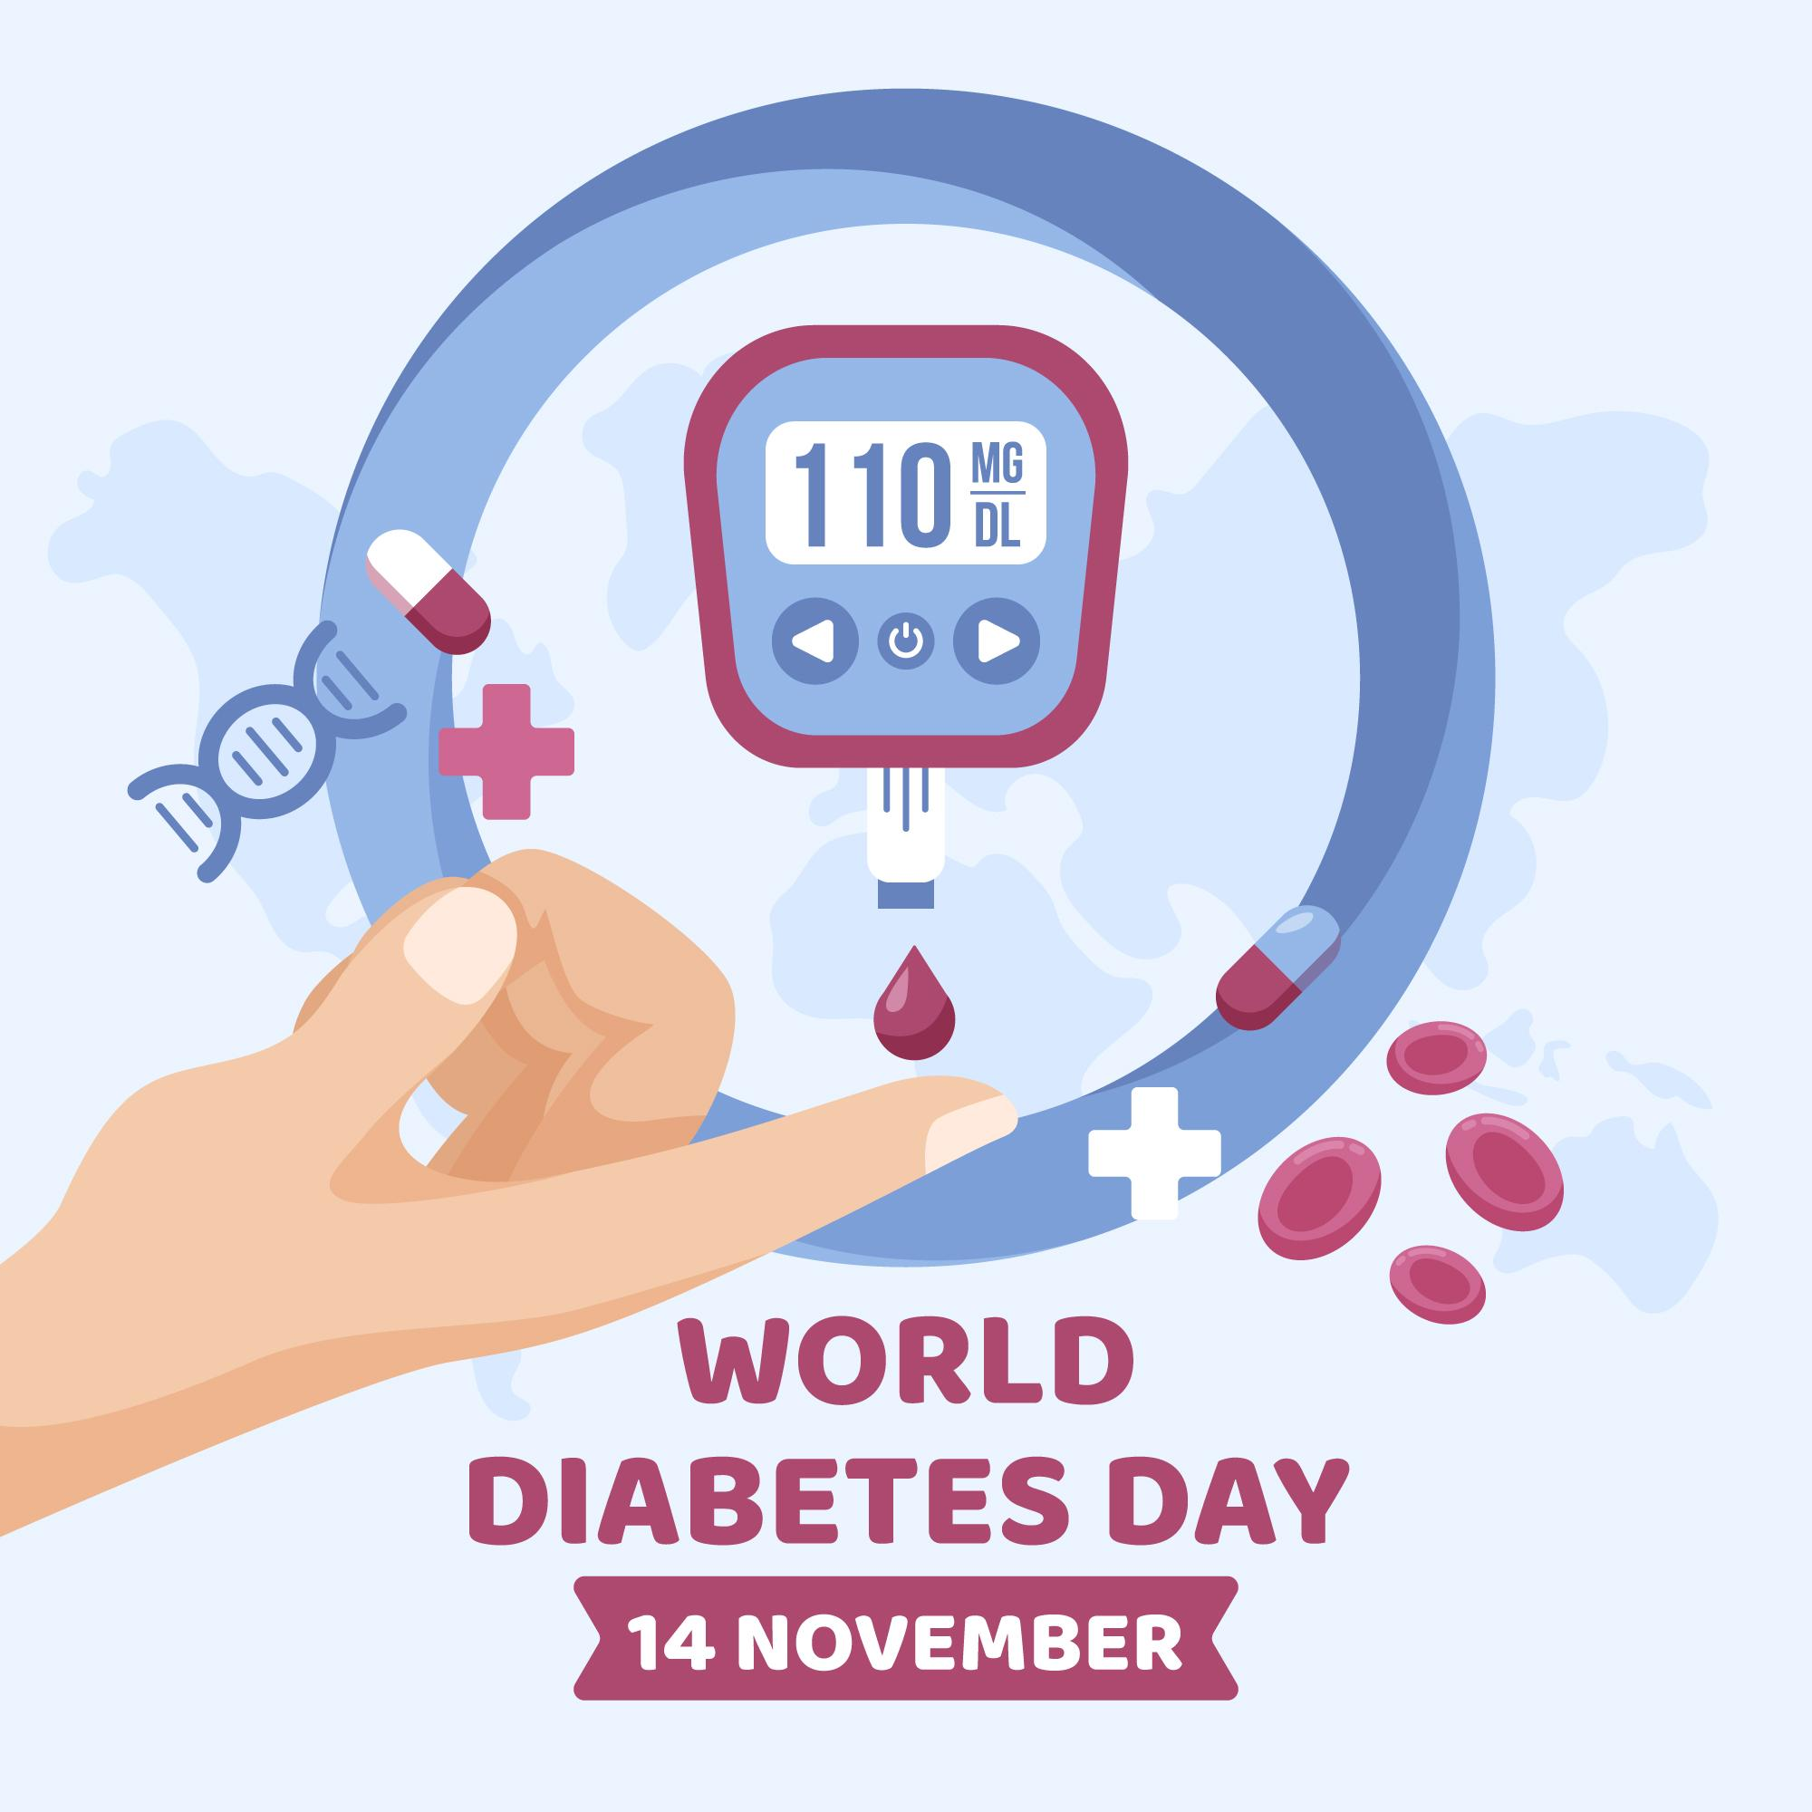
THANK YOU
file:///C:/Users/israa/Downloads/WHO-UCN-NCD-20.1-eng.pdf
https://www.who.int/publications/i/item/who-ucn-ncd-20.1

