Slide 1
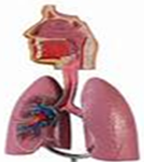
Respiratory System Module
Lecture 3
Streptococci
Dr. Amin Aqel
Department of Microbiology and immunology
Faculty of Medicine, Mutah University

Slide 2
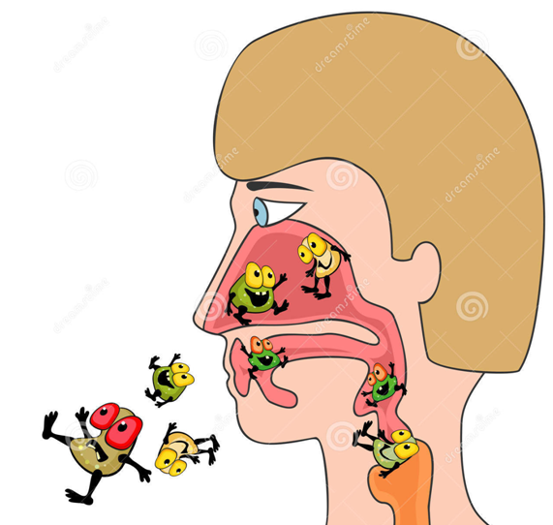
What is the importance of studying respiratory infections?
Introduction to Respiratory Infections
The respiratory system is the most commonly infected system because it is the major portal of entry for infectious organisms
Respiratory infections are seen more than any other type of infection.

Slide 3
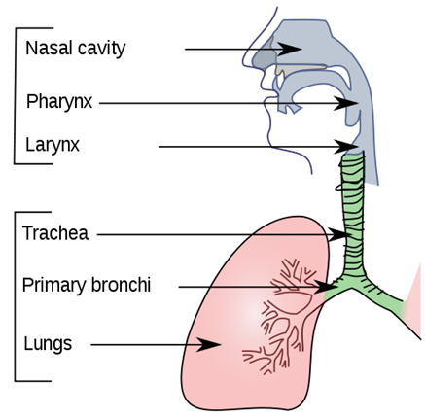
The respiratory system is divided into
Introduction to Respiratory Infections
Upper respiratory tract
Infections are fairly common
Usually nothing more than an irritation
Lower respiratory tract
Infections are more dangerous
Can be very difficult to treat

Slide 4
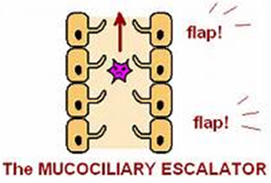
Introduction to Respiratory Infections
The respiratory system has significant defense mechanisms including:
The upper respiratory tract has:
Mucociliary escalator
Coughing
2. The lower respiratory tract has:
Alveolar macrophages

Slide 5
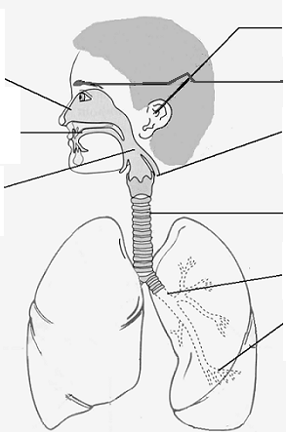
Infections of the Respiratory System
Tuberculosis
M. tuberculosis

Slide 6
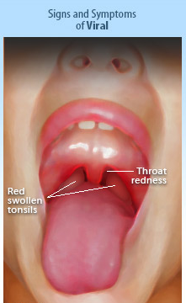
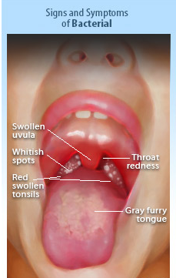
Bacterial vs. viral infections
Headache
Fever
Nausea, vomiting, and abdominal pain
Tender enlarged anterior cervical LN
`
Rhinitis
Conjunctivitis
Cough
Diarrhea

Slide 7
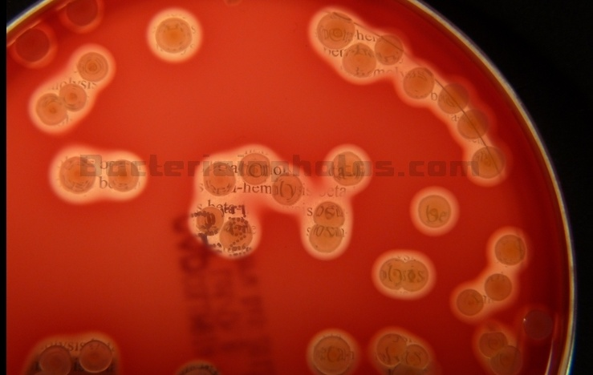
Streptococcus pyogenes Group A Hemolytic streptococci

Slide 8
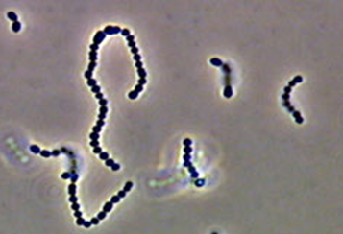
Streptococcus pyogenes
Physiology & Metabolism
Facultative anaerobes
Fastidious growth requirements
Catalase negative (2H₂O₂ ---> O₂ + 2H₂O)
Separation of streptococci from staphylococci
Oxidase negative
Beta hemolysis on blood agar
Morphology
Gram-Positive Cocci in Pairs or Chains

Slide 9
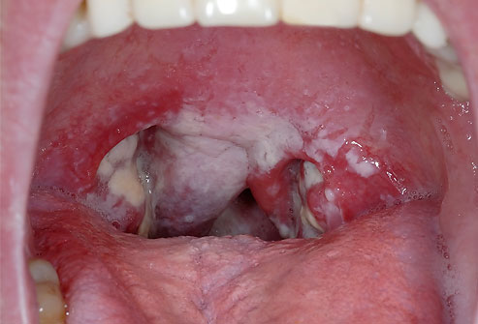
Streptococcus pyogenes
Beta-Hemolytic Streptococci in Human Diseases
Non-Suppurative Sequelae:
ARF
RHD
AG
Suppurative Diseases:
Pharyngitis and tonsilitis
Scarlet Fever
Cutaneous & Soft Tissue Infections
Systemic Disease
Systemic TSS
Foodborne Disease

Slide 10
Streptococcus pyogenes
Pathophysiology
S pyogenes tends to colonize the upper respiratory tract and is highly virulent as it overcomes the host defense system.
The antigenic components of the cell are the virulence factors.
Extracellular Virulence Factors
Streptolysin O (SLO): Lytic for variety of cells
Streptolysin S (SLS): Lytic for red and white blood cells
Nucleases
Streptokinases
C5a Peptidase
Hyaluronidase
Cellular Virulence Factors
M-Protein
- Adhesin
- Antiphagocytic
Inhibits alternate Complement pathway and opsonization
Capsule
Antiphagocytic; Nonspecific adherence
Hyaluronic acid (polysaccharide) mimics animal tissue (immune evasion)
Notes:
Streptolysin O (SLO):
Hemolytic and Cytolytic
Prototype of oxygen-labile and thiol-activated cytolytic exotoxins (e.g., Streptococcus, Bacillus, Clostridium, Listeria)
Lytic for variety of cells: bind to cholesterol-containing membranes and form arc- or ring- shaped oligomers that make cell leaky (RBC's, WBC’s, PMN's, platelets, etc.)
Causes sub-surface hemolysis on BAP
Stimulate release of lysosomal enzymes
SLO titer indicates recent infection (300-500 in pediatric populations)
Streptolysin S (SLS):
Hemolytic and Cytolytic
Oxygen stable, non-antigenic
Lytic for red and white blood cells and wall-less forms (protoplast, L- forms)
Causes surface hemolysis on BAP
Pyrogenic (Erythrogenic) Exotoxins (Types A, B &C)
Produced by more than 90% of Grp A strep
Lysogeny: Structural gene is carried by temperate bacteriophage, as is the case with diphtheria toxin
Mediate pyrogenicity (fever)
Causes scarlet fever (scarletiniform) rash
Increase susceptibility to endotoxic shock
Type C toxin increases permeability of blood-brain barrier
Enhance DTH
Mitogenic for T lymphocytes (cause cell division), myocardial and hepatic necrosis, decrease in antibody synthesis
Immunomodulators (superantigens): stimulate T cells to release cytokines
Enzymes:
Nucleases: Four antigenic types (A,B,C,D)
Facilitate liquefication of pus generating growth substrates
Nucleases A, C have DNase activity
Nucleases B, D also have RNase activity
Streptokinases: Two different forms
Lyse blood clots: catalyze conversion of plasminogen to plasmin, leading to digestion of fibrin
C5a Peptidase: destroys C’ chemotactic signals (C5a)
Hyaluronidase: hydrolyzes hyaluronic acid
Others: Proteinase, NADase, ATPase, phosphatase, etc.
Cellular Virulence Factors
Lipoteichoic Acid
Cytotoxic for wide variety of cells
Adherence: Complexes with M protein (LTA-M) and binds to fibronectin on epithelial cells
M-like Proteins: bind IgM and IgG
F Protein: mediates adherence

Slide 11
Streptococcus pyogenes
Epidemiology of Acute Streptococcal Infection
Preference for upper respiratory tract or skin
Group A commonly colonize oropharynx of healthy children
Transmitted by droplets from respiratory secretions
Crowding increases risk (e.g., classrooms, day care facilities)

Slide 12
Streptococcus pyogenes
Symptoms of Streptococcal pharyngitis
Absence of a cough
Swollen and tender cervical lymph nodes
Temperature >38.0 °C (100.4 °F)
Tonsillar exudate or swelling
Other symptoms include:
Headache
Nausea
Vomiting
Abdominal pain
Muscle pain
Palatal petechiae: uncommon but highly specific finding.
The incubation period: between 1-3 days post contact.
Strep throat is unlikely when any of the symptoms of red eyes, hoarseness, runny nose, or mouth ulcers are present, and when there is no fever

Slide 13
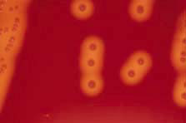
Streptococcus pyogenes
Lab Identification
Culture
Encapsulated cells produce mucoid colonies
Beta-hemolytic: zone several times greater than
diameter of colony
Catalase Negative:
Differentiates from Staphylococcus
3. Bacitracin test:
S. pyogenes is bacitracin sensitive
4. Rapid Identification Tests:
Based on extraction of Group A carbohydrate directly from throat swabs
ELISA
Fluorescent antibody
5. A rapid strep test (also called rapid antigen detection testing or RADT):
It employs latex beads covered with antigens that will visibly agglutinate around GAS antibodies if these are present

Slide 14
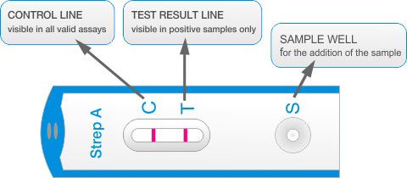
Streptococcus pyogenes
Lab Identification
A rapid strep test
The patient’s throat is first swabbed to collect a sample of mucus.
The sample is applied to a strip of nitrocellulose film and, if GAS antigens are present, these will migrate along the film to form a visible line of antigen bound to labeled antibodies

Slide 15
Streptococcus pyogenes
Treatment

Slide 16
Streptococcus pneumoniae
Commonly referred to as pneumococcus
Formerly Diplococcus pneumoniae
Pneumonia
Meningitis
Bacteraemia

Slide 17
Streptococcus pneumoniae
Gram-positive diplococci (in pairs)
Encapsulated ovoid or lanceolate coccus
Non-motile
Fastidious (enriched media)
Blood or chocolate agar
5-10 % CO2
Alpha haemolysis + draughtsman appearance
Some strains are mucoid
Soluble in bile
Optochin sensitive

Slide 18
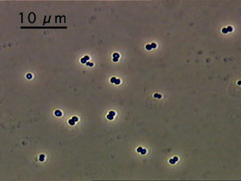
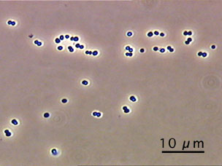
S. pneumoniae
Diplococcus

Slide 19
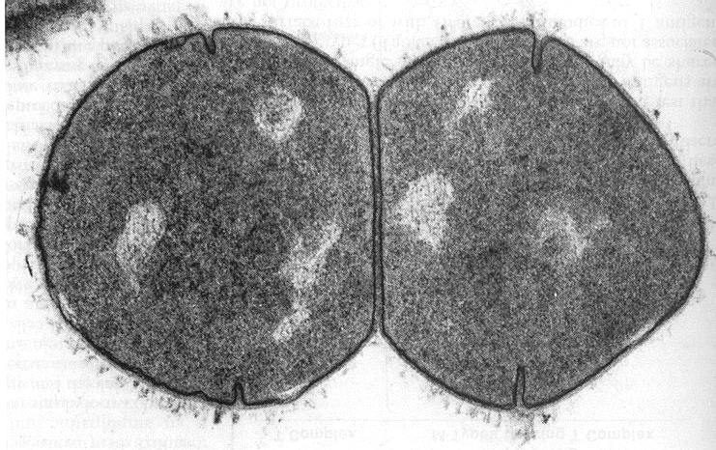
S. pneumoniae: lancet-shaped diplococcus

Slide 20
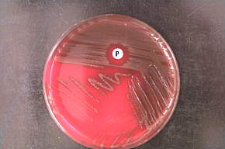
Optochin Sensitivity
Taxo P
Streptococcus pneumoniae

Slide 21
Streptococcus pneumoniae-Pathogenesis
Virulence factors
Capsular polysaccharide
The major factor
84 serotypes
Both antigenic and type specific
Antiphagocytic
Serotype 3 , 7 are most virulent
90% of cases of bacteraemic pneumococcal pneumonia and meningitis are caused by 23 serotypes
Quellung reaction , india ink
Pneumolysin
Membrane damaging toxin

Slide 22
Streptococcus pneumoniae-Pathogenesis
Carrier rate
Oropharyngeal flora of 5 – 70% of the
population
Significance in respiratory infection

Slide 23
Streptococcus pneumoniae-Disease
Respiratory tract infections
Lobar pneumonia ( commonest cause of CAP )
Empyema
Otitis media (6 months – 3 yrs )
Mastoiditis
Sinusitis
Acute exacerbation of chronic bronchitis
Meningitis
Conjunctivitis
Peritonitis ( primary )
Bacteraemia ( 15 % of pneumonia )
septicaemia

Slide 24
Streptococcus pneumoniae-Clinical Feature
Lobar pneumonia
Sudden onset
Fever
rigor
Cough , rusty sputum
Pleural pain
Signs of lobar consolidation
Polymorphonuclear leucocytosis
Empyema , pericarditis

Slide 25
Streptococcus pneumoniae-Laboratory Diagnosis
Specimen
Sputum
CSF
Swabs
Pus
Blood culture
Aspirate

Slide 26
Streptococcus pneumoniae-Laboratory Diagnosis
Microscopy
Gram stained smear
Gram-positive diplococci + pus cells
culture
Blood agar , chocolate agar + 10 % CO2
identification
Alph-haemolytic colonies
Optochin sensitive
Bile soluble

Slide 27
Streptococcus pneumoniae-Treatment
Meningitis
Parenteral ceftriaxone + vancomycin
pneumonia
Outpatients
Erythromycin
Amoxacillin – clavulanic acid
Cefuroxime or ceftriaxone (IV) + oral b- lactam
Inpatients
Parenteral cefuroxime or ceftriaxone

