Slide 1
Recurrent vomiting in first month
Done by :
Hanin Amer Al-khatib
Adnan Kifayeh
Supervised by :
Dr. Abdallah alrawie

Slide 2
1- Hypertrophic pyloric stenosis ( HPS)
Clinical presentation :
1- vomiting ( progressive projectile nonbilious vomiting without signs of infection with immediate postprandial vomiting in an infant between two and six weeks of age
later in the disease course tend to have more severe symptoms, including marked weight loss and dehydration.
and may be larthargic
Visible peristaltic waves
● Palpation of the "olive“ was palpable in 50 to 90 percent of infants with HPS.

Slide 3
Diagnosis & mangement
Investigations:
- US- The diagnostic criteria for pyloric stenosis are a muscle thickness ofhas become the standard technique for diagnosing HPS.≥4 mm and a pyloric length of ≥16 mm, diameter of the pylorus12mm .- If the US findings are equivocal, then an upper gastrointestinal series can be helpful in confirming the diagnosis (String Sign).
▪ Management
✓ Pre-op- NPO, IV fluids, avoid NG tube (exacerbate the electrolyte imbalance!)- Correction of metabolic alkalosis required for safe anesthesia. (hypokalemia→muscle weakness)
✓ Surgery:- Pyloromyotomy (Open or Laparoscopic) – Ramstdet surgery

Slide 4
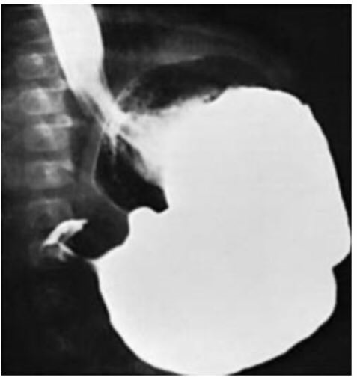
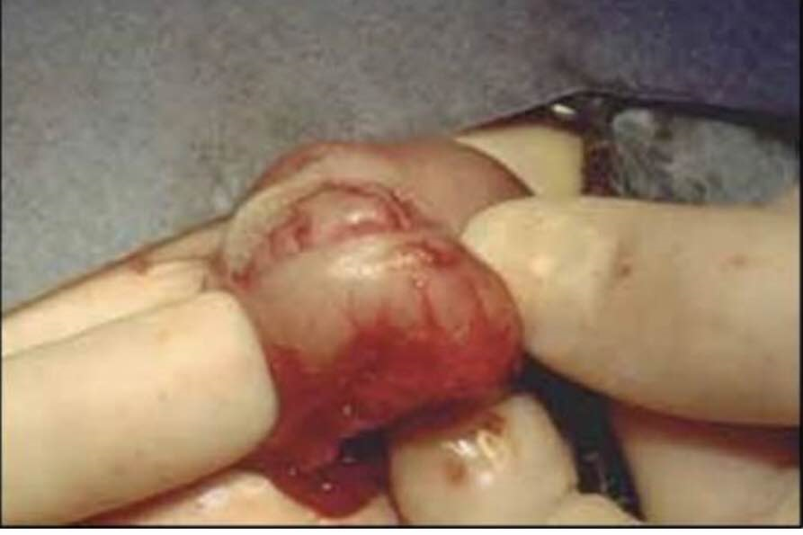
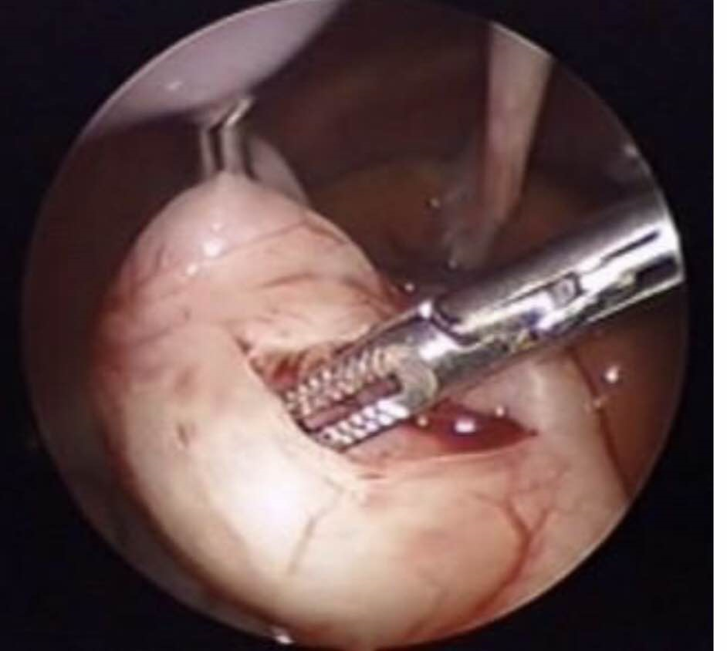

Slide 5
2- Malrotation
Intestinal malrotation: arrest in the normal rotation of the gut in utero, resulting in an abnormal orientation of the bowel and mesentery within the abdominal cavity
1/6000 live birth incidence.
• 90% present within first year of life (75% within 1 month
• Disease of abnormal rotation or non-rotation of intestines
• Presentation varies but most severe type is with midgut volvulus which is due to twisting of the abnormally fixated small bowel around a narrow- based mesentery and SMA
• Bilious emesis in newborn is malrotation until proven otherwise
• UGI is diagnostic test of choice

Slide 6
Operation
OpenLadd’sProcedure
– RUQ transverse incision or midline laparotomy– Eviscerate intestinal contents– Detorse counter-clockwise if volvulus is present• Resect grossly necrotic bowel– Release Ladd’s cecal bands– Broaden the small intestine mesentery– Incidental appendectomy– Place small bowel on right and colon on lef

Slide 7
3-GERD
Etiology:
persistent lower esophageal sphincter insufficiency.
Clinical features :
Poor appetite
refusal to feed
weight loss
Failure to thrive
Crying and irritability
Abdominal distention, pain/discomfort
Regurgitation, persistent vomiting
Extraesophageal symptoms: wheezing, stridor, hoarseness, chronic cough.
Diagnostics:
based on clinical findingsH&P (e.g., presence of red flags in GERD, nutritional assessment, cow's milk and/or soy protein intolerance)
Imaging: may be indicated if symptoms after initiation of empirical treatment persist Esophagogastroduodenoscopy with biopsies Upper gastrointestinal imaging series (suspicion of anatomical abnormalities like malrotation or annular pancreas)

Slide 8
Treatment
consevative measures:
lifestyle and dietary changes should be re-evaluated every 2–4 weeks
Positioning therapy: maintain the infant in an upright position for 20–30 minutes after feeding
If there is suspicion of cow's milk and/or soy protein intolerance:Remove cow's milk or soy protein from the infant's diet In breastfed infants, remove soy protein, cow's milk proteins, and beef from the mother's diet.

Slide 9
Treatment
In formula-fed infants, substitute for a hypoallergenic formula Using food thickener
Avoid exposure to tobacco smoke
pharmacological treatment2–4 week trial with PPIs (e.g., esomeprazole),
H2-receptor blockers (e.g., cimetidine)
Indications Infants with persistent significant symptoms (failure to thrive, feeding refusal, poor weight gain) and in which all conservative measures have failed Esophagitis on endoscopic findings
Surgical treatment (complete or partial Nissen fundoplication): indicated in infants with complications from severe GERD who did not respond to conservative and pharmacological treatment

Slide 10
Thank you

