Slide 1
Caesarean section
Presented by:
Tamer jaafreh
Maha alhajes
Rama mosleh
Alia qablan
Fuad khaled

Slide 2
Caesarean section
Definition:
is a surgical procedure in which incisions are made through a woman’s abdomen (laparotomy) and uterus (hysterotomy) to deliver one or more babies.
Classification:
Elective: CSs are planned in ahead time.
Emergency: When the cesarean section is done because of sudden deterioration in maternal or fetal condition during labor or due to non-progress, failed induction or failed trial.

Slide 3
Classification according to the urgency:
immediate threat to life of woman or fetus (requiring immediate delivery)
maternal or fetal compromise which is not immediately life- threatening (requiring urgent delivery)
(needing early delivery) but no maternal or fetal compromise
at a time to suit the patient and maternity team (elective delivery)
Maternal mortality rate for all Caesarean sections is 5 times that for vaginal delivery, especially with
emergency cesareans performed in labor.
Maternal mortality is largely anesthetic related.
Risks are those from any major procedure:
hemorrhage, infection, visceral injury (injury of the bladder or bowel),
thrombosis.

Slide 4
Indication:
Fetal:
maternal:
. Cord prolapse
. fetal distress
. Fetal macrosomia > 4500 gm 4. Multiple pregnancy
. Transverse lie and Malpresentation brow, mentoposterior, shoulder & compound presentations, breech
. Failed induction, obstructed labor and Failure to progress in labor (Dystocia) (CPD)
. Severe PET-relative contraindication
. Repeat cesarean delivery
. Abnormal placentation (eg. placenta Previa, placenta accrete).
. Obstructive lesions in the lower genital tract, including leiomyomas of the lower uterine segment that interfere with engagement of the fetal head
. Pelvic abnormalities that preclude engagement or interfere with descent of the fetal presentation in labor.
5. Active genital herpes infection or maternal HIV infection

Slide 5
If there is a previous CS can we try with vaginal delivery?
Yess (trial of labor)
Successful vaginal delivery rate is up to 80% in carefully selected patients.
Criteria for trial of labor include:
patient consent
non-repetitive cesarean indication (e.g., breech, placenta Previa), 3.previous low segment transverse uterine incision
4.clinically adequate pelvis.

Slide 6
. Unless there are maternal or fetal indications for cesarean delivery, vaginal delivery should be recommended
2. Should not be performed before 39 weeks gestation
without verifying fetal lung maturity (due to a potential risk of respiratory problems for the baby)
. It is not recommended for women who want more children??
(due to the increased risk for placenta Previa/accreta and gravid hysterectomy with each cesarean delivery)

Slide 7
What should we do
Nursing:
preoperatively?
consent
Usually she is asked to be fasting 12 hours preoperative
I.V line.
Fluids.
Foley catheter.
External fetal and maternal monitors.
Antibiotic prophylaxis.
Antacids.
Lab tests:
CBC.
Blood type and cross match.
Coagulation study.
Ultrasound (document fetal position and estimated fetal weight and site of placenta)

Slide 8
 | Spinal | General | Epidural
How? | injection of a local sedation into the subarachnoid space, through a fine needle, 9 cm long | Through systemic sedation and NO inhalation | injection of a local sedation into the epidural space
+ves | Simple and rapid onset Minimal fetal exposure to drug Allow time for careful abdominal wall incision and good hemostasis Avoidance of complication of general anesthesia (uterine atony and pulmonary aspiration) | Can be given quickly (suitable for emergency CS) Blood pressure and breathing are easily controlled Better in patient with psychological problems | Less incidence of hypotension because of slow onset of sympathetic block Less incidence of spinal headache Allow repeated administration through epidural catheter if the surgery is prolonged Epidural catheter allow administration of post-operative analgesia
-ves | Hypotension intrapartum nausea and vomiting spinal headache Post-operative shivering | Extraction of the fetus should be within 15 min. Nitrous oxide can cross placental blood barrier →cardiacrespiratory depressant effect on the fetus Acid aspiration syndrome High incidence of uterine atony (Effect of halothane)

Slide 9
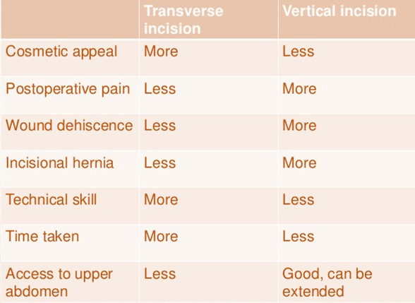
Abdominal wall incisions two type
Vertical –in the midline extends from below the umbilicus to 2cm above the symphysis pubis indicated in cases of extreme maternal obesity and in significant intra-abdominal adhesion (emergent incision).
Transverse(pfannenstiel)-extends transversely for 15cm above symphysis pubis nearly 2cm..the incision is cephalad at the level of the pubic hair decreased analgesic requirements. (other names: maylard, Joel Cohen ...)

Slide 10
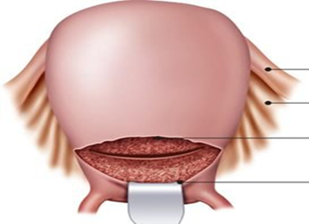
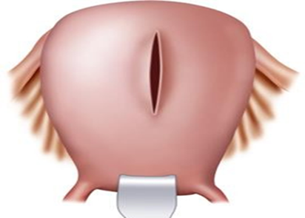
Low segment transverse incision
(Monroe-Kerr)
Classical upper segment
incision
(Kronig or Delee)
Uterine incision:( according to the GA, fetal presentation, placental location and the presence of well-developed uterine segment.)

Slide 11
 | Low segment transverse incision (Monroe-Kerr) | Classical upper segment incision (Kronig or Delee)
general | Most common uterine incision 90% Low transverse incision is smaller, horizontal and made near the bikini line made in the noncontractile portion of the uterus. The bladder must be dissected inferiorly to expose the lower segment, and the bladder blade has been placed. | less commonly performed. Larger vertical incision made in the contractile fundus of the uterus and (when the lower segment not developed, if an anterior placenta Previa is present, or if the fetus is in a transverse lie or in a preterm nonvertex presentation) Again, the bladder has been dissected inferiorly to expose the lower segment, and the bladder blade has been placed.
+ves | 1.trial of labor in subsequent pregnancy is safe 2. Less likely to rupture in next pregnancy (.5-1.5%) 3.Less risk of bleeding 4.Less adhesions 5.less uterine infection 6.Easy to repair | 1. any fetus(es) regardless of intrauterine orientation can be delivered 2. lower segment varicosities or myomas can be bypassed
-ves | 1.fetus must be longitudinal lie 2. lower segment must be developed 3. varicosities or myomas in the lower segment. 4.because of smaller incision the obstetricians may need vacuum or forceps for delivery | 1.trial of labor in a subsequent pregnancy is unsafe?? Higher risk of rupture in subsequent pregnancies 1.5% - 5% 2. More bleeding 3. Difficult to repair 4. High risk for adhesion

Slide 12
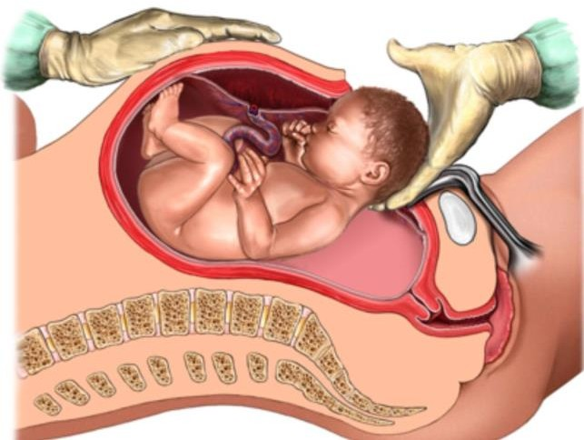
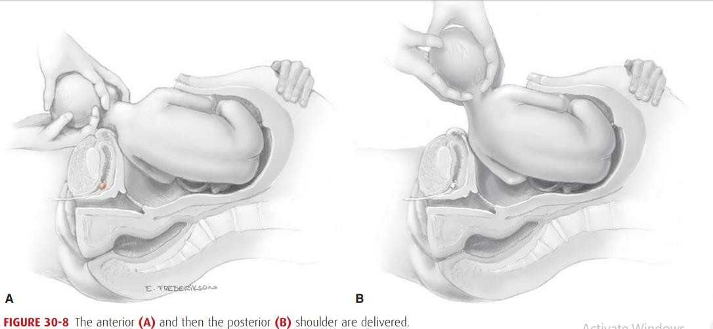
Delivery of the Fetus:
In a cephalic presentation, a hand is slipped into the uterine cavity between the symphysis and fetal head.
The head is elevated gently with the fingers and palm through the incision.
Once the head enters the incision,
delivery may be aided by modest transabdominal fundal pressure
After head delivery, a finger should be passed across the fetal neck.
The head is rotated to an occiput transverse position,
The sides of the head are grasped with two hands, and gentle downward traction is applied until the anterior shoulder enters the hysterotomy incision
Next, by upward movement,
the posterior shoulder is
delivered.

Slide 13
Two important aspects of the delivery are
the incision to delivery time (especially in previously compromised fetuses): Longer incision to delivery times are associated with worsening neonatal outcomes
delivery of the impacted fetal head: can be delivered either through pushing the head up from the vagina and elevating it up through the incision or by pulling it up as if it were a breech delivery.
After the fetus is delivered, the umbilical cord is doubly clamped and cut

Slide 14
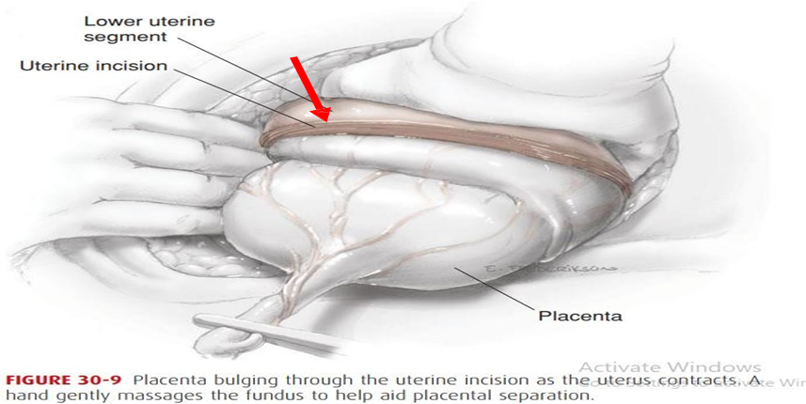
Placental Delivery:
After delivery, oxytocin (20 U) is placed in the intravenous (IV) fluid to increase contractions of the uterus.
The placenta is then delivered spontaneously, or manually along with some cord traction may reduce the risk of operative blood loss and infection
Fundal massage may begin as soon as the fetus is delivered to hasten placental separation and delivery.
Immediately after delivery and gross inspection of the placenta, the uterine cavity is suctioned and wiped out to remove avulsed membranes, vernix, and clots.
The average blood loss in CS is approximately 1000ml

Slide 15
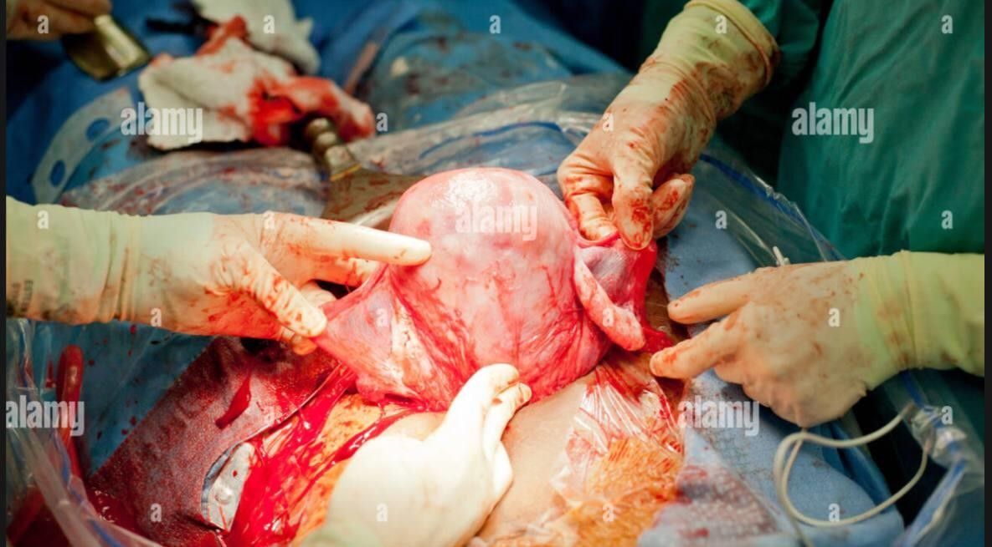
Repair of Uterus
Repair of the uterus can be facilitated by manual delivery of the uterine fundus through the abdominal incision (Externalizing): facilitates uterine massage, the ability to assess whether the uterus is atonic, and the examination of the adnexa.
Inspection of:
The incision is inspected for other bleeding vessels
any extensions of the incision
the bladder and lower segment inferior to the incision.
The principal disadvantage is discomfort and vomiting caused by traction in cesarean deliveries performed under regional analgesia.

Slide 16
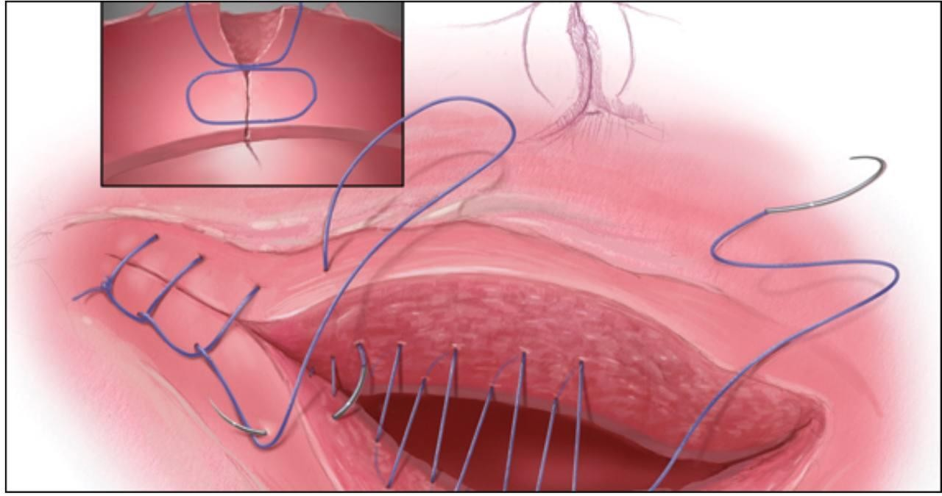
Repair of a low transverse uterine incision should be performed in either a 1-layer or 2-layer fashion with 0 or 2-0 chromic or polyglactin suture (absorbable sutures).
The first layer should include stitches placed lateral to each angle,
with prior palpation of the location of the lateral uterine vessels. Most physicians use a continuous locking stitch.
If the first layer is hemostatic, the second layer (Lembert stitch) (continuous or interrupted)
Single-layer closure is typically faster and is not associated with higher rates of infection or transfusion

Slide 17
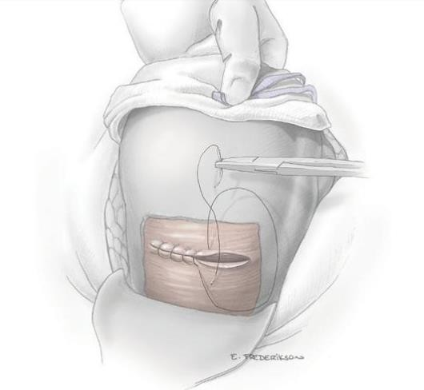
Postoperative care:
Maternal monitoring in the immediate postoperative period:
vital signs, uterine tone, vaginal and incisional bleeding, and urine output are monitored closely.
pain relieving:
analgesia followed by oral nonsteroidal anti-inflammatory drugs.
Bladder catheter:
Removing the catheter as soon as possible minimizes the risk of infection.
Diet and activity:
Early ambulation (when the effects of anesthesia have abated) and oral intake (within six hours of delivery) are encouraged
Breastfeeding:
can be initiated in the delivery room.
Wound care:
Dressings can be removed, and patients may shower within 48 hours of surgery.

Slide 18
Complications of CS:
short term
Long term risks to future pregnancies
risks to the newborn
Hemorrhage:
Blood loss during a cesarean delivery may be greater than during a vaginal delivery, however, the transfusion rate remains low at 1% to 2% of patients undergoing cesarean section.
Causes:
laceration of uterine vessels that occurs with extension of the uterine incision.
Additional lacerations may extend into the vagina
The mean estimated blood loss at cesarean delivery is approximately 1000 mL.

Slide 19
Infection:
Infection is one of the most common complications of cesarean delivery. In the absence of prophylactic antibiotics, the rates of postpartum endomyometritis can be as high as 35% to 40%.
Another common complication of cesarean delivery is wound infection. may occur in 2.5% to 16% of cesareans.
Risk for Infection increase with:
the presence of ruptured membranes [ most important] from genital tract.
obesity particularly important role in the occurrence of wound infection
blood transfusion.
Atelectasis.
Pneumonia (Aspiration).
Bacteremia.
Urinary tract infection.
Deep Abscesses.

Slide 20
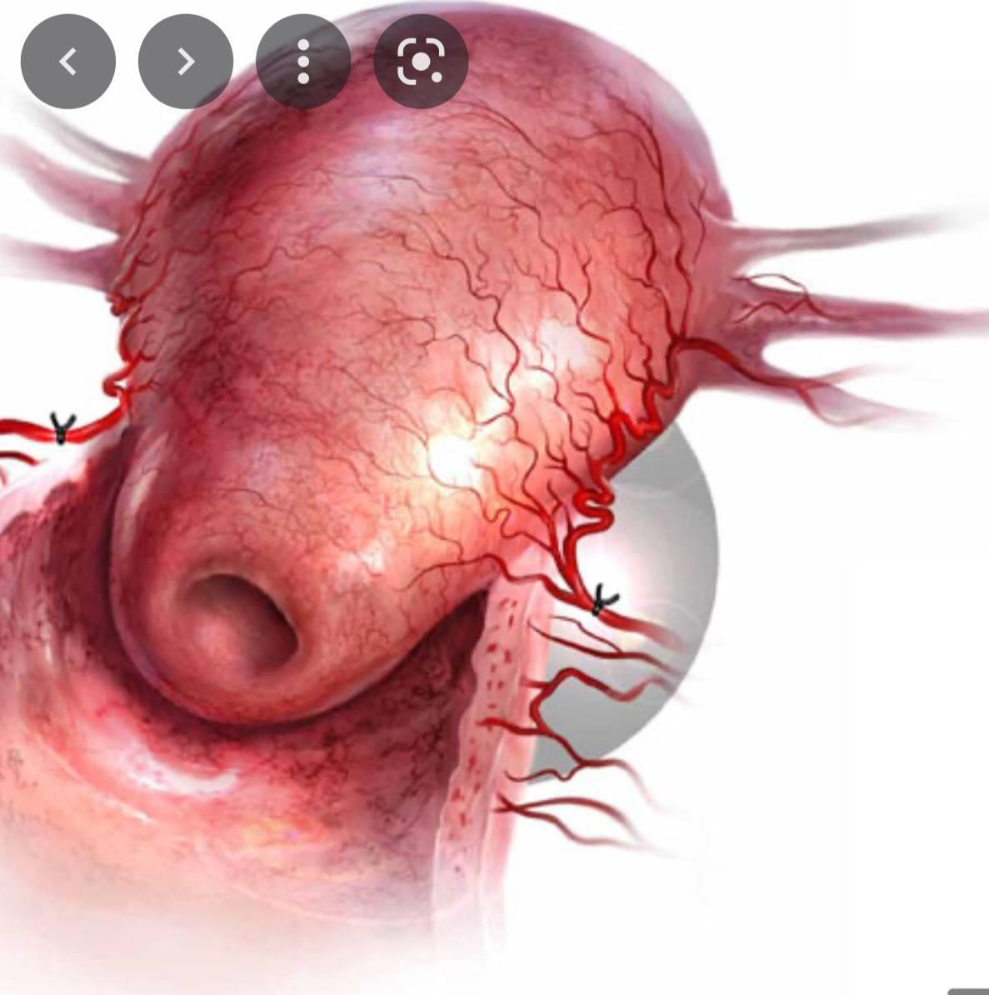
Incidental Surgical Injuries:
Bladder injuries are the most common injuries
bowel or ureters less common surgical injuries.
Risk factors:
prior pelvic surgery (including prior cesarean
deliveries), emergency cesarean delivery.
Early recognition and prompt management of these injuries are key to preventing the development of further
complications, such as sepsis, renalfailure, and fistula formation.
Emergent Hysterectomy:
The risk of the need for hysterectomy after or during a cesarean delivery is greater than after a vaginal delivery.
The most important risk factor :
is a previous Caesarean section especially when placenta overlies the old scar , increasing the risk of placenta accreta.
The most common indication: uncontrollable maternal hemorrhage,
other: atony, uterine rupture, extension of transverse uterine incision & fibroids preventing uterine closure & hemostasis.

Slide 21
Pain:
More in CS
narcotic pain medications can
have a significant impact on initial bonding between the mother and the newborn
on breastfeeding success rates
maternal functioning postpartum
the risk for postpartum depression may be greater.
Thromboembolism:
One of the leading causes of maternal mortality related to cesarean delivery is deep vein thrombosis resulting in pulmonary embolism.
The incidence of such complication can be reduced by adequate hydration, early embolization & administration of prophylactic heparin.
Paralytic ileus:
Expected in the first few days.
Bowel sound are absent or hypoactive and there is no passage of gas.
Anesthesia complication:
Abscess / meningitis
epidural hematoma
Failed intubation
High neuroaxial block
neurologic injury
Respiratory arrest

Slide 22
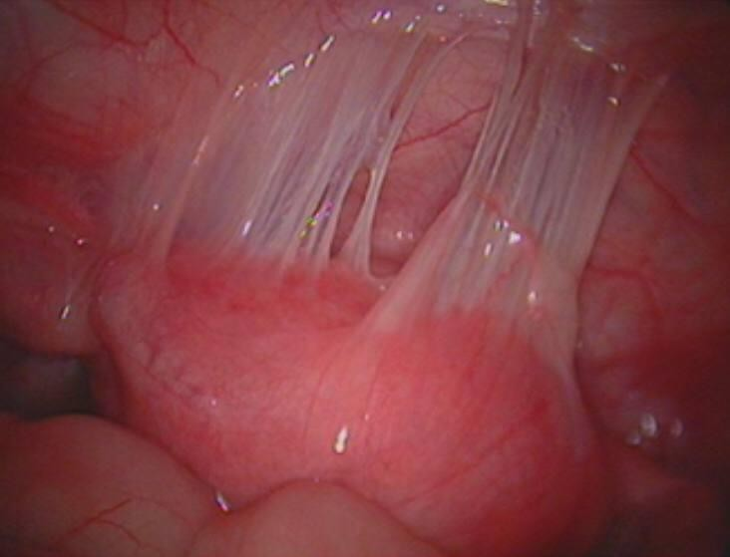
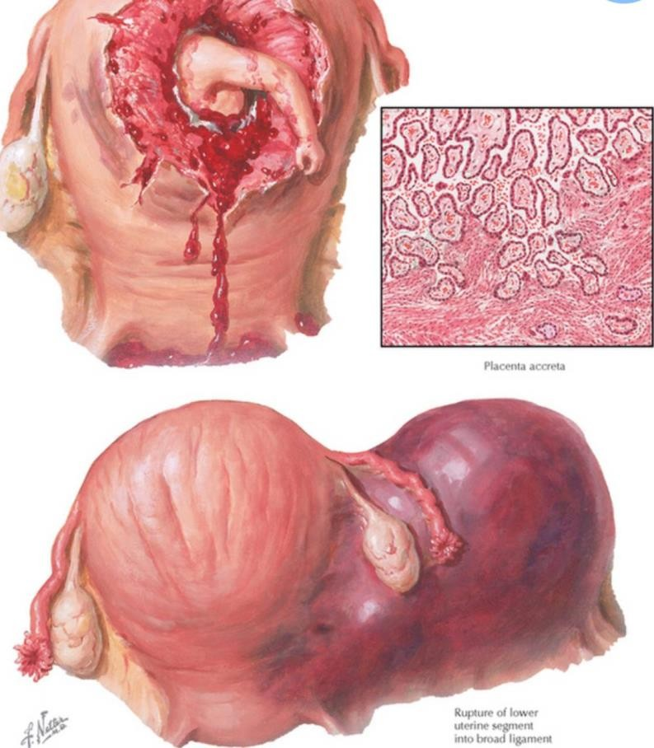
Long term and risks to future pregnancies
Adhesion formation:
So→ (Ectopic pregnancy risk will increase).
can cause significant morbidity and mortality related to bowel obstruction, subinfertility, or organ injury during repeat abdominal surgery.
Uterine Rupture:
The incidence of uterine rupture is higher in women who undergo a trial of labor after cesarean delivery.

Slide 23
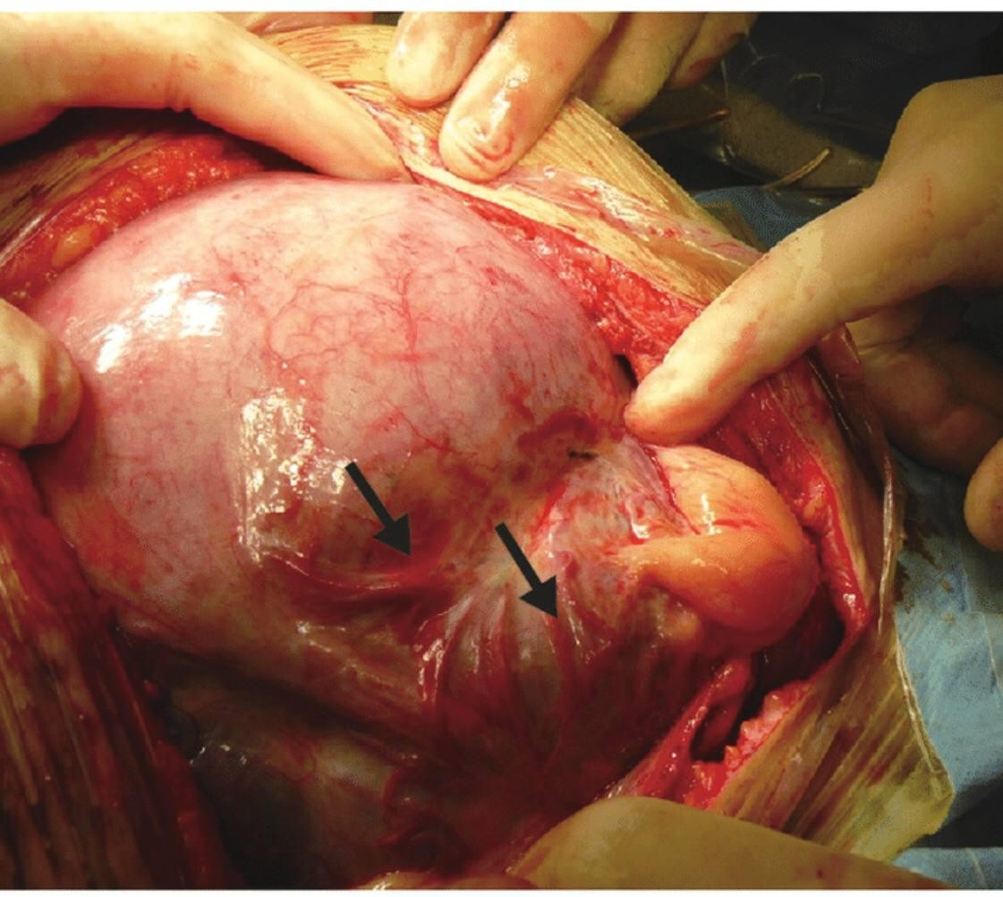
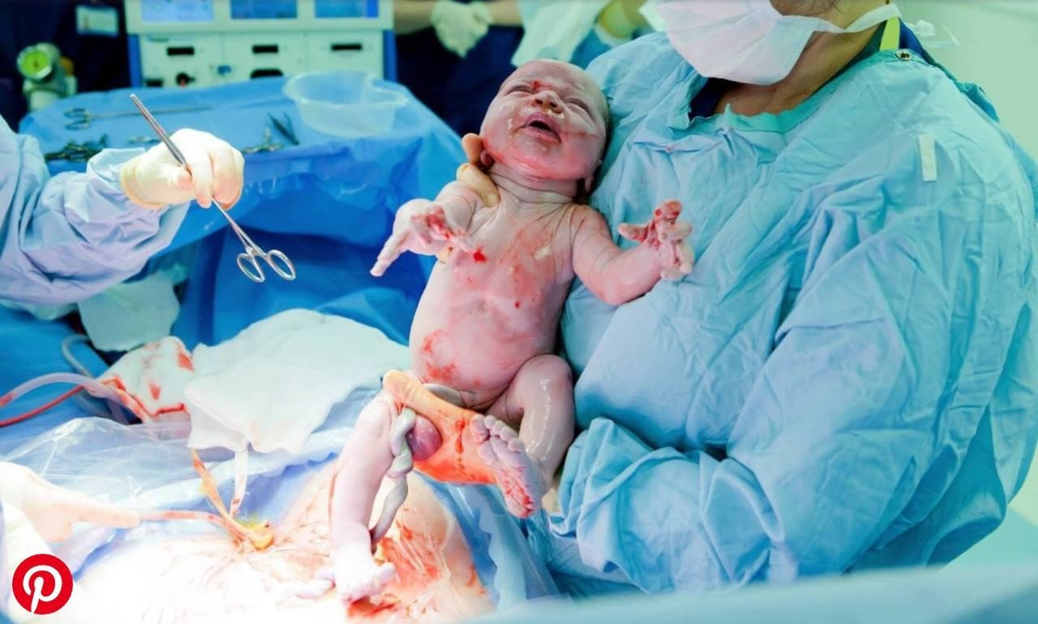
3. Abnormal placentation:
placenta Previa, accrete, Abruptio.
Scar complications:
Long-term abdominal scar complications include numbness, pain [ Branches of the ilioinguinal nerve and the iliohypogastric nerve are severed by transverse abdominal incisions].
Uterine scar complications include cesarean scar pregnancy and postmenstrual spotting (an indentation on the endometrial side of the
cesarean scar).
risks to the newborn
Respiratory Difficulties.
Iatrogenic injury.
Failure to Breastfeed.

