Slide 1
Pleural effusion
Obada Abu Ali
Ahmad Al-Doghmi
Ghaith Zidan

Slide 2
Definition
is an unusual(increase) amount of fluid around the lung in the pleural cavity
This excess fluid can impair breathing by limiting the expansion of the lungs

Slide 3
Pleural cavity
The pleura is a thin serous membrane that line the lungs and the inside of the chest cavity which act to lubricate and facilitate breathing.
this serous membrane which folds back onto itself to form a two-layered membranous pleural sac. The outer pleura (parietal pleura) is attached to the chest wall, but is separated from it by the endothoracic fascia while The inner pleura (visceral pleura) covers the lungs and adjoining structures, including blood vessels, bronchi and nerves.

Slide 4
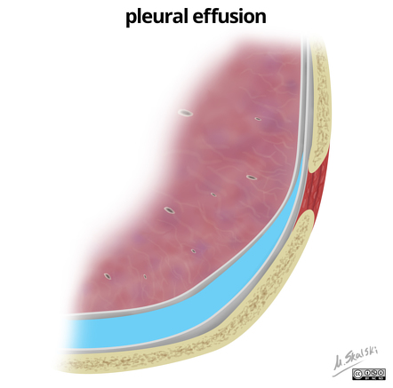
continue

Slide 5
continue
Effusion may has other content
Hemothorax: blood, usually following trauma.
Empyema: purulent fluid (pus).
Hydropneumothorax: fluid and air

Slide 6
classification
By pathophysiology we can classify the pleural effusion into two type :
1)Transudative effusion(usually bilateraly on x-ray) :is due two either elevated capillary pressure in visceral or parietal pleura as in CHF , or decreased plasma oncotic pressure as in hypoalbuminemia .
Another disease associated with it :
Cirrhosis
Peritoneal dialysis
Nephrotic syndrome
Atelectasis
Pulmonary embolism

Slide 7
continue
2)Exudative effusion (usually unilateral on x-ray) caused by increased permeability of pleural surface or decreased lymphatic flow from pleural surface because of damage to pleural membranes or vasculature .
Associated with :
Bacterial pneumonia ,TB
Malignancy ,metastatic disease
Viral infection
Collagen vascular disease
PE

Slide 8
Causes in general
CHF is the most common
Pneumonia
Malignancy: lung (36%),breast(25%),lymphoma(10%)
Pulmonary embolism
Viral diseases
Cirrhosis with ascites

Slide 9
Clinical features
The onset may be insidious depending on the size and rate of accumulation
Main Symptoms:
Often asymptomatic
Dyspnea on exertion
Peripheral edema
Orthopnea ,paroxysmal nocturnal dyspnea

Slide 10
Continue
Signs :
Dullness to percussion
Decreased breath sound over the effusion
Decreased tactile fremitus

Slide 11
Diagnosis
A pleural effusion is usually diagnosed on the basis of medical history and physical exam, and confirmed by the following :
1) chest X-rays
A) according to the position ; The fluid usually freely moving so :
Upright position :fluid falls to bases
Lying down(supine):fluid falls to posterior
Lateral decubitus(lying down on side ):fluid layers to pleura space closest to ground

Slide 12
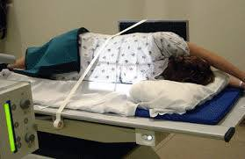
Lateral decubitus

Slide 13
continue
B) according to the amount:
PA : are the most commonly used examination to assess for the presence of a pleural effusion; however, it should be noted that on a routine erect chest x-ray as much as 250-600 mL of fluid is required before it becomes evident
A lateral decubitus film is most sensitive, able to identify even a small amount of fluid. and can also determine whether fluid is free flowing or loculated
At the other extreme supine projections can mask large quantities of fluid

Slide 14
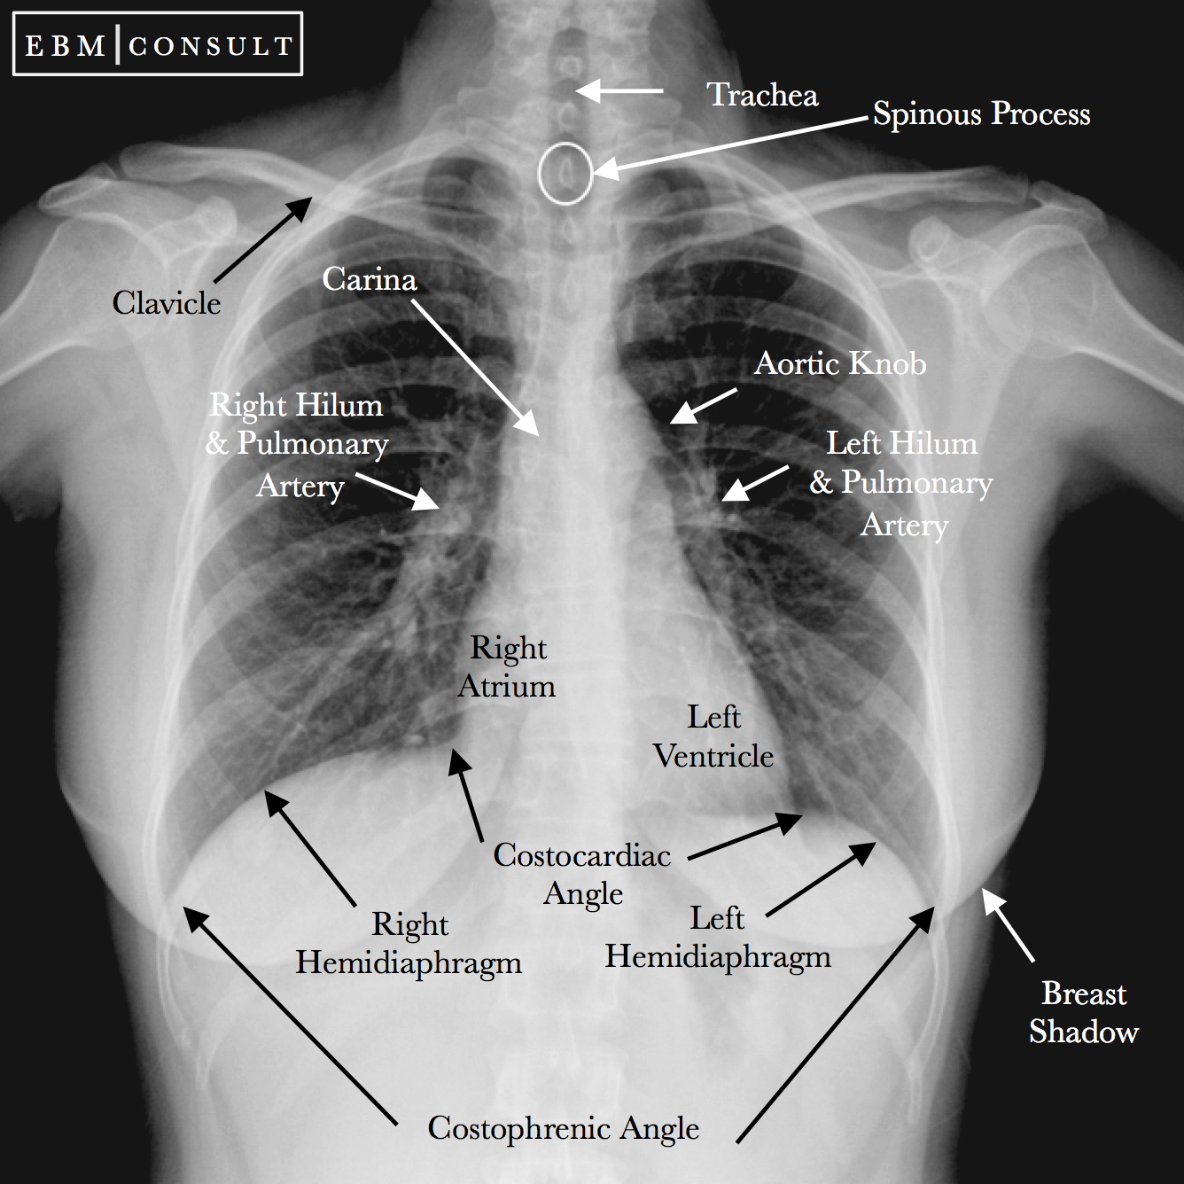
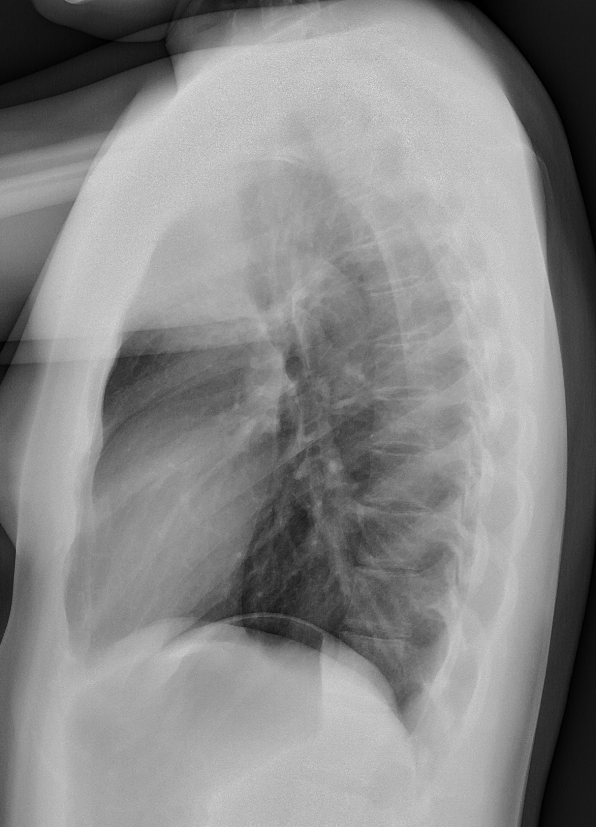
Normal chest X-ray

Slide 15
Changes in the x ray
1)Homogenous opacification
2)blunting of the costophrenic angle
This is the earliest sign of pleural effusion on the frontal view and seen When the fluid is slightly above the level of the upper portion of the diaphragm as A minimal amount of fluid (approximately 175 mL) is required to produce detectable blunting
3)blunting of the cardiophrenic angle
4) Loss of the diaphragm outline
5) Absence of pulmonary and bronchial marking
6)meniscus sign

Slide 16
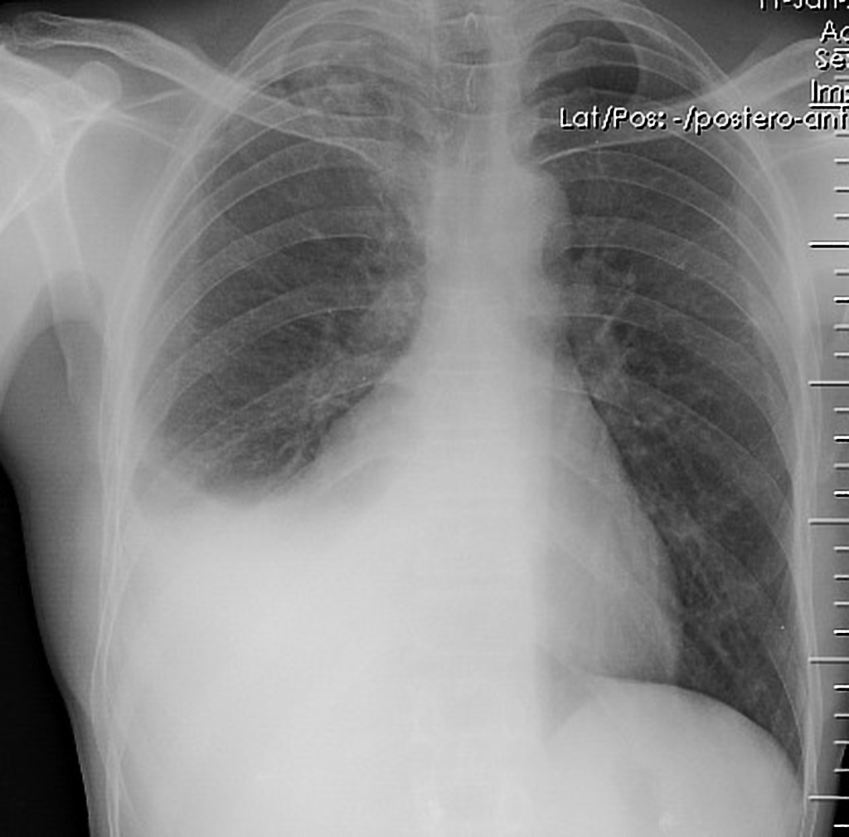

Slide 17
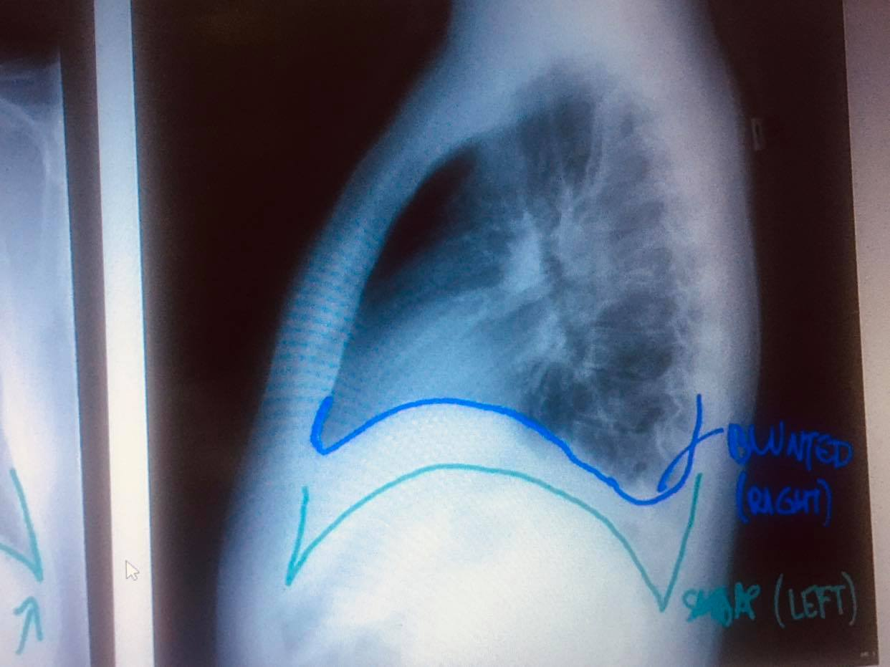
Angle blunting

Slide 18
Meniscus sign
a concave upper border of effusion, on erect frontal and lateral radiographs is called the pleural meniscus
Appear higher lateraly than medialy Because x-ray beams have to transverse a greater depth of fluid at the periphery of the thorax, the upper margin appears higher in the form of a meniscus. The superior margin of the fluid located more medially does not produce a layer of sufficient depth to be visible on the radiograph

Slide 19
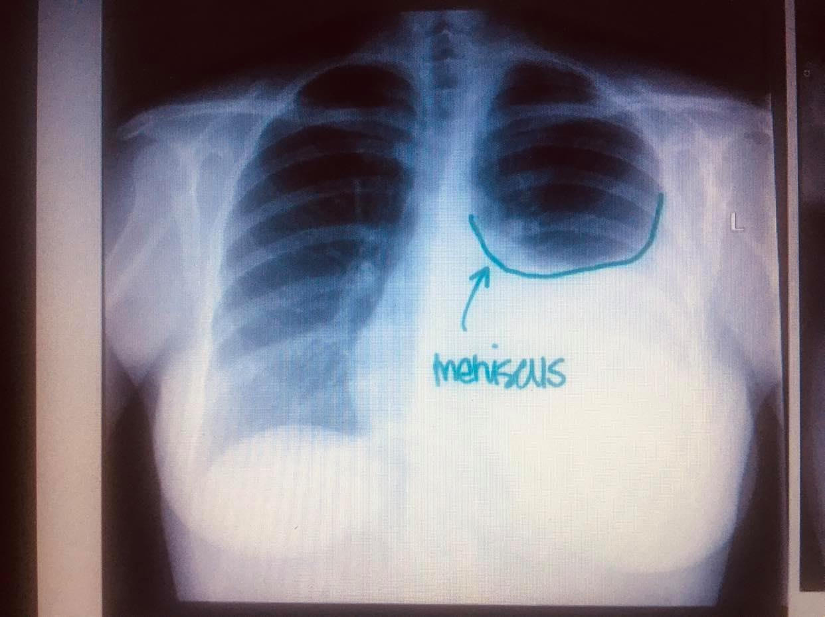
Continue

Slide 20
Subpulmonic effusion
Fluid accumulation between the lung base and the diaphragm ( causing flattening and inversion of the hemidiaphragm without significant blunting of the lateral costophrenic angle. In effect, the lung “floats” on a layer of fluid)
They are more common on the right, and usually unilateral. The following features are helpful :
right: peak of the hemidiaphragm is shifted laterally
left: increased distance between lower lobe air and gastric bubble (more than 1cm)

Slide 21
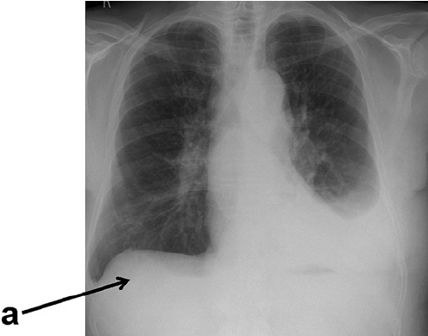
Normal a:right subpulmonic effusion

Slide 22
continue
left image: The costophrenic angle (black arrow head) is blunted and displaced medially. The distance between the stomach bubble and diaphragm has increased (Black arrow).
right image: In the lateral decubitus film fluid layers along the ribs (white arrow heads),used to confirm subpulmonic .

Slide 23
Loculated vs free flowing
In the absence of pleural adhesions ,effusion will flow freely and change location with position
But with pleural adhesion usually from old infection .the fluid may assume unusual appearance (loculated) ; defies gravity by remaining at the non dependent part

Slide 25
Fluid may be localized within the fissures and produce a rounded opacity that mistaken for a tumor .
Left heart failure case
A :before improvement(AP)
fluid in the minor (black arrow) and major (white arrow) fissures
B:before improvement (lateral)
distended minor (thin arrow) and major (thick arrow) fissures
C and D: obtained 1 week later shows decrease in fluid (arrow)
After improvement of cardiac status

Slide 26
Supine position
Present of veiling opacity in the right lung because of the pleural fluid preferentially collecting posteroinferiorly in the pleural space

Slide 27
Mediastinal shift
A very large pleural effusion appears as an opaque hemithorax with a mediastinal shift to the contralateral side. The mediastinal shift can be less prominent or even absent in the presence of underlying lung pathology (eg, atelectasis) or contralateral hemithorax abnormality

Slide 28
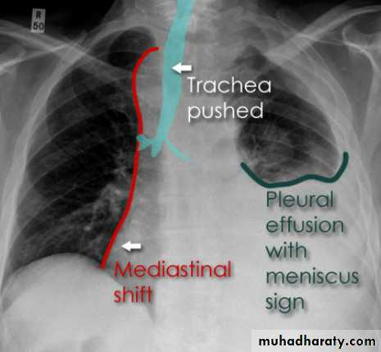
Tracheal deviation

Slide 29
Air bronchogram differentiate the opacity in pneumonia from effusion

Slide 30
Other investigation
2)CT: more reliable than x-ray image
3)Thoracentesis is useful if etiology is not obvious
And maybe therapeutic (drainage provide relief for large effusion )

Slide 31
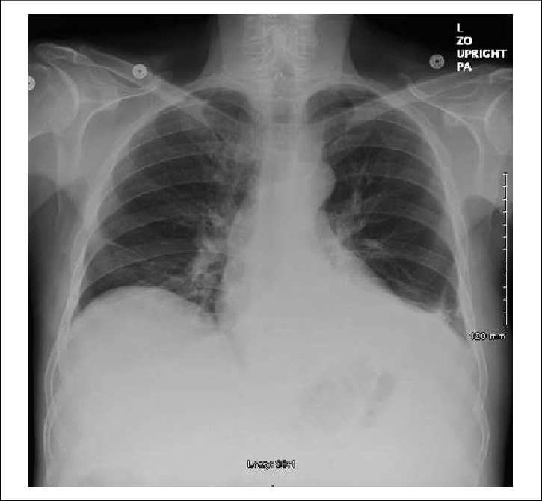
Before and after thoracentesis

Slide 32
Case study(1)
A 35-year-old woman presented with a 2-month history of progressive dyspnoea, oppressive chest pain and difficulty breathing when lying flat (orthopnoea), as well as night sweats, fever and weight loss. Her blood pressure was 120/70 mm Hg, heart rate 92 bpm and oxygen saturation 92% on room air. She had no medical history of interest and was not taking any medication.
Left massive pleural effusion (A). Complete collapse of the left lower lobe and partial collapse of the left upper lobe, and large mediastinal mass shift

Slide 33
Case study (2)
A 74-year-old woman was admitted to the hospital with malaise, weight loss, cough and dyspnoea. The rest of the clinical examination was normal. The patient's blood pressure was 144/80 mm Hg, heart rate 90 bpm and oxygen saturation 95% on room air. She had type 2 diabetes.
Chest X-ray at hospital admission showed the presence of left pleural effusion and right mediastinal shift.

