Slide 1
بِسْمِ اللّهِ الرَّحْمَنِ الرَّحِيمِ

Slide 2
Epidemiological and Research Studies
Part III
Prof DR. Waqar Al – Kubaisy

Slide 3
Observational studies
Descriptive
Case report
Case series
Epidemiological reports
Cross-sectional
Analytical studies
Cross-sectional
Case-control
Cohort
Intervention(experimental studies
Clinical trials
Community trials

Slide 4
Cross-sectional
It begins with population?????
looking to identify who have
disease
Exposure
No exposure
no disease
Exposure
No exposure
Case-control
TROHOC
It begins with group of people classified into
diseased and not diseased
And looking backward
to identify who are
exposed to a risk factor
unexposed to the risk factor

Slide 5
It begins with group of people free of disease and classified into subgroups
a group of individuals exposed to a risk factor
a group who are unexposed to the risk factor
are followed over time (often years)
Cohort Study
Issues in the design of cohort studies understand the differences from a CCS,
*Potential bias in cohort studies
*Analysis of cohort studies
*calculate the basic risk measures (RR,AR
*appreciate its strengths and weaknesses.

Slide 6
Cohort Study
Analytical studies
Cross-sectional
Case-control
Cohort
Also called : follow up study or incidence studies,
Definition:
Study in which persons,
based on their exposure to a determinant
and free of the disease outcome at the start of the study
are followed in time to assess the occurrence of the disease outcome
Issues in the design of cohort studies understand the differences from a CCS,
*Potential bias in cohort studies
*Analysis of cohort studies
*calculate the basic measures (RR,AR
*appreciate its strengths and weaknesses.
It begins with a group of people who are free of disease and who are
classified into subgroups according to exposure to a potential cause of disease or outcome .
Cases are excluded at the beginning
Variables of interest are specified and measured and
the whole cohort is followed up to see how the subsequent development of new cases of the disease (or other outcome
differs between the groups with and without exposure.

Slide 7
Cohort Studies
*Issues in the design of cohort studies understand the differences from a CCS, *Potential bias in cohort studies
*Analysis of cohort studies
*calculate the basic measures (relative risk, attributable risk etc
*appreciate its strengths &weaknesses.
Cohort studies are a form of longitudinal study
design that flows from the exposure to outcome.
In a cohort study,
a group of individuals exposed to a putative risk factor and
a group who are unexposed to the risk factor
are followed over time (often years)
to determine the occurrence of disease.
The incidence of disease
in the exposed group is compared
with the incidence of disease in the unexposed group.
The relative risk (incidence risk or incidence rate) is used
to assess whether the exposure and disease are causally linked.
Cohort studies be prospective
A prospective cohort study is also called a concurrent cohort study, where the subjects have been followed up for a period and
the outcomes of interest are recorded.
free of the disease
exposed
unexposed
determine the occurrence of disease

Slide 8
Design of a Prospective Cohort Study
+ Disease
EXPOSED
No Disease
Direction of Inquiry
+ Disease
UNEXPOSED
No Disease
It begins with group of people free of disease and classified into subgroups
a group of individuals exposed to a risk factor
a group who are unexposed to the risk factor
are followed over time (often years)

Slide 9
Issues in the design of cohort studies understand the differences from a CCS,
Potential bias in cohort studies
Analysis of cohort studies
calculate the basic measures (relative risk, attributable risk etc
appreciate its strengths and weaknesses.
Cont.…..cohort studies
1. Issues in the design of cohort studies
Selection of study groups
Measuring exposure
Measuring outcome
Methods of follow-up
Selection of study groups
The aim of a cohort study is to select study participants who are
identical with the exception of their exposure status.
All study participants must be
Free of the outcome under investigation and
have the potential to develop the outcome
under investigation.

Slide 10
. Issues in the design of cohort studies
Selection of study groups
Measuring exposure
Measuring outcome
Methods of follow-up
Cont.…..cohort studies
Measuring exposure
Levels of exposure are (e.g. packs of cigarettes smoked per year)
measured for each individual at baseline at the beginning of the study and
assessed at intervals during the period of follow-up.
When several exposures are being considered simultaneously,
the non-exposed group should comprise all those with none of the risk factors
under investigation.
A particular problem occurring in cohort studies is whether individuals
in the control group are truly unexposed. For example, study participants may start smoking or
they may fail to correctly recall past exposure.
Similarly, those in the
exposed group may change their behavior in relation to the exposure such as diet, smoking or alcohol consumption.
Exposure data may be obtained from a number of sources including
Medical or
Employment records,
standardized questionnaires, interviews and by
physical examination.

Slide 11
Measuring outcome
Cont.…..cohort studies
Issues in the design of cohort Selection of study groups
Measuring exposure
Measuring outcome
Methods of follow-up
Outcome measures may be obtained from
various sources, including
directly from the participant
medical records or
routine surveillance of cancer registry data,
death certificates,
Method used to ascertain outcome
must be identical for both exposed and unexposed groups.
Methods of follow-up
The follow-up of study participants in a cohort study is a major challenge.
A great deal of cost and time is required to ensure follow-up
of cohort members
and to update measures of exposures and confounders,
in addition to monitoring participants' health outcomes. .
The failure to collect outcome data for all members of the cohort will affect the validity of study results

Slide 12
Cont…..cohort studies
1 Issues in the design of cohort studies understand the differences from a CCS,
2 Potential bias in cohort studies
3 Analysis of cohort studies
4 calculate the basic measures (relative risk, attributable risk etc
5 appreciate its strengths and weaknesses.
2. Potential sources of bias
A major source of potential bias in cohort studies
is due to:
losses to follow-up.
Cohort members may die,
Migrate,
Change jobs or
Refuse to continue to participate in the study.
In addition, losses to follow-up may be related to the
exposure, outcome or both. For example, individuals who develop the outcome may be less likely to continue to participate in the study.
A major source of potential bias in cohort studies arises from
The degree of accuracy with which subjects have been classified with respect to their exposure or disease status.
Differential misclassification can lead to an over or underestimate of the effect between exposure and outcome

Slide 13
1 Issues in the design of cohort studies understand the differences from a CCS,
2 Potential bias in cohort studies
3 Analysis of cohort studies
4 calculate the basic measures (relative risk, attributable risk etc
5 appreciate its strengths and weaknesses.
Cont.…..cohort studies
Analysis of cohort studies
?????
Analysis of a cohort study uses either
the risk or the rate ratio of disease
in the exposed cohort
compared with the
rate or risk in the unexposed cohort.
Example:
A study done to see if smoking is a risk factor for cancer of the pancreas .A sample of 90,049 individuals was chosen ,of them 27,042 were smokers, the remaining were not. Both groups were followed for one year, 42and 7, cases of CA pancreas was detected in smoker and non smoker group respectively .Can we conclude, that smoking is a risk factor for Ca pancreas
Example

Slide 14
Analysis of cohort studies
Example:
A study done to see if smoking is a risk factor for cancer of the pancreas .A sample of 90,049 individuals was chosen ,of them 27,042 were smokers,
the remaining were not. Both groups were followed for one year, 42and 7, cases of CA pancreas was detected in smoker and non smoker group respectively .Can we conclude, that smoking is a risk factor for Ca pancreas
Cont…..cohort studies
?????
Smoking | CA Pancreas | No CA Pancreas | Total
Positive | 42 |  | 27,042
Negative | 7
Total |  |  | 90,049
?????

Slide 15
Cont. ..Analysis of cohort studies
Example:
A study done to see if smoking is a risk factor for cancer of the pancreas .A sample of 90,049 individuals was chosen ,of them 27,042 were smokers, the remaining were not. Both groups were followed for one year, 42and 7, cases of CA pancreas was detected in smoker and non smoker group respectively .Can we conclude, that smoking is a risk factor for Ca pancreas
Smoking | CA Pancreas | No CA Pancreas | Total
Positive | 42 | 27,000 | 27,042
Negative | 7 | 6300 | 63007
Total | 49 | 90000 | 90,049
?????
r0
?????
Incidence rate of disease in exposed group (r1) =no. of disease among exposed
no. of exposed person
Incidence rate of disease in un exposed group (r0) =no. of disease among un exposed
no. of un exposed person

Slide 16
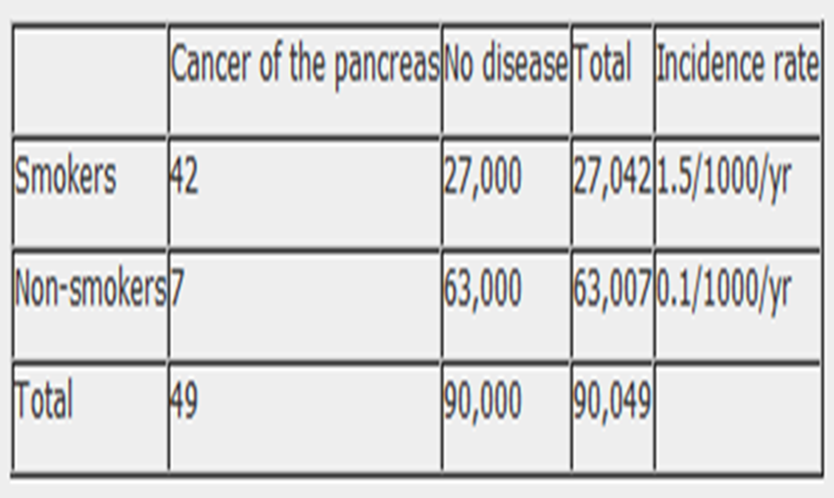
Example:
A study done to see if smoking is a risk factor for cancer of the pancreas .A sample of 90,049 individuals was chosen ,of them 27,042 were smokers, the remaining were not. Both groups were followed for one year, 42and 7, cases of CA pancreas was detected in smoker and non smoker group respectively
.Can we conclude, that smoking is a risk factor for Ca pancreas
Can we conclude, that smoking is a risk factor for Ca pancreas
Measurements of risk
?????
?????
?????

Slide 17
Risk estimates
To estimate risk of event to occur when exposed to a risk factor.
Relative risk (RR)
Relative risk
RR= a/(a+b)
c/(c+d)
Used in cohort study
The risk is the relative incidence in the exposed and non exposed group
RR = proportion of disease in exposed group
proportion of disease in unexposed group

Slide 18
Relative Risk = Incidence rate of disease in exposed group (r1)
Incidence rate of disease in unexposed group (r0)
RR = 1.5/0.1 = 15
The RR of 15 indicates that
the risk of cancer of the pancreas is 15 times higher
among smokers than non-smokers.
attributable risk can be calculated ???
is the difference in the disease rates in exposed and unexposed individuals

Slide 19
Cont. ..Analysis of cohort studies
the data, taken from a hypothetical cohort study to investigate the association between smoking and cancer of the pancreas, the relative and attributable risk can be calculated as follows:
Attributable risk is the difference in the probability of disease in exposed people and the probability of disease in unexposed people. it is expressed as a percentage
Attributable risk =
Incidence of disease in exposed group (r1)▬Incidence of disease in unexposed group (r0)
AR = 1.5-0.1 X100 = 14%
Example

Slide 20
ARP = (r1 – r0 ) / r0 x 100
POPULATION ATTRIBUTABLE RISK (PAR) )AND
POPULATION ATTRIBUTABLE RISK PERCENT (PAR%),

Slide 21
Cont…..cohort studies
1 Issues in the design of cohort studies understand the differences from a CCS,
2 Potential bias in cohort studies
3 Analysis of cohort studies
4 calculate the basic measures (relative risk, attributable risk etc
5 appreciate its strengths &weaknesses.
4. Strengths and weaknesses of cohort studies
Weaknesses
Costly and time consuming.
Prone to bias due to loss to
follow-up.
Prone to confounding.
Participants may move between one exposure category
Knowledge of exposure status may bias classification of the outcome.
Being in the study may alter participant's behaviour.
Poor choice for the study of a rare disease.
Classification of individuals (exposure or outcome status) can be affected by changes in diagnostic procedures.
Strengths
Multiple outcomes can be measured for any one exposure.
Can look at multiple exposures.
Exposure is measured before the onset of disease
Good for measuring rare exposures, for example among different occupations.
Demonstrate direction of causality.
Can measure incidence

Slide 22
Thank you for attention
Qs ????

