Slide 1
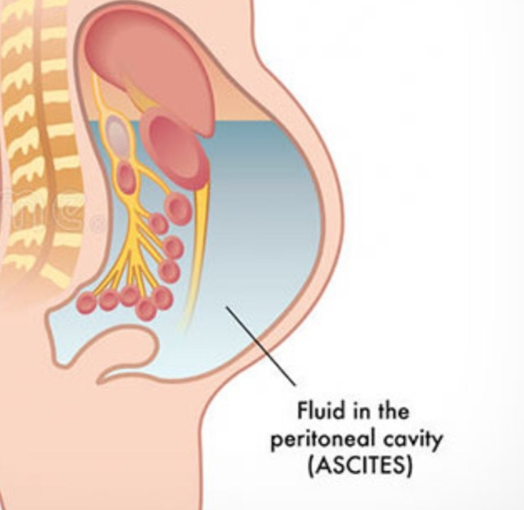
Ascites
Supervised by:-Rami Dwairi
Presented by:- Hala Alaween
Nebal Atallah

Slide 2
Ascites
Abnormal buildup or accumulation of free fluid in the peritoneal cavity.
Small amounts of ascites are asymptomatic, but with larger accumulations of fluid more than 1 L there is :
* abdominal distension
*fullness in the flanks
* shifting dullness on percussion
* fluid thrill/ fluid wave when ascites marked

Slide 3
Feature of ascites
Eversion of umbilicus .
Herniae.
Abdominal striae.
Divarication of recti and scrotal edema.
Dilated superficial abdominal veins due to portal hypertension.

Slide 4
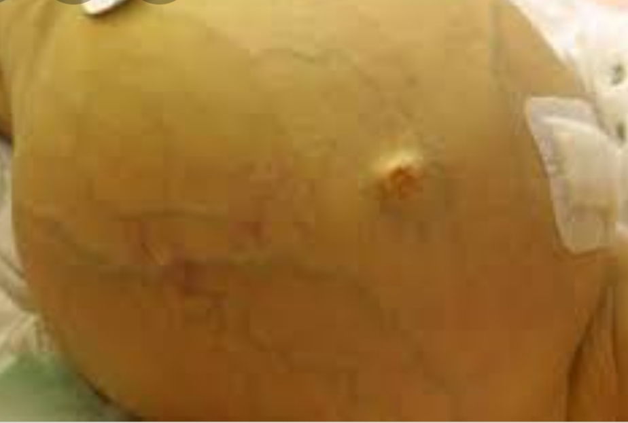
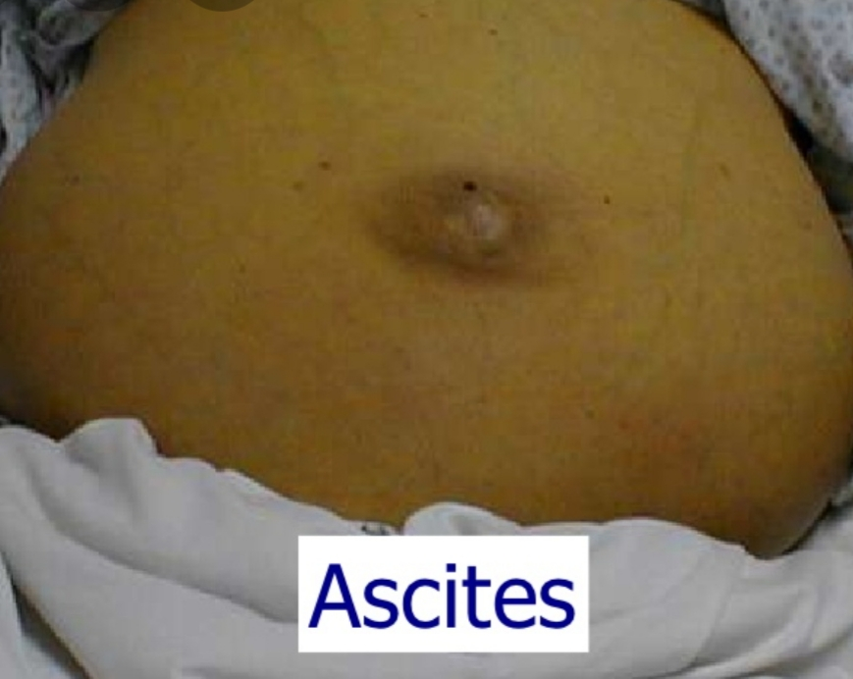
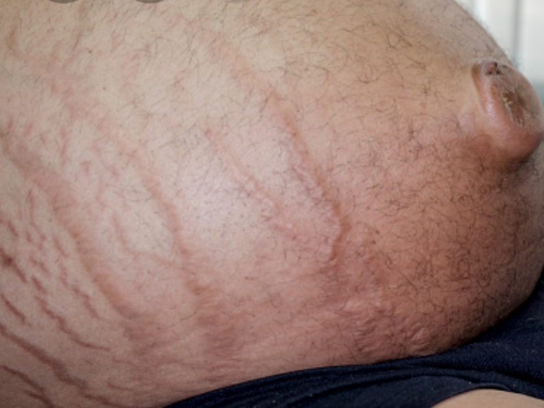

Slide 5
Causes:
Causes of high serum ascites albumin gradient(SAAG) are:
Heart failure
Hepatic cirrhosis
Cause of low Serum ascites albumin gradient (SAAG) are:
Malignant * hepatic
* peritoneal
Other causes :
Acute pancreatitis
Lymphatic obstruction
Infection (TB)
Hepatic venous occlusion as( budd-chiari syndrome )
Notes:
SAAG = (serum albumin) − (albumin level of ascitic fluid).
Transudate is extravascular fluid with low protein content and a low specific gravity. It results from increased fluid pressures or diminished colloid oncotic forces in the plasma.
Exudative :fluid with high protein content and high specific gravity .it results from increase vessel permeability for protein

Slide 6
Splanchnic vasodilation is thought to be main factor leading to ascites in cirrhosis. This is mediated by vasodilators ( nitric oxide) that are released when portal hypertension causes shunting of blood into the systemic circulation. This lead to fall systemic arterial pressure this leade to activation renin-angiotensin with secondary aldosteronism Increased sympathetic nervous activity and atrial natriuretic hormone secretion

Slide 7
These systems tend to normalise arterial pressure but produce salt and water retention. In this setting the combination of splanchnic arterial vasodilation and portal hypertension alters intestinal capillary permeability promoting accumulation fluid within perineum.

Slide 8
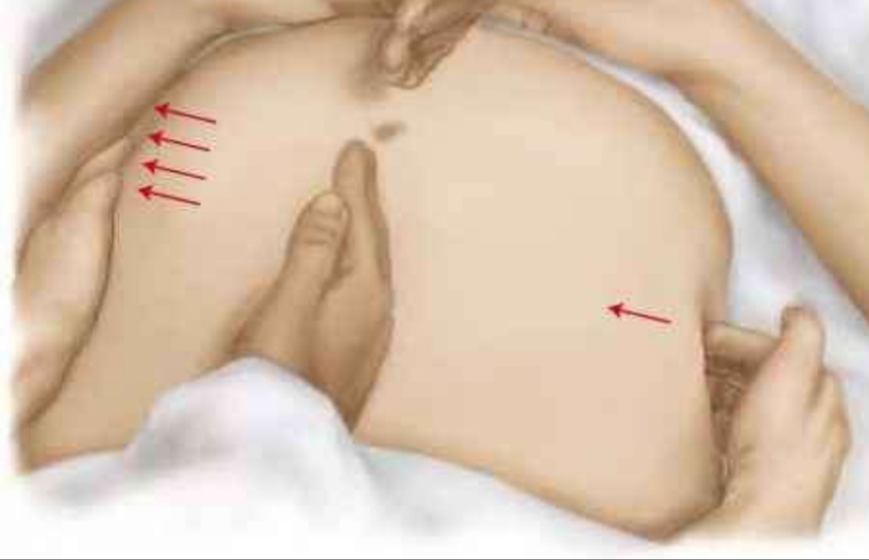
Physical examination
Transmitted thrill/fluid wave
Shifting dullness
In ascites the dullness shifting in More dependant side , while tympany Shift to top

Slide 9
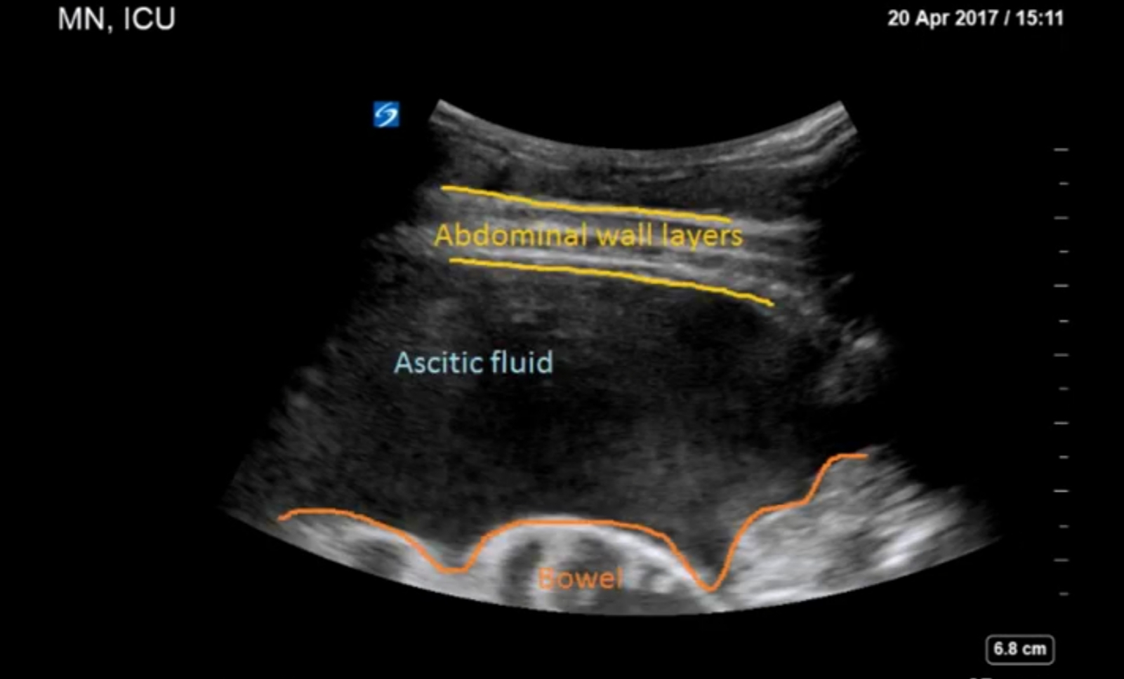
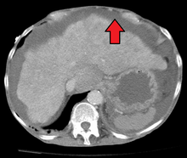
Investigation
Ultasonography is the best mean of detecting ascites particularly in the obese patient and those with small volumes of fluid .
Paracentesis can be used to obtain ascites fluid for analysis (Peritoneal cavity is punctured by needle to sample peritoneal fluid) .
Pleural effusion are found in 10% of patient usually in right side ( hepatic hydrothorax) most small and identified only on chest x ray but occasionally a massive hydro thorax occured. Pleural effusion in left side should not be assumed to be due to the ascites .
CT: The most sensitive technique

Slide 10
Fluid analysis
(SAAG) can be a useful tool to distinguish ascites of different aetiologies
Transudative: protein concentration < 25 g/L (2.5 g/dL)) and relatively few cells so SAAG > 11 g/L (1.1 g/dL) which caused by Venous outflow obstruction due to cardiac failure or hepatic venous outflow obstruction
exudative :protein concentration > 25 g/L (2.5 g/dL) or a SAAG of < 11 g/L (1.1 g/dL) raises the possibility of infection (especially tuberculosis), malignancy, pancreatic ascites or, rarely, hypothyroidism
triglyceride at a level > 1.1 g/L (110 mg/dL suggests anatomical or functional abnormality of lymphatic drainage from the abdomen. The ascites in this context has a characteristic milky-white appearance.

Slide 11
Management
Treatment of transudative ascites :
on restricting sodium and water intake
promoting urine output with diuretics
if necessary, removing ascites directly by paracentesis
During management of ascites, the patient should be weighed regularly. Diuretics should be titrated to remove no more than 1 L of fluid daily, so body weight should not fall by more than 1 kg daily to avoid excessive fluid depletion.
Treatment of exudative ascites :
is treated with paracentesis

Slide 12
Sodium and water restriction
Restriction of dietary sodium intake is essential to achieve negative sodium balance and a few patients can be managed satisfactorily by this alone
. Restriction of sodium intake to 100 mmol/24 hrs (‘no added salt diet’) is usually adequate.
Drugs containing relatively large amounts of sodium, and those promoting sodium retention, such as non-steroidal anti-inflammatory drugs (NSAIDs), must be avoided
Restriction of water intake to 1.0–1.5 L/24 hrs is necessary only if the plasma sodium falls below 125 mmol/L

Slide 14
Diuretics
Diuretics Most patients require diuretics in addition to sodium restriction
Diuresis may be improved if patients are rested in bed, perhaps because renal blood flow increases in the horizontal position
Spironolactone (100–400 mg/day): is the first-line drug because it is a powerful aldosterone antagonist
SIDE EFFECT:painful gynaecomastia and hyperkalaemia
amiloride (5–10 mg/day) can be substitution for spironolactone
loop diuretics, such as furosemide: but these can lead to fluid and electrolyte imbalance and renal dysfunction
Patients who do not respond to doses of 400 mg spironolactone and 160 mg furosemide, or who are unable to tolerate these doses due to hyponatraemia or renal impairment, are considered to have refractory or diuretic-resistant ascites and should be treated by other measures

Slide 15
Paracentesis
First-line treatment of refractory ascites is large-volume paracentesis.
Paracentesis to dryness is safe, provided the circulation is supported with an intravenous colloid such as human albumin (6–8 g albumin for each one liter of aspirated fluid if 5 L removed at once ) .
Paracentesis can be used as an initial therapy or when other treatments fail

Slide 16
Complications
Renal failure
It can be pre-renal and due to vasodilatation from sepsis and/or diuretic therapy, or due to hepatorenal syndrome which occurs in 10% of patients with advanced cirrhosis complicated by ascites,
Hepatorenal syndrome
It is a acute reversible form of renal failure in patient with cirrhosis
Cause:unkown
Triggers: refractory ascites….large volume paracentesis without albumin replacement ….SBP
Caused by combination of VD in splanchnic and VC in renal circulation
The first line of treatment : vasopressin (terlipressin) and albumin
Liver transplantation is the best option esp. for type 1

Slide 18
Spontaneous bacterial peritonitis
Infection of ascites fluid without detectable intra abdominal infection and caused usually by E.coli
Mechanism :
1.Translocation of gut bacteria through intestinal wall to colonize mesenteric LN ,thus entering the blood circulation and ascitic fluid
2.Hematogenous
S&S: fever –abdominal pain and tenderness—rebound tenderness-no bowel sounds—altered mental status
Diagnosis is based on :
1.Positive ascitic bacterial culture (monomicrobial)
2.Elevated absolute PMN count in ascitic fluid (more than 250cells /mm3)
Treatment: broad-spectrum antibiotics, such as cefotaxime (5-10 days)

Slide 19
Thank you

