Slide 1
تجميع لمادة د عادل لامتحان ال miniosce
اسالة سنوات
اسالة من عندنا
نفس نمط اسالة السنوات من السلايدات
اعداد محمد هاشم و اسيل عدنان
to study this file play the presentation and do it a qustion at a time

Slide 2
NORMAL MENSTRUAL CYCLE
Mean duration of the MC? Mean 28 days ( Range 21-36)
Average duration of menses? 3-7days
Normal estimated blood loss? 20 – 80 ml
When does ovulation occur? Usually day 14 before menses
relation of ovulation to the LH surge? 10 -- 12 hrs after the onset of mid-cycle LH surge.
life spane of the ovem after ovulation? 24 hr

Slide 3
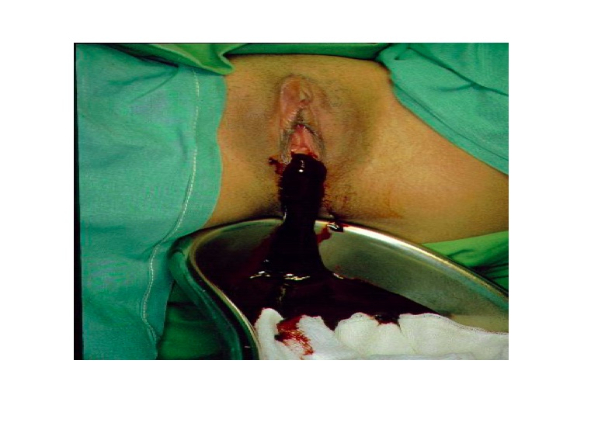
5. A 19-year-old patient attends the gynaecology clinic complaining of heavy painful periods for the last 2 years. The pain usually starts 4-5 days before the onset of blood flow. Back at the age of 16, and due to primary amenorrhea, she had underwent the procedure that is shown in the image. According to her new complaint, and given that no significant findings on exam, the essential investigation for the most probable diagnosis is:
a. Karyotyping
b. Ultrasound scan
c. Diagnostic laparoscopy
d. Urogram
e. Hysteroscopy

Slide 4
Q1 : what is the patient excepted karyotype ( normal pelvis anatomy on US)
Answer : XX

Slide 5
Q2 :What are two steps in managment ( normal pelvis anatomy on US)
Answer :
1. Incise the Hymen, drain the blood
2. Needs IVP ( intravenous pyelogram /urogram ) to exclude renal malformation

Slide 6
This female is 8 years old , came with her mother due to vaginal discharge .
What is the diagnosis ?
precocious puberty
Mention 2 features in this picture that confirm your diagnosis ?
Thelarche (breast budding )
Pubarche (pubic hair)
What's your concern and why ?
Short stature due to premature closure of metaphysis ?
6 investigations you should order to confirm ?
FSH , LH , testesterone , pituitary MRI …??
What is the treatment ?
GnRH agonist

Slide 7
What is the diagnosis ?
Turner's syndrome
Mention features in this picture that confirm your diagnosis ?
short stature, web neck, lymphedema, shield chest with widely spaced nipples, short metacarpal bones , wide carrying angle
Investigations you should order to confirm ?
karyotyping
Noticable lab values ?
High FSH and LH levels.
What is the treatment ?
HRT (hormonal replacement
assosiated conginital anomalies ?
renal anomalies, coarctation of the aorta, bicusbid valve

Slide 8
Q : 15 years old endocrine investigations show normal results no anatomical abnormality amenorrhea
Diagnosis: Constitutional delay Helpful test : bone age ( X-ray Wrist joint)
Cause : immature pulsatile release of gonadotrophin- releasing hormone

Slide 9
Q :Secondary amenorrhoea after curettage
Diagnosis : Asherman
how is this picture take : hysterescopy
Managment :
Under G.A. → breakdown Adhesions through hysteroscope
insert an IUCD to prevent reformation
hormone therapy (E2 + P)
You can also use : Hysterography

Slide 10
Q: Secondary amenorrhoea
Most propabe cause: Anorexia Nervosa
regular menstrual cycle is unlikely to occur at what cut of point : BMI of 19

Slide 11
Q:
what is this phenomina called : Ambiguous external genitalia
Possible causes :
Congenital adrenal hyperplasia
Androgen-secreting tumor
5-Alpha-reductase deficiency

Slide 12
Q:
what is this phenomina called :
Gonadal dysgenesis (the gonads here are only a small streak)
next lab test and why use this test :
Karyotyping for the gonads because If there Y chromosome (Mixed gonadal dygenesis) do gonadectomy because of high risk of malignancy

Slide 13
Q2 what is in the pic answer : levonogesrel

Slide 14
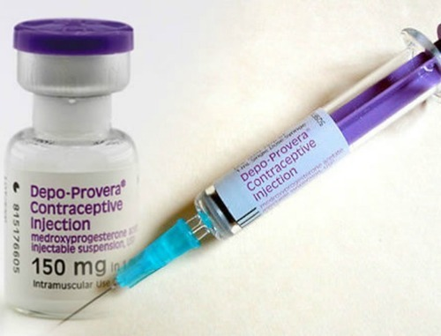
Q1
1-What's the name of this
contraceptive method
It is an injectable contraceptive (IM)
2-What the scientific name?
Depot medroxyprogesterone acetate (DMPA,Depo-Provera طبعا ما كان موجود اسمه بالصورة زي اللي فوق
3-What route of administratin ?
Deep intramascular

Slide 15
4-Name 3 benefits of this?
It's not affected by other medicines.
Doesn't require daily action. Decreases menstrual cramps and pain.
5-How to tell patient how to use it? and what time to take it ?
The 1st injection should be administered within five days after ‘ onset of menses . ---
Injections should be repeated every 3 months .

Slide 16
6-Whats the MECHANISM of action
thickening the cervical mucus, thereby presenting a barrier for sperm penetration.
changes to the endometrium make it an unfavourable environment for implantation
prevent pregnancy by the inhibition of ovulation weak effect
7-If women want to get pregnant can she ? Why?
After stopping Delayed return to fertility: 6-18 months. By 18 months, 90% will have ovulated.

Slide 17
Side effect of medroxyprogesterone
1. Irregular bleeding
the most common reason for discontinuation (Up to 25% in the first year of use)
2. Amenorrhea:
3. Weight Gain, 4.3 kg increase over 5 years
4. Use of DMPA is associated with loss of BMD (bone mass density). After stopping, recovery of BMD is seen &return to baseline in 1-4 years.

Slide 18
what's the name of the contraceptive method ?
Etonogestrel Implant (Implanon)
its mechanism of action ?
Inhibits Ovulation
effective for how long ?
3 years
the most common reason for discontinuation ?
Bleeding irregularity
most common side effect ?
Amenorrhea
other important side effects?
Acne Weight gain
what is its contraindications?
SLE, Hepatocellular adenoma, Migraines with aura and Unexplained vaginal bleeding

Slide 19
Side effect of implanon
1. Amenorrhea ~20% in 1st year, Increases to 30-
40% after 1st year
2. Acne: 17% reported acne. 1.3% of women discontinued for acne
3. Weight gain: Overall increase in BMI 0.7kg/m² , 12.7% of women reported weight gain, 3.3% of women discontinued for weight gain
4. Bleeding irregularity is the most common reason for discontinuation , U.S. studies: 13-14%
Overall U.S. Implanon continuation rate: 75%-84%

Slide 20
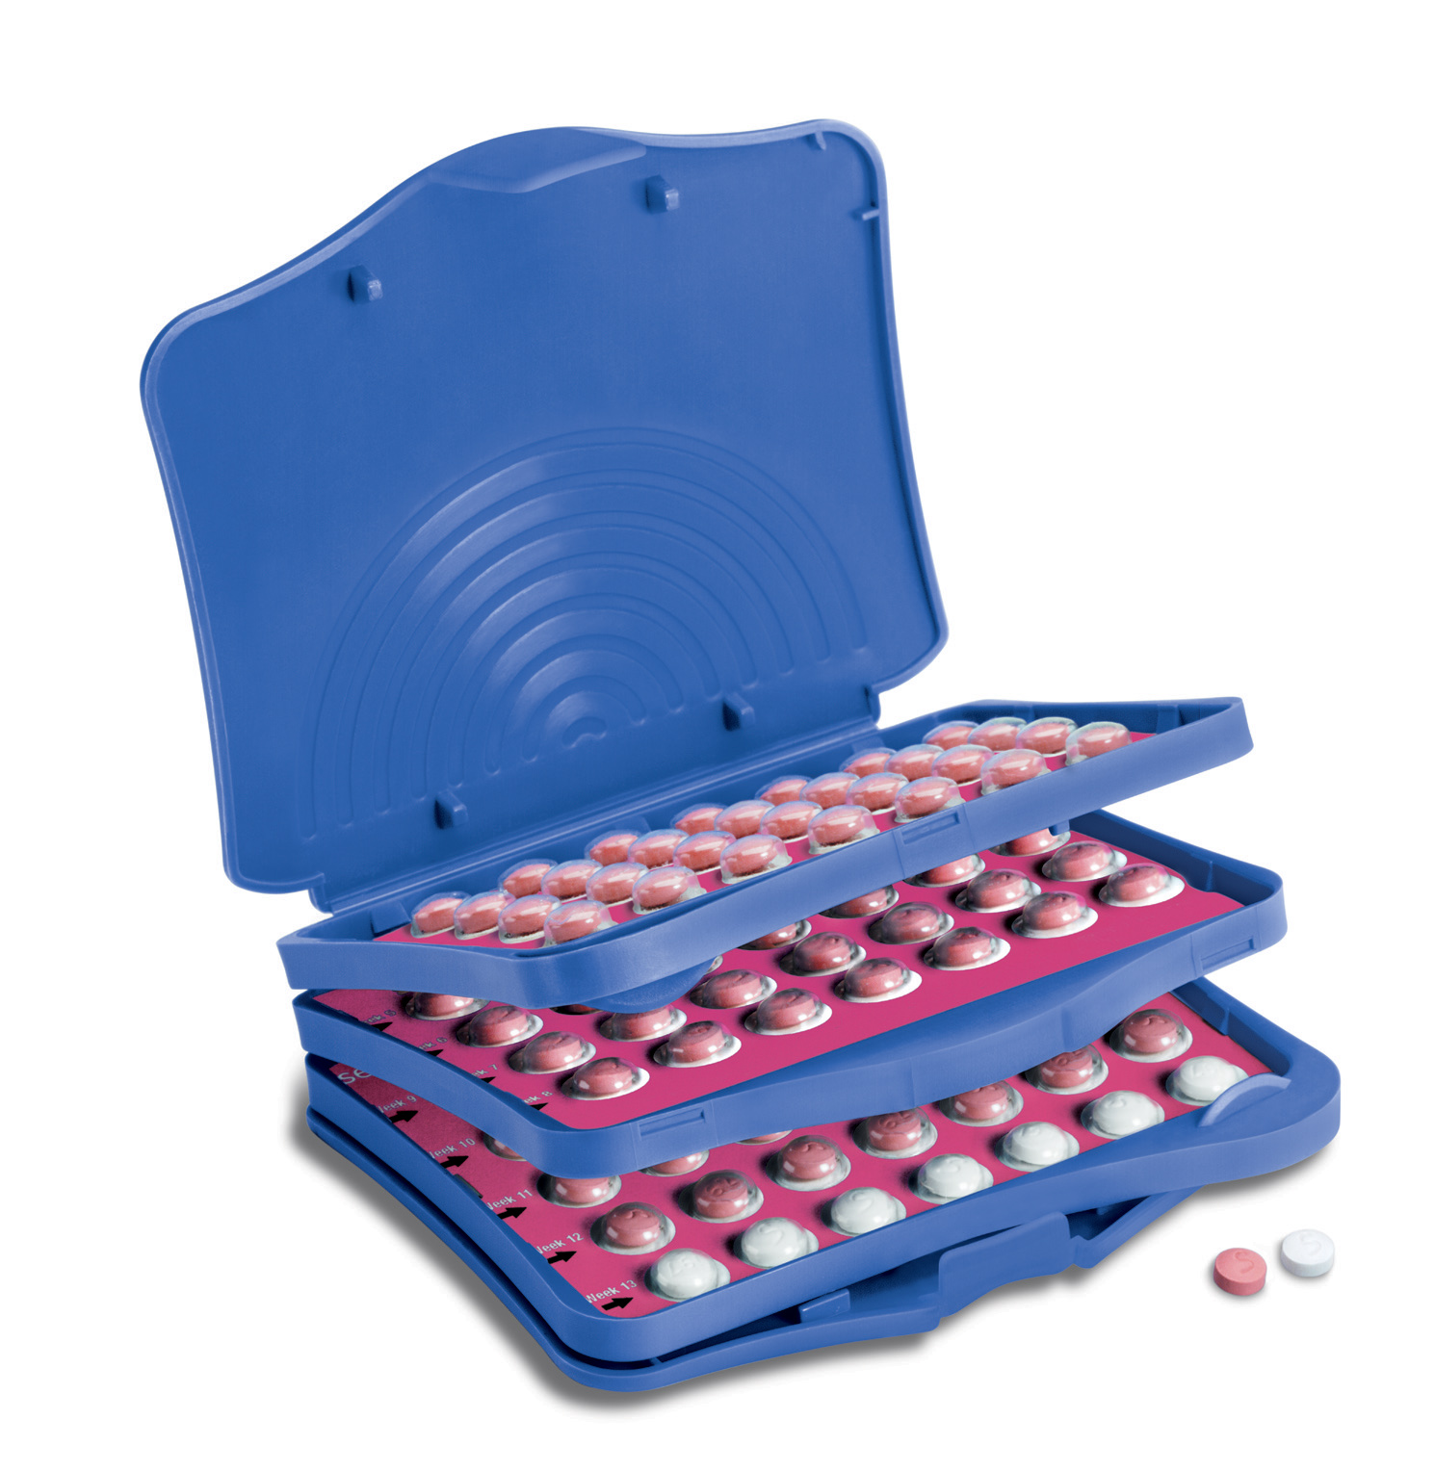
what's the name of the contraceptive method ?
combined hormonal contraseptive
what is the mchanism of action ?
suppression of ovulation
What is the regimen for using these methods ?
Pill: daily pill for 3 weeks every 4 weeks (the last week of or plasebo )
Transdermal patch and ring: used for 3 weeks and one week off
what are the advantges for using it ?
1. Decreased follicular activity
2. Potential for increased efficacy
3. Fewer bleeding days.
what is the most commen side effect and how to mange it ?
breakthrough bleeding , managment
If near end of cycle, discontinue early
If severe, consider exogenous estrogen or higher estrogen dose pill

Slide 21
what contraception is recommended to use in breast feeding ?
Progesteron only pill
what is the only contraception method that offers protection from STIs?
Male Condoms
what are the non-reversible methods for contraception?
which non-reversible methods has the higher faluier rate ?
Vasectomy and tubal ligation
Tubal ligation for female has higher failure rates

Slide 22
what is the name of this metohd?
Vaginal DIAPRAGHM
how is it used ?
Fitted by physician
how long can it be left for ?
18 hours before intercourse and can be left for 24 hours

Slide 23
what must be done after intercourse when using this method for contraception ?
left in place six hours after sexual intercourse

Slide 24
Emergency contraception
what is the most effective method ?
copper IUD
time frame ? within 5 days
Other notable methods ?
1) levonogestrl (as single dose , or 2 doses 12 h apart )
2)combined E+P
Levonogestrl time frame : within 5 days

Slide 25
Q 4
No pic in this question
36 year-old patient came with severe chronic lower abdominal pain and menorrhagia since 2 years , on examination the uterus size was normal , on pelvic examination there were painful nodules in posterior fornix
What is your diagnosis ?
Endometriosis
How to confirm it ?
Laparoscope
Give another gyne presentation this patient may suffer from ?
Deep dysparuenia , dysmenorrhea
Another finding on examination ?
Lower abdominal tenderness , fixed retroverted uterus
What is the surgical treatment ?
Hysterectomy

Slide 26
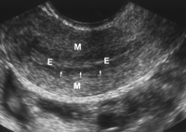
Q : findings in this US image of the uterus
Answer : Normal

Slide 27
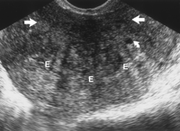
Q : findings in this US image of the uterus
Answer : Adenomyosis

Slide 28
Q : findings in this US image of the uterus
Answer : Adenomyosis
Typical symptoms :
Pelvic pain
Dysmenorrhea
menorrhagia unresponsive to hormonal therapy
Findings on physical examination : soft and boggy uterus that is enlarged (like 10 weeks of pregnancy

Slide 29
Q1 : findings in this MRI image of the uterus
Answer : Adenomyosis
Q2 definitive treatment :
total hysterectomy
Q3 managment preserving fertility :
GnRH- agonists
GnRH- agonists before laparoscopic surgery
conservative surgery

Slide 30
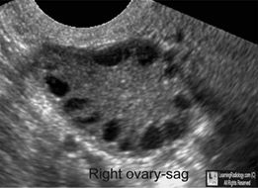
Q2
1 _Whats your diagnosis?
PCOS 2_ mention 6 result of hormonal abnormalities?
Serum luteinizing hormone (LH) elevated
Serum estrone elevated
Fasting insulin: elevated
Free testosterone: elevated
elevated serum androgen level
high LH/FSH ratio >2

Slide 31
3-how can You manage the infertility in this pt?
Life style management of Weight Reduction (Clomiphene Citrate or Metformin)
Laparoscopic Ovarian drilling
Gonadotrophines
4 mention 4 long term complication
. Insulin Resistance, Obesity, Endometrial Cancer , Sleep Apnea ,Dyslipidaemia, Hypertension and Endothelial Dysfunction, Depression, Cardiovascular Disease
5 _mention 2 complication if it become pregnant (I dont remember the Q exactly)
Spontaneous Abortions Increased in high BMI/PCOS patients,
Impaired Glucose Tolerance Gestational Diabetes,
Hypertension,
Small for Gestational Age

Slide 32
6_ mention diffrential diagnosis ?
Hyperprolactinemia
Congenital Adrenal Hyperplasia
Ovarian and adrenal tumors
Drugs
7_what are the benifts form using contraceptive here ?
Suppress ovarian androgen
Increase SHBG
Regular menstrual cyclicity
Progestin opposition
Contraception
8_ what anti-androgens can be given in this case ?
Spironolactone , Cypreterone acetate

Slide 33
9_what tests to order ?
Serum HCG
Serum prolactin
Thyroid function test
FSH: r/o ovarian failure
Serum luteinizing hormone (LH)—elevated
Serum estradiol—normal
Serum estrone—elevated

Slide 34
what is the first line treatment for oligoamenorrhea when fertility is not desired ?
Combination estrogen-progestin pill
Treatment is for infertility in pcos?
First line : weight loss ?
second line : clomophine citrate and metormin ?
third line : laproscopic ovarian drilling ,gonadotrophins

Slide 35
what is the name of this procedure ?
Laparascopic Ovarian Drilling (diathermy in this pic )
when is it offered to the pt ?
women with normal BMI
complications ?
Pereovarian adhesions.
Premature ovarian failure-very rare.

Slide 36
Q3
infertility ( Azosperima
in male )
1- The name of this procedure ?
intracytoplasmic sperm injection
2- Mention 4 indications ?
oligospermia ,,asthenospermia ,,teratospermia ,,failed IVF
3- Mention 3 complication ?
multiple pregnancy .. ectopic pregnancy... Ohss

Slide 37
4- Drugs used in preparing for this procedure ?
GnRH agonist or antagonist according to protocol
Hmg
Hcg
5- From where you can get the sperms ?
testis or epididymis

Slide 38
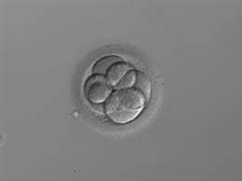
Q5
1-What do you see in image?
6-8 cell stage empryo
2-What technique used ??
In vetro fertalization
3-When you transfer it to be implanted ?
Can transfer at Day 3 cleavage embryo
Or at Day 5 blastocyst
4-Why YOU CHOOSE this technique in this case?
……………..
5-Three medication used in this technique?
Gonadotrophic releasing hormone analogue or agonist (GnRHa) Deycapeptyl
HMG
HCG
6-What Percentage of ectopic pregnancy in this technique?
5%
7-What Percentage of miscarriage?
SAME AS SPONTANOUS PREGNANCY (8-20) النسبه من محاضرة الدكتور محمد خضر

Slide 39
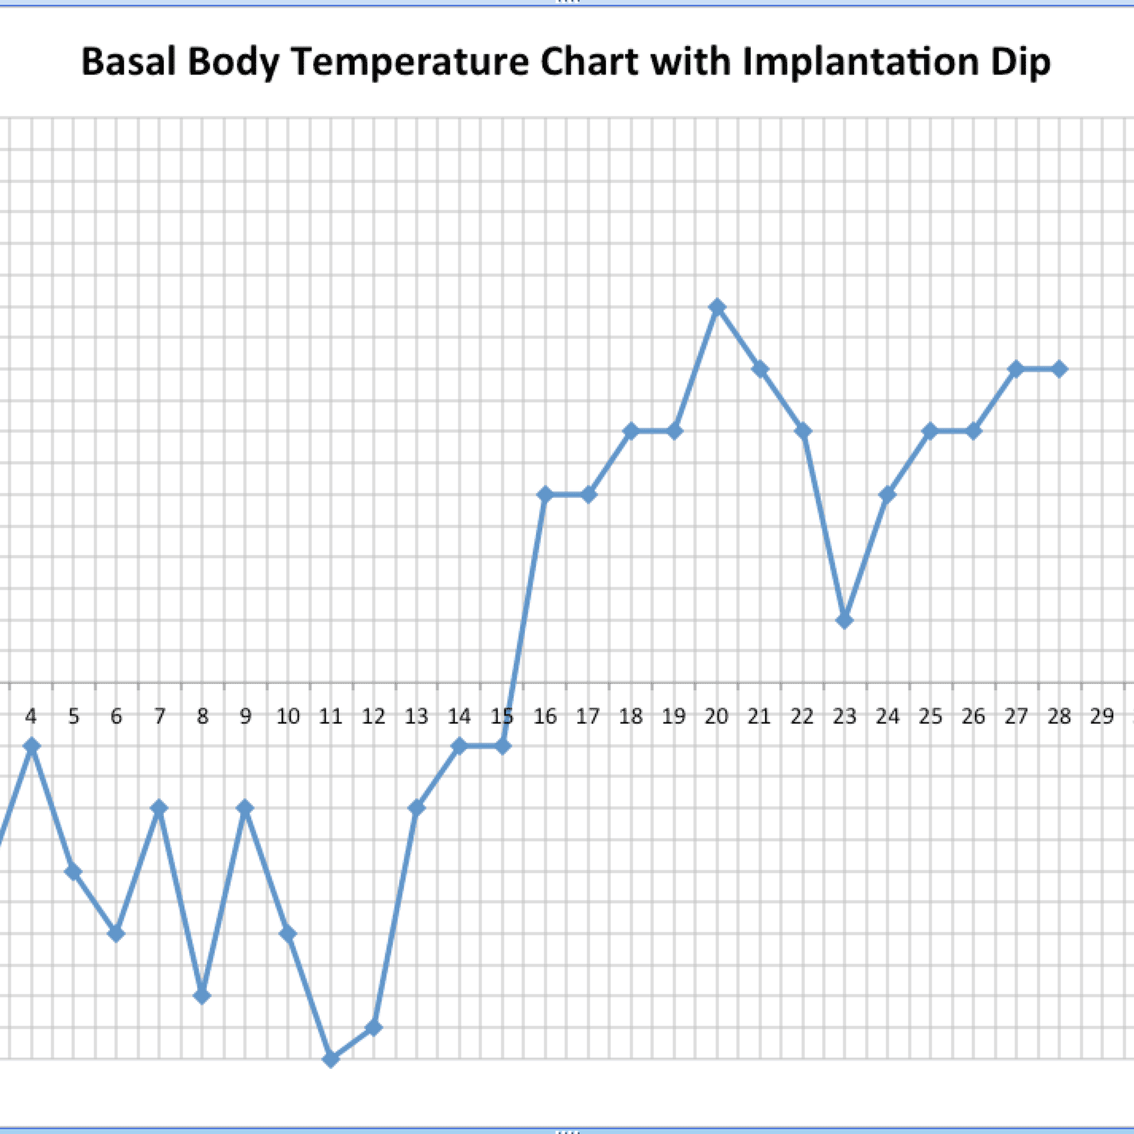
Q4
Name of the chart Basal body temperature chart
Is she ovulating, why ? And at any day? Yes, drop in temperature by 0.3 at time of ovulation then increase by 0.5
Give instructions to the women?
its the fertile phase of the cycle and timing of intercourse in these phase increase the rate of pregnancy
Best day to do this investigation مش موجود بالسلايد الجواب اجتهاد شخصي
Ideally should start charting on the first day of the period and continue to take BBT temperature every morning throughout the entire cycle
I guess the day 11 of menses and follow as LH surge﻿

Slide 40
A merried couple came to your clinic , have been trying to conceive for 2 years , take relevant history from both ?
male :
pelvic infection , pelvic surgery , radiation exposure , mumps infection , heat exposure .
female :
PID , surgery (pelvic , uterine , cervical) , irreguler period , endometriosis , stress , weight changes , excersise
in general :
previous pregnancies , length of time without pregnany , sexual hx.

Slide 41
what does the test assess?
LH surges 24 hours before ovulation (tries to predects ovulation)
what is the advantage and disadvantage ?
Very sensitive and accurate
Downside: price, obsession with timing of intercourse

Slide 42
What is this test ?
Endometrial Biopsy
what does it assess in case of infertility?
Ovulation
when is it preformed ?
Done in the lutal phase of the cycle
explain the finding ?
If histology shows proilferative endometrium this means patient is NOT ovulating
if shows secretory endometrium this means OVULATION (secrotory endometrium means theres progestirone )
how to confirm dx?
Must be done in two different cycles to confirm diagnosis of LPD

Slide 43
name of procedure ?
Hysterosalpingography (HSG)
why preformed ?
to assess tubal function
when preformed ?
early proliferative phase (avoids pregnancy)
what can it detect ?
intrauterine and tubal disorders (like : uterine malformation, Uterine adhesions (Asherman syndrome),submucous fibroid and congenital uterine malformation )

Slide 44
name of procedure, what is it used for ?
Intrauterine insemination (IUI) , anovulation
other treatment options for anovulation ?
Clomiphene Citrate
Letrizole
hMG
Ovulation Induction + IUI (often done but unjustified)

Slide 45
3 causes of hyperprlactinemia ?
drugs , hypothyroidism, piuitary gland adenoma
how to dx ?
Check TSH , MRI to exclude pituitary adenoma, and visual field
3 Treatments?
Bromocriptine
Cabergoline
Trans Sphenoidal Hypophesectomy

Slide 46
what drugs can be used to induct ovulation ?
clomophine citrate , letrazole human menopausal gonadotophons
Complications of using these drugs ?
CC : vasomotor symptoms , ovarian enlargement , multiple gestation
hMG or FSH : muliple gestation, OHSS

