Slide 1
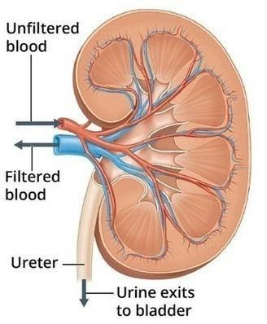
Urinary t ract Infections (UTI’s)
1

Slide 2
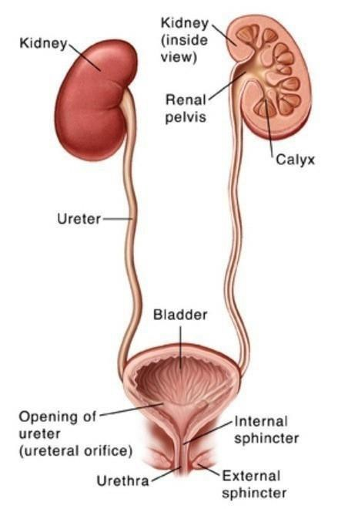
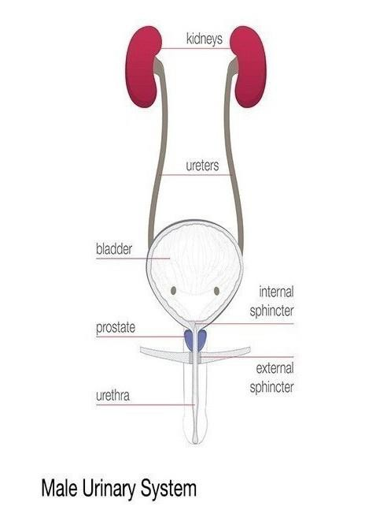
Anatomy
4

Slide 3
What is a Urinary Tract Infection?
4

Slide 4
Definition
UTI :-
Infection in any part of the urinary system including urethra,
prostate,bladder ,ureter and kidneys.
* The majority of UTIs are caused by ascension of pathogens
from urethra to the bladder
, these pathogens are from fecal flora .
*The most common cause of UTI is E.COLI
EPIDEMIOLOGY
The prevalence of UTI in woman is about 3% at 20 yo increasing by about 1%in each subsequent decade. in men UTI is uncommon ,except in the first year of life and over 60 yo
5

Slide 5
Routes of infection
There are many potential routes of infection :
retrograde infection (ascending ) :
Urethera to bladder to ureter to kidney It is the most common route of infection
hematogenous infection (descending ) :
bacteremia
Less than 5% of UTI
Kidney Acute pyelonephritis
4

Slide 6
Routes of infection
Hematogenous spread can occur in immunocompromised patients and in neonates. Staphylococcus aureus, Candida species, and Mycobacterium tuberculosis are common pathogens that travel through the blood to infect the urinary tract.
3-Lymphatogenous spread through the rectal, colonic, and periuterine .lymphatics has been postulated as a cause for UTI
4-Direct extension of bacteria from adjacent organs into the urinary tract can occur in patients with intraperitoneal abscesses or vesicointestinal or vesicovaginal fistulas
4

Slide 7
classification
The urinary tract infection is divided into upper and lower tracts :
Lower: urethritis, prostatitis and cystits
Upper : pyelonephritis
(inflammation of ureter,renal pelvis and kidney )
6

Slide 8
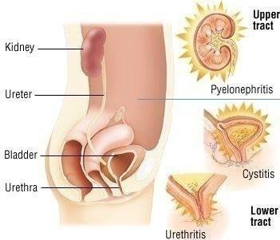
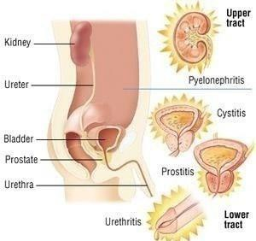
classification
Cystitis :- is an infection within the bladder, and is the most common type of
lower UTI.
Pyelonephritis :- is an infection within the kidneys.
Pyelonephritis is more serious than urethritis or cystitis, but less common.
Female
Male
6

Slide 9
Symptoms & signs
4

Slide 10
Symptoms & signs
*Cystitis
No fever ,suprapubic pain, dysuria, frequency, urgency and hematuria(visible
or non visible) , cloudy urine and have an unpleasant odour
physical examination: suprapubic tenderness
*Pyelonephritis
Fever, flank pain, dysuria, frequency, urgency, hematuria,nausea,
.vomiting and diarrhea
Physical examination: Fever and costovertebral tenderness

Slide 11
Acute pyelonephritis
Acute pyelonephritis
Pyelonephritis is an infection of the upper urinary tract .The kidneys are infected in a minority of patients with UTI. it presents as a classic triad of
loin pain, fever and tenderness over the kidneys. The renal pelvis is inflamed and small abscesses are often evident in the renal parenchyma Renal infection is almost always caused by organisms ascending from the bladder (E.Coli) , the bacterial profile is the same as for lower urinary trac infection. Rarely, bacteraemia may give rise to renal or perinephric abscesses, most commonly due to staphylococci . Predisposing factors, such as cysts or renal scarring, facilitate infection.
7

Slide 12
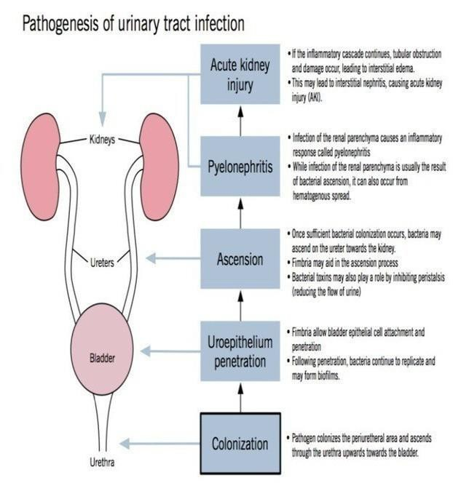
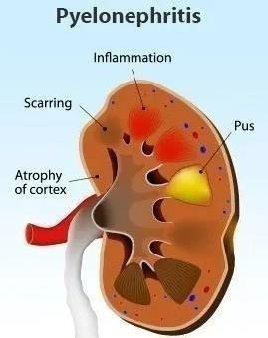
Acute pyelonephritis
7

Slide 13
Clinical features :
Symptoms:
Fever , chills Flank pain
Nausea , vomiting and sometimes diarrhea
Signs
Fever with tachycardia
Patients are generally more ill than patients with cystitis
Costovertebral angle tenderness (unilateral or bilateral ) Abdominal tenderness maybe present on examination
7

Slide 14
Types of UTI’s
7

Slide 15
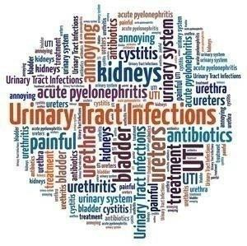
Types of UTI’s
Uncomplicated.
Complicated.
Recurrent.
Relapse.
Catheter-associated (CAUTI’s).

Slide 16
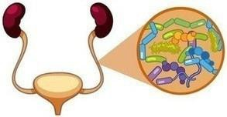
Types of UTI’s
Uncomplicated UTI’s :- is usually considered to be cystitis or pyelonephritis that occurs in premenopausal adults women & nonpregnant with no structure or function abnormality of the urinary tract
Complicated UTI’s :- the presence of one of the following factors:
1)- pregnancy
2)- male sex
3)- immunosuppression,
4)- An enlarged prostate in men
5)- neurological disorder (i.e. multiple sclerosis), epilepsy cerebral palsy,
diabetes or conditions which affect the spine.
−Bladder or kidney stones.
−Bladder or kidney tumors.

Slide 17
or

Slide 18
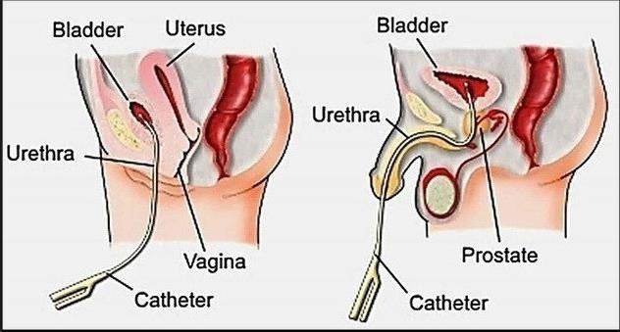
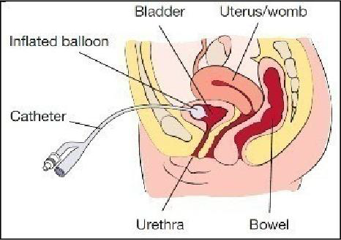
Types of UTI’s
Catheter-associated UTI’s (CAUTI’s) occur when a person has urinary or supra-pubic catheter and or has recently been
catheterized in the past 48 hours.
11

Slide 19
Risk Factors for UTI’s
12

Slide 20
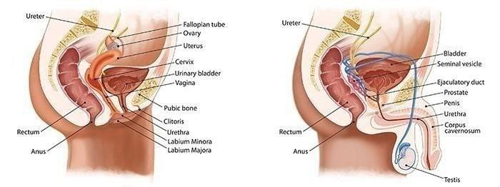
Risk Factors
Related to All Types of UTI’s
Female gender
UTI’s are more common in women and girls than in men because their urethra is shorter than males.
A females urethra is approximately 4 cm in length, and
closer to the rectum, where more bacteria exists and can easy travel into the urinary tract.
13

Slide 21
Risk Factors
Related to All Types of UTI’s
1. Female gender
UTIs relate to changes in their hormonal levels. Some are more likely to get an infection during certain times in their menstrual cycle, such as just before a period or during pregnancy.
In older women, the tissues of the urethra and bladder become thinner and drier with age as well as after menopause or a hysterectomy. This can be linked to increased UTIs.
During pregnancy, the drainage system from the kidney to the bladder widens so
urine does not drain as quickly. This makes it easier to get a UTI.
UTIs during pregnancy can result in increased blood pressure, so it is very important to
have them treated as soon as possible.
13

Slide 22
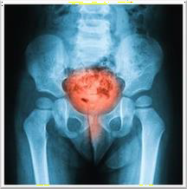
Risk Factors Related to All Types of UTIs continued…
2 •Previous UTI’s.
•Family-related risk (a mother, sister, aunt, or grandmother with history of UTI’s).
•Changes in a female’s bacterial growth caused by medication used for vaginal infections, or during menopause.
•Diabetes (People with diabetes are at increased risk of having UTIs as their urine may have a high glucose (sugar) content, which makes it easier for bacteria to multiply. Diabetes may also change the body’s immune (defence) system making it harder to fight a UTI. The risk of developing a UTI increases as diabetes progresses.

Slide 23
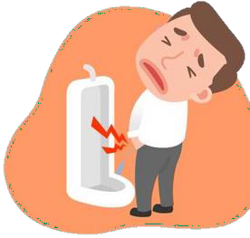
Risk Factors Related to All Types of UTI’s continued…
6 •Neuropathy (incomplete emptying of the bladder due to diabetic-
related nerve damage).
7. •Men with an enlarged prostate
8 •Young children being toilet trained,
Reflux is caused by a bladder valve problem allowing urine to flow back into
the kidneys from the bladder. Reflux can cause the urine to stay inside the body increasing the risk of infection. It may lead to kidney scarring, which in turn leads to high blood pressure and sometimes kidney problems.
9•Prolonged use of an indwelling urinary or suprapubic catheter and or having recently
experienced urinary catheterization in the hospital or medical environment.

Slide 24
Causes of UTI’s
17

Slide 25
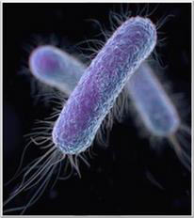
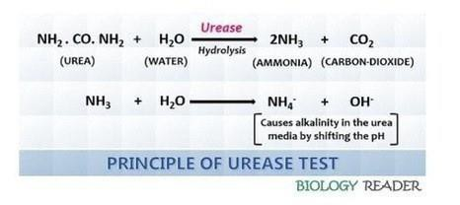
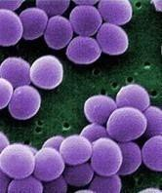
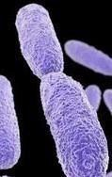
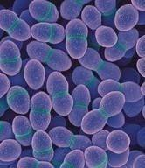
Causes of UTI’s
Most common organism is E. Coli
greater than 80% of all diagnoses.
Second most common is Enterococcus
.Urease producing organisms: Proteus, Klebsiella
.They will break urea to ammonia (alkaline) > alkaline urine (pH >8)
.Others:Staphylococcus/saprophyticus, Pseudomonas/ Enterobacter
19

Slide 26
Pathophysiology
Pathophysiology
Urine is an excellent culture medium for bacteria; in addition, the
urothelium of susceptible persons may have more receptors, to
which virulent strains of E. coli become adherent. In women, the ascent of organisms into the bladder is easier than in men; the urethra is shorter and the absence of bactericidal prostatic secretions may be relevant. Sexual intercourse may cause minor urethral trauma and transfer bacteria from the perineum into the bladder. Instrumentation of the bladder may also introduce organisms.
17

Slide 27
Pathophysiology
Pyelonephritis
Cystitis
38

Slide 28
UTI
Complications
38

Slide 29
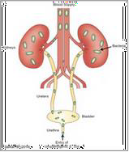
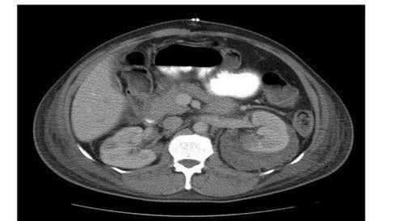
UTI Complications
1-Sepsis, a potentially life-threatening complication of an infection, especially if the
infection works its way up your urinary tract to your kidneys.
.Renal vein thrombosis
.Tissue death.
Sepsis
4. Perinephric abscess: diagnosed with CT scan. Suspected if not responded on antibiotics.
39

Slide 30
UTI Complications
5. Permanent kidney damage from an acute or chronic kidney infection (pyelonephritis) due to an untreated UTI.
Increased risk in pregnant women of delivering low birth weight or prematur
infants.
Urethral narrowing (stricture) in men from recurrent urethritis,
previously seen with gonococcal urethritis.
39

Slide 31
Investigations
46

Slide 32
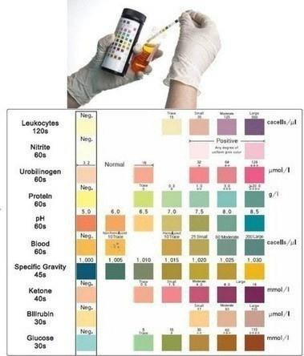
Investigations
1. Urinalysis
:A) Dipstick urinalysis
Positive urine leukocyte esterase test— reflects pyuria
-
Positive nitrite test for presence of bacteria (gram- negative)—nitrite test
is sensitive and specific for detecting Enterobacteriaceae.
But it lacks sensitivity for other
organisms, so a negative test should be interpreted with
.caution
Combining the above two tests yields a sensitivity of 85%
.and specificity of 75%

Slide 33
Investigations
1. Urinalysis
B. Microscopic (clean-catch midstream)
-
Adequacy of collection: presence of epithelial (squamous) cells indicates vulvar or
urethral contamination. If contamination is suspected, perform a straight catheterization of the bladder
Criteria for UTI
Bacteruria: >1 organism per field. Bacteriuria without WBCs
may reflect contamination
pyuria is the most valuable finding for diagnosis: Greater than
or equal to 10 leukocytes/μL is abnormal. leukocyte casts >
pyelonephritis
3.
Other findings—hematuria and mild proteinuria may be
present

Slide 34
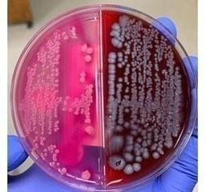
Investigations
1. Urinalysis
C. Urine Gram stain
.A count of >105 organisms/mL represents significant bacteriuria; it is 90% sensitive and 88% specific
D. Urine culture
Confirms the diagnosis (high specificity). if a complicated infection is suspected, or if
symptoms persist despite prior antibiotic treatment
Traditional criteria: ≥105 CFU/mL of urine from a clean-catch sample; misses up to -
.one-third of UTIs
Colony counts as low as 102 to 104 CFU/mL are adequate for diagnosis if clinical symptoms are present

Slide 35
Investigations
CBC: Leukocytosis with left shift (in pyelonephritis)
KFT: Impairment is usually reversible, especially with IV fluid
(in pyelonephritis)
4in. Blood culture: obtain
hospitalized patients(urosepsis)
ill-appearing
patients
and a
5. Ultrasound: to rule out anatomical problem and may use voidin
cystourethrogram)

Slide 36
Treatment
47

Slide 37
Treatment
1. For uncomplicated pyelonephritis.
a. Use outpatient treatment if the patient can take oral antibiotics.
Treat based on Gram stain:
TMP/SMX or a fluoroquinolone for 10 to 14 days is effective for most
gram negative rods.
Amoxicillin is appropriate for gram-positive cocci (enterococci, S. saprophyticus).
A single dose of ceftriaxone or gentamicin is often given initially before
starting oral treatment.
Repeat urine culture 2 to 4 days after cessation of therapy.
If symptoms fail to resolve within 48 hours, adjust treatment
based on urine culture.
Failure to respond to appropriate antimicrobial therapy suggests a functional or structural abnormality; perform a urologic investigation.
47

Slide 38
Treatment
2 lF the patient is very ill, elderly, pregnant, unable to
tolerate oral medication, or has significant comorbidities, or if
urosepsis is suspected
Hospitalize the patient and give IV fluids.
Treat with antibiotics.
Start with parenteral antibiotics (broad-spectrum)-ampicillin PLUS gentamicin OR CIPROFLOXACIN as an initial choices
If blood cultures are negative, treat with IV antibiotics until the patient is febrile for 24 hours, then give oral antibiotics to complete a 14- to 21-day course.
If blood cultures are positive (urosepsis), treat with IV
antibiotics for 2 to 3 weeks.
47

Slide 39
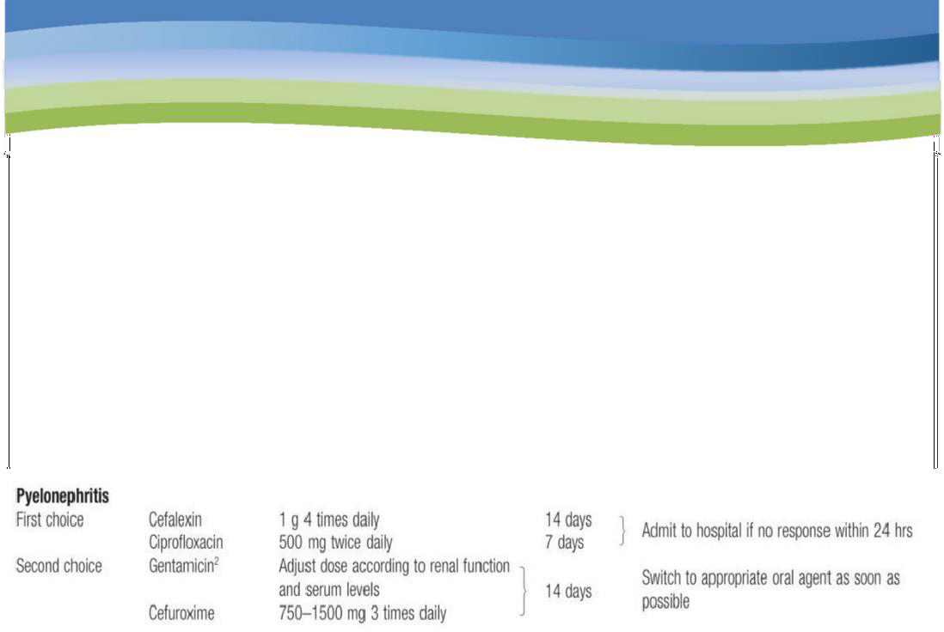
Treatment
For recurrent pyelonephritis.
If relapse is due to the same organism despite appropriate
treatment, treat for 6 weeks.
If relapse is due to a new organism, treat with appropriate therapy for 2 weeks.
47

Slide 40
49

