Slide 1
PLEURAL EFFUSION

Slide 2
Overview
Introduction
Classification
Pathogenesis
Etiology
Clinical features
Investigations
Management

Slide 3
Introduction
Pleural effusion is defined as abnormal accumulation of fluid in the pleural space, i.e., the space between parietal and visceral pleura
The pleural space contains normally 0.3ml/kg body weight of pleural fluid¹. There is a continuous circulation of this fluid and the lymphatic vessels can cope with several millilitres of extra fluid per 24hours
Fluid accumulates in the pleural cavity due to either altered hydrostatic and oncotic pressures or altered permeability of the pleura

Slide 5
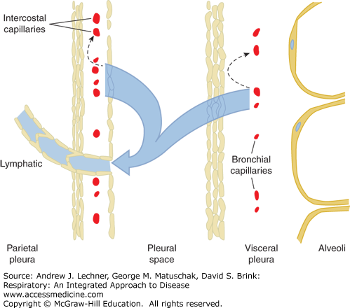

Slide 6
More Definitions ?
Parapneumonic Effusion : pleural effusion associated with bacterial pneumonia, bronchiectasis, or lung abscess .
Loculated Effusion : Fluid anatomically confined and not freely flowing in the pleural space when there are adhesions between the visceral and the parietal pleura .
Sub-Pulmonic Effusion:accumulation of fluid between the lung & the diaphragm which gives the false impression of an elevated hemi-diaphragm

Slide 7
Pleural Effusion
Parapneumonic effusion
Subpulmonic Effusion
Loculated Effusion

Slide 8
Composition of pleural fluid
Clear ultra filtrate of plasma
Volume
Cells/ mm3
Mesothelial cells
Monocytes
Lymphocytes
PMN’s
Protein
LDH
Glucose
pH
0.3 mL/kg 1000 – 5000
60%
30%
5%
5%
1-2 g/dL
<50% plasma level(105-333IU/L)
≅ plasma level(90-120)
≥ plasma level(7.6-7.64)

Slide 9
Classification
A) Can be unilateral or bilateral
B)Based on mechanism and type of pleural fluid
Transudative (alteration in hydrostatic and oncotic pressure)
Exudative (alteration in pleural permeability)

Slide 10
Transudative pleural effusions
Alteration of hydrostatic and oncotic factors that increase the formation or decrease the absorption of pleural fluid (e.g., increased mean capillary pressure [heart failure] or decreased oncotic pressure [cirrhosis or nephrotic syndrome]).

Slide 11
Exudative pleural effusions
Damage or disruption of the normal pleural membranes or vasculature (e.g., tumor involvement of the pleural space, infection, inflammatory conditions, or trauma) leads to increased capillary permeability or decreased lymphatic drainage.

Slide 12
Pathogenesis
Increased vascular permeability allows migration of inflammatory cells (neutrophils, lymphocytes, and eosinophils) into the pleural space.
The process is mediated by a number of cytokines such as interleukin IL-1, IL-6, IL-8, tumour necrosis factor (TNF)-alpha and platelet activating factor released by mesothelial cells lining the pleural space. The result is the exudative stage of a pleural effusion. This progresses to the fibro-purulent stage due to increased fluid accumulation and bacterial invasion across the damaged epithelium.
Neutrophil migration occurs as well as activation of the coagulation cascade leading to pro-coagulant activity and decreased fibrinolysis. Deposition of fibrin in the pleural space then leads to septation or loculation. The pleural fluid pH and glucose level falls while LDH levels increase.

Slide 13
Etiology
EXUDATIVE
Infective: Pneumonia, Bronchiectasis, Pancreatitis, TB, Lung
abscess
Collagen vascular disease: SLE, Rheumatoid arthritis, Polyarteritis
Neoplastic: leukemias and lymphomas
Uremia
Drugs: Bromocriptine, amiodarone, nitofurantoin, dantrolene, INH,
PAS
Postradiation
Traumatic

Slide 14
TRANSUDATIVE:
Renal cause: Nephrotic syndrome
Cardiac cause: Congestive cardiac failure
Hepatic cause: Hepatic failure
Nutritional: Protein energy malnutrition
Hypothyroidism

Slide 15
Empyema:
Lung abscess
Septicemia
Chest wall injuries
Rupture of subphrenic abscess
Rupture of liver abscess

Slide 16
CHYLOUS:
Trauma to thoracic duct
Tumour (mediastinal lymphoma)
Tuberculosis
Lymphatic obstruction

Slide 17
HEMOTHORAX:
Chest wall injuries
Bleeding disorders
Neoplasms-leukemias, lymphoma, mesothelioma
Drugs-anticoagulants
Pulmonary infarction

Slide 18
PSEUDOCHYLOUS:
Rheumatoid pleuritis
Tuberculosis or paragonimiasis(lung fluke infection)
HYDROTHORAX:
Congestive heart failure
Hepatic & Renal failure

Slide 19
Urinothorax
Due to obstructive uropathy
Urine arrives in the pleural space either retroperitoneally under the posterior diaphragm, or via the retroperitoneal lymphatics
Pleural fluid smells of urine.
Pleural fluid Creatinine ≈ Serum Creatinine

Slide 21
Clinical Presentation
The underlying cause of the effusion usually dictates the symptoms, although patients may be asymptomatic.
Pleural inflammation, abnormal pulmonary mechanics, and worsened alveolar gas exchange produce symptoms and signs of disease.

Slide 22
Symptoms and signs
Inflammation of the parietal pleura leads to pain in local (intercostal) involved areas or referred (phrenic) distributions (shoulder).
Dyspnea is frequent and may be present and out of proportion to the size of the effusion.
Cough can occur.

Slide 23
Physical examination
Inspection:
Absent or diminished movements of affected side
Fullness of chest with bulging intercostal spaces Palpation:
Diminished breath sounds over the site of the effusion
Decreased or absent tactile fremitus
Percussion:
Stony dullness to percussion Auscultation:
Absence of breath sounds over the effusion
Vocal resonance absent
Signs of pneumonia like bronchial breathing, crackles etc.

Slide 24
Investigations
Total and differential leucocyte counts
Acute phase reactants-white cell count, total neutrophil count, CRP, ESR, pro-calcitonin distinguish bacterial from viral causes
Radiological examination
X-ray chest PA view done in erect position-a total of 300mL of fluid is needed to diagnose pleural effusion clinically and radiologically
Even 50mL of fluid can be demonstrated radiologically in lateral decubitus

Slide 25
Findings
Obliteration of cardiophrenic and costophrenic angles
Loculated effusions
Subpulmonic effusion-collection of fluid below the diaphragm will lead to elevation of diaphragm, confirmed by X-ray in lateral decubitus
Lateral decubitus on side of effusion will show a shift in the fluid level
Tracheal and mediastinal shifts are seen in massive effusion

Slide 26
P-A view lateral decubitus view

Slide 27
Ultrasonogram
Useful in differentiating between loculated pleural effusion and tumour
CT Scan
Helpful if the effusion is minimal or loculated or to localise underlying lesion
Pleural fluid aspiration (Thoracocentesis)
Diagnostic: Helps to differentiate between exudates and transudates
Therapeutic: Massive collection or
rapid collection of pleural fluid
Severe respiratory distress Suspected empyema
Massive mediastinal shift

Slide 28
Gross appearance
Straw-coloured
Blood stained
Purulent
Chylous

Slide 29
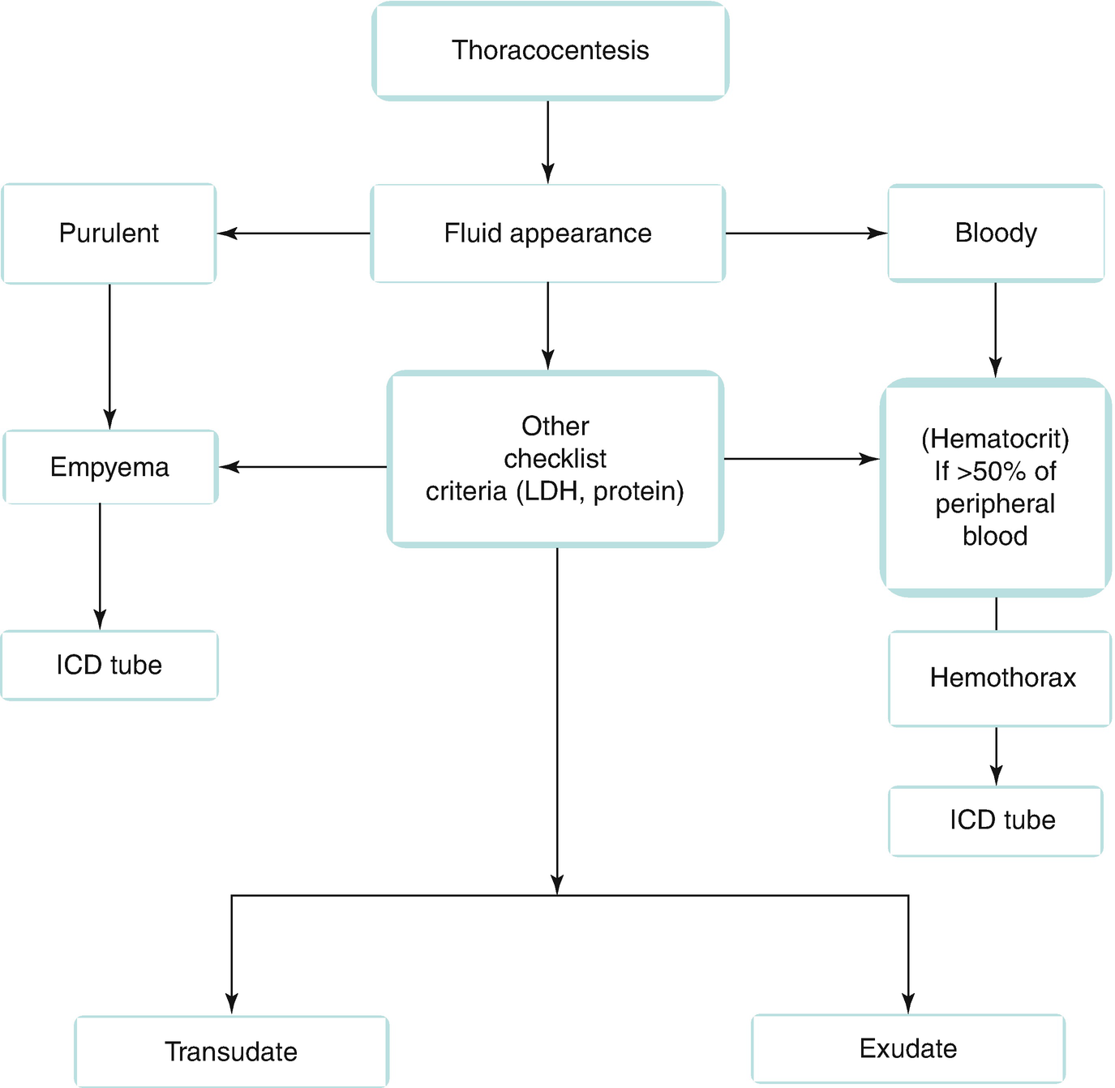

Slide 30
Transudate & Exudate

Slide 31
LIGHT’S CRITERIA:
Atleast one of the following criteria should be
satisfied to identify exudates:
Pleural fluid to serum total protein ratio- more than 0.5
Pleural fluid to serum LDH ratio- more than 0.6
Pleural fluid LDH- more than two-third of serum LDH
None of these criteria should be satisfied in a transudative effusion

Slide 32
Pleural fluid appearance
Most transudates are clear, straw colored, nonviscid, and without odor
Red-tinged pleural effusions indicate the presence of blood.

Slide 33
Bloody pleural fluid (Haemorrhgic effusion)
If the blood is due to thoracentesis, the degree of discoloration should clear during the aspiration.
Bloody pleural fluid usually indicates the presence of malignancy, pulmonary embolism (PE), or trauma.

Slide 34
Hemothorax
The presence of gross blood should lead to the measurement of a pleural fluid hematocrit.
Hemothorax is defined as a pleural fluid to blood hematocrit ratio of >0.5, and chest tube drainage should be considered.

Slide 35
Lymphocytosis (>50% of the total nucleated cell count) is suggestive of malignancy or tuberculosis.
Mesothelial cells argues against the diagnosis of tuberculosis.
Plasma cells suggest a diagnosis of multiple myeloma.

Slide 36
Glucose concentration
A glucose concentration of <60 mg/dL is probably due to
tuberculosis,
malignancy,
rheumatoid arthritis, or
parapneumonic effusion.
For parapneumonic pleural effusions with a glucose of <60 mg/dL, tube thoracostomy should be considered.

Slide 37
Pleural fluid with a low pH
A pH of <7.3 is seen with
empyema,
tuberculosis,
malignancy,
collagen vascular disease, or
esophageal rupture.

Slide 38
Amylase
An elevation of amylase suggests that the patient has pancreatic disease, malignancy, or esophageal rupture.
Malignancy and esophageal rupture have salivary amylase elevations and not pancreatic amylase elevations.

Slide 39
Turbid or milky fluid
After it is centrifuged.
If the supernatant clears, the cloudiness is likely due to cells and debris.
If the supernatant remains turbid, pleural lipids should be measured. Elevation of triglycerides (>110 mg/dL) suggests that a chylothorax is present, usually due to disruption of the thoracic duct from trauma, surgery, or malignancy (i.e., lymphoma).

Slide 40
Cytology
Cytology is positive in approximately 60% of malignant effusions.
The volume of pleural fluid analyzed does not impact the yield of cytologic diagnosis.
Repeat thoracentesis increases the diagnostic yield.

Slide 41
Other investigations
Suspected TB
Adenosine deaminase (> 50 IU/L)
PCR (Sens 100%, Spec 95%)
AFB (smear 10-20%;
cx 25-50%)
Suspected Rheumatoid
Pleural RF
Low glucose
Suspected SLE
Serum Complement
Pleural ANA
LE cells
Suspected Pneumonia
pH
Gram stain and culture
Suspected Pancreatitis
Pleural Amylase

Slide 42
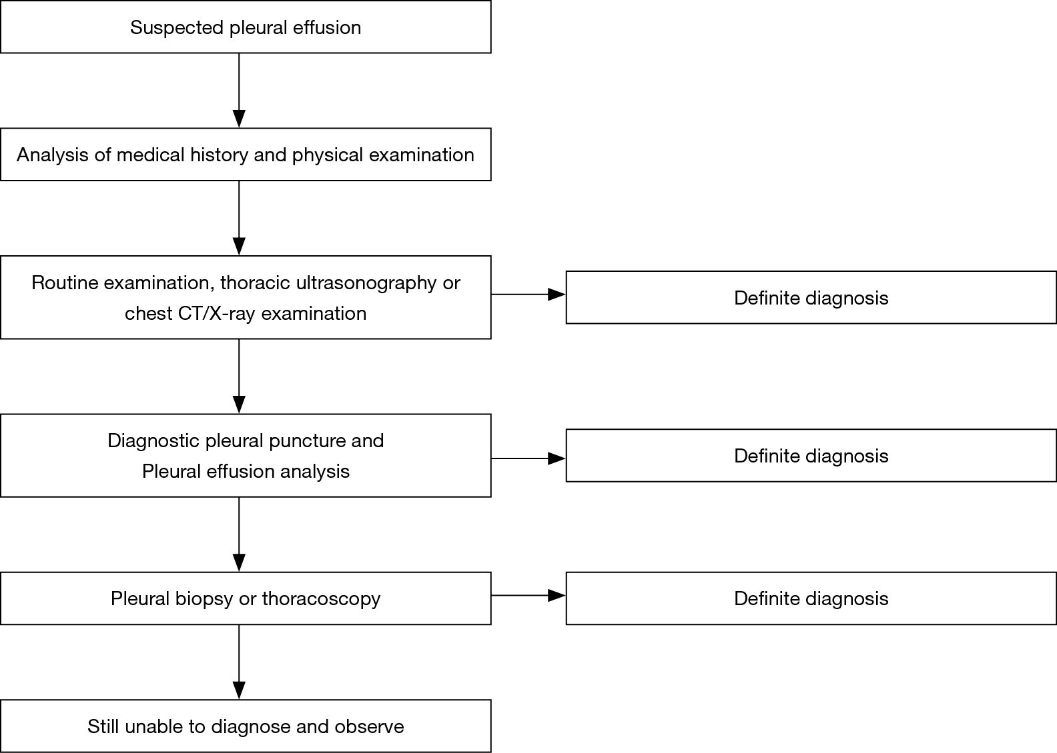

Slide 43
Management

Slide 44
Medical
Treat the cause
Pneumonia- initial antibiotic treatment
A) Following community acquired pneumonia
B) Hospital acquired pneumonia
Tuberculosis- Category I treatment
2HRZE+4HR
Prednisolone 1-2mg/kg orally 4-6weeks promotes rapid absorption of the pleural fluid and prevents fibrosis
Congestive cardiac failure- treat with diuretics and other anti-failure medications

Slide 45
Surgical
Pleural fluid aspiration is done by using a wide bore needle. If the fluid is thick and cannot be drained by a needle, an intercostal drainage(under water seal) at the most dependant part should be done.

Slide 46
Tube Thoracostomy
Pneumothorax
Pleural fluid loculated
Recurrent Pleural effusion - malignancy
Effusion filling more than half the hemithorax
Air fluid level – Hydro/Pyopneumothorax
Pus in the pleural space - Empyema
Hemothorax/Chylothorax
Para pneumonic effusion
oPositive stain for microorganisms
oPositive pleural fluid cultures
oPleural fluid pH <7.2
oPleural fluid glucose <60 mg/dL

Slide 47
Underwater seal bag is used as one way valve mechanism.
The air or fluid/pus from the pleura enters the underwater drainage bag, but the atmospheric air cannot enter pleura due to under water seal

Slide 50
VATS
Failure to drain with a single small-bore tube should also lead to thoracic surgery consultation to avoid delays in case video assisted thoracoscopy (VATS) becomes necessary.

Slide 51
Chemical pleurodesis
Chemical pleurodesis is an effective therapy for recurrent effusions. This treatment is recommended in patients whose symptoms are relieved with initial drainage but who have rapid reaccumulation of fluid.
Talc slurry - Effective and inexpensive.
Doxycycline or minocycline can also be instilled into the pleural space via a chest tube.
Pain is more prevalent and severe following doxycycline and minocycline than following talc.

Slide 52
THANK YOU

