Slide 1
Peripheral Nervous system Pathology
Sura Al Rawabdeh, MD
Mar 7th 2021

Slide 2
Peripheral Nervous system Pathology
Anatomy of peripheral nerves:
Epineurium: fibrous tissue that encloses the whole nerve.
Perineurium: fibrous tissue that surrounds and divides the nerve into fascicles.
Endoneurium: fibrous tissue that surrounds each nerve fiber.
Nerve fibers: the principle structural component composed of an axon with its Schwann cells and myelin sheath.

Slide 3
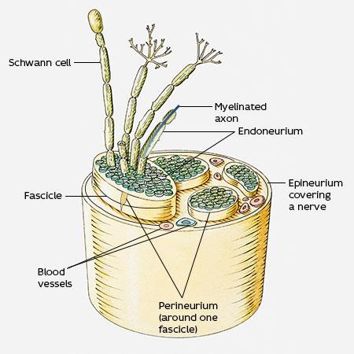
Axons are bundled
together by three major connective tissue components: + the epineurium: encloses the entire nerve. + the perineurium:
a multilayered concentric connective tissue sheath
that groups subsets of axons into fascicles. +endoneurium: surrounds individual nerve fibers

Slide 4
Peripheral neuropathies are subclassified as:
Axonal neuropathies:
Caused by insults that directly injure the axon. The entire distal portion of an affected axon degenerates. Secondary myelin loss can happen . (Wallerian degeneration)
Demyelinating neuropathies
Damage to Schwann cells or myelin with relative axonal sparing.
Typically occurs discontinuously → segmental demyelination

Slide 5
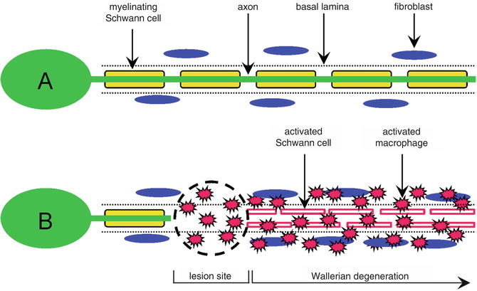

Slide 6
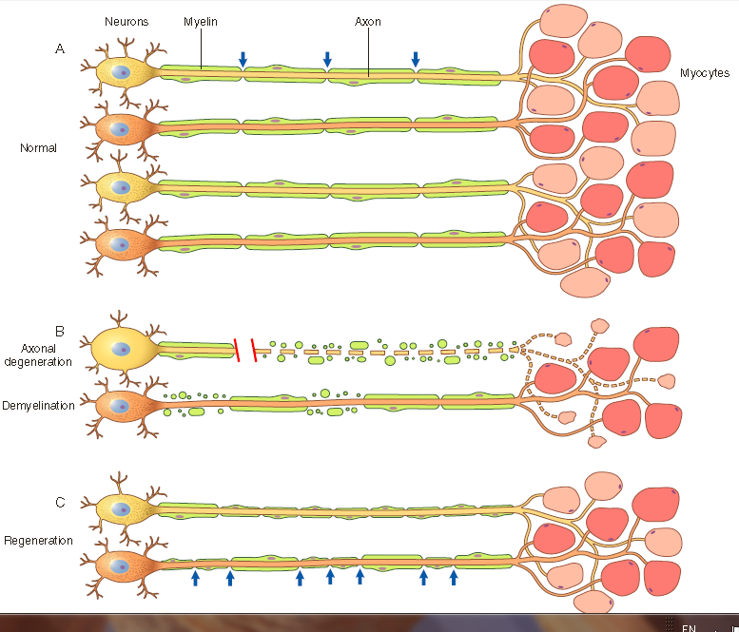

Slide 7
Axonal neuropathies
Regeneration takes place through axonal regrowth and subsequent remyelination of the distal axon, where the proximal stump of the axon sprouts and elongate.
The morphologic hallmark of axonal neuropathies is a decrease in the density of axons, which in electrophysiologic studies correlates with a decrease in the signal strength or amplitude of nerve impulses.

Slide 8
Demyelinating neuropathies
Segmental demyelination: affecting individual internodes along the length of an axon (while saving others) in a random pattern.
Resulting in slow nerve conduction velocities but preserved amplitude, with relatively normal density of axons.

Slide 9
Demyelinating neuropathies
Techniques used to study nerve pathology:
Nerve conduction studies, measures the velocity of conduction of an impulse within a given nerve.
Biopsy: usually obtained from the Sural nerve, because of the feasibility and less association with complication.

Slide 10
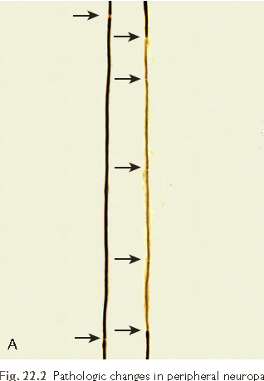
Demyelinating neuropathies
Denuded axon provides a stimulus for remyelination & cells within the endoneurium differentiating to replace injured Schwann cells.
Regeneration gives thinly myelinated internodes of uneven length (shorter).

Slide 11
Peripheral neuropathies anatomic patterns.
Polyneuropathies
Mononeuritis multiplex
Mononeuropathy

Slide 12
Polyneuropathies
A symmetrical multiple nerves involvement, length-dependent fashion;
Axonal loss is more pronounced in the distal segments of the longest nerves;
Patients present with loss of sensation and paresthesias that start in the toes and spread upward. “stocking-and-glove” distribution.
This pattern is often encountered with toxic and metabolic damage. (Diabetes mellitus)

Slide 13
Simple & multiplex Mononeuritis
Mononeuritis multiplex: the damage randomly affects individual nerves, resulting (eg. A right radial nerve palsy & wrist drop, & at a separate point in time, a left foot drop.) Often caused by vasculitis.
A simple mononeuropathy: only involves a single nerve & is most commonly the result of traumatic injury, entrapment (e.g., carpal tunnel syndrome), or certain infections such as Lyme disease.

Slide 14
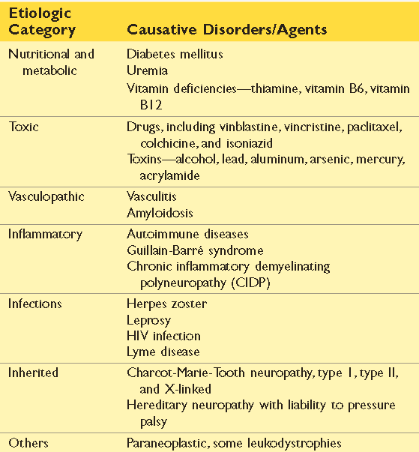

Slide 15
Guillain-Barré Syndrome
A rare Acute Inflammatory Demyelinating Polyneuropathy.
A rapidly progressive acute demyelinating disorder characterized clinically by weakness beginning in the distal limb→ rapidly advances to proximal muscle function → “ascending paralysis”
One of the most common life-threatening diseases of PNS, may lead to death from failure of respiratory muscles in days.

Slide 16
GBS – pathogenesis & morphology
Triggered by an infection or vaccination → breaks down self-tolerance → an autoimmune response.
Usually acute, influenza-like illness from which the affected individual has recovered by the time the neuropathy becomes symptomatic.
Infections with Campylobacter jejuni, CMV, Epstein-Barr virus, & Mycoplasma pneumoniae are ass./w GBS
Histological findings include Segmental demyelination & inflammation of peripheral nerves, (perivenular and endoneurial mononuclear cell infiltrates rich in macrophages).

Slide 17
GBS- Clinical
CSF protein levels are elevated due to inflammation and altered permeability of the microcirculation within the spinal roots.
Treatments include plasmapheresis (to remove offending antibodies), intravenous immunoglobulin, and supportive care, such as ventilatory support.
Patients who survive the initial acute phase of the disease usually recover with time.

Slide 18
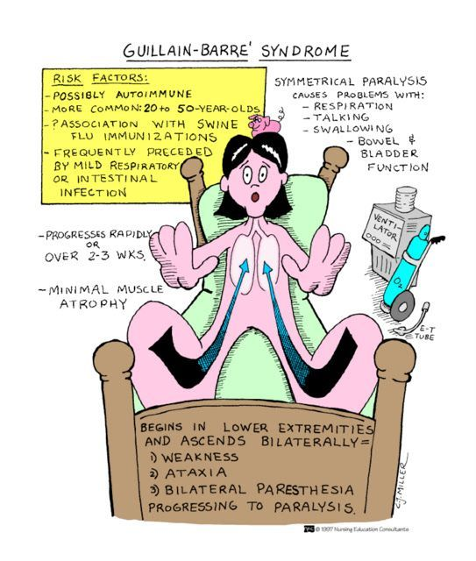

Slide 19
Chronic Inflammatory Demyelinating Poly(radiculo)neuropathy (CIDP)
The most common chronic acquired inflammatory peripheral neuropathy.
Characterized by symmetrical mixed sensorimotor polyneuropathy that persists for 2 months (at least) or more.
Abnormalities include weakness, difficulty in walking, numbness, and pain or tingling sensations.
CIDP is immune mediated also, but in contrast to GBS, CIDP follows a chronic relapsing-remitting, or progressive course.

Slide 20
Chronic Inflammatory Demyelinating Poly(radiculo)neuropathy (CIDP)
The peripheral nerves show segments of demyelination and remyelination.
Tx : Plasmapheresis and administration of immunosuppressive agents. Some patients recover completely, but more often recurrent bouts of symptomatic disease lead to permanent loss of nerve function.
The time course and the response to steroids distinguish chronic inflammatory demyelinating polyradiculoneuropathy from Guillain-Barré syndrome.

Slide 21
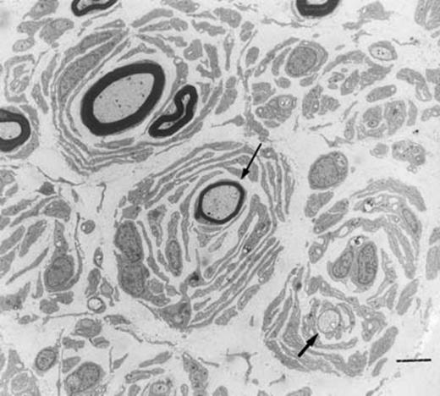
In long-standing cases, repeated activation and proliferation of Schwann cells result in the concentric arrangement of multiple Schwann cells around individual axons to produce multilayered structures → onion bulbs.

Slide 22
Diabetic Peripheral Neuropathy
Diabetes is the most common cause of peripheral neuropathy → developing with long-standing disease.
Includes several forms (can occur singly or together)
1. Autonomic neuropathy is characterized by changes in bowel, bladder, cardiac, or sexual function.
2. Lumbosacral radiculopathy manifests with asymmetric pain that can progress to lower extremity weakness & muscle atrophy.
3. Distal symmetric sensorimotor polyneuropathy is the most common form of diabetic neuropathy.

Slide 23
Diabetic Peripheral Neuropathy
Sensory axons are more severely affected than motor axons → a presentation dominated by paresthesias & numbness.
This form results from the length-dependent degeneration of peripheral nerves & often exhibits features of both axonal & myelin injuries.
Pathogenesis is complex; hyperglycemia → accumulation of advanced glycosylation end products(AGEs), increased levels of reactive oxygen species, microvascular injuries, & changes in axonal metabolism.
The best therapy: Strict glycemic control.

Slide 24
PERIPHERAL NERVE SHEATH TUMORS

Slide 25
Schwannomas
Benign encapsulated tumors that may occur in soft tissues, internal organs, or spinal nerve roots.
The most commonly affected CN is the vestibular portion of the eighth nerve, symptoms related to nerve root compression, which includes hearing loss here.
Most are sporadic, ~10% are ass with familial neurofibromatosis type 2 (NF2)

Slide 26
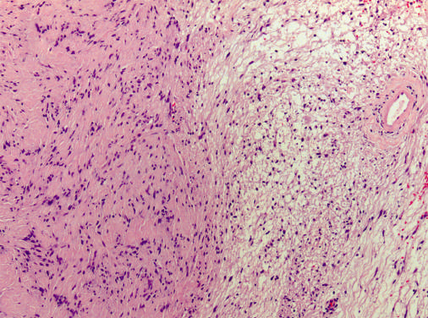
Schwannomas - Morphology
Grossly: Circumscribed masses abutting an adjacent nerve.
Microscopically: an admixture of dense & loose areas referred to as Antoni A and B, respectively.

Slide 27
Schwannomas - Morphology
Antoni A: dense areas, bland spindle cells arranged into intersecting fascicles, often align to produce nuclear palisading →
Verocay bodies: alternating bands of nuclear & anuclear areas.
Antoni B: loose areas, the spindle cells are spread apart by a prominent myxoid extracellular matrix. Thick-walled hyalinized vessels often are present
Axons are largely excluded from the tumor.
Hemorrhage or cystic changes.

Slide 28
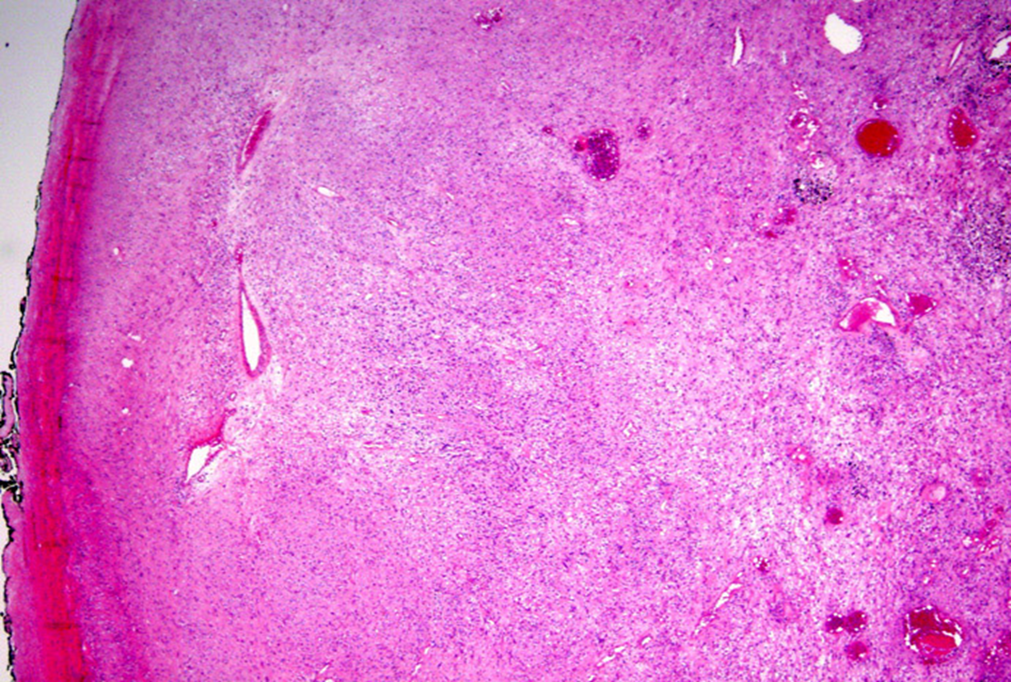

Slide 29
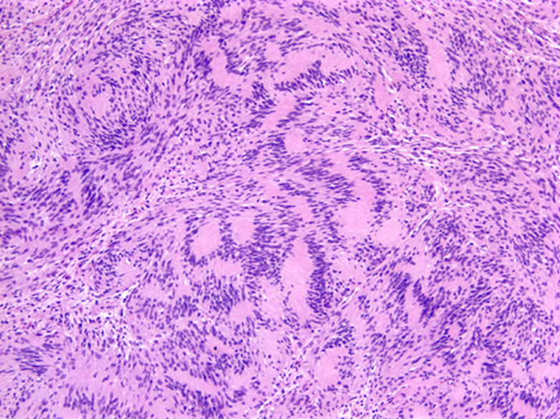

Slide 30
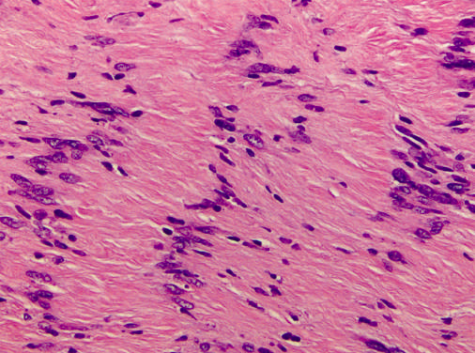
Tumor cells aligned in palisading rows → Verocay bodies:

Slide 31
Neurofibromas
Neurofibromas are not encapsulated benign PNS tumor.
Can be localized cutaneous tumors, Diffuse or Plexiform,
In contrast to schwannomas, the neoplastic Schwann cells in neurofibroma are admixed with other cell types, mast cells, fibroblast like cells, & perineurial-like cells.
The background stroma often contains loose wavy collagen bundles.
Malignant Peripheral Nerve Sheath Tumors can arise from them or de novo (50% of MPNST have NF1)

Slide 32
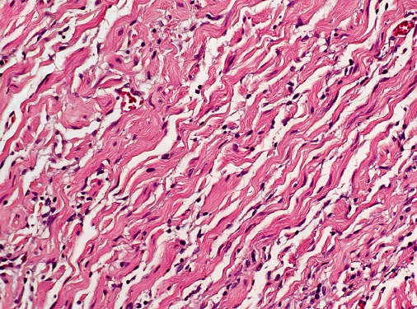
Neurofibromas

Slide 33
Familial Neurofibromatosis
Type 1 (1:3000)
AD, Chr. 17
Neurofibromas, malignant peripheral nerve sheath tumors, optic gliomas.
pigmented nodules in iris (Lisch nodules).
pigmented skin lesions (freckling & café-au-lait spots)
Type 2(1:40,000)
AD, Chr. 22
risk of developing multiple schwannomas, meningiomas, & ependymomas.
Hearing loss, vertigo
Multiple CN neuropathies.

Slide 34
Malignant Peripheral Nerve Sheath Tumors
Neoplasms seen in adults.
They may arise from transformation of a neurofibroma, (usually of the plexiform type).
About one-half of such tumors arise in patients with NF1, (3-10%) of all patients with NF1 develop MPNST.
Histologically, highly cellular and exhibit features of overt malignancy; anaplasia, necrosis, infiltrative growth pattern, pleomorphism, and high proliferative activity (mitoses).

Slide 35
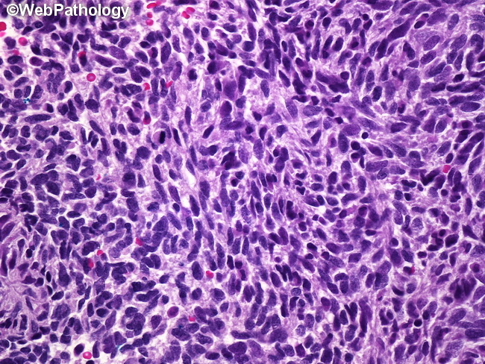
MPNST

Slide 36
Thank You ..& Good Luck! ☺

