Slide 1
Instruments in OBS\GYN
Dania Al-amreen

Slide 2
Bimanual examination

Slide 3
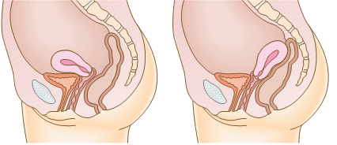
Bimanual examination
After emptying the urinary bladder , bimanual examination Should be done before doing any procedure introducing to the uterus .
➔ Sterile hands with gloves , then :-
■1- Apply lubricating gel to your right index and middle finger.
■2- Gently insert them into the vagina and feel for the firm cervix.
The uterus is usually anteverted and you feel its firmness anterior to the cervix.
If the uterus is retroverted and lying over the bowel, feel the firmness posterior to the cervix .

Slide 4
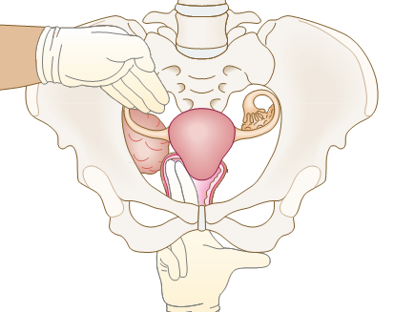
■3- Push your fingers into the posterior fornix
and lift the uterus while pushing on the abdomen
with your left hand.
■4- Place your left hand above the umbilicus
and bring it down, palpating the uterus between
both hands and note its size, regularity and
any discomfort.
■5- Move your fingers to the lateral fornix and,
with your left hand above and lateral to the
Umbilicus, bring it down to assess any adnexal
masses between your hands on each side.

Slide 5
So from the bimanual examination we can determine :
The consistency of the cervix .
The size of the cervix ,
if there is any tenderness to motion.
The size of the uterus .
SHAP-REGULARITY-masses in uterus .
Mobile or fixed. “as in endometriosis”
The direction of the uterus. “we should know it to avoid the uterine perforation”
If there is any adnexal masses .

Slide 6
Instruments in OBS\GYN

Slide 7
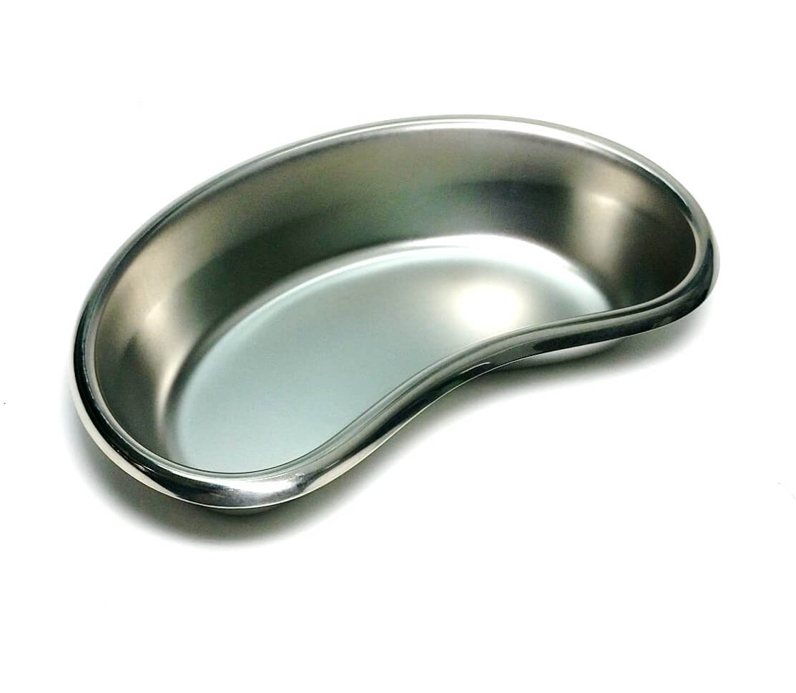
Kidney dish
To Receive and holding :
Dressing
Needles
Medical waste
Instruments
Biopsy
Drainage

Slide 8
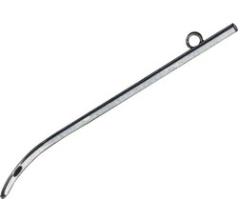
Female catheter
For intermittent catheterization of the urinary bladder , when you went to do a “vaginal examination” while the patient is under GA .

Slide 9
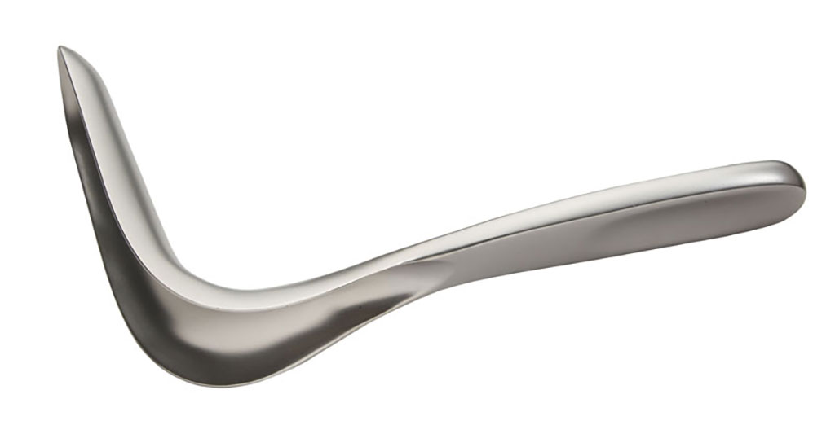
Univalve vaginal speculum “sim’s speculum”
*Uses :
To examine Genital prolaps “vaginal wall prolaps”
In D & C
In Hysteroscopy
In Curettage under anesthesia
In Vaginal hysterectomy
Blade
Handle
It need assistant during examination of the vagina and
The patient should be in the “left lateral position” !
Notes:
*It should be used in any vaginal procedure done under GA

Slide 10
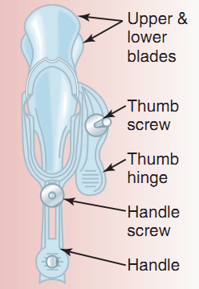
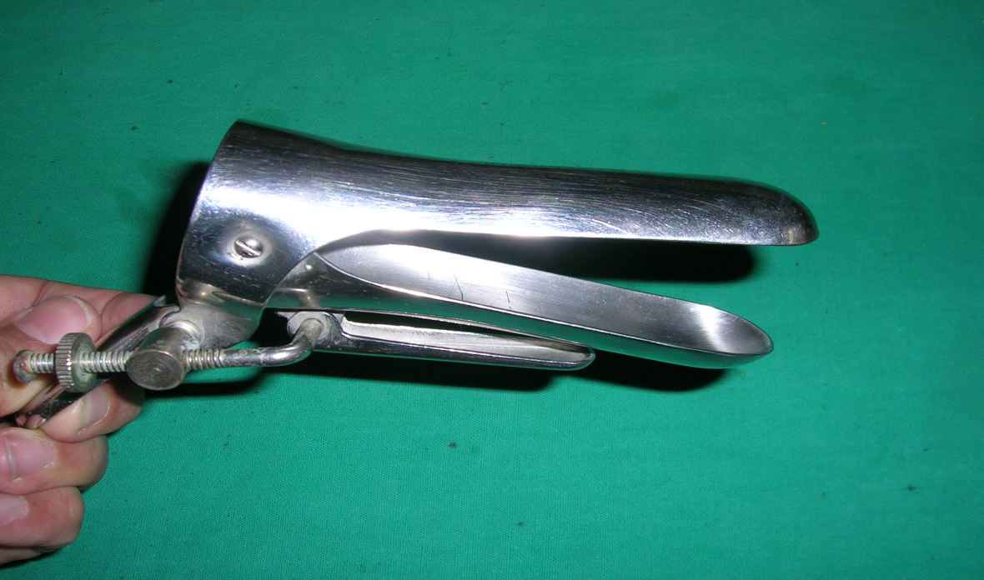
Bivalve vaginal wall self retaining speculum
or
Cusco's Speculum

Slide 11
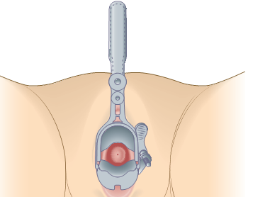
Proceed as follows:
Should be applied under full aseptic conditions.
➔Gently part the labia using your left hand.
➔ With your right hand gently insert
a lightly lubricated** bivalve speculum
with the blades vertical, fully into
the vagina.
➔Rotating the speculum 90o so that the
handles point anteriorly and the blades
are now horizontal ,Slowly open the
blades and see the cervix between them.
Note any discharge or vaginal or cervical
abnormalities
Notes:
**which should be warmed and lubricated with warm water only, so as not to interfere with the examination of cervical cytology or any vaginal exudate.

Slide 12
Reasons to carry out a bivalve speculum examination
To perform a cervical smear.
To inspect the cervix for any lacerations or polyps.
To examine for vaginal discharge.
To examine for vaginal bleeding .
Apical vaginal prolapse
To take a high vaginal swab or endocervical swab for culture
To insert, remove and follow up of IUD .
To conﬁrm potential rupture of membranes.
For doing hysterosalpingogram
For embryo transfer in case of “IVF”
For Office hysteroscope
Notes:
Obstetric and gynecological indications

Slide 13
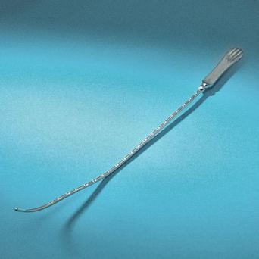
There is a high risk of uterine perforation with wrong use.
Uterine sound
To examine the uterine size “non pregnant uterus” before :
D&C
IUD insertion
Taking endometrial biopsy
The insertion ➔ Depends on the bimanual examination “direction of the uterus”

Slide 14
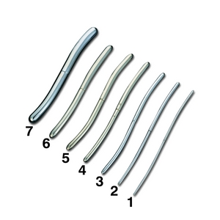
Hegar’s dilator
Are dilators used to induce cervical dilation
in order to gain entry to the interior of the uterus.
With various sizes
The degree of dilatation will depend on the
next procedure .
Should be insert until it reaches the
internal os “resistance”
One enters by one till we reached
the desired dilatation .

Slide 15
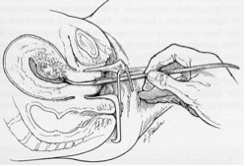
Hegar’s dilator
It precede :
Evacuation of product of conception after missed or incomplete miscarriage .
Endometrial biopsy.
Evacuation of molar
pregnancy .

Slide 16
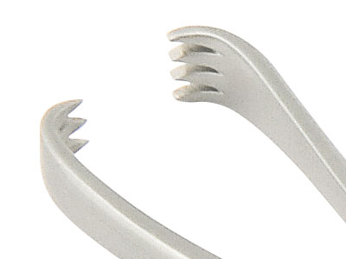
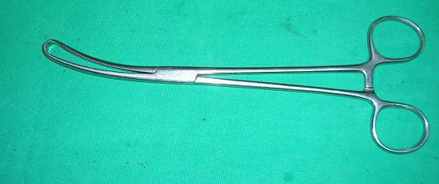
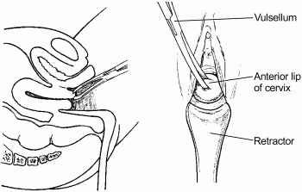
Vulsellum
To catch the anterior lip’s of
the cervix “fixation” .

Slide 17
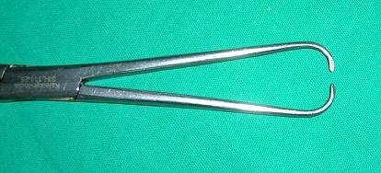
Tenaculum
To grasp the cervix

Slide 18
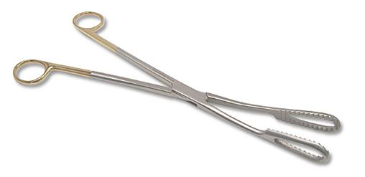
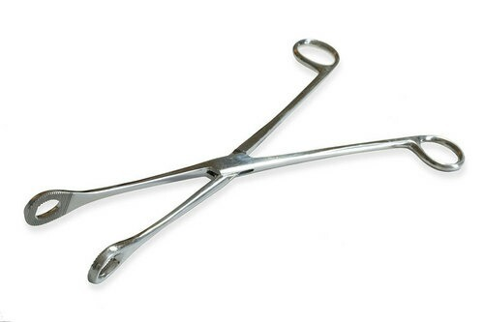
Ovum & spongy forceps
It will be inserted remains closed, then opened inside the endometrial cavity to evacuate the product of conception
and to remove the cervical polyps
Ovum
Used at cleaning phase “catch the gauze”
Used to explorate/clear field the cervix ,
To role out the cervical laceration “in case of PPH”
spongy

Slide 19
Uterine Curette
2 types : sharp and blunt “according to the edge”
= blunt edge = in pregnant uterus .

Slide 20
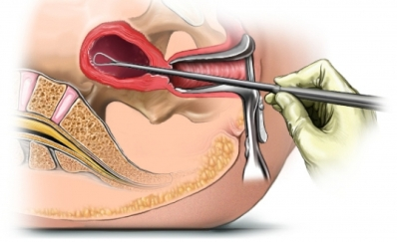
For :
Taking endometrial biopsy
Uterine curettage “anterior , lateral then posterior wall” There are distinctive sound when the uterus is empty .
Evacuation
Aggressive curettage can cause ➔ uterine adhesion ”Asherman syndrome” **
Notes:
** ASHERMAN syndrome :
A = Acquired anomaly
S = secondary to surgery
H = Hysterosalpingography confirms diagnosis
E = endometrial damage\ Eugonadotropic
R = repeated uterine trauma
M = missed menses “amenorrhea”
A = adhesions
N = normal estrogen and progesterone 😐

Slide 21
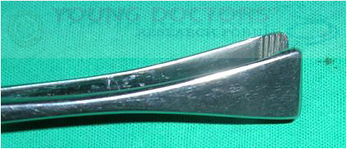
Green armytage
In case of CS , to catch the angle of the uterus , to ensure homeostasis.

Slide 22
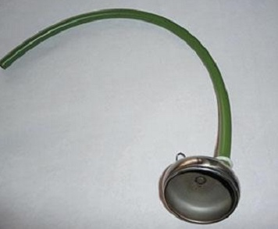
Metal vacuum
For vacuum vaginal delivery.
2 types ➔ metal & plastic vacuum .
With different sizes .”according to the size of the fetal head and wither she is multi or primi”
Indications :
- Prolonged second-stage labor.
- fetal distress
Prerequisite :
Fully dilated cervix .
Membrane ruptured and engaged head .
Vertex presentation .
Adequate pelvis with empty bladder .
Verbal concept from the patient

Slide 23
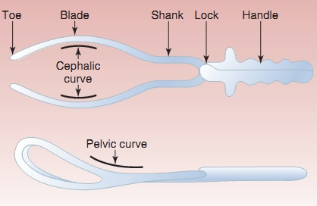
Forceps
Commonly used in case of preterm delivery .
3 types :
- Outlet
Low cavity
Mid cavity
التتّمة بالسيمينار 😐

Slide 24
stations from previous years

Slide 25
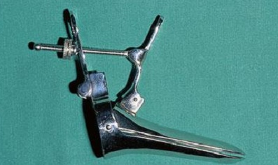
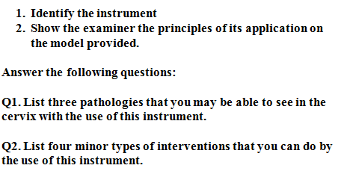
Station #1

Slide 26
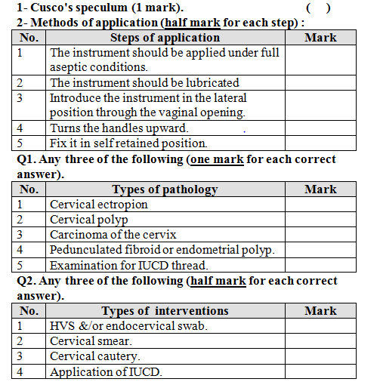

Slide 27
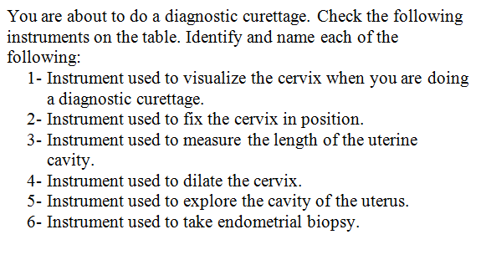
Station #2

Slide 28
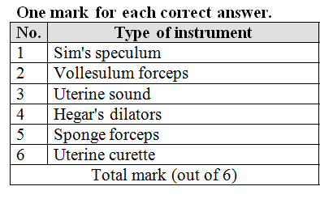

Slide 29
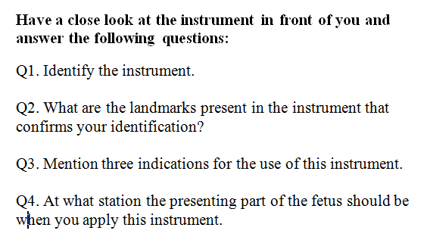
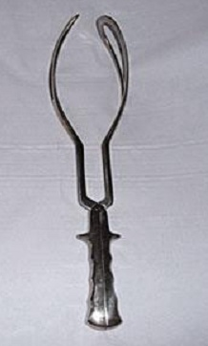
Station #3

Slide 30
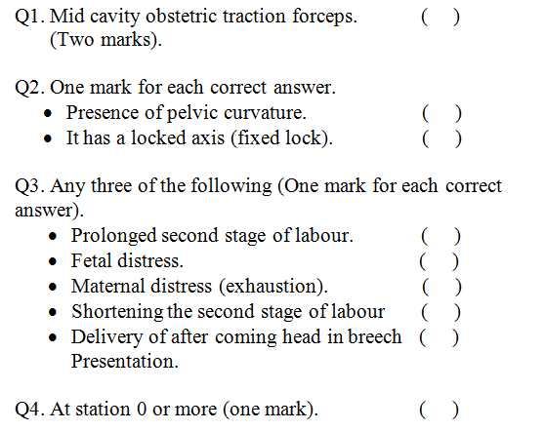

Slide 31
Thank you :D

Slide 33
operative | vacuum |  | Forceps
1- delay in second stage of labor (eg. Uterine inertia) 2-Maternal indications (Pre-eclampsia , Intrapartum infection , bleeding , Cardiac or pulmonary diseases) 3-Fetal indications (Fetal distress or compromise “Abnormal heart rate pattern , Abnormal scalp blood pH “ ,Fetal malpositions including the after-coming head in breech vaginal delivery) |  |  |  |  | indications
1- Informed consent 2-Vertex , Engaged 3-Fully dilated cervix 4-Membranes ruptured 5-Adequate maternal pelvis 6-Adequate anesthesia 7-Maternal empty bladder 8-fetal and maternal assessment |  | 1- Informed consent 2-Prepared physician 3-Prepared patient 4-Acceptable analgesia/anesthesia (regional (eg, pudendal block) or a conduction anesthetic (eg, epidural, spinal, saddle block ) |  | 1- head must be engaged 2-cervix must be fully dilated and retracted 3-position of the head must be known 4-no CPD 5-membranes must be ruptured 6-patient must have adequate analgesia | Prerequisites
1-Non-verex presentation 2-non-engaged vertex 3-Incompletely dilated cervix 4-Clinical evidence of CPD 5-< 34 weeks gestation 6-Need for device rotation 7-Deflexed attitude of fetal head 8-Fetal conditions (e.g. thrombocytopenia) |  | 1-Inability to achieve a correct application 2-lack of a standard indication 3-Uncertaint fetal position or station 4-Suspicion of CPD 5-inappropriate presentation 6-known or suspected fetal bleeding diathesis or demineralizing bone disease |  | 1-Any contraindication to vaginal delivery 2-Inability to obtain adequate verbal consent 3-A cervix that is not fully dilated or retracted 4-Inability to determine the presentation and fetal head position 5-Inadequate pelvic size 6-Confirmed CPD 7-insufficiently experienced operator | contraindications

Slide 34
complications
Mostly due to faulty technique rather than the instrument.
Maternal: more in forceps
Injury: (acute)
Extension of the episiotomy involving anus & rectum or vaginal vault.
Vaginal lacerations and cervical tear if cervix was not fully dilated.
Post partum haemorrhage: Due to trauma or Atonic uterus.
Shock, due to blood loss, dehydration or prolonged labour.
34

Slide 35
Cont..
Long term
Urinary incontinence has been reported in up to 24% of women within 6 months of a forceps delivery.
Decrease in pelvic muscle strength, as a result increase in fecal incontinence and in a general index of pelvic floor disorders (incontinence of urine and feces and pelvic organ prolapse).
Fistula
35

Slide 36
Cont..
Fetal complications: more in vaccum
Asphyxia.
Trauma:
Intracranial haemorrhage.
Cephalic haematoma.
Facial / Brachial palsy.
Injury to the soft tissues of face & forehead.
Skull fractures.
Cerebral palsy, mental retardation, and behavioral problems.
The risk for serious morbidity is 1.5% and the risk of fetal or neonatal death is 0.05%.
36

Slide 37
classification of forceps operations
Outlet forceps:
Fetal head is at the perineum,,(The scalp is visible at the introitus, without separating the labia. )
Sagittal suture in anterior or posterior diameter (DOA-DOP).
Rotation is < 45º (ROA-LOA).
Low-cavity Forceps:
Fetal head is at station (+2, or more), but not on perineum, any degree of rotation maybe present
Rotation is > 45º
Mid-cavity forceps:
fetal head at station (0 to +1) head engaged
high forceps : ( head is not engaged not used anymore )…….

Slide 38
1-Outlet forceps. (Wrigley’s) | Fetal scalp is visible at the introitus, without separating the labia. Fetal skull has reached the pelvic floor Most forceps used here
2-Low forceps. (Simpson) | The leading point of the fetal skull is at a station >/= +2 cm below the ischial spine and is not on the pelvic floor.
3-Mid forceps. (Simpson) | The station is above +2 cm, but the head is engaged.
4-High forceps (killand) | Head is not engaged Not included and not recommended

Slide 39
tractional

Slide 40
Each blade consists of: - The Blade proper, that fits on the head. - The Shank, that connects the blade to the handle. - The Lock, where the two blades cross each other - The handle, by which traction is done. Each blade is fenestrated: - To minimize compression - To make its weight lighter - To prevent slipping as the parietal eminences protrudes through the fenestration

Slide 41
Structure
Lock
Shanks
Cephalic curve
Handles
Blades
Pelvic curve

Slide 42
function
Traction: the most important function.
Should be steady (not rocking) and in the line of the birth canal.
Should be exerted with each contraction and in conjunction with maternal expulsive efforts.
Forceps can be relaxed between contractions to reduce fetal cranial compression.
Rotation of head: (Kielland's forceps) never done now .
Protective cage: When applied on a premature baby it protects from the pressure of the birth canal, and when applied on the after-coming head it reduces the sudden decompression effect.

Slide 43
Wrigley's Forceps is designed for use when the head is on the perineum and local anaesthesia is being used. It is a short light instrument with pelvic and cephalic curves

Slide 44
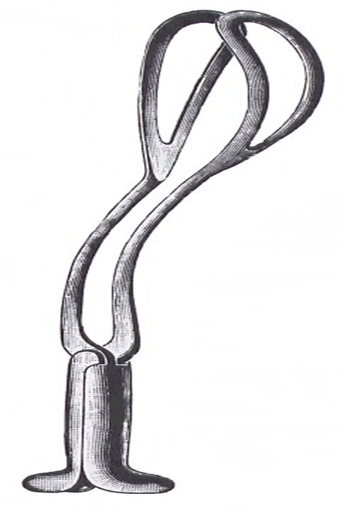
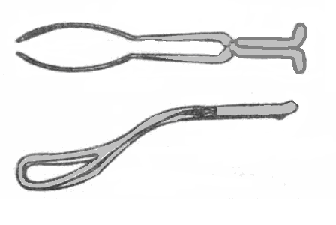
The Pippers Forceps
It is a long forceps designed to facilitate delivery of the after coming head in breech presentation

Slide 45
It is characterized by a long shank with the presence of a perineal curve.
It promotes flexion of the fetal head.
It prevents sudden compression and decompression on the fetal head.
It allows safer traction on the after coming head and not on the fetal neck.

Slide 46
Rigid VS. Soft cups
Soft Cups (polyethylene or silastic ) : are associated with less scalp injuries and appropriate for occipitoanterior position .
Rigid cups (Metal or Plastic ) are more suitable for occipitoposterior , transverse , and difficult occipitoanterior position where the infant is larger.
There is higher rate of failure with soft cups .
Notes:
Cups diameter average 40-60 mm
Shapes : mushroom , bell

Slide 47
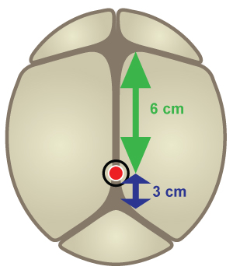
Ant Fontanelle
6 cm
Pivot Point
3 cm
Post Fontanelle

Slide 48
Advantages of VE :
1- less training
2- no risk of excessive traction
3-clear cut roles
4-less injury to mother
Disdvantages :
1-cannot used for ➔ preterm , face or breech presentaion , and the mother is unable to assist the delivery with expulsive effort
2-need more complex equipments
3-more trauma for baby

Slide 49
The ventouse compared to forceps is more likely to be associated with :
Failure to achieve a vaginal delivery.
Cephalohaematoma (subperiosteal bleed).
Retinal haemorrhage.
Maternal worries about the baby.

Slide 50
The ventouse compared to forceps is significantly less likely to be associated With:
Use of maternal regional/general anaesthesia.
Significant maternal perineal and vaginal trauma.
Severe perineal pain at 24 hours.

Slide 51
The ventouse compared to forceps is similar in terms of:
Delivery by caesarean section (where failed vacuum is completed by forceps).
Low 5 minute Apgar scores.

Slide 52
Analgesia
Analgesic requirements are greater for forceps than for ventouse delivery. rotational forceps or midpelvic direct traction forceps are needed regional analgesia is preferred
. For a rigid cup ventouse delivery, a pudendal block
Whith perineal infiltration may be all that is needed soft
if soft cup is used analgesic requirements may be limited to perineal infiltration with local anaesthetic

Slide 53
If one failed don’t try other
If 2 try vacuum without decent go cs
Max pressure vaccume is 400-600 mmhg
Max time vacum is 15- 20 minute .

