Slide 1
PERIPHERAL NERVOUS SYSTEM
INTERNAL EAR & CN VIII
Dr. Aiman Qais Afar
Surgical Anatomist
College of Medicine / University of Mutah

Slide 2
INTERNAL EAR (LABYRINTH)
SITE: inside the petrous part of temporal bone.
Structure: it consists of 2 parts:
Bony labyrinth: boney cavities inside the petrous temporal bone.
Membranous labyrinth: interconnected sacs and ducts inside the bony labyrinth.

Slide 3
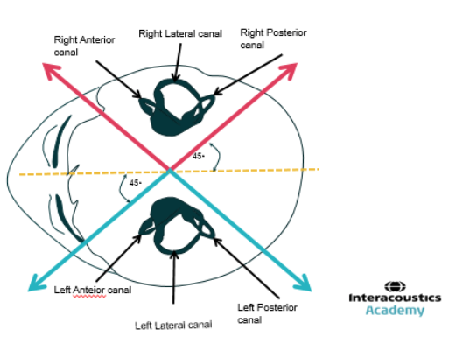
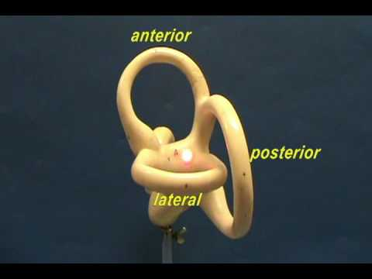
BONY LABYRINTH
Thursday 16 March 2023
I- Semicircular canals: are 3 arched canals set at right angles to each other.
1) Superior semicircular canal: lies in a vertical plane.
2) Posterior semicircular canal lies also in a vertical plane.
3) Lateral semicircular canal lies in a horizontal plane.
- These 3 canals open in the posterior aspect of the vestibule by 5 orifices (one is common to 2 canals).

Slide 4
BONY LABYRINTH
II- The vestibule: is the central part of bony labyrinth.
a- Its anterior wall shows the opening of the scala vestibuli of the cochlea.
b- Its posterior wall receives the 5 openings of the 3 semicircular canals.

Slide 5
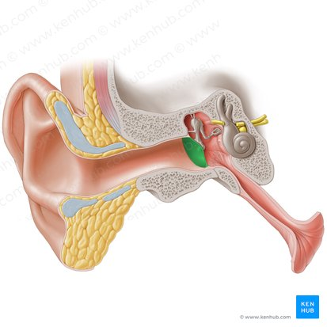
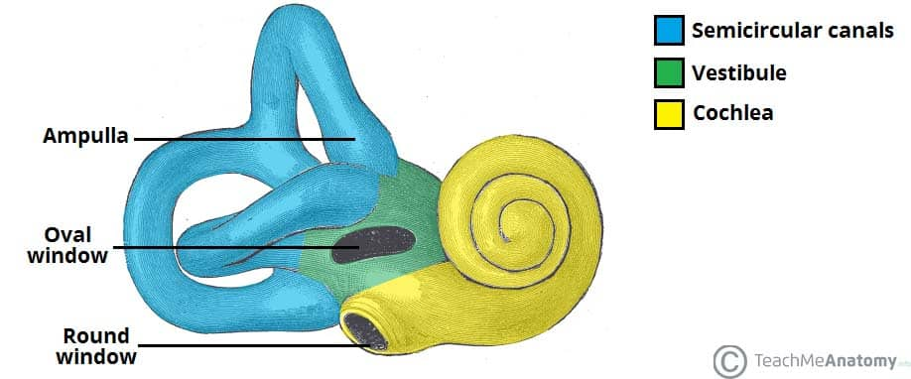
BONY LABYRINTH
II- The vestibule:
c- Its lateral wall is related to the middle ear and shows fenstera vestibuli which is closed by the foot of stapes.
d- Its medial wall forms the bottom of the internal auditory meatus and is perforated by the 8th cranial nerve.

Slide 6
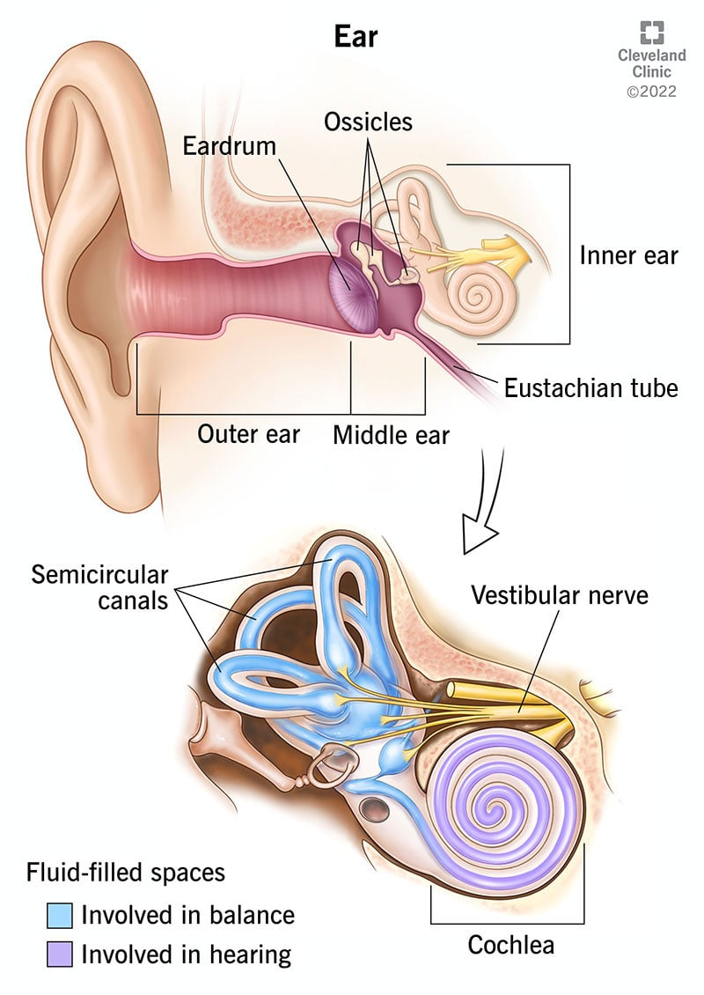
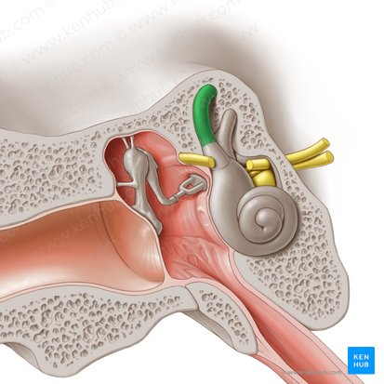
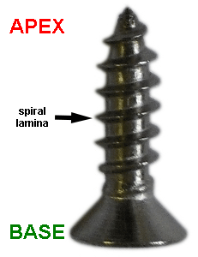
BONY LABYRINTH
III- The cochlea: is the anterior part of the boney labyrinth:
- It resembles the shell of a common snail forming 2 and 1/2 turns around its axis called modulus.
- Its base is directed medially towards the bottom of the internal auditory meatus and is perforated by the fibres of the cochlear nerve.

Slide 7
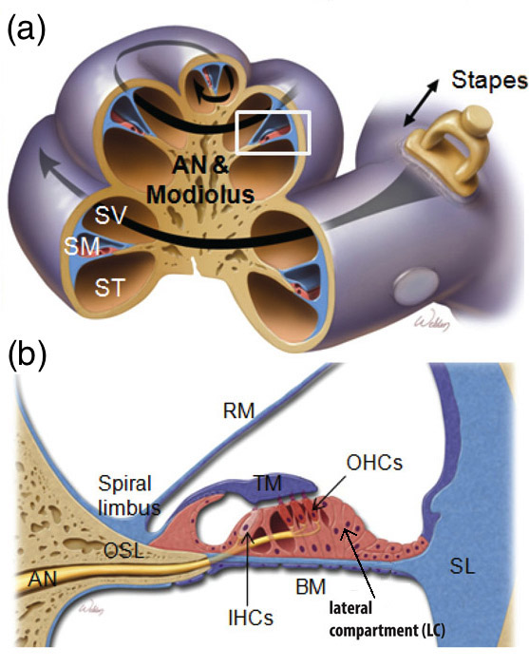
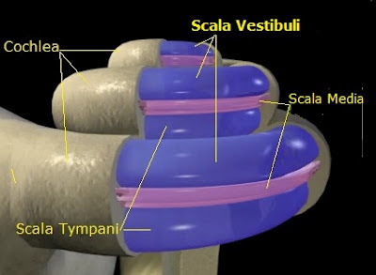
BONY LABYRINTH
Its apex is directed laterally towards the medial wall of the tympanic cavity.
- The cochlear canal lodges the cochlear duct.
- Spiral bony lamina projects from the modulus dividing the cochlear canal into scala vestibuli above and scala tympani below.

Slide 8
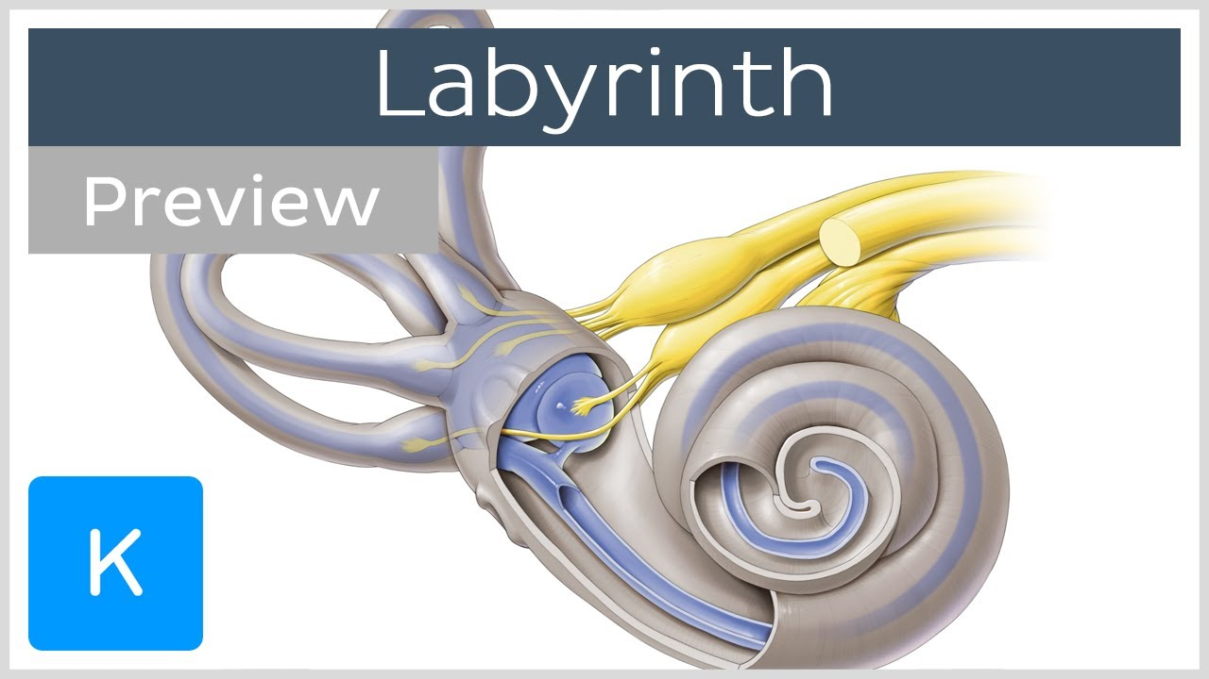
MEMBRANOUS LABYRINTH
Structure: it consists of number of membranous cavities inside the bony labyrinth.
These cavities are filled with fluid called endolymph.
- They are separated from the bony labyrinth by fluid called perilymph.

Slide 9
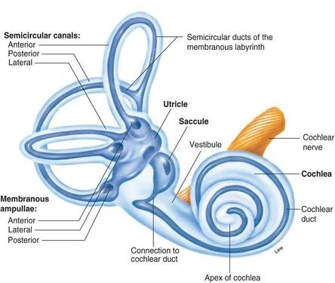
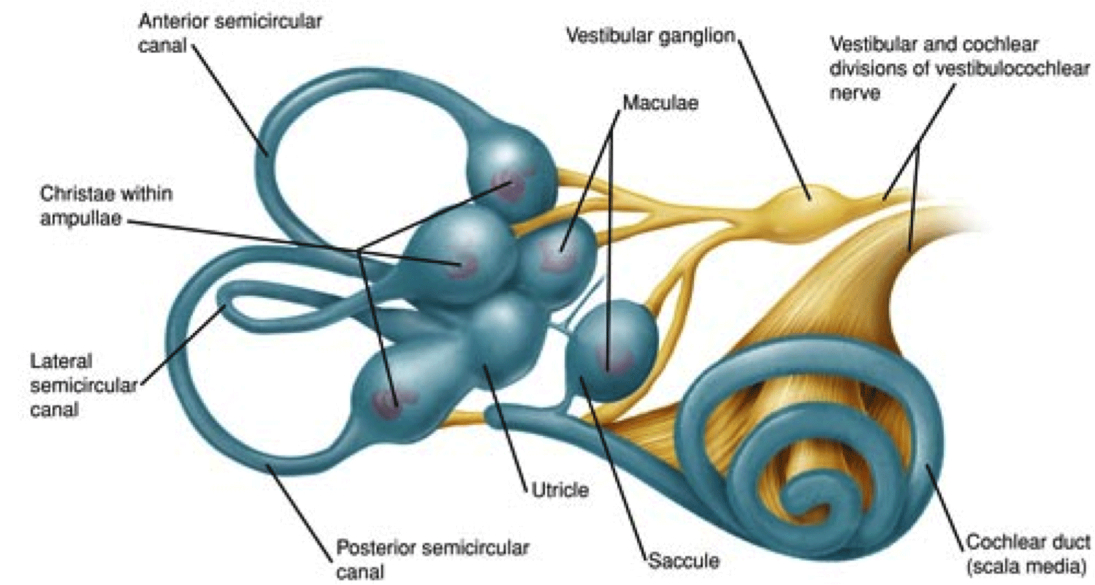
MEMBRANOUS LABYRINTH
Parts:
The 3 semicircular ducts :
- They lie within the corresponding bony canals.
- They open in the utricle.
- Each duct has a dilatation at one of its ends called ampulla.

Slide 10
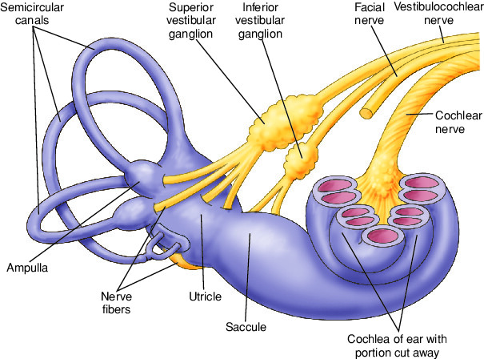
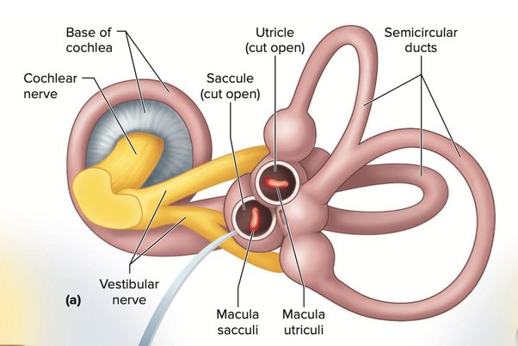
MEMBRANOUS LABYRINTH
(2) The utricle and saccule: they are 2 small sacs which lie in the vestibule.
A. Utricle: receives the 3 semicircular ducts.
- Its lateral wall in thickened to form a macula.

Slide 11
MEMBRANOUS LABYRINTH
B. Saccule: lies close to the base of the cochlea.
- It is connected to the basal turn of cochlea by ductus reunines.
- Its anterior wall in thickened to form a macula.
- The macula receives the fibres of the vestibular nerve.

Slide 12
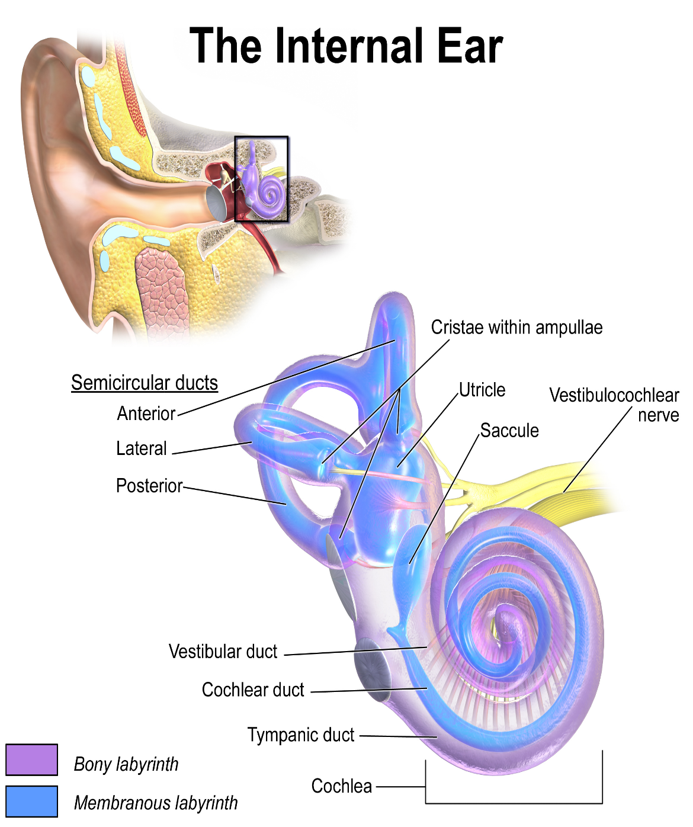
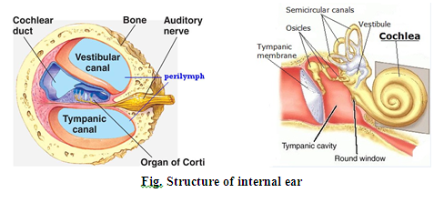
MEMBRANOUS LABYRINTH
(3) The cochlear duct (inside the cochlear canal)
It contains endolymph and organ of corti (sensory end organ of hearing).
- It extends between scala vestibuli above and scala tympani below.

Slide 13
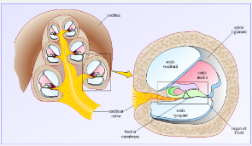
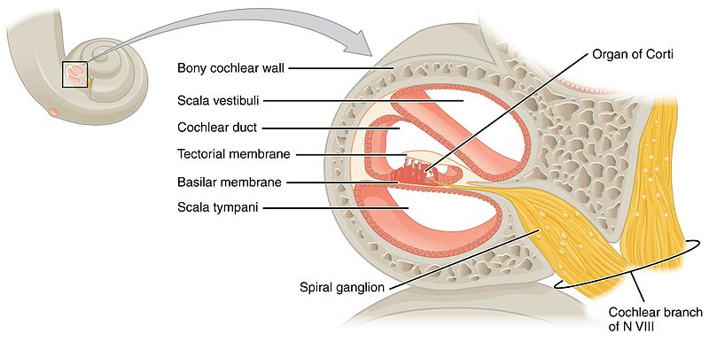
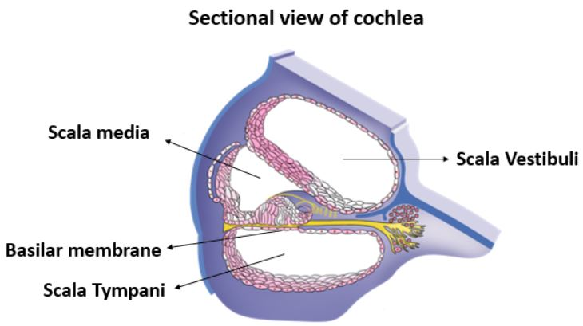
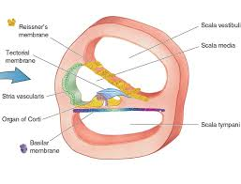
MEMBRANOUS LABYRINTH
- It is separated from the scala vestbuli by the vestibular membrane.
- It is separated from the scala tympani by the basilar membrane.
- Spiral ganglion, the peripheral processes pass to the organ of corti and the central from the cochlear nerve.

Slide 14
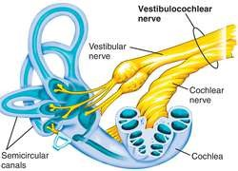
Nerve supply of the labyrinth
- It is supplied by the vestibule-cochlear nerve as following:
· Its cochlear division for the hearing.
· Its vestibular division for the equilibrium.

Slide 15
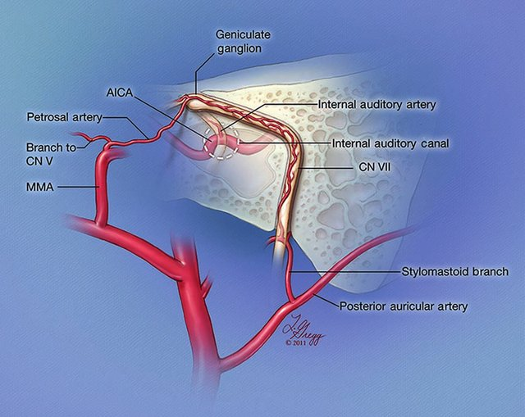
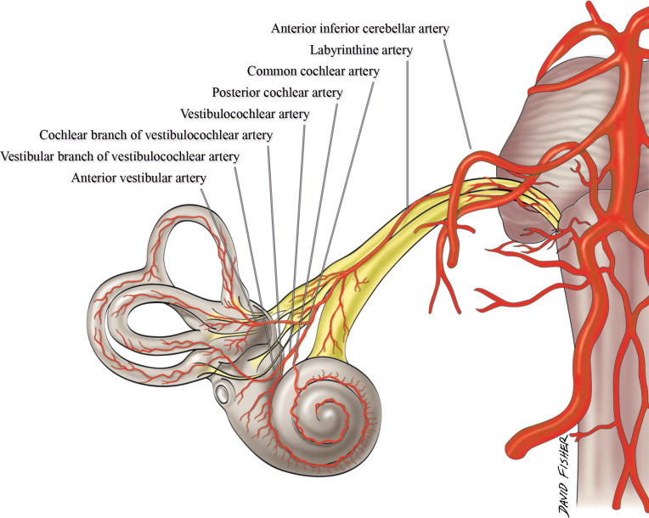
Blood supply of the labyrinth
Arterial supply: (1) Labyrinthine branch of basilar artery.
(2) Stylomastoid branch of posterior auricular artery.
Venous drainage: into superior Petrosal sinus or transvers sinus.

Slide 16
VESTIBULO – COCUHLEAR NERVE
Type: special sensory nerve (purely sensory) formed of 2 parts .
Cochlear part: carrying hearing impulses.
Vestibular part: carrying equilibrium impulses .
Exit from the brain stem: from the anterior aspect at the ponto-meduallary junction.

Slide 17
VESTIBULO – COCUHLEAR NERVE
Course: it enters the internal auditory meatus (with facial nerve) where:
1) Cochlear part ends in the cochlea.
2) Vestibular part ends in the utricle, saccule and 3 semicircular canals.

Slide 18
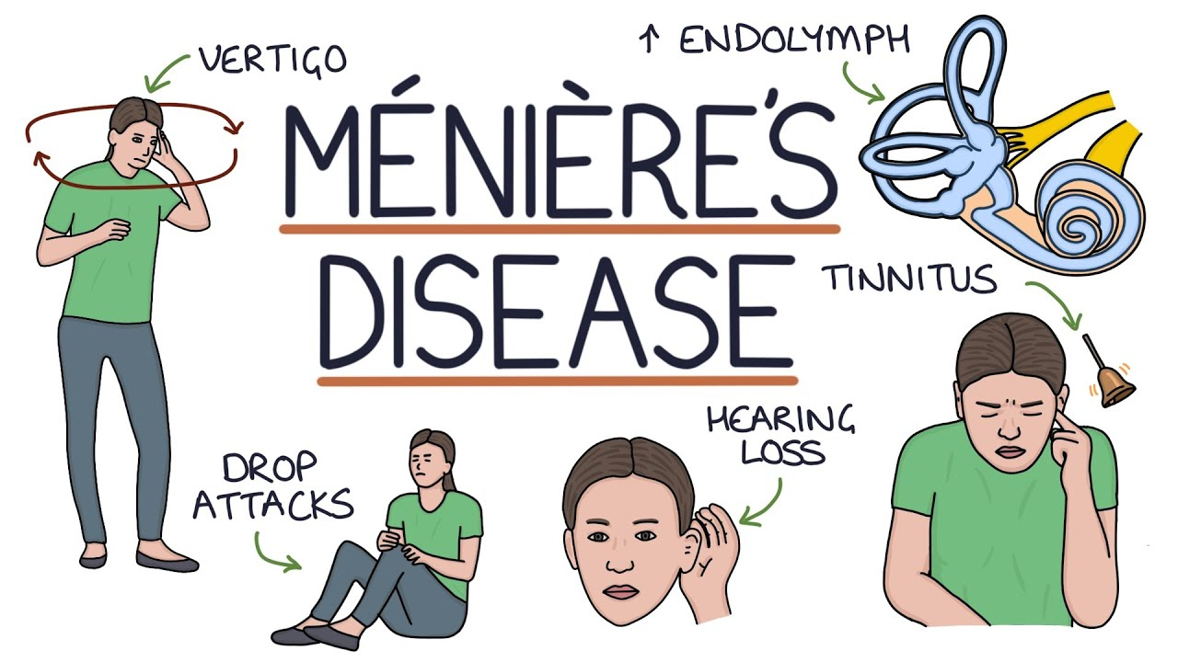
Applied anatomy; Meniere's disease
- It is characterized by vertigo (giddiness, nystagmus, nausea and vomiting), associated with tinnitus and deafness.
- It is caused by distension of endolymph (due to disturbed fluid or allergy) with degenerative changes in the organ of Corti.

Slide 19
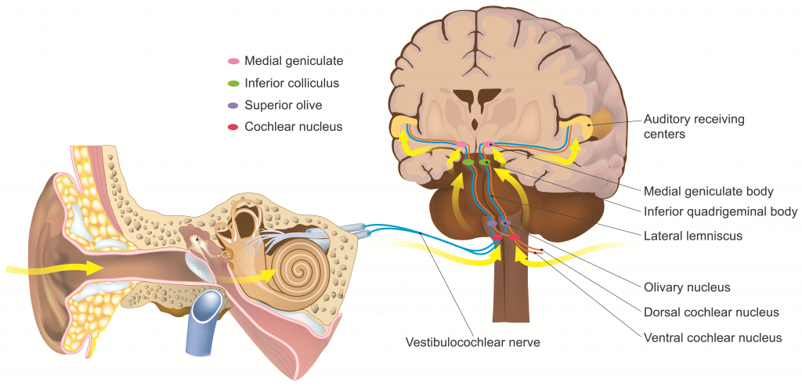
AUDITORY (Hearing) PATHWAY
** Receptors: the organ of corti in the cochlear duct.
1- First neuron: bipolar cells of the spiral ganglion of the cochlea.
- The peripheral processes receive the sensation from the receptors.
- Their axons form the cochlear nerve which ends in the ventral and dorsal cochlear nuclei.

Slide 20
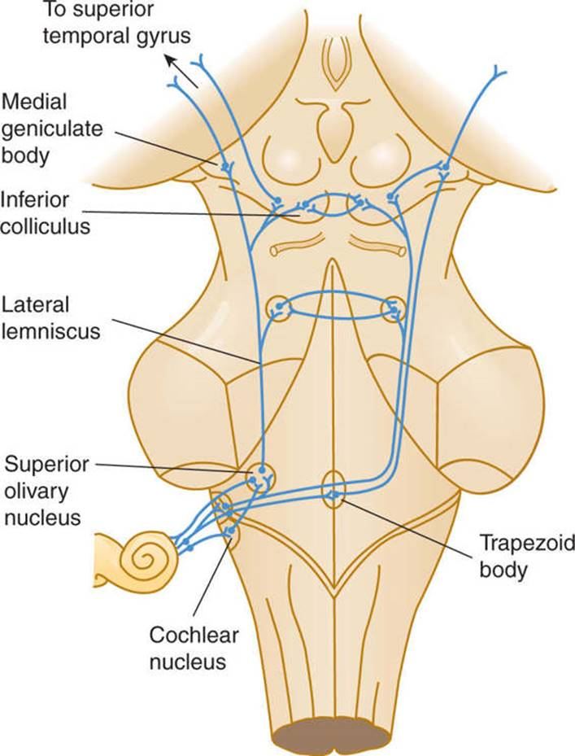
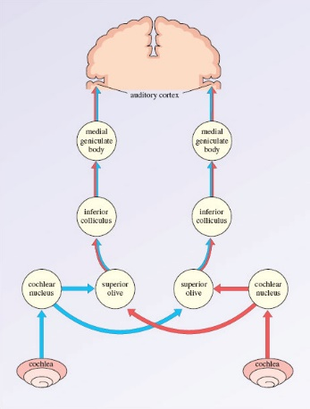
AUDITORY (Hearing) PATHWAY
2- Second neuron: ventral and dorsal cochlear nuclei.
Most of the axons of these cells cross to the opposite side → trapezoid body → ascend as a lateral leminscus with some fibres from the same side.
Few fibers do not cross but ascend in the lateral lemniscus of the same side.
- Many of them relay in the superior olivary nucleus and nucleus of the trapezoid body

Slide 21
AUDITORY (Hearing) PATHWAY
3- Third order neuron (superior olivary nucleus and nucleus of the trapezoid body)
The axons of their cells ascend as the lateral lemniscus.
- On reaching the midbrain;
a- most of the fibers terminate in the inferior colliculus.
b- The remainder of fibres pass through the inferior brachium to end in the medial geniculate body.

Slide 22
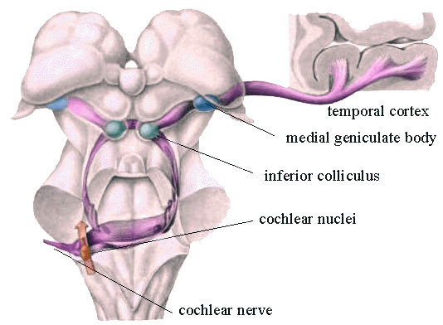
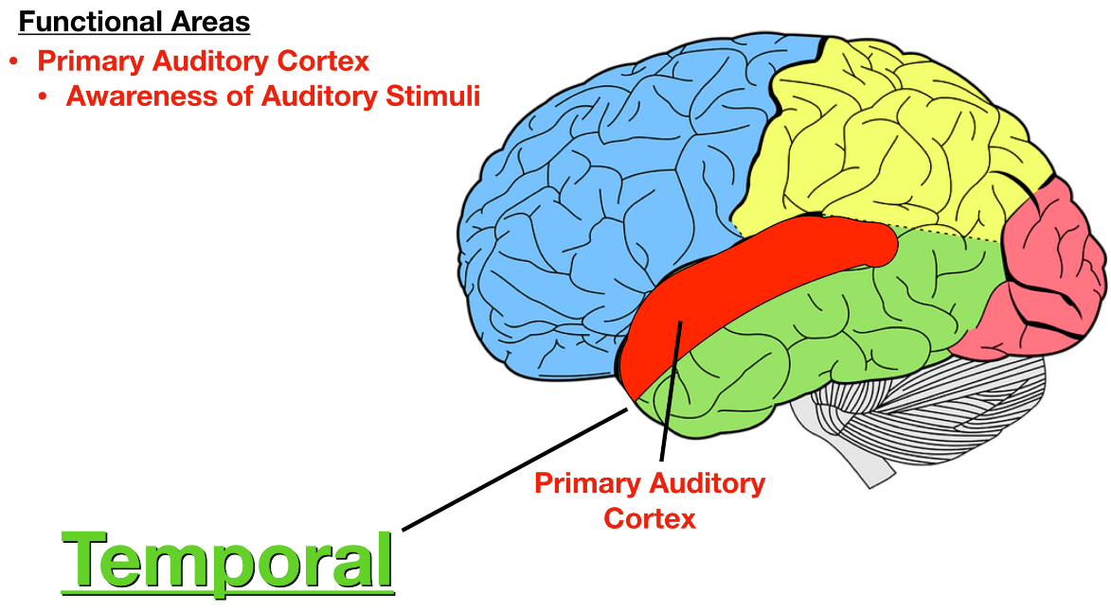
AUDITORY (Hearing) PATHWAY
4- The 4th order neuron (Medial geniculate body):
Their axons form the auditory radiation which passes through the sublentiform of internal capsule to end in the auditory area of cerebral cortex.
* Auditory area: (Heschl's gyrus) lies in the middle part of superior temporal gyrus

Slide 23
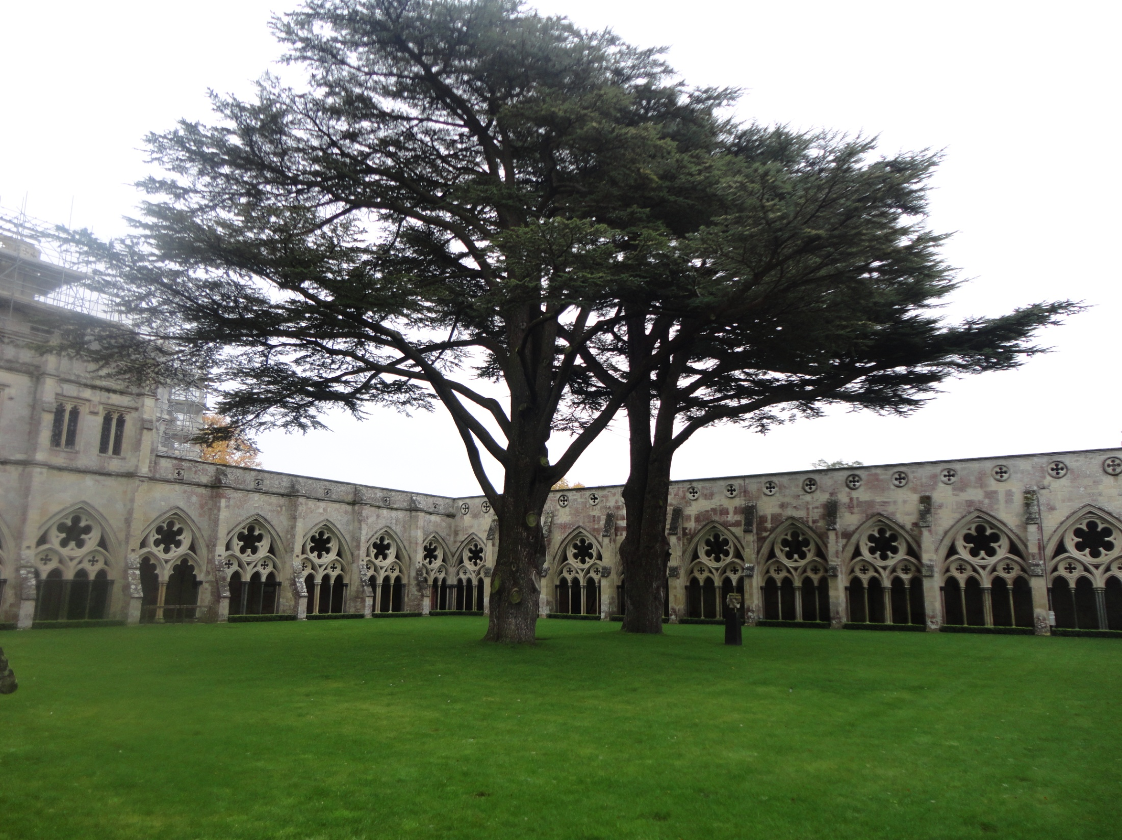
Dr. Aiman Qais Afar
Thursday 16 March 2023

