Slide 1
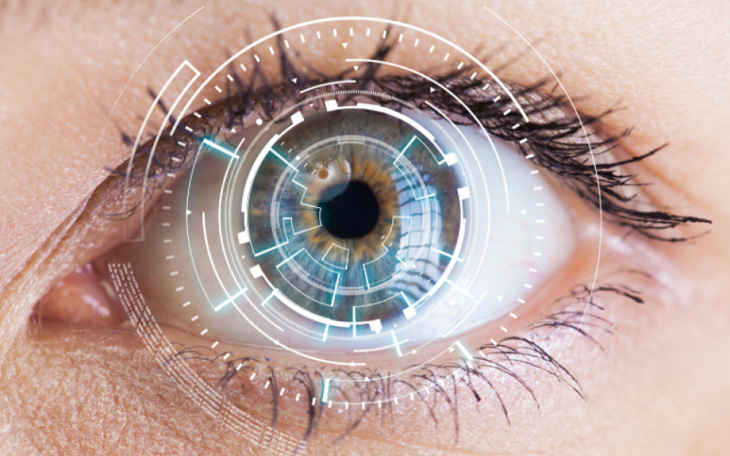
Ophthalmology History & physical examination
Supervised By :
Dr Khalil al-salem
Prepared By :
Mohammad Rabai

Slide 2
Patients profile:
History is important for many reasons:
Focuses your attention to the patients problem
Narrows down your deferential diagnosis
Screen the patient for other disease, the patient might not be aware of.
Protect other people from harmful events inflected on others, because of the patients problem.
Name of the patient
Age
Sex
Residence

Slide 3
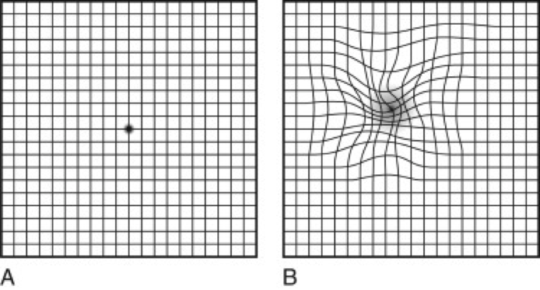
Chief complaint and the main Symptoms:
Blurring of vision.
Scotoma,
metamorphopsia,
Eye pain
Eye itching
Eye redness
Eye lacrimation And discharge

Slide 4
Vision related symptoms
Ask:
-Did the change in vision start suddenly or gradually?
-How is the vision affected exactly? ( is it loss of vision? Cloudy vision? Floaters? )
-Unilateral or bilateral?
-Whole or part of the visual field affected?
-If partial, which part of the visual field affected?

Slide 5
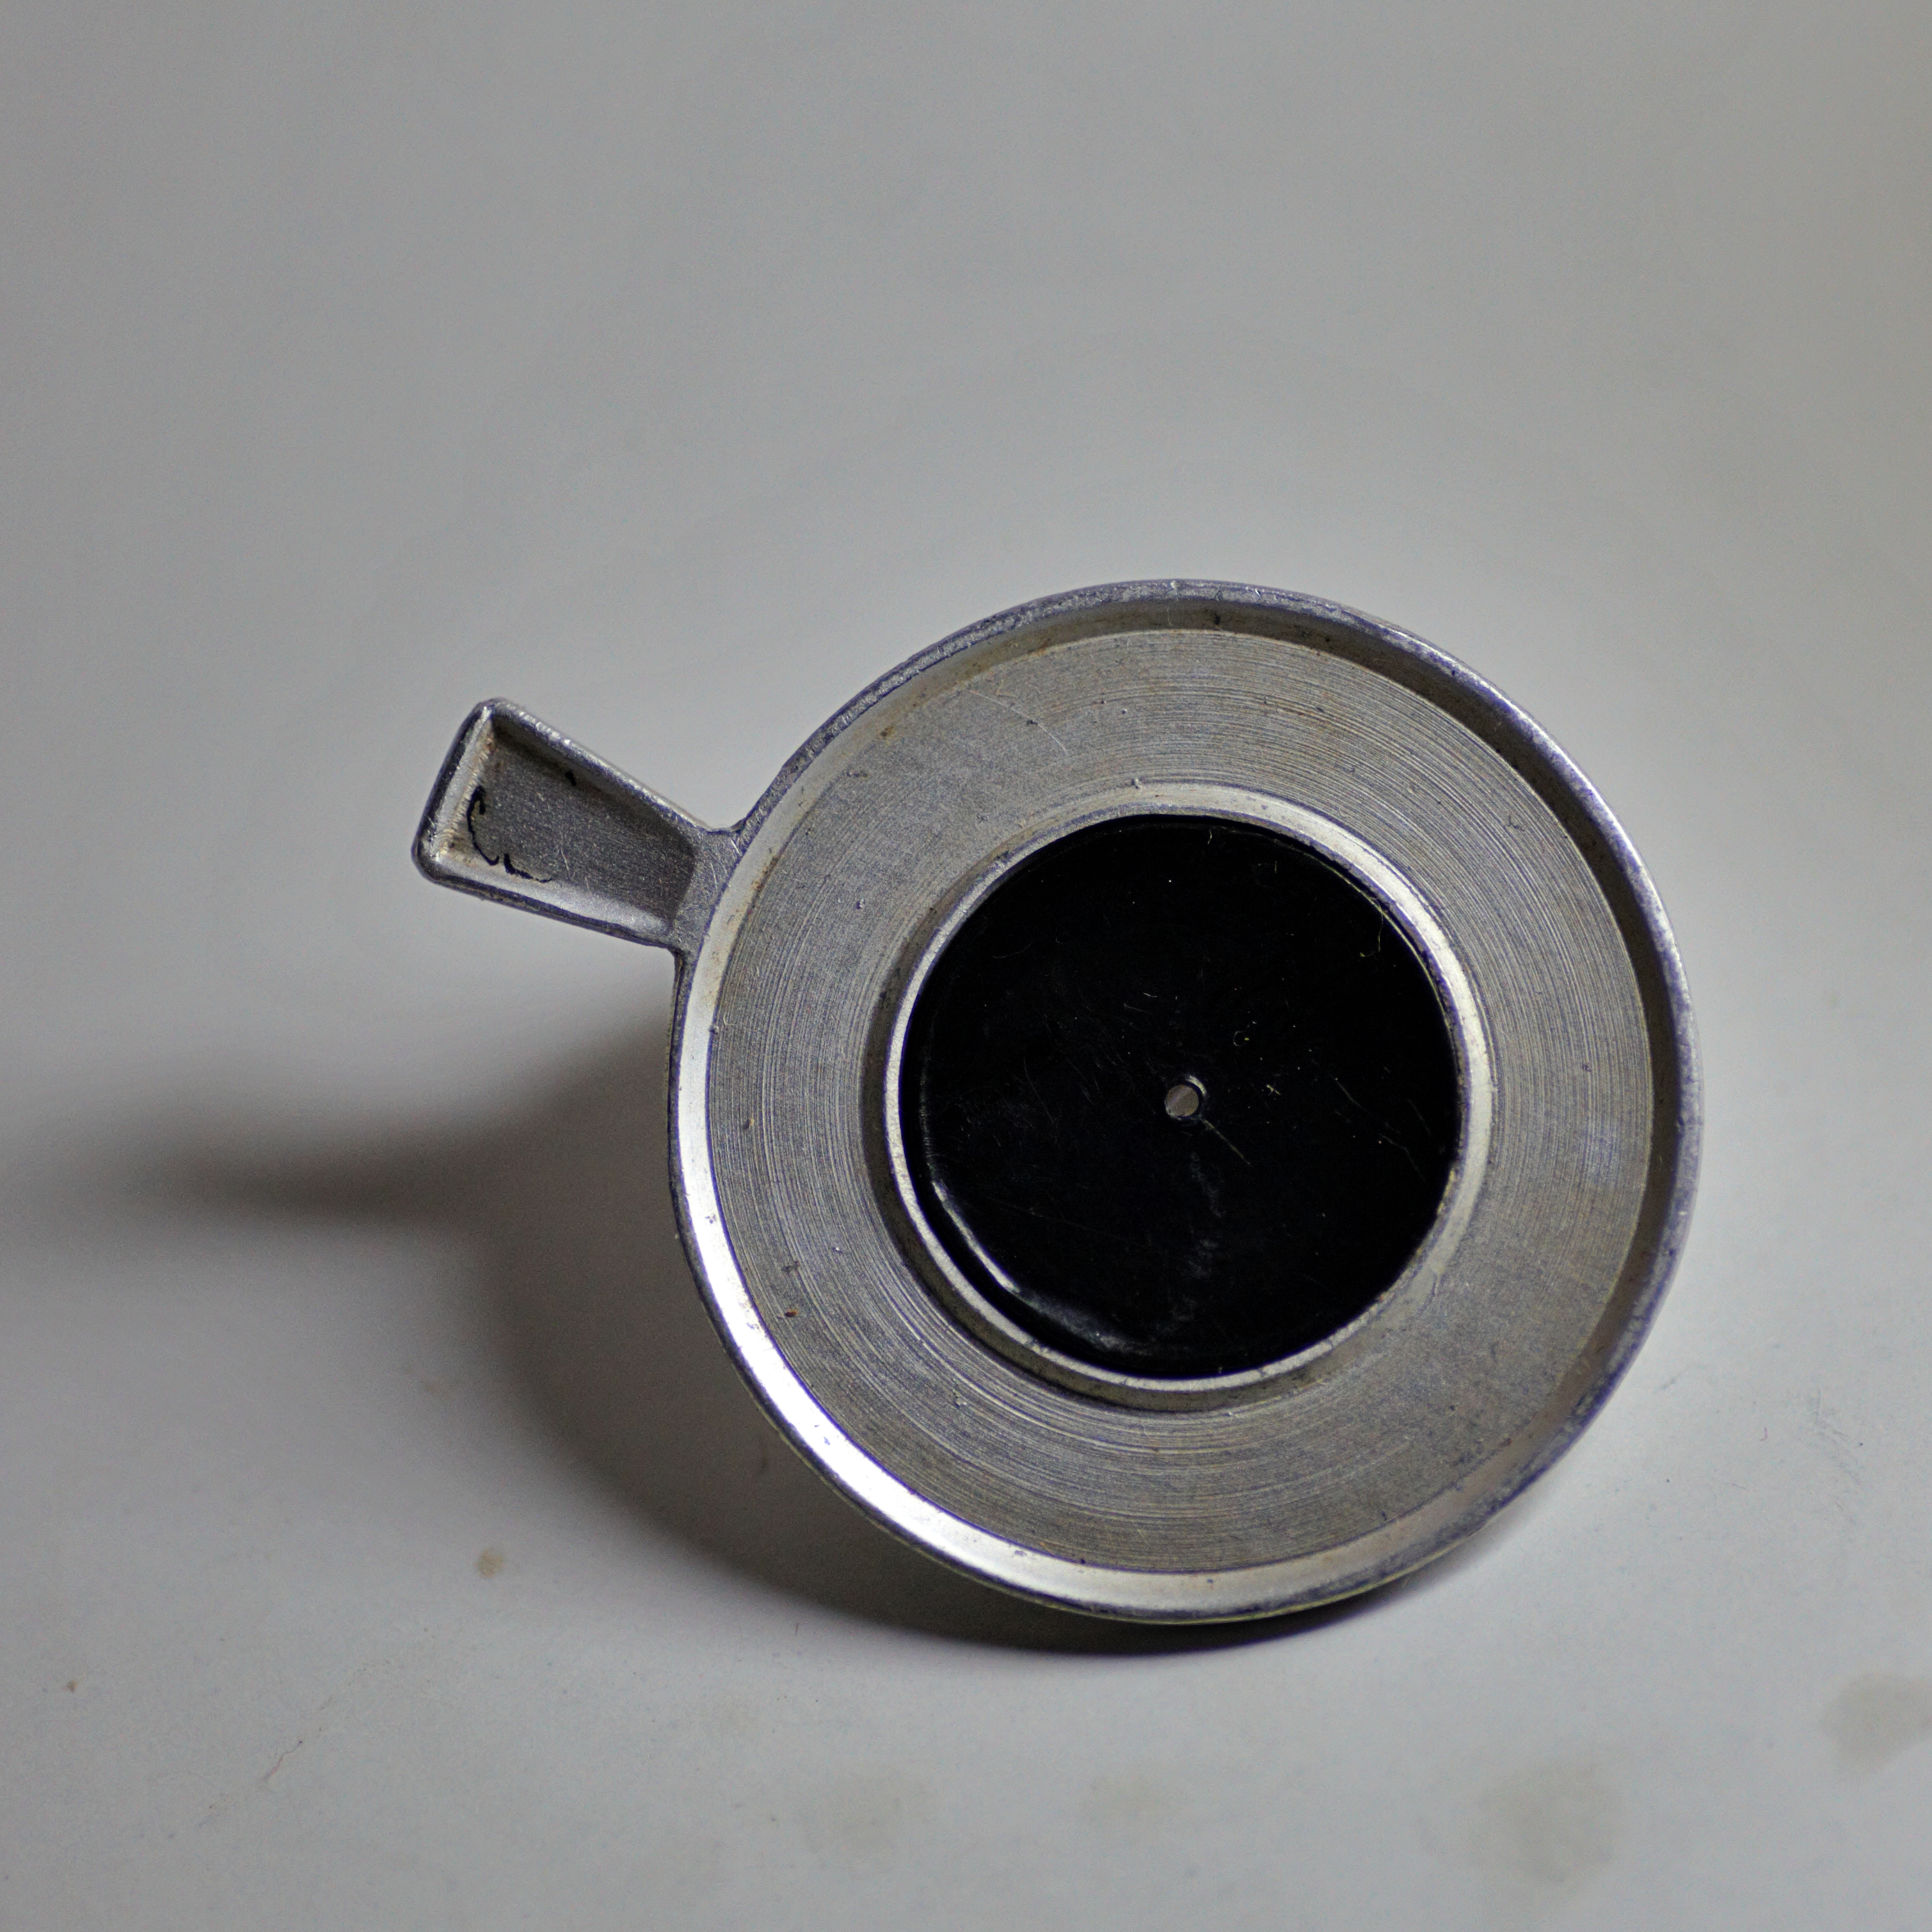
Blurring of vision:
Refractive error.
Organic problem in the eye (conrea, lens, retina, vitreous, optic nerve disease)
How to differentiate:
Pinhole test: (the test can correct +/- 4 Diopters)

Slide 6
Blurred vision:
With pain
Closed angle glaucoma
Keratitis
Without pain
Macular edema
Retinal artery occlusion
endophthalmitis
Uveitis
Retinal detachment
Retinal hemorrhage
Retinal vein occlusion
Optic neuritis!!

Slide 7
Ocular pain:
Site of pain
Severity
Aggravating factors
Relieving factors
Radiation
Associated symptoms, Neusea, vomiting, fever, weekness, headache.
History of associated trauma !!

Slide 8
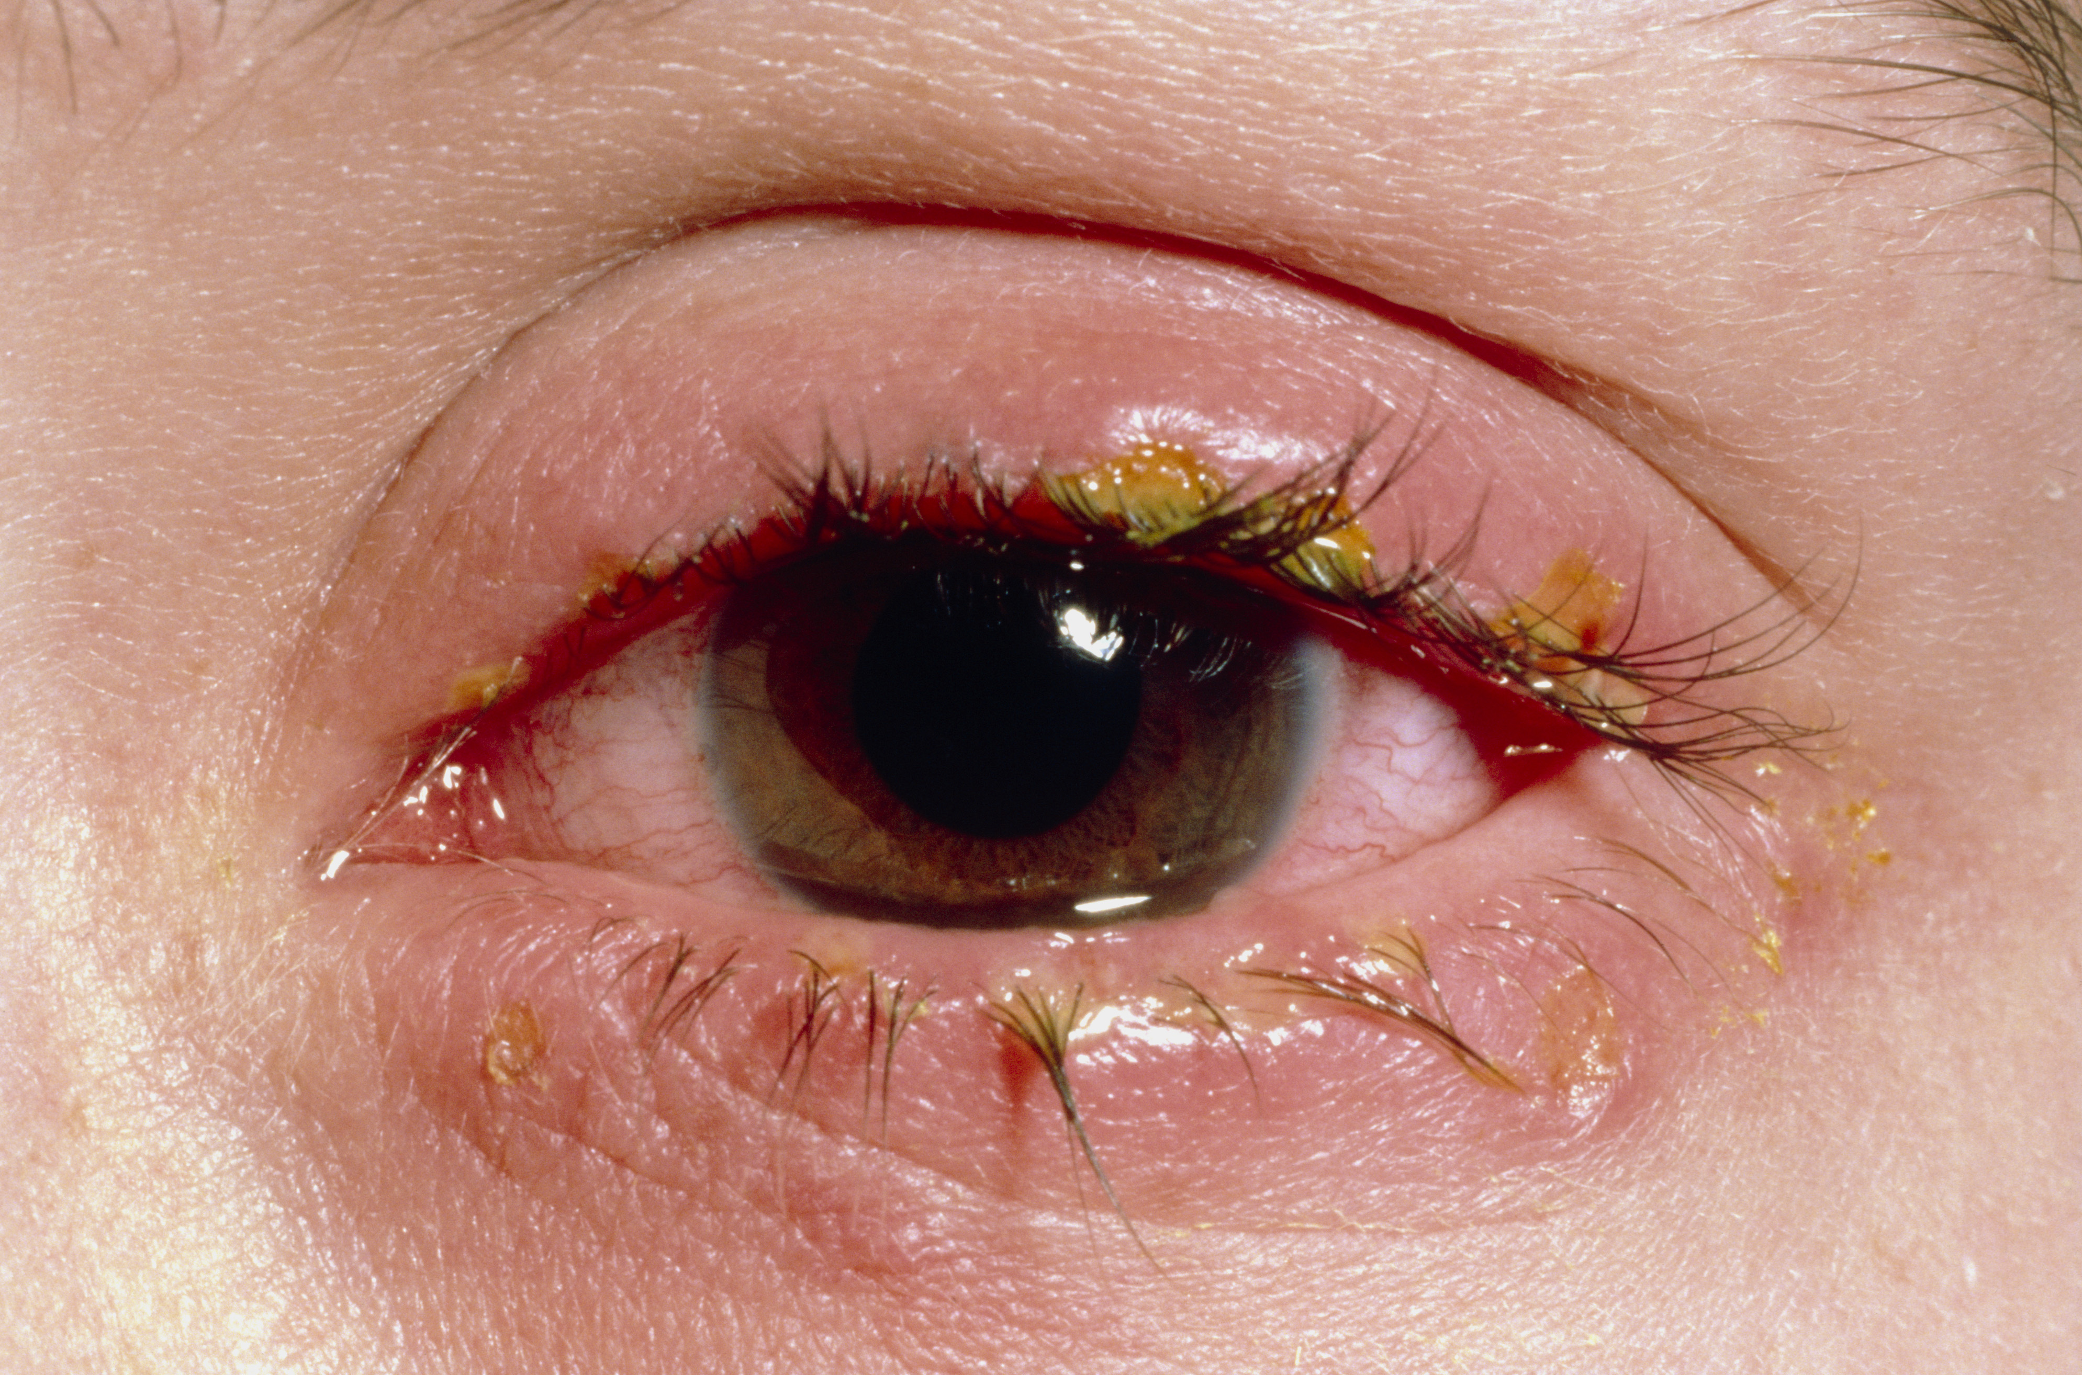
Eye itching:
Dryness
Eye allergy
Contact dermatitis
Eyelid mass ( ex: sclerosing basal cell carcinoma)
Blepharitis

Slide 9
Photophobia
Corneal symptoms : punctate erosion , corneal abrasion , corneal ulcer
Uveitis with or without high intra-ocular pressure
Herpetic uveitis , Toxoplasmosis
HLA-B27 uveitis: ankylosing spondylitis, inflammatory bowel disease, psoriasis and Reiter's syndrome
Headache , Migraine (classical and common)

Slide 10
floaters
The sense of swimming flies or amorphous organism in space that are no sticking to one side of visual field, typically floaters change position with eye movement
Uveitis
Vitreous detachment

Slide 11
Lacrimation and discharge
Ask :
- Is the discharge clear or opaque?
- Associated pain? Foreign body sensation? Itchiness?
- Other symptoms (e.g. red eye)?

Slide 12
Past medical history:
History of D.M , Dyslipidemia , HT: ask about duration, control, complication, medications ( type and compliance)
Congenital diseases ( bleeding disorders)
Drug allergies
History of uveitis or any medical eye problems.
Drug history :
- Insulin
- HTN treatment
- Chlorquine > Retinal toxicity
- Isoniazide
- Steroids > ( Acute : Glaucoma , Chronic Use : cataract )

Slide 13
Social history:
Smoking and alcohol use: this may affect vascular and optic nerve function within the eye.
Socioeconomic status : examples trachoma is more prevalent in the poor . Gout is more prevalent in the rich
Occupation:
certain occupations are more likely to get injured in the eye more than others. Example: the act of welding, carpenters, black smiths.
certain professions, including drivers of heavy goods and pilots, require specific visual acuity criteria.
Visual impairment has a wide range of effects on daily life. Ask about:
Daily activities requiring good vision: reading, television, sport, hobbies and so on.
Driving.

Slide 14
Past surgical history :
Previous surgeries
Previous use of eye glasses
Previous eye injections .
Previous laser to the eye.

Slide 15
Physical examination
Done by: Ghazi jadeed
Supervised by: dr. Khalil al-salem

Slide 16
Physical examination
General examination
Visual acuity
Pupils
Extra-ocular motility
Slit-lamp exam
IOP
Funduscopy
Visual field

Slide 17
General examination
Carefully and systematically examine:
-Posture and gait
-Head position
-Facial asymmetry and dysmorphic features
-Eyelid position and periocular skin
-Position and symmetry of gaze (any squint/strabismus?).

Slide 18
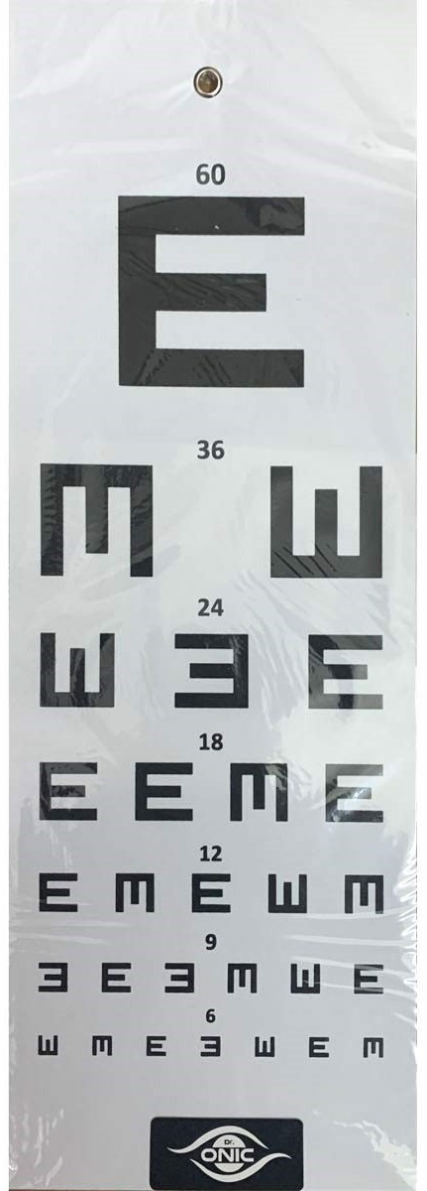
Visual acuity
Using Snellen chart, 6m away from the patient.
Test each eye separately.
If the patient cannot see the largest font, reduce the chart distance to 3m, then to 1m if necessary. If they still cannot see the largest font, document whether they can count fingers, see hand movement or just perceive the difference between light and dark.
Express visual acuity as the distance at which the text is read (6 metres) over the number of the smallest font line read correctly on the chart. Example: 6/60 means the patient can read the largest font line from 6 metres away, while someone with normal visual acuity can read the same font from 60 metres away.

Slide 19
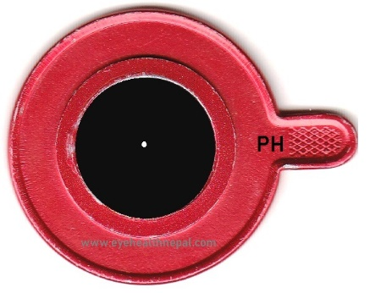
Visual acuity cont.
If the patient cannot read down to the last line, place a pinhole directly in front of the eye. If the visual acuity does not improve, this indicates the presence of eye disease not related to the refractive apparatus alone, such as retinal or optic nerve pathology.
Assess near vision with a similar test using text of reducing font size held at comfortable reading distance.

Slide 20
Pupils
They should be round, regular and reactive.
Anisocoria – The eyes should be assessed to determine which is the abnormal pupil, by increasing and decreasing the illumination and looking for change in the anisocoria. If the degree of anisocoria is greater in brighter lighting, then it is the larger pupil that is abnormal. If it is more pronounced in dim lighting, the smaller pupil is the abnormal one.
Direct and consensual light reflex. -Relative afferent pupillary defect (RAPD): Light in the affected eye causes weaker constriction compared to light shone in the normal eye. It is due to a disease of the retina or optic nerve that reduces the response to a light stimulus. Detected by moving the light briskly from one eye to the other, but place it on each eye for a minimum of 3 seconds. In normal patients, this results in symmetrical constriction. In RAPD, light in the affected eye causes weaker constriction compared to light shone in the normal eye.
Accommodation.

Slide 22
Extraocular motility
Ocular alignment and eye movements.
Detection of squint.
Ocular movements.
Nystagmus.

Slide 23
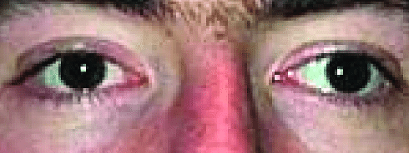
Detection of squint
Sit 1 metre away from the patient and hold a pen torch directly in front of them and instruct them to look at the light.
Observe the reflection of the light on the cornea in relation to the pupil. The reflections should be symmetrical between the two eyes.
Ask the patient if they see single or double light (seeing double light may indicate the presence of squint, but not seeing double does not exclude it).
If the reflection is on the nasal aspect of the pupil in one eye, this suggests that the eye is deviated outwards and is described as an exotropia.

Slide 24
Detection of squint cont.
To confirm the presence of squint, perform the cover/uncover test:
-Ask the patient to look at the pen torch at all times and then cover one eye.
-Look at the uncovered eye for any movement. It may be helpful to repeat this several times.
-Inward movement of the uncovered eye suggests that it was positioned abnormally outwards and is described as exotropia.
-Conversely, if the eye moves outwards when the contralateral eye is covered, this suggests that it was abnormally positioned inwards and is described as an esotropia.

Slide 25
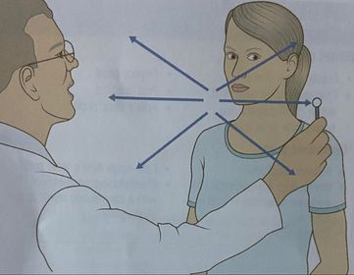
Ocular movements
In the same seating position, ask the patient to look at a target or pen-torch light about 50 cm away.
Ask them to say if and when they experience diplopia.
Starting from the primary position, move the target in the six positions of gaze.
If diplopia is present, ask whether this is horizontal, vertical or a combination of the two.
Determine where the image separation is most pronounced.
Look for nystagmus and determine whether the eye movement is smooth.

Slide 26
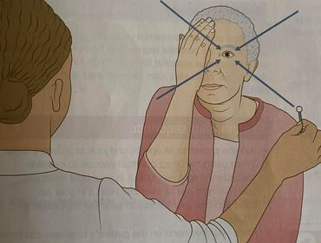
Visual fields
Sit directly facing the patient about 1 metre away, and ask the patient whether they have any difficulty seeing parts of your face.
Ask the patient to close or cover one eye, and cover yours too.
Hold your hands out and bring an extended finger in from the periphery towards the centre of the visual field. Ask the patient to point to it when they first see it. If the patient fails to notice your finger when it is clearly visible to you, their field is reduced in that area.

Slide 27
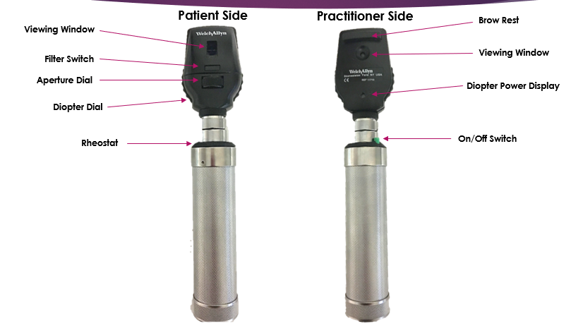
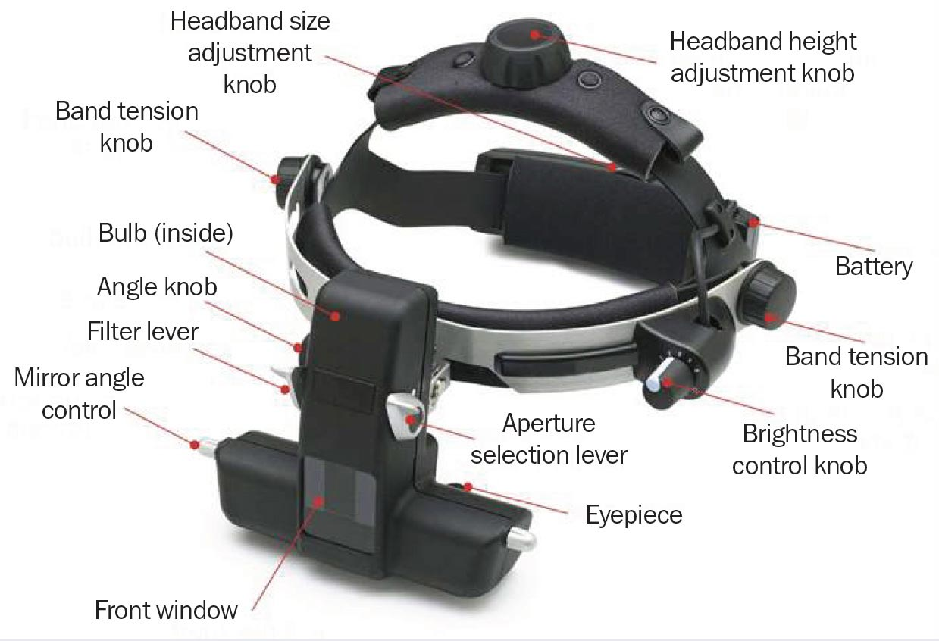
Ophthalmoscopy
Pharmacological pupil dilatation is essential for a thorough fundus examination.
Direct & indirect opthalmoscope.
Ophthalmoscopy can detect lens or vitreous opacities and identify retinal and vascular changes.

Slide 28
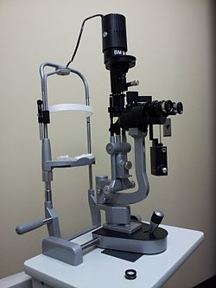
Slit-lamp examination
Can view the lids and lacrimal system, conjunctiva, cornea and sclera, anterior chamber, pupil, iris, lens, anterior vitreous, and with a handheld condensing lens, it can also be used for detailed examination of the retina and macula.

Slide 29
Intra-ocular pressure
Intraocular pressure (IOP) is the fluid pressure inside the eye. It is normally between 9 and 21 mmHg.
Methods of measurement : Applanation, Indentation
Hand-held tonometers, noncontact air-puff tonometry, Goldmann applantation tonometry. *Goldmann applantation tonometre is the most accurate one but it requires practice as it is difficult to use.

