Slide 1
Thoracic injury
Rawan Fayoumi
Nadine Naser
Suha Khaled
Loulou Mahmoud
Supervised by Dr. Ali Alkayed

Slide 2
Anatomy

Slide 6
Types of trauma
A- Blunt trauma: non-penetrating, such as car accidents.
B- Penetrating trauma: (pleura is injured)

Slide 7
Epidemiology
20-25% of trauma death are due to the thoracic injuries.
Blunt trauma from motor vehicle accidents has accounted for 70-80% of thoracic injuries.
More than 75% of patients hospitalized with thoracic trauma had other associated injuries.

Slide 8
In most of these patients, the cause of death is haemorrhage.
About 80% of patients with chest injury can be managed non-operatively.
The key to a good outcome is early physiological resuscitation followed by a correct diagnosis.

Slide 9
Prognosis
majority of patients with blunt chest trauma, outcome and prognosis are excellent.
The most important determinant of outcome is the presence or absence of significant associated injuries of the central nervous system, abdomen, and pelvis.
Some injuries, such as cardiac chamber rupture, thoracic aortic rupture, injuries of the intrathoracic IVC and SVC, and delayed recognition of esophageal rupture, are associated with high morbidity and mortality.

Slide 10
Clinical presentation
History
The time of injury
mechanism of injury,
estimates of motor vehicle accident (MVA) velocity
evidence of associated injury to other systems (eg, loss of consciousness)
Chest pain and dyspnea

Slide 11
Physical exam
General exam
- Signs of shock (pallor, hypotension,tachcardia)
Signs of respiratory distress (cyanosis)
Local exam
- bruises & ecchymosis
- Pneumothorax (mediastinal shift, hyper-resonance, decresed air entry).
- Hemothorax (shifted mediastinum, dullness, decresed air entry).
- Rib fracture ( localized tenderness & crepitus at the site of fracture).

Slide 12
INITIAL EVALUATION AND RESUSCITATION OF THE INJURED PATIENT
Primary Survey
to identify and treat conditions that constitute an immediate threat to life
assessment of the “ABCs” (Airway with cervical spine protection, Breathing, and Circulation)

Slide 13
Lab test
CBC ( routine test)
ABG
Electrolytes
Coagulation profile(PT, PTT,fibrinogen,D dimer)
Troponin, creatinine kinase
Lactate
Blood type and cross match

Slide 14
Chest x-ray
provide good information regarding tracheal deviation,lung and mediastinal pathology.
pneumothorax, fluid meniscus,
presence of free gas under the diaphragm indicating the presence of a hollow abdominal viscus perforation.
Fracture

Slide 15
Ultrasound – extended focused assessment with sonar for trauma
- cardiac tamponade or free blood and air in the hemithorax on each side.
- assessment for blood in the abdominal cavity, in the paracolic gutters, subdiaphragmatic spaces and pelvis.

Slide 16
Underwater chest drain
In the physiologically grossly unstable patient, where physical examination is inconclusive and there is no time for radiological investigations.
insertion of an underwater chest drainage tube can be a diagnostic procedure as well as a therapeutic.

Slide 17
- Computed tomography scan (It has become the principal and most reliable examination for major injury in thoracic trauma)
Esophagoscopy is the initial diagnostic procedure of choice in patients with possible esophageal injuries.
Fiberoptic or rigid bronchoscopy is performed in patients with possible tracheobronchial injuries.
Electrocardiography is a standard test performed on all thoracic trauma victims

Slide 18
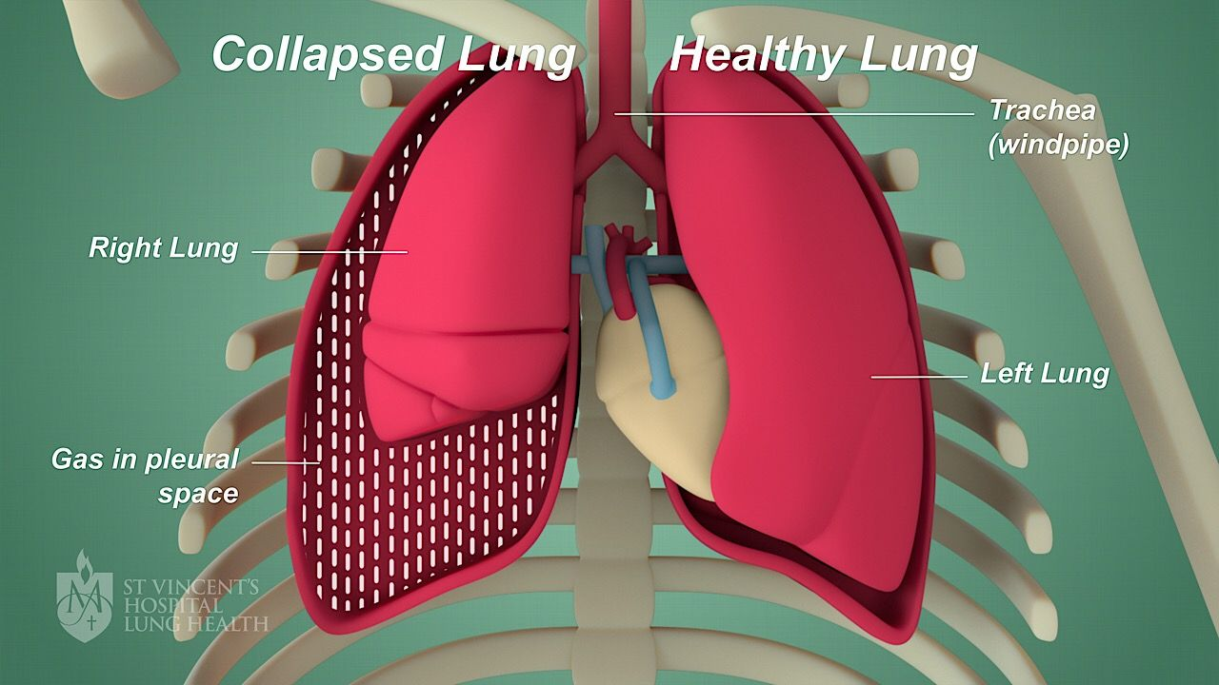
Pneumothorax
the presence of air or gas in the pleural cavity, which can impair oxygenation and/or ventilation.
Classification:
spontaneous: primary or secondary
Acquired: Iatrogenic or traumatic

Slide 19
Pathological types
Closed (simple) pneumothorax.
Open pneumothorax.
Tension pneumothorax.

Slide 22
Tension pneumothorax
A tension pneumothorax is a life-threatening condition that develops when air is trapped in the pleural cavity under positive pressure, displacing mediastinal structures and compromising cardiopulmonary function.
Immediate decompression of the thorax is mandatory when tension pneumothorax is suspected. This should not be delayed for radiographic confirmation.

Slide 23
Clinical presentation
Signs:
-lnspection: - decreased movements at the affected side.
-Palpation: diminished movements, decreased TVF, but there is NO mediastinal shift in closed pneumothorax.
- Percussion: Hyper-resonance.
Auscultation: decressed air entry.
(Tachycardia, Hypotension, Jugular venous distention, Cardiac apical displacement are findings seen in tension pneumothorax).

Slide 24
Diagnosis
Chest X ray
decreased lung markings extending to the chest wall and the lung border may be visible.
A CT scan
It is not always necessary, but is another modality available to diagnose a pneumothorax.
A CT can be more accurate than a chest x-ray, especially for a small pneumothorax. They may also be necessary to better evaluate underlying lung pathology.

Slide 25
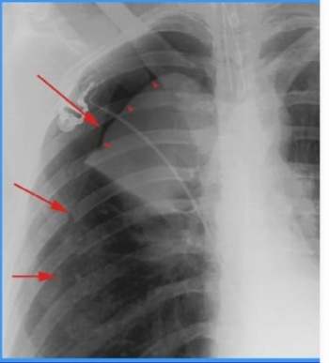
Imaging- chest X-ray film
characteristics of pneumothorax
Pleural line
No lung markings in pneumothorax
The outer margin of visceral pleura separated from the parietal pleura by a lucent gas space devoid of pulmonary vessels

Slide 27
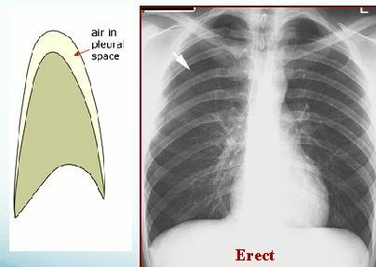
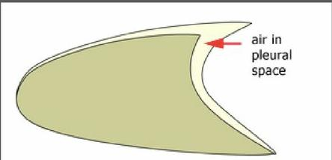
Supine vs erect CXR

Slide 29
Lateral decubitus

Slide 33
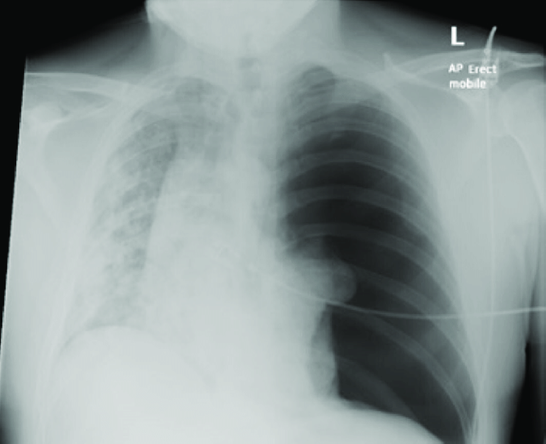
Tension pneumothorax
Findings
ipsilateral lung collapse at the hilum
increased thoracic volume
trachea and mediastinum deviation to the contralateral side
widened intercostal spaces on the affected side

Slide 34
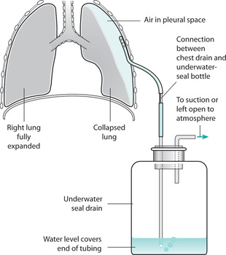
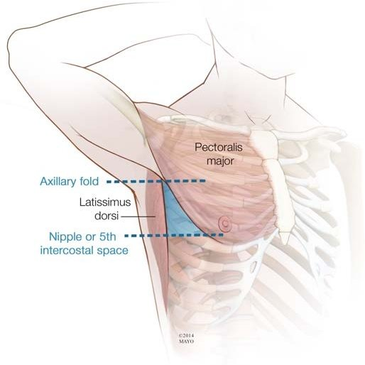
Treatment
lf the amount of air is small & the patient is mildly symptomatic: The patient is treated conservatively (monitoring vital signs & repeated ABGs are done) until spontaneous absorption of the air takes place.
Open and tension pneumothorax
- An intercostal tube in the fifth space in anterior axillary line.

Slide 35
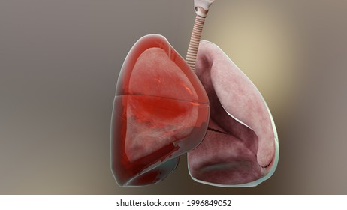
Massive Hemothorax

Slide 36
Hemothorax is accumulation of blood in the pleural space
The most common cause of massive haemothorax in blunt injury is continuing bleeding from torn intercostal vessels or occasionally from the internal mammary artery secondary to fractures of the ribs.
In penetrating injury, a variety of viscera, both thoracic and abdominal (with blood leaking through a hole in the diaphragm from the positive pressure abdomen into the negative pressure thorax) may be involved.
Sources of bleeding
1) Intercostal vessels
2) Internal mammary artery
3) Pulmonary parenchymal injuries
4) Major pulmonary vessels
5) Injury to the heart or great vessels

Slide 37
Accumulation of blood in a haemothorax can significantly compromise respiratory efforts, compressing the lung and preventing adequate ventilation.
Presentation is with: hemorrhagic shock, flat neck veins, unilateral absence of breath sounds and dullness to percussion.
Sometimes the condition is diagnosed clinically but a chest x-ray may be required to confirm the diagnosis. Provisional diagnosis is achieved by CT scan (assessment of size).

Slide 39
CT shows a right sided hemothorax related to fracture of 10th rib posteriorly.

Slide 40
Blood in the pleural space should be removed as completely and rapidly as possible to prevent ongoing bleeding, an empyema or fibrothorax later.
The initial treatment consists of
correcting the hypovolaemic shock,
insertion of an intercostal drain
and, in some cases, intubation.
Initial drainage of more than 1500 mL of blood or ongoing haemorrhage of more than 200 mL/h over 3–4 hours is generally considered an indication for urgent thoracotomy. Thoracotomy is also indicated when there is progressive opacification on chest X-ray that is consistent with findings of progressive hemothorax on examination.

Slide 41
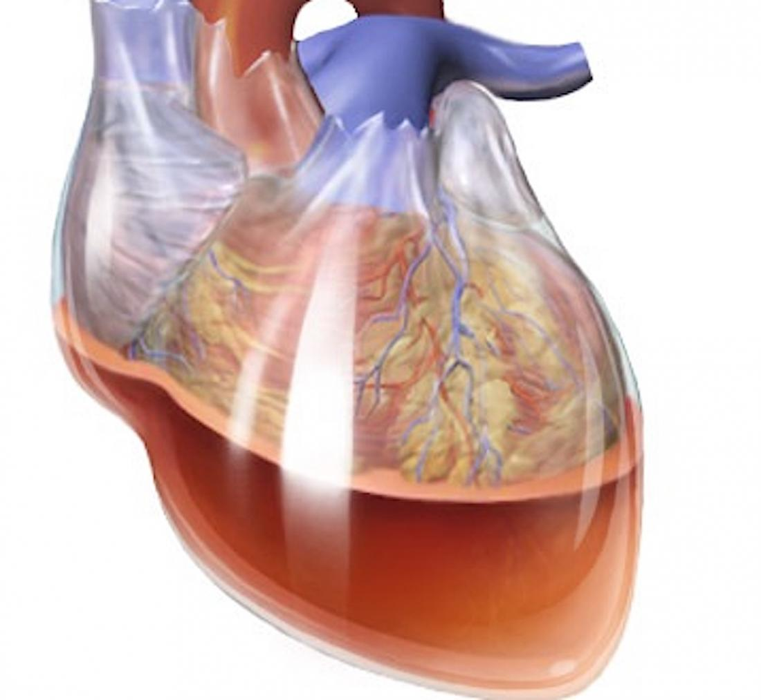
Massive Hemothorax
Pericardial tamponade

Slide 42
It is most commonly the result of penetrating trauma.
Accumulation of a relatively small amount of blood into the non-distensible pericardial sac can produce compression of the heart and obstruction of the venous return, leading to decreased filling of the cardiac chambers during diastole.
All patients with penetrating injury anywhere near the heart plus shock must be considered to have a cardiac injury until proven otherwise.

Slide 43
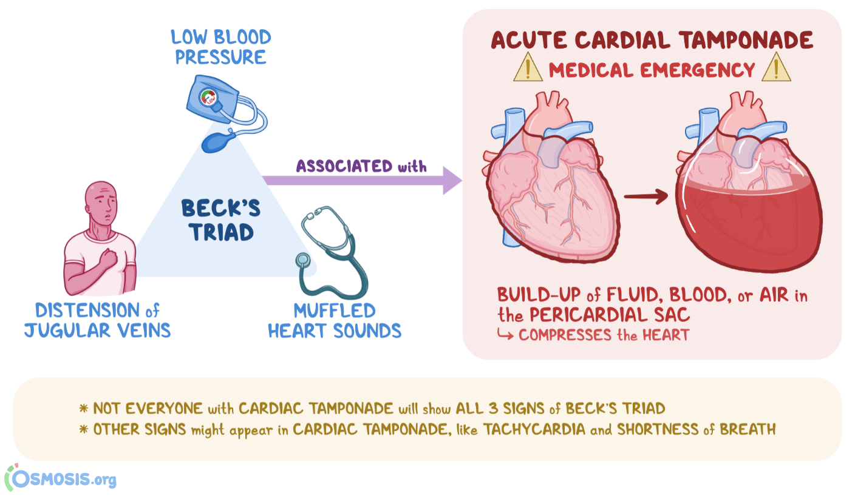
Classically, the presentation consists of
Central venous pressure elevation (as the hemopericardium prevents diastolic filling)
Decline in arterial pressure (as the preload decreases so does the cardiac output)
Tachycardia and muffled heart sounds.

Slide 44
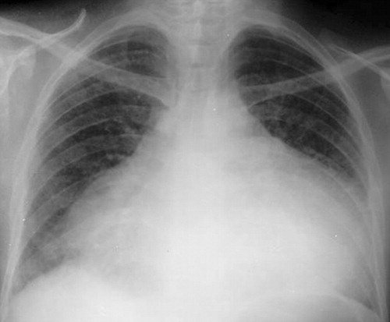
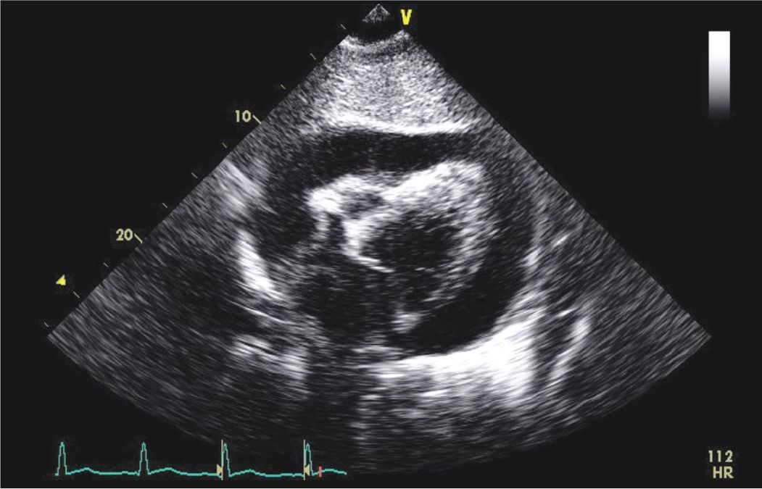
A high index of suspicion and further diagnostic investigations (e.g. chest radiography showing an enlarged heart shadow or a cardiac echo showing fluid in the pericardial sac, and insertion of a central line with a rising central venous pressure) are required for the subclinical case

Slide 45
The correct immediate treatment of tamponade is operative, either via a subxiphoid window, or by open surgery (sternotomy or left thoracotomy), with repair of the heart in the operating theatre if time allows or otherwise in the emergency room
Needle pericardiocentesis has been suggested. However, in penetrating injury to the heart there is usually a substantial clot in the pericardium, which may prevent aspiration. A dry pericardiocentesis proves only that there is a ‘clot’ on both ends of the needle!
Pericardiocentesis has a high potential for iatrogenic injury to the heart and it should, at the most, be regarded as a desperate temporizing measure in a transport situation (under electrocardiogram (ECG) control).

Slide 47
Thoracic aortic disruption

Slide 48
Traumatic aortic rupture is a common cause of sudden death after an automobile accident or fall from a great height. The vessel is relatively fixed distal to the ligamentum arteriosum, just distal to the origin of the left subclavian artery. The shear forces from a sudden impact disrupt the intima and media.
Aortic disruption should be clinically suspected in
patients with gross asymmetry in systolic blood pressure (between the two upper limbs, or between upper and lower limbs)
widened pulse pressure
chest wall contusion.

Slide 49
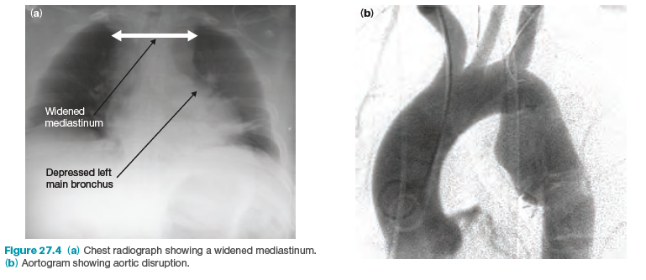
Erect chest radiography can also suggest thoracic aortic disruption, the most common radiological finding being a widened mediastinum
The diagnosis is confirmed by a CT scan of the mediastinum, or possibly by transoesophageal echocardiography, in unstable patients who cannot be moved to the scanner.

Slide 51
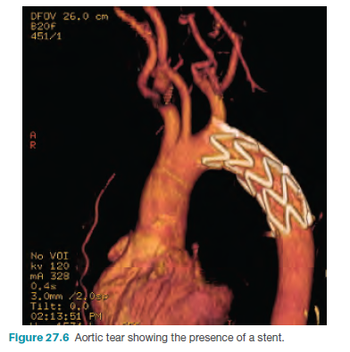
Initially, management consists of control of the systolic arterial blood pressure (to less than 120 mmHg). Thereafter, an endovascular intra-aortic stent can be placed, or the tear can be operatively repaired by direct repair or excision and grafting using a Dacron graft.

Slide 52
Esophageal Rupture

Slide 53
Most esophageal injuries result from penetrating trauma; blunt injury is rare.
The concern with esophageal rupture is the development of mediastinitis and septic shock secondary to invasion of bacteria from the esophagus into the mediastinum and so pleural effusion and pneumothorax may develop, causing pnuemohydrothorax.
Dissection of air from the esophagus through the soft tissues can cause subcutaneous (surgical) or mediastinal emphysema, especially when the cervical esophagus is involved.
The patient can present with: shock, dyspnea, cyanosis and history may reveal the presence of sudden severe epigastric, chest, or lower back pain.
On examination subcutaneous emphysema may be evident which may give rise to crackling sensation over gas containing tissue.
Mediastinal and deep cervical emphysema are evidence of an aerodigestive injury until proven otherwise.

Slide 54
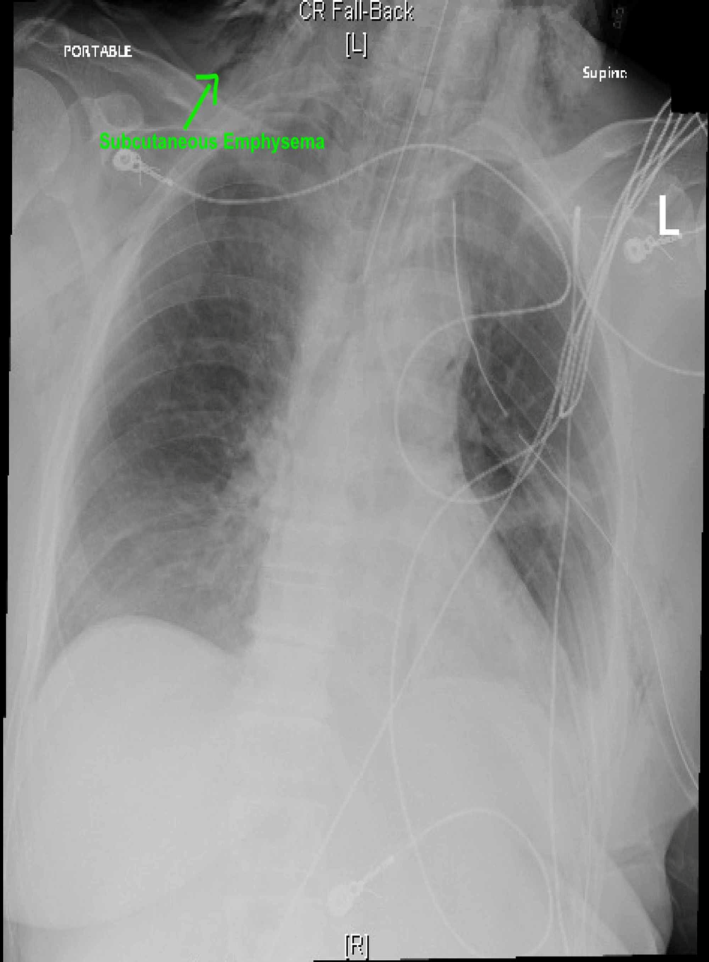

Slide 55
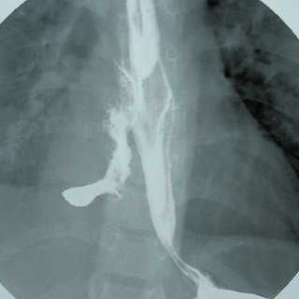
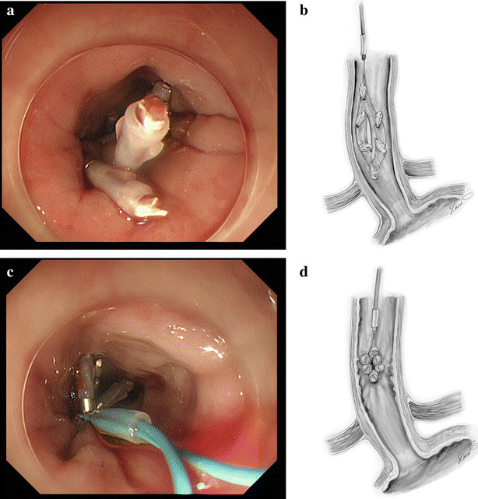
The mortality rate rises exponentially if treatment is delayed.
A combination of esophagogram in the decubitus position and esophagoscopy confirm the diagnosis in the great majority of cases.
Treatment involves resuscitation (the patient should be kept NPO), antibiotics, treatment of pneumothorax and surgical closure of the defect and drainage

Slide 56
Thoracic duct injury

Slide 57
The thoracic duct is the larger of the two lymph ducts of the lymphatic system. It is also known as the left lymphatic duct, alimentary duct, chyliferous duct, and Van Hoorne's canal. The other duct is the right lymphatic duct. The thoracic duct carries chyle, a liquid containing both lymph and emulsified fats, rather than pure lymph. It also collects most of the lymph in the body other than from the right thorax, arm, head, and neck (which are drained by the right lymphatic duct).
The thoracic duct usually starts from the level of the twelfth thoracic vertebrae (T12) and extends to the root of the neck.
It drains into the systemic (blood) circulation at the junction of the left subclavian and internal jugular veins, at the commencement of the brachiocephalic vein

Slide 58
Wounds to the thoracic duct are usually iatrogenic and usually left sided, occurring when lymph node level IV is dissected during a neck dissection.
Usually presented with chylous effusion
A small chylothorax may not cause any symptoms and only be detected on a chest X-ray while large chylothorax may lead to dyspnea caused by fluid restricting the expansion of the lungs, although large chylothoraces may remain asymptomatic
On examination, chylothorax may lead to reduced breath sounds on the affected side, associated with a dull sound on percussion. Rapidly accumulating chylothoraces can cause a sudden drop in blood volume, leading to low blood pressure.
Chest X-rays can detect a chylothorax. It appears as a dense, homogenous area that obscures the costophrenic and cardiophrenic angles.
Ultrasounds can also detect a chylothorax, which appears as an echoic region that is isodense with no septation or loculation. However, neither a normal chest x-ray nor an ultrasound can differentiate a chylothorax from any other type of pleural effusion.

Slide 59
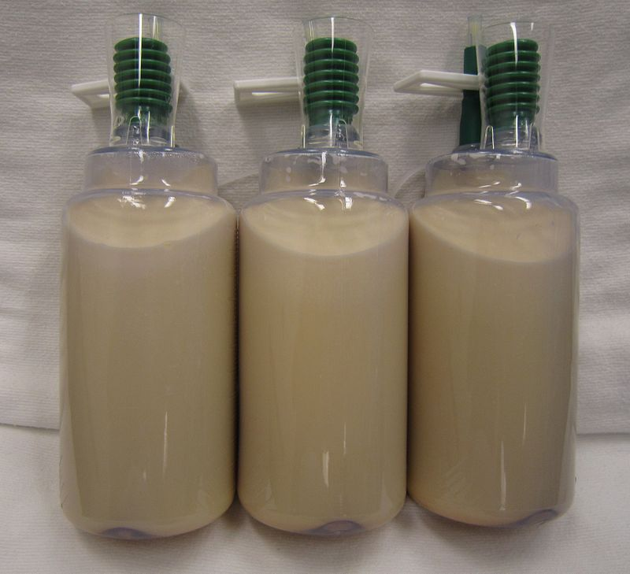
If the damage is recognized during an operation, the proximal end of the duct must be ligated. Ligation of the duct is not harmful because there are a number of anastomotic channels between the lymphatic and venous system in the lower neck and chylous should be aspirated in addition to low fat diet

Slide 60
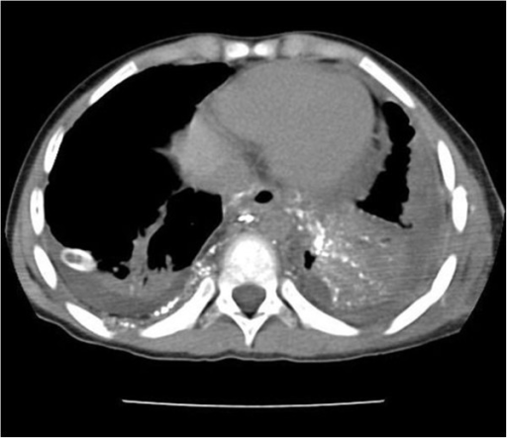
Chest X-ray showing bilateral chylothorax
CT scan showing extensive chylothorax caused by leakage from the thoracic duct

Slide 61
Rib fractures
The chest wall consists of 12 pairs of ribs, the first seven of which articulate both posteriorly with the spine and anteriorly with the sternum .
Ribs 8 to 10 attach anteriorly to the costal cartilage. The lowest two ribs are "floating" and do not connect anteriorly. Immediately below each rib travels its neurovascular bundle, including the intercostal vein, artery, and nerve.
The superior ribs (numbers 1 to 3) are relatively protected by the scapula, clavicle, and soft tissue, while the inferior "floating" ribs are relatively mobile. Therefore, the more vulnerable middle ribs (numbers 4 to 10) are most susceptible to injury from blunt trauma. Fractures of superior ribs reflect trauma involving significant force and the potential for injury to major vessels and lung parenchyma.

Slide 62
Causes
Rib fractures are common injuries that occur most often following blunt thoracic trauma but can also result from severe coughing, athletic activities (eg, rowing, swinging golf clubs), nonaccidental trauma (ie, child abuse), and bone metastases
Most rib fractures are caused by direct trauma to the chest wall. This can occur from blunt (eg, motor vehicle crash) or penetrating (eg, gunshot) trauma. Both displaced and nondisplaced fractures can be seen in adults and children . Due to the greater pliability of children's ribs, greater force is required to produce a fracture.
Rib fractures may be pathologic. Cancers that metastasize to bone (eg, prostate, breast, renal) frequently become apparent in a rib. Ribs are relatively thin compared with major long bones and are more likely to fracture when invaded by a metastatic lesion.
In the absence of significant trauma (eg, motor vehicle collision), rib fractures in infants are extremely uncommon. Clinicians must investigate possible nonaccidental trauma (ie, child abuse) when such fractures are discovered. Ribs can sustain stress fractures from repetitive minor trauma . Stress fractures may be seen in patients with a chronic cough.

Slide 63
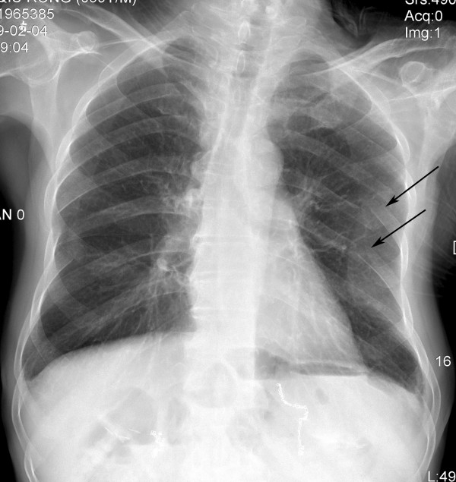
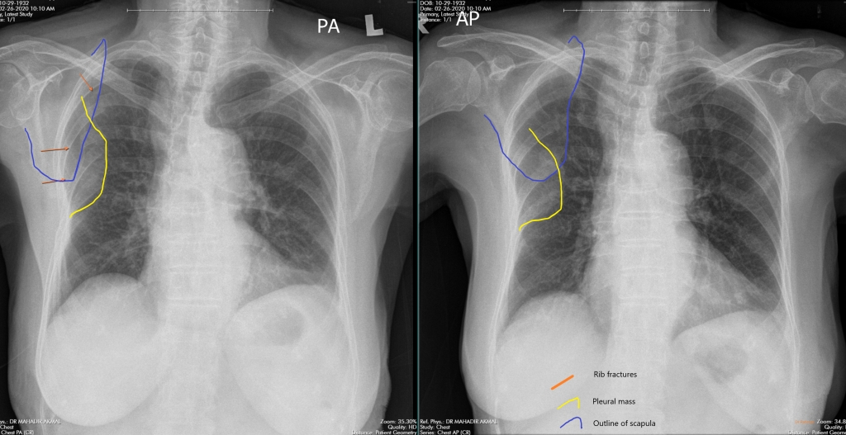
Standard l (PA) and lateral chest radiographs are adequate to identify most rib fractures. If these studies cannot be readily obtained, a simple (AP) chest radiograph can provide useful information. Ultrasound may be useful for diagnosis of rib fractures and potential complications (eg, pneumothorax). A skeletal survey should be obtained in infants suspected of being abused. Findings consistent with abuse include the presence of multiple rib fractures in various stages of healing

Slide 64
Assosiation
Intrathoracic injury — Pneumothorax, hemothorax, and pulmonary contusion are common in patients with multiple rib fractures. Hemothorax and pneumothorax are usually apparent upon initial presentation; however, delayed hemothorax or pneumothorax can occu
Sternal fracture — Sternal fracture may accompany rib fractures when there is an anterior blow to the chest, such as an impact with the steering wheel in a motor vehicle collision. A palpable sternal step-off may be appreciated. In one study, sternal fracture occurred in 7 percent of patients with flail chest. The presence of a sternal fracture should raise concern for blunt cardiac injury, and appropriate workup should be initiated
Intra-abdominal injury — The spleen and liver are the most commonly injured intra-abdominal organs following blunt trauma, occurring in 2 to 4 percent of patients. Fractures of the right lower ribs lead to hepatic injury, fractures of the left lower ribs to splenic injury, and fractures of the posterior portion of the lower ribs can cause renal injury
Head injuy
Upper extremity fracture

Slide 65
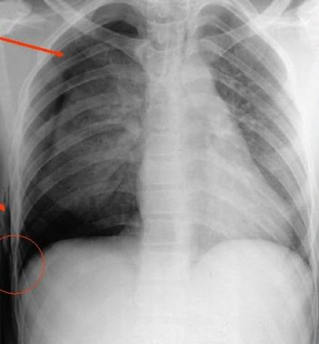
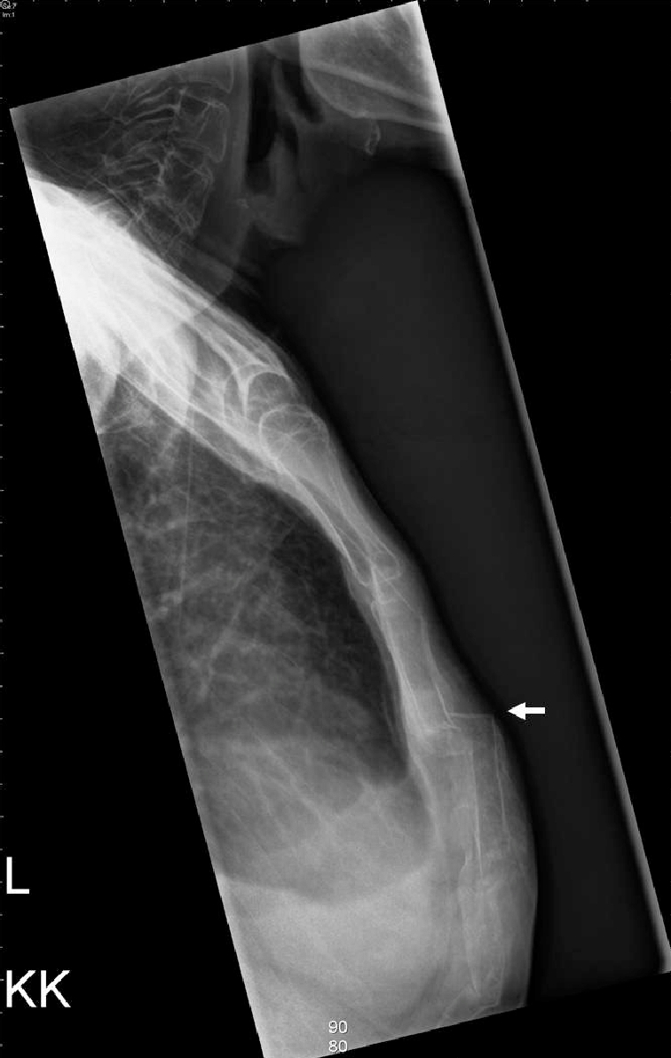

Slide 66
Complications of traumatic rib fractures include pneumonia (most common), retained hemothorax or empyema, respiratory failure requiring intubation, and fracture nonunion, which can lead to chronic pain and disability. In a review of the National Trauma Data Bank, 59 percent of patients admitted with a flail chest required mechanical ventilation, with a mean duration of 12.1 days and with 54 percent having an associated pulmonary contusion . In-hospital complications included pneumonia in 21 percent, acute respiratory distress syndrome (ARDS) in 14 percent, and sepsis in 7 percent. Death occurred in 16 percent

Slide 67
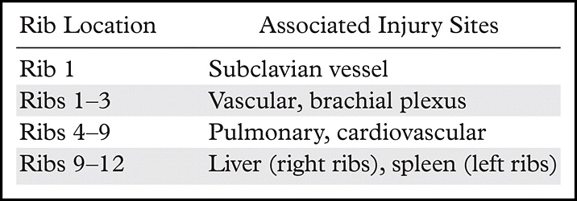
Rib fractures
Emergency department (ED) evaluation is needed when rib fractures are accompanied by other major injuries (such as pneumothorax, liver or spleen lacerations, and cardiac or pulmonary contusions), or when such injuries are suspected. Multiple rib fractures correlate more closely with serious intrathoracic and intraabdominal injuries. Fractures of superior ribs (numbers 1 to 3) reflect trauma involving significant force and the potential for injury to major blood vessels and lung parenchyma. Displaced fractures increase the risk of internal injury and delayed bleeding and generally warrant admission.
●We suggest hospitalization for patients with three or more rib fractures in nearly all cases, but a more conservative threshold for admission is appropriate in many cases, particularly in older or frail adults and those at increased risk for pulmonary complications.
●Treatment of rib fractures should be focused on early and adequate pain relief to avoid complications from splinting and atelectasis, primarily pneumonia. To provide analgesia, clinicians most often use nonsteroidal antiinflammatory drugs (NSAIDs) , epidural analgesia with or without opioids. Intercostal nerve blocks are another effective approach for some patients
●Rib stress fractures are treated similarly to other low-risk stress fractures. Treatment begins with restriction of the inciting activity for four to six weeks, followed by a gradual return to the activity as tolerated.
●Virtually all rib fractures heal well with conservative management. Follow-up chest radiographs are unnecessary, unless indicated by clinical symptoms (eg, new shortness of breath)

Slide 68
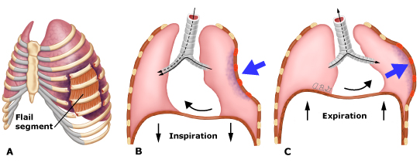
Flail chest
Flail chest — Flail chest (ie, "stoved-in" chest, crushed chest) is defined as fractures of three or more ribs in two or more places, which create a floating segment that loses its mechanical continuity with the remainder of the chest wall. Sternal flail occurs when the sternum becomes dissociated from the hemithoraces because of bilateral, multiple, anterior cartilage, or rib fractures. Sternal fracture may also accompany rib fractures.
Flail chest occurs in 5 to 13 percent of patients with chest wall injury.
Flail chest is most commonly due to a blunt mechanism of injury whereby significant force is imparted on the chest. Such scenarios can include a motor vehicle collision where the chest strikes the steering wheel, an automobile accident with a pedestrian or bicyclist, a fall from a height onto the chest, an ejection from a motor vehicle or motorcycle, or an assault with a blunt weapon such as a baseball bat. Although less common, flail chest following penetrating trauma (eg, shotgun blast) has been reported . Because of the severe injury mechanisms associated with flail chest, pulmonary contusion is much more common compared with multiple rib fractures without flail, and these patients have a high risk for acute respiratory failure .
Flail chest is clinically diagnosed by the observation of paradoxical motion of the chest wall with respiration. Paradoxical chest wall motion arises from the effect of negative pleural forces acting upon the detached segment. The rib cage normally expands upward and outward during inspiration as the diaphragm contracts and flattens, creating the negative intrathoracic pressure necessary to expand the lungs. With flail chest, the detached segment of the chest wall is pulled into the chest cavity during inspiration and pushed outward during expiration. This abnormal motion increases the work of breathing, compromises respiratory function, and may necessitate intubation and ventilatory support.
A flail chest can be missed early in the clinical course because muscle splinting can conceal motion of the involved segment of ribs. It may also be difficult to diagnose in patients who require immediate mechanical ventilation because ventilatory support may minimize paradoxical chest wall motion.

Slide 69
Triage and disposition — An increasing number of rib fractures are clearly associated with increased morbidity and mortality. As such, we recommend the following regarding triage and disposition of the patient:
●For limited, isolated traumatic rib injuries (<3 fractures, no associated injuries), outpatient management with oral analgesics and incentive spirometry may suffice.
●The presence of ≥3 rib fractures suggests the need for hospitalization or transfer to a regional trauma facility.
●Hospital admission should be considered for any older adult patient (>65 years) because of their comorbidities and increased risk for complications related to rib fractures.
●Depending upon the number of rib fractures, the nature and severity of associated injuries, and the nature of medical comorbidities, the patient may be cared for in a monitored unit or intensive care unit. Level of pain, oxygenation and ventilation, and respiratory parameters (eg, incentive spirometry volume) are followed closely with continuous pulse oximetry.

Slide 70
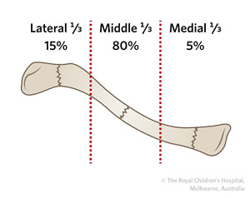
clavicle fracture, also known as a broken collarbone ,it is common because superfacial located.
Pain, sharp pain particularly with arm movement or on the front part of upper chest,
Swelling Often, after the swelling has subsided, the fracture can be felt through the skin.
Referred pain: dull to extreme ache in and around clavicle area, including surrounding muscles
Possible nausea, dizziness, and/or spotty vision due to extreme pain

Slide 71
Cause : Fall onto a shoulder, outstretched arm, or direct trauma
Complications : Pneumothorax, injury to the nerves or blood vessels in the area, unpleasant appearance
Nearly all clavicular fractures can be managed without surgery. Primary treatment consists of immobilization with a figure-of-eight dressing or bandage ( brace : cross between scapula ), clavicle strap, or sling.
Spontineus healing

Slide 72
Surgery is considered when one or more of the following conditions presents:
Comminution with separation (bone is broken into multiple pieces)
Skin penetration (open fracture)
Associated nervous and vascular trauma (brachial plexus or supraclavicular nerves)
Nonunion after several months (3–6 months, typically)
Displaced distal third fractures (high risk of nonunion)
Although shortening (as a result of overlap of fracture ends) has often been suggested as an indication for surgery, a review found that people treated without surgery for shortening of mid shaft clavicle fractures did not affect outcomes
Healing time varies based on age, health, complexity, and location of the break, as well as the bone displacement
Up to five months for complete healing

Slide 73
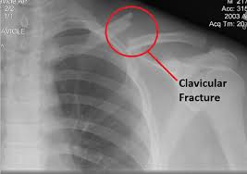
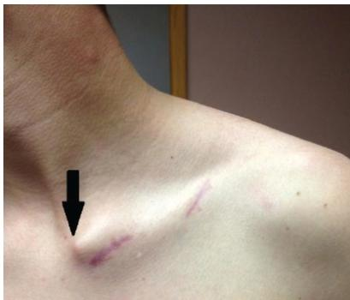

Slide 75
Diaphragmatic injury
The left hemidiaphragm is involved in 65% to 80% of cases.
Blunt > Penetrating
These injuries do not heal spontaneously and can produce herniation ,so need operative repair when diagnosed
Diagnosis can be difficult; therefore, have a high index of suspicion based on mechanism.
Rapid deceleration or direct crush to the upper abdomen
Severe chest trauma, lower rib fractures
Penetrating injuries to the chest and upper abdomen.

Slide 76
CXR is diagnostic in only 25% to 50% of cases of blunt trauma.
Possible findings include:
Hemidiaphragmatic elevation.
Stomach, colon, or small bowel in chest.
CT scan may miss diaphragmatic injury in the absence of gross hollow visceral herniation.
Direct visualization of the injury by laparotomy, laparoscopy, or thoracoscopy remains the gold standard for diagnosis.

Slide 77
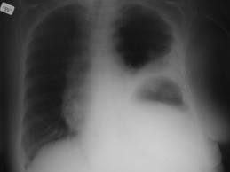

Slide 78
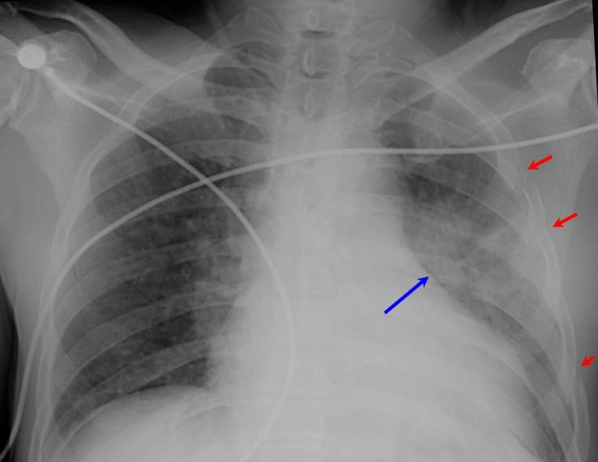
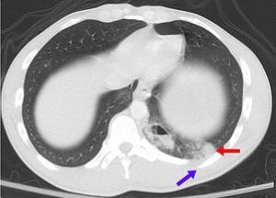
Pulmonary contusion :Haemorrhage into the alveolar and interstitial spaces.
Pulmonary contusion is a bruise of the lung, caused by chest trauma.
Pulmonary laceration is a chest injury in which lung tissue is torn or cut. An injury that is potentially more serious than pulmonary contusion, pulmonary laceration involves disruption of the architecture of the lung.
Dx :by CXR
Tx: Can often be treated with just supplemental oxygen, ventilation, and drainage of fluids from the chest cavity

Slide 79
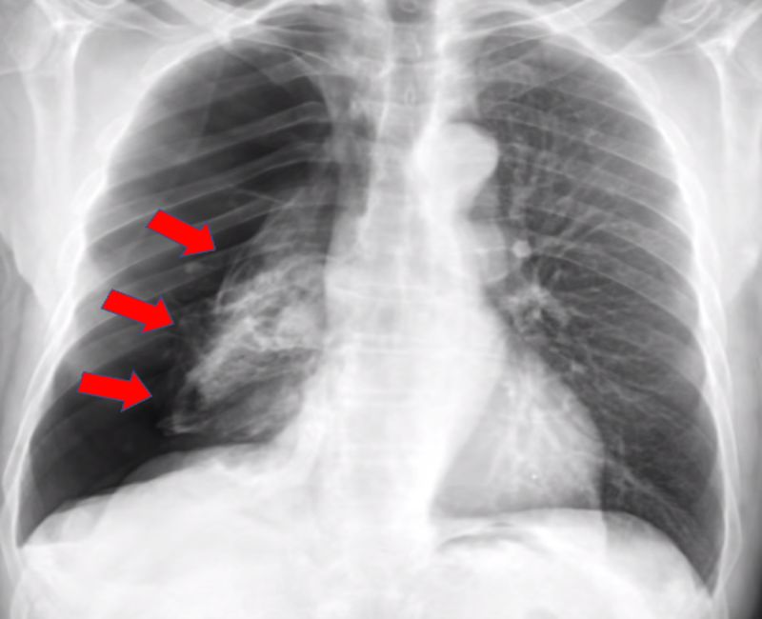
Treacheobronchial Trauma
Mechanisms :
Linear rupture of the membranous portion of trachea.
Disruption of trachea at point of fixation.
Carina and cricoid – shariong forces and rapid deceleration.
3) Laceration or transection of trachea near the carina.
Diagnosis:
Subcutaneous emphysema.
Dyspne.
Dysphonia.
Haemoptysis.
CXR – Fallen Lung Sign.

Slide 80
Complications
Empyema.
Clotted Haemothorax.
Bronchopleural fistula.
Bronchial stenosis.
Chylothorax.

