Slide 1
obs and gyna archive 7/5/2024
done by : khozama saadah

Slide 2
Q1. G3P0+2 /GA :8Weeks presented with mild vaginal bleeding
1)Relevant hx
2) name of us finding ( anembryonic gestational sac )
3) if bleeding increased +abdominal pain+ open cervix :
a. Diagnosis
b. Managment
4)If she came to the clinic after 6 weeks . what investigations you would order

Slide 3
Q2. G2p1 previous delivery by cs / GA : 33 came to clinic with vaginal spotting
1)diagnosis
2) Relivant points in hx
3 )If this is her first visit what investigation you should ask for
4) if she come after that with mild bleeding ,managment?

Slide 4
Q3. Case of abnormal uterine bleeding 35 age woman Married for 3 years nulliparous
1. Indication for perfoming hysteroscopy
2.if she complains of delayed pregnancy. What would you chek for in hysterscopy
3. Diagnosis : fibroid
4. Tx : myomectomy
5. Complications of the procedures perfomed in Q3?

Slide 5
Q4. 23 years old (GA:10) (G2 P1) HX of DVT in previous pregnancy / labs : (Hb=9 / WBC :15000 / reticulocytes count :6% Hb S was detected in electrophoresis
1. Diagnosis
2. Complications on the mother and fetus?
3. Other labs you would ask for?
4. Managment?
5. The best contraception method to be used

Slide 6
5. A patient came to the clinic one month after inserting IUD. LMP: before one month . US was perfomed
1. What is the indication to do TVUS for this patiet
2. The finding in US
3.What are the risk factors for your diagnosis
4. The best contraception method to be used in the future for her case?

Slide 7
Q6.16 years old come to the clinic with her mother complaining she didn't have any menstrual bleeding in her life , please answer the questions below and use the figure when it is required
1.Points to ask in history
2. 4 DDx
3.According to the figure , what is your diagnosis
4.Other complaints the patient will come with
5. What will happen to FSH levels in her case
6.Management

Slide 8
OBS and GYNE Mini osce 7/3/2024
Malak hamasha

Slide 9
Hx : 40 y female, para5 , complain of heavy menstrual bleeding and dysmenorrhea
MRI pictures
1. Questions would ask it about her cycle ?
Frequency, duration, severity ,
2. Other investigation you do it for this patient ?
Transvaginal ultrasound / CBC /
3. Your diagnosis ?
Adenomyosis
4. From history what the risk factor that will help you in your diagnosis ?
Multipara
5. Conservative management ?
NSAID / OCP / mirina / progestins
6. What your management if conservative treatment failed ?
Hysterectomy

Slide 10
Urodynamic study for some women :
What the name of test ?
Uroflowmetry
2. What the points (A/B/C) and the normal volume of them ?
A : flow time (20-30 seconds )
B : flow rate ( 15ml/sec )
C : urine volume (400-600 cc)
3. What this shape indicate ?
Normal bell shape
4. What other volume you measure it after voiding and its value ?
Residual urine volume (>50 cc)
5. If she came with third stage prolapse , what the changes you see it in the graph ?
It will cause obstructive so more flow time /intermittent / increase urine flow
What are the obstetric complication related to this ?
Macrosomia/ prolonged second stage of labour
C
B
A

Slide 11
What are the presentation in first picture and the dominator ?
Longitudinal breach , sacrum is the dominator
2. What this maneuver called ?
External cephalic version
3. What you find in your examination in first picture ?
-hard part at fundus
-soft buttock in pelvic inlet
-heart auscultate above umbullicus
4. What are the conditions that prevent us to do this maneuver ?
-placenta Previa -rupture of membrane –oligohydramnios
5. Management of last picture ?
Can delivery vaginally

Slide 12
Old age women , menopause for 2 years , complain of bleeding
TVUS
What this picture indicate ?
Increased endometrial thickness
2. Differential diagnosis ?
-endometrial hyperplasia -endometrial cancer
-fibroid - adenomyosis
3. What are the drugs that women may be took and cause this ?
-hormones replacement therapy
-tamoxifen - anti-coagulant
4. Definitive diagnosis by ?
Hysteroscopy and biopsy

Slide 13
What are these points
A: myometrium
B: endometrium with unseparated placenta
2. The diagnosis and most common cause of this condition ?
Uterine inversion caused by uncontrolled cord traction
3. What are the symptoms of patient ?
-severe vaginal bleeding -sever abdominal pain
4. What you find in examination ?
-hypotension - tachycardia
-absence of uterine fundus in abdomen
-smooth round uterus outside vagina
5. Management ?
Resuscitate the patient and immediately bimanual return of uterus
B
A

Slide 14
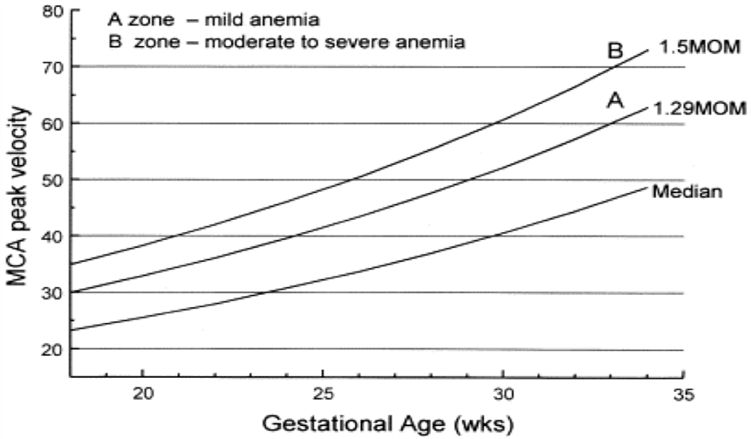
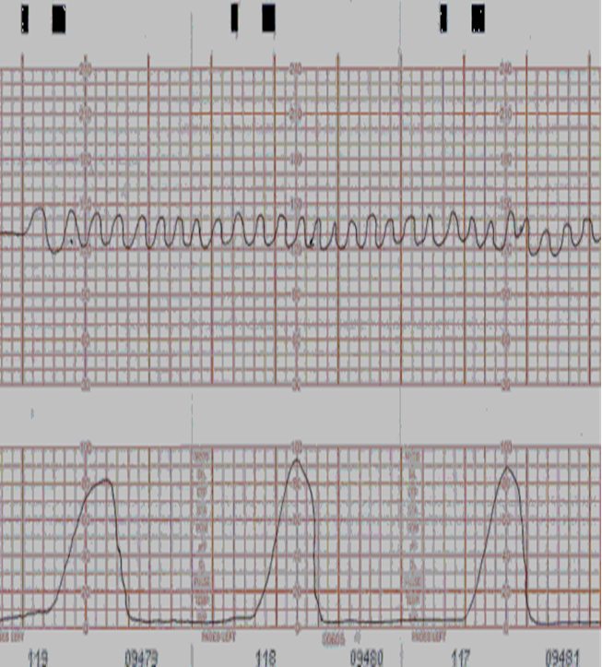
Rh negative women with Rh positive father , second pregnancy the antibodies titer was 1/16
A
1.Diagnosis ? Rh alloisoimmunization
2. What would ask the women in history ?
In picture A , what the vessel that used for checking ?
-middle cerebral artery velocity
What the normal level ?
>1.29 MOM
In picture B , your interpretation ?
MCA <1.5 so sever fetal anemia
Management ? Intrauterine blood transfusion
In picture C , what is this pattern ?
sinusoidal pattern and its associate with sever fetal anemia
x
B
C

Slide 15
OSCE station

Slide 16
History : women pregnant in 10 week GA ,on examination the uterus between symphysis pubis and umbilicus
What the wrong things related to history ?
Large for date uterus
2.Give me 3 differentials ?
Wrong date /multiple gestation/molar pregnancy
3. Other investigation and what you look for ?
US /B-hCG
4. other questions asked by examiner

Slide 17
Couple trying to have baby since 2 years , the male sperm analysis is normal
What would you ask in history ?
Investigations ?
If PCOS what treatment
Asked by examiners

Slide 18
OB&GYN archive 26/12/2023

Slide 19
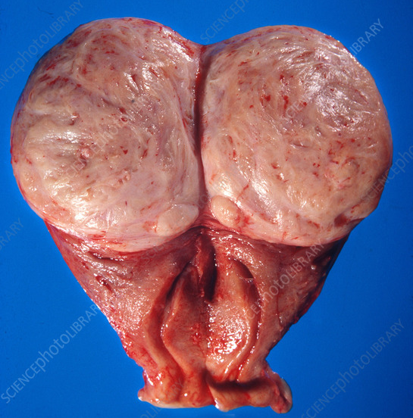
1st station: a 45-year-old woman G3P3 underwent a hysterectomy due to heavy menstrual bleeding, the following picture shows the uterus.
1. If her only complaint is heavy menstrual bleeding how would you describe her period?
Regular, normal frequency, prolonged duration, heavy volume
2. Name the lesion
Intramural leiomyoma
3. Primary investigation
Ultrasound
4. Protective factor in history
Multiparity
5. Less invasive treatment modalities
Myomectomy, uterine artery embolization or medical treatment like Mirena

Slide 20
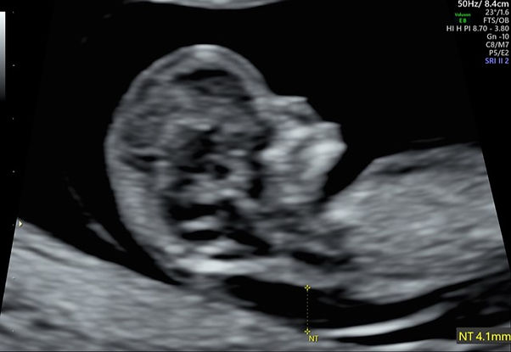
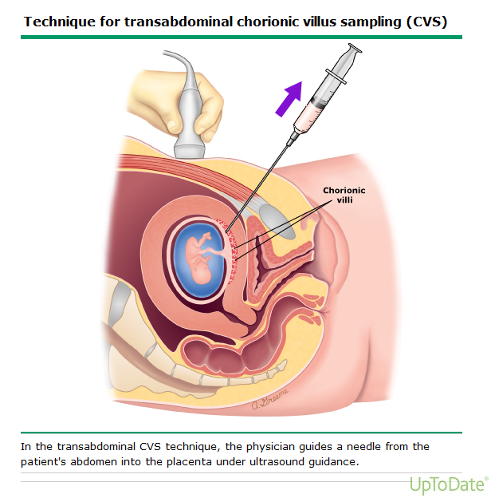
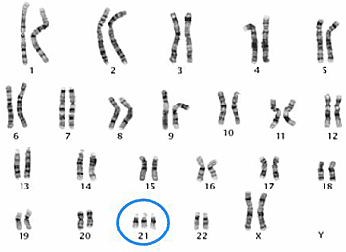
2nd station: a 12 week pregnant woman came to the clinic because she is worried that her baby might have congenital anomalies, she did the following tests
Look at image A What are the features shown? And their significance
Absent nasal bone
Increased nuchal translucency
Significance: soft markers that mean increased risk of fetal aneuploidy
2. Other tests that can be used at this stage
Bhcg and PAPP-A
Regarding Image b
3. what is the test called?
Transabdominal chorionic villous sampling
4. How can it be used to be helpful for the mother?
The collected sample can be karyotyped to diagnose and confirm aneuploidy
5. Complications of this procedure (only 2)
Infection, fetomaternal hemorrhage, rupture of membranes, bleeding, fetal loss, contamination
6. Image c shows 21 trisomy, later on, what other findings can be found on ultrasound?
Nuchal fold, congenital heart defects, short long bones (humerus, femur) duodenal atresia (double bubble sign)

Slide 21
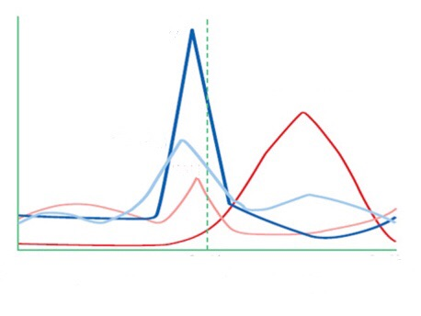
3rd station, look at the diagram and answer the following questions
Name the labelled lines
A: LH B: Estrogen C: FSH D: Progesterone
E: follicular phase F: ovulation G: luteal phase
2. What is the source of hormones?
A and C: anterior pituitary
B and D: Ovary
3. Between E and G, what phase is more constant?
G
4. On what cells does each hormone act on
A: theca cells
B: granulosa cells
5. Give 3 tests to confirm ovulation
Basal body temperature, serum progesterone measurement, urinary LH measurement
A
D
C
B
E
F
G

Slide 22
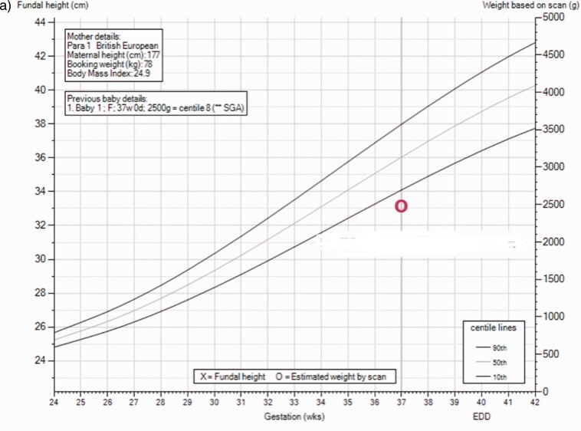
4th station: a woman came to the clinic at 34 w
Regarding image A (image shows 29 cm)
What is the name of this part of physical examination?
- symphyseal fundal height
2. What is your interpretation?
Small for gestational age (date-height discrepancy)
3. Other findings on obstetric examination?
Determine fetal lie, presentation and engagement
4. Mention 4 causes of this finding
Wrong date, oligohydramnios, IUGR, IUFD, preeclampsia
Regarding image B
5. What is your interpretation?
Small for gestational age
6. What is your management?
Follow-up by serial ultrasound to determine growth velocity, and serial BPP, weekly doppler velocimetry

Slide 23
5th station: a case of a woman who wishes to use a contraceptive that is long-term and reversible, and she suffers from heavy menstrual bleeding and dysmenorrhea
Mention 2 long term contraceptives
Intrauterine device (copper or mirena), Implanon, depo-povera
Which contraceptive is best for her, and justify your answer
Mirena, because the progesterone in it opposes the estrogen and decreases the heavy menstrual bleeding
4 side effects of the contraceptive you chose
Amenorrhea, irregular bleeding, PMS-like symptoms, infection
Mechanism of action of the contraceptive
Thickens cervical mucus, thins endometrium, local inflammatory reaction

Slide 24
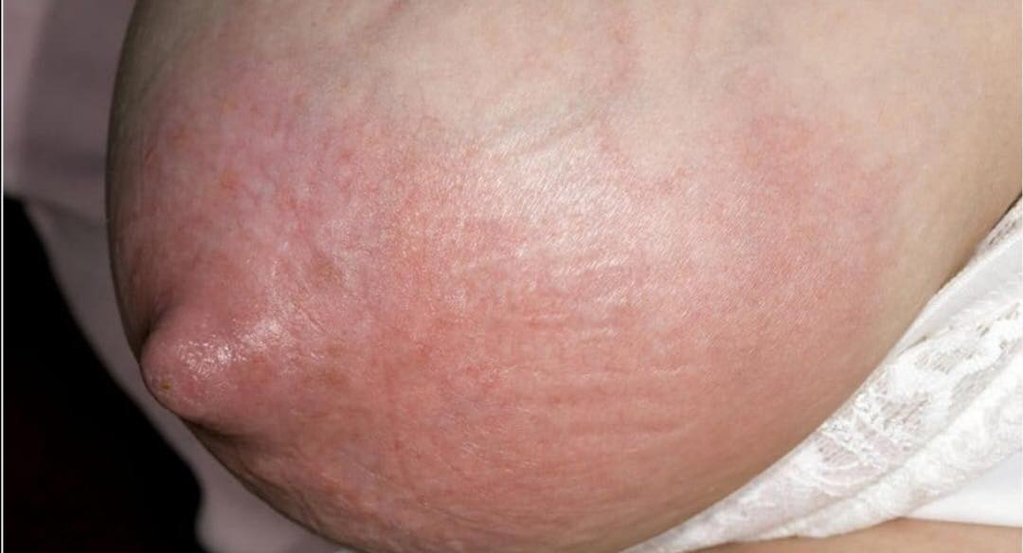
6th station: a woman came to the ER due to painful breasts, she delivered vaginally 4 days ago
What is the diagnosis?
Mastitis
What are 2 relevant points you should ask in history?
Breastfeeding, fever
Findings in physical examination that would confirm your diagnosis?
Unilateral edema, erythema and tenderness, area feels firm and hot
2 points to look for in abdominal and pelvic examination
Uterus position, look for abdominal or pelvic masses
What is the most likely cause?
Accumulation of milk, growth of staph aureus
If she wants to continue breastfeeding, what would you advise her?
Encourage her to continue breastfeeding, massage the breast or put warm compresses, analgesia, increase feeding frequency

Slide 25
OSCE stations
1st station: postpartum hemorrhage after precipitous vaginal delivery of a 4.2 kg baby
What is the condition called: primary postpartum hemorrhage
What questions would you ask the midwife to establish etiology
Investigations
Management (for a group it was uterine atony and for another group it was vaginal tear)
2nd station: a 17-year-old girl came with her mother due to delay in menstruation onset
What is this condition called
Relevant points in history
Relevant points in physical examination
Diagnosis (for a group everything was normal so most likely mullerian agenesis and for another group there was no breast development so most likely turner)

Slide 26
Gynecology & Obstetric

Slide 27
Q1) صورة بارتوجرام واحنا نعبي عليها المعلومات من خلال الهيستوري…السؤال طويل شوي لكنه واضح وسهل *

Slide 28
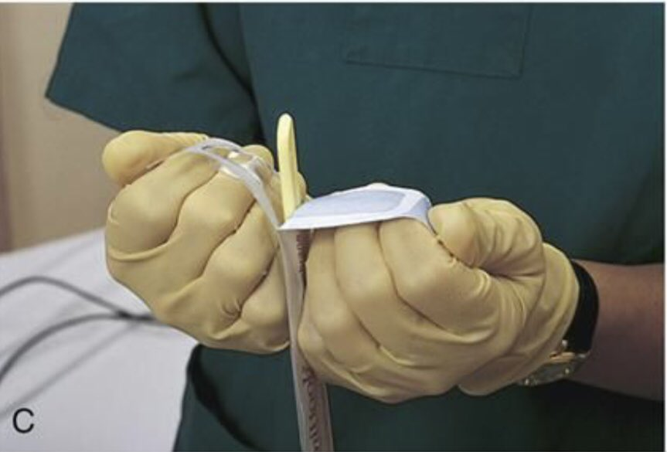
Q2) a-what is the name of this device? b-name of the procedure? C-4 advantage for this procedure? d)if the amniotic index was 29 and on rule of 5 was 5/5 what well happen if you use this instrument? E)if the patient had previous one C/S can you use this instrument and why? *

Slide 29
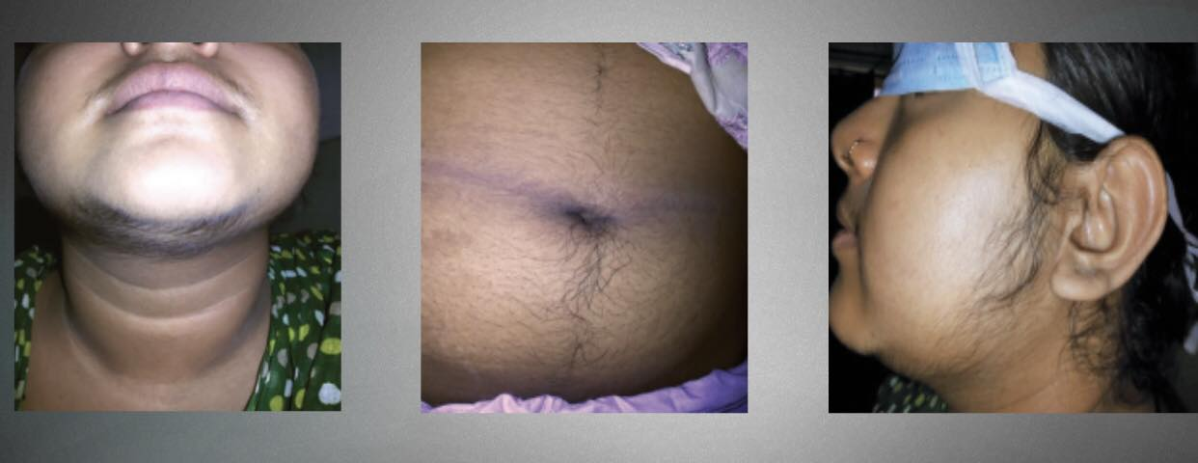
Q3)19 years old female complaining of hairsutism,acne: a-give 2 questions you will ask her in history b-give to finding you will see in P/E C-investigation to this patient d-if there is ultrasound findings of 12 follicles with normal total testosterone level what is you’re diagnosis? e- If it PCOS what is you’re management? **

Slide 30
Q4)a 70 years old female patient complaining of mass protrusion from her vagina with cytometry image: a- what are the findings in cystometry? b-what is the probable diagnosis and what the cause of it c-what is the pelvic floor problem in this patient? d- give other symptoms the patient may complain e) fill this table

Slide 31
Q5)female patient came with abdominal contractions pain, GA 32, a-what is the name of this test? b-reflect for what? c-if the reading was 22.000 what is the name of the result d-what is the next step? e-if there is gush of fluid what is youre probable diagnosis? f-how you will diagnose PPROM clinically? g-what is you’re management? *

Slide 32
Q6) a 7 years old female patient came for vaginal bleeding for 4days, no acne or hairsutism ☹image with secondary sexual finding) a-what is the diagnosis (precocious puberty) b-investigation c-what is the most common type of this diagnosis d-suppose all investigations are normal what is the probable diagnosis? E)what is you’re management

Slide 33
Gynecology & Obstetric
29/8/2023

Slide 34
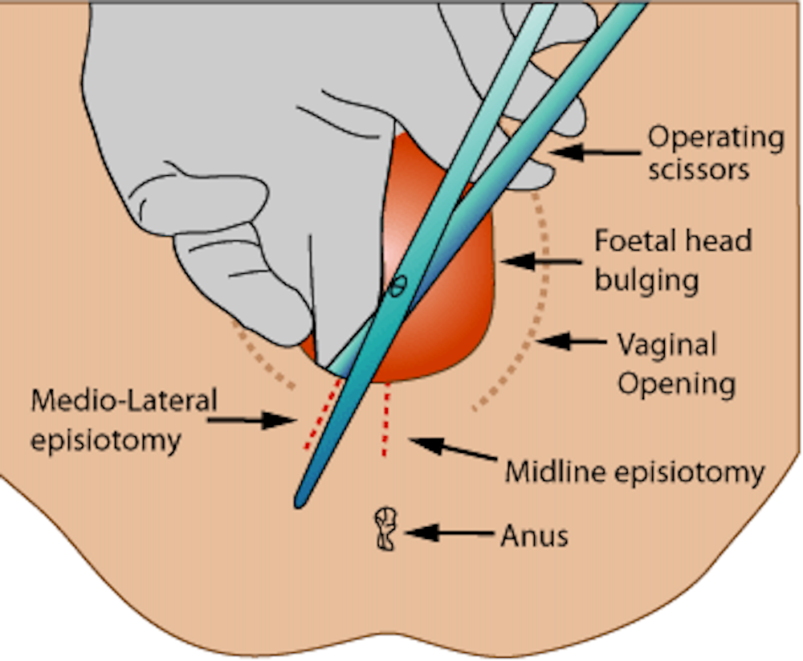
Station 1
1. What is the procedure and type ? 2. Instruments used 3. If she complain after 3 hours of perineal pain what do u think the cause? 4. How to confirm? 5. Mangment

Slide 35
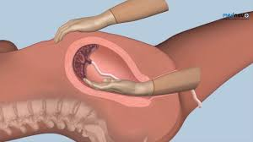
Station 2
1.what is this, indication?
2. Complication?
3.the patient come after 3 days, complaining from fever what do you think the most common cause of her complaint?
4.Managment

Slide 36
Station 3
33 female, para 1 by ovarian stimulation,( cs before 5 years) , infrequent cycle, hairstusim, DM 1. What are the cause of infrequent cycle in general? 2. What is the diagnosis in this case? 3. Investigation? 4. Mangment? 5. If she came with vaginal sottig what is the mangment?

Slide 37
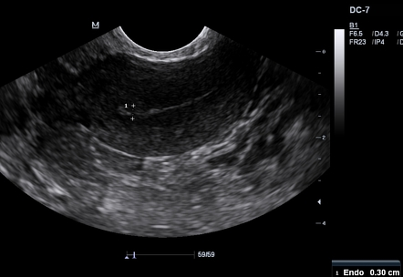
Station 4
57 female, menopause 2 years, complain of vaginal spotting 1. What will you ask in histroy? 2.examination? 3. If tests unmarkable what is the most cause? 4.How to confirm your diagnosis?
Thickness <2mm

Slide 38
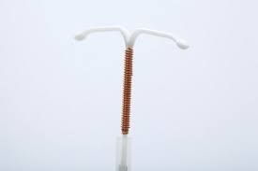
Station5
1. What is this 2. Prequset 3. Complication 4. If she get pregnant with iucd what is the mangment?

Slide 39
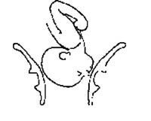
Station 6
1. What is the presentation? 2.Diameter and it's name
3.finding in examination 4. If she is -2 station with 5cm dilatation and after 6hours she still like that what do you think the cause is ? 5. How would you deliver her?

Slide 40
Osce
27 year old married woman G4P0+4 come to clinic my to explore the cause in US the uterus is normal What is the name of this case ? What is the possible causes? What are the relevant questions in history? “”””””””””””””in examination? What is the investigation if the cause is antiphospholiped syndrom ? What are the treatments?

Slide 41
37 year old married woman G4P2+1 the GA37 week CC decrase fetal movement In US absent fetal heart In examination fundal high is 32 What the relevant question in history “””””””””in examination ? Most common causes? Investigation ? Management? (Medical and surgical)

Slide 42
37years old recurrent miscarrage para zero +4 1.cause of miscarrage in general? 2.most common cause with this case? 3.management 4.investigation

Slide 43
RTA, Admitted via ER, 26 Years old, GA34 week, abdominal pain. 1.what the relevant question in history? 2.physical examination finding? 3.CTG For fetus»* baseline heart rate *variability 4. managment?

Slide 44
2 previous second trimester miscarrage. one preterm labor
1.what is the most likely cause?
2.what is the relievant point in history and examination
3.investigation
4.managment

