Slide 1
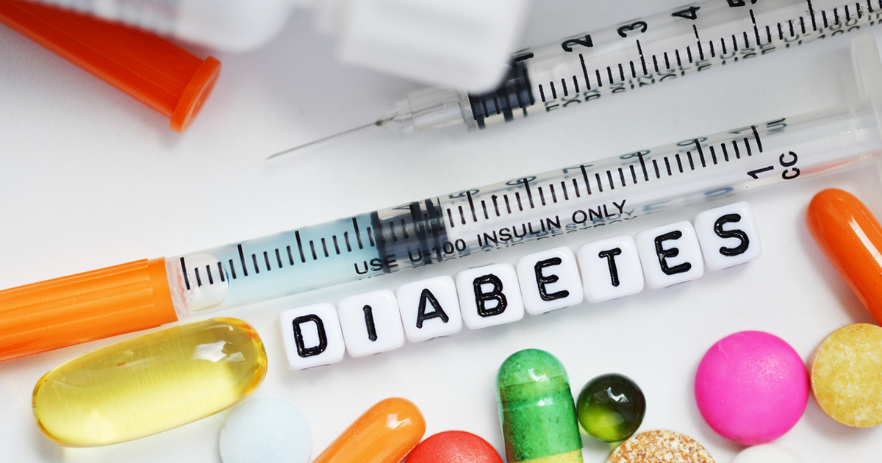
Diabetes. Community health
Dr. Israa Al-Rawashdeh MD,MPH,PhD
Faculty of Medicine
Mutah University
2020

Slide 2
Definition
The term diabetes describes a group of metabolic disorders characterized and identified by the presence of hyperglycaemia in the absence of treatment. The heterogeneous aetio-pathology includes defects in insulin secretion, insulin action, or both, and disturbances of carbohydrate, fat and protein metabolism (WHO, 2019).

Slide 3
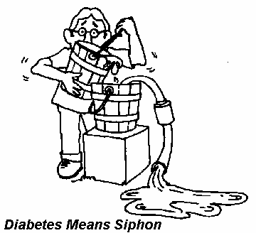
Historical background
Diabetes mellitus is derived from the Greek word diabetes meaning siphon - to pass through and the Latin word mellitus meaning honeyed or sweet.
Diabetes has been known about for many centuries. As early as the 5th century AD descriptions of diabetes mentioned two forms, one in older, fatter people and the other in thinner people with short survival.

Slide 4
Epidemiology and global burden of diabetes
Diabetes is found in every population in the world and in all regions.
The number of people with diabetes is steadily rising, with WHO estimating there were 422 million people and 1.6 million deaths are directly attributed to diabetes each year.
The age-adjusted prevalence in adults is 8.5% in 2014, with the greatest rise in low- and middle-income countries compared to high-income countries.
In addition, the International Diabetes Federation (IDF) estimates that 1.1 million children and adolescents aged 14–19 years have T1DM.
High blood glucose causes almost 4 million deaths each year.
Almost half of all deaths attributable to high blood glucose occur before the age of 70 years. WHO estimates that diabetes was the seventh leading cause of death in 2016.

Slide 5
Epidemiology and global burden of diabetes
The rising prevalence of T2DM is associated with rapid cultural and social changes, ageing populations, increasing urbanization, dietary changes, reduced physical activity and other unhealthy lifestyle and behavioural patterns.

Slide 6
Epidemiology and global burden of diabetes
One in two (50.1%) people living with diabetes do not know that they have diabetes.
IDF estimates that the annual global health care spending on diabetes among adults was US$ 850 billion in 2017.
The effects of diabetes extend beyond the individual to affect their families and whole societies. It has broad socio-economic consequences and threatens national productivity and economies, especially in low- and middle-income countries where diabetes is often accompanied by other diseases.

Slide 7
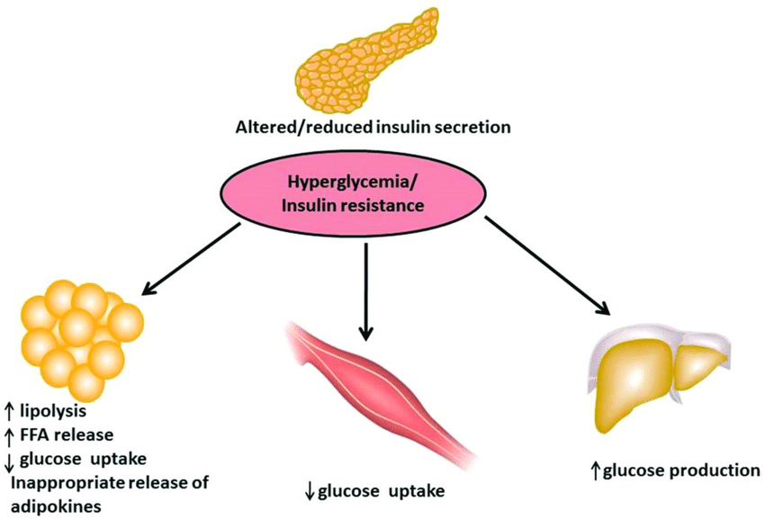
Aetio-pathology of diabetes
The underlying characteristic common to all forms of diabetes is the dysfunction or destruction of pancreatic β-cells.
Many mechanisms can lead to a decline in function or the complete destruction of β-cells (these cells are not replaced, as the human pancreas seems incapable of renewing β-cells after the age of 30 years).
These mechanisms include genetic predisposition and abnormalities, epigenetic processes, insulin resistance, auto-immunity, concurrent illnesses, inflammation, and environmental factors.

Slide 8
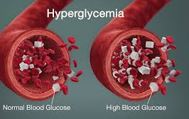
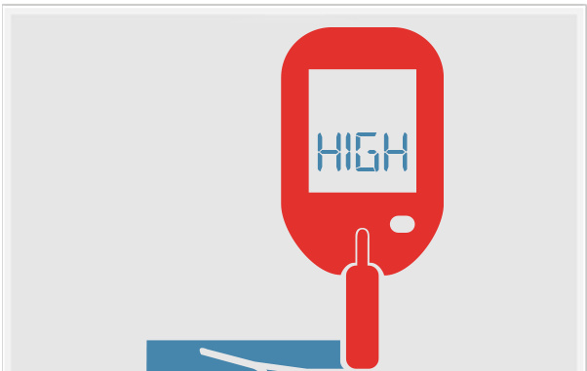
Definition
Hyperglycaemia or raised blood sugar is a common effect of uncontrolled diabetes
Impaired glucose tolerance (IGT) and impaired fasting glycaemia (IFG):
Are intermediate conditions in the transition between “normality” and diabetes.

Slide 9
Classification systems for diabetes
Purpose of a classification system for diabetes
Hyperglycaemia is the defining common feature of all types of diabetes, but aetiology, underlying pathogenic mechanisms, natural history and treatment for the different types of diabetes differ.
Classification systems can broadly be used for three primary aims:
» Guide clinical care decisions
» Stimulate research into aetio-pathology
» Provide a basis for epidemiological studies

Slide 10
WHO classification of diabetes 2019
Type 1 diabetes
Type 2 diabetes
Hyperglycaemia first detected during pregnancy
Diabetes mellitus in pregnancy
Gestational diabetes mellitus
Hybrid forms of diabetes
Slowly evolving immune-mediated diabetes of adults
Ketosis prone type 2 diabetes
Other specific types
Monogenic diabetes
Monogenic defects of β-cell function
Monogenic defects in insulin action
Diseases of the exocrine pancreas
Endocrine disorders
Drug- or chemical-induced
Infections
Uncommon specific forms of immune-mediated diabetes
Other genetic syndromes sometimes associated with diabetes
Unclassified diabetes: This category should be used temporarily when there is not a clear diagnostic category especially close to the time of diagnosis of diabetes

Slide 11
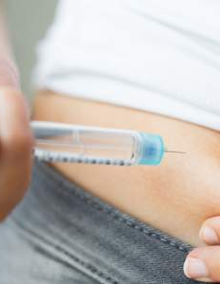
Type 1 diabetes (T1DM):
Previously known as insulin-dependent or childhood-onset diabetes IDDM.
Between 70% and 90% of people with T1DM at diagnosis have evidence of an immune-mediated process with β-cell autoantibodies against glutamic acid decarboxylase (GAD65), islet antigen-2 (IA-2), ZnT8 transporter or insulin
Characterized by a lack of insulin production.
Males and females are equally affected. Despite T1DM occurring frequently in childhood, onset can occur in adults. (The rate of β-cell destruction is rapid in some individuals and slow in others).
In adults, T1DM accounts for approximately 5% of all diagnosed cases of diabetes globally (CDC, 2011).

Slide 12
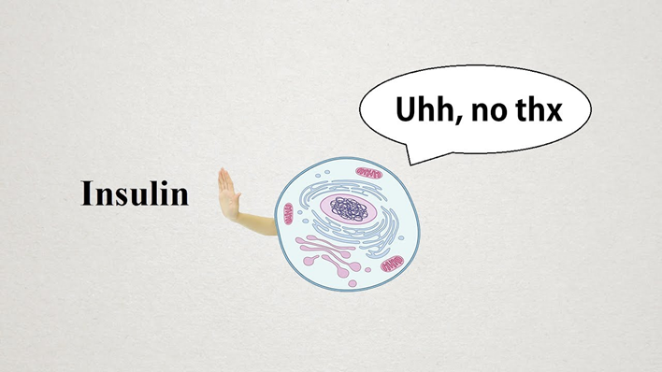
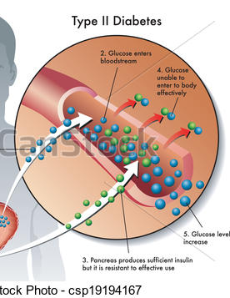
Type 2 diabetes mellitus (T2DM)
Formerly called Non–Insulin-Dependent Diabetes Mellitus (NIDDM) or adult-onset diabetes.
It results from the body’s ineffective use of insulin and is the most common type among adults (90%) (CDC, 2011).
Unlike patients with T1DM, patients with T2DM are not absolutely dependant on insulin. This distinction was the basis for the older terminology for types 1 and 2 (Insulin Dependent and Non-Insulin Dependent Diabetes Mellitus) respectively (CDC, 2011).
T2DM is most common in adults, but an increasing number of children and adolescents are also affected
Most people with T2DM are overweight or obese, which either causes or aggravates insulin resistance.

Slide 13
Hyperglycaemia first detected during pregnancy
Diabetes mellitus in pregnancy: defined by the same criteria as in non-pregnant persons.
Gestational diabetes mellitus
It is considered as a risk factor for developing T2DM in mothers later in life.
Diagnosed at glucose cut-off points that are lower than those for diabetes

Slide 14
Other specific types
These could result from specific genetic conditions (such as maturity-onset diabetes of youth), surgery, medications, infections, pancreatic disease, and other illnesses. Such types of diabetes account for 1-5% of all diagnosed cases

Slide 15
Infection-related diabetes
Viral exposure.
Particular viruses have been associated with β-cell destruction and have been implicated in inducing or triggering T1DM.
Diabetes occurs in some people with congenital rubella.
Coxsackie B and viruses such as cytomegalovirus, adenovirus and mumps may trigger the autoimmune destruction of the islet cells, or the virus may directly infect the islet cells leading to T1DM

Slide 16
Drugs or chemicals that can induce diabetes
Glucocorticoids
Thyroid hormone
Thiazides
Alpha-adrenergic agonists
Beta-adrenergic agonists
Dilantin
Pentamidine
Nicotinic acid
Pyrinuron
Interferon-alpha
Others

Slide 17
Risk factors for T2DM
Aetiology of T2DM is multifactorial!
Many factors increase the risk of developing T2DM including age, obesity, unhealthy lifestyles (smoking, diet, low physical exercise) and prior gestational diabetes (GDM).
Ethnic and racial factors, there are populations that have a higher occurrence of type 2 diabetes, for example Native Americans, Pacific Islanders, and populations in the Middle East and South Asia.
It is also often associated with strong familial, likely genetic or epigenetic predisposition. Two thirds of patients with T2DM report a family history of diabetes.
However, the genetics of T2DM are complex and not clearly defined, studies suggest that some common genetic variants of T2DM occur among many ethnic groups and populations.

Slide 18
Risk factors and risk markers for Gestational diabetes
Age (the older a woman of reproductive age is, the higher her risk of GDM);
Overweight or obesity;
Excessive weight gain during pregnancy;
A family history of diabetes;
GDM during a previous pregnancy;
A history of stillbirth or giving birth to an infant with congenital abnormality;
and excess glucose in urine during pregnancy .
Diabetes in pregnancy and GDM increase the risk of future obesity and type 2 diabetes in offspring.

Slide 19
Clinical presentation
The course of T2DM is usually insidious!
T2DM often remains undiagnosed for many years because the hyperglycaemia is not severe enough to provoke noticeable symptoms of diabetes
By the time these appear and diagnosis is confirmed, the majority of patients are likely to have already developed vascular complications , hence the importance of early diagnosis.

Slide 20
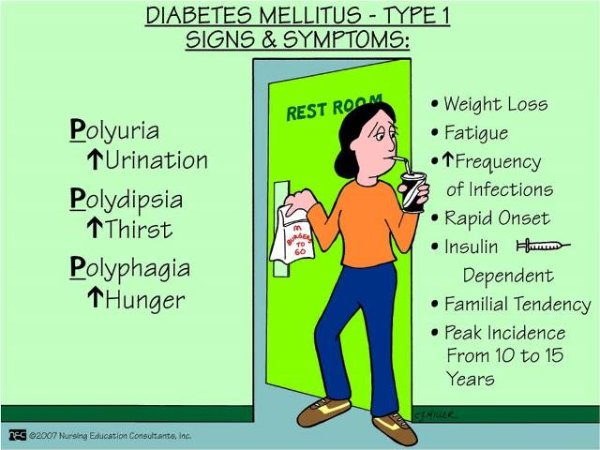
Clinical presentation
Symptoms of hyperglycaemia include Polydipsia (thirst), Polyuria (urine frequency), Polyphagia.
Fatigue, weight loss.
T1DM: Nausea, vomiting, Ketoacidosis (DKA) maybe the first presenting sign
T2DM: Blurred vision, Slow healing infections
Notes:
in T2DM symptoms are often not severe, or may be absent, owing to the slow pace at which the hyperglycaemia is worsening.
As a result, in the absence of biochemical testing, hyperglycaemia sufficient to cause pathological and functional changes may be present for a long time before a diagnosis is made, resulting in the presence of complications at diagnosis. It is estimated that a significant percentage of cases of diabetes (30–80%, depending on the country) are undiagnosed

Slide 21
Impaired glucose tolerance
Two-hour glucose levels of 140 to 199 mg per dL (7.8 to 11.0 mmol) on the 75-g oral glucose tolerance test.
A patient is said to be under the condition of IGT when he/she has an intermediately raised glucose level after 2 hours, but less than would qualify for type 2 diabetes mellitus. The fasting glucose may be either normal or mildly elevated.

Slide 22
Diagnosis
Four diagnostic tests for diabetes are currently recommended including measurement of:
fasting plasma glucose;
2-hour (2-h) post-load plasma glucose after a 75 g oral glucose tolerance test (OGTT);
HbA1c; and
A random blood glucose in the presence of signs and symptoms of diabetes.

Slide 23
Criteria for the Diagnosis of Diabetes
Fasting plasma glucose (FPG) ≥126 mg/dL (7.0 mmol/L)
OR
2-h plasma glucose ≥200 mg/dL (11.1 mmol/L) during an OGTT
OR
A1C ≥6.5%
OR
Classic diabetes symptoms + random plasma glucose ≥200 mg/dL (11.1 mmol/L)
American Diabetes Association Standards of Medical Care in Diabetes. Classification and diagnosis of diabetes. Diabetes Care 2017; 40 (Suppl. 1): S11-S24
Notes:
Fasting plasma glucose, the 2 hour plasma glucose after a 75-g oral glucose tolerance test, and A1C are equally appropriate diagnostic tests for diabetes.
These diagnostic criteria are:
Fasting plasma glucose (FPG) ≥126 mg/dL
OR
2-hour plasma glucose ≥200 mg/dL during an OGTT
OR
A1C ≥6.5%
Or in a patient with classic symptoms of hyperglycemia a random plasma glucose ≥ 200 can also be used.
In the absence of unequivocal hyperglycemia, the result should be confirmed by repeat testing.
[SLIDE]
23
Reference
American Diabetes Association. Standards of medical care in diabetes—2014. Diabetes Care 2014;37(suppl 1):S15; Table 2

Slide 24
Complications
All types of Diabetes can lead to complications in many parts of the body and can increase the overall risk of dying prematurely.
The long-term specific effects of diabetes include retinopathy, nephropathy and neuropathy. People with diabetes are also at increased risk of other diseases including heart, peripheral arterial and cerebrovascular disease, obesity, cataracts, erectile dysfunction, and nonalcoholic fatty liver disease.
Adults with diabetes also have two- to three-fold increased risk of heart attacks and strokes.
In pregnancy, poorly controlled diabetes increases the risk of fetal death and other complications.
Nearly 3% of global blindness can be attributed to diabetic retinopathy, which occurs as a result of long-term accumulated damage to the blood vessels in the retina.
Diabetes is also among the leading causes of kidney failure.
Reduced blood flow and nerve damage in the feet caused by diabetes can lead to foot ulcers, and the associated infections and complications can lead to the need for limb amputation, as well as severe and life-long health problems.

Slide 25
Prevention
At present, type 1 diabetes cannot be prevented.
For type 2 diabetes lifestyle modification with physical activity and/or healthy diet can delay or prevent the onset of type 2 diabetes.
Community-based interventions can reach individuals and families through campaigns, education, social marketing and encourage physical activity both inside and outside school and the workplace. IDF recommends physical activity at least between three to five days a week, for a minimum of 30-45 minutes.
The earlier healthy habits acquired, the better outcome.
Population based interventions and policies allow healthy choices through policies in trade, agriculture, transport and urban planning to become more accessible and easy. Healthy choices can be promoted in specific settings (school, workplace and home) and contribute to better health for everyone. They include exercising regularly and eating wisely which will help to maintain normal levels of blood glucose, blood pressure and lipids.

Slide 26
Treatment
The aim is to maintain serum glucose level within normal.

Slide 27
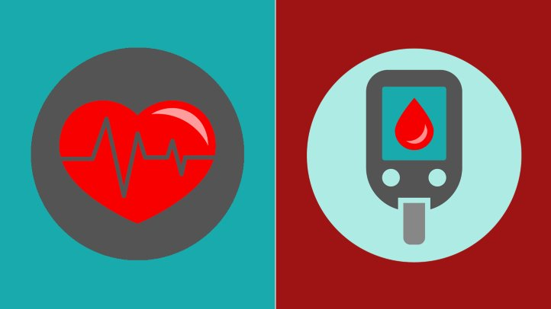
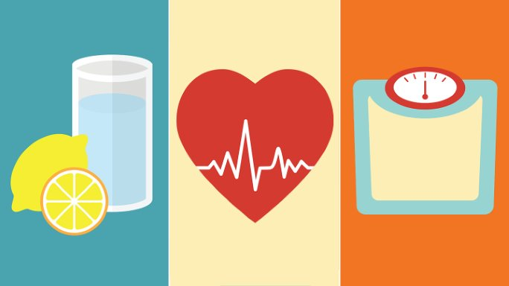
Treatment
T1DM
Insulin
T2DM
Lifestyle modifications can increase insulin secretion and decrease insulin resistance.
Proper nutrition, weight loss, and physical exercise are the first line of treatment for DM 2.
Medications are given either to increase insulin secretion to help overcome the resistance, or to directly decrease the resistance and re-sensitize insulin receptor.
Many classes of drugs; biguanides (metformin) and sulfonylureas. Given orally.

Slide 28
Complications managment
Diabetes is associated with various complications, e.g. blindness, kidney failure, coronary thrombosis…etc.
The aim is to treat complications and rehabilitate patient to lead a life as normal as possible.
For example it should entail periodic checkups for visual acuity (retinopathy), renal function (nephropathy), and testing peripheral nerves sensation (neuropathy), in order to prevent farther deterioration

Slide 29
Complications screening tests
Retinopathy
Nephropathy
Neuropathy
Foot care
T1DM : annually after 5 years of diagnosis; patient is >15 years old.
T2DM : annually, starting at the time of diagnosis.

Slide 30
IN JORDAN
Estimations of the prevalence of T2DM in Jordan were reported variably over the past decade to range from 11-17% (Ajlouni et al., 2008) (Internationa Diabetes Federation, 2015).
An increase in the prevalence of T2DM by 31.5% was reported between 1998 and 2008 (Ajlouni et al. 1998; Ajlouni et al. 2008).

Slide 31
In Jordan
Overweight 62.3%
Obesity 28.1%
Physical inactivity 12.1%
WHO 2016

Slide 32
Health services for diabetes patients IN JORDAN
Health sectors (public and private) provide primary, secondary and tertiary healthcare services to patients with diabetes (MoH, 2014).
In addition, a National Centre for Diabetes, Endocrinology and Genetics (NCDEG) was established in 1996.
NCDEG attracts patients from all over the country who are either physician-referred or self-referred.

Slide 33
So,
A worldwide disease.
Jordan has high prevalence.
DM causes blindness, kidney failure, heart disease, neural damage, foot ulceration and amputation, and increases risk of early death.
Financial burden on patients and governments.

Slide 34
THANK YOU

