Slide 1
INTRODUCTION TO NERVUOS SYSTEM / 2
Dr. Aiman Q. Afar
Surgical Anatomist
College of Medicine / University of Mutah

Slide 2
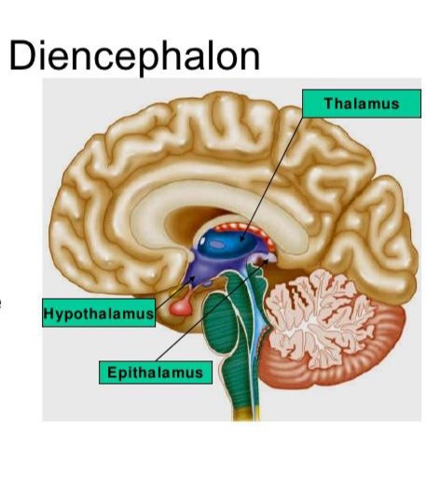
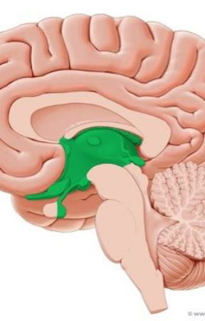
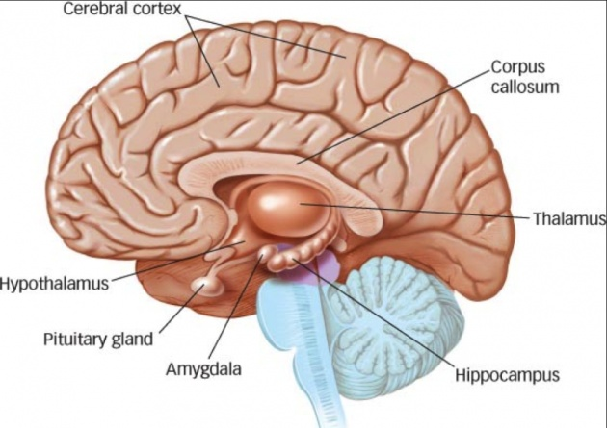
The forebrain
The forebrain comprises the diencephalon (between brain), which is the central part of the forebrain, and the cerebrum.

Slide 3
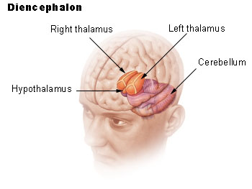
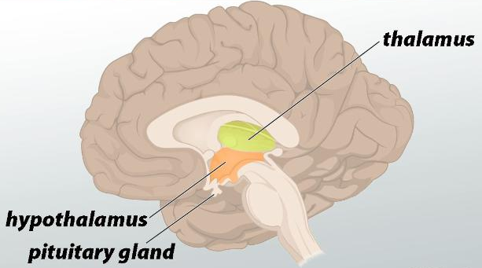
Diencephalon
The diencephalon is almost completely hidden from the surface of the brain.
It consists of a dorsal thalamus and a ventral hypothalamus
The thalamus is a large, egg-shaped mass of gray matter that lies on either side of the third ventricle.

Slide 4
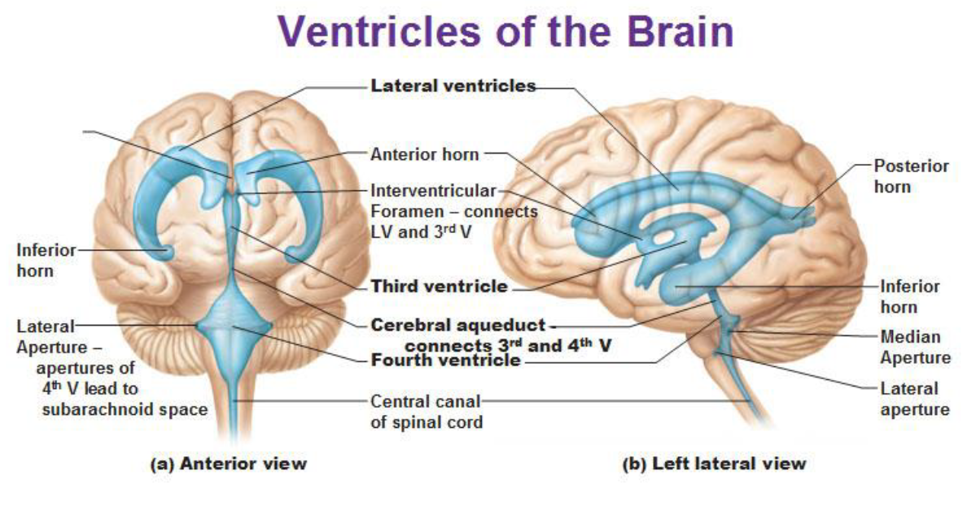
Diencephalon
The anterior end of the thalamus forms the posterior boundary of the interventricular foramen, the opening between the third and lateral ventricles.
The hypothalamus forms the lower part of the lateral wall and floor of the third ventricle.

Slide 5
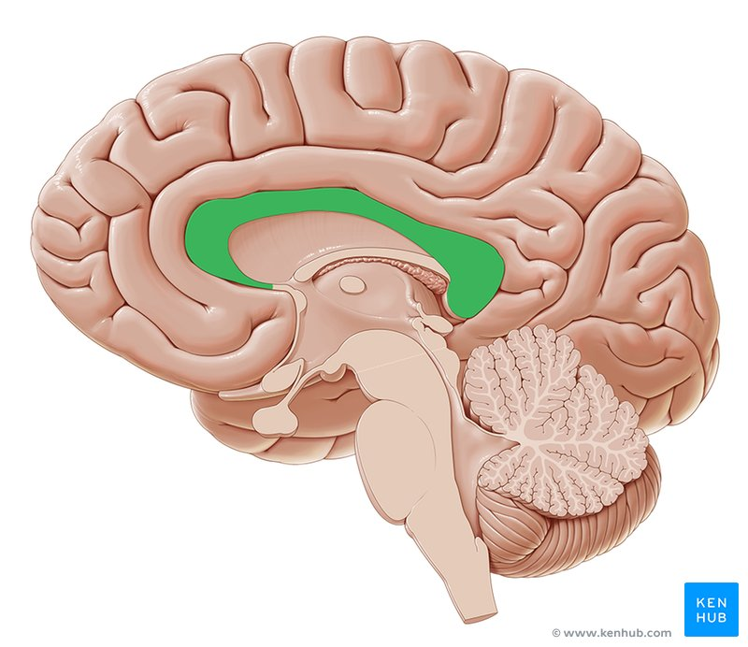
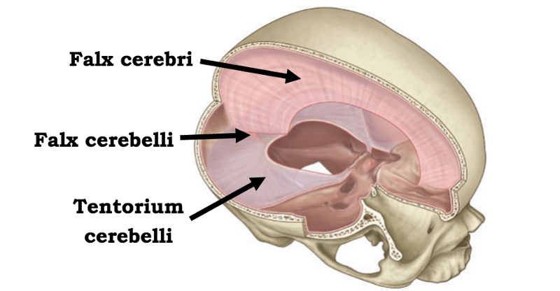
Cerebrum
The cerebrum, the largest part of the brain, consists of two cerebral hemispheres, which are connected by a mass of white matter called the corpus callosum
Each hemisphere extends from the frontal to the occipital bones in the skull, superior to
the anterior and middle cranial fossae; posteriorly, the cerebrum lies above the tentorium cerebelli
The hemispheres are separated by a deep cleft, the longitudinal fissure, into which projects the falx cerebri

Slide 6
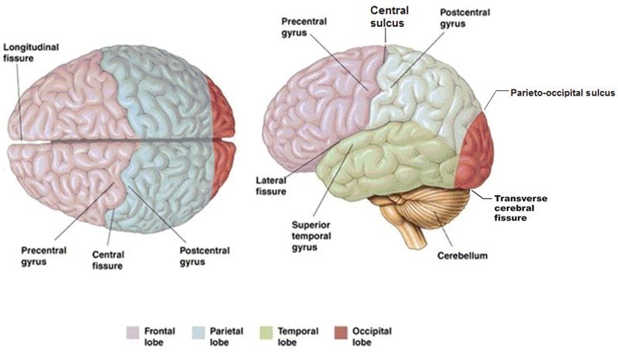
Cerebrum
The surface layer of each hemisphere, the cortex, is composed of gray matter.
The cerebral cortex is thrown into folds (gyri) separated by fissures, or sulci
This arrangement greatly increases the surface area of the cortex.
A number of the large sulci are conveniently used to subdivide the surface of each hemisphere into lobes, which are named from the bones of the cranium they lie under.

Slide 7
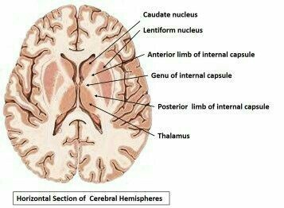
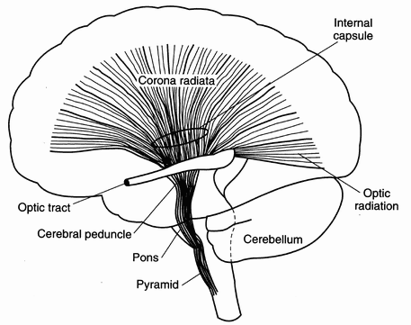
Cerebrum
Within the hemisphere is a central core of white matter containing several large masses of gray matter, the basal nuclei or ganglia.
A fan-shaped collection of nerve fibers, the corona radiata , passes in the white matter to and from the cerebral cortex to the brainstem.
The corona radiata converges on the basal nuclei and passes between them as the internal capsule
.

Slide 8
Cerebrum
The tailed nucleus situated on the medial side of the internal capsule is the caudate nucleus and
the lens-shaped nucleus on the lateral side of the internal capsule is the lentiform nucleus.
Within each cerebral hemisphere is a cavity called the lateral ventricle

Slide 9
Cerebrum
The lateral ventricles communicate with the third ventricle through the interventricular foramina.

Slide 10
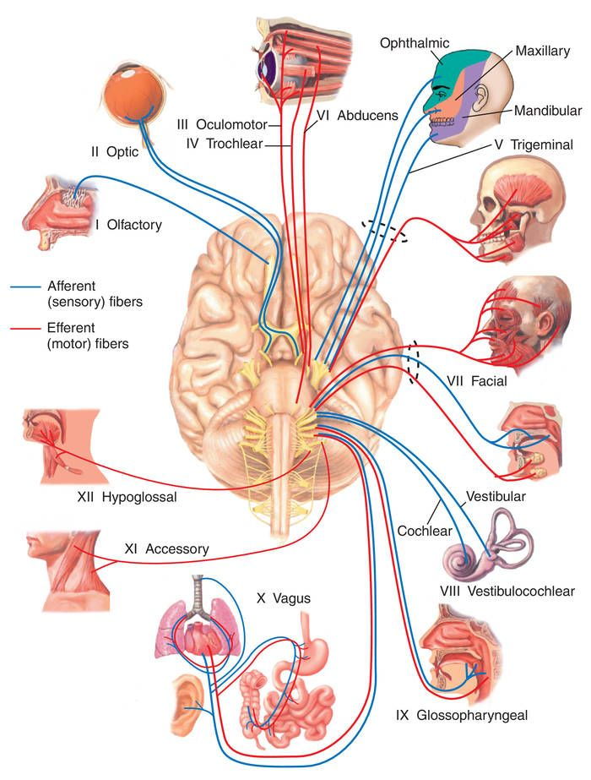
MAJOR DIVISIONS OF THE PERIPHERAL NERVOUS SYSTEM
The PNS comprises the cranial and spinal nerves and their associated ganglia.
Cranial and Spinal Nerves
The cranial and spinal nerves are made up of bundles of nerve fibers supported by connective tissue.
The 12 pairs of cranial nerves leave the brain and pass through foramina in the skull..

Slide 11
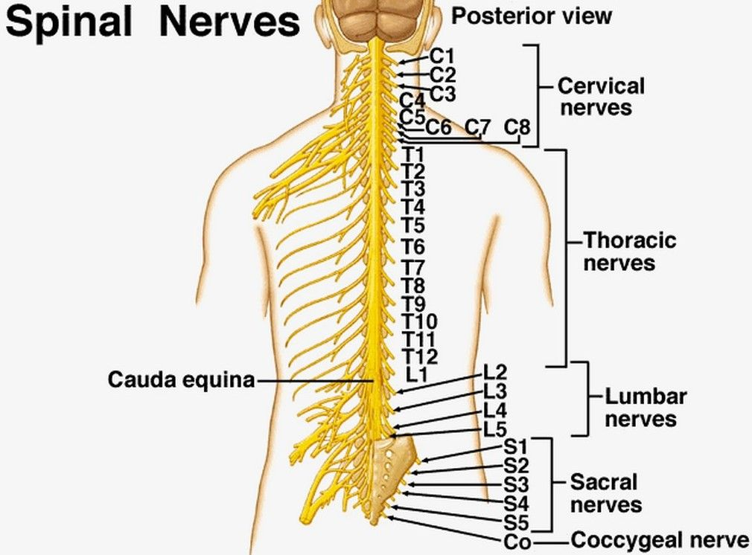
Cranial and Spinal Nerves
The 31 pairs of spinal nerves leave the spinal cord and pass through intervertebral foramina in the vertebral column.
The spinal nerves are associated with regions of the spinal cord:
8 cervical,
12 thoracic,
5 lumbar,
5 sacral, and
1 coccygeal.
Note that there are 8 cervical nerves yet only 7 cervical vertebrae and that there is 1 coccygeal nerve but 4 coccygeal vertebrae

Slide 12
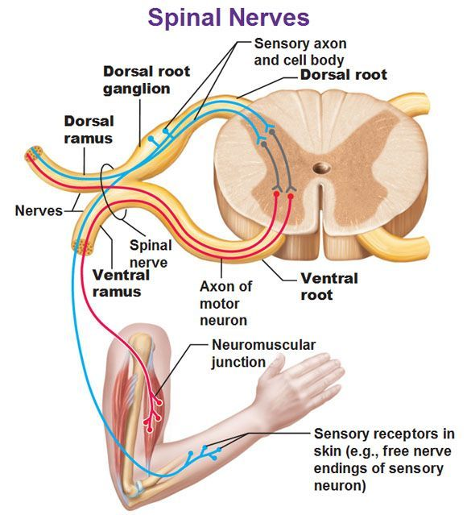
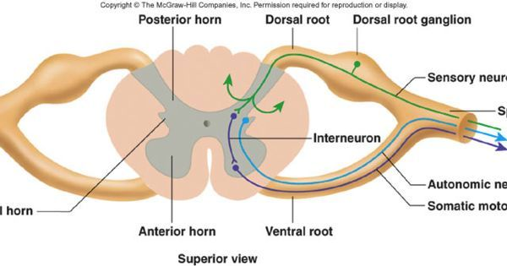
Cranial and Spinal Nerves
Each spinal nerve is connected to the spinal cord by two roots: the anterior root and the posterior root
The anterior root consists of bundles of nerve fibers carrying nerve impulses away from the CNS—efferent fibers.
Those that go to skeletal muscles and cause them to contract are motor fibers.
Their cells of origin lie in the anterior gray horn of the spinal cord

Slide 13
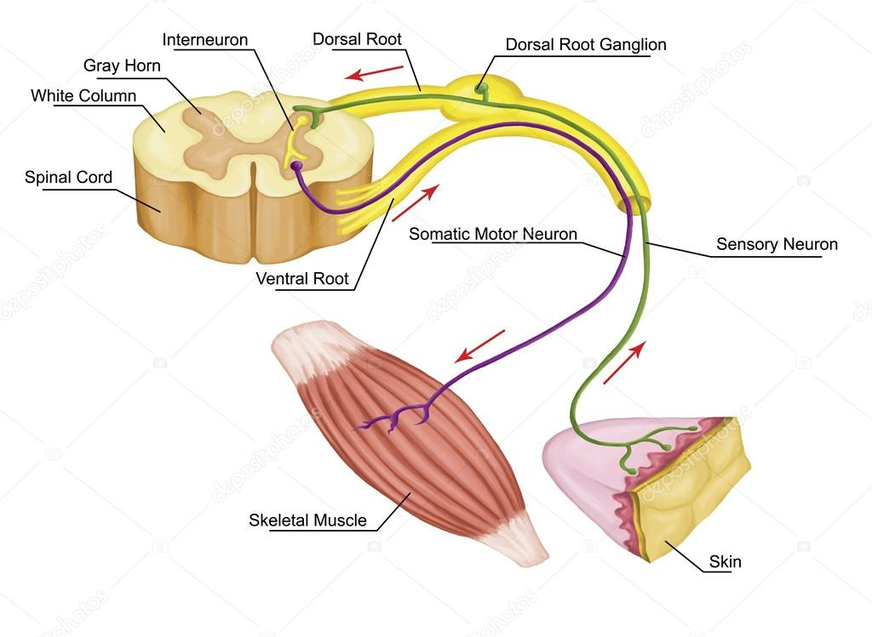
Cranial and Spinal Nerves
The posterior root consists of bundles of afferent fibers that carry nervous impulses to the CNS.
Because these fibers convey information about sensations of touch, pain, temperature, and vibration, they are called sensory fibers.
The cell bodies of these nerve fibers are situated in a swelling on the posterior root called the posterior root ganglion

Slide 14
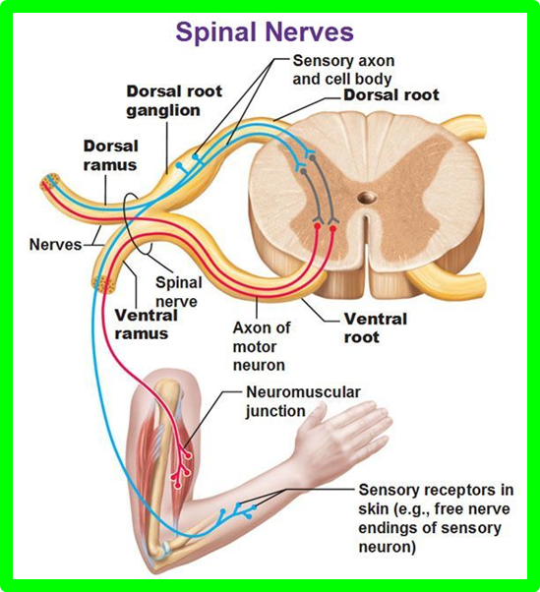
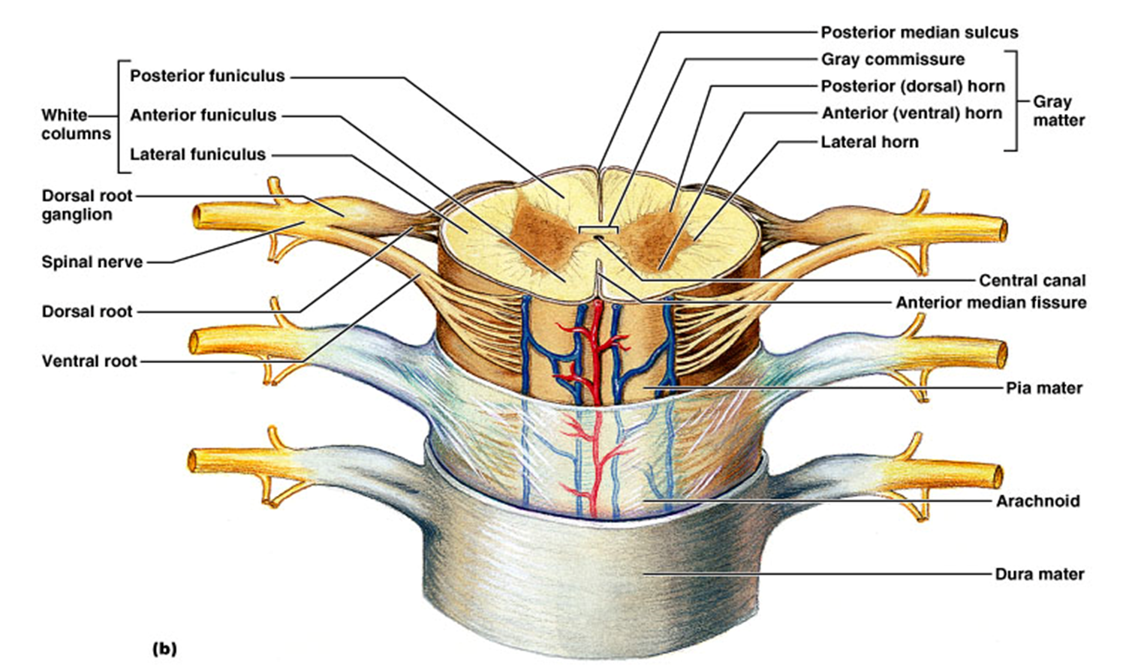
Cranial and Spinal Nerves
The spinal nerve roots pass from the spinal cord to the level of their respective intervertebral foramina, where they unite to form a spinal nerve
Here, the motor and sensory fibers mix together; thus, a spinal nerve comprises both motor and sensory fibers

Slide 15
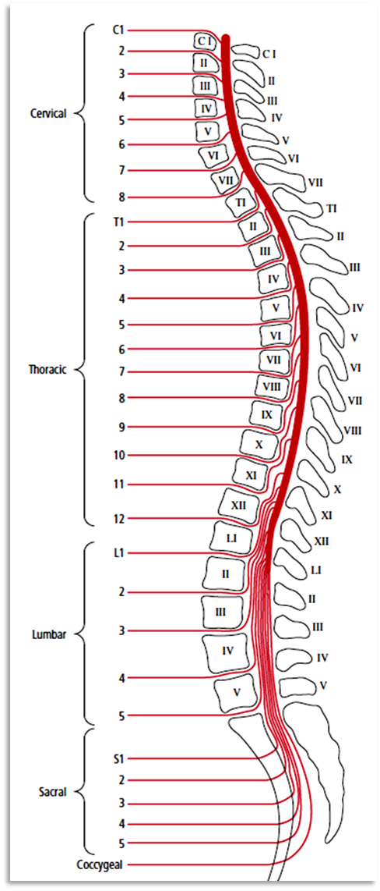
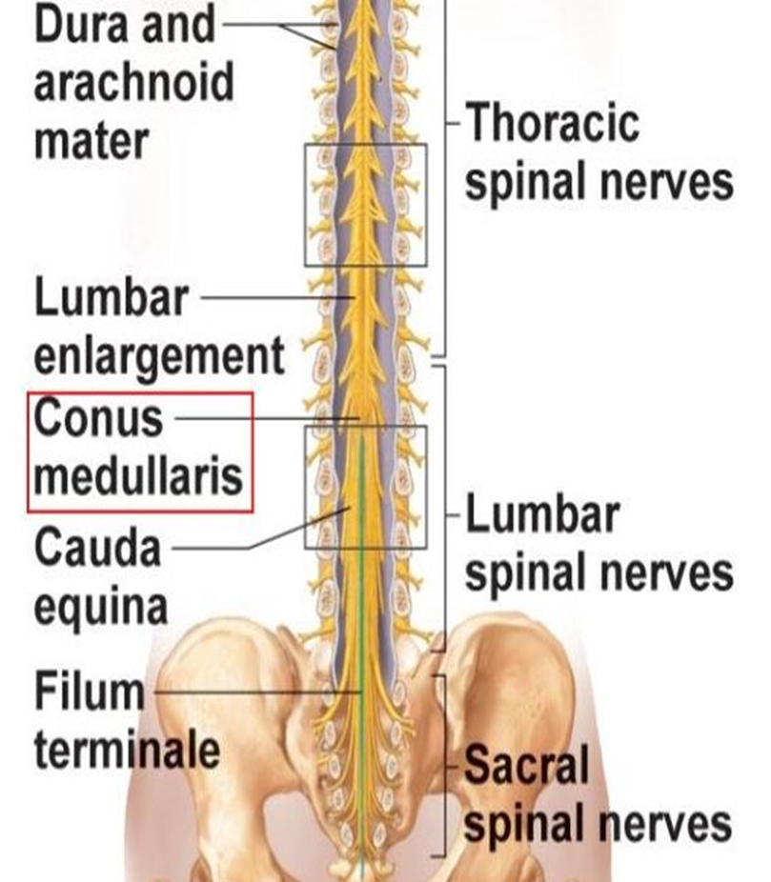
Cranial and Spinal Nerves
Because of the disproportionate growth in length of the vertebral column during development, compared with that of the spinal cord, the length of the roots increases progressively from above downward.

Slide 16
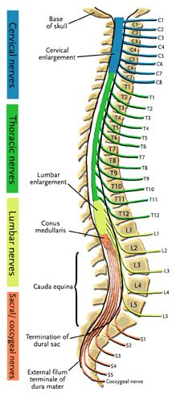
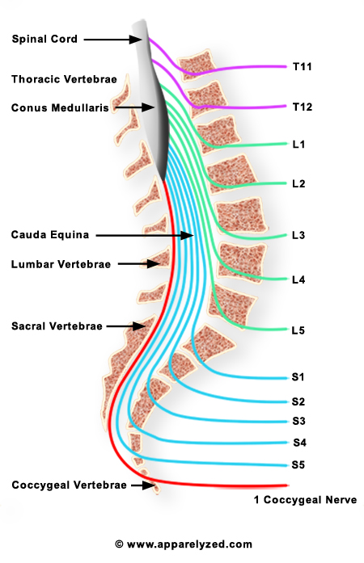
Cranial and Spinal Nerves
In the upper cervical region, the spinal nerve roots are short and run almost horizontally,
but the roots of the lumbar and sacral nerves below the level of the termination of the cord (lower border of the lst lumbar vertebra in the adult) form a vertical leash of nerves around the filum terminale
Together, these lower nerve roots are called the cauda equina

Slide 17
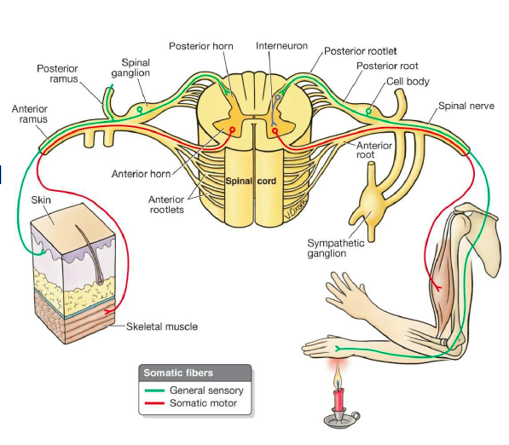
Cranial and Spinal Nerves
After emerging from the intervertebral foramen, each spinal nerve immediately divides into a large anterior ramus and a smaller posterior ramus, each containing both motor and sensory fibers.
The posterior ramus passes posteriorly around the vertebral column to supply the muscles and skin of the back.
The anterior ramus continues anteriorly to supply the muscles and skin over the anterolateral body wall and all the muscles and skin of the limbs.

Slide 18
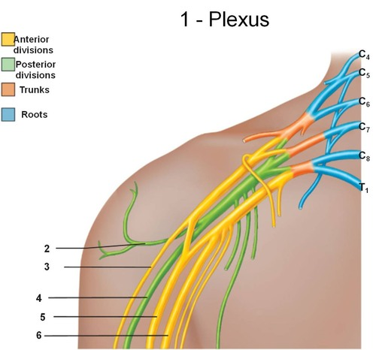
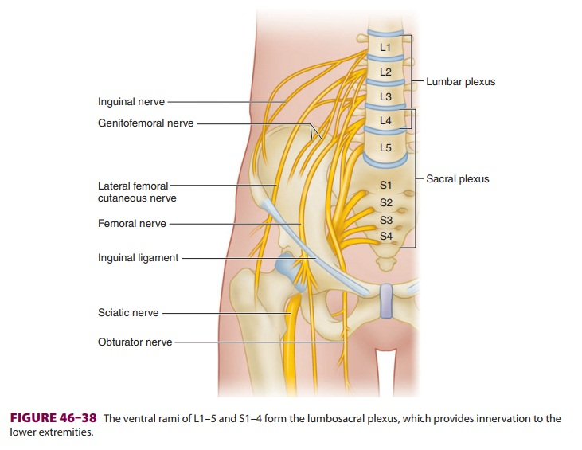
Cranial and Spinal Nerves
The anterior rami join one another at the root of the limbs to form complicated nerve plexuses.
The cervical and brachial plexuses are found at the
root of the upper limbs, and the lumbar and sacral plexuses are found at the root of the lower limbs.

Slide 19
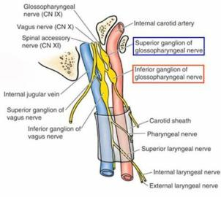
Cranial and Spinal Nerves
Ganglia
Ganglia can be divided into sensory ganglia of spinal nerves (posterior root ganglia) and cranial nerves and autonomic ganglia.
Sensory ganglia
Sensory ganglia are fusiform swellings on the posterior root of each spinal nerve just proximal to the root’s junction with a corresponding anterior root.
They are referred to as posterior root ganglia.
Similar ganglia found along the course of cranial nerves V, VII, VIII, IX, and X are the sensory ganglia of these nerves.

Slide 20
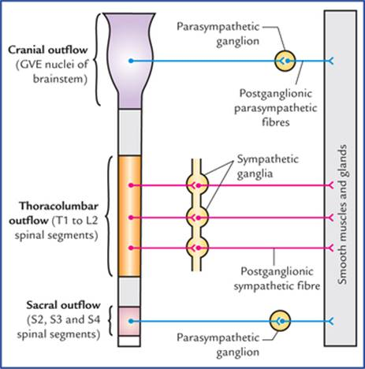
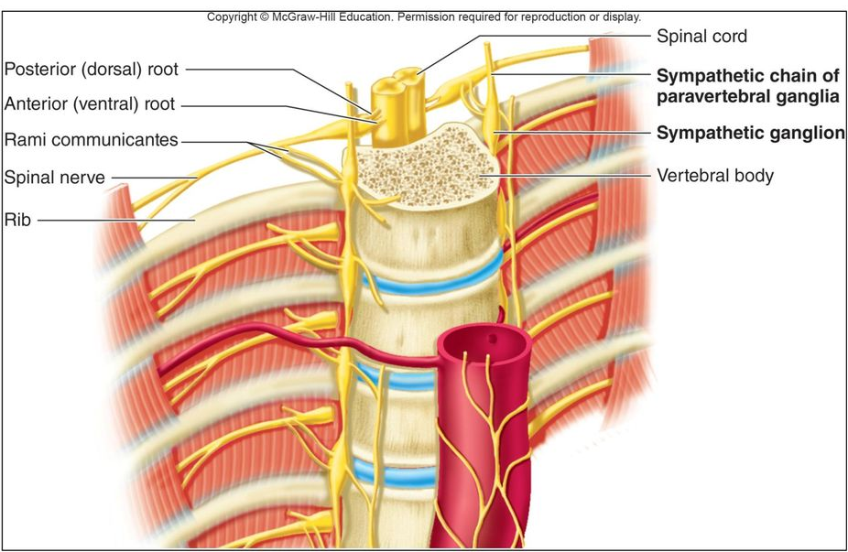
Cranial and Spinal Nerves
Autonomic ganglia, which are often irregular in shape, are situated along the course of efferent nerve fibers of the ANS. They are found in the paravertebral sympathetic
chains around the roots of the great visceral arteries in the abdomen and close to, or embedded within, the walls of various viscera

Slide 21
Dr. Aiman Qais Afar
Thursday 16. April. 2020

