Slide 1
Obstetric Analgesia and Anaesthesia
Prepared by:
Sarah khirfan
Laith naimat
Gharam al majali
Supervised By:
Dr. Ahlam Kharabsheh

Slide 2
Part I Sarah khirfan

Slide 3
Introduction
Pain is a common labour symptom and may be located in the abdomen, back, pelvic floor, perineum, or other locations. Physiologic drivers of labour pain include factors such as uterine contractions, cervical dilation, and pressure from the fetus.
Many women, especially nulliparas, rate the pain of labour as very severe or intolerable. The pain of labour and delivery varies among women, and each of a woman’s labours may be quite different. As an example, an abnormal fetal presentation (eg, occiput posterior) is associated with more severe pain.

Slide 4
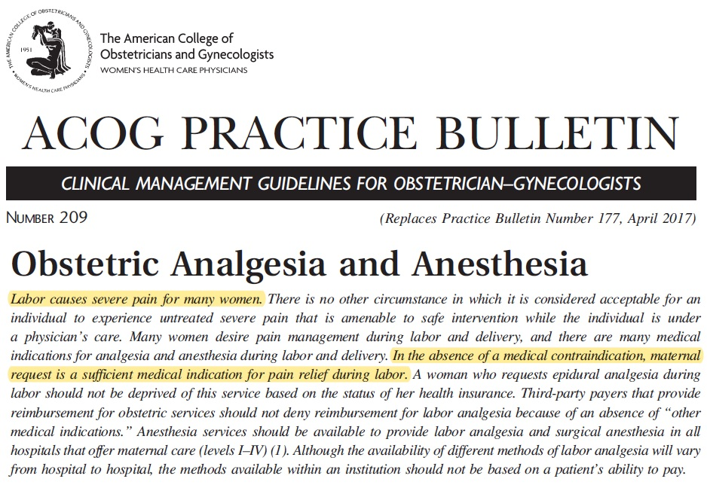

Slide 5
Pain Pathways
First stage of labour — Pain during the first stage of labour is visceral or cramping. It originates in the uterus and cervix, and is produced by distention of uterine and cervical mechanoreceptors and by ischemia of uterine and cervical tissues.
Although lower abdominal pain is a nearly universal feature of labor, a significant percentage of women also will experience lower back pain.
The pain signal enters the spinal cord after traversing the T10, T11, T12, and L1 white rami communicantes.
In addition to the uterus, labour pain can be referred to the lumbosacral region, iliac crests, gluteal areas, and thighs.
Notes:
There is anatomical support for the hypothesis that at least some low back pain during labor is actually referred pain since the nerves originating from the corpus uteri and cervix terminate in the dorsal horns of the spinal segments T10 to L1 and reflect visceral pain, which is often referred to the lower back

Slide 6
Transition (7 to 10 cm cervical dilation) refers to the shift from the late first stage to the second stage of labour. Transition is associated with greater nociceptive input as the parturient begins to experience somatic pain from vaginal distention.
Second stage of labour — Pain in the second stage of labour is reported as being more severe than first stage pain. As the fetus descends in the late first stage or second stage of labour, distention of the vagina, pelvic floor, and perineum elicit stimuli through the pudendal nerve (S2, S3, and S4).
Second stage pain includes a combination of visceral pain from uterine contractions and cervical stretching, and somatic pain (predominantly) from distention of vaginal and perineal tissues.

Slide 8
Uterine Blood Flow
Regional analgesia or anesthesia may increase uterine blood flow, especially in patients with preeclampsia, by relieving pain and stress and reducing circulating catecholamines.
Regional analgesia or anesthesia may also decrease uterine blood flow if hypotension occurs and is not properly and promptly treated. Adequate hydration (e.g., 1000 mL of lactated Ringer solution) 30 to 60 minutes before regional anesthesia helps to improve uterine blood flow and mitigate the risk of hypotension. If hypotension does occur (>15% below baseline or <100 mm Hg systolic blood pressure), a vasopressor (e.g., 10 mg of IV ephedrine) will typically restore maternal blood pressure and uterine blood flow.
Notes:
Labor pain results in increased levels of circulating catecholamines.
Neuraxial anesthesia-induced sympathetic blockade causes vasodilation and decrease in venous return to the heart, which can result in maternal hypotension.

Slide 9
ADVERSE CONSEQUENCES OF LABOR PAIN
Notes:
Pain causes a neuroendocrine stress response, with effects on multiple maternal and fetal organ systems
1. Intermittent hyperventilation consistently accompanies labor pain (hyperventilation-hypoventilation syndrome ). The resultant hypocarbia can inhibit ventilatory drive (hypoventilation) and, in the absence of supplemental oxygen, can cause maternal and fetal hypoxemia. Respiratory alkalosis shifts the oxyhemoglobin curve to the left, increasing the affinity of oxygen for maternal hemoglobin, thereby decreasing off-loading of oxygen across the placenta to the fetus.
2. Neurohumoral responses to stress and pain may adversely affect placental perfusion and fetal oxygenation. Elevated plasma catecholamines increase maternal peripheral vascular resistance and decrease uteroplacental perfusion.
3. Women who experience unrelieved pain during childbirth may be more likely to develop postpartum depression.

Slide 10
Analgesia Methods
Many women have strong preferences about using pharmacologic versus nonpharmacologic pain relief to cope with pain during labor, but even among those who prefer pharmacologic care, most will also use some nonpharmacologic approaches for managing labor pain prior to, during, or after use of pharmacologic methods.
Role of antenatal education – women need information prenatally about the risks and benefits of both pharmacologic and nonpharmacologic methods of pain management.

Slide 11
Classification Of Approaches
● Low-resource interventions are simple, readily available, inexpensive, and low-risk techniques including distraction, self-help, and comforting strategies or tools.
● Moderate-resource interventions require patient motivation, specialized training, professional assistance, specific equipment, financial resources, or a combination thereof.
● High-resource interventions require professional training and monitoring, have greater risk of adverse effects on mother, fetus, or labour, require increasingly complex equipment and training by staff and/or patient, and incur significant cost.
Notes:
High-resource interventions are highly effective in reducing labor pain, and include neuraxial analgesia and anesthesia and inhaled anesthesia.

Slide 12
The Non-pharmacologic Methods
Education and psychoprophylaxis (Lamaze method)
Emotional support
Back massage
Hydrotherapy (Water Immersion) not more than 2 hours
Biofeedback
Transcutaneous electrical nerve stimulation (TENS)
Acupuncture: In most studies, acupuncture has been found to decrease pain.
Hypnosis (hypnobirthing).
These techniques tend to work best early in the first stage of labor, when the pain is least intense, and may decrease pharmacologic usage at that time.
Notes:
Lamaze breathing — It is a breathing technique that helps a woman to be distracted from pain during contractions. As labour advances, contractions become long, intense and more rapid. The trick is to breathe slow and take shallow breaths.
Touch and Massage — The impact of touch in labor (hand-holding, patting, stroking) to convey caring, reassurance, or a message to release tension.
Water immersion (Hydrotherapy) —Relaxation in warm water during the first stage of labour often leads to a sense of well-being and allows women to cope much better with the pain. The temperature of the water should not exceed 37.5 C.
Biofeedback — Biofeedback is a therapeutic technique where individuals receive training to gain control over physiological responses with the aid of electronic instruments.
Transcutaneous electrical nerve stimulation — is the transmission of low-voltage electrical impulses from a hand-held battery-powered generator to the skin via surface electrodes.
Acupuncture — Acupuncture involves placement of needles at specific points on the body (termed acupuncture points).
Hypnosis — Hypnosis, or hypnotherapy, appears to result in altered states of consciousness that prevent normally perceived experiences, such as pain, from reaching the conscious mind.

Slide 13
Movement — Labouring women have always walked, moved, and changed positions to make themselves more comfortable. Pelvic dimensions vary with differences in maternal positions; thus, these changes may help to ameliorate labour pain.
Yoga — At least one study has reported that the relaxation, breathing, and posture techniques of yoga appear to reduce maternal anxiety regarding childbirth.
Birth ball — Use of a birth ball (an exercise ball or physical therapy ball) during labour encourages relaxation of the trunk and pelvic floor and also provides some pain relief while allowing women freedom of movement and personal control of the intervention.
Notes:
When used in the sitting position, the ball applies a nonpainful pressure to the perineum, which may block part of the nociceptive message at the level of the spinal cord and thereby reduce the sensation of pain.

Slide 14
The Pharmacologic Approaches
Pharmacologic treatment options include:
1. Parenteral analgesia (opioid and non-opioid agents).
2. Regional anaesthesia (epidural, spinal, combined spinal-epidural, paracervical, and pudendal nerve blocks).
3. Inhalational anaesthesia.
Systemic analgesics may be associated with sedation and respiratory depression,and are transferred across the placenta to the fetus. However, systemic analgesics or nerve blocks may be beneficial for patients who prefer less invasive analgesic techniques (compared with neuraxial analgesia), or in whom neuraxial techniques are not reasonable options due to coagulopathy or anatomic abnormalities (eg, spinal deformity or hardware).

Slide 15
Parenteral (Systemic) Narcotics
Parenteral narcotics have very limited efficacy for the relief of labor pain. They work best in the early first stage, when the pain is primarily visceral and less intense.
Parenteral opioids continue to have a role in peripartum analgesia. They are inexpensive, and their use requires no specialized expertise.
However, parenteral opioids have little effect on maternal pain scores, provide unreliable analgesia, and commonly have adverse effects such as nausea, vomiting and drowsiness.

Slide 16
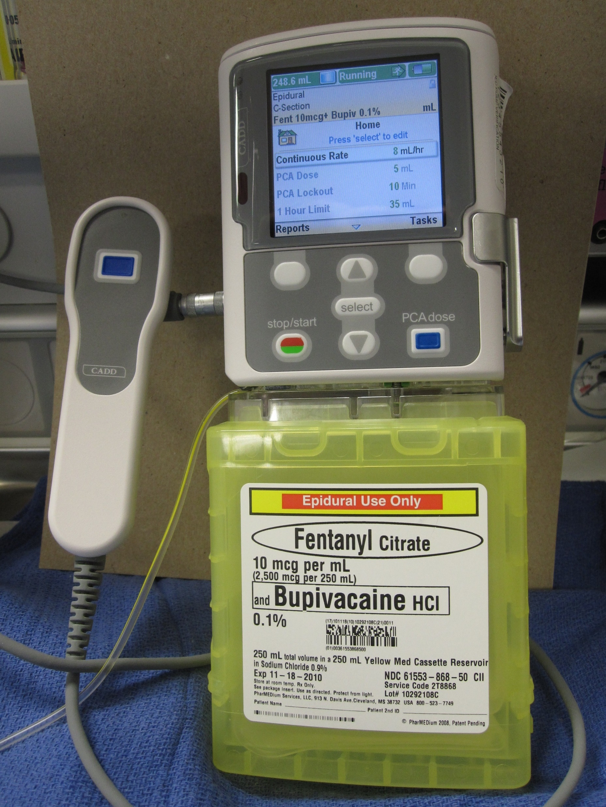
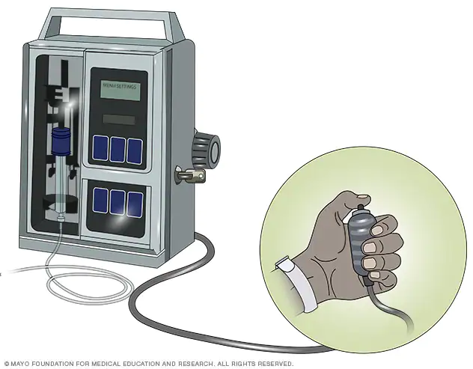
Fentanyl, morphine, nalbuphine, butorphanol, and remifentanil are used commonly.
These drugs may be given intramuscularly or intravenously.
Remifentanil is an ultrashort-acting opioid and is administered only as a patient-controlled intravenous infusion (Patient controlled analgesia (PCA))
Use of a patient controlled analgesia pump allows the patient to self-administer a programmed dose of IV medication with lockout intervals between doses.
Notes:
Use of a PCA pump allows the patient to self-administer a programmed dose of IV medication with lockout intervals between doses.
A bolus of 10-50mcg with lockout interval for 2-6 minutes avoid additional dose before peak effect which occurs within 2.5 minutes and unwanted adverse effects.

Slide 17
The use of Meperidine (Pethidine) generally is not recommended for peripartum analgesia because its active metabolite, normeperidine, has a prolonged half-life in adults and a half-life of up to 72 hours in the neonate; the normeperidine effect cannot be antagonized by naloxone.
Remifentanil is an ultra-short-acting opioid without active metabolites. Its pharmacokinetics allow for easy titration during labour and for less risk of respiratory depression in the newborn.
Remifentanil is administered intravenously by patient-controlled analgesia, seems to provide better pain relief during labour than other opioids (although less so than epidural analgesia), and has become increasingly popular as an option during labour.
Notes:
Naloxone is a pure opioid antagonist that competes and displaces opioids at opioid receptor sites.

Slide 18
All opioids cross the placenta and may have adverse effects for the fetus or newborn. This may be reflected in:
Loss of variability in the fetal heart rate (FHR)
Reduction in the FHR baseline
Neonatal respiratory depression (usually short-term)
Neurobehavioral changes
Impaired neonatal breastfeeding
Drug elimination takes longer in newborns than in adults, so effects may be prolonged, particularly if administered near the time of delivery.

Slide 19
Adverse effects on the labouring woman:
Nausea and Vomiting (they should always been given with an anti-emetic);
Maternal drowsiness and sedation;
Delayed gastric emptying (increasing the risks if general anaesthesia is subsequently required);
Respiratory arrest has occurred with use of remifentanil patient-controlled analgesia, and consideration should be given to one-to-one nurse-to-patient ratios, respiratory monitoring, and provision of supplemental oxygen.
Notes:
Opioids have three potentially emetogenic mechanisms: a direct effect on the chemoreceptor trigger zone, enhanced vestibular sensitivity, and delayed gastric emptying.

Slide 20
Note
Nalbuphine and butorphanol are mixed agonist–antagonists and, therefore, are associated with less respiratory depression for an equianalgesic dose.
Importantly, mixed agonist–antagonist (ie, pentazocine, nalbuphine, and butorphanol) or partial agonist (buprenorphine) analgesics should be avoided in patients who have received or currently are receiving a full opioid agonist analgesic treatment course, including hydrocodone bitartrate.
In such patients, the use of mixed agonist–antagonist and partial agonist analgesics may diminish the analgesic effect, trigger withdrawal symptoms, or both.
Notes:
Mixed agonist-antagonist and partial agonists works by stimulating one receptor and blocking others (full antagonist or weak antagonist). When the patient has not received opioids they work as agonist; but in those received opioids, they exert a blocking effect leading to sudden and rapid decrease in the effect of opiods.
Acute opioid withdrawal (eg, sweating, vomiting, lacrimation, hypertension, fever, and anxiety)

Slide 21
Non-opioid Agents
A Cochrane review analyzed a variety of agents, including antihistamines, antispasmodics, sedatives, and nonsteroidal anti-inflammatory drugs (NSAIDs) for pain relief during labour.
Nonsteroidal anti-inflammatory drugs and antihistamines were even less satisfactory for pain relief during labour than opioids, although they were more satisfactory than placebo.
NSAIDs are avoided during labour because of their potential for precipitating premature closure of the ductus arteriosus.
We do not offer acetaminophen for labour analgesia because of its limited efficacy.

Slide 22
Various agents have been used to minimize opioid side effects or provide sedation, relief from anxiety, or analgesia during labor. Nonopioid agents (eg, promethazine, a phenothiazine, or hydroxyzine, an antihistamine) are often administered in combination with an opioid to potentiate analgesia and decrease nausea and vomiting.

Slide 23
Benzodiazepines (eg, midazolam and diazepam) are anxiolytics that may be used for sedation during vaginal delivery. Midazolam is preferred because it is non-irritating to veins, and has a short duration of action.
Ketamine produces a dissociative state and analgesia. It is a potent amnestic, and has a rapid onset of action (less than one minute after intravenous administration).
Ketamine will induce general anesthesia at doses of 1 mg/kg IV, but lower doses (0.1 to 0.2 mg/kg IV titrated to effect) may be used to provide analgesia for vaginal delivery or minor operative procedures, such as manual uterine exploration.
Notes:
Ketamine’s propensity to produce psychotomimetic effects may be prevented with coadministration of benzodiazepines.

Slide 24
Barbiturates such as pentobarbital and secobarbital are hypnotics and anxiolytics, not analgesics. They may be administered orally and are sometimes prescribed by obstetricians to enable a patient to sleep through early labor.
Scopolamine is a muscarinic anticholinergic drug that induces a dissociative state. Scopolamine was used in combination with an opioid for “twilight sleep,” a technique popularized at the beginning of the 20th century, but it causes delirium and extreme agitation, sedation, and amnesia, and is rarely used for labor analgesia today.
Limited Use (If any)
Notes:
Twilight sleep is an amnestic state characterized by insensitivity to pain without loss of consciousness, induced by an injection of morphine and scopolamine.

Slide 27
Post-Cesarean Delivery Pain Control
Acetaminophen — is a key component of multimodal, opioid-sparing post-caesarean delivery analgesia, due to its favorable side effect profile and apparent effectiveness when administered along with nonsteroidal anti-inflammatory drugs (NSAIDs) and neuraxial opioids. For maximal efficacy, acetaminophen should be administered on a regularly scheduled basis around the clock.
1 g IV during surgical closure.
Starting six hours after the intraoperative dose, 650 mg orally (or IV for patients who are not able to take oral medication) every six hours for 48 to 72 hours postoperatively.
Dosing Regimen

Slide 28
Nonsteroidal anti-inflammatory drugs — We routinely administer NSAIDs for 48 hours after caecarean delivery, including in patients with preeclampsia and/or hypertension, and avoid NSAIDs for patients with thrombocytopenia.
When administered as part of multimodal postoperative pain control strategy, NSAIDs have been shown to reduce pain and opioid consumption.
Adverse effects:
• Hypertension
• Effects on platelet function
• Effects on the neonate
Notes:
The transfer of NSAIDs to breast milk is low and administration of NSAIDs to women who breastfeed is generally safe, particularly in the first 24 to 72 hours postpartum when low volumes of breast milk are produced. However, NSAIDs (including COX-2 inhibitors) should be considered carefully for breastfeeding mothers of infants with ductal-dependent cardiac lesions (transposition of great vessels and hypoplastic left heart syndrome)

Slide 29
Systemic opioids — The need for opioids after caesarean delivery varies widely among patients, with some patients requiring opioids even within the first 24 hours after surgery, when neuraxial opioids should still be in effect.
It is suggested to use oral opioids rather than intravenous (IV) opioids in patients who tolerate oral intake.
Orally — A consensus statement from the Society for Obstetric Anesthesia and Perinatology that oral oxycodone or hydrocodone are the preferred rescue opioids for breakthrough pain after caesarean delivery in breastfeeding women.
Intravenously — For PCA use, morphine and hydromorphone provide effective analgesia with high levels of patient satisfaction.
Hydromorphone does not have active metabolites and may be preferable in breastfeeding women.

Slide 30
Part II Huthaifa Hawajreh

Slide 31
Neuraxial anesthesia (regional anesthesia)

Slide 32
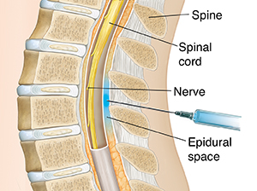
Neuraxial anesthesia (regional anesthesia)
There are two main types of neuraxial anesthesia : epidural anesthesia and spinal anesthesia, epidural anesthesia is the most common method used: epidural anesthesia: in this method the anesthetic and/or analgesic agents are injected into the epidural space ,Epidural administration involves an initial bolus of local anesthetic bupivacaine, ropivacaine, or lidocaine as well as narcotics such as fentanyl or sufentanil followed by an infusion of a dilute solution of the same agents until delivery.
Notes:
the placement of a catheter into the epidural space, which may remain in place for the duration of the treatment.

Slide 33
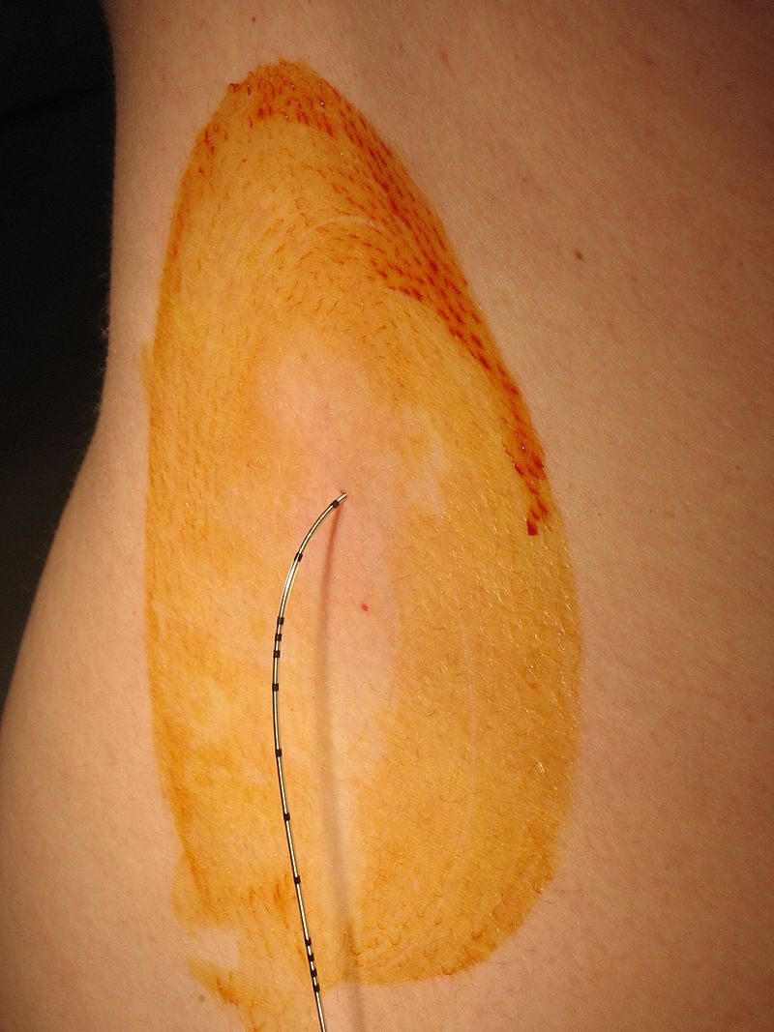

Slide 34
Neuraxial anesthesia (regional anesthesia)
Epidural anesthesia: notice that Epidural administration involves the placement of a catheter into the epidural space, which may remain in place for the duration of labour also notice that we gave a combination of anesthetic agent +analgesic agent→ because Combining the opioid with the local anaesthetic reduces the amount of local anaesthetic required and this reduces the motor blockade and peripheral autonomic effect (hypotension) of the epidural anesthesia anesthetic agents work by blocking the transmission of signals through nerve fibers first fibers to be affected by anesthesia are sensory fibers( responsible of normal sensation and pain so if we block it we block both pain and normal sensation) second fibers to be effected are autonomic fibers (if it is blocked this result in hypotension) last fibers to be affected are the motor fibers (if blocked the mother will lose ambulation and expulsive fore) this order of nerve fiber anesthesia is regulated by the dose(concentration) of the anesthetic agent being administered which mean that at lower concentrations sensory lose occurs and as you increase the dose motor blockade and peripheral autonomic may occur

Slide 35
Neuraxial anesthesia (regional anesthesia)
Epidural anesthesia: The effect of epidural anesthesia on labour duration: Patients who receive epidural anesthesia for labor pain have a similar duration of the first stage of labor, but the second stage may be prolonged by 15 minutes on average the reason why epidural anesthesia may prolong the second stage of labour is due to Impaired ability to push (unlikely as long as motor block is avoided by appropriate adjustment of the epidural infusion) or due to decreased maternal urge to push caused by sensory blockade Reducing the rate of an epidural infusion in the second stage may increase the maternal urge to push, but care should be taken that the analgesic effect is not compromised. Dilute solutions can be used that permit ambulation, referred to as the “walking epidural.” The goal is to avoid motor block to minimize any adverse effects on maternal expulsive efforts in the second stage of labor
Notes:
--It is important to warn the woman that she may lose sensation and movement in her legs temporarily --A fall in blood pressure may result from the vasodilatation
caused by blocking of the sympathetic tone to peripheral blood vessels. This hypotension is usually short lived, but may cause a fetal bradycardia due to redirection of maternal blood away from the uterus.

Slide 36
Neuraxial anesthesia (regional anesthesia)
Epidural anesthesia: The onset of analgesia is approximately 25–30 minutes in an epidural according to that the main use of epidural anesthesia is to provide a pain relief during normal vaginal delivery however if complication occurs and there is a need to convert into cesarean section this can occur by injecting a higher concentration of local anesthetics by the pre-existing catheter, the block may be intensified and extended to provide surgical anesthesia for cesarean delivery remember that as you increase the dose, the higher risk to have autonomic effect(hypotension) and muscular blockade(it is better to keep ambulation since the long duration of normal vaginal delivery )
Notes:
1. If no epidural is in place, a spinal block is frequently us 2. Women should be encouraged to move around and adopt whichever upright position suits them bested.

Slide 37
Neuraxial anesthesia (regional anesthesia)
Epidural anesthesia: technique: The epidural catheter is normally inserted at the L3–L4 or L4–L5 interspace and should come to lie in the epidural space, which contains blood vessels, nerve roots and fat. The catheter is aspirated to check for position and, if no blood or CSF is obtained(right site) a loading dose can be administered. * the woman’s back is cleansed at the side of injection(iodine)
Notes:
the woman’s back is cleansed and local anaesthetic is used to infiltrate the skin

Slide 38
Neuraxial anesthesia (regional anesthesia)
Epidural anesthesia: CONTRAINDICATIONS TO REGIONAL ANESTHESIA
Absolute Contraindications:
Patient refusal
Coagulopathy (like thrombocytopenia, or systemic anticoagulation)…epidural hematoma!!
Infection at needle insertion site (eg: cellulitis)
Severe hypovolemia with ongoing blood loss
Relative Contraindications (Selected):
Prior back surgery (including Harrington rod placement)
Certain cardiac lesions, especially aortic stenosis
Increased intracranial pressure

Slide 39
Neuraxial anesthesia (regional anesthesia)
Spinal anaesthesia: in this method the anesthetic agents are injected into the subarachnoid space as the needle is passed through the epidural space, through the dura and into the subarachnoid space, which contains the CSF. A small volume of local anaesthetic is injected, after which the spinal needle is withdrawn. This may be used as anesthesia for caesarean sections

Slide 40
Neuraxial anesthesia (regional anesthesia)
Spinal anesthesia: 1. notice that in this method there is no catheter (no infusion) and the anesthesia is given in a single shot only so it is only used in cesarean delivery and it is not used to relief the pain during normal vaginal delivery “long period of time”
2. spinal anesthesia is considered more effective and stronger, that patient will lose ambulation( muscular bloackade) and have an autonomic effect (hypotension) 3. spinal anesthesia is faster (within 5 minute) so it is suitable for cs delivery

Slide 41
Neuraxial anesthesia (regional anesthesia)
Comparison between spinal anesthesia and epidural anesthesia: spinal anesthesia: *faster onset within 5 minute *lower dose(1.5-3.5ml) *defined (limited) duration *higher chance of post-dural puncture headache * denser block (more effective and stronger) ,minimal chance for patchy block * single shot only no catheter no redosing *lower drug exposure for mother and fetus(because of low dose)

Slide 42
Neuraxial anesthesia (regional anesthesia)
complications: *post-dural puncture headache: it occurs due to piercing the dura matter(during spinal anesthesia or incidentally during epidural anesthesia) Cerebrospinal fluid leaks through the hole in the dura, resulting in low intracranial pressure. The hallmark is a severe positional headache: little or no headache if supine, but sudden onset of severe headache when sitting upright or standing. The dural hole will heal in about 1 week, or it can be sealed with an epidural blood patch *Accidental total spinal anaesthesia (injection of epidural doses of local anaesthetic into the subarachnoid space) causes severe hypotension, respiratory failure,unconsciousness and death if not recognized and treated immediately *Abscess/meningitis *Epidural hematoma (indicate coagulopathy like thrombocytopenia) *fever (0.5° C increase)

Slide 44
Pudendal Nerve Block
Pudendal block is typically used to alleviate pain from minor surgical procedures involving the perineum and events related to delivery, such as :
Introital distension during the second stage of labor leading to perineal pain.
Operative vaginal delivery (provides analgesia for low forceps delivery).
Repair of perineal lacerations (e.g. episiotomy and episiotomy repair).
Of note, pudendal nerve block does not decrease the pain associated with uterine contractions and cervical dilatation in the first stage of labor.

Slide 45
It is still sometimes used when there are contraindications to neuraxial anesthesia and an anesthetic is needed for a low vaginal and/or posterior perineal procedure.
Additionally, at least one study has reported successful use of pudendal nerve block for the placement of McDonald cerclage.

Slide 46
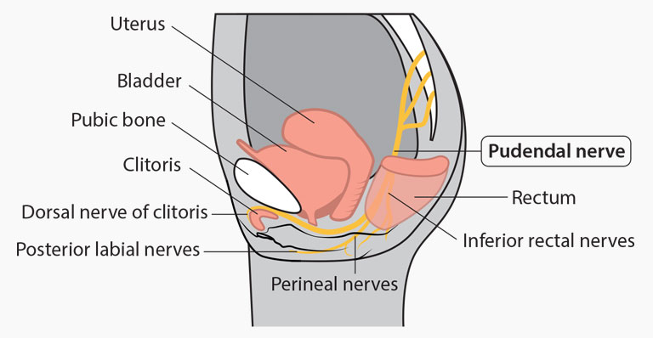
Infiltration of a local anesthetic around the trunk of the pudendal nerve at the level of the ischial spine results in analgesia of these areas (lower vagina, posterior perineum and vulva).

Slide 47
Of note, pudendal nerve block does not abolish sensation to the anterior part of the perineum because this region is supplied by branches of the ilioinguinal and genitofemoral nerves.

Slide 48
Local anesthetics produce reversible blockade of nerve conduction by blocking sodium channels.
Epinephrine may be added to local anesthetic solutions to delay absorption and increase duration of blockade by inducing vasoconstriction of the blood vessels in the area. Epinephrine also is useful because it serves as a marker for intravascular injection: an increase in heart rate or blood pressure suggests that the mixture has entered the maternal circulation.
However, epinephrine should not be used in women with medical conditions, such as cardiac disorders, that necessitate the avoidance of maternal tachycardia.

Slide 49
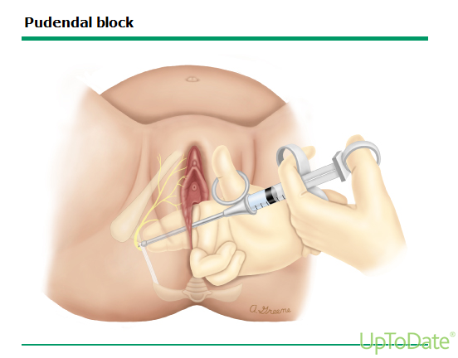
While either a transvaginal or transperineal approach to the ischial spine can be used, the transvaginal approach is almost always employed, except for laboring women in whom the fetal head has descended so far that the clinician cannot access the ischial spines.
Notes:
The nerve crosses posterior to the sacrospinous ligament in close approximation to where the ligament attaches to the ischial spine.

Slide 50
Complications
Hematoma
Infection – Infection can occur at the site of injection.
Nerve injury – Ischial region paresthesias or sacral neuropathy can result from nerve injury incurred during block placement.
Systemic toxicity – Local anesthetic systemic toxicity (LAST) can occur with intravascular administration of a local anesthetic.
Allergic reaction and toxicity – mostly with chloroprocaine and tetracaine.
Neonatal anesthetic toxicity –
Notes:
Hematoma formation from perforation of a blood vessel during needle insertion. Patients with bleeding diatheses or on anticoagulants are at increased risk.
One report described three cases of neonatal lidocaine intoxication, which manifested as transient hypotonia, apnea, seizures, mydriasis, cyanosis, and need for mechanical ventilation; all of the neonates recovered completely.

Slide 51
Paracervical Block
It is no longer used in the United States, in part because of concerns about post-block fetal bradycardia.
Warning
Paracervical block is most commonly used to provide analgesia during gynecologic procedures involving cervical dilation or manipulation.
Typical applications include:
Relief from the pain of uterine contractions and cervical dilation during the active phase of labor.
Pregnancy termination.
Hysteroscopy.

Slide 52
Paracervical anesthetics block transmission of pain through sympathetic, parasympathetic, and visceral sensory fibers before they enter the uterus at the level of the internal os.
The anatomic basis for the paracervical block is that the upper vagina, cervix, and lower uterus are innervated by the uterovaginal (or Frankenhäuser) plexus, which contains fibers derived from the inferior hypogastric (pelvic) plexus (T10-L1) and sacral nerve roots (S1-S4).
Paracervical block does not affect the motor pathways or provide pain relief to the perineum.
Notes:
When used in laboring women, progression of labor should not be significantly affected, motor function of the legs is maintained and women can ambulate, and perineal sensation persists.

Slide 54
If alternative pain management options are not available, a paracervical block can be used to reduce the pain associated with cervical dilation during the active phase of labor. The procedure is not effective for pain relief during the second stage because sensory nerves from the perineum are not blocked.

Slide 55
Notes:
To perform the procedure, the clinician's right hand is used to position the needle guide when injecting the maternal right side. Two fingers interposed between the cervix (or fetal head) and the needle guide are used to direct the tip of the guide into the lateral vaginal fornix (as you see in the figure). The direction of the needle should be slightly lateral to the cervix and fetal head to avoid puncturing the fetus.

Slide 56
Complications
Post-block fetal bradycardia – typically occurs 2 to 10 minutes after infiltration. It is usually transient, but can last as long as 40 minutes.
Maternal systemic toxicity after intravascular administration – Intravascular injection of the local anesthetic may cause excessive sedation, generalized convulsions, and cardiovascular collapse.
Other – Lower extremity paresthesias have been reported in up to 7 percent of cases, and vaginal/broad ligament hematoma or infection in 0.4 percent of cases. Allergic reactions are rare with local anesthetics
Notes:
In studies published after 1975, all affected fetuses recovered and were delivered vaginally without signs of asphyxia; however, there are older reports of fetal acidemia, low Apgar scores, and fetal death.

Slide 57
General Anesthesia

Slide 58
Definition:
An altered physiological state Characterized by: - reversible loss of consciousness and sensation - Analgesia of entire body
- Amnesia and sleep

Slide 59
General anaesthesia was once the primary anaesthetic technique used in obstetrics. As the field of obstetric anaesthesia has advanced, the use of GA has been largely replaced by neuraxial techniques. The latest decennial survey on obstetric anaesthesia practices in the USA reported a reduction of the use of GA for CS from 35% in 1981 to less than 25% in 2011
It is currently estimated that about 6% of CS still require GA and tracheal intubation.

Slide 60
Advantages of general anesthesia:
It can be given very quickly.
blood pressure is more easily controlled.
breathing is more easily controlled once the ability to breathe for the patient is obtained.
On patients with bleeding and clotting abnormalities, patients with neurological problems, patients with infections that might be spread to the spinal area if regional anesthesia is done, etc.

Slide 61
Disadvantages of general anesthesia
Possibility of maternal aspiration
Narcotization of the newborn
Problems of airway management
Maternal awareness during light general anesthesia

Slide 62
1. Possibility of maternal aspiration
Factors increase risk of aspiration include:
Diminished tone in the lower oesophageal sphincter
In later pregnancy the raised intra-abdominal pressure
Altered gastro-oesophageal angle make gastric reflux more likely
In labour the administration of opioids markedly slows gastric emptying
During induction of anaesthesia passive regurgitation of stomach contents into the pharynx may occur, and lead to aspiration pneumonia.
This is likely if the pH of the stomach contents is less than 3 (very acidic) and more than 30 mls of fluid is aspirated.

Slide 63
2. Narcotization of the newborn
Many drugs used in anaesthesia cross the placental barrier, Thus may affect the fetus, particularly opioids such as morphine and sedatives such as diazepam.
During anaesthesia these drugs should be avoided until the umbilical cord has been clamped.

Slide 64
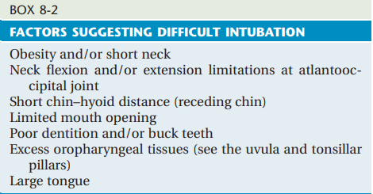
3. Problems of airway management
Difficult intubation is one of the most important concerns of general anesthesia .
a detailed history and physical examination should be done to exclude factors suggesting that intubation maybe difficult .

Slide 65
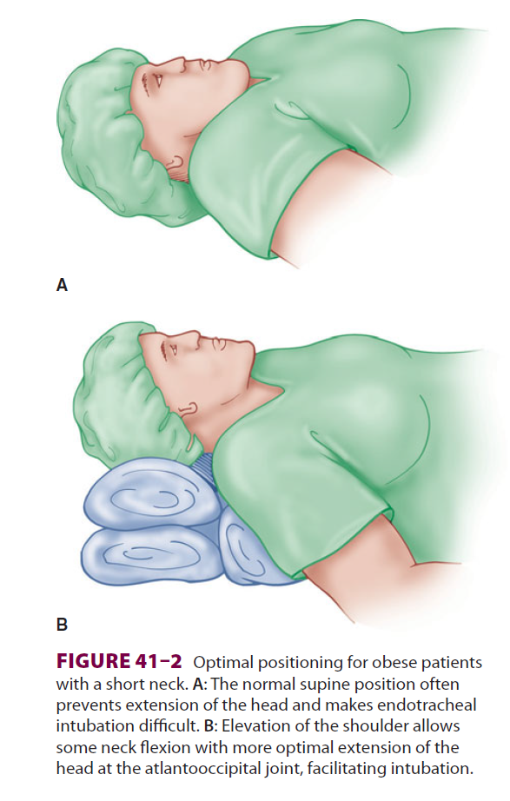

Slide 66
Women in labor have a higher risk of airway complications than nonpregnant patients because they have:
1. a twofold higher chance of failed intubation
2.a 60% increased oxygen consumption
3.a decreased functional residual capacity, resulting in a lower oxygen store
4.a potentially increased risk of aspiration.

Slide 67
4. Maternal awareness during light general anesthesia
Awareness with recall is relatively common during GA for CD. The rate of awareness under anesthesia for obstetric patients may be as high as 1:212, compared with 1:19,600 for all types of surgery . The 5 National Audit Project from the United Kingdom reported that many of these cases of awareness were preventable

Slide 68
Suggested mechanisms for awareness in these patients include the following:
1. Underdosing or omission of sedative premedication, induction agents, and opioids to avoid placental transfer to the fetus
2. Underdosing of inhalation anesthetics to avoid uterine relaxation and bleeding Changes in drug distribution related to physiologic changes of pregnancy (eg, increase in cardiac output)
3. Increase in difficulty with airway management, which is associated with awareness in all patients
4. High percentage of emergencies among patients who have general anesthesia for cesarean delivery
General anesthesia during cesarean delivery is administered differently than other surgeries due to fetal concerns and maternal physiology; some of the changes in anesthetic technique may contribute to the high incidence of awareness in obstetric patients.

Slide 69
To minimize the possibility of awareness, we administer a high concentration of volatile anesthetic after induction of anesthesia leading up to delivery, and routinely administer midazolam and opioids after delivery.

Slide 70
General anesthesia is employed for cesarean delivery in three situations:
There is extreme urgency and no preexisting epidural catheter.
(2) There is a contraindication to regional anesthesia.
(3) Regional anesthesia has failed (1.7% incidence).

Slide 71
(1) There is extreme urgency and no preexisting epidural catheter .
Emergency CD, with insufficient time to perform neuraxial anesthesia or to achieve a surgical level of anesthesia via labor epidural catheter.
For urgent or emergency CD, spinal anesthesia may be appropriate, particularly for patients who have increased risks associated with general anesthesia (ie, known difficult airway, recent oral intake of food, or malignant hyperthermia susceptibility). A single shot spinal anesthetic by an experienced provider does not take much longer than general anesthesia induction. The anesthesia and obstetric providers should collaborate to determine the degree of urgency so the appropriate anesthetic plan can be formulated.

Slide 72
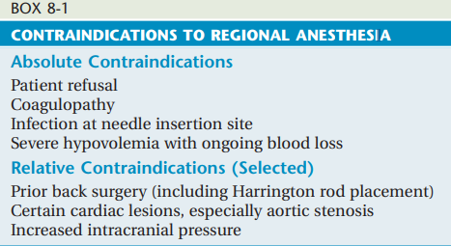
(2) There is a contraindication to regional anesthesia

Slide 73
(3) Regional anesthesia has failed (1.7% incidence).
A neuraxial block inadequate for surgery may occur if there is no block, a low spinal level, or a patchy block.
Management of inadequate block depends on the degree of urgency and patient factors. In urgent situations, general anesthesia should be induced rather than making further attempts at neuraxial anesthesia.

Slide 74
PREPARATION FOR ANESTHESIA
1 . Aspiration prophylaxis :
Because worse outcome may be associated with aspiration of particulate matter, acidic material, and of large volumes, goals for aspiration prophylaxis are to eliminate particulate gastric contents and to decrease the volume and acidity of stomach contents at the time of induction of anesthesia.
Aspiration prophylaxis is done by preoperative fasting and pharmacological prophylaxis

Slide 75
Preoperative fasting:
Gastric emptying is not changed by pregnancy ,and preoperative fasting guidelines are the same for elective cesarean delivery as for other surgical procedures (ie, two hour fast for clear liquids, six hours for solids, eight hours for fatty meals).
B. Pharmacological prophylaxis:
American Society of Anesthesiologists Practice Guidelines for Obstetric Anesthesia, which state that the timely administration of nonparticulate antacids, H2 receptor antagonists and/or metoclopramide should be considered , they also listed proton pump inhibitors in consideration

Slide 76
1. nonparticulate anatacids :sodium citrate-citric acid 30 mL orally . Sodium citrate and citric acid oral solution increases stomach pH immediately and for approximately one hour , while the other prophylactic medications require 30 to 40 minutes to be maximally effective.
2.H2 receptor blockers :famotidine 20 mg IV .
The combined administration of antacids with H2 antagonists was more effective at reducing gastric acidity (ie, pH <2.5)
3.proton pump inhibitors : pantoprazole 40 mg IV.
4. prokinetic agents : metoclopramide 10 mg IV over one to two minutes. Metoclopramide promotes stomach emptying and also increases lower esophageal sphincter tone, which may be particularly helpful in parturients who typically have lower esophageal sphincter dysfunction due to hormonal and anatomical factors.

Slide 77
2. Premedications :Unlike many other surgical procedures, sedatives are not generally administered as premedication prior to cesarean delivery, as these medications cross the placenta and also may result in some degree of amnesia for the baby's birth. Reassurance and verbal support by the anesthesia clinician provide sufficient anxiolysis for most patients.
3. IV access : one 16- to 18-gauge intravenous (IV) catheter , additional IV catheters as indicated by the risk of hemorrhage.
4. Monitoring : pulse rate, blood pressure measurement, electrocardiography, oxygen saturation via pulse oximetry, and temperature monitoring when significant changes in body temperature are expected.
5. The fetal heart rate should be documented prior to cesarean delivery. If possible, laboring patients who were monitored in the labor room should continue to be monitored after transfer to the operating room when surgery is significantly delayed or when clinically indicated.

Slide 78
6. Preoperative antibiotics – A single intravenous dose of a narrow spectrum antibiotic should be administered preoperatively within 60 minutes of incision to all women undergoing planned cesarean delivery
Cesarean delivery (intact membranes, not in labor) : Cefazolin <120 kg: 2 g IV ≥120 kg: 3 g IV OR Clindamycin900 mg IV + Gentamicin5 mg/kg IV (if overweight or obese, based on adjusted body weight)
Cesarean delivery (in labor, ruptured membrane) : Cefazolin <120 kg: 2 g IV ≥120 kg: 3 g IV + Azithromycin500 mg IV OR Clindamycin900 mg IV + Gentamicin5 mg/kg IV (if overweight or obese, based on adjusted body weight) + Azithromycin500 mg IV

Slide 79
Prior to general anesthesia, the patient is positioned on the operating table with left uterine displacement, with the head and neck positioned optimally for intubation. The patient's abdomen is typically prepared and draped prior to induction of anesthesia, to minimize the time between induction and delivery and fetal exposure to anesthetics. The surgeon makes an incision only after the anesthesia clinician has the airway secured.

Slide 80
Induction of anesthesia
Rapid sequence induction and intubation (RSII) is the standard induction technique for cesarean delivery.
Induction agents of choice :
1-Propofol (2 to 2.5 mg/kg IV)
Side effects: 1. Maternal hypersensitivity
2. It crosses the placenta and maybe associated with neonatal respiratory depression and neurotoxicity
2-Etomidate (0.3 to 0.5 mg/kg IV)
Used when cardiovascular stability is particularly desirable
3- Ketamine
used for patients with hypovolemia or asthma
4-Thiopental
Notes:
Rapid sequence induction (RSI) is an established method of inducing anaesthesia in patients who are at risk of aspiration of gastric contents into the lungs. It involves loss of consciousness during cricoid pressure followed by intubation without face mask ventilation. The aim is to intubate the trachea as quickly and as safely as possible.

Slide 81
Neuromuscular blocking agents : muscle relaxant used to facilitate intubation is succinylcholine (unless contraindicated), because of its rapid onset and brief duration of action. If contraindicated, vecuronium or rocuronium may be used.
Notes:
Contraindications ????/??

Slide 82
Maintenance of general anesthesia
Nitrous oxide may be added. After induction, a potent inhalational agent is administered at a modest level (0.5 minimum alveolar concentration) to minimize myometrial relaxation .
Oxygen delivery is maintained at 50-100% until delivery if the baby is stressed.
Narcotics may be administered after the delivery of the baby to reduce the need for inhalational anesthesia and provide postoperative pain relief.
The patient must be extubated only when fully awake to minimize the risk of aspiration.

Slide 83
COVID-19

Slide 84
Patients with confirmed or suspected COVID-19
Use droplet and contact precautions with eye protection regardless of the type of anesthesia (gown, gloves, mask, face shield).
Patients should wear a surgical mask at all times.
Patients with COVID-19 often receive venous thromboembolism prophylaxis. The anticoagulation regimen should be carefully considered.

Slide 85
Neuraxial anesthetic is not contraindicated in patients with known or suspected COVID-19 and has several advantages in laboring patients: it provides excellent analgesia and thus reduces cardiopulmonary stress from pain and anxiety.
Consider checking a platelet count prior to neuraxial anesthesia in symptomatic patients. Thrombocytopenia has been reported in patients with COVID-19.
Avoid allowing cerebrospinal fluid (CSF) to drip from the needle when performing spinal anesthesia, and avoid contact with CSF. It is not known whether severe acute respiratory syndrome coronavirus 2 (SARS-CoV-2), the virus responsible for COVID-19, enters CSF. However, in patients infected with some other coronaviruses, those viruses have been detected in CSF.

