Slide 1
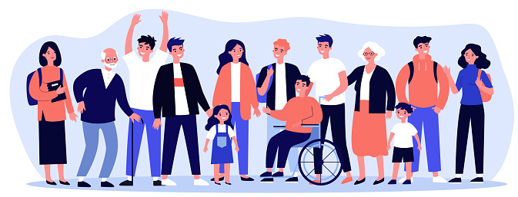
Introduction What is Public Health?
Dr. Israa Al-Rawashdeh MD,MPH,PhD
Faculty of Medicine
Mutah University
2022

Slide 2
Course title: Public health Course code: 1506202
Credit hours: 2 hours

Slide 3
Tips to kick-off the new academic year successfully
Reflect on previous year’s mistakes and draw personal conclusions
Plan time and set your goals
Organise your study environment
Ask for help
Try new things
Develop anti-stress strategies
Attending classes is always better than copying notes from your peers, audio tracks..etc..

Slide 4
Objectives of this lecture:
To identify concepts of health, disease, public health and other related concepts.
How public health is different from clinical medicine?
To get introduced to a brief history of public health.
To acknowledge the importance of public health in a community.
To identify how public health approach works.

Slide 5
First: What is Health?
Feeling healthy is core to our everyday lives
“A state of complete physical, mental and social well being and not merely the absence of disease or infirmity”.
The World Health Organization (WHO), 1948
Recently this statement has been expanded to include the ability to lead a “socially and economically productive life”.
Notes:
Too idealistic, different perceptions of health to different people, differentiate physical and mental, difficult to measure (operationalise)!

Slide 6
Health is multidimensional
The WHO definition mentions three specific dimensions (physical, mental, and social), some other dimensions like spiritual, emotional may also be included.
Physical health- anatomical integrity and physiological functioning of the body. It means the ability to perform routine tasks without any physical restriction. E.g., Physical fitness is needed to walk from place to place.
Mental Health- is the ability to learn and think clearly and coherently. E.g., a person who is not mentally fit may not learn something new at the same pace in which a mentally fit person learns.

Slide 7
Health is multidimensional
Social health- is the ability to make and maintain acceptable interaction with other people. E.g. to celebrate during festivals; to mourn when a close family member dies; to create and maintain friendship and intimacy, etc.
Emotional health - is the ability of expressing emotions in the appropriate way, for example to fear, to be happy, and to be angry. The response of the body should be suitable with that of the stimuli. It also means maintaining one’s own integrity in the presence of stressful situation such as tension, depression and anxiety. Emotional health is related to mental health and includes feelings.
Spiritual Health - Some people relate health with religion; for others it has to do with personal values, beliefs, principles in which all are related to their spiritual wellbeing.
A few other dimensions such as philosophical dimension, cultural dimension, socioeconomic dimension, environmental dimension, educational dimension, nutritional dimension, and so on.

Slide 8
Spectrum of Health
There is no single cut-off point.
The lowest point on the health-disease spectrum is death and the highest point corresponds to the WHO definition of positive health.
There are degrees or "levels of health", as there are degrees or severity of illness.
Health is a state, not to be attained once and for all, but ever to be promoted, preserved, and restored when impaired.
Health is a dynamic phenomenon
The primary focus of today’s medical care system is (sick)!

Slide 9
DETERMINANTS OF HEALTH
They are the product of a complex interaction of different factors: this works at both individual and population levels.
These can be grouped into categories:

Slide 11
DETERMINANTS OF HEALTH
Human biology: includes all those aspects of health, both physical and mental, which are developed within the human body. For example, age, gender, genetic inheritance.
Environment includes factors related to health which are external to the human body and the individual has little or no control on them. Examples : geography, climate, industrial development and the economy (income level, crowding, place of residence). Socio-cultural determinants include the beliefs, traditions, and social customs in the community.
Lifestyle : is made up of the habits and usual practices of human beings which affect their health. The individual can have control over them. For example people who smoke are at more risk of acquiring lung cancer. Other examples: Unsafe sport practice ,Eating contaminated food, etc.
Health care organisation consists of the arrangement and resources that are used in the provision of healthcare (the healthcare system)+ Quality of care. For example if someone is sick from a disease and there are no health facilities nearby to treat the patient, the patient is more likely to develop a severe complication and may even die.

Slide 12
Risk factors
Risk factors are those inherited, environmental and behavioural influences which are known or thought to increase the likelihood of illness.
Risk factors are determined across a large population of people. However, not everyone will be equally affected. For example someone might drive dangerously and never have an accident, or smoke too much and never get lung cancer.
Risk factors can be divided into two categories:
Non-modifiable (non-changeable or non-controllable) risk factors: These are things that individuals cannot change or do not have control over (factors such as age, sex and inherited genes)
Modifiable (changeable or controllable) risk factors: These are things that individuals can change and control . Example: their sedentary lifestyle, smoking, drinking alcohol ,unsafe behaviours or poor dietary habits..
These two categories of risk factors can be interrelated and combined ( example: If an old person (non-modifiable factor) smokes and eats unhealthy food (modifiable risk factors) the likelihood of become ill is higher than with individual risk factors.

Slide 13
What is a population/community?
“Population” describes a group of people with a similar characteristic. That characteristic can vary: age (elderly, children, mothers..), geographic area (rural, urban..), similar diagnosis (Cancer, Diabetes, TB…), employees of the same company (workers, students…), disabled persons, or groups based on socioeconomic status or ethnicity are all examples of populations.
Aim of public health: provide everyone, everywhere the best chance to live long, healthy, fulfilling lives from the beginning to the vey end!

Slide 14
Now: What is Public Health?

Slide 15
Imagine yourself a clinician in your clinic:
You make all you can to make the
sick individual in front of you better!
You are committed to your job and
very busy treating those who come for help!
You have similar attitude for other patients sitting outside
In the waiting room!
BUT, what about those who have not come to you?

Slide 16
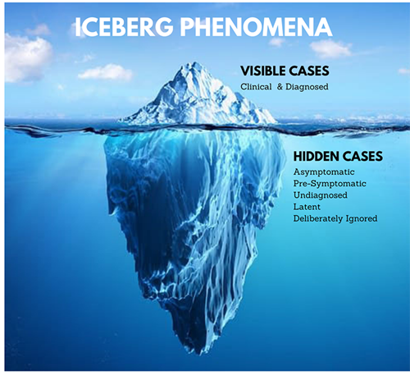

Slide 17
Clinical Medicine and Public Health
Clinical medicine is concerned with diagnosing and treating diseases in individual patients. It has evolved from primarily a medical and nursing service to involve a highly complex team of professionals.
Public health refers to the health status of a defined group of people and the governmental actions and conditions to promote, protect and preserve their health.

Slide 18
Clinical medicine Vs Public health
Items | Public health | Clinical medicine
Objective | prevent diseases | cure diseases
Customers | All community (healthy and diseased) | Individuals (diseased only)
Methods of diagnosis | Demographics Vital statistics Epidemiology | Individual data: History, clinical exam, laboratory investigations
Management | Community health programs | Medical/surgical treatment
Evaluation | Assessment of health programs and health status of a community | Follow up of patients
Branches | Epidemiology, environmental health, management, health services, statistics…… | Internal medicine, surgery, pediatrics, gynecology…

Slide 19
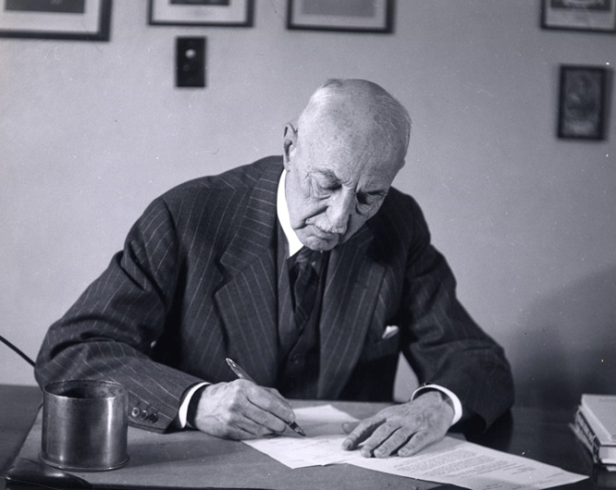
Public Health Defined
“The science and art of preventing disease, prolonging life, and promoting health through the organised efforts and informed choices of society, organizations, public and private communities, and individuals.”
—CEA Winslow
PREVENTION
PROTECTION
PROMOTION
Winslow CEA. The untilled field of public health. Mod Med 1920;2:183–91.

Slide 20
Jordan Life Expectancy 1950-2022
Improving the health of a population!
Source: www.macrotrends.net

Slide 21
The Historical Development of Modern Public Health
The history of public health goes back to almost as long as history of civilization.
1800s-1900s: The Industrial Revolution--population growth—Insanitary conditions—infectious diseases—emergence of epidemics such as cholera--low life expectancy-- key element in the emergence of the Great Sanitary Awakening.
Edwin Chadwick: Public Health Act 1848-
Dr. John Snow: The outbreak of cholera epidemic 1854 (The Broad Street pump)
Louis Pasteur (The germ theory) 1864 .
The beginning of the modern public health movement.
Early public health work focused on the prevention of infectious diseases.

Slide 22
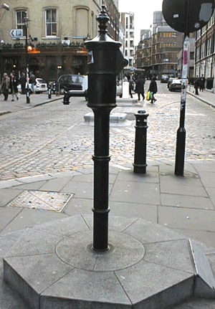
The Broad Street pump

Slide 23
The Historical Development of Modern Public Health
A new concept of disease etiology “multi-factorial causation” .
Modern life and risk factors-Globalisation.
Important features of modern public health include the following characteristic features:
■ Multidisciplinary;
■ Multisectoral;
■ Evidence-based;
■ Equity-oriented.

Slide 24
Prevention There are three levels of prevention
PRIMARY
■ Target population : entire population with special attention to healthy individuals
■ Objective: prevent onset of illness
■ Methods: education, immunization, nutrition,
sanitation, etc.

Slide 25
Prevention
SECONDARY
■ Target population: at risk and individuals at early illness
■ Objective: early diagnosis and treatment to prevent
further damage to the individual and in cases of
infectious diseases, spread to the community
■ Methods: screening of high risk groups e.g. Pap
smears, sputum examination for TB; monitoring
of vulnerable groups – children, pregnant women

Slide 26
Prevention
TERTIARY
■ Target population: sick patients
■ Objective: reduce damage from disease and restore function
■ Method: clinical care and rehabilitation

Slide 27
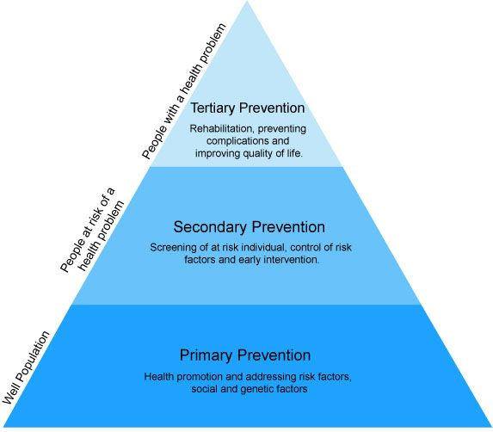

Slide 28
Health promotion
Activities intended to enhance individual and community health well-being.
It seeks to increase involvement and control of the individual and the community in their own health.
Health promotion is a key element in public health and is done in the community, clinics or hospitals, and in all other service settings (schools, universities,..etc.).
Raising awareness: informing/teaching people about health and lifestyle factors that might put them at risk.

Slide 29
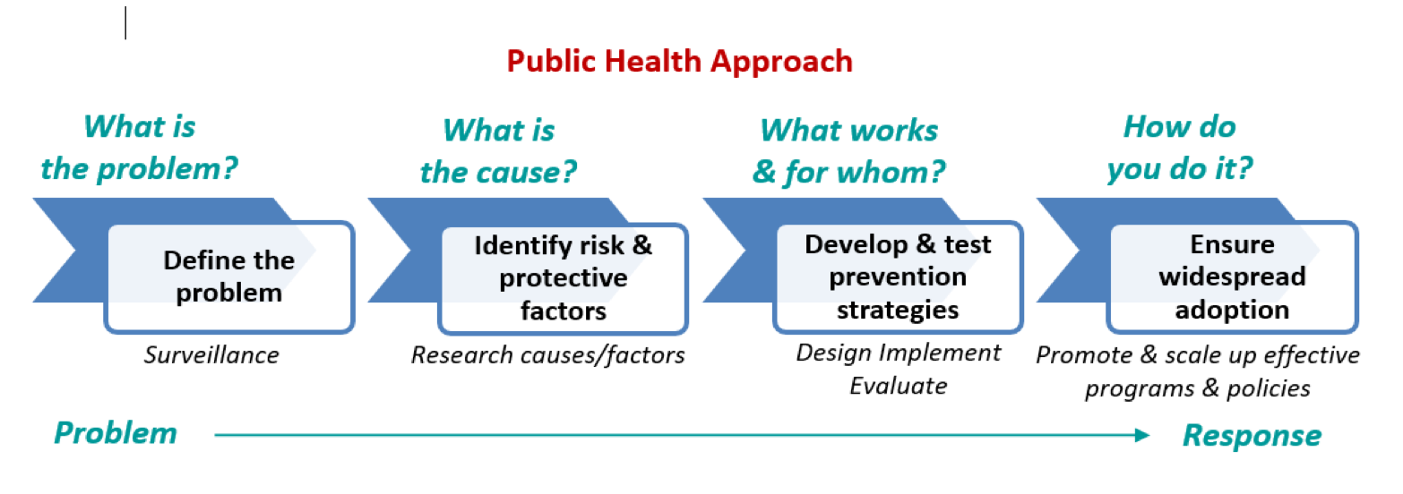
Public health approach

Slide 30
A Public Health System Is Complex
Mosques
Community Centers
Police
Emergency
Airports
Health Department
Home Health
Hospitals
Schools
Parks
Doctors
Jails
Elected Officials
Mass Transit
CHCs
Environmental Health
Civic Groups
Fire
Local Health
Laboratory Facilities
Drug Treatment
Employers
Economic Development
Mental Health

Slide 31
Three Core Functions of Public Health
Systematically collect, analyze, and make available information on healthy communities and Identify problems related to the public’s health, and measure their extent
Assessment
Policy
Development
Prioritize problems, find possible solutions, set regulations to achieve change, and predict effect on the population using of a scientific knowledge base (Evidence based Public Health) in policy and decision making
Assurance
Ensure provision of services to those in need, widespread adoption and dissemination.
Ensure provision of technical assistance and evaluation.
Institute of Medicine. The future of public health. Washington, DC: National Academies Press; 1988.
31

Slide 32
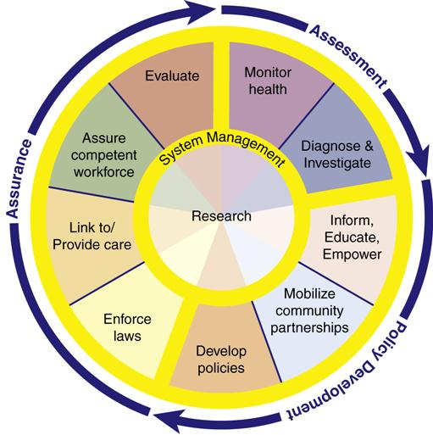
The 10 Essential Public Health Services describe the public health activities that all communities should undertake:
Monitor health status to identify and solve community health problems
Diagnose and investigate health problems and health hazards in the community
Inform, educate, and empower people about health issues
Mobilize community partnerships and action to identify and solve health problems
Develop policies and plans that support individual and community health efforts
Enforce laws and regulations that protect health and ensure safety
Link people to needed personal health services and assure the provision of health care when otherwise unavailable
Assure competent public and personal health care workforce
Evaluate effectiveness, accessibility, and quality of personal and population-based health services
Research for new insights and innovative solutions to health problems

Slide 33
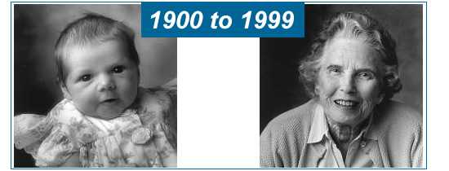
The great public health achievements
Vaccination
Motor-vehicle safety
Safer workplaces
Control of infectious diseases
Decline in deaths from coronary heart disease and stroke
Safer and healthier foods
Healthier mothers and babies
Family planning
Fluoridation of drinking water
Recognition of tobacco use as a health hazard
CDC, 1999

Slide 34
Cancer screening
Improved Preparedness and Response to Global Health Threats.

Slide 35
Thank you

