Slide 1
Non-ossifying fibroma (fibrous cortical defect)
The commonest benign lesion of bone.
Developmental defect, nest of fibrous tissue appear within the bone and persist for years before ossifying.
Clinical features: asymptomatic and is almost always encountered as an incidental finding on x-ray.
Usual sites are metaphysis of long bones.

Slide 2
X-rays: The appearance is unmistakable. There is a more or less oval radiolucent area in or adjacent to the cortex.
Although it looks cystic on x-ray, it is a solid lesion consisting of unremarkable fibrous tissue.
As the bone grows it heals spontaneously, it may enlarge and cause pathological fracture.
Treatment :except for a pathological fracture treatment is conservative and follow up.

Slide 4
Fibrous dysplasia
Developmental disorder.
Areas of trabecular bone are replaced by fibrous tissue, osteoid and woven bone.
The condition may affect one bone (monostotic), one limb (monomelic) or many bones (polyostotic).
Notes:
Clinical features: Small, single lesions are asymptomatic. Large, monostotic lesions may cause pain and bone deformity, or may be discovered only when the patient develops a pathological fracture.

Slide 5
X-rays :Cyst-like areas in the metaphysis or shaft have a hazy (so-called ground-glass)
The weight-bearing bones may be bent, and one of the classic features is the ‘shepherd’s crook’ deformity of the proximal femur.
Pathology: The histological picture is of cellular fibrous tissue with patches of woven bone and scattered giant cells.

Slide 6
Notes:
Small lesions need no treatment.
- Those that are large and painful or threatening to fracture (or have fractured) can be curetted and grafted, but there is a strong tendency for the abnormality to recur.

Slide 7
Osteoid osteoma
Benign tumor consisting of osteoid and newly formed bone.
It is small(usually less than 1 cm) round or oval in shape and encased in dense bone.
Usually in patient under 30 years, and over one half of cases occur in the femur or tibia.
Clinical features: the leading symptom is pain which is sometimes sever, usually relieved by aspirin not by rest.

Slide 8
X-rays: The important feature is a tiny radiolucent area, the so called ‘nidus’
DDx: small Brodie’s abscess (may need biopsy).
Treatment : complete removal of the nidus or Radiofrequency ablation

Slide 10
Chondroma (enchondroma)
The tensional tissue is indistinguishable from normal hyaline cartilage, but there is often a central area of degeneration and calcification.
Clinical features: Chondromas are usually asymptomatic and discovered incidentally on x-ray or after a pathological fracture.

Slide 12
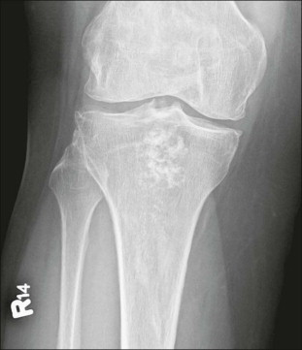
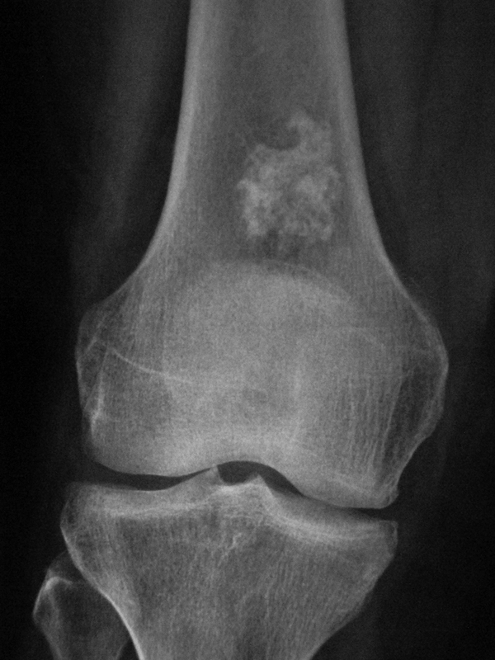

Slide 13
Treatment
Painful or enlarging or if it presents as a pathological fracture it should be removed as thoroughly as possible with curettage, the defect is filled by bone graft.
There is a small risk of malignant transformation, suspect in adults if :
1- onset of pain 2-enlargment of the lesion 3- cortical erosions >>>>>> if these features are present especially in older patients the tumor is treated as a low grade malignancy.
Notes:
X-ray: central (sometimes expanded) radiolucent area near the bone end (distinguished from other cyst like lesions by the presence of tiny flecks of calcifications in the lucent area).

Slide 14
Osteochondroma (cartilage capped exostosis)
There is a small risk of malignant transformation.
Clinical features: The patient is usually a teenager or young adult when the lump is first discovered. The exostosis may go on enlarging up to the end of the normal growth period for that bone; any further enlargement after that is suggestive of malignant change.

Slide 15
Notes:
X-RAYS: a well-defined bony protuberance (exostosis) emerging from the metaphysis. It looks smaller than it feels, why ?
large lesions undergo cartilage degeneration and calcification and then the x-ray shows the bony exostosis surrounded by blotches of calcified material.

Slide 17
Treatment
If the tumor causes symptoms it should be excised; if, in an adult, it has recently become bigger or painful then operation is urgent, for these features suggest malignancy, even if the histology looks ‘benign’.

Slide 18
Chondroblastoma
This rare tumour of immature cartilage cells
Is one of the very few lesions to appear primarily in the epiphysis, usually of the proximal humerus, femur or tibia.
Clinical features :The presenting symptom is aching and tenderness adjacent to the joint.

Slide 19
Notes:
X-rays: The characteristic x-ray appearance is of a well-demarcated radiolucent area in the epiphysis.

Slide 20
Treatment
In children the risk of damage to the physis makes it risky to remove the lesion.
In adults this is not a problem; however, there is a high risk of recurrence after incomplete removal, and if this happens repeatedly there may be serious damage to the nearby joint.

Slide 21
Simple bone cyst
This is a true solitary or unicameral bone cyst.
It appears during childhood, typically in the metaphysis of one of the long bones and most commonly in the proximal humerus or femur.
It is not a tumour, tends to heal spontaneously and is seldom seen in adults.
Clinical features: The condition is usually discovered after a pathological fracture or as an incidental finding on x-ray.

Slide 22
Notes:
X-rays: The appearance on x-ray is of a large bubble inside the bone. It may occupy the entire metaphysis but it does not extend beyond the physeal plate.

Slide 23
Treatment
Asymptomatic lesions in older children can be left alone but the patient should be cautioned to avoid injury which might cause a fracture.
‘Active’ cysts (those in young children, usually abutting against the physeal plate and obviously enlarging in sequential x-rays) should be treated.

Slide 24
Aneurysmal bone cyst
Cystic tumor like lesion, occurs chiefly in the spine and metaphysis of long bones.
Usually affects young adults, no risk of malignant transformation.
It may expand and cause marked thinning of the cortex.
Contains clotted blood and lined by a flesh membrane

Slide 25
Notes:
X-rays:
In growing tubular bone: the cyst is always situated in the metaphysis and may resemble a simple cyst.
In adults: it can be mistaken for giant cell tumor
Treatment: the cyst should be curetted and packed with bone grafts

Slide 26
Giant-cell tumor
Giant-cell tumor is a lesion of uncertain origin that appears after the end of bone growth.
Aggressive lesions have a poorly-defined ‘floor’ and appear to extend into the surrounding bone.

Slide 27
About one-third of these tumor remain truly benign; one-third become locally invasive and one third metastasize.
Clinical features: The patient is usually a young adult who complains of pain at the end of a long bone; sometimes there is slight swelling. Pathological fracture occurs in 10–15% of cases.

Slide 28
Notes:
Histologically the striking feature is an abundance of multinucleated giant cells scattered on a background of stromal cells with little or no visible intercellular tissue.

Slide 29
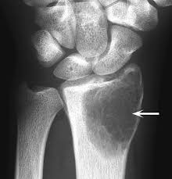
Notes:
Imaging:
Although this is a solid tumour, it appears on x-ray as a ‘cystic’ (i.e. radiolucent) area situated eccentrically at the end of a long bone. Unlike any of the other ‘cystic’ lesions, it always extends right up to the subchondral bone plate
The endosteal margin is usually clear-cut, but in invasive lesions it is ill defined.

