Slide 1
e
Presented by: Neveen Masarwah

Slide 2
Introduction
Fatigue is one of the most common symptoms in clinical medicine.
Fatigue is a symptom, not a condition. For many people, fatigue is caused by a combination of lifestyle, social, psychological and general wellbeing issues rather than an underlying medical condition.
In the context of clinical medicine, fatigue is most typically and practically defined difficulty or inability to initiate activity (subjective sense of weakness); reduced capacity to maintain activity (easy fatigability); or difficulty with concentration, memory, and emotional stability (mental fatigue)

Slide 3
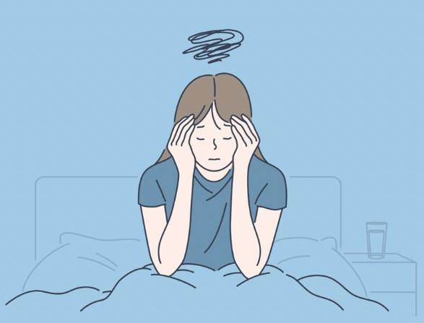
Fatigue should be distinguished from muscle weakness, Weakness is a lack of muscle strength and power and a reduced ability to move your body.
Fatigue is also distinct from somnolence, which refers to sleepiness in the context of disturbed sleep-wake physiology, and from dyspnea on exertion, although patients may use the word fatigue to describe those symptoms.

Slide 4
Epidemiology And Global Concerns
Variability in the definitions of fatigue and the survey instruments used in different studies makes it difficult to arrive at precise figures about the global burden of fatigue.
• It is one of the top 10 chief complaints leading to family practice office visits
• Fatigue occurs in up to 20% of patients seeking care
• Higher in women than in men.
• Psychiatric illness is present in 60 to 80 % of patients with chronic fatigue

Slide 5
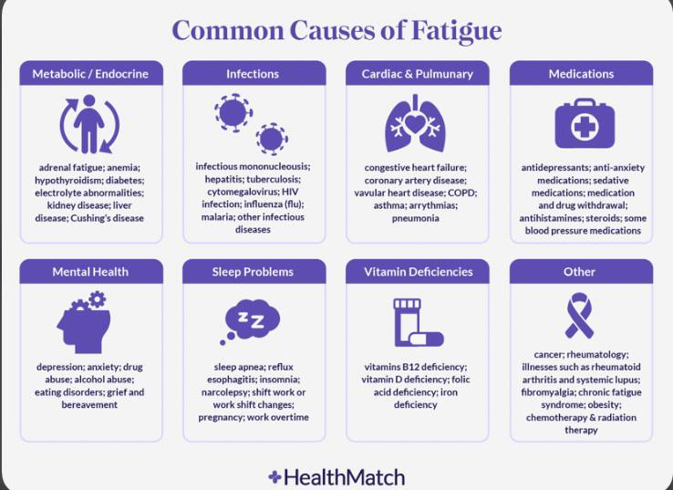
Causes of fatigue (DDx)

Slide 6
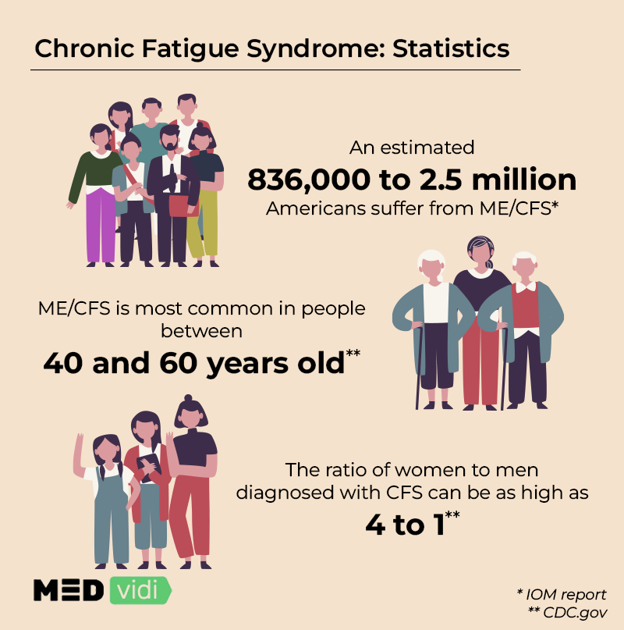
- Fatigue of unknown etiology:
Chronic fatigue syndrome
(CFS is profound fatigue for longer than 6 months, that is not due to a medical or psychiatric disorder.)
2) Idiopathic chronic fatigue
-Only 5% of cases are diagnosed as CFS.
-Most cases of chronic fatigue are due to depression, anxiety, or both (up to two-thirds of cases).
-Between 20% and 25% of cases are idiopathic, yet do not fit the criteria for CFS.
-

Slide 7
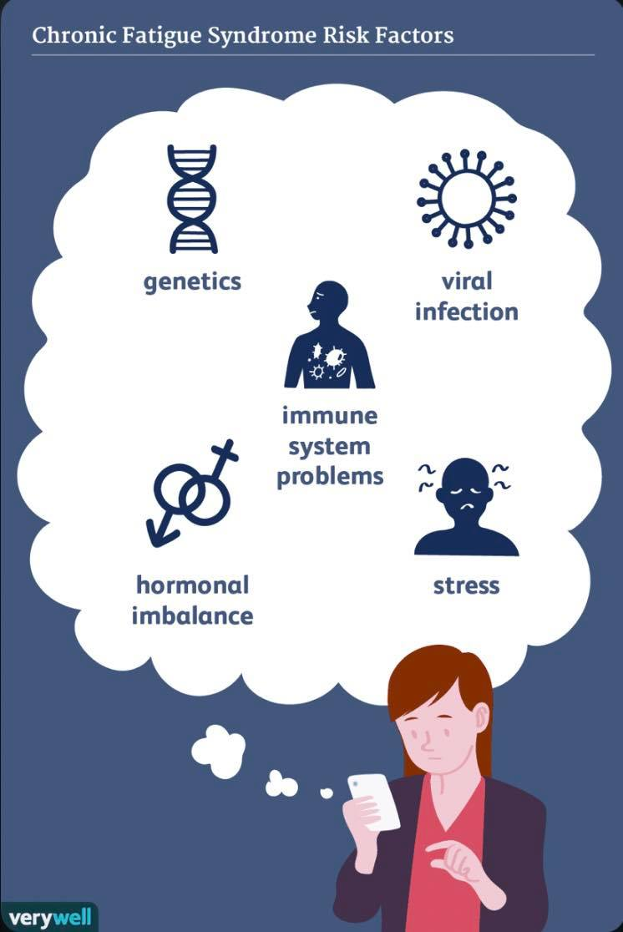
- Chronic fatigue syndrome :
* The etiology of CFS is not completely understood. Factors possibly involved include the following:
Genetics: Chronic fatigue syndrome
appears to run in some families, so some
people may be born with a higher likelihood
of developing the disorder.
2) Infections : as HSV-6, enterovirus, HIV.
3) Physical or emotional trauma: Some people report that
they experienced an injury, surgery or significant
emotional stress shortly before their symptoms began.
4) Problems with energy usage.

Slide 8
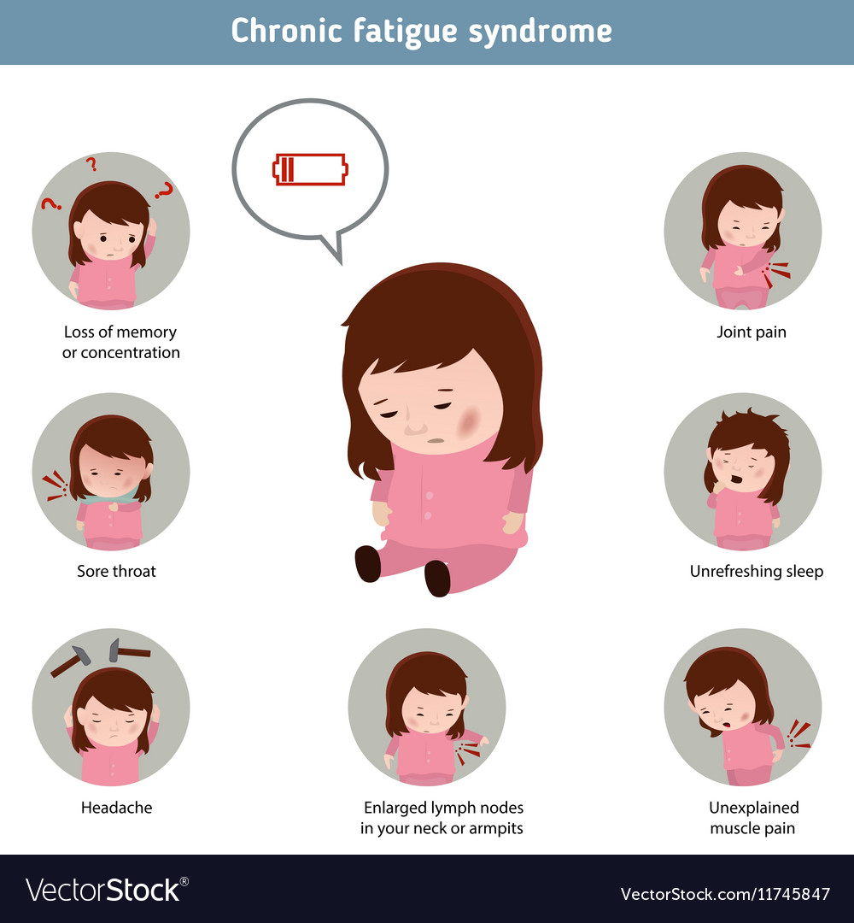
Clinical features:
Most common symptoms:
Unexplained fatigue that is not relieved by rest
Post-exertional malaise (e.g.,muscle/joint pain, headache)
Unrefreshing sleep (daytime hypersomnolence and nighttime insomnia)
Cognitive impairment (e.g., impaired short term memory, decreased attention span)
Orthostatic intolerance (e.g., dizziness, nausea, vomiting)
Psychiatric symptoms (e.g., anxiety, depression)
Symptoms are typically exacerbated by excessive physical activity or stress (e.g., infection).
Physical examination is typically normal.

Slide 9
2015 IOM diagnostic criteria for CFS:
-Presence of all three of the following symptoms:
New-onset (not life-long) and often profound fatigue that
Is not alleviated by rest.
Is not the result of excessive exertion.
Substantially impairs academic, professional, leisure, or social function for > 6 months
Post-exertional malaise
Unrefreshing sleep
-Presence of at least one of the following two symptoms:
Cognitive impairment
Orthostatic intolerance
-Diagnosis should be reassessed if symptoms are not moderate to severe at least 50% of the time.
Rule out other causes:
CBC with differential count (to rule out, anemia or leukemia)
Glucose, electrolytes (to rule out, diabetes mellitus)
Renal function tests (to rule out, adrenal abnormalities), liver function tests (to rule out hepatitis C)
TSH (to rule out hypothyroidism or hyper)
Creatine kinase (to rule out idiopathic inflammatory myopathies)
Sleep study (to rule out obstructive sleep apnea)

Slide 10
Treatment:
-Since there is no curative treatment, management focuses on alleviating symptoms.
-Improve sleep hygiene for better quality of sleep.
-NSAIDs if pain is present.
-Low-dose tricyclic antidepressants :
If nocturnal awakenings persist despite improved sleep hygiene
Can also be used for pain management
-Fludrocortisone or atenolol for dizziness.
-Individualized exercise.
Prognosis:
-In most patients, symptoms improve with treatment but complete resolution of symptoms is rare (∼ 2% of cases).

Slide 11
How to assess Fatigue patient (Approach)
History taking
Physical examination
Investigation

Slide 12
Key aspects of history
- First step in the diagnostic process is assessment of the characteristic of fatigue:
● Onset – Abrupt or gradual, relationship to illness or life event
● Course – Stable, improving, or worsening
● Duration and daily pattern
● Factors that alleviate or exacerbate it
● Impact on daily life – Ability to work, socialize, participate in usual activities
Medical history
Family & social history
Drug history
Sleep d/o assessment
Psychiatric/Mood assessment

Slide 13
▸ Thorough and systematic physical examination is mandatory
‣ Can identifies signs suggestive of secondary underlying causes
‣ But no positive physical signs on examination cannot totally exclude organic causes of fatigue

Slide 14
Investigations
Laboratory testing is likely to identify the cause of chronic fatigue in only about 5% of cases.
Beyond a few standard screening tests, laboratory evaluation should be guided by the history and physical examination; extensive testing is more likely to lead to false-positive results that require explanation and unnecessary follow-up investigation, and should be avoided in lieu of frequent clinical follow-up.
Basic laboratory tests to exclude other causes—consider CBC, LFTs, serum electrolytes, calcium, TSH, erythrocyte sedimentation rate, and HIV testing (if indicated).
Extensive testing other than the above is not indicated.
Additional unfocused studies, such as whole-body imaging scans, are usually not indicated; in addition to their inconvenience, potential risk, and cost, they often reveal unrelated incidental findings that can prolong the workup unnecessarily.

Slide 15
Chronic fatigue more than 6 months
+
No red flags S/S suggestive for organic disease
+
Normal basic investigations
Chronic fatigue
syndrome
Idiopathic chronic
fatigue

Slide 16
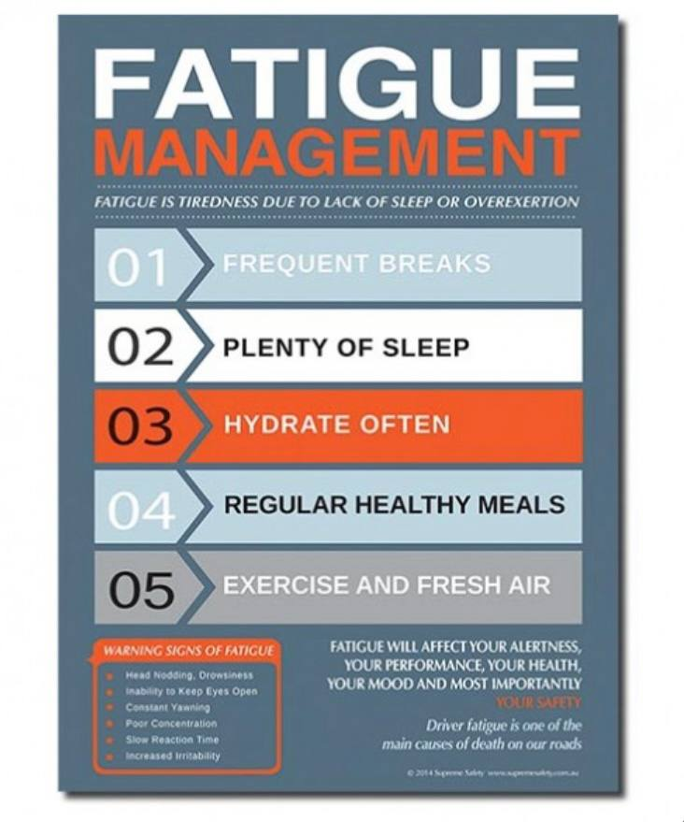
How to manage?
Multidisciplinary approach
Good doctor-patient relation ship is important

Slide 17
The first priority of treatment is to address the underlying disorder or disorders that account for fatigue, because this can be curative in select contexts and palliative in others.
If organic cause is found, treat the underlying cause
If more in favor of psychiatry, refer to psychiatrist for further assessment and treatment(antidepressant, CBT, Exercise therapy)
If due physiological and social factors, patient education on healthy life style and help to solve difficulties
. If no cause is identified, Patient education and encouragement, exercise therapy

Slide 18
Take home message
Fatigue is the most common unexplained presenting to OPD clinic.
There is a wide range of possible diagnoses from serious disease to just coping a problem.
Analyzing the symptoms and signs and reaching a diagnosis without overestimating is the key(by history and examination)
Successful management need multidisciplinary team approach and good doctor patient relationship.

