Slide 1
Obs & Gyni online discussions

Slide 3
تشكر لجنة الطب والجراحة – جامعة مؤتة الزملاء :
كوثر المومني ، آلاء الضمور ، أسيل السليحات
سرين صالح ، لين عمرات ، براءة الرشايدة
عمار أبوطرية ، لين عازر
لجهدهم الكبير في إعداد هذا الملف والذي يحتوي على تبيض لمحاضرات ” التعليم عن بعد “ لمادة النسائية والتوليد
سائلين الله الله أن يجزيهم خير الجزاء ؛ في الدنيا والآخرة ..

Slide 4
Hello our doctors to be I know you have been through a lot but you are finally here now just believe in yourself & always seek to be the best may good luck be always with you wateen’s 2020
“
”

Slide 5
Start a slide show & click on your desired subject it , you will be automatically transferred to the chosen slide (hyperlinked ) And you will have the opportunity to test yourself ☺

Slide 6
Subject | Doctor | Slide number
Obstetric subjects
Early pregnancy bleeding | Dr. Ahlam al kharabsheh | 7-27
Early pregnancy bleeding | Dr. Ala’a aweis | 28-41
Antepartum hemorrhage | Dr. Mohammad khader | 42-49
Post partum bleeding | Dr.Ahlam al kharabsheh | 50-66
Post partum bleeding | Dr.Adel abu al hija | 67-73
PROM , preterm labor | Dr.Omar al-dabbas | 74-92
Pre-eclampsia | Dr.Ala’a aweis | 93-103
Medical Problems in Pregnancy - Cases Discussion | Dr. Seham abu friejha | 104-129
Gynecological subjects
Fibroid | Dr. Hashim yassin | 130-164
Endometriosis & adenomyosis | Dr . Mohammad khader | 165-180
PCOS | Dr.Omar al-dabbas | 181-195
Infertility | Dr. Seham abu frijah | 196-220
Ovarian mass | Dr.Adel abu al hija | 221-233
Postmenopausal bleeding | Dr.Malik al-qasem | 234-242

Slide 7
Dr.ahlam al-kharabsheh online discussion
Early pregnancy bleeding
Sreen saleh

Slide 8
Case
A 36 years old primigravida presents to the emergency room at 8 weeks of gestation with vaginal bleeding
**open in slide show so you will get the chance to test yourself

Slide 9
What is the chief complain ?
can you give me a definite diagnosis ?
If yes what is it ? If no what your differential diagnosis ?

Slide 10
Question one : early vaginal bleeding
Question two : NOOOO , no enough information
Question three :
-miscarriage (early pregnancy loss)
-ectopic pregnancy
-molar pregnancy
Local causes:
In vagina (laceration , infection,warts ,cancer )
In cervix (polyp , infection ,ectropion ,cancer )
Fibroid

Slide 11
What is the most important points in the hx to ask about ?
Analysis of the bleeding ( amount , clots ,tissues )
Abdominal pain analysis (for ex miscarriage is cramping pain but ectopic is sharp pain ), any pelvic pain
Any vaginal discharge (PID)
Provoked factors (spontaneous or post coital)
Symptoms of anemia (headache palpitation dyspnea )
Pregnancy symptoms and its exaggerated or normal
This pregnancy is spontaneous or IVF (risk of ectopic is higher is IVF)
Gynecological hx (recent pap smear for cervical cancer )
Always remember that the first step in evaluation in these cases whether the patient has had an US examination and the results of this examination

Slide 12
she started to have bright red vaginal spotting one week ago which she thought to be normal in early pregnancy .since then the bleeding is now almost as heavy as period (2nd day ) there are no clots and no tissues
She has no abdominal pain
She has felt nausea for weeks and has vomited occassionaly

Slide 13
What is your ddx now ?
According to miscarriage
-we exclude complete (must have scant bleeding and mild cramping)
-we exclude missed (must have minimal bleeding with no pregnancy symptoms)
-we exclude inevitable (must have abdominal pain)
According to ectopic we exclude it (must have abdominal pain and mild bleeding )
So the ddx now is
threatened miscarriage
molar pregnancy
most common presentations is :
-85%vaginal bleeding and increasing more in 2nd trimester
-large for date uterus in complete mole
Because IUGR in partial mole
-hyperemesis gravidarum
-passage of vesicles (rare)
-abdominal pain not very common
-and sometimes as missed miscarriage
local causes

Slide 14
What is the most important points in the examination to focus on ?
Vital signs (stability to assess severity)
Signs of anemia
Thyroid examination
Abdominal examination
-tenderness (in miscarriage its minimal suprapubic ,in ectopic its unilateral and adnexal tenderness )
-uterine size by fundal height
If its larger than date suspect molar pregnancy (because the blood is collected inside the uterus )
BUT put in your mind it could be normal pregnancy with multiple fetuses
-auscultation by Doppler US
Vaginal examination
-inspection for any visible bleeding to determine its heavy or not
-speculum for any local causes infection laceration warts
Any cervical diltation by visualizing and blood or tissues through the cervix
-digital examination
In threatened & local causes the cervix closed
In molar could be open or closed
-bimanual examination
Uterine size
Cervical motion tenderness
Adnexal tenderness

Slide 15
On examination
Her pulse 70bpm BP 105/70
The abdomen is soft and non tender
Speculum examination :
normal closed cervix with a small amount of fresh blood coming through the cervix
On bimanual examination :
bulky soft uterus about 10 weeks in size no cervical excitation or adnexal tenderness

Slide 16
Whats is your ddx now ?
notice a normal closed cervix > exclude local causes
Notice no cervical or adnexal tenderness >confirms exclusion of ectopic
Notice large for date uterus (mostly molar but could be threatened misacarrige with multiple pregnancies )
So the ddx :
-molar
-threatened miscarriage

Slide 17
What is your next step ?
Do US

Slide 18
This is a normal looking pregnancy on US
Visible gestation sac with fetus and amniotic fluid

Slide 19
But our patient had this On US examination

Slide 20
What can you see ?and whats your definite diagnosis ?
No gestational sac
Heterogenous mass
No fetus
Not well visible but snow storm appearance
The definite diagnosis is complete molar pregnancy

Slide 21
What is your management ?
Suction & curettage with histopathalogical examination of the tissue and make sure of complete evacuation by US
You could do hysterectomy

Slide 22
What are the complications of this procedure ? What preparations you should do before it ?

Slide 23
Qst 1 : bleeding & perforation
Qst 2 :
1-admission
2-2 large IV canula
3-CBC , cross match (for transfusion & anti D), clotting factors
4-BHCG for follow up
5-TSH > risk of thyroid storm because of the α subunit of the BHCG it works as TSH
6-no need for CXR she is asymptomatic
7-dilate the cervix either :
-Mechnical >ballon , catheter
-Osmotic dilator > dilapan , laminaria
-PG
**BUT DON’T use misoprostol PG E1 >> cause vigorous contractions may lead to shuttering and reaching maternal circulation (lung ) causing mets .
8-oxytocin is not given before surgery its used during the surgery to decrease bleeding >> the heavy bleeding occurs due to the separation of the chorionic villi from the decidua

Slide 24
Why need follow up for these patiets ? And how you follow up ?
Because after a complete mole 15-17% of women develop GTN
And after a partial mole 3.5-4.5% of women develop GTN
The follow up is by monitoring B-HCG
Measure it the 1st day after the removal , 7th day , 14th day , 21st day (weekly )
Between each reading more than 10% drop must be found
We keep monitoring it weekly tell it become undetectable then monthly for 6 months

Slide 25
What could happen to the B-HCG readings during the follow up ?
Keep decreasing more than 10%
Increasing more than 10%
Plateuing by 10%
Keep monitoring for for 3 values in 3 weeks period if its still increasing or plateauing value > confirm GTN > refer to oncologist

Slide 26
What precautions a patient must be aware of during the follow up ?
Any vaginal bleeding ( incomplete evacuation , malignancy )
Don’t get pregnant (distrubtion of the BHCG level )
The best contraception method is abstinence
Other option is OCP , progestin , barrier
But definitely NOT IUCD (risk of infection ,perforation,hemorrhage )
Once the BHCG is undetectable you can put IUCD
IF SHE GETS PREGNANT
she is at risk of miscarriage , stillbirth, recurrent molar , ectopic ---must be monitored for the whole 1st trimester
If she developed other symptoms (dypnea )

Slide 27
What is the management of subsequent pregnancies ?

Slide 28
Early pregnancy bleeding Ectopic pregnancy
Dr. Alaa owais
Done by : Ala’a dmour
Bara’a rashaydeh

Slide 29
Whats your Ddx ?
-miscarriage
-ectopic pregnancy

Slide 30
What are the important points in the history to ask about ?
ask about LMP with details, and how pregnancy was confirmed .
Always ask about booking visit, and antenatal care.
abdominal pain in miscarriage in the lower abdomen radiate to back but in EP is more unilateral localized pain

Slide 31
What are the important points in the examination to focus on ?
General examination (pallor, mental status)
Vital signs (Pulse and BP most important)
In abd ex. We are looking for tenderness, rigidity.
Vaginal ex we are looking for cervical changes and visible blood or tissue.

Slide 32
What is your next step ?
-Order beta hCG levels first, the patient may not be pregnant and this bleeding is only menses!
-Beta hCG changes over two readings 72 hours apart are usually enough to determine the nature of this pregnancy.
-Ectopic pregnancy can present in this way
- outpatient management of pregnancy of unknown location is acceptable if the women is asymptomatic
-If the pt is unstable, U/S

Slide 33
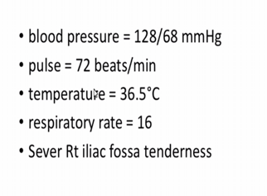

Slide 36
What is your management ?

Slide 37
If stable ?

Slide 38
If not stable ?

Slide 40
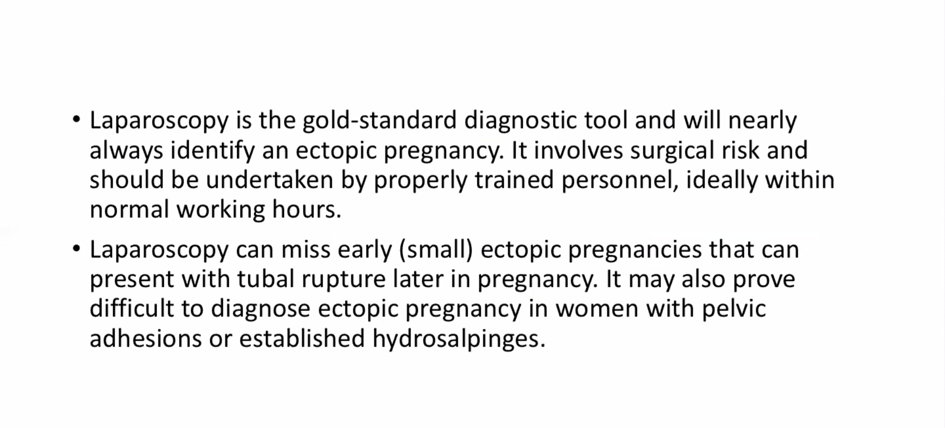
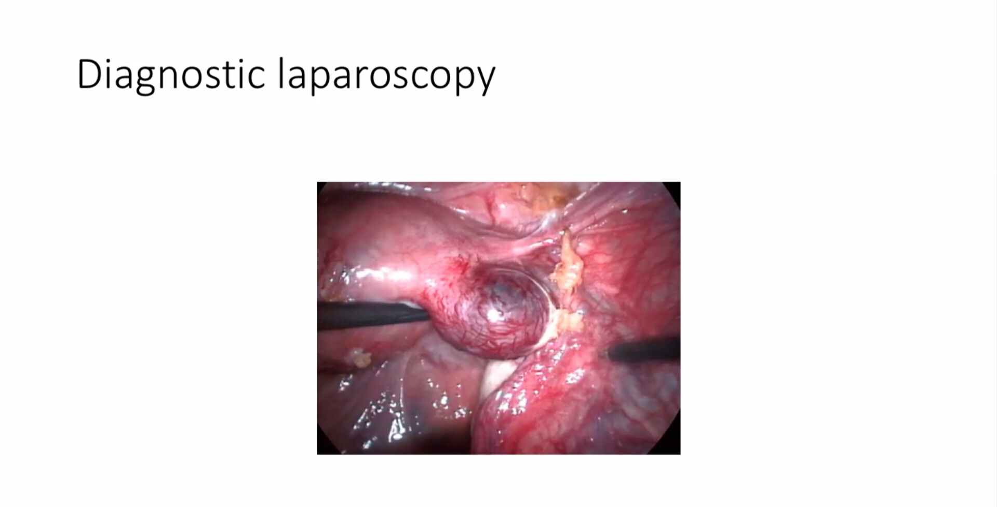

Slide 42
Antepartum Hemorrhage
Dr. Mohammad khader
Done by: Bara'a Rashaydeh

Slide 43
Case
30 y/o patient, G3P2, 30 weeks gestation presented with vaginal bleeding
*no further information were given, just mentioning the general approach

Slide 44
1-Take a relevant Hx:
Profile and blood group
Booking visit and antenatal care.
Analysis of chief complain (amount of bleeding(color, clots?m soaked clothes) pain and any associated symptoms , hx of preceding trauma, intercourse
Look for Risk factors in history:
HTN (gestational or pregestational)
Anemia
Smoking
Medications (anticoagulants?)
Fetal movement
Obstetric hx

Slide 45
What are the Important points in the examination
General examination ( pallor, mental status, pain Labor? 90% of pt's e abruptio placenta will proceed to labor )
Vital signs (Pulse and BP most important)
Abdominal examination (tenderness, rigidity may be due to peritoneal irritation)
Obstetric Ex: Fundal height ( may be decreased in IUGR or may be PROM , contracted uterus, lie of the fetus)
Vaginal examination: digital examination is contraindicated before proper localization of the placenta by U/S
BUT speculum examination is not, you can use speculum to inspect the
cervix and exclude local causes of bleeding.

Slide 46
3- what Investigations you will order
U/S : placenta is seen homogenous hyperechoic
-location of placenta
-retroplacental hematoma seen in 20% if abruptios
-fetal lie and presentation,
-fetal wellbeing and growth, if you had time do fetal anomaly scan.
CTG
Lab investigations :
CBC, Blood grouping and crossmatch –prepare 4 units-
Coagulation profile
KFT, LFT baseline.

Slide 47
What are the causes of antepartum hemorrhage ?

Slide 48
What is your management ?

Slide 49
Management: shown in the diagram below
1st stabilize the mother … 2nd assess fetal wellbeing
Notes:
Mother stable but the fetus is DEAD ➔ Vaginal delivery unless contraindicated
Abruptio placenta patient stable and bleeding ceased for 48 hours , no maternal/fetal complications the pt can go home and continue until term with weekly antenatal surveillance

Slide 50
Postpartum hemorrhage
Dr. Ahlam al-kharabsheh

Slide 51
Case
A 32 year old woman is brought to the ER by ambulance complaining of vaginal bleeding with abdomainal pain , she delevired vaginally 6 days ago
What is the diagnosis ?
What are the causes ?
What is your next step ?

Slide 52
1) Question one
make provisional dx → (PPH not enough) you have to say 2ry PPH
2ry PPH from 24 hrs up to 6 weeks
***1ry PPH from the end of the second stage of labor (delivery of the baby) up to 24 hrs

Slide 53
Question two
→look for the cause ..
2ry PPH most commonly due to retained product of conception
(more commonly post vaginal delivery because in CS you explore the uterus..)
subinvolution of placental bed (inadequate sloughing of the spiral arterioles / bleeding due to this usually presents 10-14 weeks postpartum)
endometritis.
acquired coagulopathy like TTP : (hemolysis and thrombocytopenia) differentiated from HELLP syndrome in that :
HELLP : hemolysis and thrombocytopenia disappears and parameters return to normal within 3 days after delivery
TTP : continues beyond 3 days
*also important to ask about drugs : warfarin or other anticoagulants
Rare causes :
Pseudoaneurysm of the uterine artery
AV malformations
Choriocarcinoma
Undiagnosed carcinoma of the cervix
Adenomyosis
Infected polyp or submucosal fibroid
Uterine diverticulum
Ecxess bleeding with resumption of menses

Slide 54
Question 3
obtain more information through history , physical examination , investigations
analysis of the bleeding : amount , pads , clots and their size / bleeding analysis is also important to asses the severity .
lochia : vaginal discharge after delivery
abdominal pain analysis → pain is usually cramping in nature → retained product of conception
placenta delivered by controlled cord traction : less likely to be retained ..
delivery with instruments
multiple vaginal examinations during delivery
presence of meconium ..
abruptio placenta → coagulopathy and DIC later on ..
medications after delivery like heparin indicated for patients with higher risk of thrombosis , thrombophilia, DVT.. (especially due to HIT syndrome)
severity of bleeding → by analysis of bleeding / signs and symptoms of hypovolemia

Slide 55
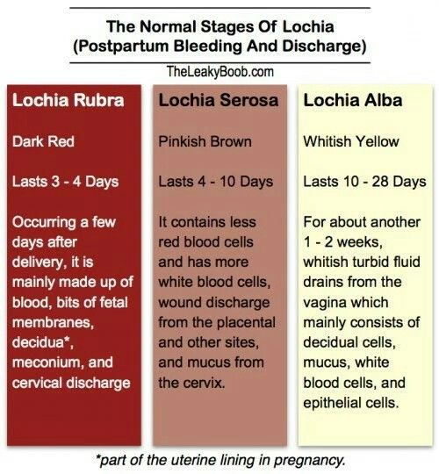
Question 4 What are the stages of lochia ?
lochia : vaginal discharge after delivery
lochia alba → 15% of women lasts up to 6-8 w postpartum

Slide 56
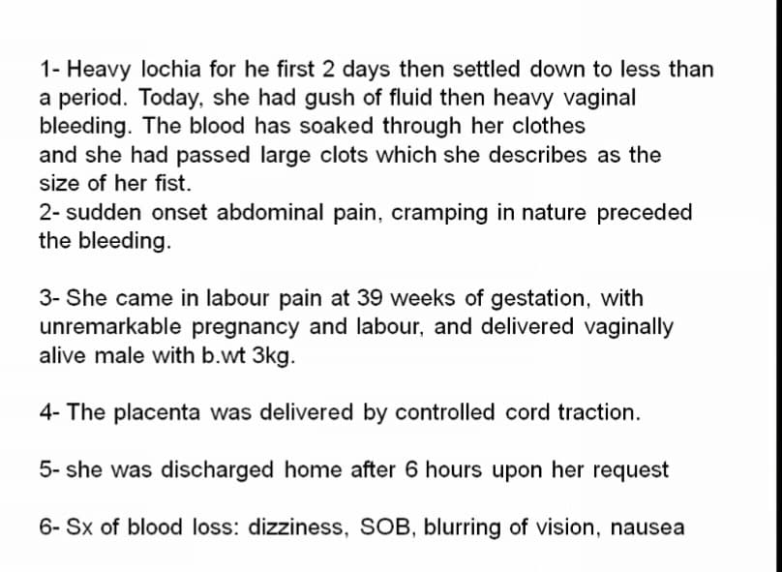
*coagulopathy cause painless bleeding
*clots indicate that there is no coagulopathy
*retained product of conception causes cramping pain
*unremarkable pregnancy → no abruption , seizures ..
*6 hours is the minimum hospital stay after vaginal delivery because most PPH happen in this period
indicates that the bleeding was severe
*summary : 2ry PPH , 6 days post vaginal delivery , bleeding is heavy with clots , associated with cramping abdominal pain , pregnancy and delivery were uneventful , she has signs of anemia

Slide 57
Question 5 What are the most important things in the examination ?
1)General
2)Vitals → fever : endometritis / BP & pulse → severity
3)Abdominal exmaination : tenderness / uterine size / is the uterus firm or soft
*involution of the uterus : (involution :return to normal size)
- on bed directly after delivery : midway between umbilicus and symphysis pubis
- next 12 hrs : just above or below umbilicus (rising up)
- then 1 cm per day ..
- end of first week : midway between umbilicus and symphysis pubis
- end of week 2 : returns to the pelvis / not palpable
4)Vaginal examination by speculum :
-open cervix = retained product of conception
-malodor = endometritis
-look for other causes of bleeding (polyp,..)

Slide 58
6 days post delivery it should be midway between symphysis pubis and umbilicus so its normal
*tender + soft + subinvolution = retained product of conception with endometritis
*tender + soft + subinvolution = retained product of conception with endometritis
*now most likely diagnosis is retained product of conception /but the patient also has low grade fever so its infected retained product of conception

Slide 59
What is the immediate management ?
What is the subsequent management ?

Slide 60
*CBC : WBCs for endometritis / normally there is leukocytosis during labor up to 20k but WBCs return back to normal within 3-4 days after delivery
PLT for thrombocytopenia
*KFT to check for prerenal acute kidney injury (which starts with acute tubular necrosis)
*overall the patient is hypovolemic ( hypotension , symptoms of anemia, cold hands and feet …)
*fluids : if available give colloid not crystaloid / if not →ringers lactate
*take blood sample before giving fluids (to prevent dilution)

Slide 61
*IV antibiotics because there is low grade fever .. Endometritis is usually caused by mixed organisms so give:
1) clindamycin + gentamycin
2)cefotriaxone + metronidazole
3)cephoxitin + metronidazole
*if the patient is breastfeeding avoid gentamycin

Slide 62
Case 2

Slide 63
*Diagnosis : 1ry PPH
*causes of 1ry PPH :
uterine atony (most common) →due to retained placenta / overdistention of the uterus..
birth tract injury
uterine inverion
*examination (fundus found to be firm) rules out uterine atony and uterine inversion
*So 1ry PPH due to birth tract injury so the answer is D
*what PG is given IM? PGf2a given in cases of uterine atony

Slide 64
Case 3

Slide 65
Diagnosis :
1ry PPH due to uterine atony (because it’s the most common cause / she is grandmultipara)
*1ry PPH >500 cc so in this case this is severe bleeding
2) Next step :
1- 2 large bore canulas …
2- palpate for uterine fundus if soft start massage and give uterotonic agent→options : oxytocin , carbetocin , PGf2a , misoprostol (PGE1)rectally
*avoid methergine because the patient has PE
3-reasses if no improvement we go to surgery → Bakri balloon (uterine tamponade) / if patient wants to preserve uterus →B-lynch surgery/ last resort is hysterectomy

Slide 66
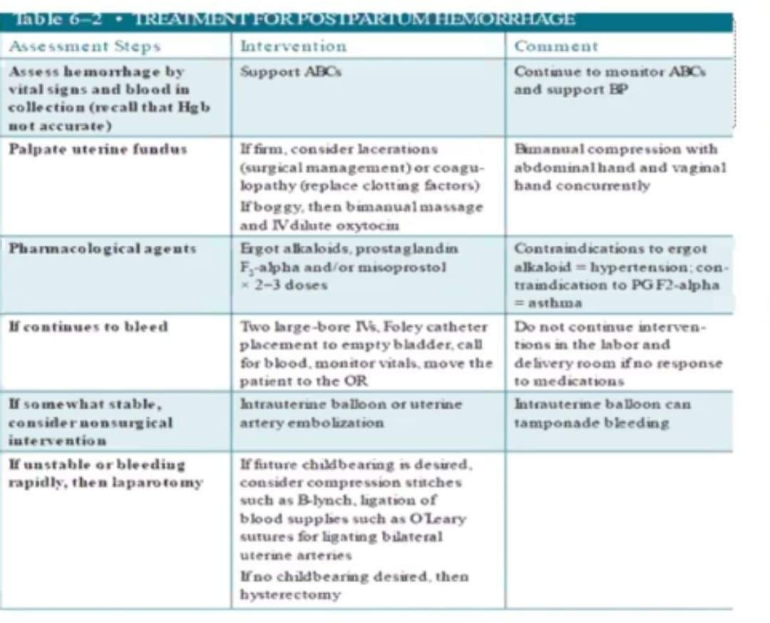

Slide 67
Postpartum hemorrhage
Dr. Adel Abulheja
Done by : aseel al-sliehat
Ammar abu tarieh

Slide 68
Case
35 year old pt. , P3 , labour was in 25 min , and she is bleeding

Slide 69
What are the most important points in the history to focus on?
Hx of HTN ?
Pre-eclampsia (during this preg.)?
Trauma?
Hx of infection (chorioaminionitis)?
If placenta delivered totally? (retained products of conception)
Fibriod? (never cause antepartum hemorrhage)
Use of MgSO4 ?
Duration of labour?
Prolonged labour?
Hx of bleeding disorder?
Hx of previous PPH?
Hx of previous C/S ?
If she is grand multiparity?
Hx of polyhydrominos during preg.?
Instrumental using during labour?
If there is induction of labour?

Slide 70
What are the most important points in the examination to focus on ?
General : (pale , sweaty , conscious , … )?
Vital signs : (HR, BP, Temp.)?
Abdominal : *1st thing to be examined → contracted / lax uterus ? *fundal height :- above umbilicus ( overdistended uterus. Causes: multiple gestation, polyhydrominos, full bladder(MCC)). *shape of the uterus , contour of the abd. ?
Pelvic: *perineum (episiotomy)? *vaginal on cervical tear? *retained placenta, rupture uterus? (manually by putting fingers) , clots also ?

Slide 71
What is your management ?
Depends on cause of PPH: (atony(80%), traumatic, uterine rupture, …)
*In all causes we have to resuscitate the pt.
Atonic PPH : *bimaniual massage . *oxytocin/Ergometrin/prostaglandin. *if not respond → uterine packing (Bakry balloon) *if not respond → surgery
Traumatic PPH : →contracted uterus a. pressure (to stop bleeding). b. examination under anesthesia (EUA) : ( to explore genetal tract). c. Tx the cause.

Slide 72
3)Uterine rupture :
lapratomy immediately ( to identify the state of uterus )
After repair : 1. must increase intervals between pregnancies. 2. C/S for all pregnancies after repair. 3. must deliver earlier ( shouldn't exceed 34 w.) . 4. advise her to not get pregnant ( bcz risk for uterine rupture in next time) the most effective method is implanon (more effective than sterilization and tubal ligation)
Can be treated :
- repair of the uterus .
Cant be treated:
- uterine artery ligation.
- hysterectomy.
Common side effects of implanon:
Vaginal candidiasis.
Heavy bleeding (menorrhagia).
Amenorrhea and retained infertility ( takes very long time) .

Slide 73
What are the Complications of PPH ?
Sheehan’s syndrome : -failure of lactation is the 1st symptom . -she will never get pregnant (she will never ovulate) .
AKI : - <0.5ml/Kg/hr. Or <30ml/hr for 2 consecutive hrs.
DIC : main cause of death .
Notes :
*** amniotic fluid embolism → develops ARDS and DIC (30% may survive).
*** If pt. is breastfeeding → start contraception after 42 days of delivery .
*** if pt. isn’t breastfeeding → start contraception after 21 days of delivery .
*** use progesterone only methods ( mini-pills, mirena, implanon) .

Slide 74
Dr.omar al-dabbas online discussion
PROM & preterm labor
Done by: sreen saleh

Slide 75
Case 1
1- what is your diagnosis ?
2- what are the relative points in history you should ask ?
3-what are the relative points in the examination you should look for ?
4-what is your management ?
25 years old patient , G3P2 presented at GA 33 weeks with abdominal pain
On examination : regular contractions were felt
Vaginal examination : 1CM dilated cervix , 2CM long posterior

Slide 76
Question 1
Threatened preterm labor not preterm labor > it means the patient may precede in any minute to preterm labor but she didn’t start yet
Why ?
To confirm labor ( regular uterine contractions and cervical changes must be present )
But here no significant cervical changes

Slide 77
Question 2
Rupture of membranes ( colour of fluid , smell , amount )
History of preterm labor
Interpretation of the abdominal pain
Regularity of the contractions
Urinary symptoms
Previouse cervical injury (tear )
Fetal movement
Cervical cerculage
Uterine anomalies (septate uterus could be removed on the opposite of bicornuate uterus that cant be fixed )
Fibroid

Slide 78
Question 3
General examination & vital signs
(Temperture is not very important because there is no ROM so the risk for chorioamnionitis is very minimal )
On abdominal examination:
-assess contractions
-abdominal tenderness
-presentation & lie (to decide the mode for deleviry )(for ex. Transverse lie cant be delevired vaginally )
On vaginal examination :
- If contractions are present You MUST do digtal examination BUT if ROM do speculum NOT digital BECAUSE risk of infection .
-assess the cervical changes
-look for any fluid of discharge

Slide 79
Question 4
She is a high risk for preterm labor
Do CTG
US (presentation , liquor )
Do US before digital examination to confirm placental location if it is not previously confirmed
IV fluids
Dexamethasone (12mg *2 every 12 hours )
Tocolytics for 48hrs why? To give a window for the dexamethasone to effect
-most common nifidibine ( ca channel blocker 3 times ) (available and cheap )
-b-agonist (rotordine )
-NSAIDS (indomethacin) (but serious side effect : premature closure of ductus arteriousus , renal effect )
-oxytocin antagonist (very expensive )
-MGSO4
Lab work (CBC ,ESR,CRP, urine analysis )
NO NEED FOR Antibiotics
Continue Observation & CTG monitioring >> if stable and no ROM >> you can discharge

Slide 80
Case 2
If the same patient presented to you earlier at 20-22 weeks with cervical length less than 2.5 cm with no contractions
What is your management ?

Slide 81
She is a high risk for preterm labor
Oral / suppositories (vaginal , rectal ) progesterone
If no contractions Don’t give tocolytics
Emergency cerculage ( NO approved studies on its benefit in preventing preterm labor )
Steroids are not given tell 24-34 weeks
Fibronectin test is done between (25-27)weeks if cervix is less than 3cm length

Slide 82
** The elective cerculage should be done at the end of the 1st trimester if it meets the criteria why ?
Because 70-80% of congenital anomalies miscarriages occur in the 1st trimester
DON’T PUT macdonald stetch before confirming normality of the fetus
At 11-13 weeks you should screen for congenital anomalies
-nuchal transluceny if high >> do non invasive test as free DNA or invasive test as chorionic villi sampling TO CONFIRM

Slide 83
Case 3
If after 2 days your pt returned with ROM
GA 33 weeks
1- what is the important points in the examination you will look for ?
2- what is your management ?
3- what is the 1st ,2nd ,3rd sign & symptos of chorioamnionitis ?

Slide 84
Question 1
By inspection look for pooling of fluid in the posterior fornix by bivalve speculum
And fluid through the cervix (finding both of them is the confirmation for ROM)
If you find only one of them DO nitrazine test
Color of discharge ( if bloody suspect > placental abrubtio , if meconium>chronic hypoxia (IUGR , placental insufficiency )
DON’T DO DIGITAL EXAMINATION (risk of infection )
Give prophylactic antibiotic (erythromycin) not amoxilclav (risk of necrotizing enterocolitis ) because 70-80% of chorioamnionitis are silent
You should take a vaginal swab (in case she developed Signs&symptoms of chorioamnionitis to chose the sensitive Antibiotic)

Slide 85
Question 2
If any sign of chorioamnionitis developed >> direct deleviry
BUT remember chorioamnionitis alone is NOT an indication for C/S
Other wise according to the guidelines wait tell 34 weeks and delevir
BUT in Jordan we wait tell 36 weeks because of the need for NICU admission BUT don’t delay more than that because of the increasing risk of infection

Slide 86
Question 3
The 1st sign is fetal & maternal tachycardia
The 2nd is abdominal pain
The 3rd is vaginal discharge and chills & rigors

Slide 87
Case 4
If a patient presented with ROM at 18 weeks what is your management ?

Slide 88
If the patient presented with ROM anytime before 24 weeks (age of viability ) we prefer termination of pregnancy because of the risk of lung hypoplasia on the fetus & development of chorioamnionitis on the mother

Slide 89
Case 5
35 years old patient G5P4 all by c/s she presented at GA 32 weeks with watery vaginal discharge soaked her clothes
1- what is your DDX?
2-what important points in the hx you should focus on ?
3-what are the complications of chorioamnionitis postpartum ?

Slide 90
Question 1
ROM
Vaginal discharge
Urine
Vaginal douching
Semen (less likely white colour )

Slide 91
Question 2
Sudden ?
Assosciated symptoms (fever discharge abdominal pain)
Previous ROM(if recurrent suspect cervical incompetence )

Slide 92
Question 3
Postpartum hemorrhage (the contractility is not sufficient because of the infection )
-its complications (Sheehan syndrome , hypovolemic shock , renal failure , cardiac failure )
Sepsis (high blood supply )
Renal failure
Death

Slide 93
Preeclampsia
Dr.Alaa owis

Slide 95
What are the basic investigations you will order ?

Slide 96
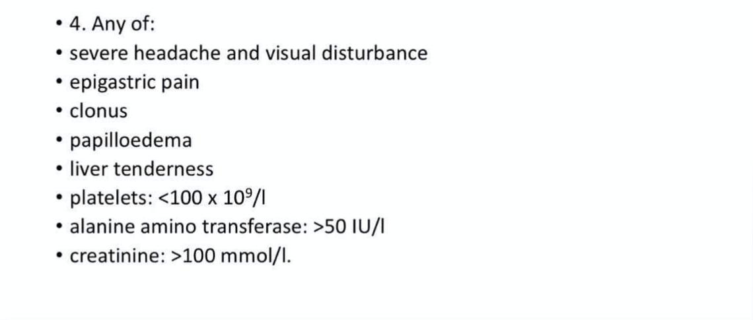

Slide 97
How can you monitor pre-eclampsic patient ?

Slide 98
What are the general measures undertaken once severe preeclampsia is diagnosed ?

Slide 99
What are the anti hypertensive drugs chosen in pregnancy ?

Slide 100
What is the management of eclampsia ?

Slide 101
What are the side effects of MGSO4 ?

Slide 103
How we delevir preeclampsic patient ?

Slide 104
Medical Problems in Pregnancy - Cases Discussion
Dr.Seham Abu freijeh
Done by: Bara'a Rashaydeh
Ala’a Dmour

Slide 105
Case 1
A 20 year old woman is referred for preconception clinic. She has a history of epilepsy and is planning for pregnancy.
What relevant points in her history you should ask her about?
How should her pregnancy be managed?

Slide 106
What relevant points in her history you should ask her about?
Detailed history about her condition -The more severe the disorder, the more likely it will worsen during pregnancy- :
Duration
Frequency of seizures
Type of seizures
Control and fit-free interval
Type and dose of medications she's on. –some meds are teratogenic, also Seizure medication clearance may will increase resulting in lower blood levels so she will need a higher dose to control seizures -
2. Obstetric history (detailed)
Epilepsy in pervious pregnancy, miscarriage, outcome(any abnormality)

Slide 107
How should her pregnancy be managed?
She should be managed in a neurology and/or obstetric clinic.
Achieve adequate seizure control with a minimal dose of antiepileptic medication.
Folic acid supplementation 5mg (preconception and during embryogenesis , at least for the first 3 months)
An early pregnancy scan and nuchal screening (n the first trimester)
Detailed anomaly scan to rule out major structural abnormalities (between 18-22 weeks)
In labor:
early epidural anesthesia + mouth piece to protect the airways during delivery
vaginal delivery unless there's an indication for CS.
During puerperium encourage breastfeeding.
Safe bathing and safe driving.

Slide 109
What is the most likely diagnosis?
What is the best management for her condistion?

Slide 110
life-threatening hypermetabolic state

Slide 111
CI in pregnancy---hypothyroidism in fetus

Slide 112
What are the complications of hyperthyroidism in pregnancy:
Thyroid storm
Heart disease: Heart failure, arrhythmias, non-immune hydrops fetalis (other causes of this condition is congenital lung mass, thalassemia).
increased spontaneous abortions
IUGR due to placental insufficiency
Preterm Delivery.
perinatal morbidity and mortality

Slide 113
What is the Management of Hyperthyroidism during Pregnancy?
• Antithyroid medications are the first line of therapy in pregnancy, but can cross the placenta leading to fetal hypothyroidism. PTU and methimazole are thioamides that block thyroid hormone synthesis Methimazole so should not be used in the first trimester, though it is acceptable in the second and third. (category D teratogenicity).
PTU has a risk of liver failure (rare) so it should be used only in the first trimester.
• Subtotal thyroidectomy is primarily indicated when antithyroid medical therapy fails and is ideally performed in the second trimester.
• Thyroid ablation with radioactive iodine (I131) is contraindicated because it can cross the placenta, leading to congenital hypothyroidism.

Slide 114
Case 3
A 35-year old PG attends the ob. Clinic at 32wks of gestation with itching that worsen at night for the previous 2 wks.
Clinical Ex. reveals no rash on the body.

Slide 115
What relevant points in hx. You should ask?
How would you confirm the diagnosis?
Enumerate the risks to mother/fetus.
What is the treatment in such condition?
When would one deliver this woman and why?

Slide 116
What relevant points in hx. You should ask?
Jaundice / urine and stool color / pain
Itching site: localized/genralized.
Family hx.
Similar symptoms with use of COCP or with pervious pregnancies
Drug hx. (methyldopa) and viral hepatitis should be excluded
Alcohol abuse / allergy
fetal movement

Slide 117
What is the most likely diagnosis?
Obstetrics cholestasis.
Multifactorial.
The levels of estrogen are highest in the third trimester and this is the time most women will present with this condition

Slide 118
How would you confirm the diagnosis?
LFT (rise in the ALT,AST in upper normal or mildly elevated)
Bile acid level (the most important)
Coagulation profile
Abdominal US to exclude other causes

Slide 119
Enumerate the risks to mother/fetus
Maternal risks | Fetal risks
Unable to sleep Preterm labor DIC ---- increase risk of mortality PPH Vit. K deficiency | Intracranial hemorrhage Premature delivery Intrauterine death Meconium aspiration Fetal distress

Slide 120
What is the ttx.?
First step: Symptomatic relief
Antihistamines (chlorpheniramine, promethazine).
Topical emollients
Vit. K (controversial)
Ursodeoxycholic acid---decrease bile acids in the blood ➔improve the pruritus symptoms and liver function.

Slide 121
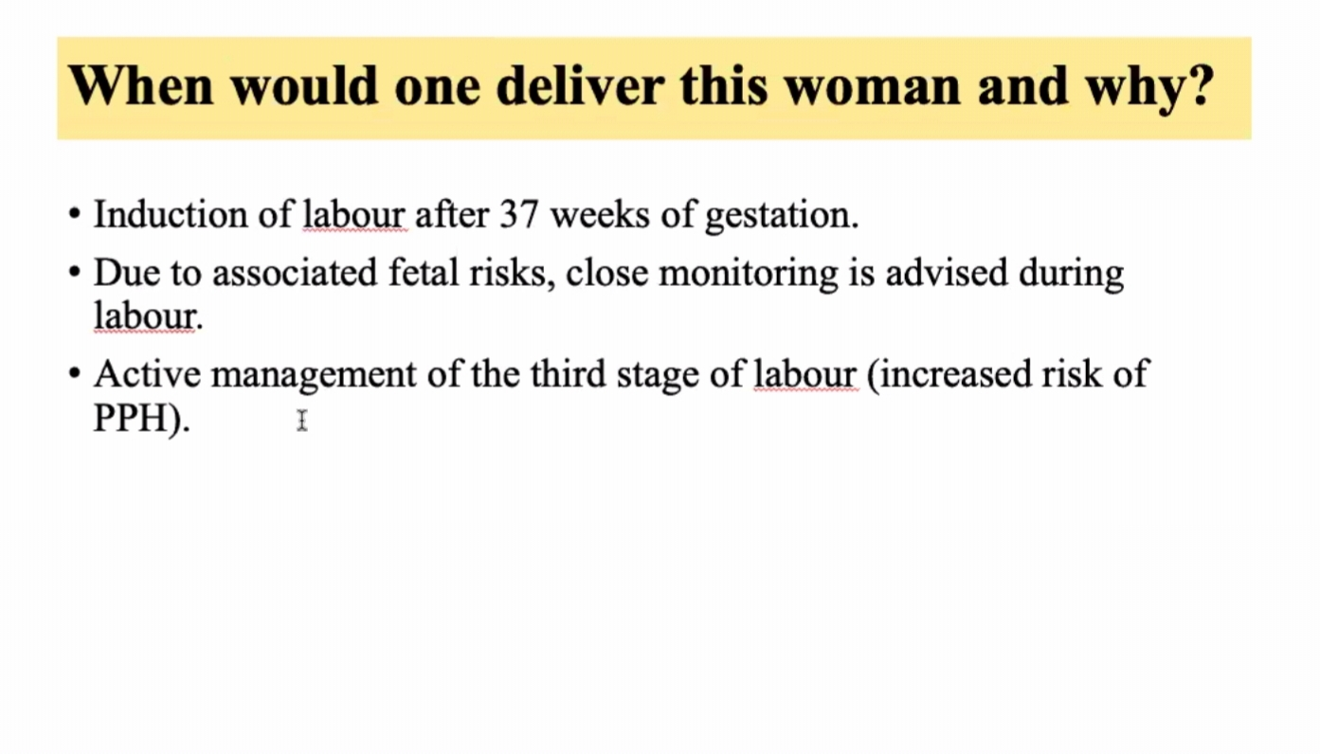

Slide 122
Case 4
A 32-year-old PG, presents at 30 weeks of gestation with nausea and vomiting for 1 week. BP is 140/90.
Investigations shows:
-Ultrasound scan: oligohydramnios.
-Urine test shows 3+ ketones, and no protein.
- alanine aminotransferase (512 U/mL), bilirubin (88 μmol/L), alkaline phosphatase (530 U/L), lactate dehydrogenase (848 U/L), urea (7 mmol/L), creatinine (210 μmol/L).
-PTT: 45 sec, and PT: 15 sec, but normal platelets and hemoglobin.
-Blood glucose is 2.8 mmol/L.

Slide 123
What are the differential diagnosis in this case?
2. What is the most likely diagnosis in this case and explain the pathophysiology behind it?
3. What is the management plan for this patient?
4. Describe the future implications for this patient.

Slide 124
What are the differential diagnosis in this case?
Acute fatty liver of pregnancy (AFLP)
Pre-eclampsia
HELLP.
Hemolytic uremic syndrome (HUS)
Thrombotic thrombocytopenic purpura (TTP)
Liver disease

Slide 125
What is the most likely diagnosis?
AFLP
- Low blood glucose.
- liver function tests (LFTs) and renal function tests (KFTs).
- Coagulopathy with normal platelets.
- Common in PG.
- Presents in 3rd trimester.
- Presentation with nausea and vomiting.

Slide 126
What is the management plan for this patient?
- Stabilize and deliver.
- Intravenous glucose, fresh frozen plasma [FFP] and albumin.
- Multidisciplinary approach.
- Transfer to intensive care unit post delivery.

Slide 127
The future implications for this patient
- Screening for enzyme deficiency.
- Chances of recurrence but incidence unknown.
- Monitor closely LFTs during next pregnancy.

Slide 128
Acute Fatty liver disease
Description. This is a rare life-threatening complication of pregnancy that usually occurs in the third trimester.
Maternal mortality rate is 20%.
It is thought to be caused by a disordered metabolism of fatty acids by mitochondria in the fetus, caused by deficiency in the long-chain 3-hydroxyacyl-coenzyme A dehydrogenase (LCHAD) enzyme.

Slide 129
Acute Fatty liver disease
Findings. Symptom onset is gradual, with nonspecific flulike symptoms including nausea, vomiting, anorexia, and epigastric pain.
• Jaundice and fever may occur in as many as 70% of patients.
• Hypertension, proteinuria, and edema can mimic preeclampsia.
• This may progress to involvement of additional systems, including acute renal failure, pancreatitis, hepatic encephalopathy, and coma.
Laboratory findings may include: moderate elevation of liver enzymes (e.g., ALT, AST, GGT), hyperbilirubinemia, DIC.
• Hypoglycemia and increased serum ammonia are unique laboratory abnormalities

Slide 130
Obs & gyni Dr. Hashem online clinical discussion fibroid
Done by : sreen saleh

Slide 131
Case 1

Slide 132
Answer the following questions
1. summarize the case .
2.what is your diagnosis ?
3. what is your approach ?
4. what are the types of fibroid ?
5. what is the old and the new classification ?
6.what is the management ?

Slide 133
Summary
Most important information to be mentioned in the summary :
*NSAIDS was tried
*D&C was done
*Conjugation with cervix indicate the relation with fibroid
*Midline site (lateral site indicates adnexal mass or broad lig.)
*Size may aid in the choice of drug (add provera or medroxy progesterone to decrease the size )
*Other assosciated symptoms (inter. Mens. Bleeding may raise suspicion to polyps or endometrial hyperplasia )
*The patient is anemic > indication for intervention

Slide 134
Diagnosis
Symptomatic large uterine fibroid
(its mostly submucosal but the doctor said don’t mention the type unless US was done and revealed the type )
Its monoclonal proliferation of smooth muscle
Commoner in Black > white
The fibroid could be asymptomatic but the Most common symptom is menorrhagia .. So why fibroid cause bleeding ?
-hormonal effect (hyper-estrogen state )
-surface area
-blood supply
One of the most common causes of menorrhagia in reproductive age

Slide 135
Clinical approach
Full Physical examination : its important to mention vital signs abdominal examination and pelvic examination
Transvaginal US is your first choice , CT and MRI
CBC is very important for ANEMIA
**** and make sure that your diagnosis is consistent with the history because fibroid may be asymptomatic ***

Slide 136
Types (very important )
Other types
-Types according to shape
Sessile or pedunculated
-Types according to location anterior posterior lateral

Slide 137
Classifications
The old & the new classification the doctor said memorize both
-ESGE (outside myometrial surface to determine management)
-FIGO
0,1,2 (submucosal )
3(intramural with endometrium contact)
4(intramural with no contact )
5,6,7 (subserosal )

Slide 138
Management
Expectant
Medical
1- non hormonal (tranexamic acid , NSAIDS )
2- hormonal ( progesterone , GnRH analogue ,mirena , COP , provera )
مهم New hormonal selective progesterone receptor modulator (SPRM) ulipristal acetate
New hormonal selective estrogen receptor modulator (SERM) tamoxifen
Non invasive
uterine fibroid embolization , radiofrequency ablation
Surgical
endometrial ablation
Myomectomy ( by laparoscope , hysteroscopy , open )
Hysterectomy ( by laparoscope , hysteroscopy , open )

Slide 139
Medical over surgical ?
-if perimenopause
-if not fit for surgery
-if large fibroid (to shrink its size )
-if anemic ( to correct anemia )
GnRH
is given for 6 months to shrink the fibroid size and decrease bleeding 90%
But be AWARE from its sideffect (osteoporosis and sweating )
Hysterscopic myomectomy ?
-if pedunculated
-if submucosal
-if type 1,2 intramural
Endometrial ablation
is contraindicated in large subserosal and intramural fibroid
It damages the basalis layer that may lead to some complications :
-light menses
-subfertility
-if the patient got pregnant may lead uterine rupture , miscarriage
**Used also in dysfunctional uterine bleeding

Slide 140
Uterine artery embolization
(now called fibroid artery embolization )
Done by interventional radiologist
indications :
-decrease the size
-un fit for surgery
-pressure symp.
-complete family
Advantages :
-It’s a day case the patient is discharged in the same day
-minor complications
-less bleeding
Complications :
-high recurrence rate
-post embolic syndrome (fever , discharge , abdominal pain , nausea, vomiting )
If the fibroid is submucosal it might separate after the procedure and become situated in the abdomen or the cervix )
May need further intervention as hysterectomy

Slide 141
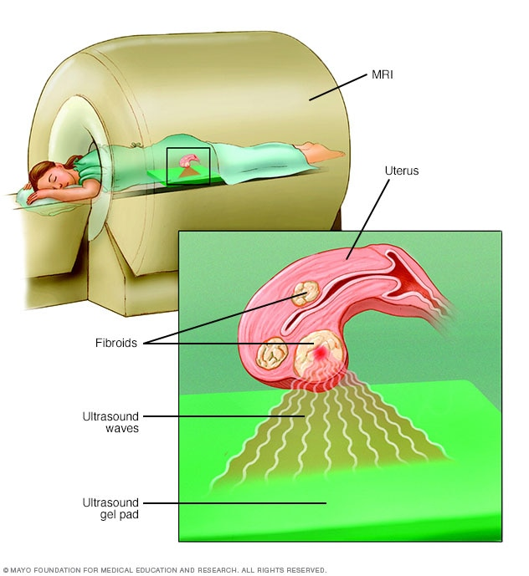
MRI guided focus US by denaturating the protein if the fibroid (myolysis)
The patient in prone position

Slide 142
Identify these types
Type 6
Pedunculated subserosal fibroid after hysterectomy specimen
Multiple fibroids with multiple sizes wih it own capsule

Slide 143
HIGH YEILD
Transvaginal US (the hyperechoic >endometrium
Type 4
Search for sign of ectopic and ring of fire

Slide 144
Saline infusion sonography + dynamic US
TVUS is better than saline infusion (because it need more preparations and have many complications
MRI lateral view with multiple fibroid (arrows )
To identify the uterus (first indentify the bladder (white filled )yellow circle

Slide 145
Laprascopic view multiple intramural fibroids
Hysteroscopic view
The white curved line in the middle picture in the resectoscope

Slide 146
Case 2 start a slide show to have the chance to test yourself before seeing the answer
A 45 years old lady mrs P presented with heavy mens bleeding of 6 months duration . On examination uterus was enlarged equivalent in size to 20 weeks pregnancy .
US revealed multiple fibroids in the uterus
Answer the following questions

Slide 147
Question 1 What are the important things to ask in the history and to do in the physical examination ?
Qst 1 what are the important points to ask in the history ?
Age , parity , analysis of the chief complain (clots ,pads , colour , timing , pain , discharge ..)
Infertilty
Pressure symp.
Suggestive anemia
Malignancy symp(weight loss )
Mens hx (intermens. Bleeding and regularity )
First attack
Qst 2 What are the most important points in the examination ?
-cachexia weight loss
-look for anemic signs (pallor)
-vitals (pulse weak rapid small volume throbbing )
-thyroid examination
-Abdominal examination (inspection ,plapation (tenderness and mases )
-genital examination (inspection for visible bleeding , nodules , polyps , prolabse , fissures
Bimanual examination (uterine mobility and size )
Speculum
**on vaginal examination (if a space is felt between the mass and the uterus >> could be anteverted uterus ,exclude uterine mass )

Slide 148
Qst 3 What's your differential diagnosis ?
Pregnancy
Fibroid
Adenomyosis
Polyp
Malignancy
Uterine sarcoma (suspect it when fibroid enlarges in short duration )

Slide 149
Qst 4 What are the most important Investigations ?
CBC
Pregnancy test
Thyroid function test
US transvaginal (visualize the cervix , endometrial thickness,adnexal mass , fiboroid size ,location,type )
Pap smear
Biobsy

Slide 150
Qst 5 What are the Complications for fibroid ?
Degenerarion (hyaline , red , calcific , myxoid )
Infertilty
Torsion
Anemia (hemorrhage when capsule ruptures )
Infection (necrosis )
Pressure symptoms
Malignancy (sarcoma)

Slide 151
Qst 6 If US revealed multiple fibroid what are the indication for treatment ?
Abnormal uterine bleeding
Pressure symptoms
Fertilty seeking (BUT after excluding other causes )
Abdominal pain (degeneration )
Recuurent pregnancy loss
Size >12 weeks
Rapid growth

Slide 152
Qst 7 What is the role of medical management in uterine fibroid ?
Pre op for downregulation
If not fit for surgery
Perimenopause
To correct anemia

Slide 153
Qst 8 Define myolysis ?
Laproscopic procedure for treating uterine fibroid that involves coagulation
(by electric current ) of blood vessels supplying the fibroid (>14weeks )with supsequent shrinkage
Have high recurrence rate and May lead to extensive adhesion formation

Slide 154
Qst 9 What are the indications for emergency hysterectomy?
Unstable patient (hemorrhagic shock )
If it led to acute abdomen
Ruptured capsule leading to intraperitoneal hemorrhage

Slide 155
Qst 10 what are the complication of fibroid during pregnancy ?
Preterm labor
Miscarrige (pressure effect and defective implantation )
Antipartum hemorrhage
Postpartum hemorrhage
Congenital malformation
Deformity
Placental abnormality

Slide 156
Qst 11 what are the changes that occur to fibroids during pregnancy ?
Rule of 1/3
1/3 increase
1/3 decrease
1/3 red degeneration (increase in size but without increasing blood supply )
Changing in shape
Infection
Torsion

Slide 157
Qst 12 management of fibroid during c/s?
DON’T TOUCH >> high risk of bleeding
Unless (necrotic , causing sever pain , pedunculated , fibroid on inscion site ) >> do myomectomy

Slide 158
Case 3
A 24 years old lady , MRS R married for 3 years seeking treatment for 1ry infertility presents with a lump lower abdomen equivalent to 16 weeks of pregnant uterus

Slide 159
What are the causes of infirtilty with uterine fibroid ?
-difficult sperm transportation
Defective implantiaon
Blocked tubes

Slide 160
Mention some gynecological disese associated with uterine fibroid ?
Endomtrial hyperplasia
Adenomyosis
Polyps
Anovulatary period

Slide 161
What is your management ?
Exclude other causes !!!!!!
Myomectomy with laparoscope is preferable
-total laparscope (abdominal )
-assisted vaginal laprascope (by abdomen but fibroid is removed from the vagina )
Advantages for laprascopic myomectomy ?
-less bleed less hospital stay less morbidity cosmetic scar but need advance experience

Slide 162
Okay lets test your knowledge with 4 questions

Slide 164
Answers
Question 1
you can do hysterectomy or myomectomy but in this case she is unfit for surgery (multi previous surgeries (adhesion )
So the most appropriate is medical therapy (Ulpristal acetate )
Question 2 transvaginal US
Question 3 hysterectomy
Question 4 endometrial biobsy

Slide 165
Endometriosis & adenomyosis
Dr.mohammad khader

Slide 166
Case 1
33 year old lady P0 presented to the clinic complianing from cyclical pain
What is your DDX?
Key points in this Hx:
33 years old, infertility, Dysmenorrhea
DDx:
Endometriosis , PID

Slide 167
What are the important points in the history ?

Slide 168
What are the important points in the examination ?
Look for Tenderness, Masses
Look for spots on vulva or anal orifice (in severe endometriosis)
Inspect vagina and cervix (Discharge—PID , Spots--- endometriosis)
Look for:
1. Adnexal mass -- Endometrioma
2. Pouch of Douglas nodularity/hardening -- Endometriosis
3.Bilateral adnexal motion tenderness – PID
* if unilateral (Look for ectopic pregnancy)
4. Fixed retroverted uterus

Slide 169
What are the simple and invasive investigations that will help you?
Simple Investigations (can be done in the clinic):
Ultrasound >>Look for masses and uterine size
Typical finding of endometrioma:Homogenous, ground glass apperance in some areas
Vaginal swab >>For PID
Invasive Investigation:
Laproscopy (for DX & Tx) **Gold Standard for Endometriosis Dx**
We can see spots, chocolate cysts, adhesions

Slide 170
Homogenous ovary
Ground glass apperance

Slide 171
Retroverted Uterus

Slide 172
Laparascope

Slide 173
What is your management ?
Medical >>NSAIDS : for pain relief in endometriosis
Hormonal >>-GnRH agonist : m.c used
-Combined OCP caues (a state of Pseudopregancy) --- Decidualization of endometrial gland --- atrophy (because of so, endometriosis diasappears with pregnancy)
-Mirena – causes glandular atrophy
Surgical >>For Chocolate Cyst, Adhesions, Failure of medical Tx, Infertility

Slide 174
Case 2
45 year old woman p5 complaining from painful cycles and heavy vaginal bleeding
What is your ddx?
Key points:
45 years old, multiparous, dysmenorrhea, menorrhagia
DDX
Adenomyosis, Fibroids, Endometrial Ca

Slide 175
What are the important points in the history to focus on ?
Risk factors for endometrial hyperplasia/ malignancy
Unopposed estrogen – so increased risk for hyperplasia /malignancy

Slide 176
Physical examination ?
Uterus is fixed only in:
1.Adhesions
2.Malignancy
Enlarged, soft boggy , tender, mobile uterus

Slide 177
Investigations
general laps
TSH, Coagulation – for menorrhagia
CBC – Check for anemia
Pelvic US >Look for masses, myometrial thickness, endometrial-myometrial border
MRI ** Gold Standard for Adenomyosis **
Endometrial biobsy To rule out hyperplasia/malignancy

Slide 178
*TVUS that shows:
-Thick Myometrium
- Hypoechoic Lesions
(Endometrial Glands)

Slide 179
* MRI showing:
-hyperechoic lesion(endometrial gland) in myometrium
Q: How did I suggest that it is endometrial gland while it's hyperechoic ? (because bladder is also hyperechoic)

Slide 180
What is your management ?
**Only Definitive Tx for Adenomyosis is hystrectomy

Slide 181
Dr.omar al-dabbas online discussion
PCOS
Sreen saleh

Slide 182
Case
17 years old female patient single presented to the clinic with irregular cycle her period came once in the last three months
**start a slide show so you will have the opportunity to test yourself before seeing the answer ☺

Slide 183
Qst 1 what is the most important points in the hx to ask about ?
Menarche > because within the first year after menarche the normal cycle is between 21-45 days so irregularity is normal
But after 3 years after menarche the normal cycle is supposed to be between 21-35 days
Secondary sexual characters > 1st to appear is breast budding
Androgen excess symptoms > hirsutism (ferriman-gallwey score )
acne , and most important male pattern baldness
Weight gain
Hypo,hyperthyroidism

Slide 184
Her BMI is 29 , with hirsutism and hair loss
Whats your ddx ?
How will you confirm your DDX?

Slide 185
Qst 1 : PCOS
Qst 2 : clinically and US according to Rotterdam criteria
The most accurate is transvaginal US with empty bladder but here she is single so do trans abdominal US on full bladder to easily visualize the ovaries
But if not sufficient do free testerone , DHEAS

Slide 186
What more investigations you will order to confirm your diagnosis ?
Fasting insulin level > to detect insulin resistance its normally low after fasting but in PCOS its high
You could do HBA1C
No need for OGTT (we only do it pregnancy or briefly after deleviry)
Prolactin > to exclude hyperprolactinemia because it causes mens.irregularity sometimes its associated with PCOS
LH:FSH > just confirmation doesn’t affect the management
TSH > to exclude hypo,hyper thyrodism
DHES > to exclude adrenal causes if high
Free testerone (sensitivity for testerone with PCOS is increased more than non-pcos females that what explains hyperandrogen syptoms )

Slide 187
Can this patient present with regular anovulatory cycles ? How we can differ ovulatory cycles ?
Yes , not every ovulatory cycle is regular & viceversa
By hx > its painful cycles (mittelchmirz pain)
By investigations >
-LH surge (done between 11-13 day of the cycle mostly 24-46 hrs before ovulation
-progesterone (7-8 days post ovulation )
-endometrial biobsy (not routinely done )

Slide 188
What is your management ?
In the beginging you must explain to the patient that it’s a syndrome and life long disease we treat symptoms only !!
So our management depends on the complain
The most effective management to start with is life style modification
weight loss > very effective even if only she loses 10% of her weight this will increase ovulation and decrease androgen and having regular of cycles
For hirsutism > because she is young OCP will do the effect
For irregular cycles >
-OCP > it increase the binding sex globulins which decrease the free testerone and decrease androgen and decrease the symptoms
-anti androgens >spironolactone , cypreterone acetate , flutamide
-metformin > for insulin resistance
And she should return after 2-3 months for follow up

Slide 189
If the same patient returned after 2 years and she is married and seeking for pregnancy she is married for 6 months and without pregnancy she stopped the ocp but continued the metformin and decreased her weight , what is your management ?

Slide 190
MOST IMPORTANT is to exclude other causes of infertility
- Timing & frequency of intercourse
-male factor by semen analysis 50-60%
Presample preparation : no ejaculation for 3-5days prior , within 1 hr of ejaculation
-female factor
Tubal by HSG (6-10 days of the cycle ) >> after the menses and to make sure no pregnancy

Slide 191
If semen analysis was normal and on HSG it was visible that both tubes are blocked what your management ?
Do laparoscope to know the cause
-mostly spasm due to sympathetic stimulation when HSG is done
-endometriosis
-PID
** sometimes a small percent of females after HSG any blockage is opened spontaneously **

Slide 192
If the semen analsyis & HSG was normal what’s your next step ?
Start induction of ovulation by clomphine citrate
Its mechanism of action : its anti estrogen that blocks pituitary & hypothalamus releasing it that causes negative feedback and lead to the increase of FSH and increase ovulation
Taken orally start with 50mg and increased in each cycle by 50mg if no effect is noticed , given for 2-6 days in the first 10 days of the cycle
Monitor it by folliculometry (11-17mm means success)
70% success rate for ovulation , 40%success rate for getting pregnant
5-10% of females get pregnant with multi fetuses
Its disadvantages is causing thick cervix that prevents sperm from entering and thin endometrium that decrease the rate of successful implantation
Other option is aromatase inhibitor (letrozole )not having the previous sideffects

Slide 193
If Clomphine citrate therapy failed what’s your next step ?
Mix it with HMG ,(FSH,LH) injections and follow with folliculometry

Slide 194
If this line fails what your next step ?
Either laprascope drilling OR IVF
We do the drilling only unilateral because it has many complications :
-premature ovarian failure
-adhesions
-its very invasive

Slide 195
What are the complications of PCOS ?
On pregnancy :
-increase risk of developing preeclampsia
-increase the risk of developing GDM
On non pregnant :
-hyperlipidemia
-endometrial hyperplasia and cancer (give progesterone as prophylaxis in the luteal phase to prevent )
-developing DM type 2 (insulin resistance )
-CVS diseases

Slide 196
Infertility
Dr. Seham Abu fraijah

Slide 197
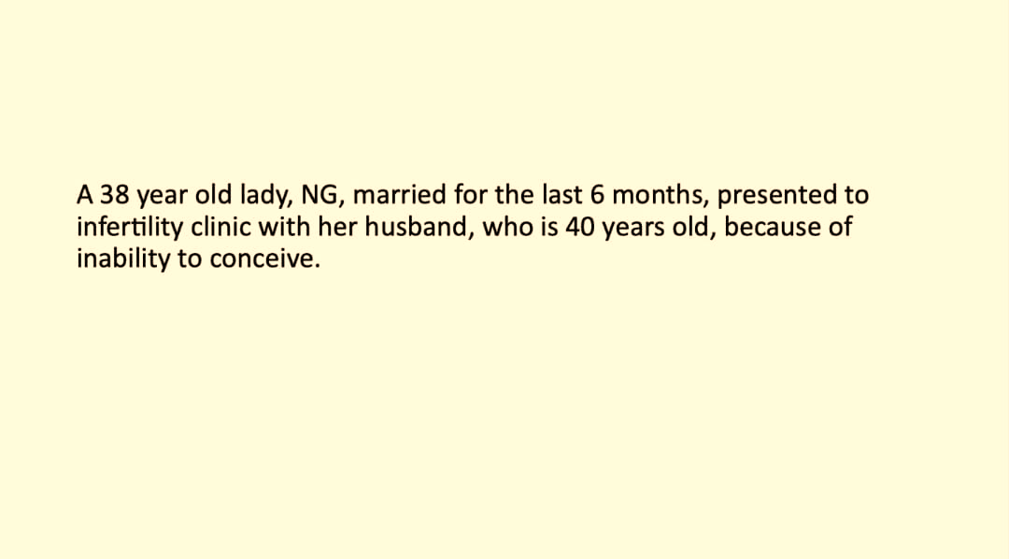
Whats is your ddx?
This is a case of primary infertility
For primary infertility :
- Age <35 → wait for 1 year
- Age >35 → wait for 6 months

Slide 198
What is the most important points in the history to ask about ?
Mesn hx :
Regularity regularity give hint for ovulatory cycle
Unovulatory cycle → irregular & oligomenorrhea.
Amount if heavy menstruation could be submucosal fibroid (especially that the patient is nulliparus)
Age of menarche if late could be due to imperforate hymen which is a risk factor for endometriosis
dysmenorrhea if 1ry : good indication of ovulation (starts with menstruation /relieved by NSAIDS).
If 2ry : suspect endometriosis (starts before and builds up and continues after mens.
Weight changes , obesity ,acne , hirsutism (hints for insulin resistant in pcos.)
Thyroid symptoms fatigue, inc. Weight, ….
If she is known case of hypothyroidism ask for drug compliant.
Galactorrhea with headache and vision abnormality→ hyperprolactenemia.
Previous pelvic surgeries (cystectomy,myomectomy,appendectomy) previous PID tubal factor infertility (adhesions)
Sexual activity & proplems (dyspareunia (PID , endometriosis ), coital frequency )
Contraception →especially long acting progestins / ovulation needs up to 1 year to return →mostly in 2ry infertility

Slide 199
In the exam choose the appropriate questions to ask about according to the scenario not everything
excessive heat / less frequent intercourse
DM (can cause erectile dysfunction)
Notes:
*medical history : HTN
DM (can cause erectile dysfunction)
*occupation : excessive heat / less frequent intercourse

Slide 200
In this patient :
*history of appendectomy and dyspareunia
*dyspareunia usually deep with infertility but superficial dyspareunia could affect intercourse process itself especially if nulliparus

Slide 201
What are the important points in the physical examination ? In both of the partners .
Female :
height
Weight >*BMI , hirsutism , acne, …
Hair disturbution
Thyroid gland
Detailed pelvic examination
-bimanual >Helps in endometriosis cases
-speculum >*abnormal discharge, cervical erythema infection take swabs.

Slide 202
*in males we generally do seminal fluid analysis first if its abnormal we refer to urologist ..

Slide 203
When to investigate ?
*chance of pregnancy in a normal cycle is ?
20-30% it has a cumulative effect so 80% of couples will get pregnant after 1 year and half of the remaining couples will get pregnant the next year.

Slide 204
What are the causes of infertility ?
male factor 20%
female factor MCC is ovulatory dysfunction followed by tubal factor
unexplained infertility 12-15% (only after all investigations are done)

Slide 205
When & What important ivestigations should be done for them ?
**Investigations for 1ry infertility usually done after 1 year of unprotected intercourse
*done after 6 months :
-if patient older than 35
-if there is an obvious cause for the infertility
*First test is seminal fluid analysis because it’s the single test for males and if its abnormal then we have an obvious cause of infertility..

Slide 206
*if anything is abnormal repeat after 3 months because (because spermatogenesis needs 3 months.) if still abnormal refer to urologist
*azospermia could be obstructive (better/treatable) or non obstructive (usually central : hypogonadotropic hypogonadism)
*oligospermia : low count
*azospermia : count from 0 to 1 million / ml
*aspermia : no ejaculation
*asthenospermia : abnormal motility
Notes:
*if abnormal repeated after 3 months because spermatogenesis needs 3 months.
*oligospermia : low count
*azospermia : count from 0 to 1 million / ml
*aspermia : no ejaculation
*motility : total (atleast 40%) vs rapid progressive ( 32%)
*asthenospermia : abnormal motility
*if anything is abnormal repeat after 3 months if still abnormal refer to urologist
*azospermia could be obstructive (better/treatable) or non obstructive (usually central : hypogonadotropic hypogonadism)

Slide 207
How can you document ovulation ?

Slide 208
Best test
*if all of these are normal then its an ovulatory cycle and we have to exclude the second most common cause : tubal factor
Notes:
*BBT : early morning , each day
ovulatory cycle is biphasic (rise in the 2nd half)
not recommended (time consuming/ needs compliance/not reliable)
*LH,FSH : in irregular cycles , old age ..
done in early follicular phase (day 2-3 of menstruation)
in IVF done for ovarian reserve if high →bad sign
other tests for ovarian reserve : anti-mullerian hormone
ultrasound → follicular tracing
*serum mid-luteal progesterone done on day 21 if 28 days cycle / if 35 days cycle → done on day 28 ..
→luteal phase is constant (14 days) doesn’t change
→follicular phase can change
→normal midluteal progestrone = 15 ng/ml
*if all of these are normal then its an ovulatory cycle and we have to exclude the second most common cause : tubal factor

Slide 209
*serum mid-luteal progesterone done on day 21 if 28 days cycle / if 35 days cycle → done on day 28 ..
→luteal phase is constant (14 days) doesn’t change
→follicular phase can change
→normal midluteal progestrone > 15 ng/ml
*LH,FSH :not in all cases (in irregular cycles , old age ..)
done in early follicular phase (day 2-3 of menstruation)
in IVF done for ovarian reserve if high →bad sign
other tests for ovarian reserve : anti-mullerian hormone
ultrasound → follicular tracing

Slide 210
How do you detect tubal , paratubal , peritoneal factors ?
1- detection of infection
by swabs(to rule out infection that cause tubal factor infertility) ..
2-HSG
done in the first half of the cycle (day 7-11)
- menstruation is done / before ovulation/ no intercourse
- speculum → cannula in cervix → inject dye
3- laparoscope and dye test > for tubal patency
4- hysteroscope saline infusion ultrasound / MRI..
For uterine pathologies & filling defct
*normal tubes don’t appear on ultrasound (appear only in diseased tubes(swollen, abscess,…)

Slide 211
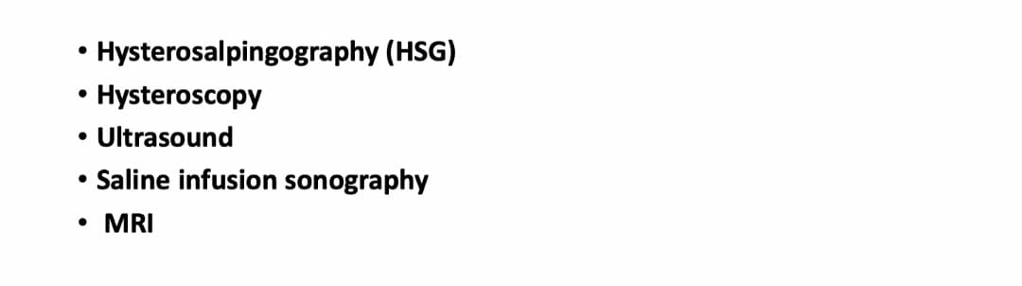
What are the methodologies available to assess intrauterine pathology ?

Slide 212
Normal HSG with patent tube and spillage of dye

Slide 213
A HSG was done
What are the findings ?
ON HSG *tubes filling defect / no tubes visible / no spillage of dye
*So proximally blocked tubes → tube factor infertility

Slide 214
What is the next step ?
Next step after blocked tubes on HSG is always diagnostic laparoscopy (why)?
*1)diagnostic and therapeutic ( adhesolysis).
*2)to rule out tubal muscle spasm. (HSG is painful so blocked tubes could be due to uterine muscles contraction so do laproscopy and dye test under anesthesia to confirm the diagnosis).
*3)to rule out hydrosalpynx (fluid is toxic for embryos)
→might cause ivf failure so do salpingectomy or clip ligation before ivf.
*4)rule out endometriosis

Slide 215
Regular cycle / normal tubes and cavity on HSG / normal seminal fluid analysis
Whats your ddx & management ?

Slide 216
*regular cycle / normal tubes and cavity on HSG / normal seminal fluid analysis →this rules out tubal factor , male factor , ovulatory dysfunction
*so it might be endometriosis : ask about 2ry dysmenorrhea , deep dyspareunia
physical examination : bimanual → uterosacral nodularity ..
*diagnosis by laparoscopy ..
*if still no causes found .. Unexplained infertility → management :
- ovulatory induction for several cycle
- intrauterine insemination
→both have great results in unexplained fertility cases..

Slide 217
*D : clomiphene citrate
*All choices could be done but we start with ovulatory induction (clomiphene citrate then HMG )
*before doing induction we must be sure of tubal patency

Slide 218
*C : tubal factor
*so next step : HSG if abnormal do laparoscopy (adhesiolysis)
*watery cervical mucus is normal and one of the signs of ovulation

Slide 219
*B : laparoscopy
*because we suspect endometriosis
*if the woman is nulliparus with this same history do seminal fluid analysis first
*even in cases of 2ry infertility do seminal analysis (because it could change)
*endometriosis : tubal factor + affects ovulation
if both HSG and ovulation are normal could be due to adhesions separating the ovary from the tubes (while maintaining tubal patency)

Slide 220
*C : laparoscopy
*blocked tubes on HSG next step is always laparoscopy
Notes:
.

Slide 221
Ovarian Masses Dr.Adel abu al-hija
Done by: Bara'a Rashaydeh

Slide 222
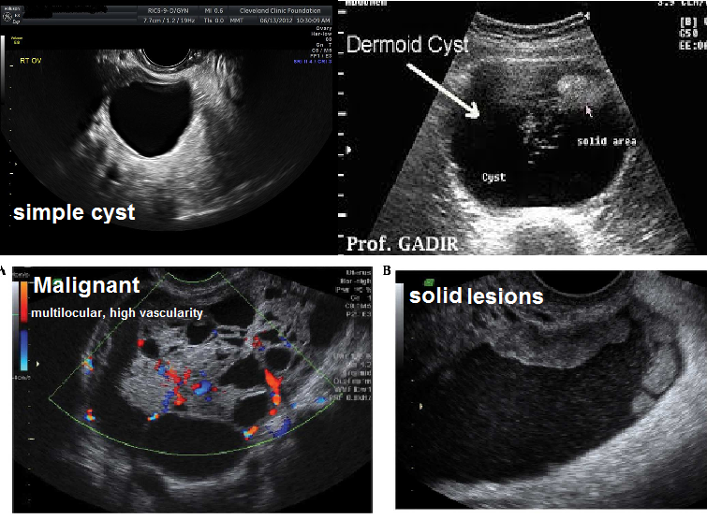

Slide 223
Case 1
25 y/o girl visited the gyne clinic today complining of vague abdominal pain, the U/S showed a simple clear cyst, 7cm in diameter in the Rt ovary.
1.What is the most likely dx?
(young age + simple clear cyst) ➔ Functional cyst (follicular or luteal)

Slide 224
2.What is your management?
Expectant management for spontaneous resolution, in case of asymptomatic, here the patient is complaining of pain so the management is combined oral contraceptive pills for 3 months .
This will suppress ovulation (inhibition of LH and FSH) so prevents formation of further cysts and allow the cyst to resolve and rupture, like any normal follicle, not decrease in size nor dissolve!
**If a functional cyst was symptomatic and didn’t resolve after COCP, we can aspirate it under u/s guidance or cystectomy and histopathology

Slide 225
3.If the cyst appeared complex with clear and solid components, what is the most likely dx then?
4.What are the tumor markers of germ cell tumors?

Slide 226
Question 3
Teratoma mostly because the patient is young
Other ddx are the other germ cell neoplasms :
1.Dysgerminoma (Malignant + bilateral + the only radiosensitive ovarian tumor)
2.yolk sac tumors 3.embryonal carcinomas 4.choriocarcinomas
Question 4
LDH , AFP , HCG

Slide 227
5.If the mass (the one with clear and solid components) appeared to be dysgerminoma after cystectomy, what is the next step ?
.
Perform unilateral salpingo-oophorectomy and cytoreduction. After the surgery give radiotherapy

Slide 228
Case 2
65 y/o patient complaining of vague abdominal pain, on U/S there was a mass reaching the umbilicus.
What is the most likely dx?
Epithelial ovarian cancer (the m/c ovarian cancer) the doctor asked about the types (High-grade serous carcinoma ,Endometrioid carcinoma, Clear cell carcinomas, Mucinous carcinoma, Low-grade serous carcinoma)

Slide 229
2.What is the next step in management?
Serum CA-125 levels and calculate the risk malignancy index (RMI)
3.RMI >200, what's the next step ?
CTS to determine the extent of the disease then cytoreduction by laparotomy (infra-umbilical vertical incision) look for visible masses and free peritoneal fluid .
The minimum surgery to be done is: Total hysterectomy + Bilateral salpingo-oophorectomy +Pelvic and paraaortic lymph node dissection+ Omentectomy, and then peritoneal wash and diaphragm cytology for further staging.
4.What are the main causes of death in ovarian ca?
Mostly intestinal obstruction and then thromboembolic events.

Slide 230
Case 3
40 y/o patient complaining of heavy vaginal bleeding, on U/S the uterus was normal in size, there was a solid unilateral ovarian mass
1.What is the most likely dx of this ovarian mass?
Granulosa cell tumor

Slide 231
2.Tumor markers?
Inhibin, estrogen, androgens
3.What is the clinical presentation of sex cord tumors in general?
Sex cord neoplasms that secrete estrogens or androgens result in endocrine-dependent clinical manifestations:
estrogen excess (eg, precocious puberty in a child, in older ages abnormal uterine bleeding, endometrial hyperplasia or carcinoma)
androgen excess (virilization) hirsutism, deepening of the voice, temporal balding, and clitoromegaly.

Slide 232
Notes:
Ascites + Solid ovarian mass(fibroma) ➔ Meig's Syndrome
Thyrotoxicosis+ complex cystic lesion(teratoma) ➔ struma ovarii
Krukenberg tumor : secondary neoplasm, bilateral, the primary site is stomach so we see mucin-secreting “signet ring” cells under the microscope.
The colon and stomach are the most common primary tumors to result in ovarian metastases, followed by the breast, lung, and contralateral ovary.

Slide 233
What are The complications of any ovarian mass?
Rupture, torsion, hemorrhage
Severe acute abdomen + ovarian mass ➔ ovarian torsion
emergent surgery to untwist the ovary, then determine viability by Doppler, if viable we anchor the ovary (oophoropexy)if not, ophorectomy.
Ruptured teratoma may lead to Shock and hemorrhage immediately, also chemical peritonitis that may lead to formation of dense adhesions later on.
Ruptured ovarian mucinous carcinoma leads to pseudomyxoma peritonei
But dr.Omar says: pseudomyxoma peritonei historically was believed to result from rupture of primary ovarian mucinous neoplasm, it is now accepted that pseudomyxoma peritonei almost always results from metastasis to the ovary, often from an appendiceal primary. The primary site should be sought in these cases.

Slide 234
Post menopausl bleeding
Dr malik
Done by : aseel Al-sleihat

Slide 235
Case: 60 years female patient , menopause since 10 years complaint with vaginal bleeding and off since 2 months .
What is your diagnosis ?
postmenopausal bleeding
**most common cause is endometrial \ vaginal atrophy ( 85%)
**any case postmenopausal bleeding is endometrial cancer until proven other wise

Slide 236
What are the important points in the history to ask about ?
a- age
b- nulliparity
C- tamoxifen use
d-early menarche and late menopause
e- DM
f- obesity
g-PCOS
h-family hx of malignancies ( breast, endometrial , ovarian)
**smoking is protective in endometrial CA but high risk factor in cervical cancer

Slide 237
3.What are the Important points in P\E ?
a-general
b-BMI
c-gynecological exam ( speculum [local lesion] , bimanual [bulky uterus] )
d-breast examination (hx of breast cancer, if pt had taken tamoxifen [usually take endometrial biopsy routinely >> acourding to endometrial thickness if >4 mm )

Slide 238
4.What are the important Investigations ?
a-CBC
b-KFT,LFT
c-ultrasound ( endometrial thickness ) if >4 mm Do endometrial biopsy
2 scenarios which one need medical intervention ?
25 years pt with ET=20 mm 50 years pt with ET=5 mm
And before mense 7 days postmenopausal
The second patient because the first one is before mense so it’s normal to have increase endometrial thickness (must know which day of the cycle) so we usually do ultrasound in the second day of cycle (most accurate to measure ET)

Slide 239
5.How to do biopsy ?
Hysteroscopy + biopsy
b- D and C
c-But if patient is not fit to anesthesia >> piplle biopsy ( done usually in the clinic >> dilation (0.5 cm) and take biopsy while pt is awake )
6.Possible Reports of histopathology ?
a-no cells
B-Hyperplasia without atypia ( risk for malignancy = 1%)
C-Hyperplasis with atypia ( 3%)
D-Complex without atypia (5%)
E-Complex with atypia (25%)

Slide 240
7.Treatment ?
a-if pt is stage 1 or not fit to surgery >> we can start with hormonal therapy ( mirena )
**The mainstay of treatment for endometrialcarcinoma is an extrafascial total abdominalhysterectomy and bilateral salpingo-oopherectomy,peritoneal washing, and lymph node biopsy.(TAH+BSO+PW+?LNB )

Slide 241
b-hystrectomy (types):
Simple (total abdominal , subtotal [preserve cevix] )
Radical\Wertheim (remove uterus,parametrium and upper 1\3 of vagina)
Modified radical
Exentration ( complete , partial)

Slide 242
Notes:
**which ovarian mass that cause vaginal bleeding in 50 years age ?
Granulosa cell tumor(estrogen secreting )and the tumor marker is inhibin
***direct mortality cause of :
Endometrial cancer >> mets (lung and liver )
Cervical cancer >> renal failure
Ovarian cancer >> intestinal obstruction
**** indication to do endometrial sampling in pt who takes tamoxifen >> according to ET if > 4mm
**** menopause pt in new studies :
a-if there is malignancy or premalignancy, we remove both ovaries
b- if it’s benign cause, we preserve the ovaries up to 75 years (to support bone and avoid osteoporosis)

