Slide 1
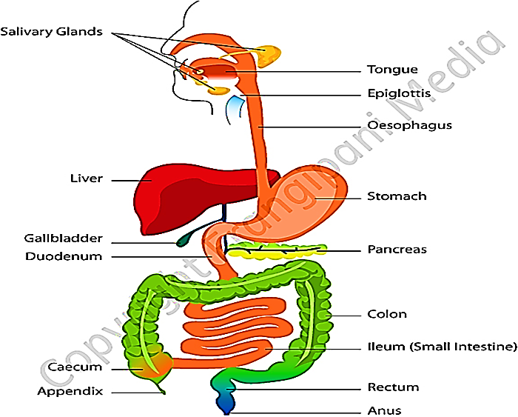
The digestive system III
Organs associated with digestive tract
Liver
Pancreas
Gall bladder

Slide 2
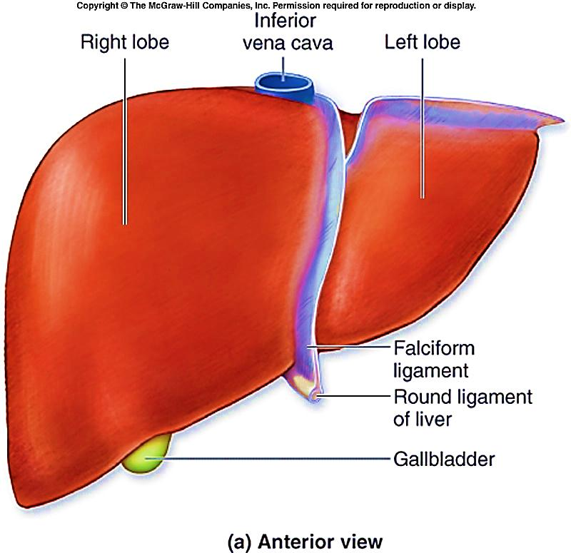
Liver

Slide 3
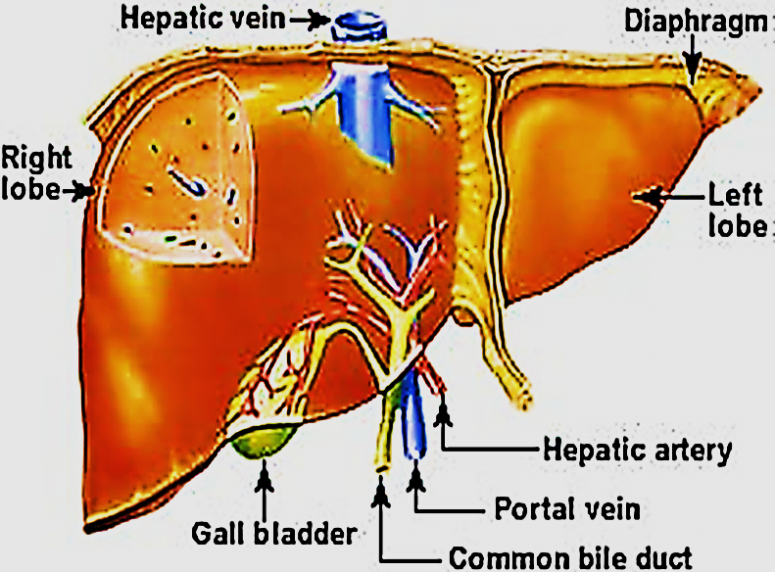
Liver
The Liver is the largest gland in the body (1.5 Kg)
Processing & metabolism of nutrients
Detoxification: modifying potentially dangerous chemicals & removal of old RBCs
Endocrine : synthesize and secrete plasma proteins (albumin, prothrombin, fibrinogen), glucose &lipids into blood via blood sinusoids
Exocrine: synthesize and secretion
of bile
5- Storage of: glucose, fat , vit. A, B, D, K

Slide 4
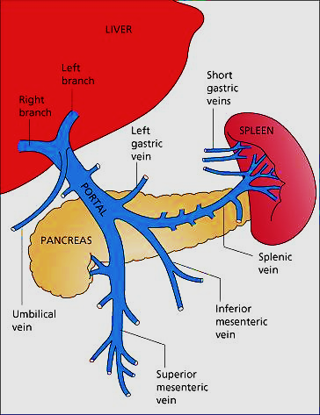
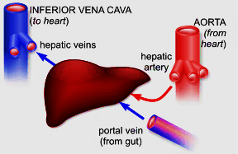
Blood supply of liver
Portal vein: 70 - 80%
Main drainage of blood from GIT, spleen, pancreas
Brings nutrient rich, toxin loaded, oxygen poor blood
Hepatic artery: 30 – 20%
Aorta→ hepatic artery
Brings oxygen rich blood to liver

Slide 5
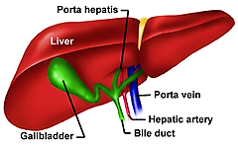
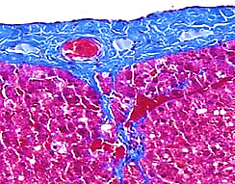
Structure of liver
Stroma & parenchyma
A) Stroma: capsule → septa → reticular fibers
Capsule of Glisson: thin fibrous C.T. sheet, covers the liver. Thick at hilum to form prota hepatis which gives rise to C.T. septa divide the liver into lobes and lobules
septa: surround lobules. Thick and easy to identify in pig’s liver.. Lobulation are not clear in humans unless??
Portal tracts: triangular masses of
C.T. at angles between hepatic lobules
Reticular fibers: delicate network
surround and support liver cells

Slide 6
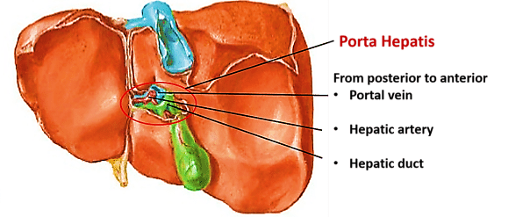
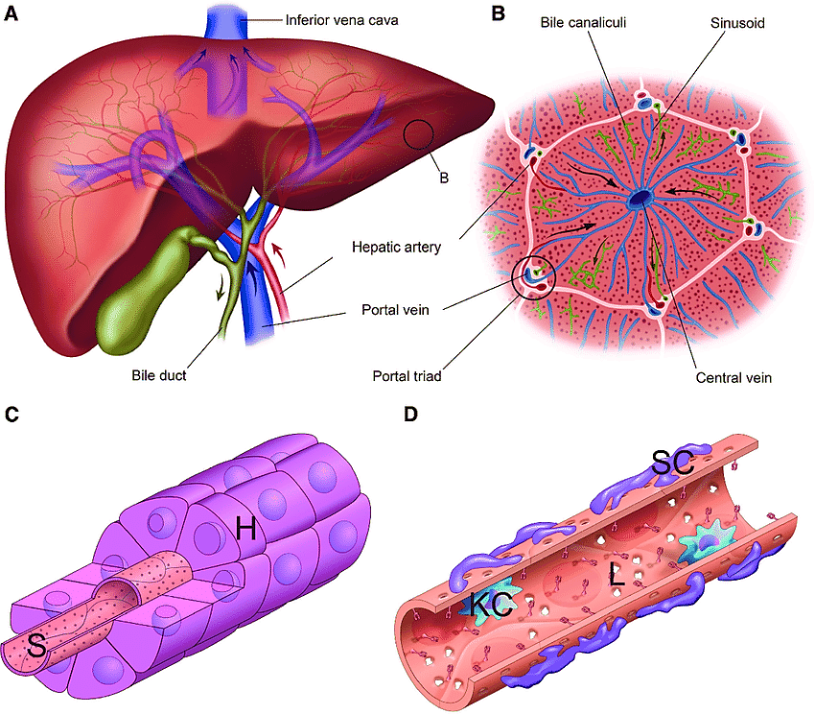
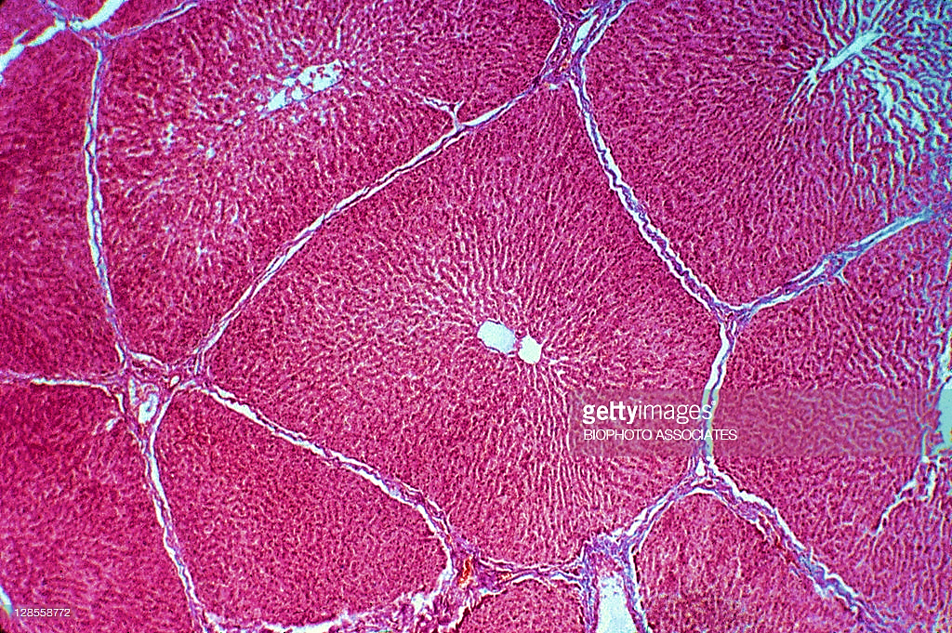
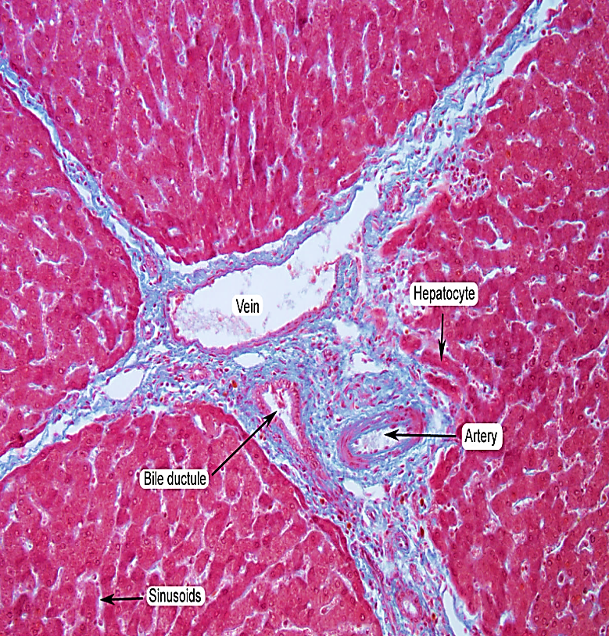
Septa are thick & the lobulation is clear in pig's liver
(similar lobulation only seen in human’s in liver cirrhosis)

Slide 7
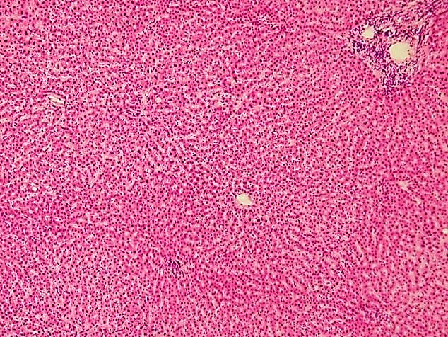
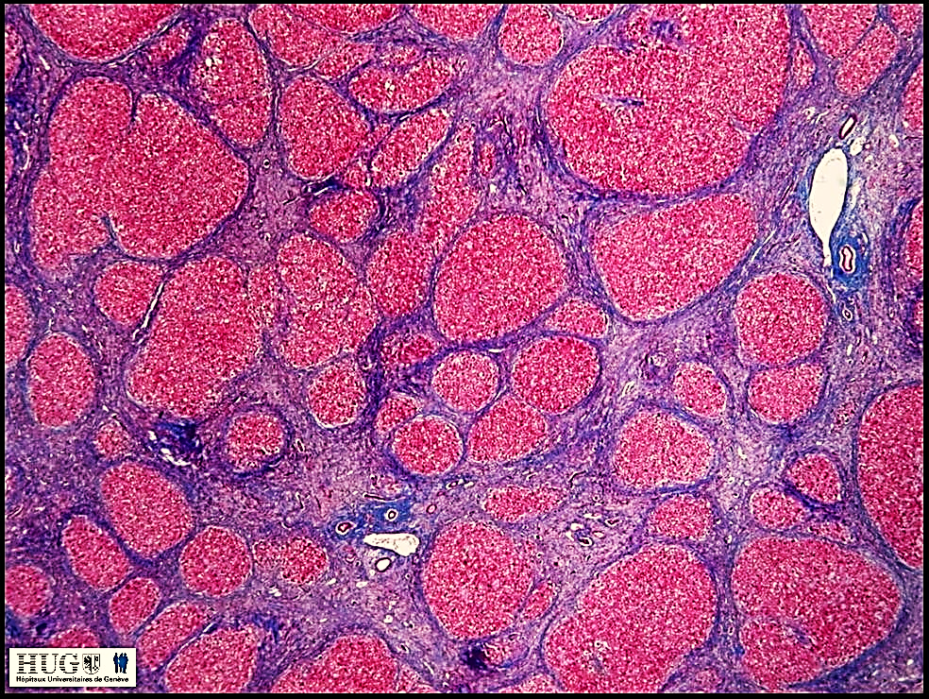

Slide 8
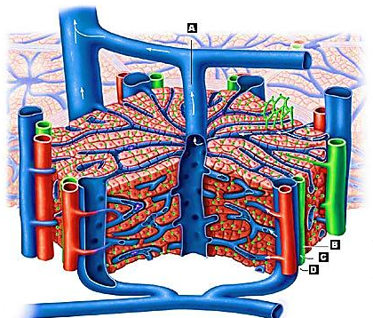

Slide 9
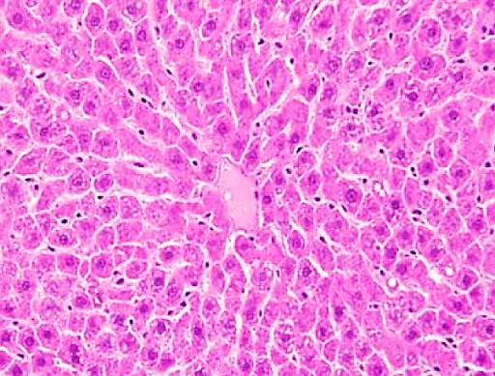
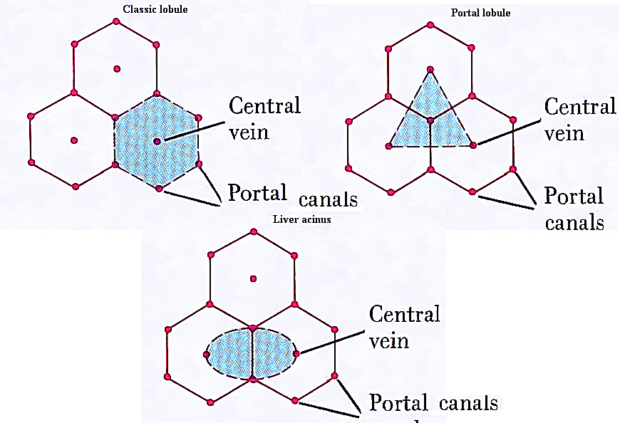
B) Parenchyma: liver cells (hepatocytes)
They are arranged to form either :
1- Classic hepatic lobules
2- Portal lobules
3- Liver acini

Slide 10
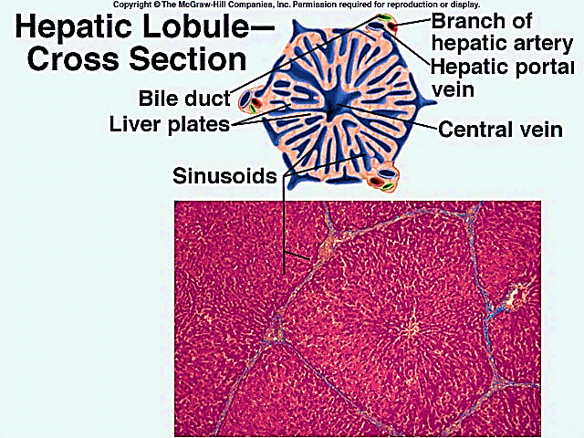
1- Classic hepatic lobule
Hexagonal or polygonal in shape (cross section)
Surrounded with thick C.T. septa in pig’s liver
Each lobule has 3-6 portal areas (portal triads) at its periphery, and central vein (CV) at its center
Central vein
Portal areas

Slide 11
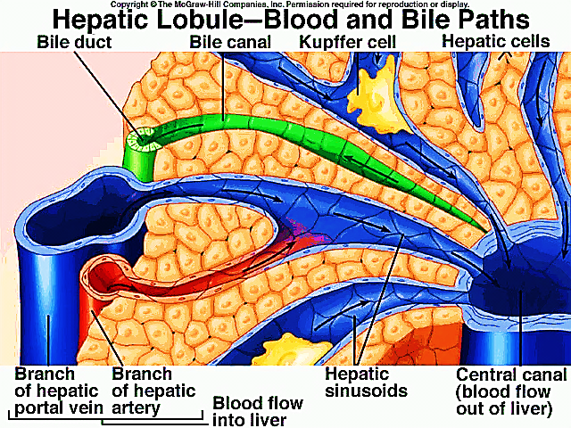
Portal areas (tracts): Each contains :
A branch of portal vein: widest with thin wall
A branch of hepatic artery: rounded with narrow lumen
A branch of bile duct: lined with cubical epithelium
Lymph vessel
Branch of lymph vessel

Slide 12
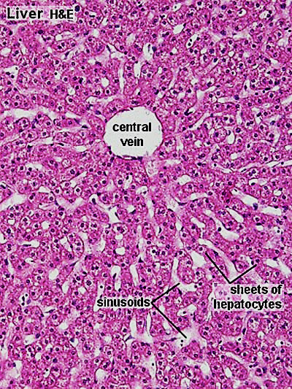
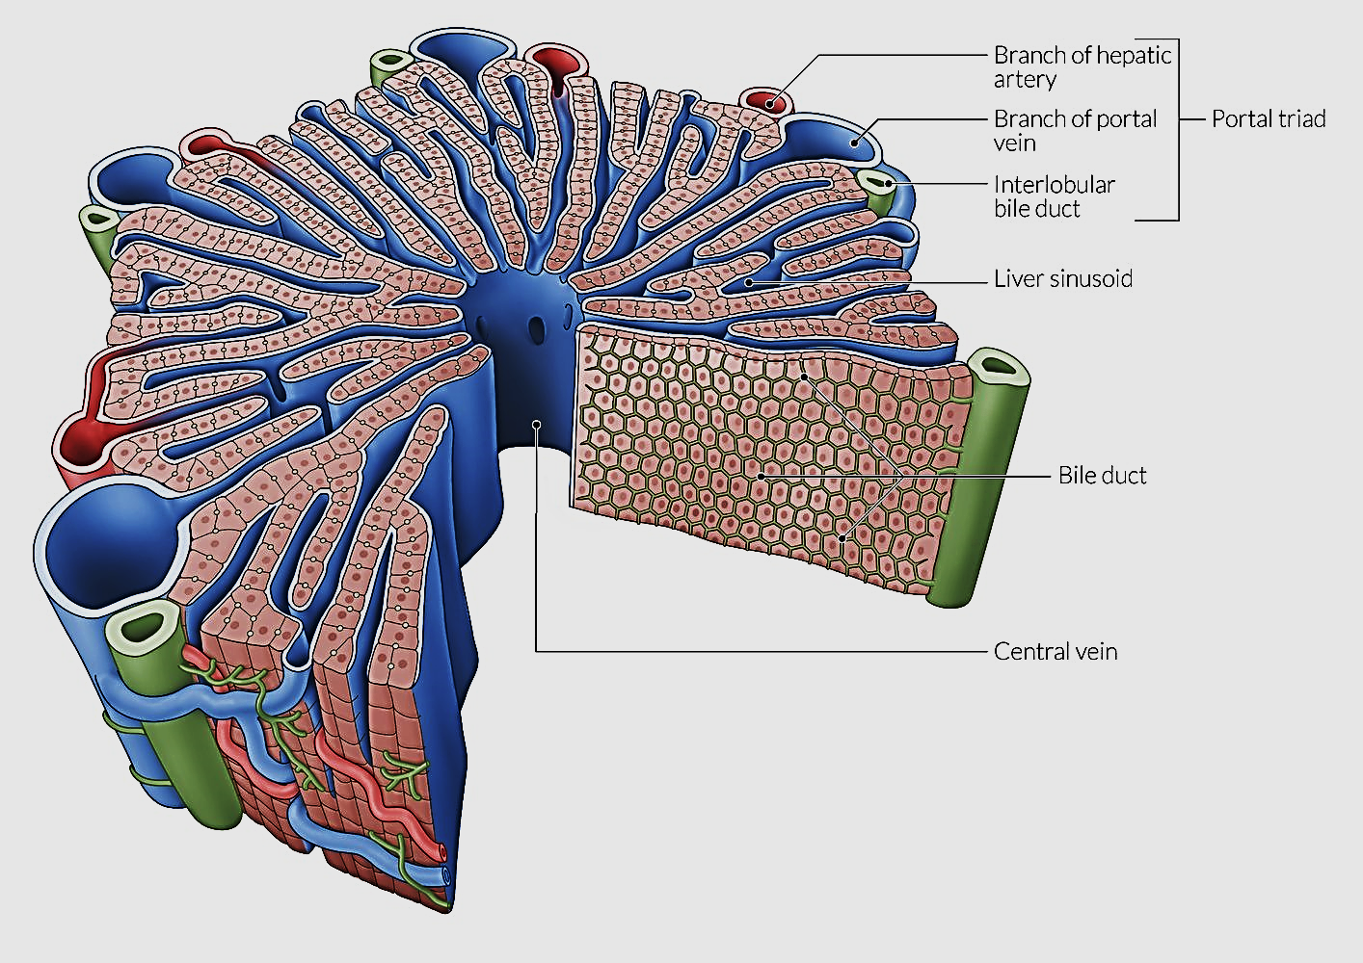
Within each lobule the liver cells arranged in interconnected plates (cords) around the central vein
The plates are two or more rows of cells width
The spaces between the plates called liver sinusoids. They drain blood into central vein

Slide 13
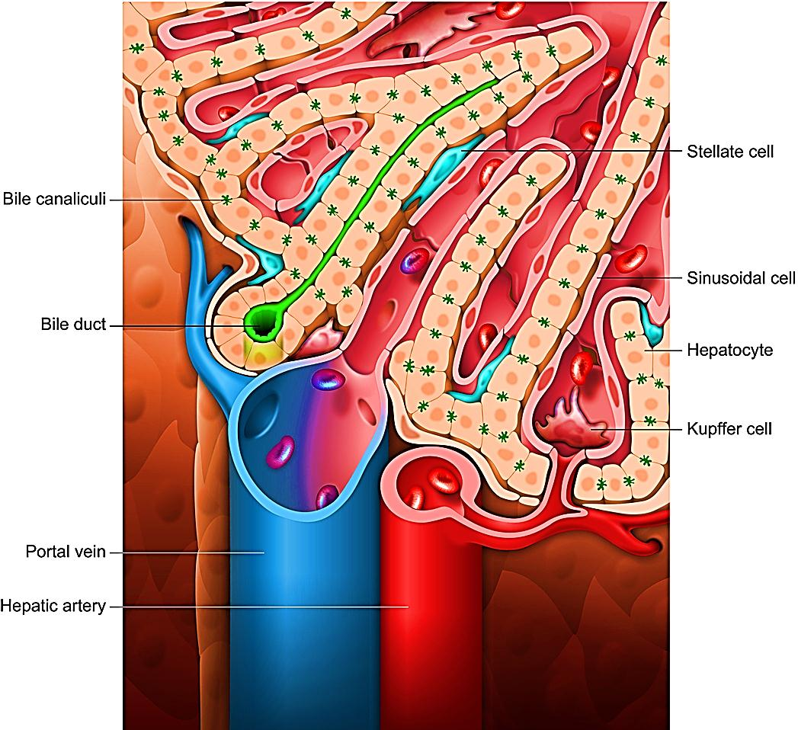
Bile canaliculi present within the plates in-between adjacent hepatocytes, they drain bile into the bile ducts in portal areas

Slide 14
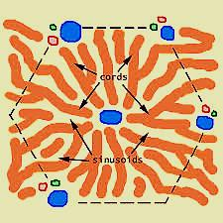
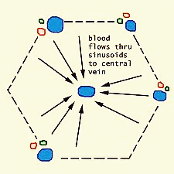
Liver sinusoids and space of Disse
A- Liver sinusoids
Minute blood channels present between plates /cords of liver cells
Transport blood from branches of portal vein & hepatic artery in portal area toward central veins (mixed blood)
The flow of blood is centripetal

Slide 15
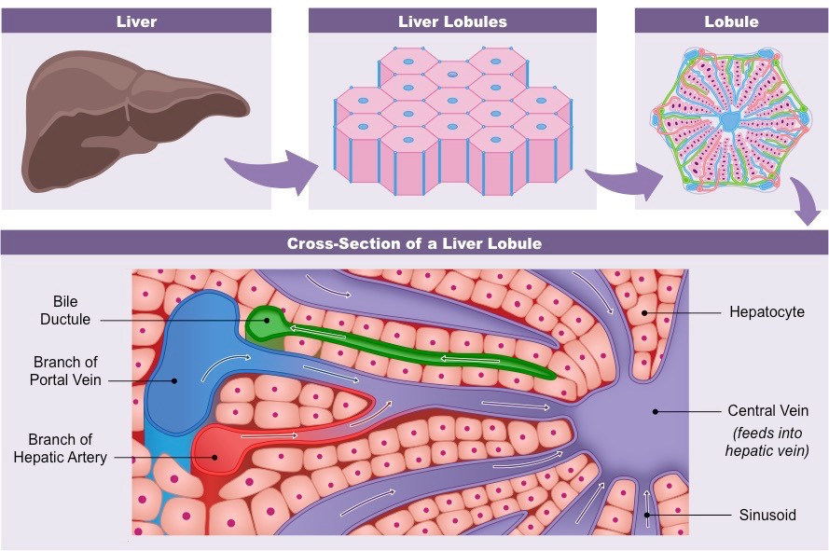
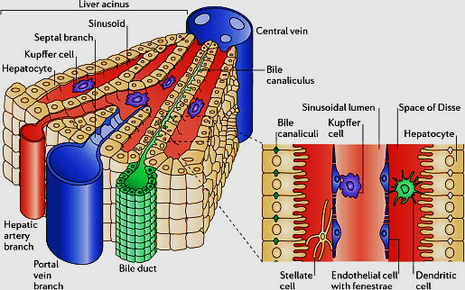
Lining of blood sinusoids consists of:
fenestrated endothelial cells
Discontinuous basal lamina
Kupffer cells
Pit cells
The wall of the sinusoids is separated from the hepatocytes by a space called space of Disse

Slide 16
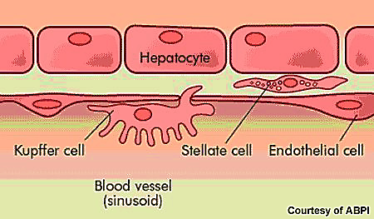
Endothelial cells lining of liver sinusoids:
Flat cells, contain many holes ( fenestrae) to allow free passage of molecules between blood and peri-sinusoidal space of Disse
Kupffer cells:
Macrophages (Fixed) , large cells with large oval nucleus and numerous cytoplasmic processes. Seen in the blood sinusoids and in between endothelial cells. Their cytoplasm contain lysosomes, pinocytotic and phagocytic vesicles.

Slide 17
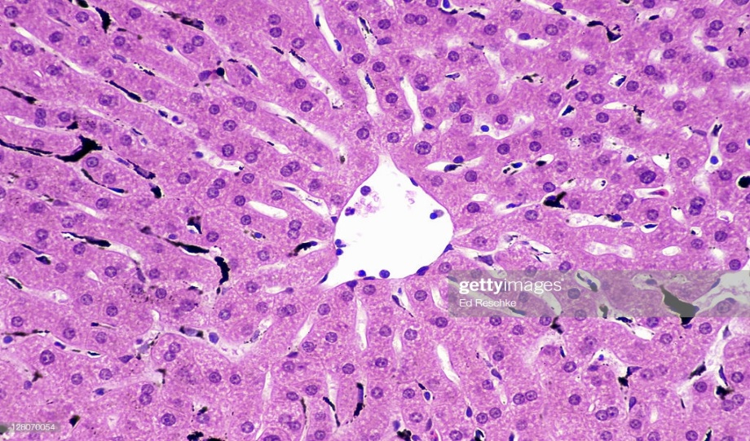
Pit cells: are liver-specific natural killer (NK) cells and belong to the group of sinusoidal cells. They are morphologically and functionally modified form of peripheral blood NK cells. localized inside the lumen of the sinusoid, closely adhering to the endothelial cells and Kupffer cells, and often extending well-developed pseudopodia suggestive of migration along the sinusoidal wall. Multivesicular dense granules are frequently found in the cytoplasm of pit cells which exert antitumor functions by exocytosis of perforin/granzyme-containing granules, which cause death of target cells through receptor-mediated apoptosis , and production of various cytokines that augment the activities of other immune cells
Kupffer cells seen in liver lobules as black cells with special stains (India ink).
Found more near portal areas

Slide 18
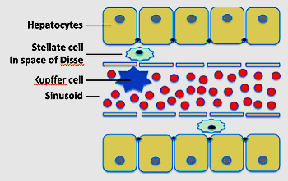
Space of Disse
EM: space separate between the endothelial cells lining of the sinusoids and hepatocytes
Through out the space exchange of metabolites between blood and hepatocytes takes place

Slide 19
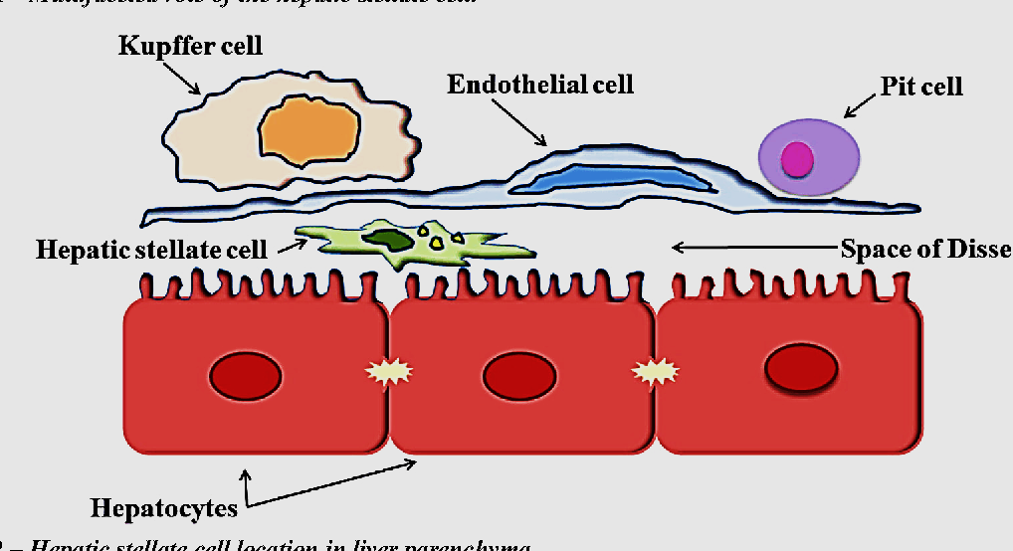
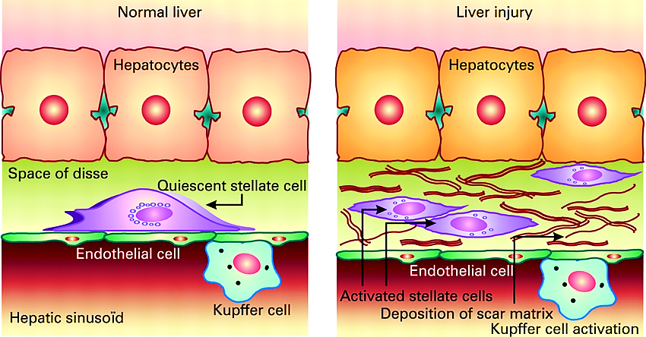
Space of Disse contains:
Fat storing cells (Ito cells, stellate cells). They store Vit. A in small lipid droplets in their cytoplasm, and maintain the extracellular matrix of the space
Long microvilli of hepatocytes project in the space ( ↑)
Blood plasma
Reticular fibers that support the wall of the sinusoids

Slide 20
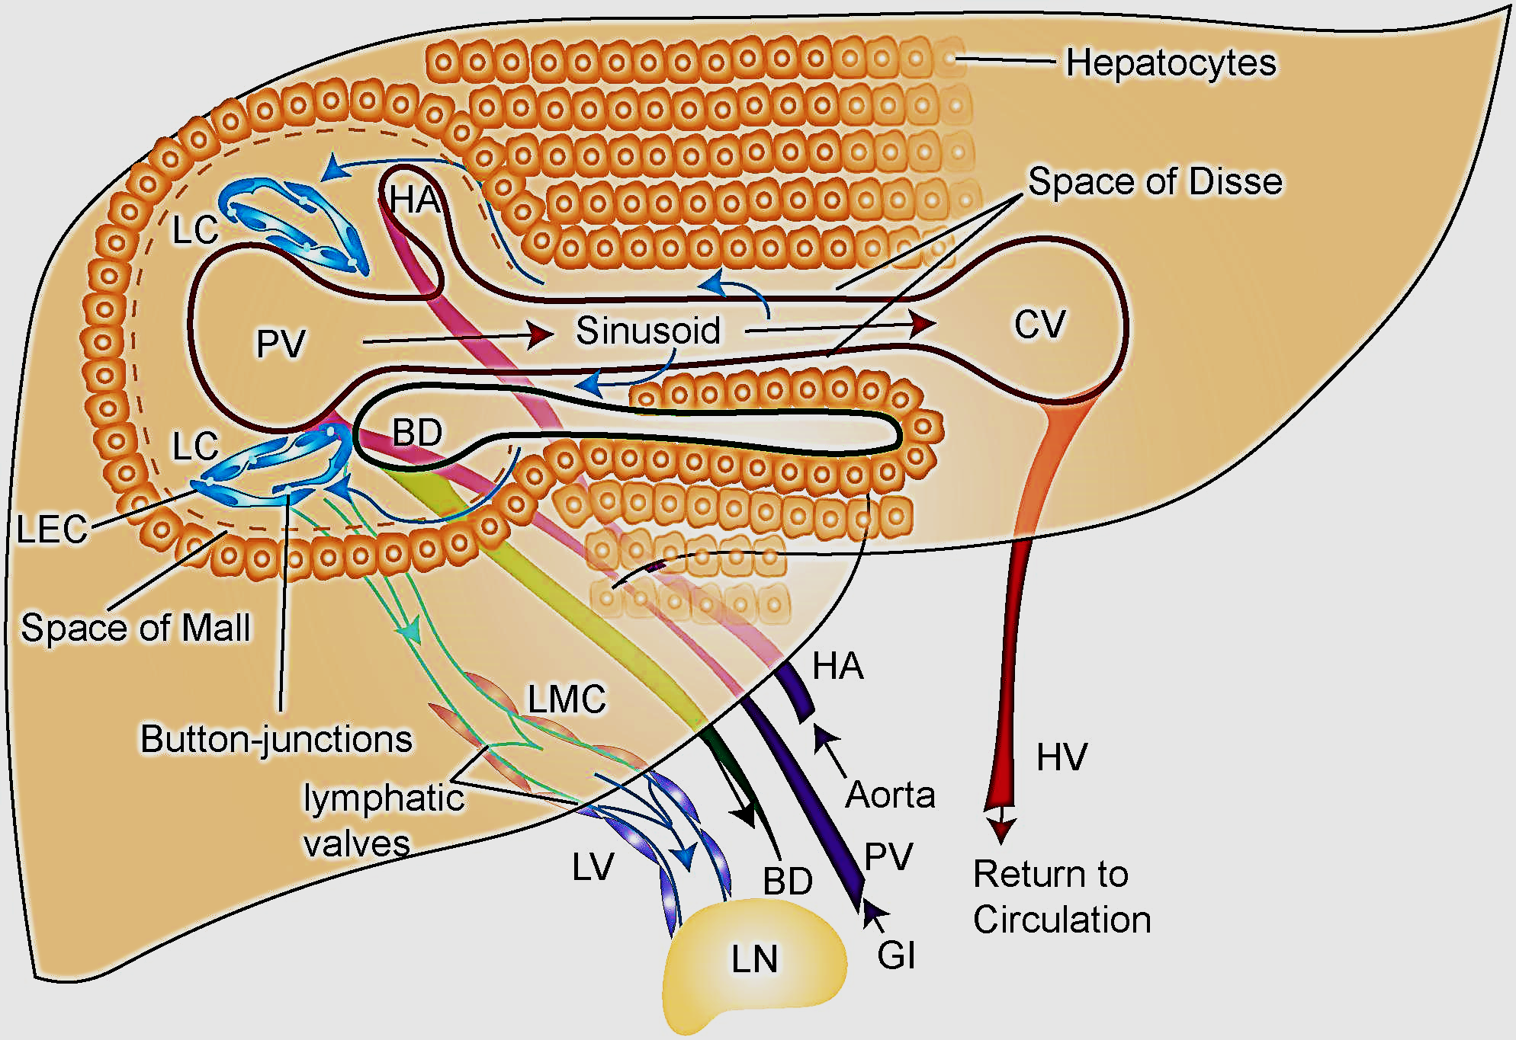
The peri-sinusoidal spaces of Disse is the beginning of the lymphatic system of the liver

Slide 21
Bile canaliculi and bile ducts
Minute canals present within hepatic plates, in-between adjacent hepatocytes.
They are bounded by the cell membrane of adjacent hepatocytes

Slide 22
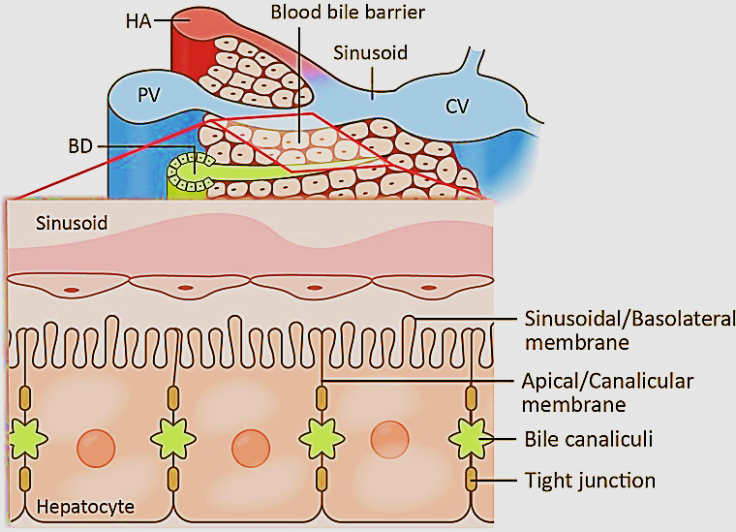
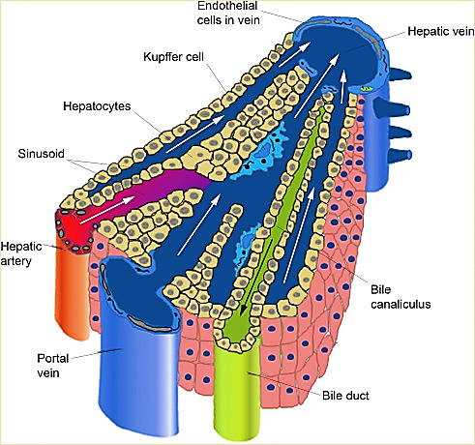
Small microvilli project from hepatocytes into the canaliculi and tight junctions
hold the cell membranes of
hepatocytes around the lumen
of the canaliculus
(hepatocyte polarization)
Bile secreted by hepatocytes drains out of the lobule.

Slide 23
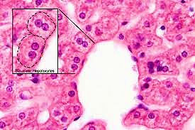
Hepatocytes
LM: large polygonal cells with 1 or 2 nuclei (bi-nucleated)
Nuclei: central, rounded, e prominent nucleoli
Acidophilic cytoplasm (rich in mitochondria& SER), it also appear vacuolated due to dissolved glycogen and fat

Slide 24
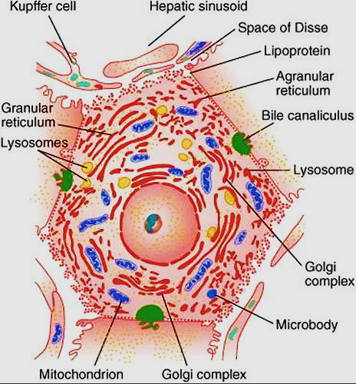
E/M:
Cytoplasm is very rich in organelles & inclusions
Organelles:
mitochondria, rER, ribosome,
sER, Golgi complex,
lysosomes & peroxisomes.
Inclusions:
glycogen granules & fat
droplets

Slide 25
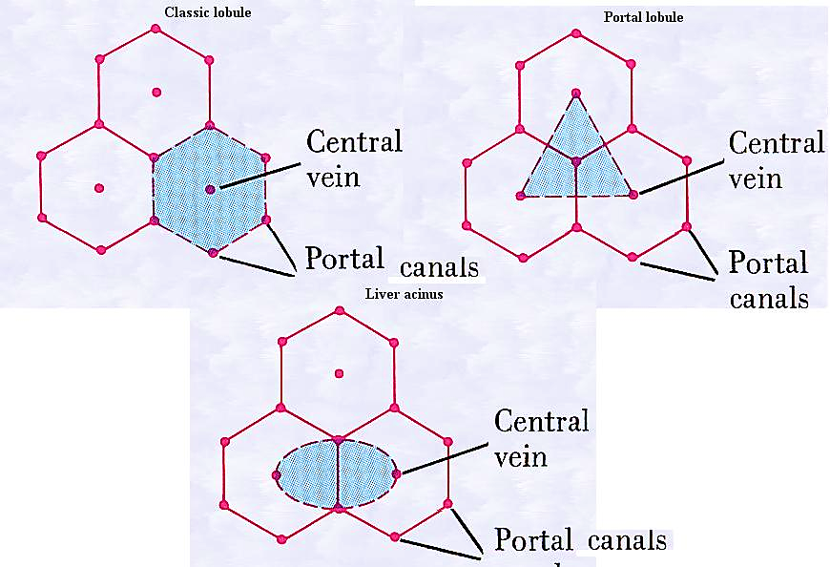
Organization of liver parenchyma/function:
Classic hepatic lobule → endocrine function
Portal lobule → exocrine function
Liver acinus → oxygen/ nutrients supply

Slide 26
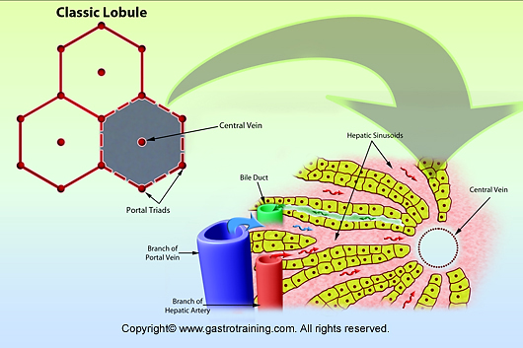
Classic hepatic lobule:
Hexagonal in shape with central vein in the center, surrounded with 3 – 6 portal tracts at the its corners
Proteins, glucose secreted by liver cells released directedly into blood sinusoids

Slide 27
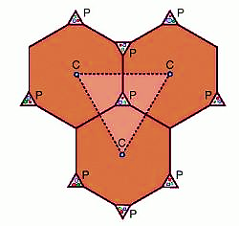
Portal lobule:
Triangular in shape, centered on portal area (tract) apices of the triangle are formed by 3 central veins.
Hepatocytes of this lobule drain their bile to a bile duct in the center of the triangle

Slide 28
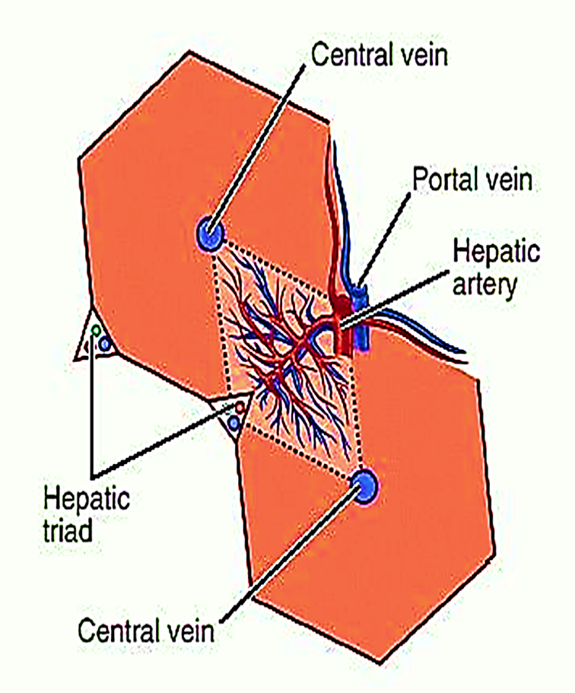
Liver acinus: is the most important classification
Diamond shaped mass of liver cells surrounding a central vascular core
It is divided into 3 zones:
Zone 1:
Close to the vascular core
Get the most oxygen and nutrients
Zone 2:
Surrounds zone 1
Get intermediate oxygen /nutrients
Zone 3:
At the periphery near the central vein
Get the least oxygen/ nutrient supply

Slide 29
Liver acinus
Arrangement of liver acinus explains the variation in liver cells damage in response to hypoxia & toxins.

Slide 30
zone 1
Cells close to the distributing vessels
higher in : oxygen, nutrient & toxin levels
Least susceptible to ischemia
first to show changes following bile duct occlusion
last to die due to circulatory impairment
first to regenerate
zone 3
Cells far from the distributing
vessels
first to show ischemic necrosis (death due to reduced circulation
(centri-lobular necrosis)
first cells to show fatty accumulation (alcoholic liver disease) because these cells important for glycolysis
last to respond to toxins

Slide 32
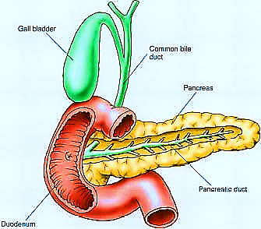
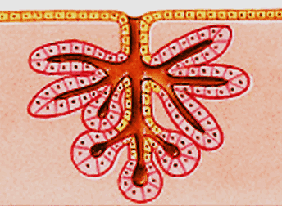
Pancreas
Mixed exocrine + endocrine gland produce both digestive enzymes and hormones
The exocrine part: compound tubulo-alveolar gland secretes pancreatic enzymes & bicarbonate
The endocrine part: Islets of Langerhans secrete hormones: insulin, glucagon, somatostatin..etc
Tubulo-alveolar gland

Slide 33
Structure of Pancreas
Stroma & Parenchyma
Stroma:
Capsule: thin C.T sheath covers the Pancreas
Septa (trabeculae): arise from the capsule, divide the organ into lobes and lobules
Reticular fibers: delicate network of fibers support the parenchyma, rich with blood supply. Stained e sliver

Slide 34
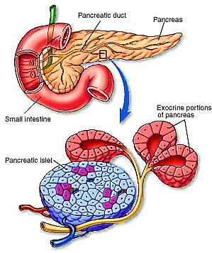
Parenchyma:
A- Exocrine part (acini & ducts)
B- Endocrine part ( islets of Langerhans)
A
B

Slide 35
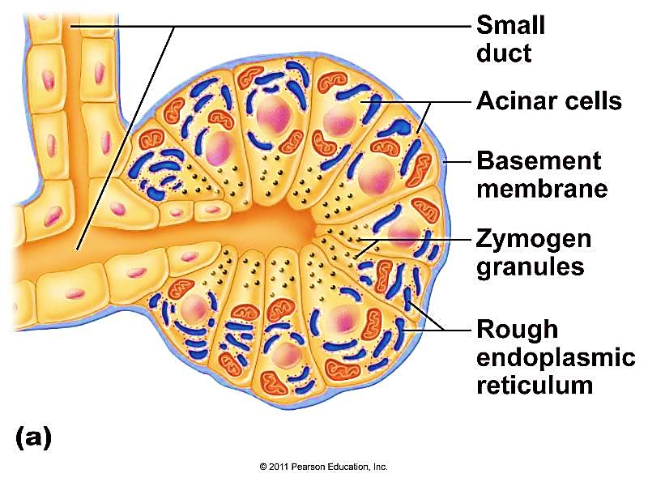
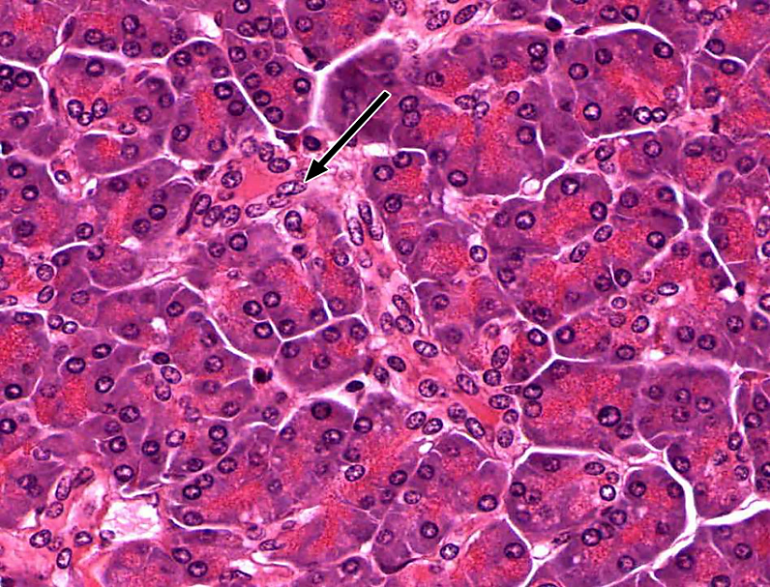
A- Exocrine part: formed of acini & duct system
Acini: L/M
Composed of serous producing cells (enzymes)
The pancreatic acini has very small lumen
Cells are pyramidal with rounded basal nuclei
Cells are protein secreting cells → (exocytosis)
Cytoplasm shows basal basophilia (rER) & apical acidophilia (zymogen granules)

Slide 36
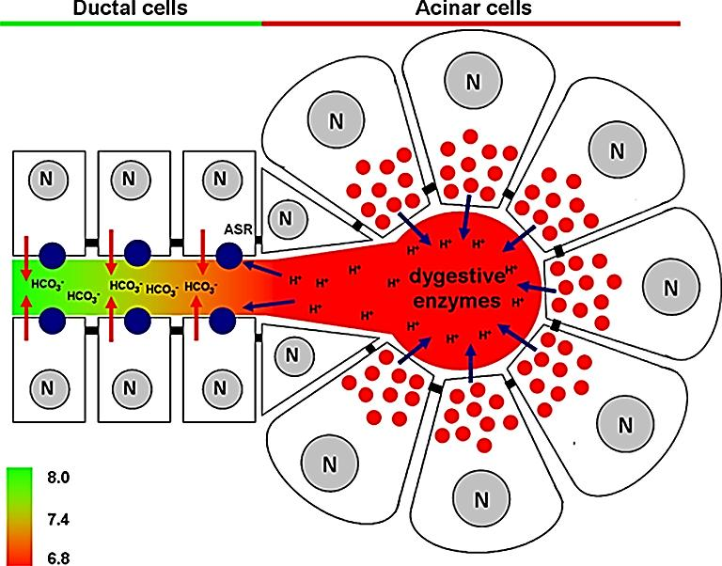
Pancreatic exocrine secretion is controlled by hormones from the endocrine cells of GIT (stomach & duodenum) :
Cholecytokinin: ++ acinar cells to secrete pancreatic enzymes.
Secretin: ++ intercalated duct cells to secrete alkaline fluid to neutralize acidic chyme in duodenum.

Slide 37
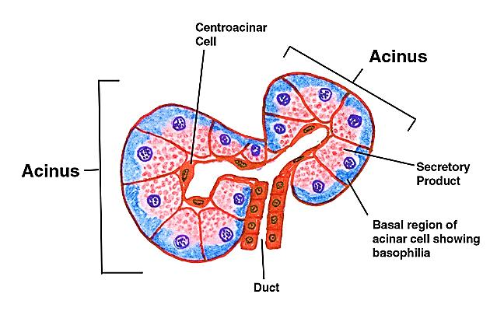
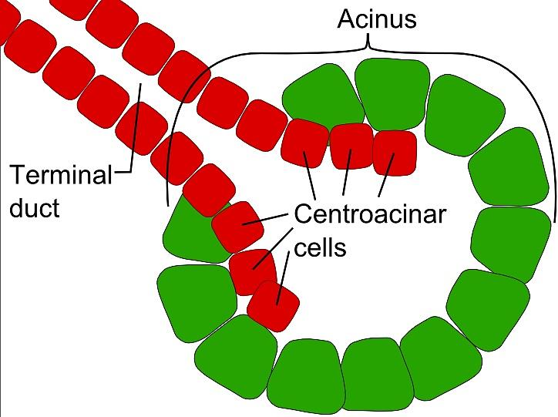
Centroacinar cells:
Flat squamous cells found lining the lumen of the acini
They represent the beginning of the cells o intercalated duct into
They secrete bicarbonate rich fluid in response to secretin

Slide 38
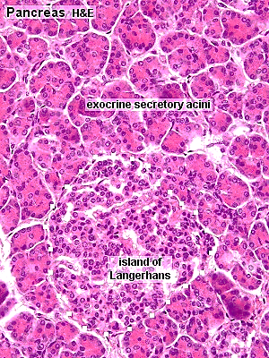
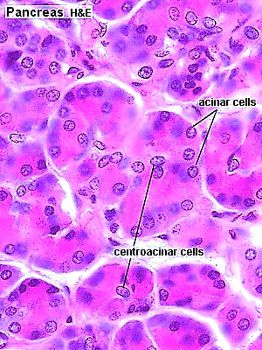
Section in the pancreas showing the exocrine acini & the endocrine islets of Langerhans
Section in pancreas showing centroacinar cells

Slide 39
Duct system
Intercalated ducts:
Thin ducts arise from within the acini
Lined with simple squamous cells.
The initial cells called centroacinar cells (secrete HCO3 rich fluid which hydrate and alkalinizes the enzymatic secretion of acinar cells)
No striated ducts in the pancreas
There are interlobular & interlobar
ducts
Intercalated duct

Slide 40
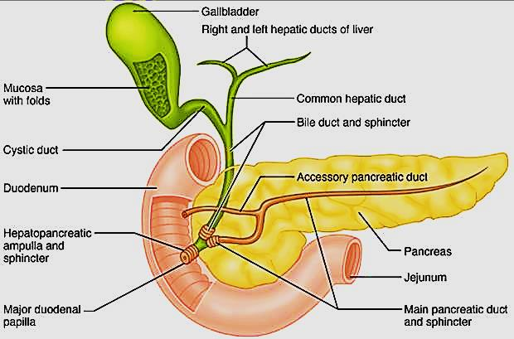
Main duct: lined with columnar epithelium+ goblet cells + enteroendocrine cells
Function of exocrine pancreas:
1- It secretes pancreatic juice rich in bicarbonate & digestive enzymes (protease, amylase, lipase, nucleases,…)

Slide 41
B- Endocrine part:
Islets of Langerhans
Masses of pale staining cells scattered between the pancreatic acini
They are more in the tail than head of pancreas
The cells are separated by fenestrated
capillaries (highly vascularized)
Nerve supply autonomic nerve fibers
Cells of islets of Langerhans are
Alpha, Beta, Delta, Ganglion, PPcells

Slide 42
Beta (B) cells (70%):
Produce insulin which lower blood sugar
Cells are small in size, most numerous cell type, central in location in the islets
Stain blue
EM: appear in two functional stages active & resting
When active synthesize insulin. When resting packed with granules storing insulin
Cells divide at very slow rate
Beta cells

Slide 43
Alpha (A) cells (15%):
Produce glucagon which increase blood sugar
Cells larger in size, fewer in number, peripheral location in Islets
Stain pink
Alpha cells

Slide 44
Delta cells:
Secret somatostatin ( growth inhibiting factor) ↓ other hormones ( insulin & glucagon )
Cells scattered at periphery and less abundant
Ganglion cells:
Aggregation of nerve cells for
autonomic nervous control of
islets secretion
F (PP) cells ( most peripheral)
Very few
Secrete pancreatic polypeptide h.
Regulate exocrine pancreas
secretions
Delta cells
PP cells

Slide 45
Regulation of blood glucose level
↑
↓

Slide 46
Pancreas vs. Parotid
Pancreas
Capsule: thin
Trabeculae: thin, loose
Ducts: few, NO striated secretory ducts inside the lobules
Acini: larger
Centroacinar cells in lumen
Islets of Langerhans: present
Parotid
Thick
Thick
Abundant, striated secretory ducts are prominent inside the lobules
Smaller
No centroacinar cells
Abscent

Slide 47
Gall bladder & biliary tract
Hollow pear shaped organ
Attach to the lower surface of liver
It stores and concentrate bile secreted by liver
Wall of gall bladder consists of:
Mucosa: (highly folded)
epithelium: simple columnar with microvilli
No muscularis mucosa
Musculosa
Bundles of irregularly arranged smooth m.
Fibers , elastic & collagenous fibers
Serosa

Slide 48
Biliary tract:
Bile canaliculi → bile ductules ( canals of hering)
→ bile ducts → hepatic ducts (RT & LF hepatic ducts)
→ common hepatic duct → merge with cystic duct
→ common bile duct
→ merge with pancreatic
duct → ampulla of Vater
→ open in duodenum
Liver regeneration:
Liver cells have high
regeneration capacity

