Slide 1
Forensic psychiatry
Here starts the lesson!

Slide 2
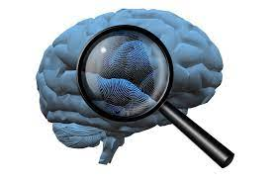
Forensic psychiatry is a medical subspecialty that includes areas in which psychiatry is applied to legal matters. Forensic psychiatrists often conduct evaluations requested by the court or attorneys.
While some (forensic) psychiatrists specialize exclusively in legal issues, almost all psychiatrists have to work within one of the many spheres where the mental health and legal system overlap

Slide 3
01
Standard of care

Slide 4
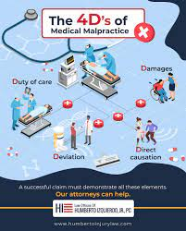
■ Malpractice :is the act of being negligent as a doctor
■ The standard of care in psychiatry is generally defined as the skill level and knowledge base of the average, prudent psychiatrist in a given community
■ Negligence : is practicing below the standard of care.

Slide 5
Confidentiality
02

Slide 6
1.When sharing relevant information with other staff members who are also treating the patient. 2.If subpoenaed—physician must supply all requested information. 3.If child abuse is suspected—obligated to report to the proper authorities. 4.If a patient is suicidal—physician may need to admit the patient, with or without the patient’s consent, and share information with the hospital staff. 5.If a patient threatens direct harm to another person—physician may have a duty to warn the intended victim
All information regarding a doctor–patient relationship should be held confidential, except when otherwise exempted by statute, such as:

Slide 7
Decision Making
03

Slide 8
■ Process by which patients knowingly and voluntarily agree to a treatment or procedure. ■ In order to make informed decisions, patients must know the purpose of the treatment, alternative treatments, and the potential risks and benefits of undergoing and of refusing the treatment. ■ The patient should have the opportunity to ask questions.
Situations that do not require informed consent:
1.Lifesaving medical emergency.
2. Prevention of suicidal or homicidal behavior.
3.Unemancipated minors (typically require informed consent from the parent or legal guardian).
Elements of informed consent (4 Rs):
■ Reason for treatment
■ Risks and benefits
■ Reasonable alternatives ■ Refused treatment
consequence

Slide 9
EMANCIPATED MINORS
Self-supporting
Married
Military
Have children or pregnant
■ Considered competent to give consent for all medical care without parental input or consent.
■ Minors are considered emancipated if they are:

Slide 10
DECISIONAL CAPACITY
Competence and capacity are terms that refer to a patient’s ability to make informed treatment decisions. ■ Capacity is a clinical term and may be assessed by physicians. ■ Competence is a legal term and can be decided only by a judge
In order for a patient to have decisional capacity, he or she must be able to:
■ Understand the relevant information regarding treatment (purpose, risks, benefits).
■ Appreciate the appropriate weight and impact of the decision.
■ Logically manipulate the information to make a decision.
■ Communicate a choice or preference

Slide 11
GUARDIANS AND CONSERVATORS
“Declaration for Mental Health Treatment” Patients can often express their wishes for treatment in advance of losing competence or capacity using a mental health advance directive form
May be appointed by a judge to make treatment decisions for incompetent patients. ■ Make decisions by substituted judgment which means making decisions based on what the patient would most likely have wanted, were the patient competent.

Slide 12
ADMISSION TO A PSYCHIATRIC HOSPITAL

Slide 13
1. Voluntary admission :
Patient requests or agrees to be admitted to the psychiatric ward. The patient is first examined by a staff psychiatrist, who determines if he or she should be hospitalized.
Patient must have capacity and be competent to be admitted as a voluntary patient to an inpatient facility and he or she may not have the right to be discharged upon request.

Slide 14
2. Involuntary admission (also known as civil commitment):
Done by two staff physicians When the patient is potentially harmful to self or others (suicidal, homicidal, unable to care for self, etc.), so the patient may be hospitalized against his or her will
After some days the case must be reviewed by an independent board to determine if continued hospitalization is necessary.
Patients must always be provided with a copy of the commitment papers, and must have any questions answered pertaining to the commitment.
Patients still have legal rights to a trial to challenge their hospitalization, and still have the right to refuse non-urgent medications

Slide 15
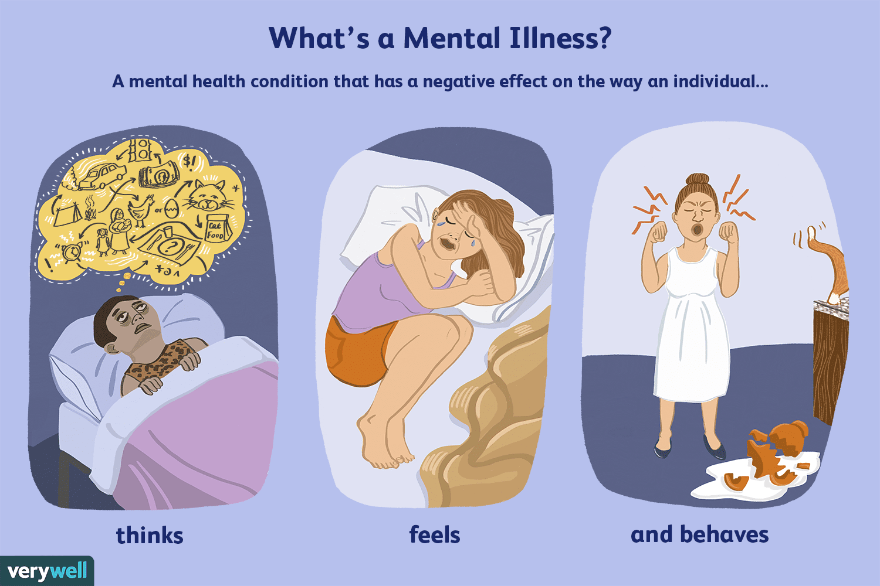
02
Disability

Slide 16
Mental impairment: Any mental or psychological disorder.
Mental disability: Alteration of an individual’s capacity to meet personal, social, or occupational demands due to a mental impairment.
To assess whether an impairment is also a disability, consider four categories:
Activities of daily living.
Social functioning.
Concentration, persistence, and pace.
Deterioration or decompensation in work settings.

Slide 17
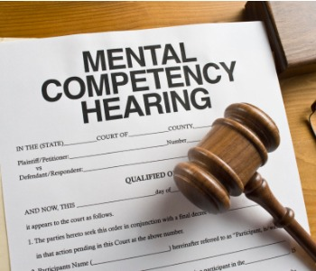
Competence to Stand Trial
Competence is a legal term for the capacity to understand, rationally
manipulate, and apply information to make a reasoned decision on a specific issue.
someone cannot be tried if they are not mentally competent to stand trial.
■ If a defendant has significant mental health problems or behaves irrationally in court, his competency to stand trial should be considered.
■ Competence to stand trial may change over time

Slide 18
To stand trial, a defendant must:
Understand the charges against him or her.
Be familiar with the courtroom personnel and procedure.
Have the ability to work with an attorney and participate trial.
Understand possible consequences

Slide 19
Not Guilty by Reason of Insanity (NGRI)
Conviction of a crime requires both an “evil deed” (actus reus) and
“evil intent” (mens rea).
■ If someone is declared legally insane, they are not criminally responsible for their act.
■ NGRI is used in less than 1% of criminal cases.
■ It is successful in 26% of cases that continue to use it throughout the trial.
■ Those found NGRI often spend the same amount of time (or more) as
involuntary psychiatric patients than they would have spent in prison if
they were found guilty

Slide 20
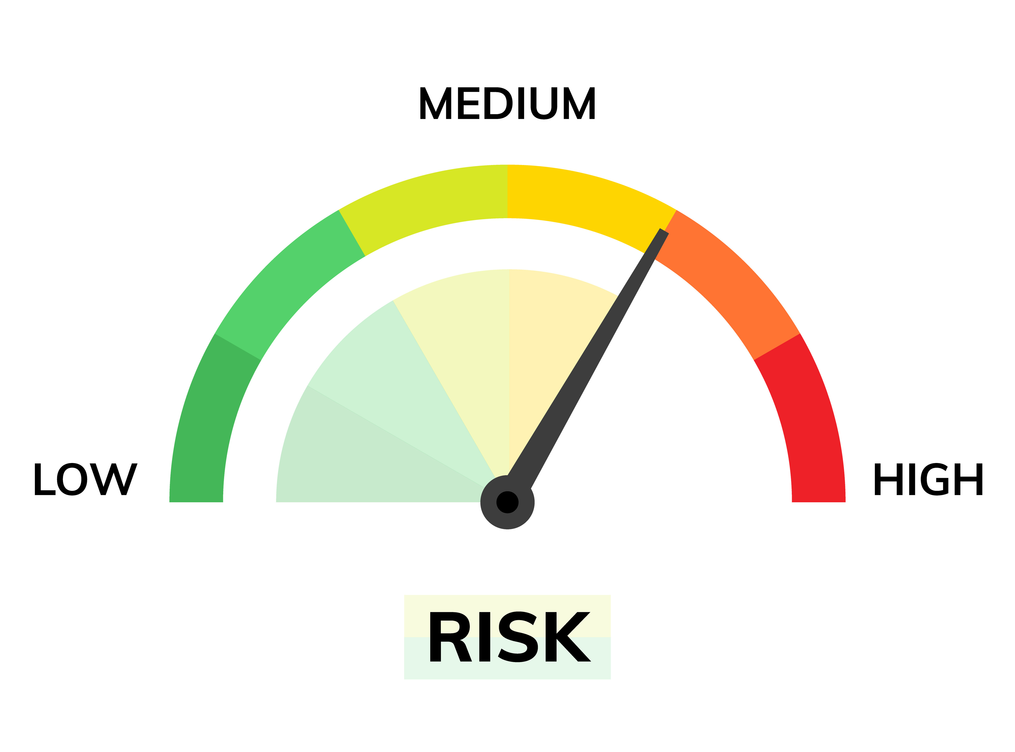
Risk Assessment
Predicting dangerousness:
■ Short-term easier than long-term.
■ High false positives because of low base rates (most people are not violent).
Mental disorders are neither necessary nor sufficient causes of violence.
The major risk factors of violence are a history of violence, being young, male, and of lower socioeconomic status.
■ Substance use is a major determinant of violence, whether it occurs in the context of a mental illness or not.

Slide 21
Signs for detecting malingering:
Malingering
■ Atypical presentation.
■ “Textbook” description of the illness.
■ History of working in the medical field.
■ Symptoms that are present only when the patient knows he/she is
being observed.
■ History of substance use or antisocial personality disorder.
■ Reluctant to engage in invasive/in-depth testing or treatment
Feigning or exaggerating symptoms for “secondary gain,” including:
Financial gain (injury law suit).
Avoiding school, work, or other responsibilities.
Obtaining medications of abuse (opioids, benzodiazepines).
Avoiding legal consequences

Slide 22
Evaluations for which a child forensic psychiatrist may be needed include:
■ Child custody.
■ Termination of parental rights.
■ Child abuse or neglect.
Child and Family Law

Slide 23
With the closing of state psychiatric hospitals (i.e., deinstitutionalization), many persons with mental illness have moved to correctional institutions. ■ Psychiatrists who practice in jails and prisons must balance treating the inmates as their patients and maintaining safety in the institution. ■ Issues of confidentiality and violence are key.
Correctional Psychiatry

Slide 24
Thank you

