Slide 1
Primary& Secondary Dysmenorrhea
Dr Moamar Al-Jefout,
MD, JBO&G, MMed (HR&HG), Ph.D Associate Professor in Human reproduction.
Endoscopic Surgeon Mutah University
Jordan
2022 drmoamar@yahoo.co.uk

Slide 2
Primary dysmenorrhea
The term dysmenorrhea is reserved for those individuals whose pain is severe enough to limit normal activity or to require medical treatment.
Primary dysmenorrhea usually occurs before age 20 years.
Because primary dysmenorrhea is almost always associated with ovulatory cycles, it is usually diagnosed in late teens rather than at menarche when cycles are often anovulatory

Slide 3
Secondary Dysmenorrhea
Secondary dysmenorrhea is menstrual pain with an identifiable etiology. It can be attributed to a number of causes.
Structural causes include:
müllerian anomalies,
cervical stenosis,
Endometriosis
Fibroids- not usually
adenomyosis,
endometrial polyps: not usually
ovarian or fallopian tube neoplasms,
as well as inflammatory changes and adhesions related to pelvic infections

Slide 4
Scope & risk factors of Dysmenorrhea
Dysmenorrhea is the most common gynaecological symptom reported by women.
Symptoms are frequently associated with time lost from school, work, and other activities.
Most women do not seek medical treatment for this condition.
More than 50% of postpubescent menstruating women are affected by dysmenorrhea, with 10–12% of them having severe dysmenorrhea with incapacitation for 1–3 days each month.
In USA, about 600 million working hours or 2 billion dollars are lost annually because of incapacitating dysmenorrhea if adequate relief is not provided

Slide 5
Diagnosis
The diagnosis of primary dysmenorrhea is made on the basis of history and the absence of organic causes.
The most common misdiagnosis of primary dysmenorrhea is endometriosis. Often, the pain of dysmenorrhea occurs with ovulatory cycles on the first or second day of menstruation, whereas pain from endometriosis may begin 1 to 2 days to weeks before menstruation, worsens 1 to 2 days before menstruation, and is relieved at or right after the onset of menstrual flow.
Associated symptoms of primary dysmenorrhea include nausea, vomiting, and headache.
On physical examination, there are no obvious abnormalities except a generalized tenderness throughout the pelvis.

Slide 6
Dysmenorrhea among Arabic adolescence Al-Jefout et al 2015
Of study subjects 152/272 (55.8%) participants had moderate and severe dysmenorrhea.
Of them, 55.8% had a family history of severe dysmenorrhea compared with 33.1% of those without dysmenorrhea (χ2 = 13.40, df = 1, P < .001).
There was strong association between severity of dysmenorrhea and:
poor university attendance (χ2 = 45.35, df = 2, P < .001),
poor social activities (χ2 = 32.06, df = 2, P < .001),
poor relationships with family (χ2 = 18.46, df = 2, P < .001)
Dysmenorrhea worsens during examination periods in 50% of cases.
The most common pain symptom was low back pain (60.2%). Body mass index, family monthly income and early age at menarche had no correlation with the occurrence of dysmenorrhea. Of those with dysmenorrhea, 69.4% were using analgesics.
Mothers were the main source of information regarding menstruation.

Slide 7
The hallmarks of primary dysmenorrhea are:
Initial onset of primary dysmenorrhea:
The condition should have begun within a few months and at the very most within 2 years of menarche. Despite such fairly rigid criteria, a diagnosis of endometriosis can be extremely difficult to exclude because endometriosis-related dysmenorrhea has a remarkable resemblance to primary dysmenorrhea. Typically, the dysmenorrhea of endometriosis in adolescents begins at 2.9 years after menarche.
Duration of the cramps:
The cramps seldom last more than 48–72 hours. Usually the pain lasts only 24 hours or less. The pain also starts a few hours before, or more frequently, only after the onset of the menstrual flow. Dysmenorrhea, which starts before the onset of menstrual flow and extends into several days throughout the flow, is less likely to be primary dysmenorrhea.
Character of the pain:
This is described as cramping or labor-like pain.
Pelvic examination:
No abnormal findings that could account for the primary dysmenorrhea should be found during the examination (including rectovaginal).

Slide 8
Primary vs Secondary Dysmenorrhea
Primary dysmenorrhea occurs only in ovulatory cycles.
Dysmenorrhea occurring in anovulatory cycles is of the secondary type.
Dysmenorrhea occurring more than 2 years after the menarche is more likely to be secondary dysmenorrhea, and the underlying cause should be vigorously sought.
In primary dysmenorrhea the pain usually starts with the periods or just before, while in Secondary dysmenorrhea it starts few days before.

Slide 9
Prostaglandins
The high levels of PGF2a and PGE2 found in the menstrual fluid and endometrium of dysmenorrheic adolescents is now the most accepted theory to explain the etiology of this syndrome.12-15 PGF2a and PGE2 cause vasoconstriction and myometrial contraction, which lead to ischemia and pain.
They may also cause an “over‐sensitivity” of the target neurons in physical and chemical stimulations.
Luteal-phase human endometrium from dysmenorrheic women has been shown in vitro to produce seven times more prostaglandin F_{2α} than luteal phase endometrium of normal women
An elevated PGF2a/PGE2 ratio occurs in patients with primary dysmenorrhea.
Intrauterine administration of PGF2a induces uterine contractility and dysmenorrhea‐like pain.
Endometrial release of LTC4, LTD4, and LTE4 is higher in women with dysmenorrhea.
Administration of anti‐PG agents results in a marked improvement of pain in nearly 80% of dysmenorrheic women.

Slide 10
Vasopressin
The role of vasopressin has been the subject of intensive study:
(a) Plasma concentrations of vasopressin during menstruation are higher in dysmenorrheic women, and
(b) the administration of vasopressin stimulates uterine activity and causes symptoms of primary dysmenorrhea, but results suggest that this effect does not involve a mechanism of increased PGF synthesis.

Slide 12
Grading Dysmenorrhea

Slide 13
Nonpharmacologic Interventions I
Exercise (Mike Armour, Cochrane, 2019)
Cochrane conducted a systematic review of the literature in 2019. 12 trials.
The current low‐quality evidence suggests that exercise, performed for about 45 to 60 minutes each time, three times per week or more, regardless of intensity, may provide a clinically significant reduction in menstrual pain intensity of around 25 mm on a 100 mm VAS. All studies used exercise regularly throughout the month, with some studies asking women not to exercise during menstruation. Given the overall health benefits of exercise, and the relatively low risk of side effects reported in the general population, women may consider using exercise, either alone or in conjunction with other modalities, such as NSAIDs, to manage menstrual pain.
Heat
Two RCTs have shown that heat applied to the low abdomen, in the form of a patch or wrap, was effective in reducing dysmenorrhea. Unlike medications, this intervention has no side effects.

Slide 14
Nonpharmacologic Interventions II
Dietary supplements for dysmenorrhea (Porjai Pattanittum, 2016, Cochrane)
There is no high quality evidence to support the effectiveness of any dietary supplement for dysmenorrhea, and evidence of safety is lacking.
Supplements versus other supplements
There was no evidence of a difference in effectiveness between ginger and zinc sulphate (MD 0.02 points, 95% CI −0.58 to 0.62; one RCT, 101 women).
Vitamin B1 may be more effective than fish oil (MD −1.59 points, 95% CI −2.25 to −0.93; one RCT, 120 women).
There was very limited evidence that chamomile was more effective than NSAIDs (MD −1.42 points, 95% CI −1.69 to −1.15; one RCT, 160 women).

Slide 15
Nonpharmacologic Interventions III
Acupuncture for dysmenorrhea: 42 RCTs (Caroline A Smith, 2016, Cochrane)
There is insufficient evidence to demonstrate whether or not acupuncture or acupressure are effective in treating primary dysmenorrhoea, and for most comparisons no data were available on adverse events. The quality of the evidence was low or very low for all comparisons. The main limitations were risk of bias, poor reporting, inconsistency and risk of publication bias.

Slide 16
ACOG giudelines
Dysmenorrhea is highly prevalent and commonly undertreated (III).
Non-steroidal anti-inflammatory drugs are more effective than placebo but have more gastrointestinal side effects. All currently available non-steroidal anti-inflammatory drugs are of comparable efficacy and safety (I).
Suppression of ovulation is associated with decreased menstrual pain (II-1).
Amenorrhea induced by any means is beneficial for the treatment of dysmenorrhea (II-2).

Slide 17
SOGC Recommendations
Both primary and secondary dysmenorrhea are likely to respond to the same medical therapy. Therefore, initiation of treatment should not depend on establishing a precise diagnosis (II-1A).
Health care providers should include specific questions regarding menstrual pain when obtaining a woman's medical history (III-B).
A pelvic examination is not necessary prior to initiating therapy (III-D).
A pelvic examination is indicated in patients not responding to conventional therapy and when organic pathology is suspected (III-B).
Non-steroidal anti-inflammatory drugs, administered with regular dosing regimens, should be considered first-line treatment for most women (I-A).
Hormonal therapies should be offered to women and girls who are not currently planning pregnancy unless contraindications exist (I-A).
Continuous or extended use combined hormonal contraceptives are recommended (I-A).

Slide 18
Efficacy of Physiotherapy Treatment in Primary Dysmenorrhea: A Systematic Review and Meta-Analysis (Remedios López-Liria, 2021)
The current low-quality evidence suggests that physiotherapy may provide a clinically significant reduction in menstrual pain intensity.
This will include:
isometric exercises,
massage therapy,
yoga,
electrotherapy,
connective tissue manipulation,
stretching,
kinesio tape,
progressive relaxation exercises
aerobic dance

Slide 19
Isometric Exercises

Slide 20
Yuga

Slide 21
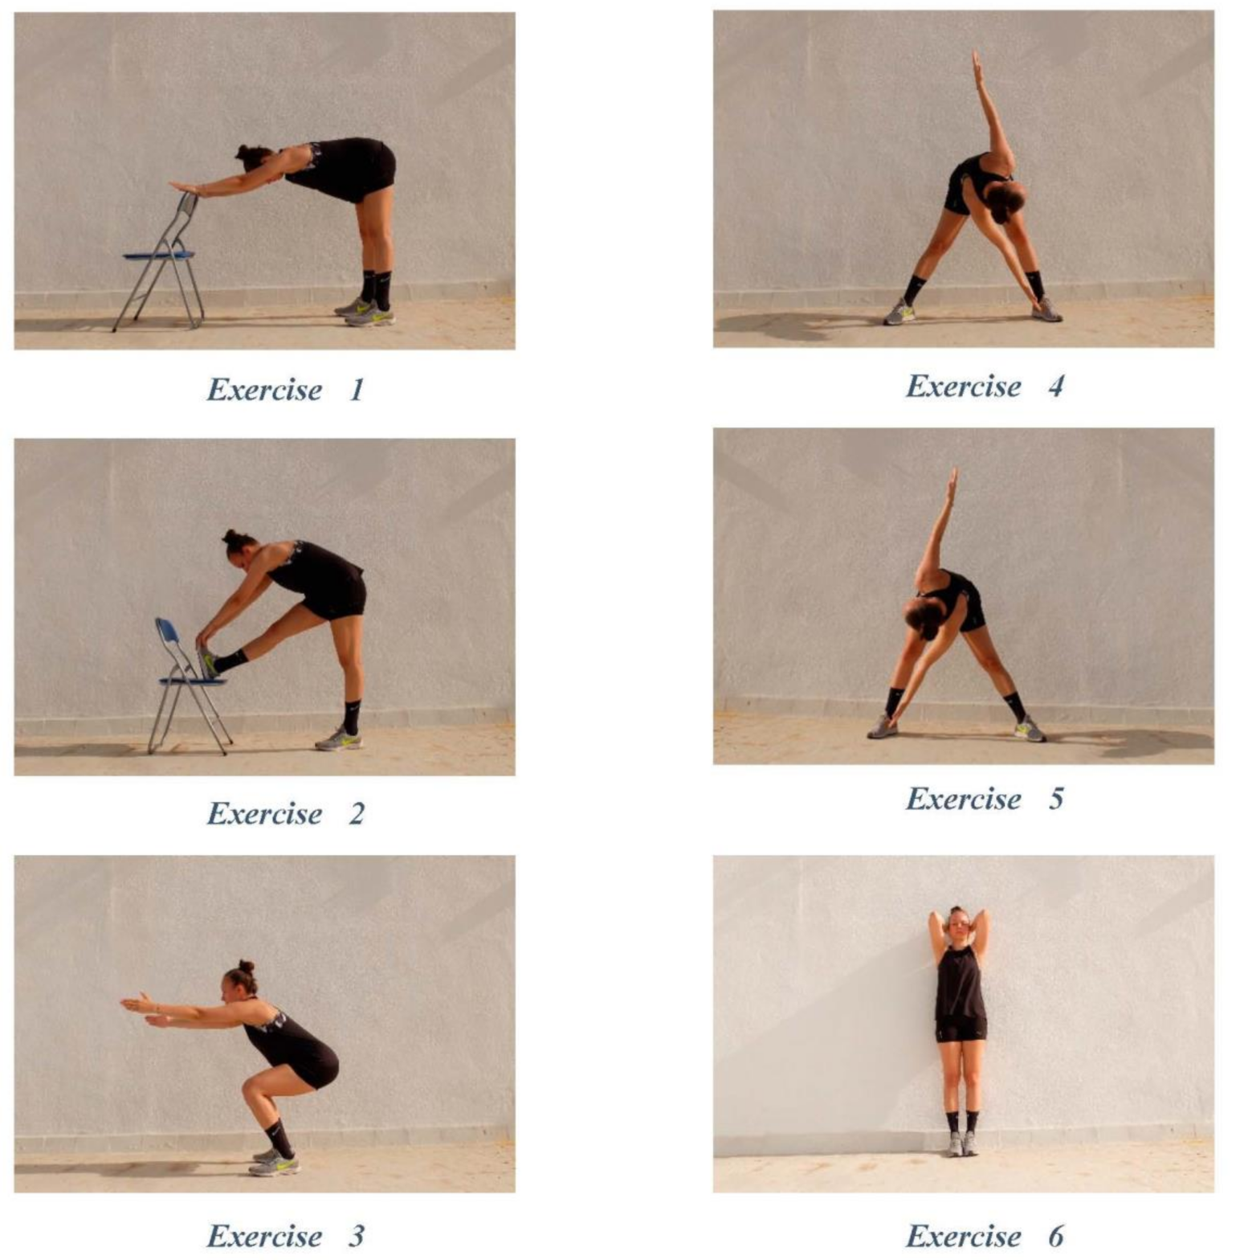
Stretching Excise

Slide 22
Efficacy of Ginger in the Treatment of Primary Dysmenorrhea: A Systematic Review and Meta-analysis (Rizu Negi, 2021)
This meta-analysis summarizes the evidence from eight RCT analyzing the effectiveness of ginger on primary dysmenorrhea.
This review provides evidence that ginger can eliminate pain related to primary dysmenorrhea.
They also found that ginger and NSAID to be equally effective on pain severity.
The authors indicate that ginger has a higher safety profile than NSAIDs for pain relief, with a smaller number of gastric side effects and fewer kidney risks.

Slide 23
Nonsteroidal anti-inflammatory drugs (NSAIDs)
Are first-line therapies for primary dysmenorrhea.
They are generally divided into two chemical groups:
the arylcarboxylic acids, which include acetylsalicylic acid (aspirin) and fenamates (mefenamic acid)
the arylalkanoic acids, including the arylpropionic acids (ibuprofen, naproxen, and ketoprofen) and the indoleacetic acids (indomethacin).
The more specific cyclooxygenase (COX-2) inhibitors such as celecoxib have similarly been shown to alleviate the primary dysmenorrheal symptoms. COX-2 expression in the uterine glandular epithelium was maximal during menstruation in one trial of ovulatory women, suggesting a possible association with the cause. The increased expression of COX-2 was eliminated with continuous use of oral contraceptives (OCs), which also offer an effective treatment (discussed later).
The specific effect of these agents on the uterine musculature is reduction of contractility, as measured by reduction of intrauterine pressure. Cox-2 inhibitors may be considered for women with gastrointestinal toxicity due to NSAIDs; however, these agents carry a risk of serious adverse events and now contain a black box warning. These medications therefore should only be used with caution and full disclosure.

Slide 24
Chemical structure of common NSAIDs

Slide 25
Mechanism of action of NSAIDs

Slide 26
NSAIDs-Cochrane review EBM
In 2010, Marjoribanks provided a review to the Cochrane Database of RCTs of NSAIDs in the treatment of dysmenorrhea.
Seventy-three RCTs were included.
NSAIDs were substantially more effective than placebo in pain reduction (odds ratio [OR] 4.50, 95% confidence interval [CI]: 3.85-5.27).
Marjoribanks J., Proctor M., Farquhar C., Derks R.S.: Nonsteroidal anti-inflammatory drugs for dysmenorrhoea. Cochrane Database Syst Rev 2010;

Slide 27
SR in Cochrane Marjoribanks J., 2016
NSAIDs appear to be a very effective treatment for dysmenorrhoea, though women using them need to be aware of the substantial risk of adverse effects. There is insufficient evidence to determine which (if any) individual NSAID is the safest and most effective for the treatment of dysmenorrhoea. We rated the quality of the evidence as low for most comparisons, mainly due to poor reporting of study methods.

Slide 28
NSAIDs versus placebo
NSAIDs were more effective for pain relief than placebo (OR 4.37, 95% CI 3.76 to 5.09; 35 RCTs, I2 = 53%, low quality evidence).
This suggests that if 18% of women taking placebo achieve moderate or excellent pain relief, between 45% and 53% taking NSAIDs will do so.
However, NSAIDs were associated with more adverse effects (overall adverse effects: OR 1.29, 95% CI 1.11 to 1.51, 25 RCTs, I2 = 0%, low quality evidence; gastrointestinal adverse effects: OR 1.58, 95% CI 1.12 to 2.23, 14 RCTs, I2 = 30%; neurological adverse effects: OR 2.74, 95% CI 1.66 to 4.53, seven RCTs, I2 = 0%, low quality evidence).
The evidence suggests that if 10% of women taking placebo experience side effects, between 11% and 14% of women taking NSAIDs will do so.

Slide 29
NSAIDs versus other NSAIDs
When NSAIDs were compared with each other there was little evidence of the superiority of any individual NSAID for either pain relief or safety.
However, the available evidence had little power to detect such differences, as most individual comparisons were based on very few small trials.

Slide 30
Cochrane NSAIDs
Non‐selective NSAIDs versus COX‐2‐specific selectors
Only two of the included studies utilised COX‐2‐specific inhibitors (etoricoxib and celecoxib). There was no evidence that COX‐2‐specific inhibitors were more effective or tolerable for the treatment of dysmenorrhea than traditional NSAIDs; however data were very scanty.
NSAIDs versus paracetamol
NSAIDs appeared to be more effective for pain relief than paracetamol (OR 1.89, 95% CI 1.05 to 3.43, three RCTs, I2 = 0%, low quality evidence). There was no evidence of a difference with regard to adverse effects, though data were very scanty.
Most of the studies were commercially funded (59%); a further 31% failed to state their source of funding.

Slide 31
Class | Generic Name | Usual Regimen (mg) ∗ | Initial Dose | Subsequent Dose
Propionic acid | Ibuprofen | 400 (qid)-800 (tid) | 500 | 250 tid-qid
 | Naproxen | 250 (qid)-500 (bid)
 | Naproxen sodium | 275 (qid)-550 (bid)
 | Ketoprofen | 25-75 (tid)
 | Fenoprofen calcium | 200 (qid)
Fenamic acid | Mefenamic acid | 250 (qid) | 550 | 275 tid-qid
 | Meclofenamate | 100 (qid)
Acetic acid | Indomethacin | 25 (tid) | 50 | 25-50 tid-qid
 | Diclofenac | 75 (bid)
 | Tolmetin | 400 (tid)
 | Diflunisal | 500 (bid)
 | Etodolac | 400 (tid-qid)
 | Ketoralac | 10 (qid)
Oxicams | Piroxicam | 20 (qd) | 500 | 250 qid

Slide 32
Points on NSAIDs use in Dysmenorrhea
NSAIDs should be given the day prior to the expected menses or at the onset of menses.
If one NSAID is ineffective, switching to a different class of NSAIDs may be helpful.
NSAIDs should not be given to patients who have shown previous hypersensitivity to such drugs.
They are also contraindicated for women who have had nasal polyps, angioedema, and bronchospasm related to aspirin or NSAIDs. I
Are contraindicated for individuals with a history of chronic ulceration or inflammatory reaction of the upper or lower GI tract and for those with preexisting chronic renal disease.
During the long term use of these agents, autoimmune hemolytic anemia, rash, edema and fluid retention, and CNS symptoms, such as dizziness, headache, nervousness, and blurred vision, can occur.
In up to 15% of users, a slight elevation of hepatic enzyme levels may also be found

Slide 33
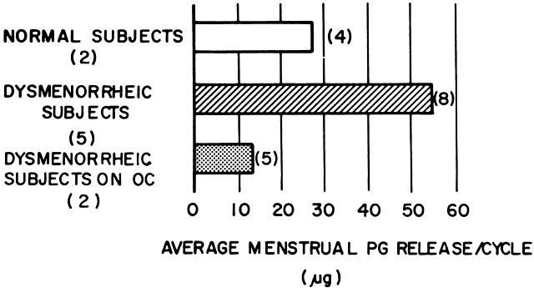
Combined Oral contraceptives Pills (COCPs)
COCPs will relieve the symptoms of primary dysmenorrhea in approximately 90% of patients.
By suppressing ovulation and endometrial proliferation.
P4 component also blocks the production of the precursor to prostaglandin formation.
The thinned endometrium from COCPs then contains less arachidonic acid, which is the precursor to prostaglandins..

Slide 34
Cochrane Database of RCTs comparing combined oral contraceptives (COCs) with other COCs, placebo, and NSAIDs.
Six studies revealed that COCs were significantly more effective than placebo for the treatment of dysmenorrhea (OR of 2.99, 95% CI: 1.76, 5.07)
Wong C.L., Farquhar C., Roberts H., Proctor M.: Oral contraceptive pill for primary dysmenorrhoea. Cochrane Database Syst Rev 2009

Slide 35
Progestin-Only Formulations
DMPA- a long-acting injectable contraceptive, has not been studied specifically for primary dysmenorrhea. Trials in contraceptive studies report a reduction in dysmenorrhea in adolescents. Because this often causes a thinned endometrium and light menses or amenorrhea, it theoretically should be effective.
LNG-IUS- has been shown in randomized controlled trials to reduce menstrual pain. Levonorgestrel is a 19-nortestosterone derivative affecting endometrial progesterone receptors, leading to an atrophic endometrial lining.
In 2013, a smaller a smaller LNG-IUS containing only 14 μg of levonorgestrel was approved by the U.S. Food and Drug Administration (FDA) and may represent another option for the management of dysmenorrhea.
Implanon-The single-rod etonogestrel-releasing contraceptive (Implanon) has also been shown in clinical trials to reduce dysmenorrhea. This and the newer version, Nexplanon, represent additional progestin-only options.
Recently, Dienogest in the dose of 1 mg was proposed as a good option (Osuga, 2020)

Slide 36
Continuous Norethisterone Acetate versus Cyclical Drospirenone 3 mg/Ethinyl Estradiol 20 μg for the Management of Primary Dysmenorrhea in Young Adult Women (al-Jefout, 2016) Adopted by ACOG and SOGC
Both drugs were similar in suppressing dysmenorrhea at the 3-month follow-up visit; VAS score mean (±SD) in group N and P were 1.30 ± 1.22 and 1.28 ± 0.83 (P = .22), respectively, and after 6 months, with mean VAS scores (±SD) of 1.30 ± 1.22 and 1.28 ± 0.83, respectively (P = .95).
The cost of the treatment in the N group was much less than in the P group.
Participants in the N group were less likely to use pain killers: 20% and 44% in the N and P groups, respectively (P = .006) in the first month and only 5% and 17% (P = .019) in the N and P groups, respectively, at the 3-month follow-up, and none of them used any analgesics at the 6-month follow-up.
Conclusion: A continuous NET-A regimen is a well tolerated, effective, and inexpensive option for dysmenorrhea treatment and was as good as COC.

Slide 37
