Slide 1
ATRIAL FIBRILLATION
Marah Al-tarawneh
Rana al-Nawaiseh

Slide 2
, in normal heart electrical signal send out from SA node in the right atrium it then propagate through out both atrias super fast which allow them all depolarize in the same time and this give coordinated contraction of the atria , that signal then moves to the ventricles force them to contract shortly after

Slide 3
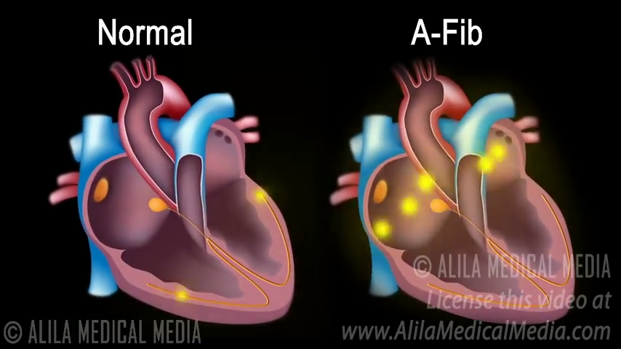
With atrial fibrillation signal move from the atrium in completely disorganised way and instead of one big contraction , it will be multiple miny contraction look like quivering.

Slide 4
Atrial fibrillation (AF) is the most common, clinically significant cardiac arrhythmia. It occurs when a diffuse and chaotic pattern of electrical activity in the atria suppresses or replaces the normal sinus mechanism, leading to deterioration of mechanical function. Atrial fibrillation is a major cause of morbidity, mortality, and health care expenditures;. Atrial fibrillation is associated with a 5-fold increased risk for stroke and is estimated to cause 15% of all strokes

Slide 5
Who is at risk for atrial fibrillation?
Atrial fibrillation occurs in less than 1% of individuals aged 60 to 65 years, but in 8% to 10% of those older than 80 years. Prevalence is higher in men than in women and higher in whites than in blacks The risk for AF increases with the presence and severity of underlying heart failure and valvular disease.

Slide 6
In healthy heart
At the start of atrial systole in normal heart , the ventricles are normally filled with approximately 70-80% of their capacity due to inflow during diastole , atrial contraction ( atrial kick ) contributes the remaining 20-30% of filling .
When atrial fibrillation develops , there is loss of atrial kick , with consequent decreases of cardiac out put , strock output decline by 20-30% of normal individual

Slide 7
so Symptoms are usually caused by inappropriately rapid ventricular rates or the irregularity of the ventricular response The loss of atrial contribution to ventricular filling (“atrial kick”) is well tolerated by most patients, except those with ventricular hypertrophy from long-standing hypertension, aortic stenosis, and hypertrophic obstructive cardiomyopathy.

Slide 8
. What symptoms and signs should cause clinicians to suspect atrial fibrillation?
Some patients have prominent symptoms, including palpitations, shortness of breath, exercise intolerance, chest pain, and malaise. However, many patients, particularly the elderly, have asymptomatic (silent)
AFSymptoms are generally greatest at disease onset—when episodes are typically paroxysmal—and tend to diminish over time, especially when the arrhythmia becomes persistent. Symptoms result from elevation of ventricular rate (either at rest or exaggerated by exercise), irregular ventricular rate, and loss of atrial contribution to cardiac output. On physical examination, signs of AF include a faster-than-expected heart rate, which varies greatly from patient to patient, an “irregularly irregular” time between heart sounds on auscultation, and peripheral pulses that vary irregularly in both rate and amplitude and The apical pulse rate is greater than the radial pulse

Slide 9
What underlying conditions should clinicians look for in patients with atrial fibrillation? Eighty percent of patients with AF have structural heart disease, particularly hypertensive heart disease but also coronary artery disease, valvular heart disease, or cardiomyopathy. Atrial fibrosis occurs frequently with structural heart disease, and many people consider atrial fibrosis central to the arrhythmia’s pathogenesis

Slide 10
. “Lone” AF refers to AF in the absence of heart disease. Some experts believe that the diagnosis of lone AF should be restricted to patients younger than 60 years of age because it is difficult to exclude structural heart disease in older patients). Some acute illnesses are associated with AF, including acute myocardial infarction, pulmonary embolism, and thyrotoxicosis. Atrial fibrillation occurs in approximately 40% of patients after cardiac or thoracic surgery, but it may also occur after other types of major surgery or during a severe illness. Obesity and sleep apnea are associated with an increased incidence of AF. These patients are typically men 40 to 50 years of age, and symptoms often occur at night, at rest, following vigorous exercise, or with alcohol use

Slide 11
What other electrocardiographic arrhythmias can be confused with atrial fibrillation?
Other arrhythmias that are commonly confused with AF include sinus rhythm with frequent premature atrial contractions, atrial flutter, and atrial tachycardia.

Slide 12
The key electrocardiographic findings of AF are the absence of P waves and the presence of an irregular ventricular rhythm without a recurring pattern. When an irregular rhythm is present but the diagnosis of AF is uncertain, clinicians should examine long recordings from multiple leads looking for partially obscured P waves in deformed T waves and ST segments

Slide 13
There may be flutter-like waves for 2-3 s
Normal but irregular QRE complex
No p waves
the baseline show irregular fibrillation waves

Slide 14
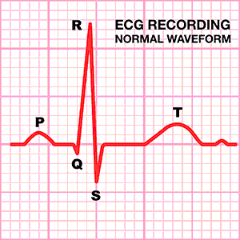

Slide 18
Types of Atrial Fibrillation
Paroxysmal fibrillation: Occasional AFib with symptoms that come and go, usually lasting a few minutes to several hours and sometimes days.
Persistent: Irregular rhythm that lasts longer than 7 days; heart rhythm does not go back to normal on its own; electrical shock or medications are needed to restore heart rhythm.
Long-standing persistent: AFib episodes that are continuous and last longer than 12 months.
Permanent: Abnormal heart rhythm cannot be restored; medications are required to control heart rate and prevent blood clots.

Slide 19
Complications of Atrial Fibrillation
1. Blood Clots
With AFib, blood does not flow through the heart properly. This can lead to the pooling of blood in the heart and the development of blood clots within the upper chambers of the heart. These blood clots may circulate to other organs and lead to ischemia, blocked blood flow.
2. Stroke
A stroke occurs when a blood clot gets stuck in a person’s brain.
3. Cardiovascular Disease
AFib is associated with a wide range of cardiovascular events, heart failure, ischemic heart disease, and sudden cardiac death.

Slide 20
Diagnosis
Electrocardiogram recordings during episodes are the only way to confirm the diagnosis. If the diagnosis is suspected and the ECG is normal, longer monitoring with a loop recorder or a Holter monitor can be helpful. The initial assessment should include laboratory tests for electrolytes, thyroid-stimulating hormone, and renal and hepatic function to rule out underlying disorders or contraindications to therapies. An echocardiogram should be done to look for structural heart disease

Slide 21
Which patients with atrial fibrillation should clinicians consider hospitalizing? AF is usually managed in an outpatient setting, clinicians should consider hospitalizing patients with AF when management requires close monitoring for safety

Slide 22
Situations in Which Patients with Atrial Fibrillation May Require Hospitalization
• Uncertain or unstable underlying arrhythmia
• Acute myocardial infarction, altered mental status, decompensated heart failure, or hypotension
• Intolerable symptoms despite hemodynamic stability
• Elective cardioversion
• Procedures such as cardiac catheterization, electrophysiologic studies, pacemakers, implantable defibrillators, or catheter or surgical ablation

Slide 23
Treatment
1- acute AF in a hemodynamically unstable patient : immediate electrical cardioversion to sinus rhythm .
2- acute AF in hemodynamically stable patient :
Rate control : by B-blocker or CCBs
Anticoagulation : aspirin or warfarin.
Rhythm control: - Cardioversion
- Antiarrythmec drugs
- Atrial ablation and atrioventricular nodal ablation therapy

Slide 24
CHADS2 (Cardiac Failure, Hypertension, Age, Diabetes, and Stroke [Doubled]) score (31, 32)
the CHA₂DS₂-VASc Score is the most commonly utilized method to predict thromboembolic risk in atrial fibrillation.
Patients with 2 or more points should receive full anticoagulation Patients with 1 point can be treated with either aspirin alone or full anticoagulation based on the specific individual.

Slide 27
New drug !
Dabigatran is a new anticoagulant that in early trials appears to be as effective as warfarin for preventing thromboembolism but has fewer adverse effects The FDA has recently approved it for prevention of stroke and systemic embolism in patients with AF

