Slide 1
Diabetes mellitus

Slide 2
Definition

Slide 4
Diabetes objectives

Slide 5
Epidemiology

Slide 7
Classification / Types

Slide 11
Risk factors of D.M

Slide 13
Screening of D.M

Slide 18
Screening for Type 2 Diabetes or Prediabetes in Asymptomatic Children and Adolescents

Slide 19
Diagnosis of DM

Slide 20
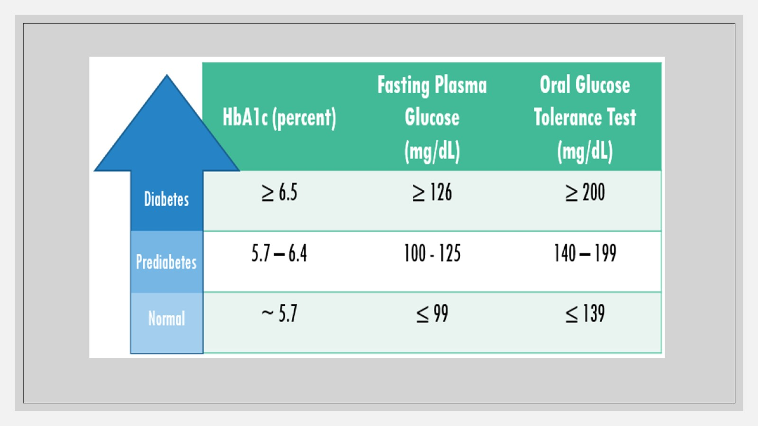

Slide 23
Diagnosis of gestational diabetes

Slide 26
Diabetes symptoms

Slide 28
Initial and follow up evaluation

Slide 29
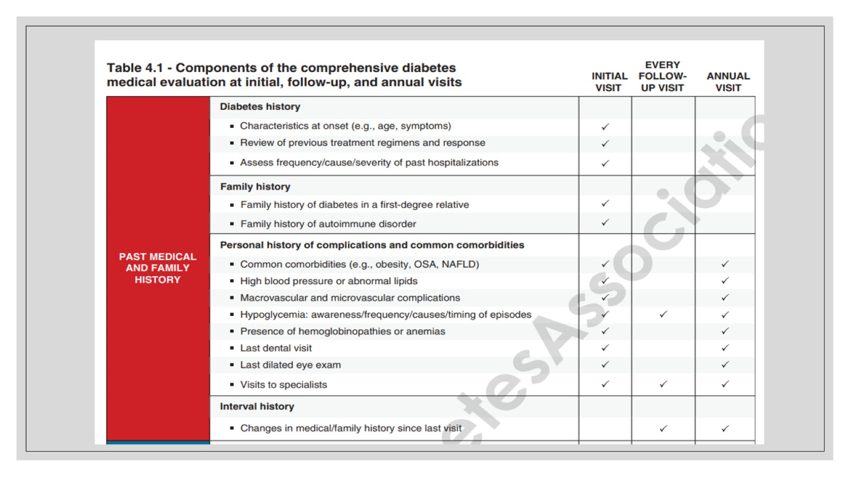

Slide 30
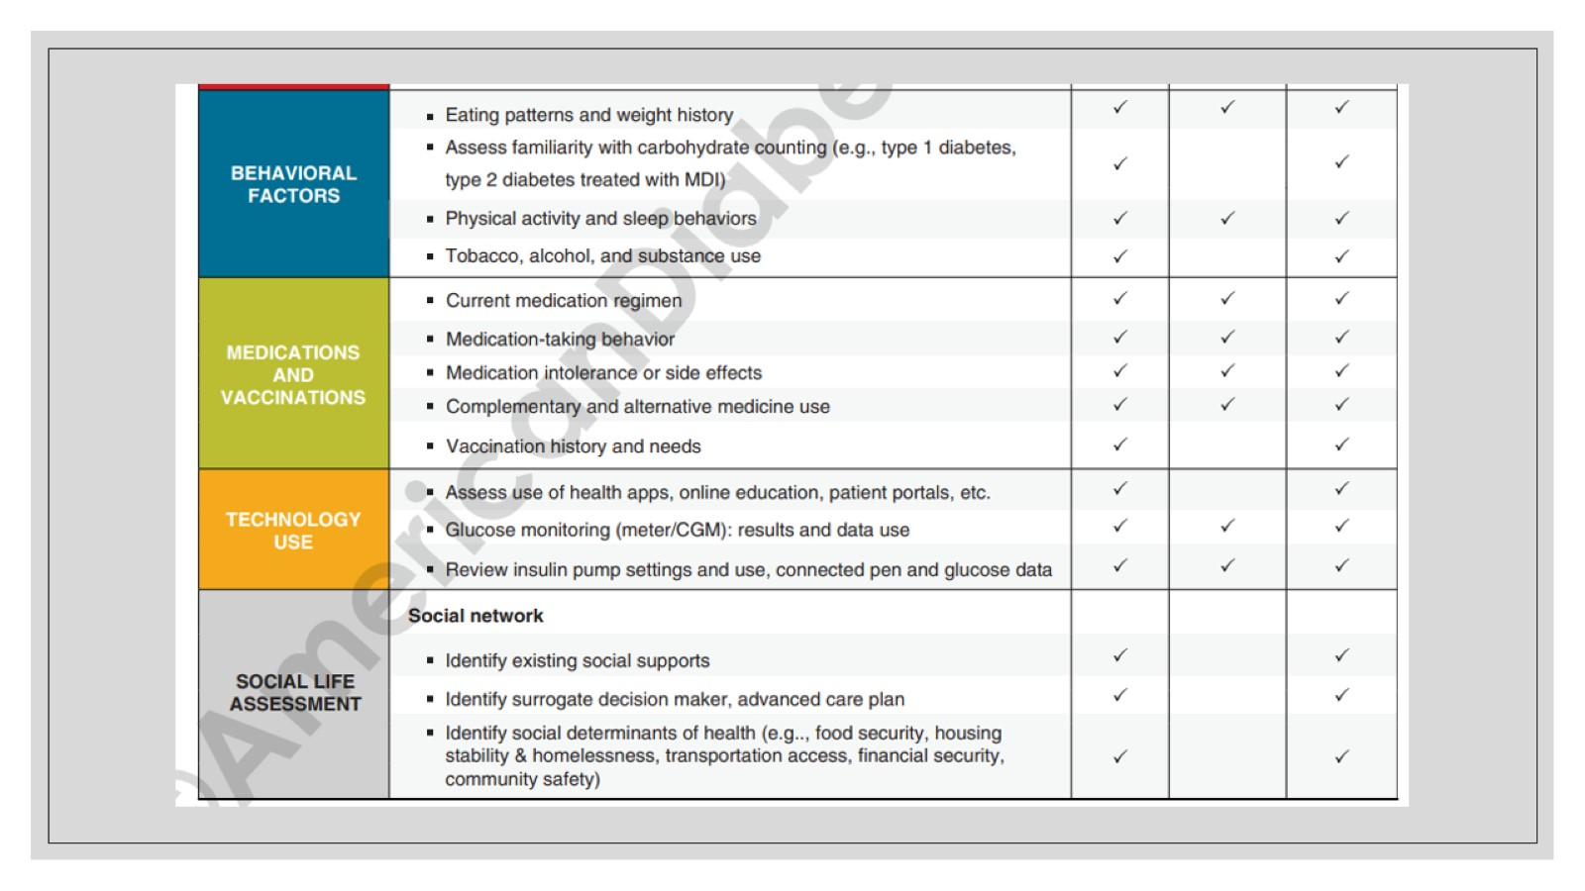

Slide 31
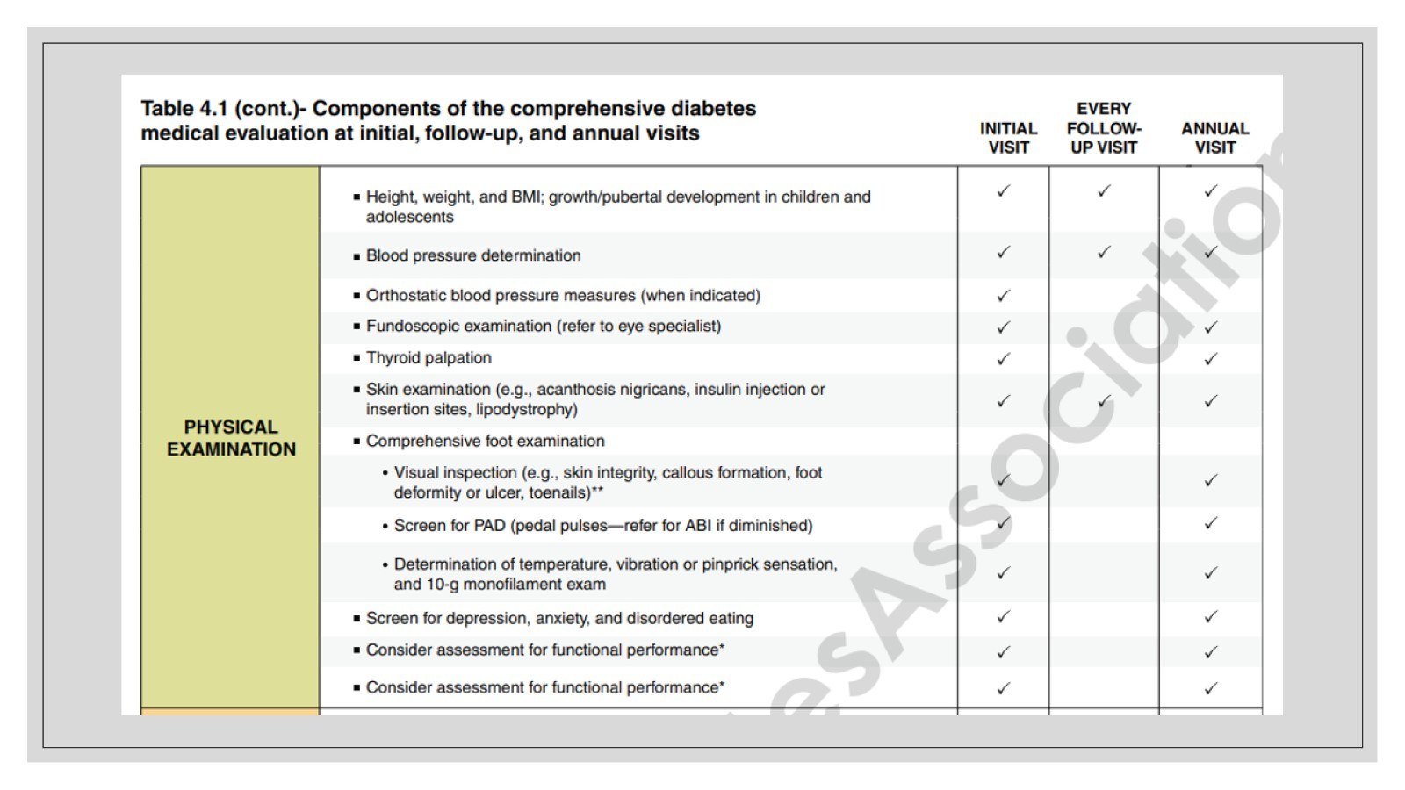

Slide 33
Management

Slide 34
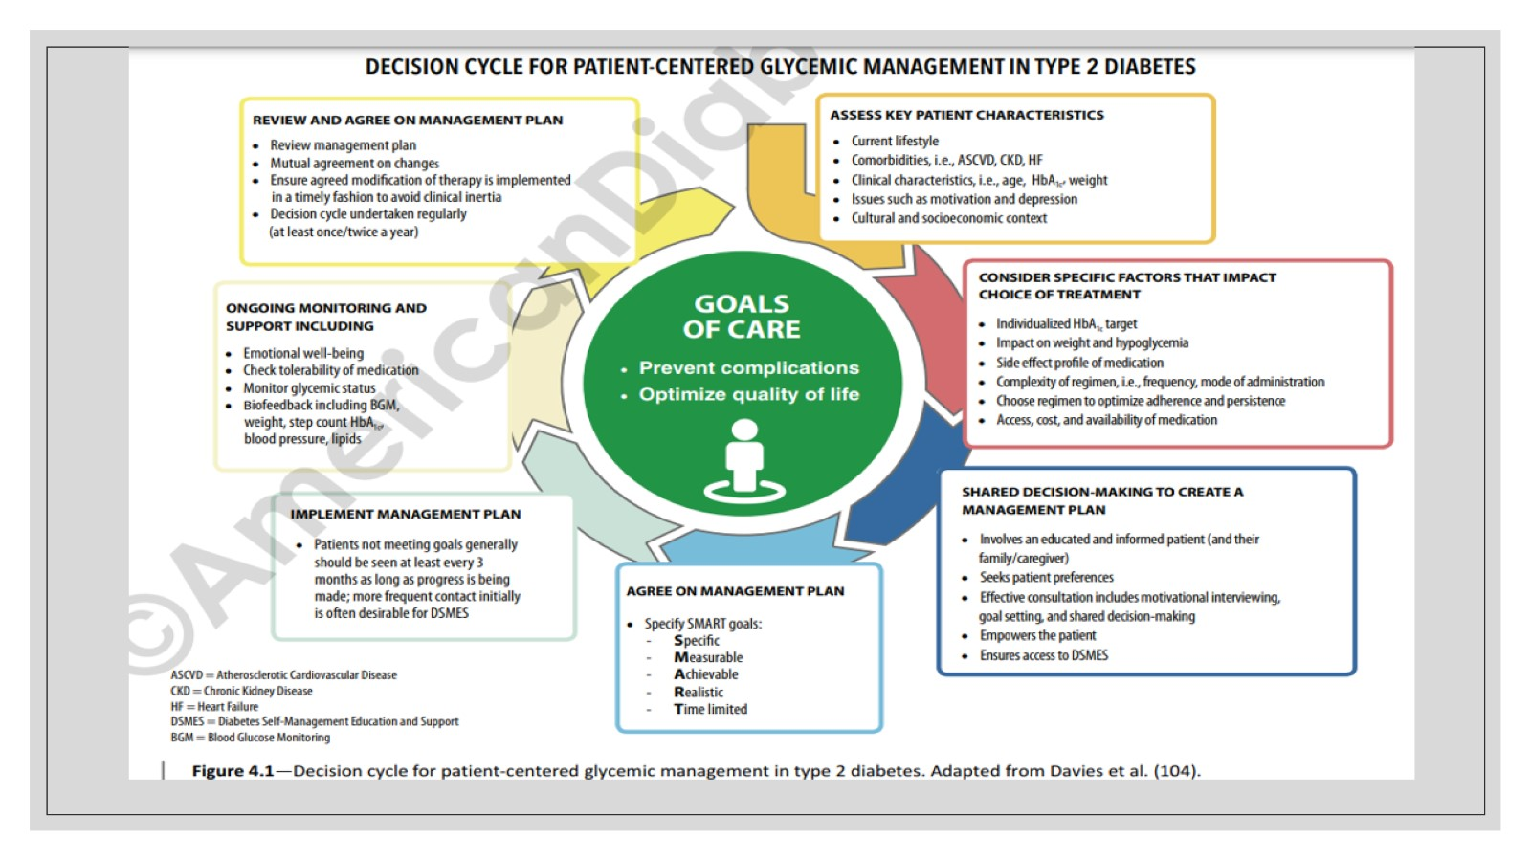

Slide 35
Treatment plan

Slide 36
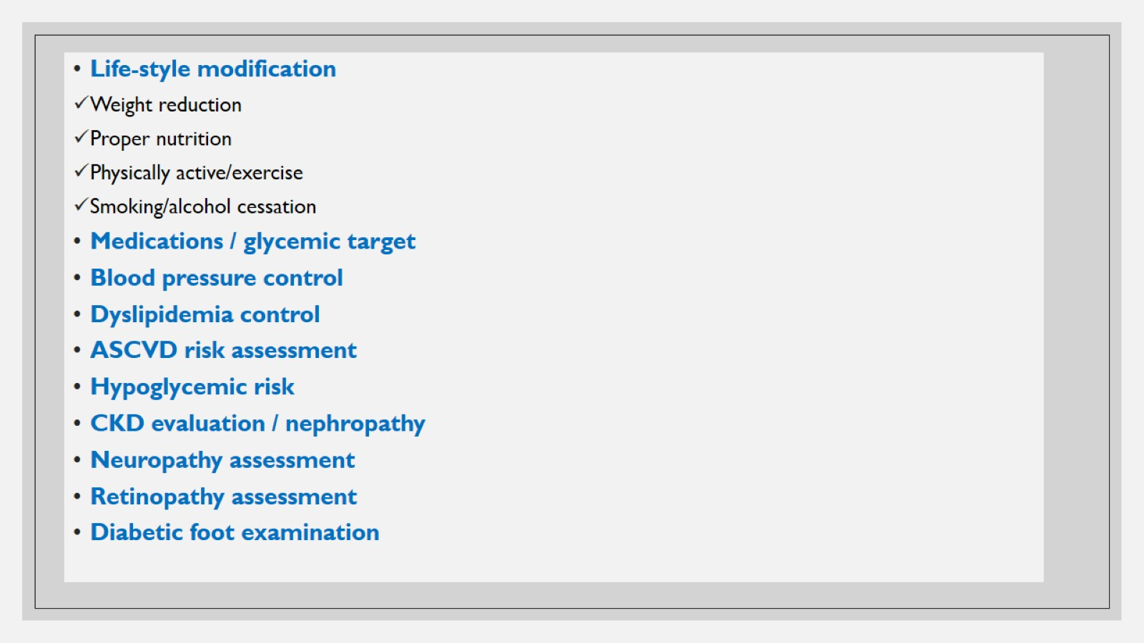

Slide 37
Life-style modification

Slide 43
Medications (D.M type 2 oral medications)

Slide 46
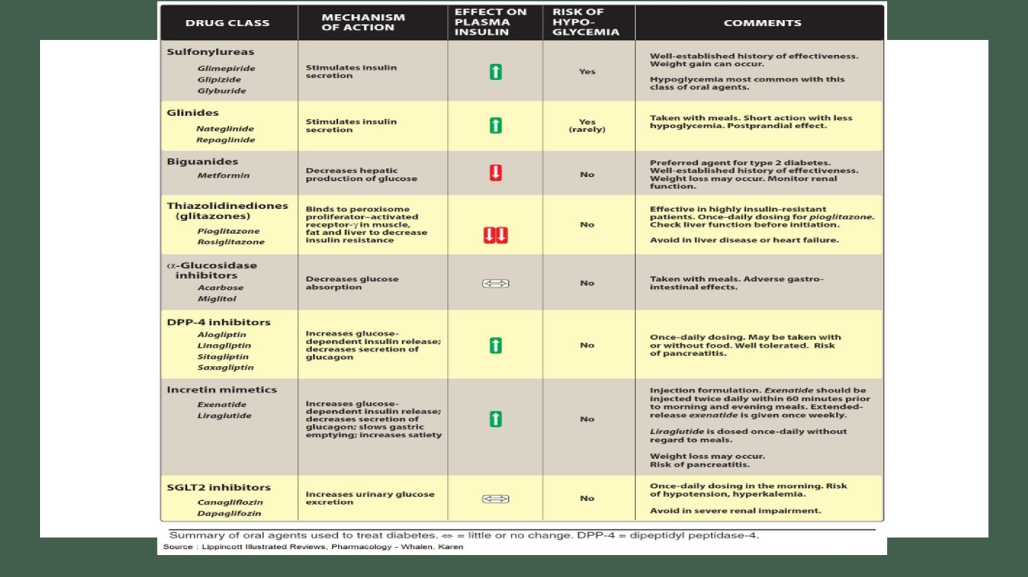

Slide 48
Notes on Medications (for type 2 D.M)

Slide 49
Glycemic target/ goal

Slide 50
Diabetes and blood pressure goals

Slide 51
Diabetes and lipid goals

Slide 52
Complications

Slide 53
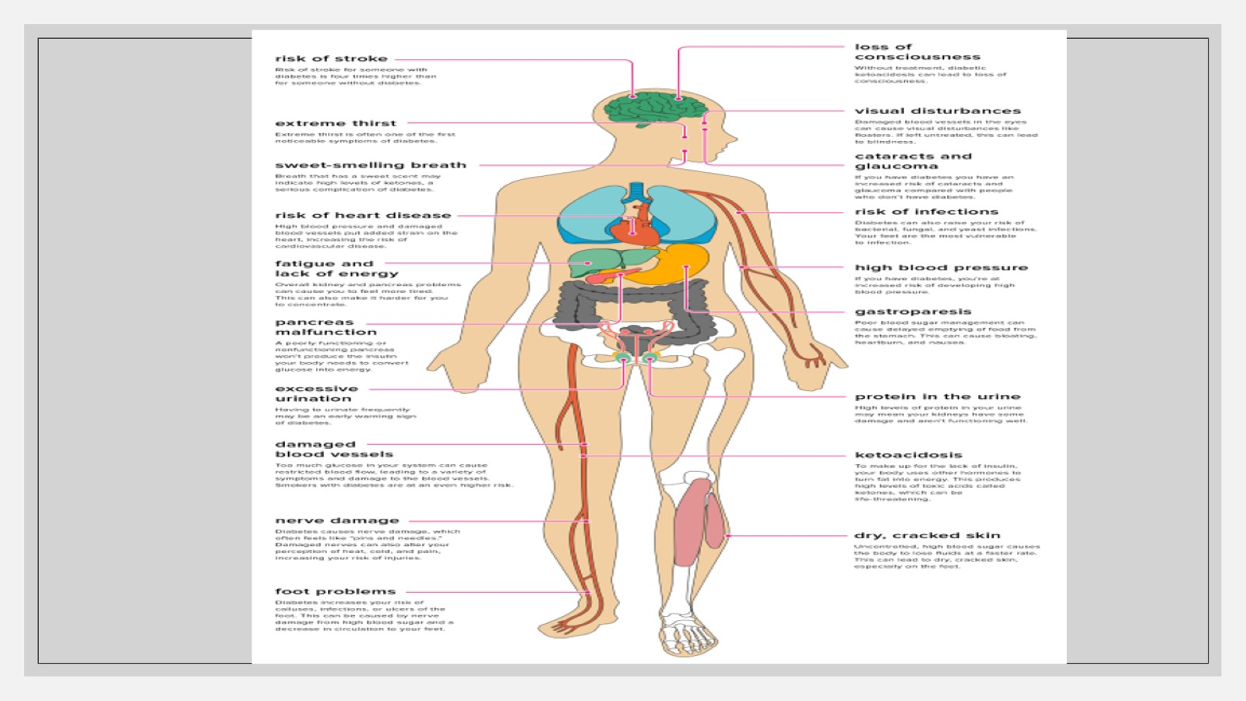

Slide 54
Diabetic complications

Slide 56
Diabetic nephropathy

Slide 57
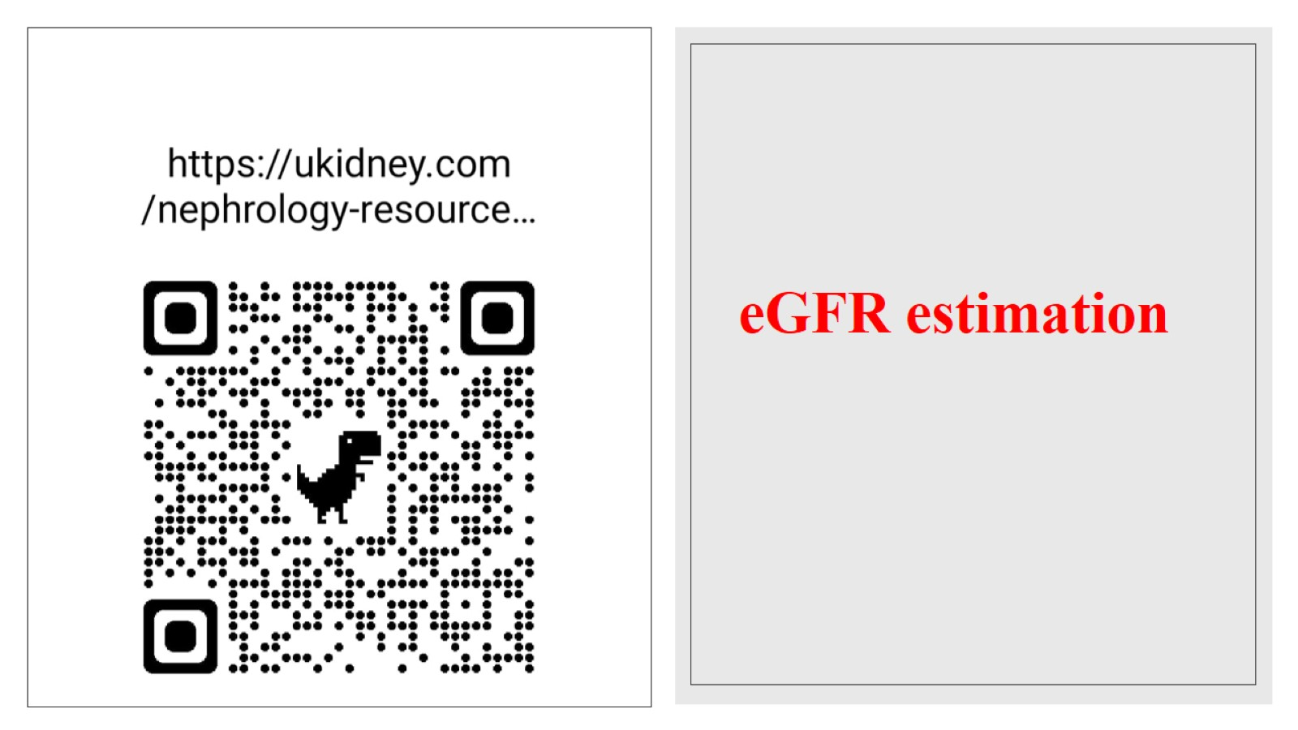

Slide 58
Diabetic Neuropathy

Slide 59
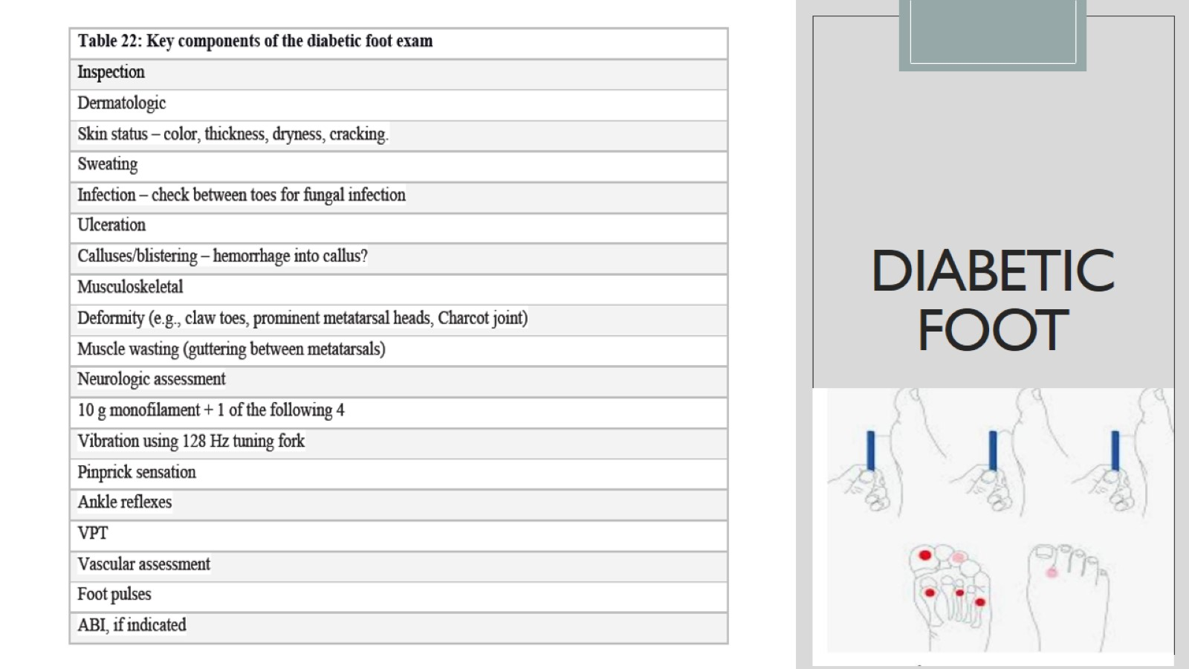
Diabetic foot

Slide 60
Diabetic foot

Slide 62
Diabetes and vaccination

Slide 64
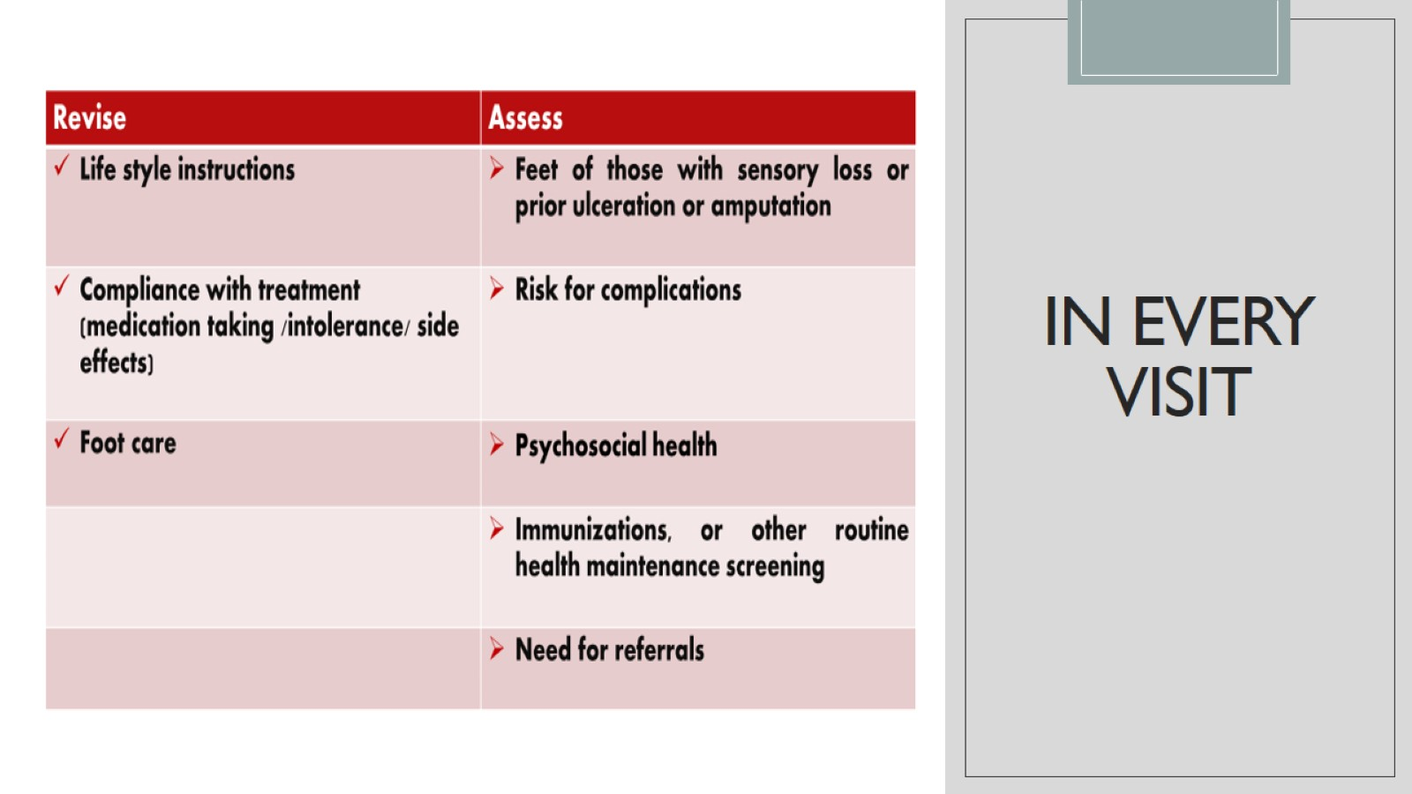
In every visit

Slide 65
Take home message

Slide 66
Metabolic syndrome

Slide 68
