Slide 1
THE ESOPHAGUS & STOMACH
Dr. Aiman Qais Afar
Surgical Anatomist
College of Medicine / University of Mutah
2021-2022

Slide 2
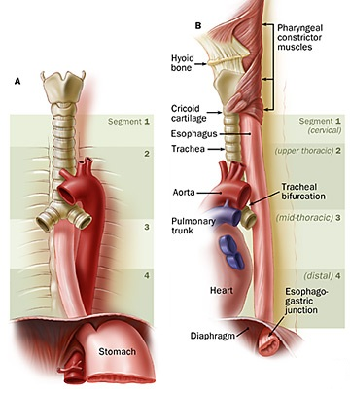
The Esophagus
The esophagus is a muscular tube about 10 in. (25 cm) long, with an average diameter of 2 cm that extending from the pharynx to the stomach
It begins at the level of the cricoid cartilage, opposite the body of the sixth cervical vertebra.
It passes through the diaphragm at the level of the 10th thoracic vertebra to join the stomach at the level of the 7th left costal cartilage and T11 vertebra
It commences in the midline, but as it descends through the neck, it inclines to the left side

Slide 3
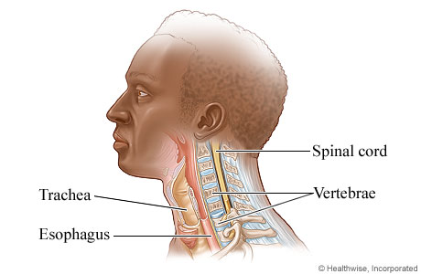
The Esophagus
In the neck, the esophagus lies in front of the vertebral column;
laterally, it is related to the lobes of the thyroid gland;
& anteriorly, it is in contact with the trachea and the recurrent laryngeal nerves
In the thorax, it passes downward and to the left through the superior and then the posterior mediastinum
At the level of the sternal angle, the aortic arch pushes the esophagus over to the midline

Slide 4
The Esophagus
■■ Anteriorly: The trachea and the left recurrent laryngeal nerve; the left principal bronchus, which constricts it; and the pericardium, which separates the esophagus from the left atrium
■■ Posteriorly: The bodies of the thoracic vertebrae; the thoracic duct; the azygos veins; the right posterior intercostal arteries; and, at its lower end, the descending thoracic aorta
■■ Right side: The mediastinal pleura and the terminal part of the azygos vein
■■ Left side: The left subclavian artery, the aortic arch, the thoracic duct, and the mediastinal pleura

Slide 5
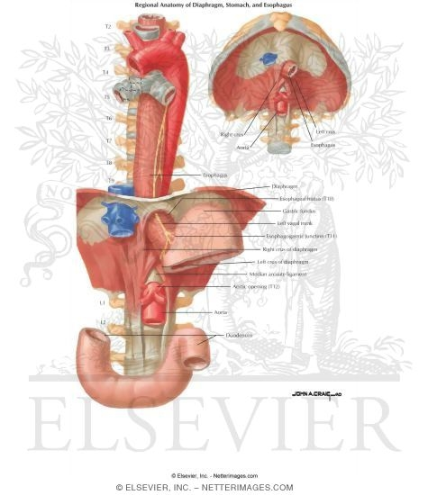
The Esophagus
Inferiorly to the level of the roots of the lungs,
The left vagus lies anterior to the esophagus, and the right vagus lies posterior.
Fibers from the right crus of the diaphragm pass around the esophagus in the form of a sling.
At the opening in the diaphragm, the esophagus is accompanied by the two vagi, branches of the left gastric blood vessels, and lymphatic vessels.
In the abdomen, the esophagus descends for about 0.5 in. (1.3 cm) and then enters the stomach. It is related to the left lobe of the liver anteriorly and to the left crus of the diaphragm posteriorly.

Slide 6
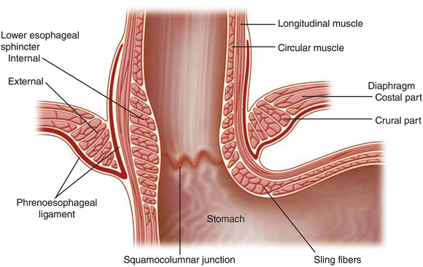
The Esophagus
The esophagogastric junction lies to the left of the T11 vertebra on the horizontal plane that passes through the tip of the xiphoid process.
Surgeons and endoscopists designate the Z-line a jagged line where the mucosa abruptly changes from esophageal to gastric mucosa,
Immediately superior to this junction, the diaphragmatic musculature forming the esophageal hiatus functions as a physiological inferior esophageal sphincter that contracts and relaxes.

Slide 7
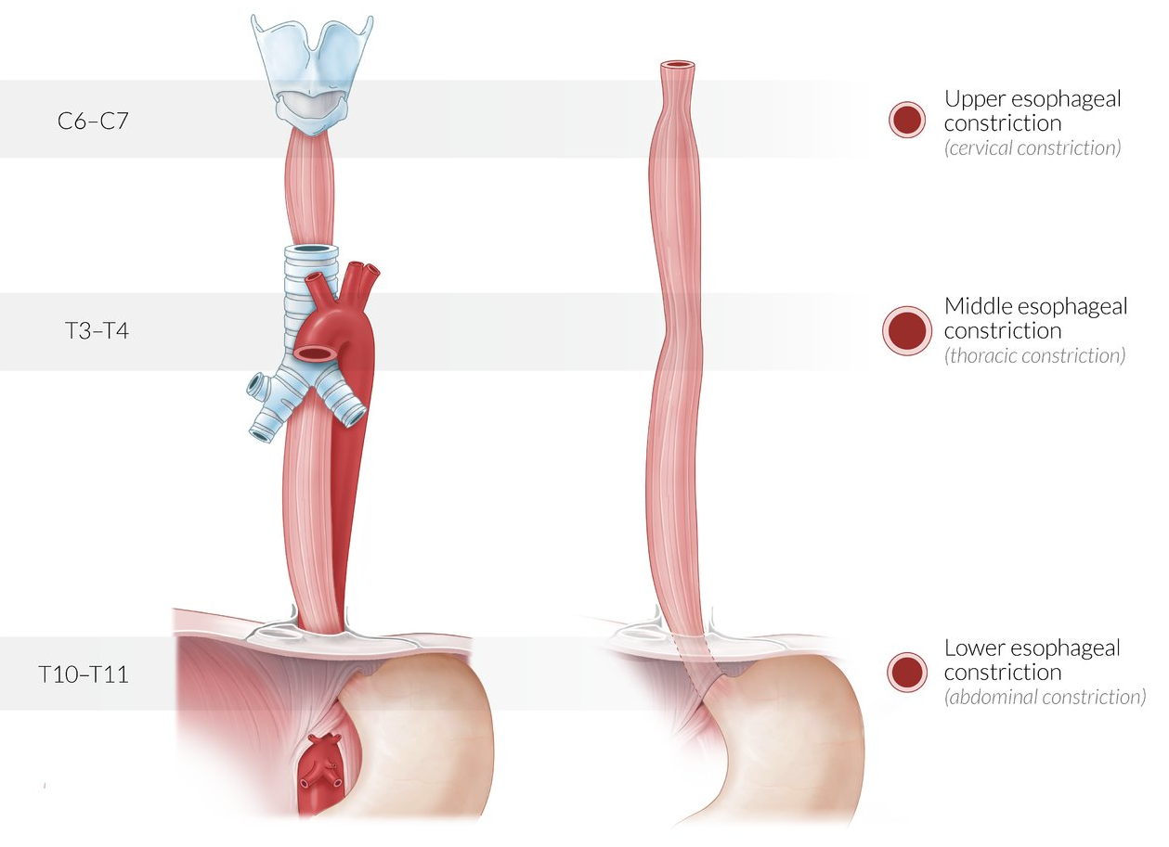
The Esophagus
The esophagus may have three impressions, or “constrictions,”
Cervical constriction (upper esophageal sphincter): at its beginning at the pharyngoesophageal junction, approximately 15 cm from the incisor teeth; caused by the cricopharyngeus muscle
Thoracic (broncho-aortic) constriction: a compound constriction where it is first crossed by the arch of the aorta, 22.5 cm from the incisor teeth, and then where it is crossed by the left main bronchus, 27.5 cm from the incisor teeth; the former is seen in anteroposterior views, the latter in lateral views.
Diaphragmatic constriction: where it passes through the esophageal hiatus of the diaphragm, approximately 40 cm from the incisor teeth

Slide 8
The Esophagus
Radiograph of esophagus after swallowing barium meal. This left posterior oblique (LPO) view demonstrates two of the three normal“constrictions” (impressions) caused by the arch of the aorta and left main bronchus.
The phrenic ampulla, which is seen only radiographically, is the distensible part of the esophagus superior to the diaphragm.

Slide 9
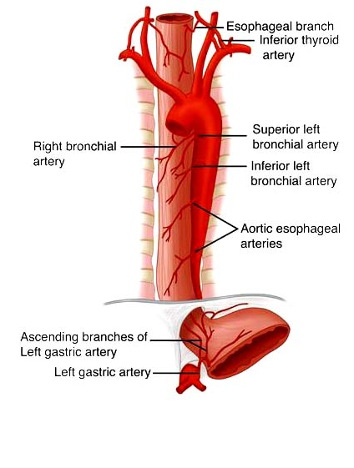
The Esophagus
Blood Supply of the Esophagus
The upper third of the esophagus is supplied by the inferior thyroid artery
The middle third by branches from the descending thoracic aorta,
The lower third by branches
from the left gastric artery.

Slide 10
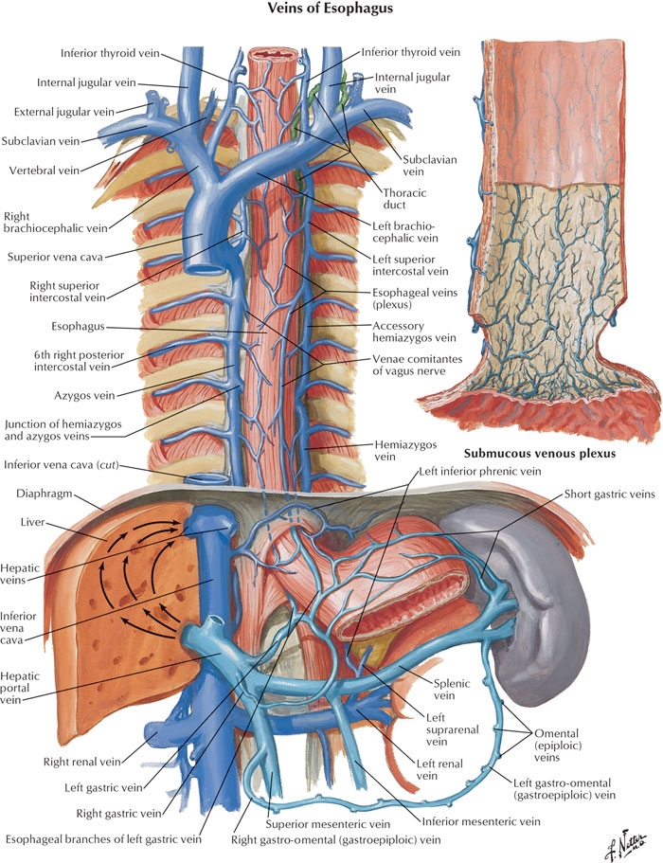
The Esophagus
The veins from the upper third drain into the inferior thyroid veins,
from the middle third
into the azygos veins,
and from the lower third into the left gastric vein, a tributary of the portal vein

Slide 11
Because the submucosal veins of the inferior esophagus drain to both the portal and systemic venous systems, they constitute a portosystemic anastomosis. In portal hypertension (an abnormally increased blood pressure in the portal venous system), blood is unable to pass through the liver via the hepatic portal vein, causing a reversal of flow in the esophageal tributary., forming esophageal varices
These distended collateral channels may rupture and cause severe hemorrhage that is life-threatening and difficult to control surgically. Esophageal varices commonly develop in persons who have developed alcoholic cirrhosis (fibrous scarring) of the liver
Esophageal Varices

Slide 12
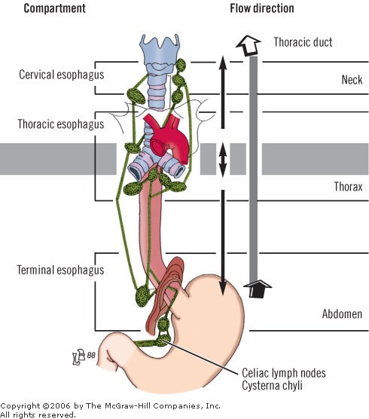
The Esophagus
Lymph Drainage of the Esophagus
Lymph vessels from the upper third of the esophagus drain into the deep cervical nodes,
From the middle third into the superior and posterior mediastinal nodes,
From the lower third into nodes along the left gastric blood vessels and the celiac nodes

Slide 13
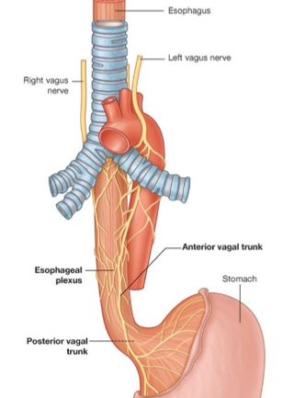
The Esophagus
Nerve Supply of the Esophagus
The esophagus is supplied by parasympathetic and sympathetic efferent and afferent fibers via the vagi and sympathetic trunks.
In the lower part of its thoracic course, the esophagus is surrounded by the esophageal nerve plexus

Slide 14
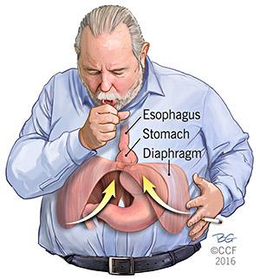
A hiatal (hiatus) hernia is a protrusion of part of the stomach into the mediastinum through the esophageal hiatus of the diaphragm. The hernias occur most often in people after middle age, possibly because of weakening of the muscular part of the diaphragm and widening of the esophageal hiatus.
the two main types are: paraesophageal hiatal hernia and sliding hiatal hernia

Slide 15
Stomach
The stomach is the dilated portion of the alimentary canal
It has a capacity of about 1500 mL
It stores food & mixes the food with gastric secretions, and it controls the rate of delivery of the chyme to the small intestine
The stomach is situated in the upper part of the abdomen, extending from beneath the left costal margin region into the epigastric and umbilical regions

Slide 16
Stomach
It is roughly J-shaped and has two openings, the cardiac and pyloric orifices;
two curvatures, the greater and lesser curvatures; and two surfaces, an anterior and a posterior surface.

Slide 17
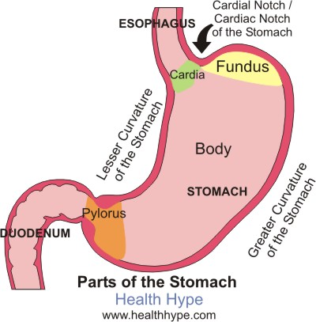
Stomach
The stomach is divided into the following parts
Fundus: This is dome-shaped and projects upward and to the left of the cardiac orifice. It is usually full of gas
Body: This extends from the level of the cardiac orifice to the level of the incisura angularis, a constant notch in the lower part of the lesser curvature .

Slide 18
Stomach
Pyloric antrum: This extends from the incisura angularis to the pylorus.
Pylorus: This is the most tubular part of the stomach. The thick muscular wall is called the pyloric sphincter, and the cavity of the pylorus is the pyloric canal

Slide 19
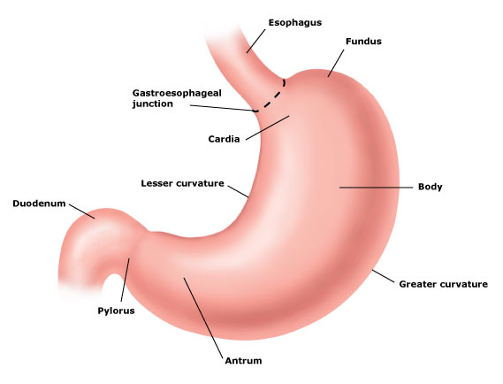
Stomach
The lesser curvature forms the right border of the stomach and extends from the cardiac orifice to the pylorus. It is suspended from the liver by the lesser omentum
The greater curvature is much longer than the lesser curvature and extends from the left of the cardiac orifice, over the dome of the fundus, and along the left border of the stomach to the pylorus

Slide 20
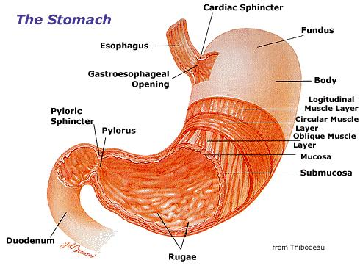
Stomach
The cardiac orifice is where the esophagus enters the stomach. that prevents regurgitation of stomach contents into the esophagus.
The pyloric orifice is formed by the pyloric canal, which is about (2.5 cm) long. The circular muscle coat is much thicker.
The pylorus lies on the transpyloric plane.

Slide 21
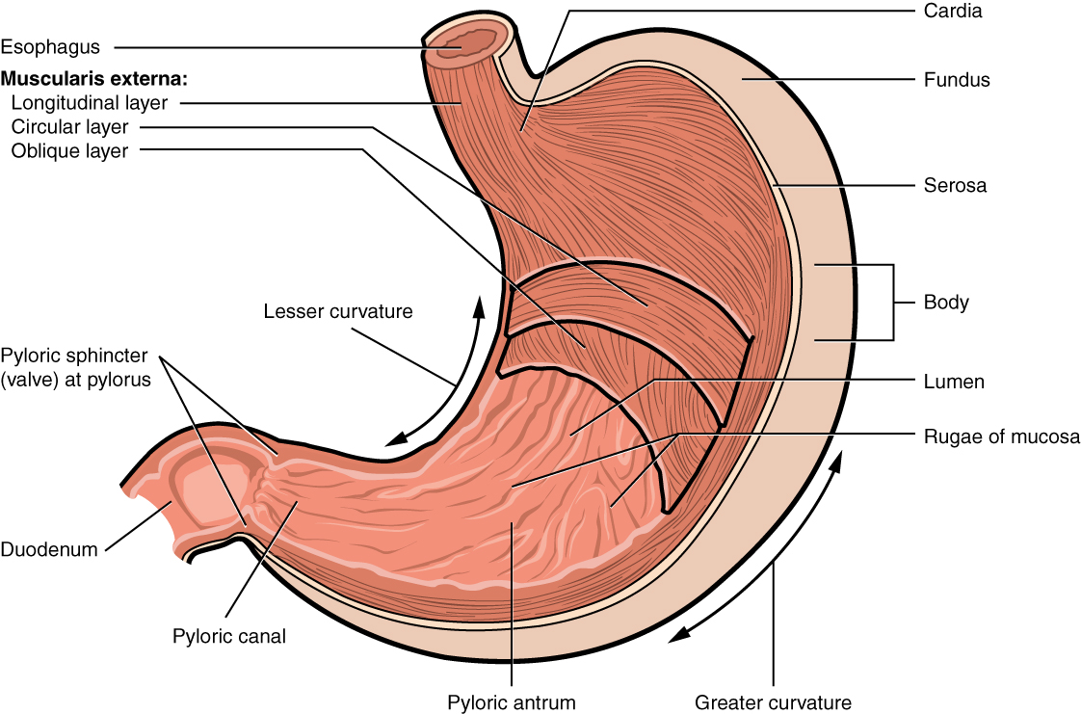
Stomach
The mucous membrane of the stomach is thick and vascular and is thrown into numerous folds, or rugae, that are mainly longitudinal in direction
The muscular wall of the stomach contains longitudinal fibers, circular fibers, and oblique fibers

Slide 22
Stomach
The peritoneum (visceral peritoneum) completely surrounds the stomach. It leaves the lesser curvature as the lesser omentum and the greater curvature as the gastrosplenic omentum and the greater omentum

Slide 23
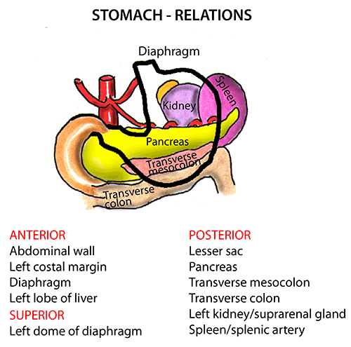
Stomach
Relations
Anteriorly: The anterior abdominal wall, the left costal margin, the left pleura and lung, the diaphragm, and the left lobe of the liver .
Posteriorly: The lesser sac, the diaphragm, the spleen, the left suprarenal gland, the upper part of the left kidney, the splenic artery, the pancreas, the transverse mesocolon, and the transverse colon

Slide 24
Stomach
Blood Supply
The arteries are derived from the branches of the celiac artery
The left gastric artery
The right gastric artery
The short gastric arteries
The left gastroepiploic artery
The right gastroepiploic artery

Slide 25
Stomach
Veins
The veins drain into the portal circulation.
The left and right gastric veins drain directly into the portal vein.
The short gastric veins and the left gastroepiploic veins join the splenic vein.
The right gastroepiploic vein joins the superior mesenteric vein.

Slide 26
Stomach
Lymph Drainage
The lymph vessels follow the arteries into the left and right gastric nodes, the left and right gastroepiploic nodes, and the short gastric nodes.
All lymph from the stomach eventually passes to the celiac nodes located around the root of the celiac artery on the posterior abdominal wall

Slide 27
Stomach
Nerve Supply
The nerve supply includes sympathetic fibers derived from the celiac plexus and parasympathetic fibers from the right and left vagus nerves
The anterior vagal trunk, which is formed mainly from the left vagus nerve, enters the abdomen on the anterior surface of the esophagus., then divides into branches that supply the anterior surface of the stomach.
A large hepatic branch passes up to the liver, and from this a pyloric branch passes down to the pylorus

Slide 28
Stomach
Nerve Supply
The posterior vagal trunk, which is formed mainly from the right vagus nerve, enters the abdomen on the posterior surface of the esophagus.
The trunk supply mainly the posterior surface of the stomach.
A large branch passes to the celiac and superior mesenteric plexuses

Slide 29
