Slide 1
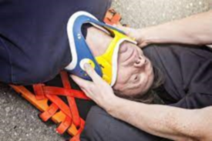
Neck Injury Supervised by Dr. mohammad asem
Presented by:
Rahaf abuqauod
Ghazal alnemer
Sarah adaileh

Slide 2
Introduction
Neck injuries is one of the most critical injuries, Its both an inlet and an outlet containing various structures.
Patient may appear normal at first but deteriorate after few hours (either death, paralysis, asphyxia, ..)
Neck anatomy is significant to identify the location of trauma and exact place of injury to predict the damaged structure.
Neck is divided to Triangles. (Anterior + posterior triangles) anterior triangle is also is divided to 3 zones (zone 2 is the most important)
Most important information to ask about in a neck trauma: 1. site 2. type of injury (blunt/penetrating) 3. Signs (Hard/soft)

Slide 3
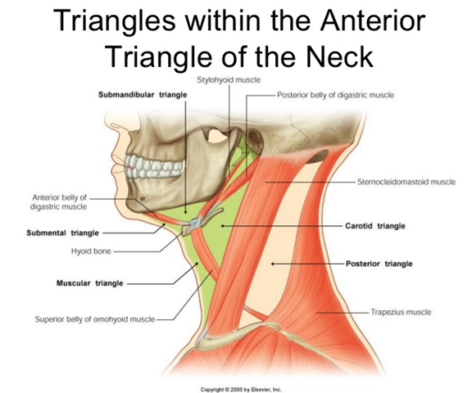
Anterior& posterior triangles separated by Sternocleidomastoid muscle.
Posterior triangle is bordered posteriorly by Trapezius muscle
Boarders of anterior triangle: Superiorly – inferior border of the mandible. Laterally – anterior border of the sternocleidomastoid. Medially – sagittal line down the midline of the neck.
Anterior Triangle is divided to: 1. Submandibular triangle 2. Submental Triangle 3. Carotid 4.Muscular triangle

Slide 6
Anterior triangle-Zone I
Blood vessels: aortic arch, subclavian, and innominate (brachiocephalic) vessels
Nerves: brachial plexus, left recurrent laryngeal nerve, spinal cord, sympathetic trunks
Respiratory: trachea, apex of the lung
Digestive: esophagus
Lymphatic: thoracic duct on the left
Thyroid gland.

Slide 7
Anterior triangle-Zone II
Blood vessels: carotid vessels, internal jugular vein
Nerves: vagus, recurrent laryngeal, phrenic nerve
Respiratory: Trachea, larynx
Digestive: oesophagus

Slide 8
Anterior triangle-Zone III
Blood vessels : carotid vessels, internal jugular vein
Nerves: cranial nerves VII-XII
Respiratory/digestive: pharynx
Glands:Parotid gland

Slide 9
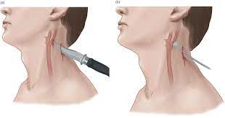
Penetrating neck injuries

Slide 10
Classification of penetrating neck injuries
Injuries penetrating the platysma are classified according to the anatomical location to:
Posterior triangle injuries Anterior triangle injuries The anterior triangle is subdivided into zone I, zone II and zone III

Slide 11
Posterior triangle injuries
Generally these injuries are less likely to involve the major structures.
The spinal cord, brachial plexus, and vertebral arteries may be at risk.
If the injury is very low, the subclavian vessels or the lung apex could be involved

Slide 13
Primary survey The initial evaluation and assessment involves resuscitation in accordance with the Advanced Trauma Life Support (ATLS) principles
Airway
Clinical signs of airway injury include hoarseness, stridor, dyspnea, subcutaneous emphysema (in the absence of pneumothorax), bubbling from the wound and large volume hemoptysis

Slide 14
Airway compromise may be directly due to injury or secondary, e.g. oedema associated with a haematoma, or vocal cord paralysis (injury to the recurrent laryngeal nerve)
If the airway is compromised, oral intubation should be attempted whenever possible
If there is an obvious open injury to the airway, it is better to consider tracheostomy as soon as possible.

Slide 15
Breathing
The apex of the lung may be involved , always do a chest X-Ray to check for a haemo- or pneumothorax.
Circulation
Vascular injuries may present as neurological complications,
(distribution of the middle cerebral artery may be secondary to a carotid artery injury)
A high-flow intravenous line should be set up. Intravenous
lines should be avoided in the arm on the side of the neck wound.
Active external bleeding can be controlled by external digital
pressure or by Foley catheter balloon tamponade that has
been carefully inserted as deep as possible into the wound.
This is an emergency measure that provides temporary control until surgery can be done.

Slide 16
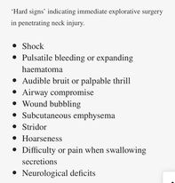

Slide 17
Investigation
Chest X-ray
Essential in all patients with neck injuries.
Do not sit patient up; if there is an open wound, it may cause a fatal air
embolism or complicate a cervical spine injury.
Cervical spine X-ray
Look for the presence of fractures, foreign bodies, or air in soft tissues.
CT scan or CT angiography
In the stable patient, a spiral CT scan (if available) with intravenous contrast will provide information on soft tissue, bony structures, wound trajectory, and vascular injuries.
Specifically look out for intimal injuries of the carotids.
Oral contrast can be given if required to identify leaks.
Color Flow Doppler (CFD)
Color flow Doppler has been suggested as a reliable alternative to angiography in the evaluation of PNI.

Slide 18
Management
Consider early intubation or surgical airway
If all the investigations are normal, the patient may be observed over-night and discharged home if there is no deterioration.
A hemothorax should be managed accordingly.
If the patient is bleeding or airway compromised or investigations are abnormal, immediate surgical intervention is required.
Small pharyngeal and tracheal injuries can be treated conservatively

Slide 19
Blunt neck trauma
motor vehicle accidents and sports
result in laryngeal, vascular, and digestive injury
easily underdiagnosed because their onset can be delayed
occult cervical spine injury
Strangulation
Blows from fists or feet
Excessive manipulation

Slide 20
Common to all traumatic mechanisms is the direct transfer of severe forces to the larynx. These forces have the potential to produce many devastating injuries, including mucosal tears, dislocations, and fractures.
Edema, hematoma, cartilage necrosis, voice alteration, cord paralysis, aspiration, and airway loss may accompany these injuries.
Common signs of laryngeal injury include stridor, subcutaneous emphysema, hemoptysis, hematoma, ecchymosis, laryngeal tenderness, vocal cord immobility, loss of anatomical landmarks, and bony crepitus.

Slide 21
Laryngeal injuries vary by anatomical location
Supraglottis: Traumatic forces commonly produce horizontal fractures of the thyroid alae and disruption of the hyoepiglottic ligament with subsequent superior and posterior displacement of the epiglottis.
Glottis: Traumatic force results in cruciate fractures of the thyroid cartilage near the attachment of the true vocal cords.
Subglottis: Crushing forces to the cricoid cartilage cause injury to the cricothyroid joint and may result in bilateral vocal cord paralysis from recurrent laryngeal nerve damage.
Hyoid bone: Found more commonly in women, hyoid fractures tend to occur in the central part of the hyoid bone because of the inherent strength of the cornua.

Slide 22
Cricoarytenoid joint: Traumatic forces that displace the thyroid alae medially or cause compression of the larynx against the cervical vertebrae often result in cricoarytenoid dislocation. This injury generally occurs unilaterally.
Cricothyroid joint: Injury occurs when traumatic forces to the anterior portion of the neck cause the inferior cornu of the thyroid cartilage to be displaced posterior to the cricoid cartilage. This dislocation limits cricothyroid muscle function and therefore pitch control. Injury to the recurrent laryngeal nerve may also contribute to vocal cord paralysis

Slide 23
