Slide 1
Acute vascular disorders
1-DVT
2-Superficial thrombophlebitis
3-Acute ischemia
4-Aortic dissection
5-Aortic aneyrysm
Supervised by: Dr.Anas Albattikhi

Slide 2
Deep Vein Thrombosis (DVT) Presented by:Rahaf Alabdallat+Heba kasasbeh.
Definition of Deep vein thrombosis (DVT) :
It is defined as the formation of a blood clot (thrombus) in a deep vein, most commonly occurring in the legs or pelvis(lower extremities) , but it can also occur in other the arms and other locations.
The clot impedes venous circulation and obstructs blood flow, potentially causing symptoms like pain, swelling, and redness.
DVT is part of a broader condition known as venous thromboembolism (VTE), which also includes pulmonary embolism (PE) when the clot travels to the lungs.

Slide 3
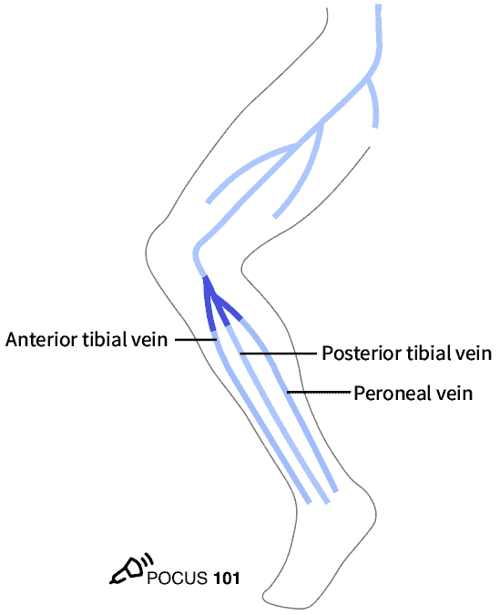
Proximal DVT: DVT of the lower extremity affecting the femoral vein, profunda femoris vein, and/or the popliteal vein (up to the calf vein trifurcation)
Distal DVT: DVT of the lower extremity that is confined to the veins beyond the calf vein trifurcation (below the knee jount )

Slide 4
Pathophysiology :
DVT develops due to a combination of abnormal blood flow, vessel wall injury, and increased coagulability, as outlined in Virchow’s Triad:
Stasis: Prolonged immobility, such as during hospital stays or long flights, reduces venous return and promotes clot formation.
Endothelial Dysfunction: Inflammation or physical injury to the vein walls (due to surgery, catheterization, or trauma) triggers clotting mechanisms by exposing the subendothelial tissue and releasing prothrombotic factors.
Hypercoagulability: Conditions like cancer, systemic inflammation, or inherited clotting disorders (e.g., Factor V Leiden) increase the blood’s propensity to clot. Additionally, external factors like hormone replacement therapy (estrogen) or pregnancy elevate the risk of clot formation

Slide 5
Risk factors :
Immobility: Prolonged bed rest or inactivity, such as during long flights or hospitalization, is a major risk factor for DVT due to reduced venous return from the legs.
Surgery: Major surgeries, especially orthopedic procedures like hip or knee replacements, significantly increase the risk of DVT due to both immobility and endothelial injury.
Cancer: Certain cancers and cancer treatments (e.g., chemotherapy) promote a hypercoagulable state, increasing the risk of clot formation.
Pregnancy and Postpartum Period: Hormonal changes during pregnancy, as well as the compression of veins by the growing uterus, increase the risk of DVT. The risk remains elevated postpartum.
Hormonal Therapy: Use of estrogen-containing contraceptives or hormone replacement therapy is associated with an increased risk of DVT.
Genetic Thrombophilias: Inherited clotting disorders such as Factor V Leiden mutation, prothrombin gene mutation, and deficiencies in protein C, S, or antithrombin III raise the risk of clot formation

Slide 6
Age: The risk of DVT increases with age, particularly in individuals over 60 years.
Obesity: Being overweight or obese increases the pressure on veins in the lower extremities, making DVT more likely.
Smoking: It increases the risk of clot formation by damaging the blood vessels and promoting a hypercoagulable state.
Prior DVT or PE: A personal history of DVT or pulmonary embolism (PE) increases the risk of recurrence.
Family History of DVT: A family history of venous thromboembolism (VTE) suggests a potential genetic predisposition.
Chronic Diseases: Conditions such as heart failure, inflammatory bowel disease, and nephrotic syndrome are associated with a higher risk of DVT

Slide 7
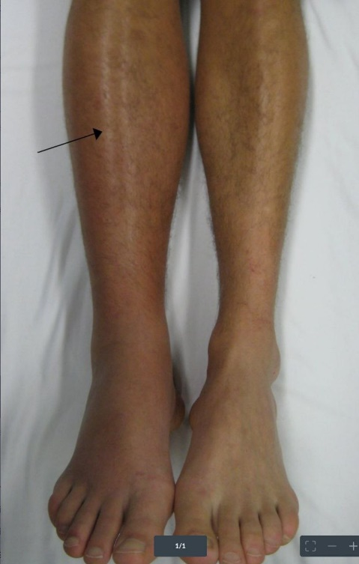
Clinical Presentation :
The clinical presentation of DVT can vary widely, ranging from asymptomatic cases to significant swelling and pain. The most common symptoms and signs include:
Unilateral Leg Swelling: DVT typically affects one leg, and swelling is usually localized to the calf or entire leg.
Pain or Tenderness: Pain often starts in the calf and can be described as cramping or soreness. It may worsen with standing or walking.
Erythema and Warmth: The skin over the affected area may become red and warm due to inflammation around the clot
Skin Discoloration: The skin may appear red or bluish, and this discoloration can sometimes extend over a significant portion of the affected leg
Dilated Superficial Veins: In some cases, prominent veins may appear on the surface of the skin.

Slide 8
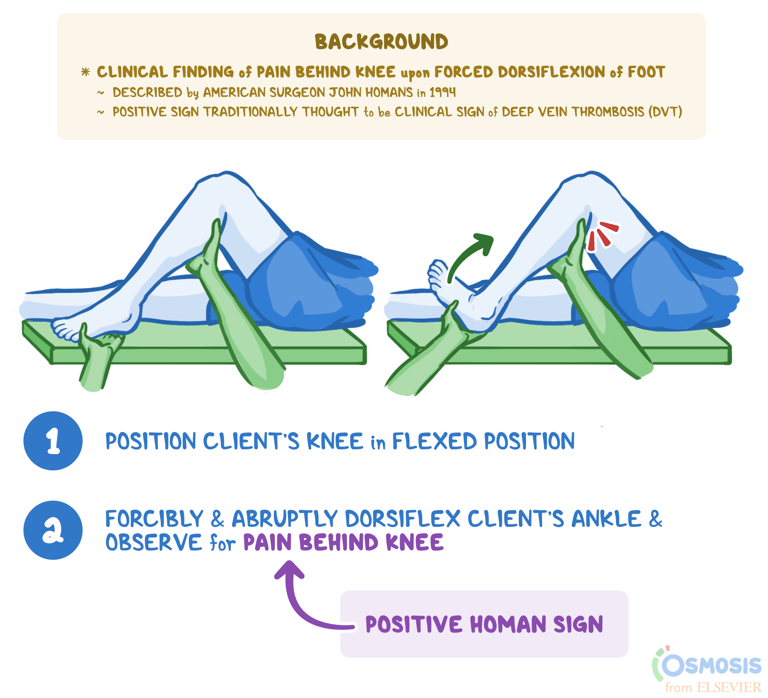
Homan’s Sign: Pain in the calf on dorsiflexion of the foot can be indicative of DVT, though it is not a highly specific test
Pulmonary Symptoms: In cases where a DVT leads to a pulmonary embolism, patients may develop chest pain, shortness of breath, or a rapid heart rate due to reduced oxygen levels in the blood

Slide 9
Diagnosis :
The diagnosis of DVT involves a combination of clinical assessment, risk stratification, and confirmatory imaging tests:
Clinical Prediction Rules: The Wells Score is commonly used to assess the likelihood of DVT. It includes factors like active cancer, recent immobilization, leg swelling, and previous DVT history. A high Wells score increases the suspicion of DVT

Slide 10
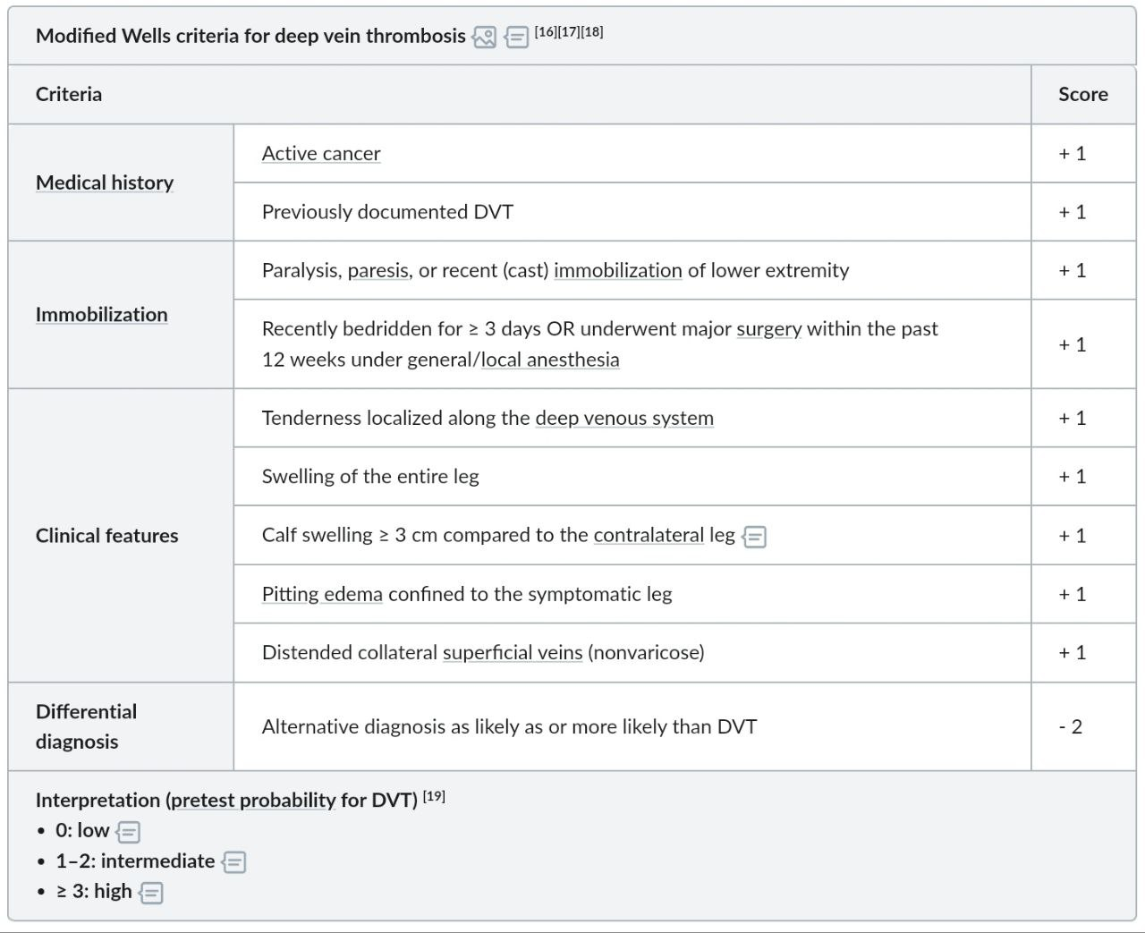

Slide 11
laboratory tests : D-dimer Testing For patients with a low or moderate pretest probability of DVT, a negative D-dimer test (<500 ng\ml) can effectively rule out the condition. Elevated D-dimer levels are non-specific but indicate the presence of clot breakdown products
Imaging : .
Compression Ultrasound: This is the first-line imaging modality for diagnosing DVT. It assesses the compressibility of veins—if the vein cannot be compressed by the ultrasound probe, a thrombus is likely present , it's particularly useful for detecting proximal DVT (femoral and popliteal artries)
Duplex Ultrasound : is the primary diagnostic tool and is highly sensitive , it helps detecting smaller less occlusive clots that may be missed by compression alone
Compression U/S of the whole leg with color Doppler (i.e.,duplex scanning) is the most accurate test for diagnosing DVT.
In cases where ultrasound results are inconclusive venography may be considered.
Venography: Although rarely used today due to the availability of non-invasive ultrasound, venography remains the gold standard diagnostic test for DVT. It involves injecting contrast dye into the veins and taking X-rays to visualize blockages
Additional Imaging: For suspected pulmonary embolism (PE), which can accompany DVT, a CT pulmonary angiography may be used

Slide 14
Management :
The management of DVT involves several key steps, focusing on preventing clot extension, embolization, and recurrence, while reducing complications such as post-thrombotic syndrome (PTS). The main treatment strategies include:
Anticoagulation Therapy:
First-line treatment for DVT is anticoagulation, aiming to prevent further clot formation and embolism.
Initial anticoagulation options include:
Low molecular weight heparin (LMWH) or unfractionated heparin: Commonly used for immediate anticoagulation.
Direct oral anticoagulants (DOACs): Such as apixaban, rivaroxaban, or dabigatran, are increasingly preferred due to ease of use (no regular monitoring required).
Vitamin K antagonists (VKAs) like warfarin: Often used in patients with contraindications to DOACs

Slide 15
Notes:
Initial treatment with DOACs (e.g., rivaroxaban, apixaban) is recommended for most patients with DVT. They are preferred over warfarin due to their ease of use and better safety profile.
For patients with cancer-associated DVT, LMWH remains a preferred option.
For patients who cannot take DOACs, warfarin with overlapping LMWH may be used.
Duration of Anticoagulation:
For provoked DVT, anticoagulation is usually limited to 3 months.
For unprovoked DVT, anticoagulation for at least 6 months is recommended, with the potential for extended or indefinite therapy based on recurrence risk and bleeding risk.

Slide 16
Thrombolytic Therapy:
For patients with extensive DVT (e.g., iliofemoral DVT) or those at high risk for limb loss, catheter-directed thrombolysis may be considered.
Systemic thrombolysis is reserved for life-threatening situations or massive pulmonary embolism, due to a higher risk of bleeding.
Inferior Vena Cava (IVC) Filter:
The ACC emphasizes that IVC filters are not routinely recommended but may be placed in patients who have contraindications to anticoagulation or those who experience recurrent DVT despite anticoagulation.
IVC filters can prevent pulmonary embolism by trapping clots that travel from the legs to the lungs, but they do not prevent the formation of new clots

Slide 17
Compression Stockings:
Graduated compression stockings are sometimes recommended to reduce the risk of post-thrombotic syndrome (PTS) and alleviate symptoms like swelling.
However, their efficacy in preventing PTS has been debated, and they are not routinely recommended for all patients .
Ambulation:
Early mobilization is generally encouraged in patients receiving anticoagulation, as prolonged bed rest may increase the risk of complications .
Patient Education:
educating patients about signs of bleeding due to anticoagulant therapy and lifestyle adjustments to minimize the risk of recurrent DVT.

Slide 18
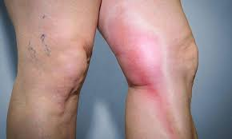
Superficial thrombophlebitis
Inflammation and thrombosis of a superficial vein
Common causes include:
Stasis: Varicose veins
Local trauma and inflammation :
IV therapy, The presence of an intravenous cannula for longer than 24–48 hours often leads to local thrombosis.
Generalised hypercoagulability: Malignancy (especially of the pancreas) and thromboangiitis obliterans

Slide 19
Clinical features :
Pain, tenderness, induration, and erythema overlying a superficial vein, often with a palpable cord (red line along the skin over the vein)
Most commonly affects the superficial veins of the leg.
Variants
Thrombophlebitis migrans(Trousseau syndrome)
Superficial thrombophlebitis of the breast

Slide 20
Diagnosis :Superficial thrombophlebitis is typically a clinical diagnosis.
The primary differential diagnoses are localized skin or soft tissue inflammation (e.g., cellulitis, vasculitis)
Compression ultrasound with/without Doppler
Indication: presence of any risk factor for concomitant DVT or if the clinical diagnosis is unclear
Findings: thickened, edematous, non compressible superficial vein with/without an intraluminal thrombus, with/without extension into a deep vein
Evaluation for the underlying cause: same as that for DVT

Slide 21
Treatment:
Symptomatic care: indicated for all patients [
Oral and/or topical analgesics
Compression therapy with graduated compression stockings
Anticoagulation: to consider based on thrombus length (e.g., ≥ 5 cm), location (i.e., proximity to the deep venous system), and risk factors for DVT
Complications:
DVT
Pulmonary embolism
Infection (septic thrombophlebitis)

Slide 22
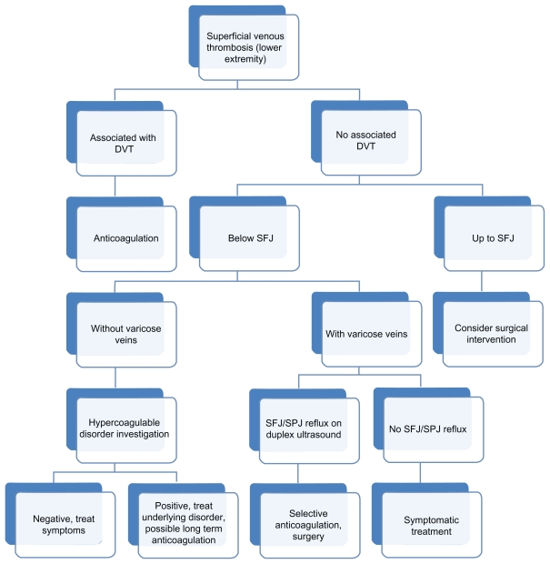

Slide 23
Acute Vascular Ischemia
1)Acute limb ischemia
2)Acute mesentric ischemia
Presented by :Marwa Fagara

Slide 24
Acute limb ischemia
ALI is characterised by a sudden decrease in arterial perfusion of the limb, with a potential threat to the survival of the limb, requiring urgent evaluation and management. ALI is considered when the symptom duration is less than two weeks. A symptom duration of greater than two weeks is usually considered to represent chronic limb ischemia.
The most common causes of ALI are embolism, thrombosis of native arteries or reconstructions, peripheral arterial aneurysm, dissection, and traumatic arterial injury.
The cause of embolisation is usually attributed to AF or left ventricular mural thrombi after acute myocardial infarction, whereas acute thrombotic occlusions occur in individuals with a high atherosclerotic burden.

Slide 25
Diagnosis and Clinical Examination
ALI is a medical emergency, and it is important that the diagnosis is confirmed promptly, and proper treatment is started in order to prevent limb loss and other severe complications. Patients with acute on chronic limb ischemia often have a history of intermittent claudication and have risk factors for PAD, such as smoking, hypertension, renal insuffi- ciency, and diabetes. It is important to include patient history in the clinical assessment. The clinical presentation of ALI depends on the location and duration of the arterial occlusion, the presence of collateral circulation, and the metabolic changes related to tissue ischaemia. Typically, after occlusion of a native artery, the signs of ischaemia are located one level / joint distal to the level of occlusion
The clinical differentiation between acute embolic and thrombotic occlusion can sometimes be difficult. A sudden onset of ALI symptoms is typical for arterial embolism. Patients with ALI due to thrombosis will present as a more gradual aggravation of symptoms, because most patients with pre-existing PAD compensate by increased collateral circulation .

Slide 26
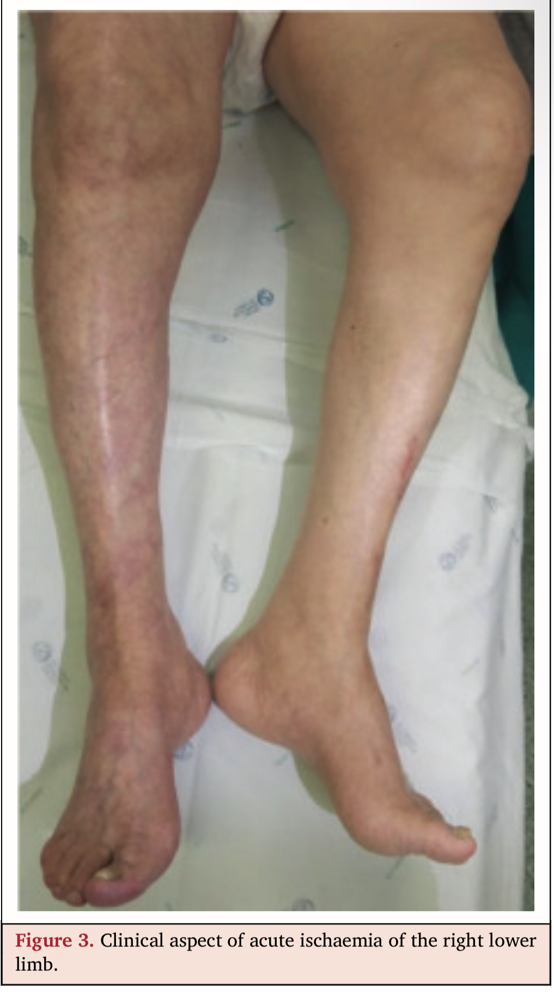
Examination
The classic “six Ps” (pain, pallor, pulselessness, poikilothermia [perishing with cold], paraesthesia, and paralysis) can help to appreciate the clinical severity of ischaemia.
The loss of sensory and motor function are symptoms of a threatened limb with a need for immediate revascularisation. The Rutherford classification for ALI is the most commonly used to determine whether the limb is viable, threatened, or irreversibly ischemic, and to guide clinical management.
It is important that both legs are examined to exclude bilateral disease and to look for bilateral conditions such as PA. Physical examination should also include all other peripheral pulses and looking for signs of visceral ischaemia (abdominal tenderness).

Slide 27
The ischemia is graded clinically according to the Rutherford ALI classification system :

Slide 28
Imaging modalities
For pa­tients pre­sent­ing with acute limb is­chaemia, di­ag­nos­tic imag­ing is rec­om­mend­ed to guide treat­ment, pro­vid­ed it does not de­lay treat­ment, or if the need for pri­ma­ry am­pu­ta­tion is ob­vi­ous.
1) Digital Subtraction Angiography: In terms of di­ag­nos­tic ac­cu­ra­cy, dig­i­tal sub­trac­tion an­giog­ra­phy (DSA) is still con­sid­ered the stan­dard in­ves­ti­ga­tion for ALI.DSA can de­lin­eate ae­ti­ol­o­gy and of­fers the ad­van­tage of al­low­ing treat­ment in the same setting.
The pres­ence of a cres­cent shaped oc­clu­sion, or menis­cus sign, com­bined with the nor­mal ap­pear­ance of the re­main­ing ves­sels is typ­i­cal of an em­bol­ic oc­clu­sion . Throm­bot­ic oc­clu­sion is typiﬁed by oth­er ar­eas of ath­er­o­scle­ro­sis and some ex­ist­ing col­lat­er­als.
2) Duplex Ultrasound
3) Computed Tomography Angiography
4) Contrast Enhanced Magnetic Resonance Angiography

Slide 29
Based on cur­rent ev­i­dence, DSA, CTA, DUS, and CE- MRA can all be con­sid­ered for imag­ing in pa­tients with ALI, and may be used based on lo­cal ex­per­tise, avail­abil­i­ty around the clock, and pref­er­ence . CTA is used most of­ten be­cause of its avail­abil­i­ty, and should be per­formed for treat­ment plan­ning, un­less the is­chaemia is too se­vere to al­low time for ad­di­tion­al imag­ing. The role of CE- MRA seems lim­it­ed, main­ly be­cause of lim­it­ed avail­abil­i­ty out of ofﬁce hours, and be­cause it has not been eval­u­at­ed in pa­tients with ALI.
For pa­tients pre­sent­ing with acute limb ischemia , du­plex ul­tra­sound or con­trast- en­hanced mag­net­ic res­o­nance an­giog­ra­phy may be con­sid­ered for al­ter­na­tive imag­ing be­fore start­ing treat­ment, de­pend­ing on avail­abil­i­ty and clin­i­cal as­sess­ment.

Slide 30
Management and Treatment
Initial med­ical treat­ment of ALI in­cludes :
For pa­tients with acute limb is­chaemia await­ing revas­cu­lar­i­sa­tion, sup­ple­men­tal oxy­gen is rec­om­mend­ed.
Appropriate anal­ge­sia and in­tra­venous ad­min­is­tra­tion of un­frac­tion­at­ed he­parin (UFH):
ini­tial­ly 5 000 IU, or 70 — 100 IU/ kg, fol­lowed by in­fu­sion, dose ad­just­ed to pa­tient re­sponse, and mon­i­tored by ac­ti­vat­ed clot­ting time or ac­ti­vat­ed par­tial throm­bo­plas­tin time (APTT). The aim is to re­duce fur­ther em­bolism or clot prop­a­ga­tion, and to pro­vide an anti- inﬂam­ma­to­ry ef­fect.

Slide 31
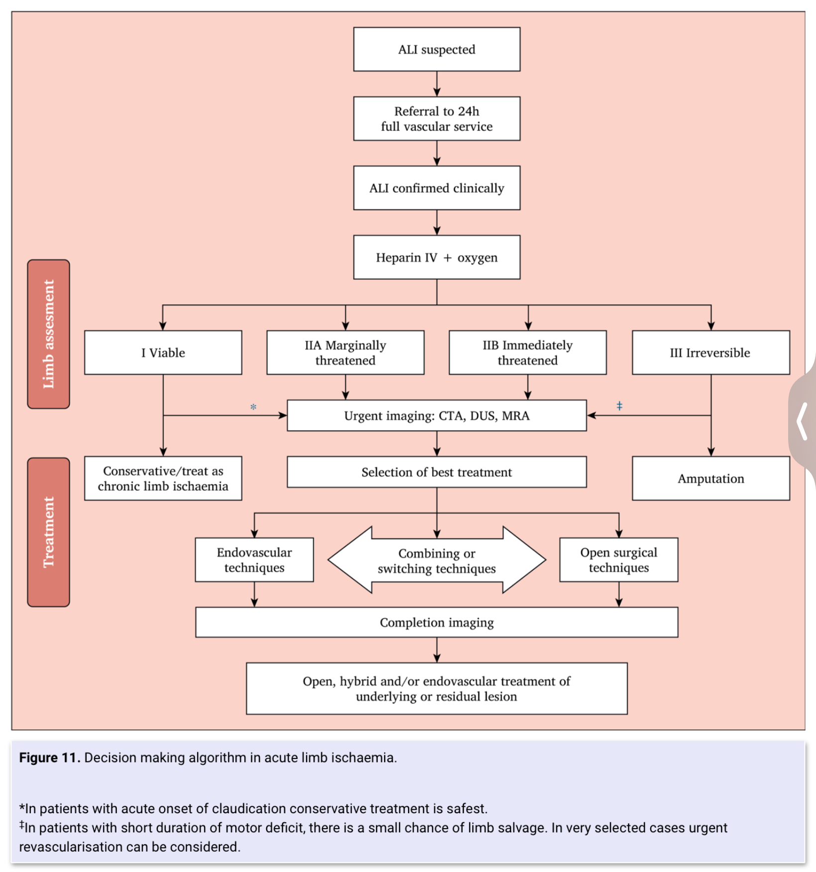

Slide 32
Treatment depends on the classification based on the degree of ischemia and limb viability. Especially acute (< 14 days symptom duration) Rutherford Categories IIa and IIb with marginally and immediately threatened limbs require definitive therapeutic intervention and are salvageable, if promptly revascularized.
The current literature suggests that open surgical revascularization is more time effective than catheter-directed thrombolysis. However, with the advent of thrombolytic delivery systems and mechanical thrombectomy devices, treatment time can be minimized and successful utilization in patients with Category IIb (Rutherford Classification for Acute Limb Ischemia) has been reported with promising limb-salvage and survival rates. Large randomized studies are still missing, and guidelines suggest choosing the method of revascularization depending on anatomic location, etiology, and local practice patterns, with the time to restore the blood flow being an important factor to consider.

Slide 33
Pa­tients with ALI should be treat­ed by spe­cial­ists in vas­cu­lar and en­dovas­cu­lar ther­a­pies, in cen­tres with a full range of fa­cil­i­ties to man­age pa­tients with vas­cu­lar dis­eases.
The ur­gency of trans­fer will de­pend on the sever­i­ty of the is­chaemia, with pa­tients with mo­tor or sen­so­ry loss (Ruther­ford IIb) re­quir­ing ur­gent trans­fer, and ur­gent revas­cu­lar­i­sa­tion is manda­to­ry.
Var­i­ous revas­cu­lar­i­sa­tion tech­niques can be used, in­clud­ing sur­gi­cal throm­boem­bolec­to­my, by­pass, per­cu­ta­neous catheter di­rect­ed throm­bol­y­sis (CDT), and hy­brid pro­ce­dures in­clud­ing thromben­darterec­to­my.
The strat­e­gy em­ployed will de­pend on a num­ber of fac­tors, in­clud­ing the ex­per­tise and fa­cil­i­ties of the treat­ing team, and pa­tient fac­tors such as the du­ra­tion and sever­i­ty of ALI, the lo­ca­tion and cause of the oc­clu­sion, co­mor­bidi­ties, and ther­a­py re­lat­ed risks.

Slide 34
ACUTE MESENTERIC ISCHAEMIA
A group of diseases characterized by an interruption of the blood supply to varying portions of the small intestine, leading to → ischemia and secondary inflammatory changes.
Etiology: (Superior mesenteric artery in 90% of cases)
- Occlusive disease ~( 80%)
• Acute mesenteric artery embolism (e.g., due to atrial fibrillation)
• Acute mesenteric artery thrombosis (e.g., due to visceral atherosclerosis)
• Mesenteric venous thrombosis (e.g., due to hypercoagulable states)
- Nonocclusive disease (~ 20%)
• Acute hypoperfusion in critically ill patients leads to ischemia.
• Typically an exacerbation of preexisting occlusion due to atherosclerosis

Slide 35
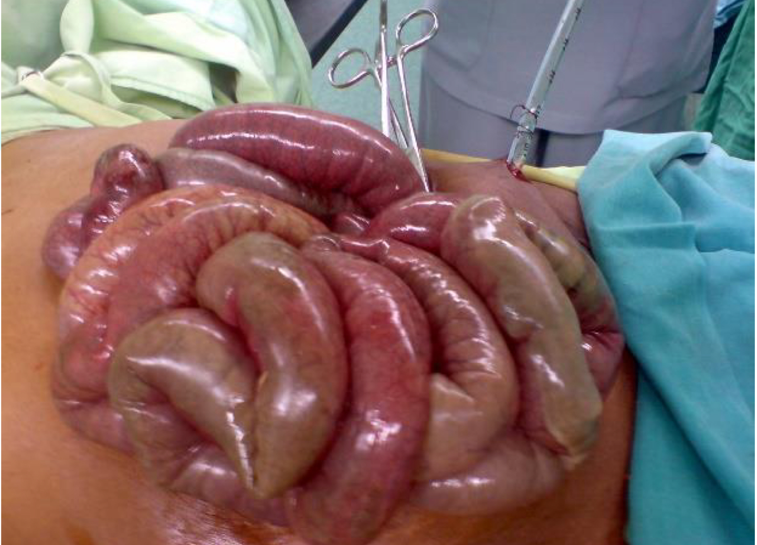
Clinical Features
• Abdominal pain out of proportion to physica examination
• Diarrhea; bloody in later stages
• Nausea and vomiting, abdominal bloating
• Systemic signs of sepsis
• Peritonitis and acute abdomen in late stages
• Symptom onset and intensity may vary with the etiology of AMI
NOTES:
The typical clinical triad for an acute embolic SMA oc- clusion is (i) severe abdominal pain with minimal findings on examination (pain out of proportion to clinical signs), (ii) bowel emptying, and (iii) the presence of a source of embolus, most often atrial fibrillation
Patients with acute mesenteric artery thrombosis typically have known cardiovascular or peripheral vascular disease and/or symptoms of CMI in addition to acute symptoms.

Slide 36
Diagnosis : (high index of suspicion, mainly clinical + Labs
Laboratory studies
• CBC: leukocytosis,> Hct (due to volume depletion) or < Hct (due to Gl bleed) > Serum lactate
• CMP: electrolyte abnormalities, > AST
• Blood gas: metabolic acidosis, ~ HCO3-
• Other: T D-dimer, T amylase, T CPK, T LDH
Images: CTA abdomen and pelvis is the test of choice (gold standard)
Em­bol­ic oc­clu­sion often ap­pears as an oval-‍shaped fill­ing de­fect sur­round­ed by con­trast in a non-‍cal­ci­fied ar­te­ri­al seg­ment lo­cat­ed in the mid­dle and dis­tal part of the main stem of the SMA
Throm­bot­ic oc­clu­sion usu­al­ly ap­pears as clot su­per­im­posed on a heav­i­ly cal­ci­fied oc­clu­sive le­sion at the ori­gin of the SMA.

Slide 37
Treatment
In­testi­nal revas­cu­lar­i­sa­tion is nec­es­sary in most pa­tients with acute SMA oc­clu­sion.
Op­ti­mal treat­ment may in­clude both open and en­dovas­cu­lar surgery, and pa­tients are best treat­ed in a vas­cu­lar cen­tre with a hy­brid op­er­at­ing room,. From pre-‍op­er­a­tive clin­i­cal and ra­di­o­log­i­cal eval­u­a­tion, it should be de­ter­mined whether or not the pa­tient has peri­toni­tis, and whether the oc­clu­sion is em­bol­ic or throm­bot­ic.
Supportive care (e.g., IV fluids, nasogastric tube, NPO)
• Broad-spectrum antibiotics
• Parenteral anticoagulation (unfractionated heparin)
Cause and severity-specific
- Endovascular revascularization (thrombosis and embolism in hemodynamically stable patients)
- Emergency laparotomy and bowel resection (signs of peritonitis, intestinal infarct, or hemodynamic instability)

Slide 38
Aortic dissection
Bayan Hamad

Slide 39
Definition
aor­tic dis­sec­tion is the re­sult of a tear in the in­ti­mal ar­te­ri­al layer, which al­lows blood to prop­a­gate with­in the me­di­al layer. This cre­ates a ﬂap, which di­vides the aorta into a true lumen (TL), and a false lumen (FL).
Any con­di­tion that in­creases in­ti­mal shear stress or de­creases ar­te­ri­al wall strength is con­sid­ered to be a risk fac­tor. Sys­temic hy­per­ten­sion is pre­sent in al­most 80% of pa­tients. In­creas­ing age and atheroscle­ro­sis are other im­por­tant risk fac­tors, as are con­gen­i­tal bi­cus­pid or uni-‍com­mis­sur­al aor­tic valves, co­caine abuse, preg­nan­cy, stren­u­ous ac­tiv­i­ties, and se­vere emo­tional stress.An­oth­er im­por­tant risk fac­tor is a pos­i­tive fam­i­ly his­to­ry of tho­racic aor­tic dis­eases

Slide 41
Classification
The DeBakey system categorizes dissections into types 1, II, and III, based on the origin of the intimal tear and the extent of the dissection:
﻿﻿Type I: Dissection tear originates in the ascending aorta and propagates distally to include the aortic arch and typically the descending aorta
﻿﻿Type II: Dissection tear is confined only to the ascending aorta
﻿﻿Type III: Dissection tear originates in the descending thoracic aorta and propagates most often distally
﻿﻿Type Illa: Dissection tear is confined only to the descending thoracic aorta
﻿﻿Type IIIb: Dissection tear originates in the descending thoracic aorta and extends below the diaphragm
The Stanford classification system divides dissections into 2 categories according to whether the ascending aorta is involved or not, regardless of the site of origin:
﻿﻿Type A: All dissections involving the ascending aorta, irrespective of the site of the intimal tear
﻿﻿Type B: All dissections that do not involve the ascending aorta (including dissections that involve the aortic arch but spare the ascending aorta)

Slide 42
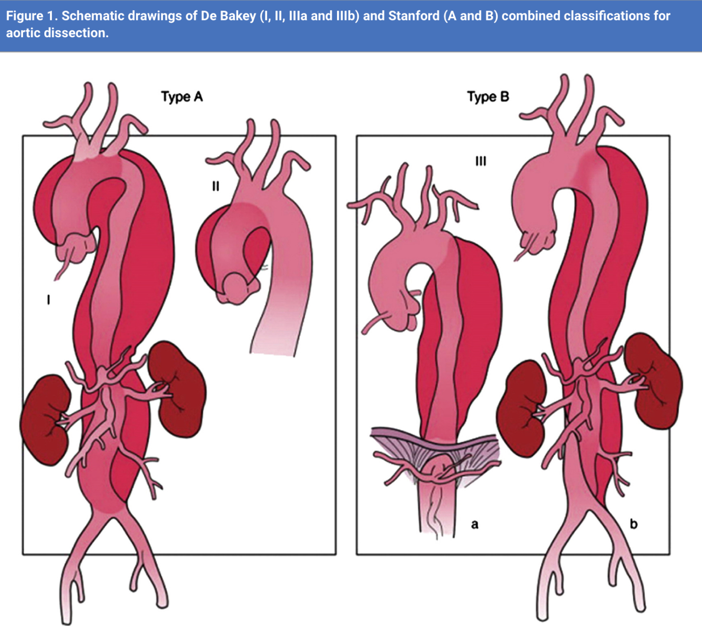

Slide 43
Clinical presentation
▪ Sudden and severe tearing/ripping pain
- Location
▫ Anterior chest (ascending) or back (descending)
▫ Interscapular or retrosternal pain
▫ Neck and jaw
▫ Abdomen or periumbilical, colicky pain
- Character: migrates as the dissected wall
propagates caudally
▪ Hypertension or hypotension
▪ Asymmetrical blood pressure and pulse
readings between limbs
▪ Wide pulse pressure
▪ Syncope, diaphoresis, confusion, or agitation

Slide 45
Complications
Acute aortic regurgitation
Cardiac tamponade
Aortic rupture
Renal or / and visceral ischemia
Acute limb ischemia
Paraplegia/para­pare­sis repre­sents a catas­troph­ic, but rare, com­pli­ca­tion of ATBAD sec­ondary to SCI
re­frac­to­ry pain
re­frac­to­ry hy­per­ten­sion
Hypotension
Shock
Hy­poten­sion/‍shock and vis­cer­al is­chaemia are con­sid­ered the most im­por­tant pre­dictors of in hos­pi­tal death.

Slide 46
Diagnosis
CT angiography
Transesophageal echcardiography
MRI
Chest x-ray

Slide 47
Management
Stanford A dissection : immediate surgery
Stanford B dissection
The aims of treat­ing ATBAD are to main­tain or re­store per­fu­sion of the vital or­gans and to pre­vent both pro­gres­sion of the dis­sec­tion and aor­tic rup­ture. There­fore, it is im­por­tant to make a risk as­sess­ment at an early stage to de­ter­mine the mer­its of med­i­cal, en­dovas­cu­lar, or sur­gi­cal in­ter­ven­tion.
Medical therapy with an­ti­hy­per­ten­sive agents is wide­ly ac­cept­ed to be the ﬁrst line treat­ment in uncom­pli­cat­ed ATBAD pa­tients.Medical man­age­ment is based on blood pres­sure re­duc­tion to limit aor­tic wall stress and to re­duce the force of left ven­tric­u­lar ejec­tion. The goal is to re­duce sys­tolic blood pres­sure be­tween 100 and 120 mm Hg and, when at­tain­able, the heart rate below 60 beats/‍ min.

Slide 48
In pa­tients with acute type B aor­tic dis­sec­tion, β-‍block­ers should be con­sid­ered as the ﬁrst line of med­i­cal ther­a­py.
In pa­tients with acute type B aor­tic dis­sec­tion who do not re­spond or are in­tol­er­ant of β-‍block­ers, cal­ci­um chan­nel an­tag­o­nists and/‍or renin-‍an­giotensin in­hibitors may be con­sid­ered as al­ter­na­tives or com­ple­men­taries
Pain re­lief is also an im­por­tant com­po­nent of op­ti­mal med­i­cal ther­a­py, as per­sist­ing pain may in­di­cate pro­gres­sion of the dis­sec­tion or im­pend­ing rup­ture, re­quir­ing ad­di­tion­al ther­a­py.

Slide 49
Surgical therapy
endovascular repair : To pre­vent aor­tic com­pli­ca­tions in uncom­pli­cat­ed acute type B aor­tic dis­sec­tion, early tho­racic en­do­graft­ing may be con­sid­ered selec­tively
open repair : In acute com­pli­cat­ed type B aor­tic dis­sec­tion, open re­pair should be con­sid­ered as an al­ter­na­tive to en­dovas­cu­lar ther­a­py fol­lowing fail­ure of en­dovas­cu­lar man­age­ment or where en­dovas­cu­lar in­ter­ven­tions are con­traindi­cat­ed

Slide 50
Aortic aneurysm
Descending Thoracic Aortic Aneurysms
Thoraco-abdominal Aortic Aneurysms

Slide 51
Descending Thoracic Aortic Aneurysms
De­scend­ing tho­racic aor­tic aneurysms (DTAA) are deﬁned as any aor­tic di­lata­tion with at least a 50% in­crease in di­am­e­ter lo­cat­ed in any seg­ment of the aorta be­tween the LSA ori­gin and the di­aphragm. Histopatho­log­i­cal­ly, it is char­ac­ter­ized by me­di­al de­gen­er­a­tion, with dis­rup­tion and loss of elas­tic ﬁbres and in­creased depo­si­tion of pro­teo­gly­cans, with or with­out atheroscle­ro­sis
May cause chest pain, back pain.
Risk fac­tors for rup­ture in­clude max­i­mum aneurysm di­am­e­ter, age, gen­der, ac­tive smok­ing sta­tus, di­as­tolic hy­per­ten­sion, and aneurysm re­lat­ed pain

Slide 53
Management
Medical management
Focuses on controlling blood pressure and reducing the risk of rupture. Beta-blockers and antihypertensives are commonly used.
Regular imaging to monitor aneurysm size and growth.
﻿﻿

Slide 54
Indications for Repair
An ini­tial di­am­e­ter of 60 mm car­ries an an­nu­al risk of rup­ture of 10%. For DTAA, there is a thresh­old of 70 mm at which the risk of rup­ture sud­denly es­ca­lates.127 In­ter­ven­tion in aneurysms below 55 mm may not af­ford a sur­vival beneﬁt, al­though a ran­dom­ized con­trolled trial is nec­es­sary to eval­u­ate the pos­si­ble beneﬁt of re­pair in the small aneurysm group.9 This thresh­old can be re­duced to 50–55 mm for women or in the set­ting of connec­tive tis­sue dis­or­ders

Slide 55
Endovascular Repair
In fit and unfit pa­tients with favourable anato­my, en­dovas­cu­lar re­pair should be con­sid­ered for de­scend­ing tho­racic aorta aneurysms >60 mm di­am­e­ter
In pa­tients with rup­tured de­scend­ing tho­racic aor­tic aneu­rysm, en­dovas­cu­lar re­pair should be the first treat­ment op­tion when the anato­my is ap­pro­pri­ate
Open repair
- Com­put­ed to­mo­graph­ic an­giog­ra­phy or mag­net­ic res­o­nance should be per­formed for pa­tients planned for de­scend­ing tho­racic aor­tic re­pair, to de­fine the ex­tent of the dis­ease and to iden­ti­fy the po­ten­tial risk of the pro­ce­dure re­lat­ed to the main in­ter­costal ar­ter­ies

Slide 56
In­di­ca­tions for OR of a DTAA are lim­it­ed to ﬁt pa­tients unsuit­able for TEVAR such as those with:
Ab­sence of ad­e­quate ar­te­ri­al ac­cess or a contrain­di­ca­tion to aor­tic/iliac con­duit graft place­ment (pres­ence of hos­tile ab­domen, se­vere aorto-‍iliac dis­ease). The use of an aor­tic/iliac sidearm graft is re­quired in ap­prox­i­mate­ly 15% of cases.
Ab­sence of prox­i­mal or dis­tal land­ing zones.
DTA as­so­ci­at­ed with a connec­tive tis­sue dis­or­der such as MFS, or DTA in young, healthy pa­tients with­out major contrain­di­ca­tions for OR.
Pro­hibitive­ly high risk of neu­ro­log­i­cal deﬁcit post-‍TEVAR caused by full ex­tent DTAA in pa­tients with pre­vi­ous ab­dom­i­nal aor­tic surgery, re­duc­ing pelvic cir­cu­la­tion and oc­clu­sion of the lum­bar ar­ter­ies.
Symp­toms re­lat­ed to com­pres­sion by a large DTAA of ad­ja­cent struc­tures such as the tho­racic ver­te­bral bod­ies (chron­ic pain syn­drome), tra­chea or left main­stem bronchus (dys­p­nea), or oe­soph­a­gus (dys­pha­gia)

Slide 57
Thoraco-abdominal Aortic Aneurysms
Associated with transmural inflammation and extracellular matrix degeneration
Risk factor : tobacco use, old age, male sex, and family history
Often asymptomatic
May present as palpable pulsatile abdominal mass
Rupture may present as triad of pulsatile abdominal mass, acute abdominal / back pain, and resistant hypotention
Most often infra-renal (distribution of vasa vasorum is reduced

Slide 58
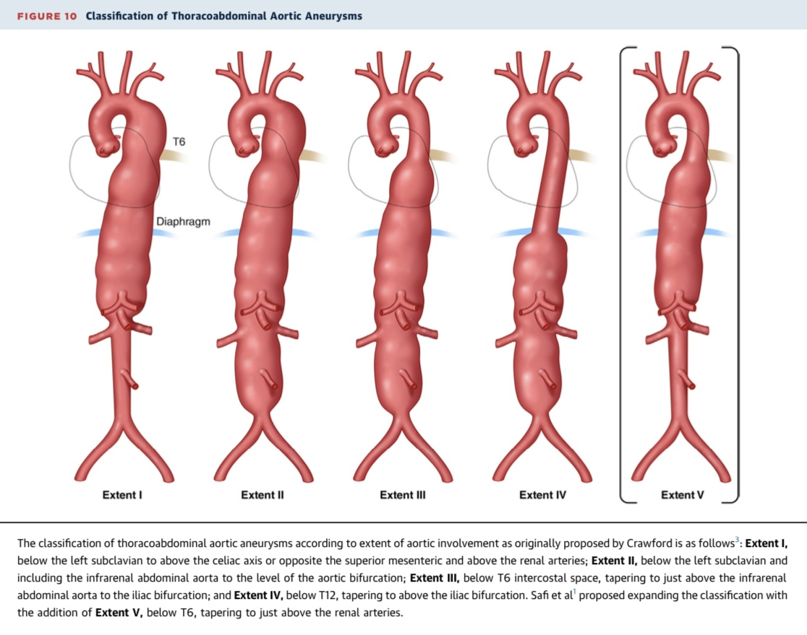
Crawford classification
Describe the extent of an aneurysm
Predict the morbidity and mortality associated with aneurysm repair

Slide 59
Management
Surveillance for smaller aneurysms (<5.5 cm in men, <5.0 cm in women) with regular imaging
﻿﻿﻿Medical management with blood pressure control, statins, and smoking cessation.

Slide 60
Indications for Repair
Open or en­dovas­cu­lar re­pair should be con­sid­ered for pa­tients at low to mod­er­ate sur­gi­cal risk, with an atheroscle­rot­ic or de­gen­er­a­tive thoraco-‍ab­dom­i­nal aor­tic aneurysm of 60 mm or larg­er di­am­e­ter, rapid aneurysm en­large­ment (>10 mm/‍year), or aneurysm re­lat­ed symp­toms

Slide 61
Open repair
In pa­tients with ex­ten­sive thoraco-‍ab­dom­i­nal aor­tic aneurysm (type I, II, III) un­der­going open re­pair, cere­brospinal fluid drainage should be con­sid­ered as a mea­sure to de­crease the risk of neu­ro­log­i­cal deficit
Endovascular Repair
In pa­tients planned for open or en­dovas­cu­lar thoraco-‍ab­dom­i­nal aor­tic aneurysm re­pair, pre-‍op­er­a­tive car­diac, pul­monary, and renal func­tion should be as­sessed to es­ti­mate sur­gi­cal risks and ini­ti­ate ther­a­py to im­prove the pre-‍op­er­a­tive sta­tus

Slide 62
Thank you

