Slide 1
Dyslipidemia

Slide 2
definition

Slide 3
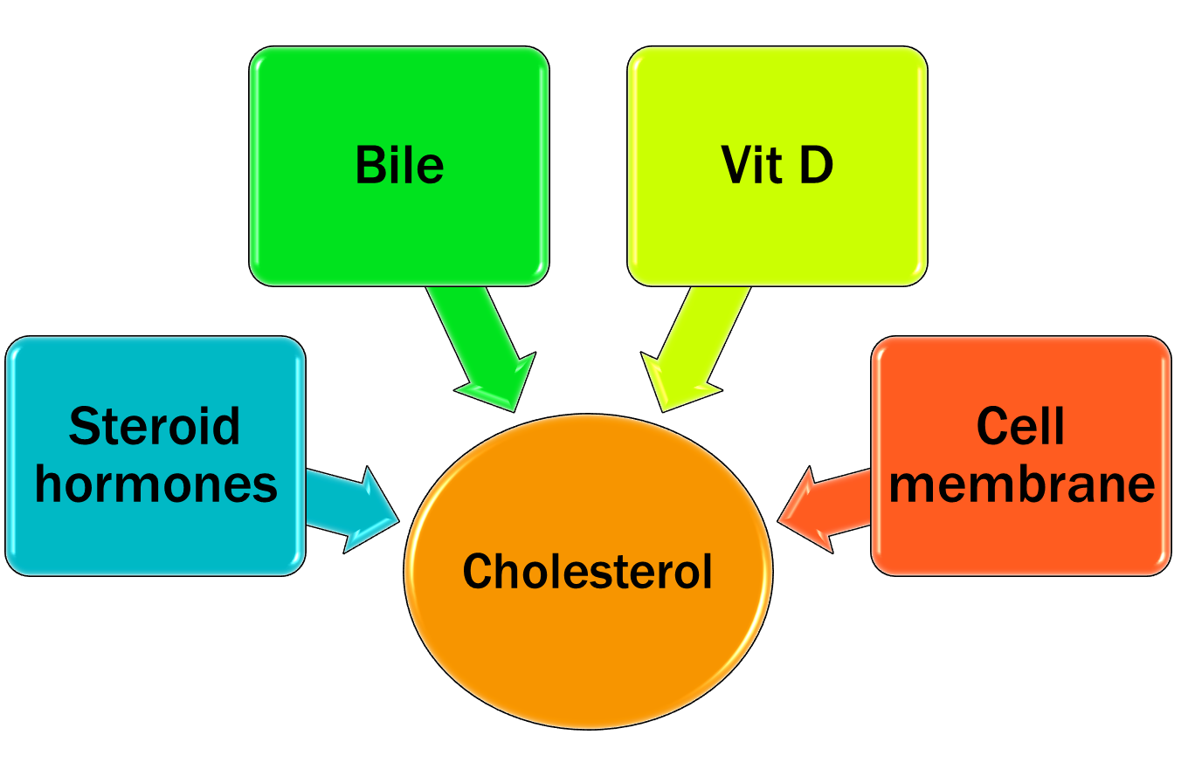
Benefits of cholesterol in our bodies

Slide 4
Sources of cholesterol

Slide 5
types

Slide 7
Normal lipid panel

Slide 8
Lipid metabolism

Slide 10
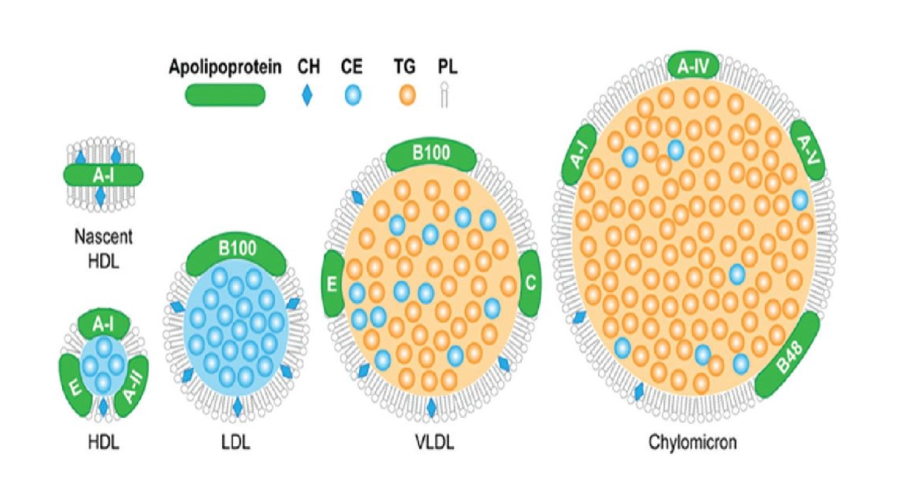

Slide 11
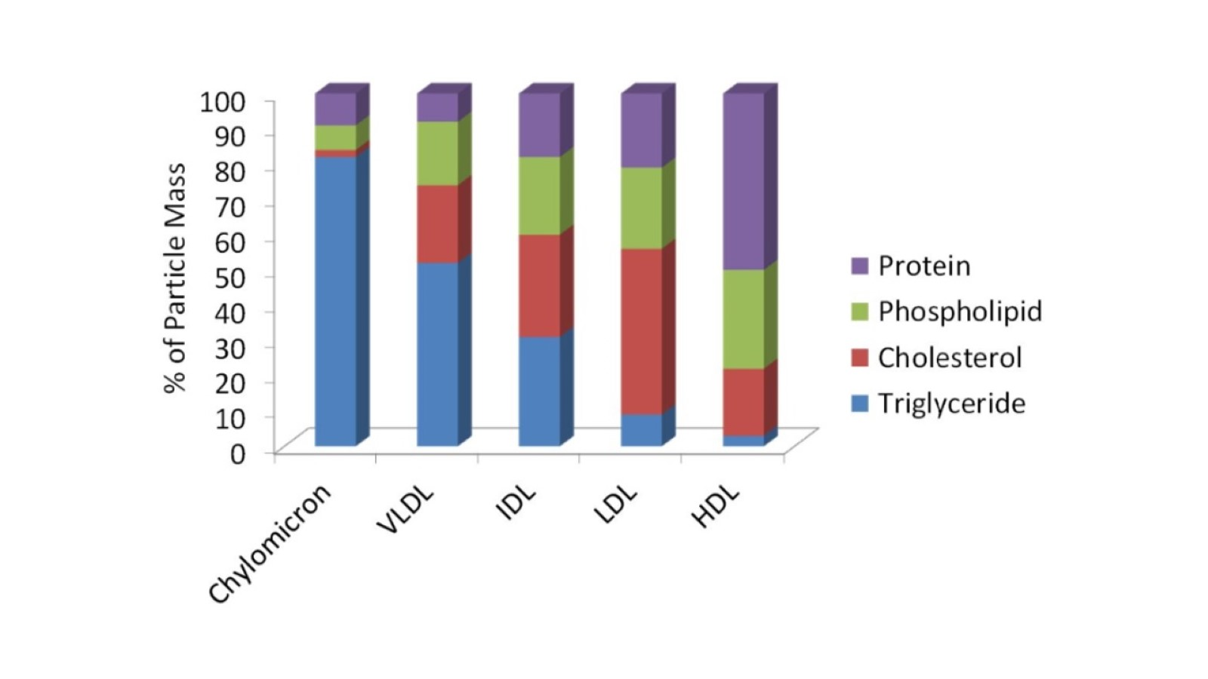

Slide 12
Primary dyslipidemia 1) Familial hypercholesterolemia (FH)

Slide 13
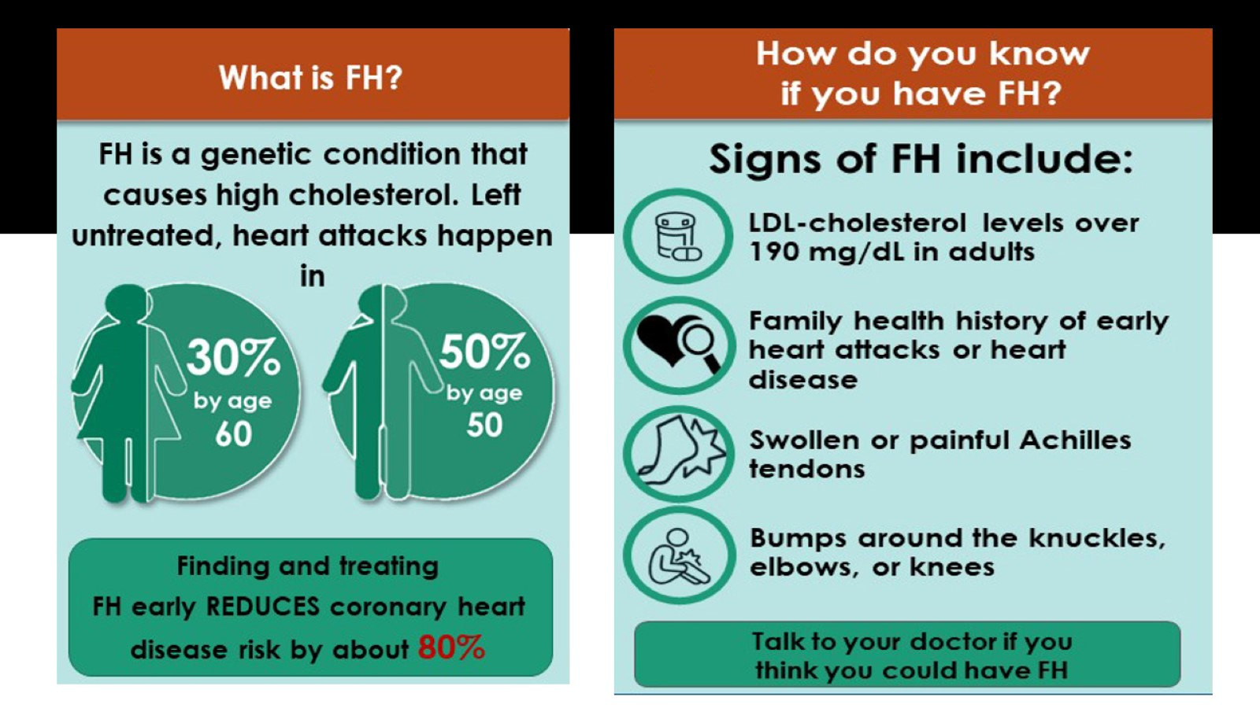

Slide 14
2) Familial Hypertriglyceridemia

Slide 16
3) Familial Combined Hyperlipidemia

Slide 17
Secondary dyslipidemia

Slide 20
Causes of secondary dyslipidemia

Slide 21
Clinical presentation

Slide 24
investigations

Slide 25
Lipid panel

Slide 31
Dyslipidemia screening

Slide 33
management

Slide 34
ASCVD Components

Slide 35
Risk of ASCVD assessment

Slide 36
Primary prevention (no clinical ASCVD)

Slide 37
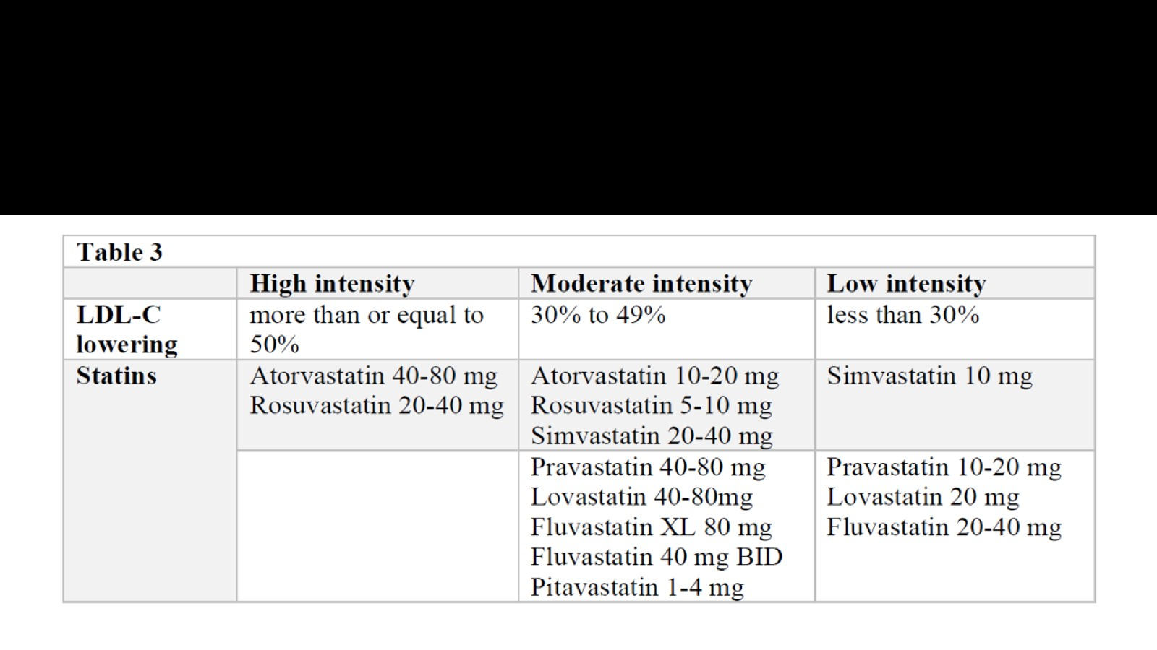

Slide 38
ADA recommendations of statin therapy in Diabetics patients

Slide 39
Secondary prevention

Slide 40
Lipid lowering classes

Slide 42
Drug selection

Slide 48
When to refer

Slide 49
Lifestyle management

